Slide 1
Network (Security) Basics
There are three kinds of death in this world.
There's heart death, there's brain death, and there's being off the network.
⎯ Guy Almes

Slide 2
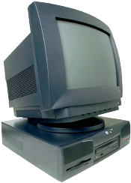



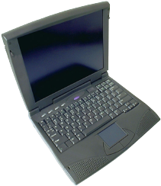

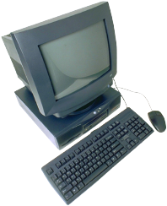
Network
Includes
  Computers
  Servers
  Routers
  Wireless devices
  Etc.
Purpose is to transmit data

Slide 3
Network Edge
Network edge includes…
…Hosts
  Computers
  Laptops
  Servers
  Cell phones
  Etc., etc.
Notes:
The goal is to push as much complexity as possible to the edge of the network---routing packets is challenge enough for the core.

Slide 4
Network Core
Network core consists of
  Interconnected mesh of routers
Purpose is to move data from host to host

Slide 5
Packet Switched Network
Telephone network is/was circuit switched
  For each call, a dedicated circuit established
  Dedicated bandwidth
Modern data networks are packet switched
  Data is chopped up into discrete packets
  Packets are transmitted independently
  No dedicated circuit is established
  More efficient bandwidth usage
  But more complex than circuit switched

Slide 6
Network Protocols
Study of networking focused on protocols
Networking protocols precisely specify “communication rules”
Details are given in RFCs
  RFC is essentially an Internet standard
Stateless protocols do not “remember”
Stateful protocols do “remember”
Many security problems related to state
  E.g., DoS is a problem with stateful protocols
Notes:
A theme of these slides is the distinction between stateless and stateful protocols…

Slide 7
Protocol Stack
Application layer protocols
  HTTP, FTP, SMTP, etc.
Transport layer protocols
  TCP, UDP
Network layer protocols
  IP, routing protocols
Link layer protocols
  Ethernet, PPP
Physical layer
user
space
application
transport
network
link
physical
OS
NIC
card
Notes:
Each layer provides a service to the layer above. Why use layering?

Slide 8
Layering in Action
router
data
application
transport
network
link
physical
application
transport
network
link
physical
data
network
link
physical
host
host
At source, data goes “down” the protocol stack
Each router processes packet “up” to network layer
  That’s where routing info lives
Router then passes packet down the protocol stack
Destination processes packet up to application layer
  That’s where the application data lives

Slide 9
Encapsulation
data X
X = application data at source
As X goes down protocol stack, each layer adds header information:
  Application layer: (H, X)
  Transport layer: (H, (H, X))
  Network layer: (H, (H, (H, X)))
  Link layer: (H, (H, (H, (H, X))))
Header has info required by layer
Note that app data is on the “inside”
application
transport
network
link
physical
packet
(H,(H,(H,(H,X))))

Slide 10
Application Layer
Applications
  For example, Web browsing, email, P2P, etc.
  Applications run on hosts
  To hosts, network details should be transparent
Application layer protocols
  HTTP, SMTP, IMAP, Gnutella, etc., etc.
Protocol is only one part of an application
  For example, HTTP only a part of web browsing

Slide 11
Client-Server Model
Client
  “speaks first”
Server
  responds to client’s request
A host is client or server, not both
Example: Web browsing
  You are the client (request web page)
  Web server is the server

Slide 12
Peer-to-Peer Paradigm
Hosts act as both clients and servers
For example, when sharing music
  You are client when requesting a file
  You are a server when someone downloads a file from you
In P2P, how does client find server?
  Many different P2P models…

Slide 13
HTTP Example
HTTP request
HTTP response
HTTP ⎯ HyperText Transfer Protocol
Client (you) requests a web page
Server responds to your request

Slide 14
Web Cookies
cookie
initial
session
HTTP request
HTTP response, cookie
Cookie
database
HTTP request, cookie
cookie
HTTP response
later
session
HTTP is stateless ⎯ cookies used to add state
Initially, cookie sent from server to browser
Browser manages cookie, sends it to server
Server uses cookie database to “remember” you

Slide 15
Web Cookies
Web cookies used for…
  Shopping carts, recommendations, etc.
  A very (very) weak form of authentication
Privacy concerns
  Web site can learn a lot about you
  Multiple web sites could learn even more

Slide 16
SMTP
SMTP used to deliver email from sender to recipient’s mail server
Then POP3, IMAP or HTTP (Web mail) used to get messages from server
As with many application protocols, SMTP commands are human readable
Sender
Recipient
SMTP
SMTP
POP3

Slide 17
Spoofed email with SMTP
User types the red lines:
> telnet eniac.cs.sjsu.edu 25
220 eniac.sjsu.edu
HELO ca.gov
250 Hello ca.gov, pleased to meet you
MAIL FROM: <arnold@ca.gov>
250 arnold@ca.gov... Sender ok
RCPT TO: <stamp@cs.sjsu.edu>
250 stamp@cs.sjsu.edu ... Recipient ok
DATA
354 Enter mail, end with "." on a line by itself
It is my pleasure to inform you that you
are terminated
.
250 Message accepted for delivery
QUIT
221 eniac.sjsu.edu closing connection

Slide 18
Application Layer
DNS ⎯ Domain Name Service
  Convert human-friendly names such as www.google.com into 32-bit IP address
  A distributed hierarchical database
Only 13 “root” DNS server clusters
  Essentially, a single point of failure for Internet
  Attacks on root servers have succeeded…
  …but, attacks did not last long enough (yet)

Slide 19
Transport Layer
The network layer offers unreliable, “best effort” delivery of packets
Any improved service must be provided by the hosts
Transport layer: 2 protocols of interest
  TCP ⎯ more service, more overhead
  UDP ⎯ less service, less overhead
TCP and UDP run on hosts, not routers

Slide 20
TCP
TCP assures that packets…
  Arrive at destination
  Are processed in order
  Are not sent too fast for receiver: flow control
TCP also attempts to provide…
  Network-wide congestion control
TCP is connection-oriented
  TCP contacts server before sending data
  Orderly setup and take down of “connection”
  But no true connection, only logical “connection”

Slide 21
TCP Header
bits
0
8
16
24
31
Source Port
Destination Port
Sequence Number
Acknowledgement Number
Offset
reserved
U
A
P
R
S
F
Window
Checksum
Urgent Pointer
Options
Padding
Data (variable length)
Source and destination port
Sequence number
Flags (ACK, SYN, RST, etc.)
Header usually 20 bytes (if no options)

Slide 22
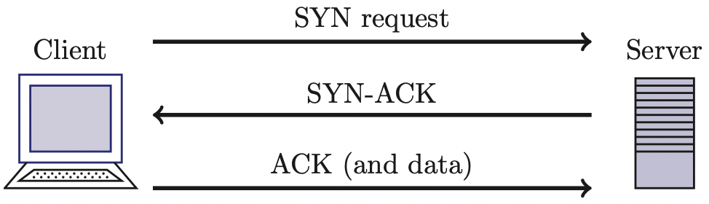
TCP Three-Way Handshake
SYN ⎯ synchronization requested
SYN-ACK ⎯ acknowledge SYN request
ACK ⎯ acknowledge SYN-ACK (send data)
Then TCP “connection” established
  Connection terminated by FIN or RST

Slide 23
Denial of Service Attack
The TCP 3-way handshake makes denial of service (DoS) attacks possible
Whenever SYN packet is received, server remembers this “half-open” connection
  Remembering connections consumes resources
  Too many half-open connections and server’s resources will be exhausted, and then…
  …server can’t respond to legitimate connections
This occurs because TCP is stateful

Slide 24
UDP
UDP is minimalist, “no frills” service
  No assurance that packets arrive
  No assurance packets are in order, etc., etc.
Why does UDP exist?
  More efficient (header only 8 bytes)
  No flow control to slow down sender
  No congestion control to slow down sender
If packets sent too fast, will be dropped
  Either at intermediate router or at destination
  But in some apps this may be OK (audio/video)
Notes:
Is it possible to have the same services as TCP when using UDP?

Slide 25
Network Layer
Core of network/Internet
  Interconnected mesh of routers
Purpose of network layer?
  Route packets through the core
Network layer protocol of interest is IP
  Follows a best effort approach
IP runs in every host and every router
Routers also run routing protocols
  Used to determine the path to send packets
  Routing protocols: RIP, OSPF, BGP, …

Slide 26
IP Addresses
IP address is 32 bits
Every host has an IP address
Big problem ⎯ not enough IP addresses!
  Lots of tricks used to extend address space
IP addresses given in dotted decimal notation
  For example: 195.72.180.27
  Each number is between 0 and 255
Usually, a host’s IP address can change

Slide 27
Socket
Each host has a 32 bit IP address
But, many processes can run on one host
  E.g., you can browse web, send email at same time
How to distinguish processes on a host?
Each process has a 16 bit port number
  Numbers below 1024 are “well-known” ports (HTTP is port 80, POP3 is port 110, etc.)
  Port numbers above 1024 are dynamic (as needed)
IP address + port number = socket
  Socket uniquely identifies process, Internet-wide

Slide 28
Network Address Translation
Network Address Translation (NAT)
  Trick to extend IP address space
Use one IP address (different port numbers) for multiple hosts
  “Translates” outside IP address (based on port number) to inside IP address
  Reduces number of IP addresses needed

Slide 29

NAT-less Example
source 11.0.0.1:1025
destination 12.0.0.1:80
source 12.0.0.1:80
destination 11.0.0.1:1025
Web
server
Alice
IP: 12.0.0.1
Port: 80
IP: 11.0.0.1
Port: 1025

Slide 30

NAT Example
src 11.0.0.1:4000
dest 12.0.0.1:80
src 10.0.0.1:1025
dest 12.0.0.1:80
src 12.0.0.1:80
dest 11.0.0.1:4000
src 12.0.0.1:80
dest 10.0.0.1:1025
Web
server
Firewall
Alice
IP: 12.0.0.1
IP: 11.0.0.1
IP: 10.0.0.1
NAT Table
4000 10.0.0.1:1025

Slide 31
NAT: The Last Word
Advantage(s)?
  Extends IP address space
  One (or a few) IP address(es) can be shared by many users
Disadvantage(s)?
  End-to-end security is more difficult
  Might make IPSec less effective (IPSec discussed in Chapter 10)

Slide 32
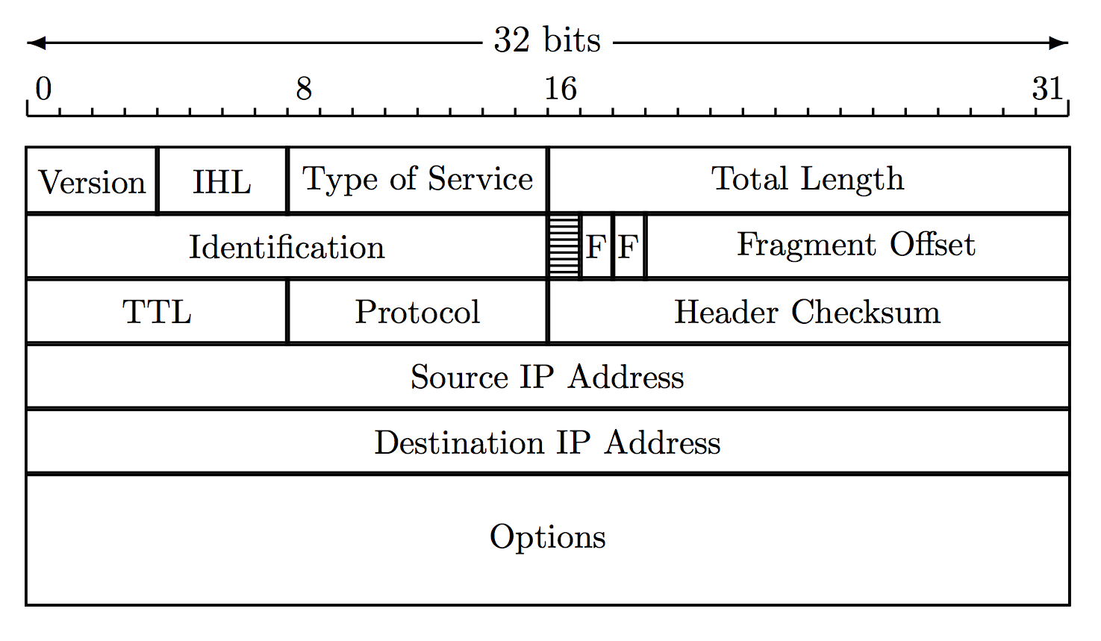
IP Header
IP header has necessary info for routers
  E.g., source and destination IP addresses
Time to live (TTL) limits number of “hops”
  So packets can’t circulate forever
Fragmentation information (see next slide)

Slide 33
IP Fragmentation
fragmented
re-assembled
Each link limits maximum size of packets
If packet is too big, router fragments it
Re-assembly occurs at destination

Slide 34
IP Fragmentation
One packet becomes multiple packets
Packets reassembled at destination
  Prevents multiple fragmentation/reassemble
Fragmentation is a security issue…
  Fragments may obscure real purpose of packet
  Fragments can overlap when reassembled
  Must reassemble packet to fully understand it
  Lots of work for firewalls, for example

Slide 35
IPv6
Current version of IP is IPv4
IPv6 is a “new-and-improved” version of IP
IPv6 is “bigger and better” than IPv4
  Bigger addresses: 128 bits
  Better security: IPSec
How to migrate from IPv4 to IPv6?
  Unfortunately, nobody thought about that…
So IPv6 has not really taken hold (yet?)

Slide 36
Link Layer
Link layer sends packet from one node to next
Links can be different
  Wired
  Wireless
  Ethernet
  Point-to-point…

Slide 37
Link Layer
On host, implemented in adapter: Network Interface Card (NIC)
  Ethernet card, wireless 802.11 card, etc.
  NIC is “semi-autonomous” device
NIC is (mostly) out of host’s control
  Implements both link and physical layers

Slide 38
Ethernet
Ethernet is a multiple access protocol
Many hosts access a shared media
  On a local area network, or LAN
With multiple access, packets can “collide”
  Data is corrupted and packets must be resent
How to efficiently deal with collisions in distributed environment?
  Many possibilities, ethernet is most popular
We won’t discuss details here…

Slide 39
Link Layer Addressing
IP addresses live at network layer
Link layer also needs addresses ⎯ Why?
  MAC address (LAN address, physical address)
MAC address
  48 bits, globally unique
  Used to forward packets over one link
Analogy…
  IP address is like your home address
  MAC address is like a social security number

Slide 40
ARP
Address Resolution Protocol (ARP)
Used by link layer ⎯ given IP address, find corresponding MAC address
Each host has ARP table, or ARP cache
  Generated automatically
  Entries expire after some time (about 20 min)
  ARP (protocol) used to find ARP table entries

Slide 41
ARP
ARP is stateless
ARP can send request and receive reply
Reply msgs used to fill/update ARP cache
IP: 111.111.111.001
IP: 111.111.111.002
LAN
MAC: AA-AA-AA-AA-AA-AA
MAC: BB-BB-BB-BB-BB-BB
111.111.111.002 | BB-BB-BB-BB-BB-BB
111.111.111.001 | AA-AA-AA-AA-AA-AA
Alice’s ARP cache
Bob’s ARP cache

Slide 42
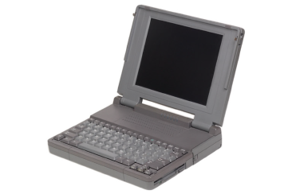
ARP Cache Poisoning
ARP is stateless, so…
Accept “reply”, even if no request sent
Trudy
111.111.111.003
CC-CC-CC-CC-CC-CC
ARP “reply”
111.111.111.002
CC-CC-CC-CC-CC-CC
ARP “reply”
111.111.111.001
CC-CC-CC-CC-CC-CC
111.111.111.001
LAN
111.111.111.002
AA-AA-AA-AA-AA-AA
BB-BB-BB-BB-BB-BB
111.111.111.002 CC-CC-CC-CC-CC-CC
111.111.111.002 BB-BB-BB-BB-BB-BB
111.111.111.001 AA-AA-AA-AA-AA-AA
111.111.111.001 CC-CC-CC-CC-CC-CC
Alice’s ARP cache
Bob’s ARP cache
Host CC-CC-CC-CC-CC-CC is man-in-the-middle

Slide 43
XSS Attacks

Slide 44
XSS Attacks
Cross-site scripting (XSS) is a form of code injection
  Alice executes code from Trudy
  Specifically, Alice’s browser executes Trudy’s evil Javascript code
Javascript runs in restricted mode
  Browser manages cookies, so Javascript has access to cookies, for example

Slide 45
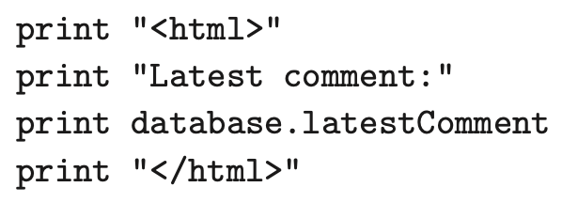
XSS Attack
XSS can be used to steal cookies
  And keystroke logging, and other attacks
Consider server-side Javascript
Supposed to display comments
Assumes latestComment is text…

Slide 46

XSS Attack
Consider server-side Javascript
Supposed to display comments
Assumes latestComment is text…
Trudy enters instead of text, where [code] is Javascript

Slide 47
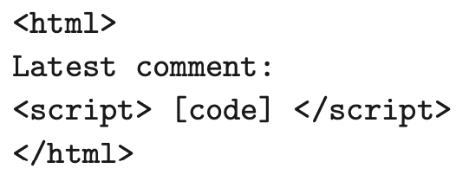
XSS Attack
Then, when Alice tries to access latest comments, browser executes
Can Trudy take advantage of this?

Slide 48
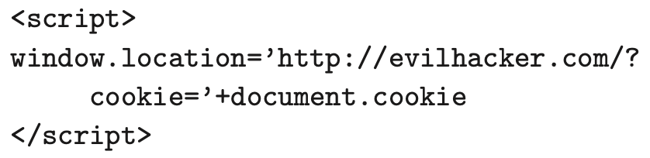
Cookie Theft
Consider the injected code
Alice’s browser will issue HTTP request to Trudy’s evilhacker.com
  With Alice’s cookie file attached
Trudy has stolen Alice’s cookies!

Slide 49
XSS Attacks
Attack on previous slides is example of “persistent XSS”
Attack requires that Alice’s browser visit Trudy’s evilhacker.com
  Browsers often warn against visiting risky websites
  A good defense against persistent XSS
But, there is another kind of XSS…

Slide 50
Reflected XSS
In reflected XSS, evil code is on an innocent server
Alice clicks on innocent link, has effect of launching an attack on Alice
Trudy needs to trick Alice into attacking herself
Explored further in homework…

Slide 51

Firewalls

Slide 52
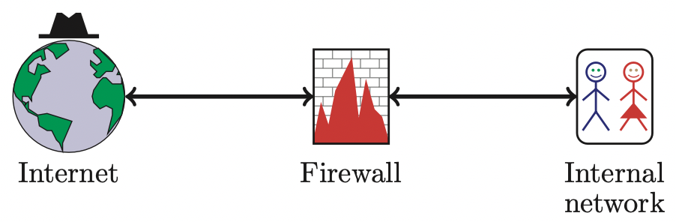
Firewalls
Firewall decides what to let into internal network and/or what to let out
Access control for the network

Slide 53
Firewall as Secretary
A firewall is like a secretary
To meet with an executive
  First contact the secretary
  Secretary decides if meeting is important
  So, secretary filters out many requests
You want to meet chair of CS department?
  Secretary does some filtering
You want to meet POTUS?
  Secretary does a lot more filtering

Slide 54
Firewall Terminology
No standard firewall terminology
Types of firewalls
  Packet filter ⎯ works at network layer
  Stateful packet filter ⎯ transport layer
  Application proxy ⎯ application layer
Lots of other terms often used
  E.g., “deep packet inspection”

Slide 55
Packet Filter
Operates at network layer
Can filters based on…
  Source IP address
  Destination IP address
  Source Port
  Destination Port
  Flag bits (SYN, ACK, etc.)
  Egress or ingress
application
transport
network
link
physical

Slide 56
Packet Filter
Advantages?
  Speed
Disadvantages?
  No concept of state
  Cannot see TCP connections
  Blind to application data
application
transport
network
link
physical

Slide 57
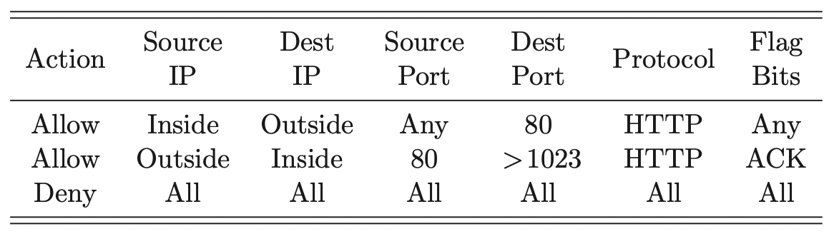
Packet Filter
Configured via Access Control Lists (ACLs)
  Different ACL than in access control chapter
Q: Intention?
A: Restrict traffic to Web browsing

Slide 58
TCP ACK Scan
Attacker scans for open ports thru firewall
  Port scanning often first step in network attack
Attacker sends packet with ACK bit set, without prior 3-way handshake
  Violates TCP/IP protocol
  ACK packet pass thru packet filter firewall
  Appears to be part of an ongoing connection
  RST sent by recipient of such packet

Slide 59
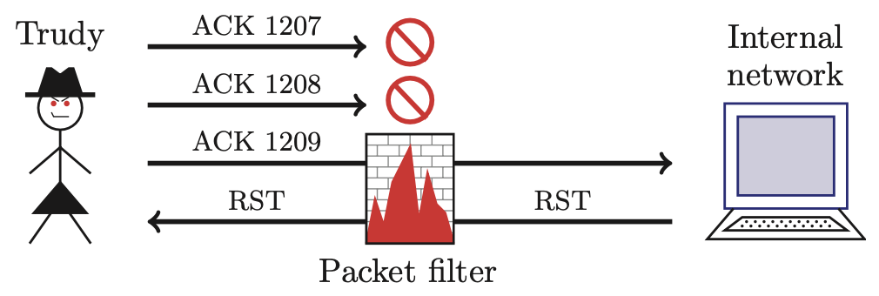
TCP ACK Scan
Attacker knows port 1209 open thru firewall
A stateful packet filter can prevent this
  Since scans not part of established connections

Slide 60
Stateful Packet Filter
Adds state to packet filter
Operates at transport layer
Remembers TCP connections, flag bits, etc.
Can even remember UDP packets (e.g., DNS requests)
application
transport
network
link
physical

Slide 61
Stateful Packet Filter
Advantages?
  Can do everything a packet filter can do plus...
  Keep track of ongoing connections (e.g., prevents TCP ACK scan)
Disadvantages?
  Cannot see application data
  Slower than packet filtering
application
transport
network
link
physical

Slide 62
Application Proxy
A proxy is something that acts on your behalf
Application proxy looks at incoming application data
Verifies that data is safe before letting it in
application
transport
network
link
physical

Slide 63
Application Proxy
Advantages?
  Complete view of connections and applications data
  Filter bad data at application layer (viruses, Word macros)
Disadvantages?
  Speed
application
transport
network
link
physical

Slide 64
Application Proxy
Creates a new packet before sending it thru to internal network
Attacker must talk to proxy and convince it to forward message
Proxy has complete view of connection
Can prevent some scans stateful packet filter cannot ⎯ next slides

Slide 65
Firewalk
Tool to scan for open ports thru firewall
Attacker knows IP address of firewall and IP address of one system inside firewall
  Set TTL to 1 more than number of hops to firewall, and set destination port to N
If firewall allows data on port N thru firewall, get time exceeded error message
  Otherwise, no response

Slide 66
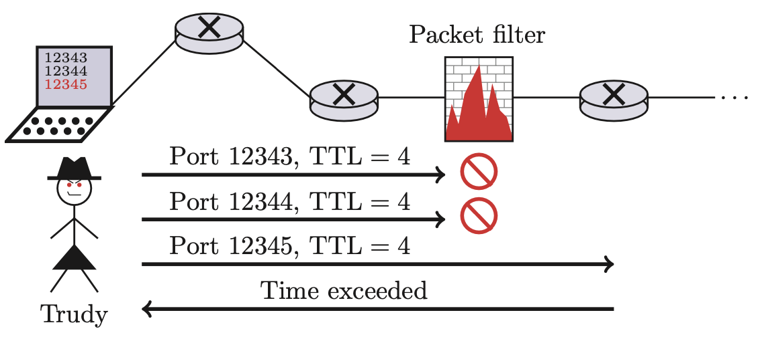
Firewalk and Proxy Firewall
This will not work thru an application proxy (why?)
The proxy creates a new packet, destroys old TTL

Slide 67
Deep Packet Inspection
Many buzzwords used for firewalls
  One example: deep packet inspection
What could this mean?
Look into packets, but don’t really “process” the packets
  Like an application proxy, but faster

Slide 68
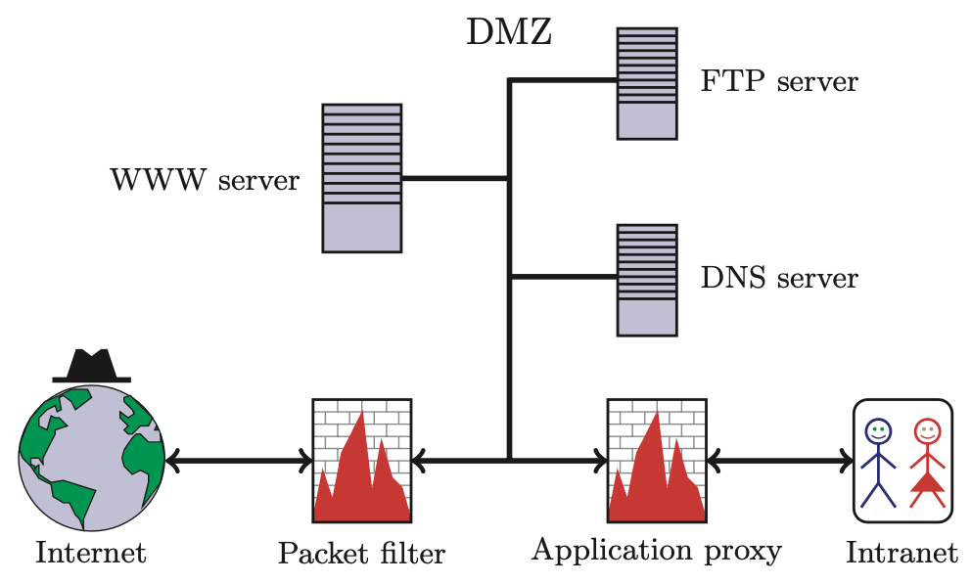
Firewalls and Defense in Depth
Possible network security architecture

Slide 69
Intrusion Detection Systems

Slide 70
Intrusion Prevention
Want to keep bad guys out
Intrusion prevention is a traditional focus of computer security
  Authentication is to prevent intrusions
  Firewalls a form of intrusion prevention
  Virus defenses aimed at intrusion prevention
  Like locking the door on your car

Slide 71
Intrusion Detection
In spite of intrusion prevention, bad guys will sometime get in
Intrusion detection systems (IDS)
  Detect attacks in progress (or soon after)
  Look for unusual or suspicious activity
IDS evolved from log file analysis
How to respond when intrusion detected?
  We don’t deal with this topic here…

Slide 72
Intrusion Detection Systems
Who is likely intruder?
  May be outsider who got thru firewall
  May be evil insider
What do intruders do?
  Launch well-known attacks
  Launch variations on well-known attacks
  Launch new/little-known attacks
  “Borrow” system resources
  Use compromised system to attack others. etc.

Slide 73
IDS
Intrusion detection approaches
  Signature-based IDS
  Anomaly-based IDS
Intrusion detection architectures
  Host-based IDS
  Network-based IDS
Any IDS can be classified as above
  In spite of marketing claims to the contrary!

Slide 74
Host-Based IDS
Monitor activities on hosts for
  Known attacks
  Suspicious behavior
Designed to detect attacks such as
  Buffer overflow
  Escalation of privilege, …
Little or no view of network activities

Slide 75
Network-Based IDS
Monitor activity on the network for…
  Known attacks
  Suspicious network activity
Designed to detect attacks such as
  Denial of service
  Network probes
  Malformed packets, etc.
Some overlap with firewall
Little or no view of host-base attacks
Can have both host and network IDS

Slide 76
Signature Detection Example
Failed login attempts may indicate password cracking attack
IDS could use the rule “N failed login attempts in M seconds” as signature
If N or more failed login attempts in M seconds, IDS warns of attack
Note that such a warning is specific
  Admin knows what attack is suspected
  Easy to verify attack (or false alarm)

Slide 77
Signature Detection
Suppose IDS warns whenever N or more failed logins in M seconds
  Set N and M so false alarms not common
  Can do this based on “normal” behavior
But, if Trudy knows the signature, she can try N − 1 logins every M seconds…
Then signature detection slows down Trudy, but might not stop her

Slide 78
Signature Detection
Many techniques used to make signature detection more robust
Goal is to detect “almost” signatures
For example, if “about” N login attempts in “about” M seconds
  Warn of possible password cracking attempt
  What are reasonable values for “about”?
  Can use statistical analysis, heuristics, etc.
  Must not increase false alarm rate too much

Slide 79
Signature Detection
Advantages of signature detection
  Simple
  Detect known attacks
  Know which attack at time of detection
  Efficient (if reasonable number of signatures)
Disadvantages of signature detection
  Signature files must be kept up to date
  Number of signatures may become large
  Can only detect known attacks
  Variation on known attack may not be detected

Slide 80
Anomaly Detection
Anomaly detection systems look for unusual or abnormal behavior
There are (at least) two challenges
  What is normal for this system?
  How “far” from normal is abnormal?
No avoiding statistics here!
  mean defines normal
  variance gives distance from normal to abnormal

Slide 81
How to Measure Normal?
How to measure normal?
  Must measure during “representative” behavior
  Must not measure during an attack…
  …or else attack will seem normal!
  Normal is statistical mean
  Must also compute variance to have any reasonable idea of abnormal

Slide 82
How to Measure Abnormal?
Abnormal is relative to some “normal”
  Abnormal indicates possible attack
Statistical discrimination techniques include
  Bayesian statistics
  Linear discriminant analysis (LDA)
  Quadratic discriminant analysis (QDA)
  Neural nets, hidden Markov models (HMMs), etc.
Fancy modeling techniques also used
  Artificial intelligence
  Artificial immune system principles
  Many, many, many others

Slide 83
Anomaly Detection (1)
Spse we monitor use of three commands:
open, read, close
Under normal use we observe Alice:
open, read, close, open, open, read, close, …
Of the six possible ordered pairs, we see four pairs are normal for Alice,
(open,read), (read,close), (close,open), (open,open)
Can we use this to identify unusual activity?

Slide 84
Anomaly Detection (1)
We monitor use of the three commands
open, read, close
If the ratio of abnormal to normal pairs is “too high”, warn of possible attack
Could improve this approach by
  Also use expected frequency of each pair
  Use more than two consecutive commands
  Include more commands/behavior in the model
  More sophisticated statistical discrimination

Slide 85
Anomaly Detection (2)
Over time, Alice has accessed file F_{n} at rate H_{n}
Recently, “Alice” has accessed F_{n} at rate A_{n}
H₀ | H₁ | H₂ | H₃
.10 | .40 | .40 | .10
A₀ | A₁ | A₂ | A₃
.10 | .40 | .30 | .20
Is this normal use for Alice?
We compute S = (H₀−A₀)²+(H₁−A₁)²+…+(H₃−A₃)² = .02
  We consider S < 0.1 to be normal, so this is normal
How to account for use that varies over time?

Slide 86
Anomaly Detection (2)
To allow “normal” to adapt to new use, we update averages: H_{n} = 0.2A_{n} + 0.8H_{n}
In this example, H_{n} are updated… H₂=.2∗.3+.8∗.4=.38 and H₃=.2∗.2+.8∗.1=.12
And we now have
H₀ | H₁ | H₂ | H₃
.10 | .40 | .38 | .12

Slide 87
Anomaly Detection (2)
The updated long term average is
Suppose new observed rates…
H₀ | H₁ | H₂ | H₃
.10 | .40 | .38 | .12
A₀ | A₁ | A₂ | A₃
.10 | .30 | .30 | .30
Is this normal use?
Compute S = (H₀−A₀)²+…+(H₃−A₃)² = .0488
  Since S = .0488 < 0.1 we consider this normal
And we again update the long term averages:
H_{n} = 0.2A_{n} + 0.8H_{n}

Slide 88
Anomaly Detection (2)
The starting averages were:
After 2 iterations, averages are:
H₀ | H₁ | H₂ | H₃
.10 | .40 | .40 | .10
H₀ | H₁ | H₂ | H₃
.10 | .38 | .364 | .156
Statistics slowly evolve to match behavior
This reduces false alarms for SA
But also opens an avenue for attack…
  Suppose Trudy always wants to access F₃
  Can she convince IDS this is normal for Alice?

Slide 89
Anomaly Detection (2)
To make this approach more robust, must incorporate the variance
Can also combine N stats S_{i} as, say,
T = (S₁ + S₂ + S₃ + … + S_{N}) / N
to obtain a more complete view of “normal”
Similar (but more sophisticated) approach is used in an IDS known as NIDES
NIDES combines anomaly & signature IDS

Slide 90
Anomaly Detection Issues
Systems constantly evolve and so must IDS
  Static system would place huge burden on admin
  But evolving IDS makes it possible for attacker to (slowly) convince IDS that an attack is normal
  Attacker may win simply by “going slow”
What does “abnormal” really mean?
  Indicates there may be an attack
  Might not be any specific info about “attack”
  How to respond to such vague information?
  In contrast, signature detection is very specific

Slide 91
Anomaly Detection
Advantages?
  Chance of detecting unknown attacks
Disadvantages?
  Cannot use anomaly detection alone…
  …must be used with signature detection
  Reliability is unclear
  May be subject to attack
  Anomaly detection indicates “something unusual”, but lacks specific info on possible attack

Slide 92
Anomaly Detection: The Bottom Line
Anomaly-based IDS is active research topic
Many security experts have high hopes for its ultimate success
Often cited as key future security technology
Hackers are not convinced!
  Title of a talk at Defcon: “Why Anomaly-based IDS is an Attacker’s Best Friend”
Anomaly detection is difficult and tricky
As hard as AI?

