Slide 1
Part IV: Software

Slide 2
Why Software?
Why is software as important to security as crypto, access control, protocols?
Virtually all information security features are implemented in software
If your software is subject to attack, your security can be broken
Regardless of strength of crypto, access control, or protocols
Software is a poor foundation for security

Slide 3
Chapter 11: Software Flaws and Malware
If automobiles had followed the same development cycle as the computer,
a Rolls-Royce would today cost $100, get a million miles per gallon,
and explode once a year, killing everyone inside.
⎯ Robert X. Cringely
My software never has bugs. It just develops random features.
⎯ Anonymous

Slide 4
Bad Software is Ubiquitous
NASA Mars Lander (cost $165 million)
Crashed into Mars due to…
…error in converting English and metric units of measure
Believe it or not
Denver airport
Baggage handling system ⎯ very buggy software
Delayed airport opening by 11 months
Cost of delay exceeded $1 million/day
What happened to person responsible for this fiasco?
MV-22 Osprey
Advanced military aircraft
Faulty software can be fatal

Slide 5
Software Issues
Alice and Bob
Find bugs and flaws by accident
Hate bad software…
…but they learn to live with it
Must make bad software work
Trudy
Actively looks for bugs and flaws
Likes bad software…
…and tries to make it misbehave
Attacks systems via bad software

Slide 6
Complexity
“Complexity is the enemy of security”, Paul Kocher, the “father of SSL”
System | Lines of Code (LOC)
Netscape | 17 million
Space Shuttle | 10 million
Linux kernel 2.6.0 | 5 million
Windows XP | 40 million
Mac OS X 10.4 | 86 million
Boeing 777 | 7 million
A new car contains more LOC than was required to land the Apollo astronauts on the moon

Slide 7
Lines of Code and Bugs
Conservative estimate: 5 bugs/10,000 LOC
Do the math
Typical computer: 3k exe’s of 100k LOC each
Conservative estimate: 50 bugs/exe
Implies about 150k bugs per computer
So, 30,000-node network has 4.5 billion bugs
Maybe only 10% of bugs security-critical and only 10% of those remotely exploitable
Then “only” 45 million critical security flaws!

Slide 8
Software Security Topics
Program flaws (unintentional)
Buffer overflow
Incomplete mediation
Race conditions
Malicious software (intentional)
Viruses
Worms
Other breeds of malware

Slide 9
Program Flaws
An error is a programming mistake
To err is human
An error may lead to incorrect state: fault
A fault is internal to the program
A fault may lead to a failure, where a system departs from its expected behavior
A failure is externally observable
error
fault
failure

Slide 10
Example
char array[10];
for(i = 0; i < 10; ++i)
array[i] = `A`;
array[10] = `B`;
This program has an error
This error might cause a fault
Incorrect internal state
If a fault occurs, it might lead to a failure
Program behaves incorrectly (external)
We use the term flaw for all of the above

Slide 11
Secure Software
In software engineering, try to ensure that a program does what is intended
Secure software engineering requires that software does what is intended…
…and nothing more
Absolutely secure software? Dream on…
Absolute security anywhere is impossible
How can we manage software risks?

Slide 12
Program Flaws
Program flaws are unintentional
But can still create security risks
We’ll consider 3 types of flaws
Buffer overflow (smashing the stack)
Incomplete mediation
Race conditions
These are the most common flaws

Slide 13
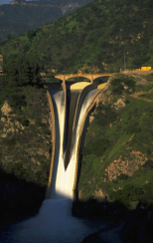
Buffer Overflow

Slide 14
Attack Scenario
Users enter data into a Web form
Web form is sent to server
Server writes data to array called buffer, without checking length of input data
Data “overflows” buffer
Such overflow might enable an attack
If so, attack could be carried out by anyone with access to the Web form

Slide 15
Buffer Overflow
int main(){
int buffer[10];
buffer[20] = 37;}
Q: What happens when code is executed?
A: Depending on what resides in memory at location “buffer[20]”
Might overwrite user data or code
Might overwrite system data or code
Or program could work just fine

Slide 16
Simple Buffer Overflow
Consider boolean flag for authentication
Buffer overflow could overwrite flag allowing anyone to authenticate
Boolean flag
buffer
F
O
U
R
S
C
…
T
F
In some cases, Trudy need not be so lucky as in this example

Slide 17
Memory Organization
Text ⎯ code
Data ⎯ static variables
Heap ⎯ dynamic data
Stack ⎯ “scratch paper”
Dynamic local variables
Parameters to functions
Return address
low
address
text
data
heap
↓
↑
stack
pointer (SP)
stack
high
address

Slide 18
Simplified Stack Example
low →
void func(int a, int b){
char buffer[10];
}
void main(){
func(1,2);
}
:
:
SP
buffer
SP
ret
return
address
a
SP
high →
b
SP

Slide 19
Smashing the Stack
low →
What happens if buffer overflows?
???
:
:
Program “returns” to wrong location
buffer
SP
overflow
SP
A crash is likely
ret
ret…
NOT!
overflow
a
SP
high →
b
SP

Slide 20
Smashing the Stack
low →
Trudy has a better idea…
:
:
Code injection
Trudy can run code of her choosing…
…on your machine
SP
evil code
ret
ret
SP
a
SP
high →
b
SP

Slide 21
Smashing the Stack
:
:
Trudy may not know…
Address of evil code
Location of ret on stack
Solutions
Precede evil code with NOP “landing pad”
Insert ret many times
NOP
:
NOP
evil code
ret
ret
ret
:
ret
:
:

Slide 22
Stack Smashing Summary
A buffer overflow must exist in the code
Not all buffer overflows are exploitable
Things must align properly
If exploitable, attacker can inject code
Trial and error is likely required
Fear not, lots of help is available online
Smashing the Stack for Fun and Profit, Aleph One
Stack smashing is “attack of the decade”…
…for many recent decades
Also heap & integer overflows, format strings, etc.

Slide 23
Stack Smashing Example
Suppose program asks for a serial number that Trudy does not know
Also, Trudy does not have source code
Trudy only has the executable (exe)
Program quits on incorrect serial number

Slide 24
Buffer Overflow Present?
By trial and error, Trudy discovers apparent buffer overflow
Note that 0x41 is ASCII for “A”
Looks like ret overwritten by 2 bytes!

Slide 25
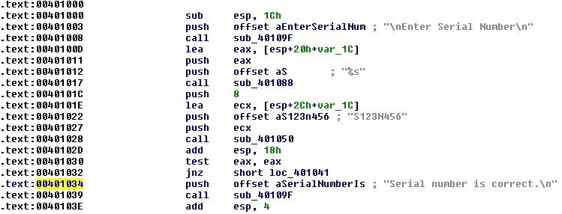
Disassemble Code
Next, disassemble bo.exe to find
The goal is to exploit buffer overflow to jump to address 0x401034

Slide 26
Buffer Overflow Attack
Find that, in ASCII, 0x401034 is “@^P4”
Byte order is reversed? What the … ?
X86 processors are “little-endian”

Slide 27
Overflow Attack, Take 2
Reverse the byte order to “4^P@” and…
Success! We’ve bypassed serial number check by exploiting a buffer overflow
What just happened?
Overwrote return address on the stack

Slide 28
Buffer Overflow
Trudy did not require access to the source code
Only tool used was a disassembler to determine address to jump to
Find desired address by trial and error?
Necessary if attacker does not have exe
For example, a remote attack

Slide 29
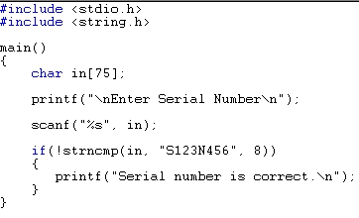
Source Code
Source code for buffer overflow example
Flaw easily exploited by attacker…
…without access to source code!

Slide 30
Stack Smashing Defenses
Employ non-executable stack
“No execute” NX bit (if available)
Seems like the logical thing to do, but some real code executes on the stack (Java, for example)
Use a canary
Address space layout randomization (ASLR)
Use safe languages (Java, C#)
Use safer C functions
For unsafe functions, safer versions exist
For example, strncpy instead of strcpy

Slide 31
Stack Smashing Defenses
low →
Canary
Run-time stack check
Push canary onto stack
Canary value:
Constant 0x000aff0d
Or, may depends on ret
:
:
buffer
overflow
canary
overflow
ret
a
high →
b

Slide 32
Microsoft’s Canary
Microsoft added buffer security check feature to C++ with /GS compiler flag
Based on canary (or “security cookie”)
Q: What to do when canary dies?
A: Check for user-supplied “handler”
Handler shown to be subject to attack
Claimed that attacker can specify handler code
If so, formerly “safe” buffer overflows become exploitable when /GS is used!

Slide 33
ASLR
Address Space Layout Randomization
Randomize place where code loaded in memory
Makes most buffer overflow attacks probabilistic
Windows Vista used 256 random layouts
So about 1/256 chance buffer overflow works
Similar thing in Mac OS X and other OSs
Attacks against Microsoft’s ASLR do exist
Possible to “de-randomize”

Slide 34
Buffer Overflow
A major security threat yesterday, today, and tomorrow
The good news?
It is possible to reduce overflow attacks (safe languages, NX bit, ASLR, education, etc.)
The bad news?
Buffer overflows will exist for a long time
Why? Legacy code, bad development practices, clever attacks, etc.

Slide 35
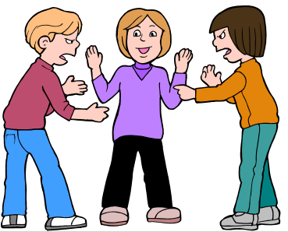
Incomplete Mediation
Notes:
Richter, Gerhard
Mediation
1986
Oil on canvas
320 x 400 cm (126 x 157 1/2 in.)
Musee des beaux-arts de Montrea

Slide 36
Input Validation
Consider: strcpy(buffer, argv[1])
A buffer overflow occurs if
len(buffer) < len(argv[1])
Software must validate the input by checking the length of argv[1]
Failure to do so is an example of a more general problem: incomplete mediation

Slide 37
Input Validation
Consider web form data
Suppose input is validated on client
For example, the following is valid
http://www.things.com/orders/final&custID=112&num=55A&qty=20&price=10&shipping=5&total=205
Suppose input is not checked on server
Why bother since input checked on client?
Then attacker could send http message
http://www.things.com/orders/final&custID=112&num=55A&qty=20&price=10&shipping=5&total=25

Slide 38
Incomplete Mediation
Linux kernel
Research revealed many buffer overflows
Lots of these due to incomplete mediation
Linux kernel is “good” software since
Open-source
Kernel ⎯ written by coding gurus
Tools exist to help find such problems
But incomplete mediation errors can be subtle
And tools useful for attackers too!

Slide 39
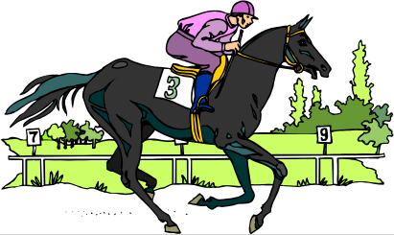
Race Conditions

Slide 40
Race Condition
Security processes should be atomic
Occur “all at once”
Race conditions can arise when security-critical process occurs in stages
Attacker makes change between stages
Often, between stage that gives authorization, but before stage that transfers ownership
Example: Unix mkdir

Slide 41
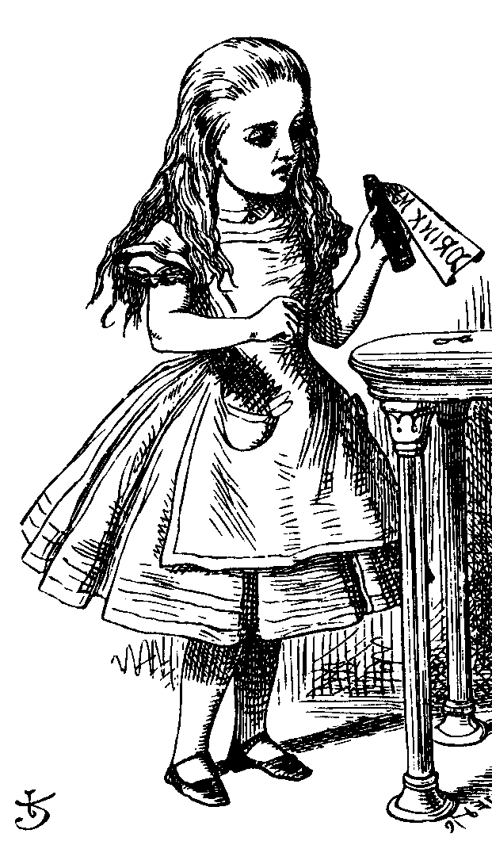
mkdir Race Condition
mkdir creates new directory
How mkdir is supposed to work
mkdir
1. Allocate
space
2. Transfer
ownership

Slide 42
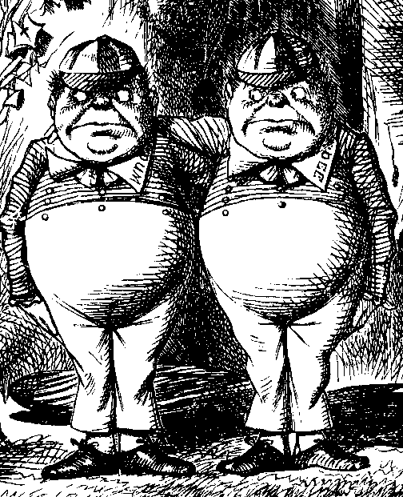
mkdir Attack
The mkdir race condition
mkdir
1. Allocate
space
3. Transfer
ownership
2. Create link to
password file
Not really a “race”
But attacker’s timing is critical

Slide 43
Race Conditions
Race conditions are common
Race conditions may be more prevalent than buffer overflows
But race conditions harder to exploit
Buffer overflow is “low hanging fruit” today
To prevent race conditions, make security-critical processes atomic
Occur all at once, not in stages
Not always easy to accomplish in practice

Slide 44
Malware

Slide 45
Malicious Software
Malware is not new…
Fred Cohen’s seminal virus work in 1980’s
Types of malware (no standard definition)
Virus ⎯ passive propagation
Worm ⎯ active propagation
Trojan horse ⎯ unexpected functionality
Trapdoor/backdoor ⎯ unauthorized access
Rabbit ⎯ exhaust system resources
Spyware ⎯ steals info, such as passwords
Botnets ⎯ malware for hire
Ransomware ⎯ Use malware to encrypt data

Slide 46
Where do Viruses Live?
They live just about anywhere, such as…
Boot sector
Take control before anything else
Memory resident
Stays in memory
Applications, macros, data, etc.
Library routines
Compilers, debuggers, virus checker, etc.
These would be particularly nasty!

Slide 47
Malware Timeline
Brain virus (1986)
Morris worm (1988)
Code Red (2001)
SQL Slammer (2004)
Botnets
Stuxnet (2010)
Ransomware
Future of malware?

Slide 48
Brain
First appeared in 1986
More annoying than harmful
A prototype for later viruses
Not much reaction by users
What it did
Placed itself in boot sector (and other places)
Screened disk calls to avoid detection
Each disk read, checked boot sector to see if boot sector infected; if not, goto 1
Brain did nothing really malicious

Slide 49
Morris Worm
Appeared in 1988
What it tried to do
Determine where it could spread, then…
…spread its infection and…
…remain undiscovered
Morris claimed his worm had a bug!
It tried to re-infect infected systems
Led to resource exhaustion
Effect was like a so-called rabbit

Slide 50
How Morris Worm Spread
Obtained access to machines by…
User account password guessing
Exploit buffer overflow in fingerd
Exploit trapdoor in sendmail
Flaws in fingerd and sendmail were well-known, but not widely patched

Slide 51
Bootstrap Loader
Once Morris worm got access…
“Bootstrap loader” sent to victim
99 lines of C code
Victim compiled and executed code
Bootstrap loader fetched the worm
Victim authenticated sender
Don’t want user to get a bad worm…

Slide 52
How to Remain Undetected?
If transmission interrupted, all code deleted
Code encrypted when downloaded
Code deleted after decrypt/compile
When running, worm regularly changed name and process identifier (PID)

Slide 53
Morris Worm: Bottom Line
Shocked the Internet community of 1988
Internet of 1988 much different than today
Internet designed to survive nuclear war
Yet, brought down by one graduate student!
At the time, Morris’ father worked at NSA…
Could have been much worse
Result? CERT, more security awareness
But should have been a wakeup call

Slide 54
Code Red Worm
Appeared in July 2001
Infected more than 250,000 systems in about 15 hours
Eventually infected 750,000 out of about 6,000,000 vulnerable systems
Exploited buffer overflow in Microsoft IIS server software
Then monitor traffic on port 80, looking for other susceptible servers

Slide 55
Code Red: What it Did
Day 1 to 19 of month: spread its infection
Day 20 to 27: distributed denial of service attack (DDoS) on www.whitehouse.gov
Later version (several variants)
Included trapdoor for remote access
Rebooted to flush worm, leaving only trapdoor
Some said it was “beta test for info warfare”
But, no evidence to support this

Slide 56
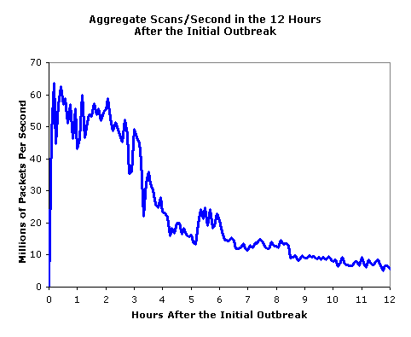
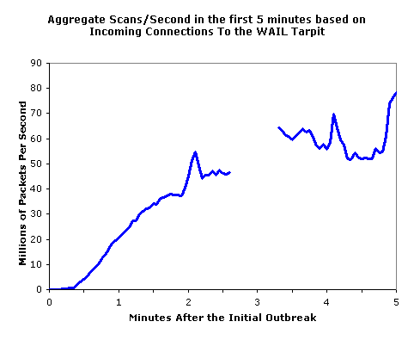
SQL Slammer
Infected 75,000 systems in 10 minutes!
At its peak, infections doubled every 8.5 seconds
Spread “too fast”…
…so it “burned out” available bandwidth

Slide 57
Why was Slammer Successful?
Worm size: one 376-byte UDP packet
Firewalls often let one packet thru
Then monitor ongoing “connections”
Expectation was that much more data required for an attack
So no need to worry about 1 small packet
Slammer defied “experts”

Slide 58
Stuxnet
Malware for information warfare…
Discovered in 2010
Origins go back to 2008, or earlier
Apparently, targeted Iranian nuclear processing facility
Reprogrammed specific type of PLC
Changed speed of centrifuges, causing damage to 1000 (or more) of them

Slide 59
Stuxnet
Many advanced features including…
Infect system via removable drives ⎯ able to get behind “airgap” firewalls
Used 4 unpatched MS vulnerabilities
Updates via P2P over LAN
Contact C&C server for code/updates
Includes a Windows rootkit for stealth
Significant exfiltration/recon capability
Used a compromised private key

Slide 60
Malware Related to Stuxnet
Duqu (2011)
Likely that developers had access to Stuxnet source code
Apparently, used mostly for info stealing
Flame (2012)
May be “most complex” malware ever
Very sophisticated spyware mechanisms
Notes:
According to one source, Flame is “20 times” more complex than Stuxnet

Slide 61
Trojan Horse Example
Trojan: unexpected functionality
Prototype trojan for the Mac
File icon for freeMusic.mp3:
For a real mp3, double click on icon
iTunes opens
Music in mp3 file plays
But for freeMusic.mp3, unexpected results…

Slide 62
Mac Trojan
Double click on freeMusic.mp3
iTunes opens (expected)
“Wild Laugh” (not expected)
Message box (not expected)

Slide 63
Trojan Example
How does freeMusic.mp3 trojan work?
This “mp3” is an application, not data
This trojan is harmless, but…
…could have done anything user could do
Delete files, download files, launch apps, etc.

Slide 64
Botnet
Botnet: “Network” of infected machines
Infected machines are “bots”
Victim is unaware of infection (stealthy)
Botmaster controls botnet
Often, using IRC
P2P botnet architectures exist
Botnets used for…
Spam, DoS attacks, keylogging, ID theft, etc.

Slide 65
Botnet Examples
XtremBot
Similar bots: Agobot, Forbot, Phatbot
Highly modular, easily modified
Source code readily available (GPL license)
UrXbot
Similar bots: SDBot, UrBot, Rbot
Less sophisticated than XtremBot type
GT-Bots and mIRC-based bots
mIRC is common IRC client for Windows

Slide 66
More Botnet Examples
Mariposa
Used to steal credit card info
Creator arrested in July 2010
Conficker
Estimated 10M infected hosts (2009)
Kraken
Largest as of 2008 (400,000 infections)
Srizbi
For spam, one of largest as of 2008

Slide 67
Ransomware
Recently, ransomware very popular
Malware encrypts important info
Key is provided only if ransom is paid
Sometimes key works, sometimes not…
To pay or not to pay?
Recent case, reportedly paid $5M
In 2020 total ransom estimated $350M
Payments are in cryptocurrency

Slide 68
Malware Detection
Malware detection techniques
Signature detection
Change detection
Anomaly detection
Machine learning (deep learning, AI, etc.)
We briefly discuss each of these
And consider advantages…
…and disadvantages

Slide 69
Signature Detection
A signature may be a string of bits in exe
Might also use wildcards, hash values, etc.
For example, W32/Beast virus has signature
83EB 0274 EB0E 740A 81EB 0301 0000
That is, this string of bits appears in virus
We can search for this signature in all files
If string found, have we found W32/Beast?
Not necessarily ⎯ string could be in normal code
At random, chance is only 1/2¹¹²
But software is not random…

Slide 70
Signature Detection
Advantages
Effective on “ordinary” or “classic” malware
Minimal burden for users/administrators
Disadvantages
Signature file can be large (10s of thousands)…
…making scanning slow
Signature files must be kept up to date
Cannot detect unknown viruses
Cannot detect some advanced types of malware
The most popular detection method

Slide 71
Change Detection
Viruses must live somewhere
If you detect that a file has changed unexpectedly, it might have been infected
How to detect changes?
Hash files and (securely) store hash values
Periodically re-compute hashes and compare
If hash changes, file might be infected

Slide 72
Change Detection
Advantages
Few (if any) false negatives
Can detect previously unknown malware
Disadvantages
Many files change ⎯ and often
May be many false alarms (false positives)
Heavy burden on users/administrators
If suspicious change detected, then what? Might have to fall back on signature detection

Slide 73
Anomaly Detection
Monitor system for anything “unusual” or “virus-like” or “potentially malicious” or …
Examples of anomalous things
Files change in some unexpected way
System misbehaves in some way
Unexpected network activity
Unexpected file access, etc., etc., etc., etc.
But, we must first define “normal”
And normal can (and must) change over time

Slide 74
Anomaly Detection
Advantages
Chance of detecting unknown malware
Disadvantages
Questionable track record
Trudy might make abnormal look normal (go slow)
Typically, anomaly detection is combined with another method (e.g., signature detection)
Also popular in intrusion detection (IDS)
Difficult unsolved (unsolvable?) problem
This sounds like a job for AI (equivalently, machine learning, deep learning, big data)

Slide 75
Machine Learning
Machine learning/AI now widely applied to malware detection problem
Some AV systems claim to only use AI
Models trained on features extracted from known malware samples
Then trained models used to classify
Models can be viewed as higher-level “signatures”

Slide 76
Future of Malware
Recent trends
Encrypted, polymorphic, metamorphic malware
Fast replication/Warhol worms
Flash worms, slow worms
Botnets, ransomware, and ???
The future is bright for malware
Good news for the bad guys…
…bad news for the good guys
Future of malware detection?

Slide 77
Encrypted Viruses
Virus writers know signature detection used
So, how to evade signature detection?
Encrypting the virus is a good approach
Ciphertext looks like random bits
Different key, then different “random” bits
So, different copies have no common signature
Encryption often used in viruses today

Slide 78
Encrypted Viruses
How to detect encrypted viruses?
Scan for the decryptor code
More-or-less standard signature detection
But may be more false alarms
Why not encrypt the decryptor code?
Then encrypt the decryptor of the decryptor (and so on…)
Encryption of limited value to virus writers

Slide 79
Polymorphic Malware
Polymorphic worm
Body of worm is encrypted
Decryptor code is “mutated” (or “morphed”)
Trying to hide decryptor signature
Like an encrypted worm on steroids…
Q: How to detect?
A: Emulation might work
Let the code decrypt itself
Slow, and anti-emulation is possible

Slide 80
Metamorphic Malware
A metamorphic worm mutates before infecting a new system
Sometimes called “body polymorphic”
Such a worm can, in principle, evade signature-based detection
Mutated worm must function the same
And be “different enough” to avoid detection
Detection is a difficult research problem

Slide 81
Metamorphic Worm
One approach to metamorphic replication…
The worm is disassembled
Worm then stripped to a base form
Random variations inserted into code (permute the code, insert dead code, etc., etc.)
Assemble the resulting code
Result is a worm with same functionality as original, but different signature

Slide 82
Future Malware Detection?
There is so much malware, maybe it is better to “detect” good code
If code not on approved list, assume it’s bad?
That is, use whitelist instead of blacklist
Machine learning (AI) is clearly the wave of the future in malware detection
Offers many practical advantages
Trudy may be able to fight back with AI too
The arms race will continue!

Slide 83
Miscellaneous Software-Based Attacks

Slide 84
Miscellaneous Attacks
Numerous attacks involve software
We’ll discuss a few issues that do not fit into previous categories
Salami attack
Linearization attack
Time bomb
Can you ever trust software?

Slide 85
Salami Attack
What is Salami attack?
Programmer “slices off” small amounts of money
Slices are hard for victim to detect
Example
Bank calculates interest on accounts
Programmer “slices off” any fraction of a cent and puts it in his own account
No customer notices missing partial cent
Bank may not notice any problem
Over time, programmer makes lots of money!

Slide 86
Salami Attack
Such attacks are possible for insiders
Do salami attacks actually occur?
Or is it just Office Space folklore?
Programmer added a few cents to every employee payroll tax withholding
But money credited to programmer’s tax
Programmer got a big tax refund!
Rent-a-car franchise in Florida inflated gas tank capacity to overcharge customers

Slide 87
Salami Attacks
Employee reprogrammed Taco Bell cash register: $2.99 item registered as $0.01
Employee pocketed $2.98 on each such item
A large “slice” of salami!
In LA, four men installed computer chip that overstated amount of gas pumped
Customers complained when they had to pay for more gas than tank could hold
Hard to detect since chip programmed to give correct amount when 5 or 10 gallons purchased
Inspector usually asked for 5 or 10 gallons

Slide 88
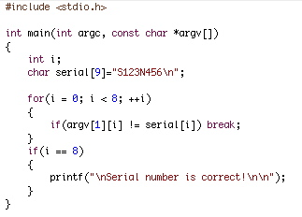
Linearization Attack
Program checks for serial number S123N456
For efficiency, check made one character at a time
Can attacker take advantage of this?

Slide 89
Linearization Attack
Correct number takes longer than incorrect
Trudy tries all 1st characters
Find that S takes longest
Then she guesses all 2nd characters: S∗
Finds S1 takes longest
And so on…
Trudy can recover one character at a time!
Same principle as used in lock picking

Slide 90
Linearization Attack
What is the advantage of attacking serial number one character at a time?
Suppose serial number is 8 characters and each has 128 possible values
Then 128⁸ = 2⁵⁶ possible serial numbers
Attacker would guess the serial number in about 2⁵⁵ tries ⎯ a lot of work!
Using the linearization attack, the work is about 8 ∗ (128/2) = 2⁹ which is easy

Slide 91
Linearization Attack
A real-world linearization attack
TENEX, an ancient OS (timeshare)
Passwords checked one character at a time
Careful timing was not necessary, instead…
…could arrange for a “page fault” when next unknown character guessed correctly
Page fault register was user accessible
This attack was very easy in practice

Slide 92
Time Bomb
In 1986 Donald Gene Burleson told employer to stop withholding taxes from his paycheck
His company refused
He planned to sue his company
He used company time to prepare legal docs…
…his company found out and fired him
Burleson had been working on malware!
After being fired, his software “time bomb” deleted important company data

Slide 93
Time Bomb
Company was reluctant to pursue the case
So, Burleson sued company for back pay!
Then the company finally sued Burleson
In 1988 Burleson fined $11,800
Case took years to prosecute…
Cost company many thousands of dollars…
Resulted in a slap on the wrist for attacker
An early example of a computer crime cases
Many cases since follow a similar pattern
That is, companies are reluctant to prosecute

Slide 94
Trusting Software
Can you ever trust software?
See Reflections on Trusting Trust
Consider the following thought experiment
Suppose C compiler has a virus
When compiling login program, virus creates backdoor (account with known password)
When recompiling the C compiler, virus incorporates itself into new C compiler
Difficult to get rid of this virus!

Slide 95
Trusting Software
Suppose you notice something is wrong
So, you start over from scratch
First, you recompile the C compiler
Then you recompile the OS
Including login program…
You have not gotten rid of the problem!
Real-world example
Underhanded C Contest
Write code that looks like it does something innocent, but instead is “subtly evil”

Slide 96
Chapter 12: Insecurity in Software
Every time I write about the impossibility of effectively protecting digital files
on a general-purpose computer, I get responses from people decrying the
death of copyright. “How will authors and artists get paid for their work?”
they ask me. Truth be told, I don’t know. I feel rather like the physicist
who just explained relativity to a group of would-be interstellar travelers,
only to be asked: “How do you expect us to get to the stars, then?”
I’m sorry, but I don't know that, either.
⎯ Bruce Schneier
So much time and so little to do! Strike that. Reverse it. Thank you.
⎯ Willy Wonka

Slide 97
Software Reverse Engineering (SRE)

Slide 98
SRE
Software Reverse Engineering
Also known as Reverse Code Engineering (RCE)
Or simply “reversing”
Can be used for good...
Understand malware
Understand legacy code
…or not-so-good
Remove usage restrictions from software
Find and exploit flaws in software
Cheat at games, etc.

Slide 99
SRE
In this discussion, we (mostly) assume…
Reverse engineer is an attacker
Attacker only has exe (no source code)
No bytecode (i.e., not Java, .Net, etc.)
Attacker might want to
Understand the software
Modify (“patch”) the software
SRE usually focused on Windows
So we focus on Windows

Slide 100
SRE Tools
Disassembler
Converts exe to assembly (as best it can)
Cannot always disassemble 100% correctly
In general, not possible to re-assemble disassembly into working executable
Debugger
Must step thru code to completely understand it
Labor intensive ⎯ lack of useful tools
Hex Editor
To patch (modify) exe file
Process Monitor, VMware, etc.

Slide 101
Specific Tools
IDA Pro ⎯ good disassembler/debugger
Costs a few hundred dollars (free version exists)
Converts binary to assembly (as best it can)
OllyDbg ⎯ high-quality shareware debugger
Includes a good disassembler
Hex editor ⎯ to view/modify bits of exe
UltraEdit is good ⎯ freeware
HIEW ⎯ useful for patching exe
Process Monitor ⎯ freeware

Slide 102
Why is Debugger Needed?
Disassembly gives static results
Good overview of program logic
User must “mentally execute” program
Difficult to jump to specific place in the code
Debugging is dynamic
Can set break points
Can treat complex code as “black box”
And code not always disassembled correctly
Disassembly and debugging both required for any serious SRE task

Slide 103
SRE Necessary Skills
Working knowledge of target assembly code
Experience with the tools
IDA Pro ⎯ sophisticated and complex
OllyDbg ⎯ good choice for this class
Knowledge of Windows Portable Executable (PE) file format
Boundless patience and optimism
SRE is a tedious and labor-intensive process
Often, like finding a needle in a haystack

Slide 104
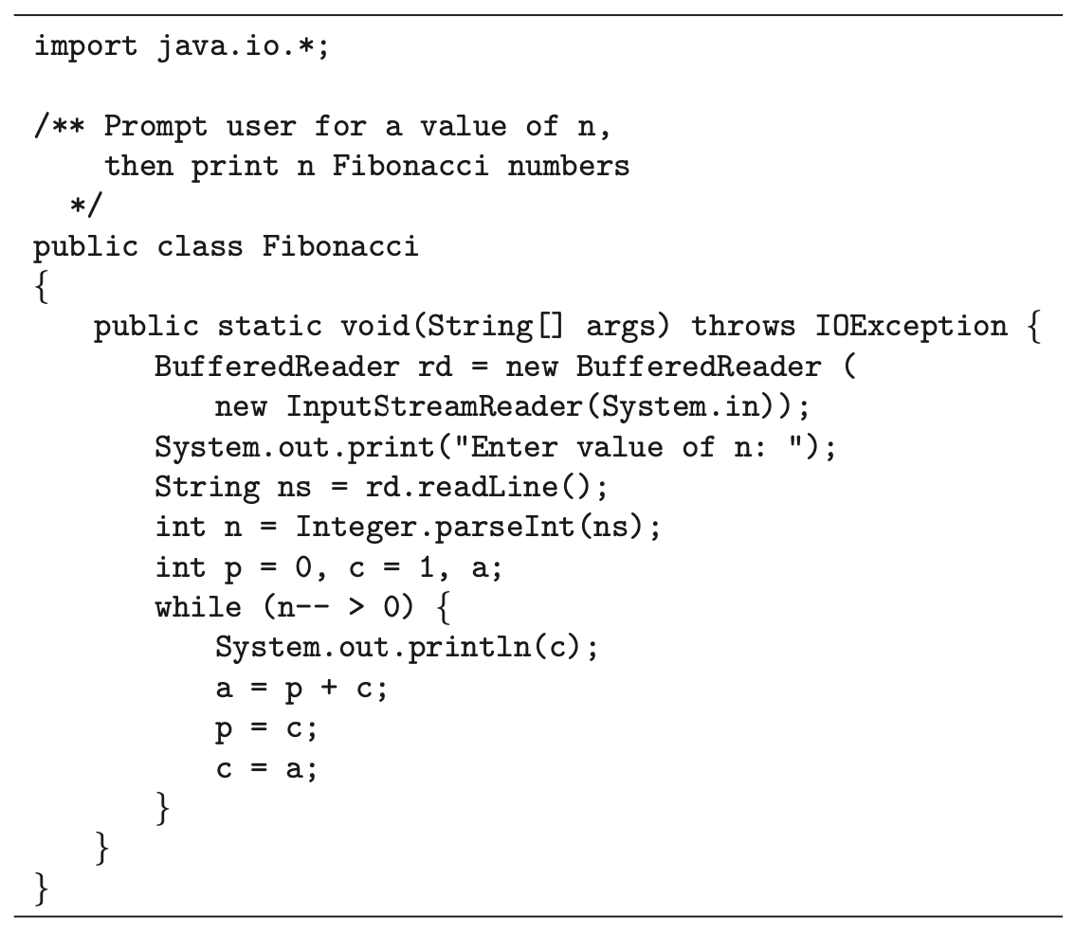
Java Example
Consider this Java program
User inputs n
Program generates n Fibonacci numbers

Slide 105
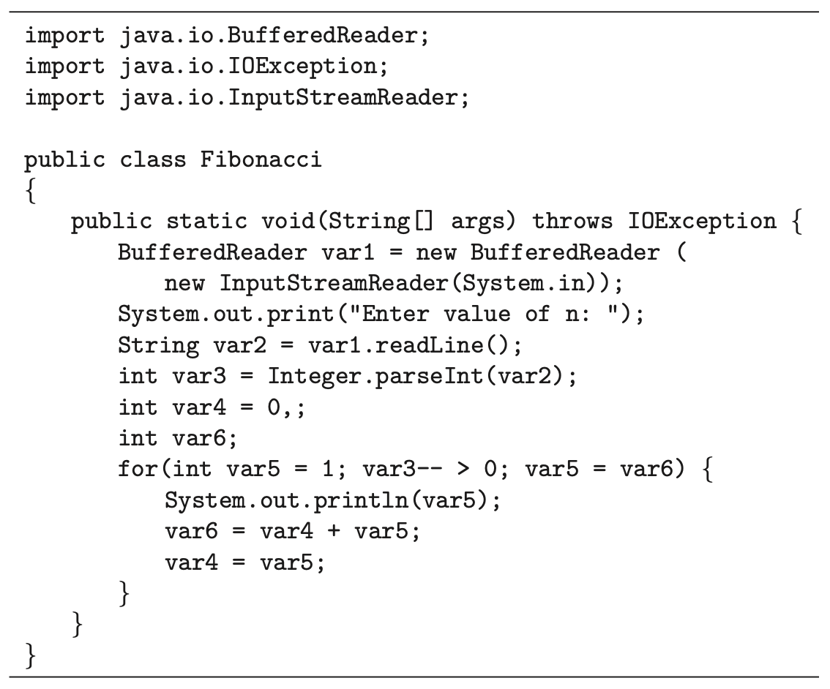
Reversing Java Bytecode
Decompile bytecode from Java program on previous slide
Used Fernflower Java decompiler
It is possible to obfuscate Java
Not too effective (homework)

Slide 106
SRE Example
Consider a simple example (compiled code)
This example only requires disassembly (IDA Pro used here) and hex editor
Trudy disassembles to understand code
Trudy also wants to patch (modify) the code
For most real-world code, would also need a debugger (e.g., OllyDbg)

Slide 107
SRE Example
Program requires serial number
But Trudy doesn’t know the serial number…
Can Trudy get serial number from exe?

Slide 108
SRE Example
IDA Pro disassembly
Looks like serial number is S123N456

Slide 109
SRE Example
Try the serial number S123N456
It works!
Can Trudy do “better”?

Slide 110
SRE Example
Again, IDA Pro disassembly
And hex view…

Slide 111
SRE Example
“test eax, eax” is AND of eax with itself
So, zero flag set only if eax is 0
If test yields 0, then jz is true
Trudy wants jz to always be true
Can Trudy patch exe so jz always holds?

Slide 112
SRE Example
Can Trudy patch exe so that jz always true?
xor
← jz always true!!!
Assembly Hex
test eax,eax 85 C0 …
xor eax,eax 33 C0 …

Slide 113
SRE Example
Can edit serial.exe with hex editor
serial.exe
serialPatch.exe
Save as serialPatch.exe

Slide 114
SRE Example
Any “serial number” now works!
Very convenient for Trudy

Slide 115
SRE Example
Back to IDA Pro disassembly…
serial.exe
serialPatch.exe

Slide 116
SRE Attack Mitigation
Impossible to prevent SRE on open systems
Can we make such attacks more difficult?
Anti-disassembly techniques
To confuse static view of code
Anti-debugging techniques
To confuse dynamic view of code
Tamper-resistance
Code checks itself to detect tampering
Code obfuscation
Make code more difficult to understand

Slide 117
Anti-disassembly
Anti-disassembly methods include
Encrypted or “packed” object code
False disassembly
Self-modifying code
Many other techniques
Encryption prevents disassembly
But need plaintext decryptor to decrypt code!
Same problem as with polymorphic viruses

Slide 118
Anti-disassembly Example
Suppose actual code instructions are
inst 1
jmp
junk
inst 3
inst 4
…
What a “dumb” disassembler sees
inst 1
inst 2
inst 3
inst 4
inst 5
inst 6
…
This is example of “false disassembly”
Persistent attacker will figure it out

Slide 119
Anti-debugging
IsDebuggerPresent() function
Can also monitor for
Use of debug registers
Inserted breakpoints
Debuggers don’t handle threads well
Interacting threads may confuse debugger…
…and therefore, confuse attacker
Many other debugger-unfriendly tricks
See next slide for one example

Slide 120
Anti-debugger Example
inst 1
inst 2
inst 3
inst 4
inst 5
inst 6
…
Suppose when program gets inst 1, it pre-fetches inst 2, inst 3, and inst 4
This is done to increase efficiency
Suppose when debugger executes inst 1, it does not pre-fetch instructions
Can we use this difference to confuse the debugger?

Slide 121
Anti-debugger Example
inst 2
inst 3
inst 4
…
inst 1
junk
inst 5
inst 6
Suppose inst 1 overwrites inst 4 in memory
Then program (without debugger) will be OK since it fetched inst 4 at same time as inst 1
Debugger will be confused when it reaches junk where inst 4 is supposed to be
Problem if this segment of code executed more than once!
Also, self-modifying code is platform-dependent
Again, clever attacker can figure this out

Slide 122
Tamper-resistance
Goal is to make patching more difficult
Code can hash parts of itself
If tampering occurs, hash check fails
Research has shown, can get good coverage of code with small performance penalty
But don’t want all checks to look similar
Or else easy for attacker to remove checks
This approach sometimes called “guards”

Slide 123
Code Obfuscation
Goal is to make code hard to understand
Opposite of good software engineering
Spaghetti code is a “good” example
Much research into more robust obfuscation
Example: opaque predicate
int x,y
:
if((x−y)∗(x−y) > (x∗x−2∗x∗y+y∗y)){…}
The if() conditional is always false
Attacker wastes time analyzing dead code

Slide 124
Code Obfuscation
Code obfuscation sometimes promoted as a powerful security technique
Diffie and Hellman’s original idea for public key crypto was based on code obfuscation
But did not prove to be a useful approach
It has been shown that obfuscation probably cannot provide strong, crypto-like security
On the (im)possibility of obfuscating programs
Obfuscation might still have practical uses
Even if it can never be as strong as crypto

Slide 125
Obfuscation
Obfuscation forces attacker to analyze larger amounts of code
Method could be combined with
Anti-disassembly techniques
Anti-debugging techniques
Code tamper-checking
All of these increase work/pain for attacker
But a persistent attacker can ultimately win!

Slide 126
Secure Software Development

Slide 127
Penetrate and Patch
Usual approach to software development
Develop product as quickly as possible
Release it without adequate testing
Patch the code as flaws are discovered
In security, this is “penetrate and patch”
A bad approach to software development
An even worse approach to secure software!

Slide 128
Why Penetrate and Patch?
First to market advantage
First to market likely to become market leader
Market leader has huge advantage in software
Users find it safer to “follow the leader”
Boss won’t complain if your system has a flaw, as long as everybody else has same flaw…
User can ask more people for support, etc.
Sometimes called “network economics”

Slide 129
Why Penetrate and Patch?
Secure software development is hard
Costly and time-consuming development
Costly and time-consuming testing
Cheaper to let customers do the work!
No serious economic disincentive
Even if software flaw causes major losses, the software vendor is not liable
Is any other product sold this way?
Would it matter if vendors were legally liable?

Slide 130
Penetrate and Patch Fallacy
Fallacy: If you keep patching software, eventually it will be secure
Why is this a fallacy?
Empirical evidence to the contrary
Patches often add new flaws
Software is a moving target: new versions, features, changing environment, new uses,…

Slide 131
Security and Testing
Can be shown that probability of a security failure after t units of testing is about
E = K/t where K is a constant
This approximation holds over large range of t
Then the “mean time between failures” is
MTBF = t/K
The good news: security improves with testing
The bad news: security only improves linearly with testing!

Slide 132
Security and Testing
The “mean time between failures” is approximately
MTBF = t/K
To have 1,000,000 hours between security failures, must test (on the order of) 1,000,000 hours!

Slide 133
Security and Testing
The fundamental problem
Good guys must find (almost) all flaws
Bad guy only needs 1 (exploitable) flaw
Software reliability far more difficult in security than elsewhere
How much more difficult?
See the next slide…

Slide 134
Security Testing: Do the Math
Recall that MTBF = t/K
Suppose 10⁶ security flaws in (very) large software
Suppose each bug has MTBF of 10⁹ hours
Expect to find 1 bug for every 10³ hours testing
Good guys spend 10⁷ hours testing: find 10⁴ bugs
Good guys have found 1% of all the bugs
Trudy spends 10³ hours of testing: finds 1 bug
Chance good guys found Trudy’s bug is only 1% !!!

Slide 135
Secure Software Development
Goal: move away from “penetrate and patch”
Penetrate and patch will always exist
But if more care taken in development, then fewer and less severe flaws to patch
Secure software development not easy
Much more time and effort required thru entire development process
Today, little economic incentive for this!

Slide 136
Security Testing: The Bottom Line
Security testing is far more demanding than non-security testing
Non-security testing ⎯ does system do what it is supposed to?
Security testing ⎯ does system do what it is supposed to and nothing more?
Usually impossible to do exhaustive testing
How much testing is enough?

Slide 137
Security Testing: The Bottom Line
How much testing is enough?
Recall MTBF = t/K
Seems to imply testing is nearly hopeless!
But there is some hope…
If we eliminate an entire class of flaws then statistical model breaks down
For example, if a single test (or a few tests) find all buffer overflows

Slide 138
Software Security
First to market advantage
Also known as “network economics”
Security suffers as a result
Little economic incentive for secure software!
Penetrate and patch
Fix code as security flaws are found
Fix can result in worse problems
Mostly done after code delivered
Proper development can reduce flaws
But costly and time-consuming

Slide 139
Software Development
Specify
Design (informal to “formal methods”)
Implement
Test (discussed this on previous slides)
Review
Document
Manage
Maintain

Slide 140
Software and Security
Even with best development practices, security flaws will still exist
Absolute security is (almost) never possible
So, it is not surprising that absolute software security is impossible
The goal is to minimize and manage risks of software flaws
Do not expect dramatic improvements in consumer software security anytime soon!

Slide 141
Software Summary
Software flaws
Buffer overflow
Race conditions
Incomplete mediation
Malware
Viruses, worms, etc.
Other software-based attacks

Slide 142
Software Summary
Software Reverse Engineering (SRE)
Secure software development
Penetrate and patch
Testing

Slide 143
Course Summary
Crypto
Symmetric key, public key, hash functions, cryptanalysis
Access Control
Authentication, authorization
Security Protocols
Simple auth., SSL, IPSec, Kerberos, GSM, etc.
Software
Flaws, malware, SRE, Software development

