Slide 1
Part III: Protocols

Slide 2
Protocol
Human protocols ⎯ the rules followed in human interactions
  Example: Asking a question in class
Networking protocols ⎯ rules followed in networked communication systems
  Examples: HTTP, FTP, etc.
Security protocol ⎯ the (communication) rules followed in a security application
  Examples: SSL, IPSec, Kerberos, etc.

Slide 3
Protocols
Protocol flaws can be very subtle
Several well-known security protocols have significant flaws
  Including WEP, GSM, and IPSec
Implementation errors can also occur
  IE implementation of SSL had a flaw
Not easy to get protocols right…

Slide 4
Ideal Security Protocol
Must satisfy security requirements
  Requirements need to be precise
Efficient
  Minimize computational requirement
  Minimize bandwidth usage, delays, etc.
Robust
  Works when attacker tries to break it
  Works if environment changes (slightly)
Easy to implement, easy to use, flexible…
Difficult to satisfy all of these!

Slide 5
Chapter 9:
Simple Security Protocols
“I quite agree with you,” said the Duchess; “and the moral of that is⎯
‘Be what you would seem to be’ ⎯or
if you'd like it put more simply⎯‘Never imagine yourself not to be
otherwise than what it might appear to others that what you were
or might have been was not otherwise than what you
had been would have appeared to them to be otherwise.’ ”
⎯ Lewis Carroll, Alice in Wonderland
Seek simplicity, and distrust it.
⎯ Alfred North Whitehead

Slide 6
Secure Entry to NSA
Insert badge into reader
Enter PIN
Correct PIN?
  Yes? Enter
  No? Get shot by security guard

Slide 7
ATM Machine Protocol
Insert ATM card
Enter PIN
Correct PIN?
  Yes? Conduct your transaction(s)
  No? Machine eats card, account locked

Slide 8
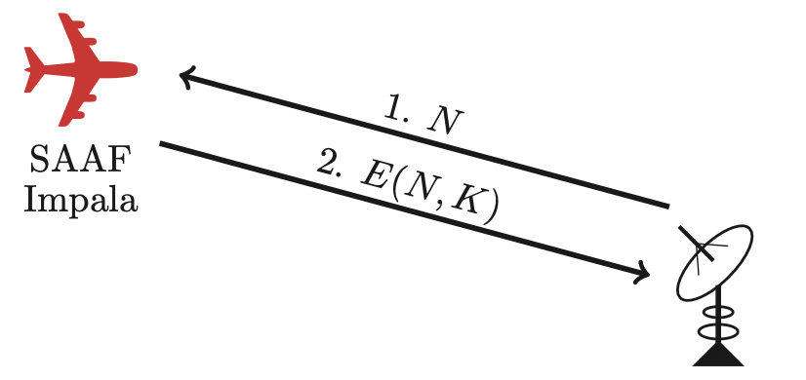
Identify Friend or Foe (IFF)

Slide 9
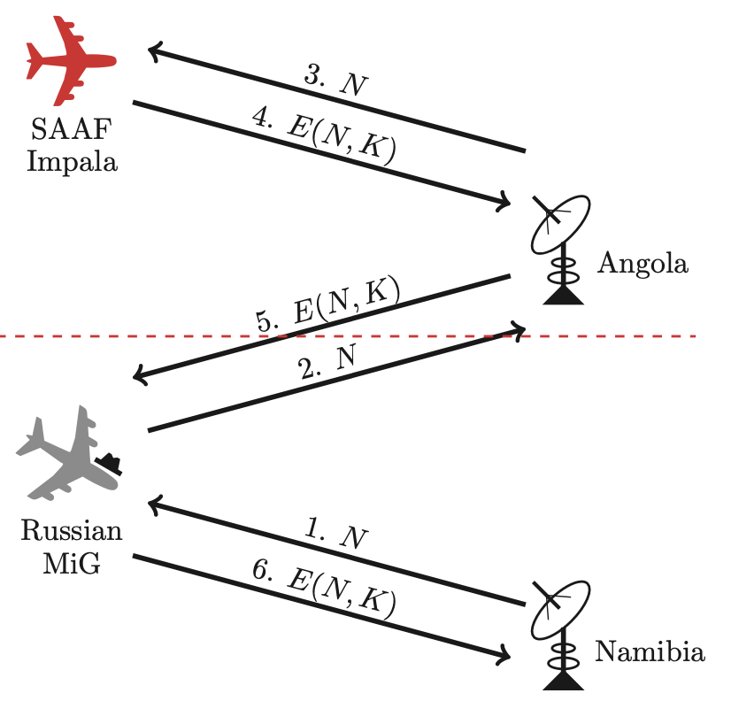
MIG in the Middle

Slide 10
Authentication Protocols

Slide 11
Authentication
Alice must prove her identity to Bob
  Alice and Bob can be humans or computers
May also require Bob to prove he’s Bob (mutual authentication)
Usually need to establish a session key
May have other requirements, such as
  Public keys, symmetric keys, hash functions, …
  Anonymity, plausible deniability, perfect forward secrecy, etc.

Slide 12
Authentication
Authentication on a stand-alone computer is relatively simple
  For example, hash a password with a salt
  “Secure path,” attacks on authentication software, keystroke logging, etc., can be issues
Authentication over a network is challenging
  Attacker can passively observe messages
  Attacker can replay messages
  Active attacks possible (insert, delete, change)

Slide 13
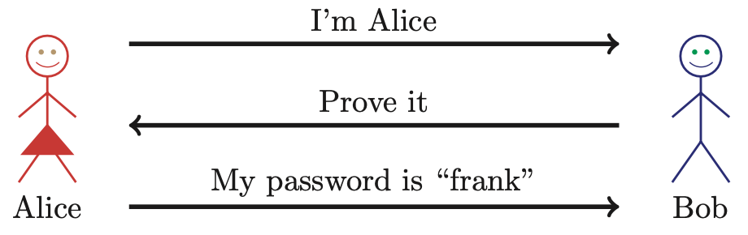
Simple Authentication
Simple and may be OK for standalone system
But highly insecure for networked system
  Subject to a replay attack (next 2 slides)
  Also, Bob must know Alice’s password

Slide 14

Authentication Attack

Slide 15
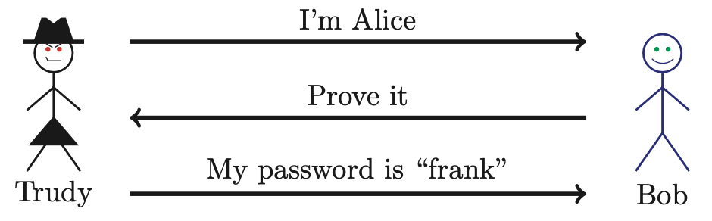
Authentication Attack
This is an example of a replay attack
How can we prevent a replay?

Slide 16
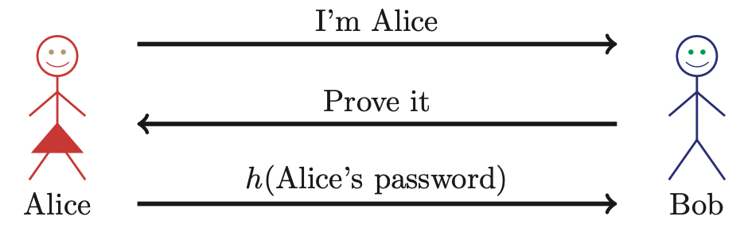
Better Authentication?
This approach hides Alice’s password
  From both Bob and Trudy
But still subject to replay attack

Slide 17
Challenge-Response
To prevent replay, use challenge-response
  Goal is to ensure “freshness”
Suppose Bob wants to authenticate Alice
  Challenge sent from Bob to Alice
Challenge is chosen so that…
  Replay is not possible
  Only Alice can provide the correct response
  Bob can verify the response

Slide 18
Nonce
To ensure freshness, can employ a nonce
  Nonce == number used once
What to use for nonces?
  That is, what is the challenge?
What should Alice do with the nonce?
  That is, how to compute the response?
How can Bob verify the response?
Should we use passwords or keys?

Slide 19
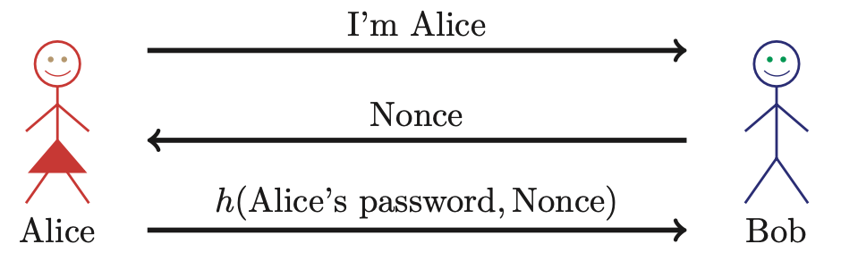
Challenge-Response
Nonce is the challenge
The hash is the response
Nonce prevents replay (ensures freshness)
Password is something Alice knows
Note: Bob must know Alice’s pwd to verify

Slide 20
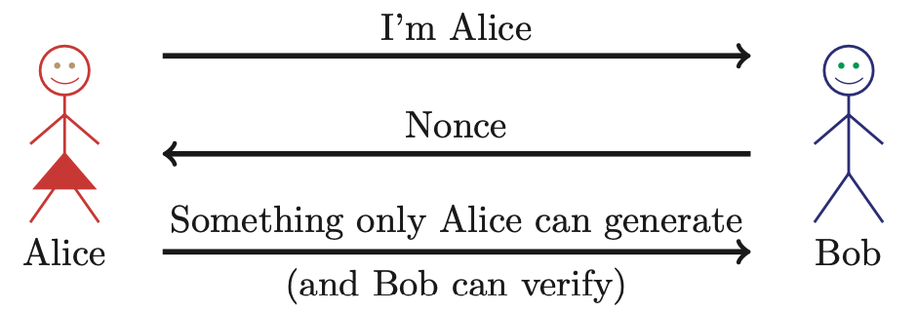
Generic Challenge-Response
In practice, how to achieve this?
Hashed password works, but…
…encryption is much better here (why?)

Slide 21
Symmetric Key Notation
Encrypt plaintext P with key K
C = E(P,K)
Decrypt ciphertext C with key K
P = D(C,K)
Here, we are concerned with attacks on protocols, not attacks on cryptography
  So, we assume crypto algorithms are secure

Slide 22
Authentication: Symmetric Key
Alice and Bob share symmetric key K
  Key K known only to Alice and Bob
Authenticate by proving knowledge of shared symmetric key
How to accomplish this?
  Cannot reveal key, must not allow replay (or other) attack, must be verifiable, …

Slide 23
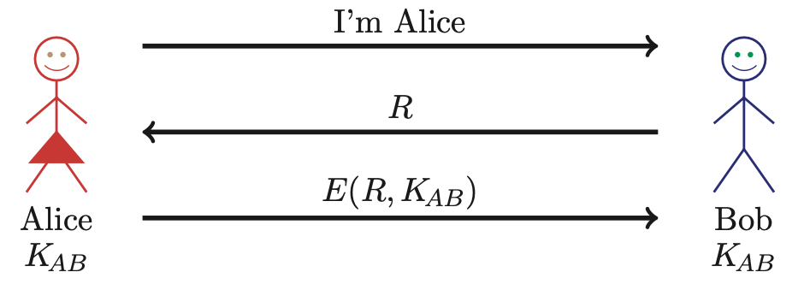
Authenticate Alice Using Symmetric Key
Secure method for Bob to authenticate Alice
But, Alice does not authenticate Bob
So, can we achieve mutual authentication?

Slide 24
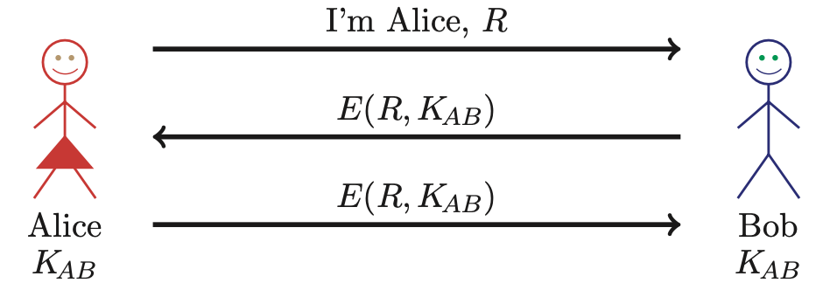
Mutual Authentication?
What’s wrong with this picture?
“Alice” could be Trudy (or anybody else)!

Slide 25
Mutual Authentication
Since we have a secure one-way authentication protocol…
The obvious thing to do is to use the protocol twice
  Once for Bob to authenticate Alice
  Once for Alice to authenticate Bob
This has got to work…

Slide 26
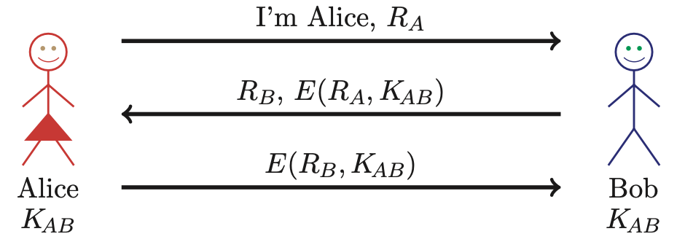
Mutual Authentication
This provides mutual authentication…
…or does it? Subject to reflection attack
  Next slide

Slide 27
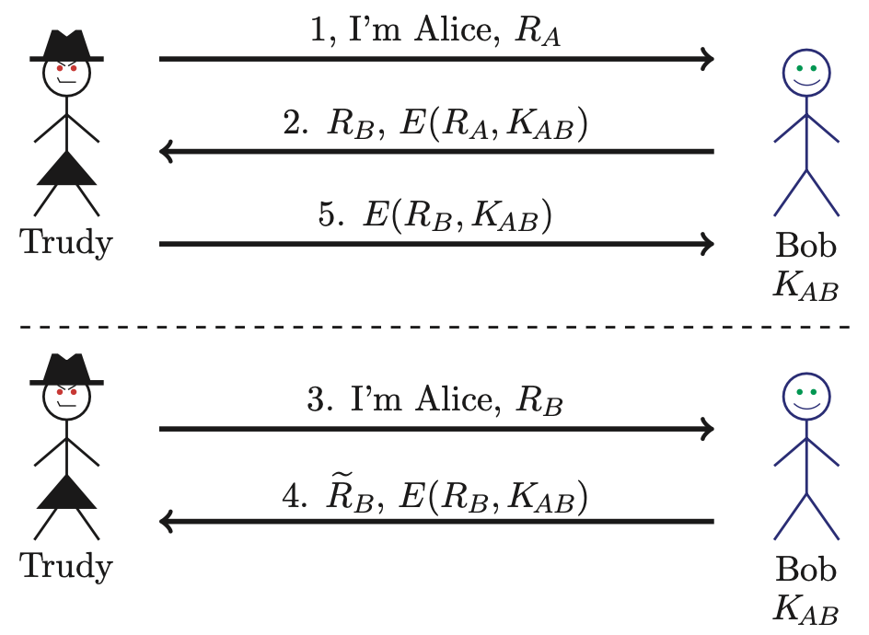
Mutual Authentication Attack

Slide 28
Mutual Authentication
Our one-way authentication protocol is not secure for mutual authentication
  Protocols are subtle!
  In this case, “obvious” solution is not secure
Also, if assumptions or environment change, protocol may not be secure
  This is a common source of security failure
  For example, Internet protocols

Slide 29
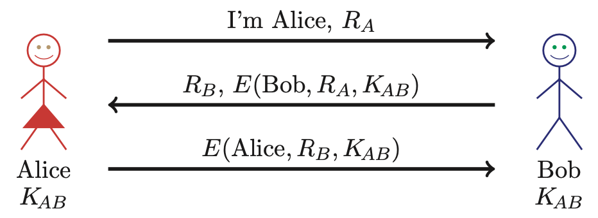
Symmetric Key Mutual Authentication
Do these “insignificant” changes help?
Yes!

Slide 30
Public Key Notation
Encrypt M with Alice’s public key: {M}_{Alice}
Sign M with Alice’s private key: [M]_{Alice}
Then
  [{M}_{Alice} ]_{Alice} = M
  {[M]_{Alice} }_{Alice} = M
Anybody can use Alice’s public key
Only Alice can use her private key

Slide 31
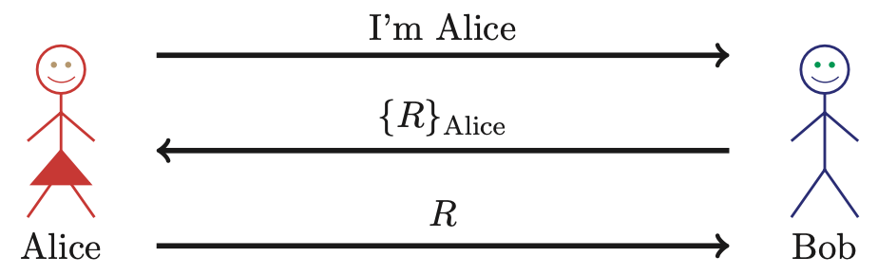
Public Key Authentication
Is this secure?
Trudy can get Alice to decrypt anything!
  Prevent this by having two key pairs

Slide 32
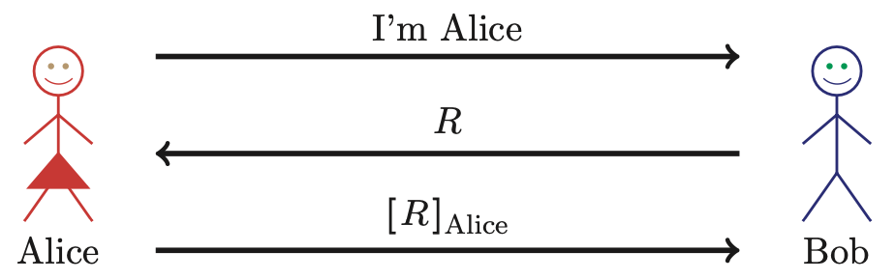
Public Key Authentication
Is this secure?
Trudy can get Alice to sign anything!
  Same a previous ⎯ should have two key pairs

Slide 33
Public Keys
Generally, a bad idea to use the same key pair for encryption and signing
Instead, should have…
  …one key pair for encryption/decryption and signing/verifying signatures…
  …and a different key pair for authentication

Slide 34
Session Key
Usually, a session key is required
  A symmetric key for current session
  Used for confidentiality and/or integrity
How to authenticate and establish a session key (i.e., shared symmetric key)?
  When authentication completed, Alice and Bob share a session key
  Trudy cannot break the authentication…
  …and Trudy cannot determine the session key

Slide 35
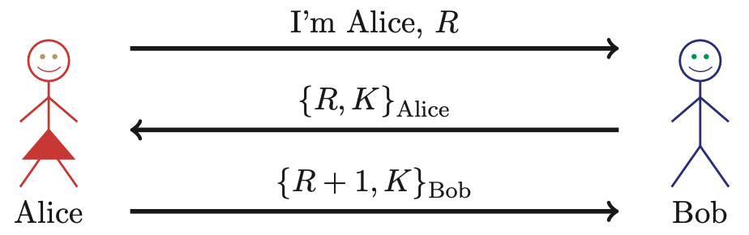
Authentication & Session Key
Is this secure?
  Alice is authenticated and session key is secure
  Alice’s “nonce”, R, useless to authenticate Bob
  The key K is acting as Bob’s nonce to Alice
No mutual authentication

Slide 36
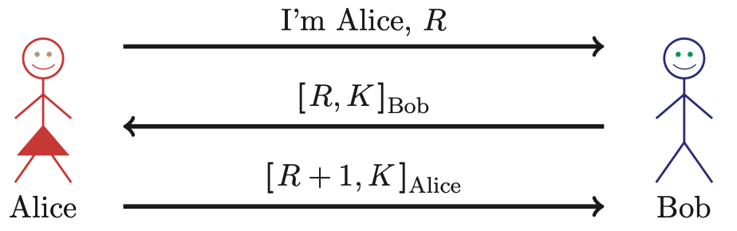
Public Key Authentication and Session Key
Is this secure?
  Mutual authentication (good), but…
  … session key is not protected (very bad)

Slide 37
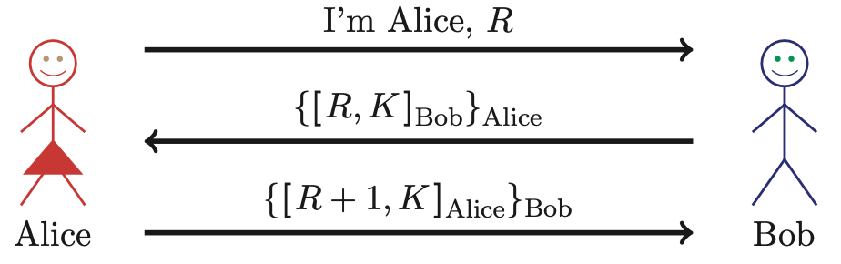
Public Key Authentication and Session Key
Secure mutual auth. and session key?
No! It’s subject to subtle MiM attack
  Homework (problem 4)

Slide 38
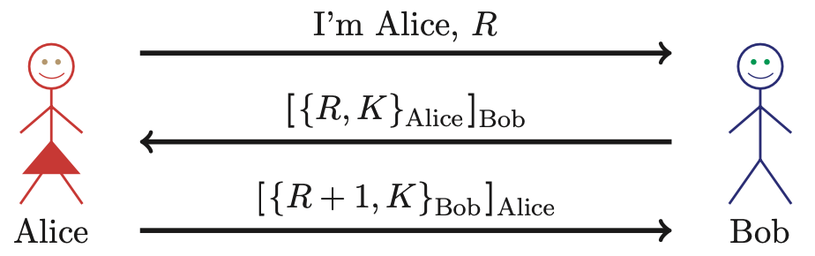
Public Key Authentication and Session Key
Is this secure?
Seems to be OK
  Anyone can see {R, K}_{Alice} and {R +1, K}_{Bob}

Slide 39
Timestamps
A timestamp T is derived from current time
Timestamps can be used to prevent replay
  Used in Kerberos, for example
Timestamps reduce number of msgs (good)
  A challenge that both sides know in advance
“Time” is a security-critical parameter (bad)
  Clocks not same and/or network delays, so must allow for clock skew ⎯ creates risk of replay
  How much clock skew is enough?

Slide 40
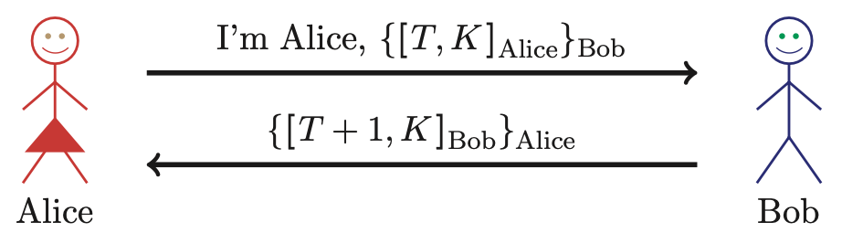
Public Key Authentication with Timestamp T
Secure mutual authentication?
Session key secure?
Seems to be OK

Slide 41
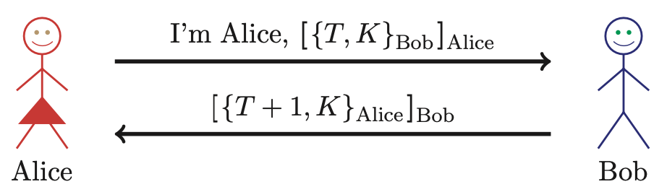
Public Key Authentication with Timestamp T
Secure authentication and session key?
Trudy can use Alice’s public key to find
{T, K}_{Bob} and then…

Slide 42
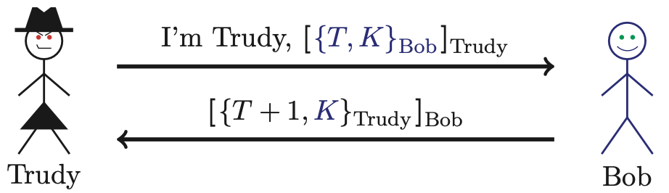
Public Key Authentication with Timestamp T
Trudy obtains Alice-Bob session key K
Note: Trudy must act within clock skew

Slide 43
Public Key Authentication
Sign and encrypt with nonce…
  Insecure
Encrypt and sign with nonce…
  Secure
Sign and encrypt with timestamp…
  Secure
Encrypt and sign with timestamp…
  Insecure
Protocols can be subtle!

Slide 44
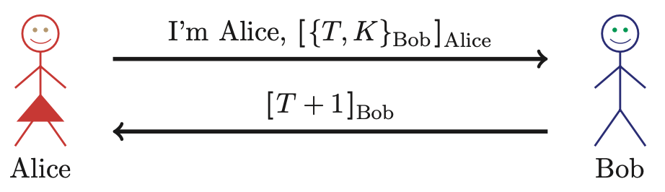
Public Key Authentication with Timestamp T
Is this “encrypt and sign” secure?
  Yes, seems to be OK
Does “sign and encrypt” also work here?

Slide 45
Perfect Forward Secrecy
Consider this “issue”…
  Alice encrypts message with shared key K and sends ciphertext to Bob
  Trudy records ciphertext and later attacks Alice’s (or Bob’s) computer to recover K
  Then Trudy decrypts recorded messages
Perfect forward secrecy (PFS): Trudy cannot later decrypt recorded ciphertext
  Even if Trudy gets key K or other secret(s)
Is PFS possible?

Slide 46
Perfect Forward Secrecy
Suppose Alice and Bob share key K
For perfect forward secrecy, Alice and Bob cannot use K to encrypt
Instead, they must use a session key K_{S} and forget it after it’s used
Can Alice and Bob agree on session key K_{S} in a way that provides PFS?

Slide 47
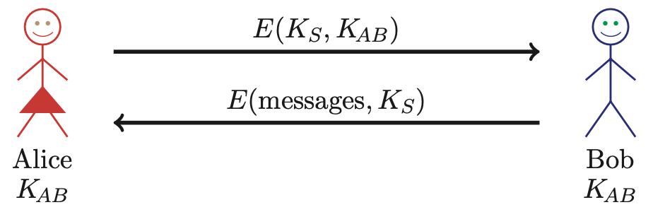
Naïve Session Key Protocol
Trudy could record E(K_{S}, K_{AB})
If Trudy later gets K_{AB}, she can get K_{S}
  Then Trudy can decrypt recorded messages
No perfect forward secrecy in this case

Slide 48
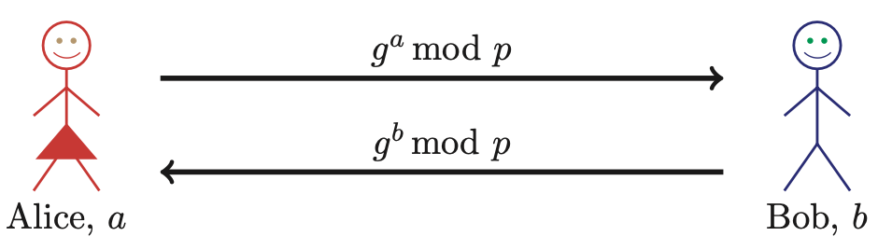
Perfect Forward Secrecy
We can use Diffie-Hellman for PFS
Recall: public g and p
But Diffie-Hellman is subject to MiM
How to get PFS and prevent MiM?

Slide 49
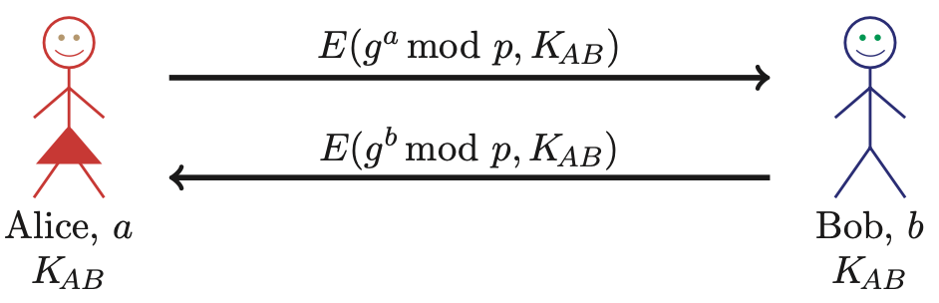
Perfect Forward Secrecy
Session key K_{S} = g^{ab} mod p
Alice forgets a, Bob forgets b
This is known as Ephemeral Diffie-Hellman
Neither Alice nor Bob can later recover K_{S}
Are there other ways to achieve PFS?

Slide 50
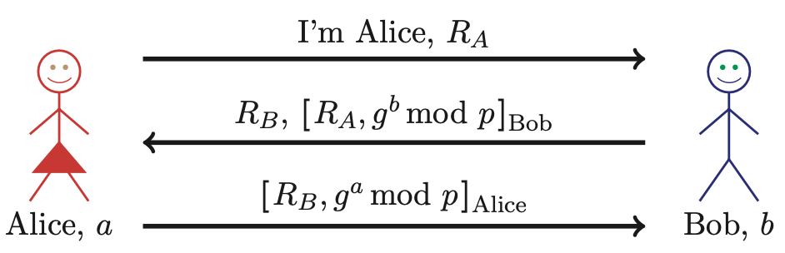
Mutual Authentication, Session Key and PFS
Session key is K = g^{ab} mod p
Alice forgets a and Bob forgets b
If Trudy later gets Bob’s and Alice’s secrets, she cannot recover session key K
Notes:
Note that encryption is not required in this protocol. Signing the DH values prevents the MiM attack (why?), while signing the nonces prevents a replay.

Slide 51
“Authentication” and TCP

Slide 52
TCP-based Authentication
TCP not intended for use as an authentication protocol
But IP address in TCP connection may be (mis)used for authentication
Also, one mode of IPSec relies on IP address for authentication

Slide 53
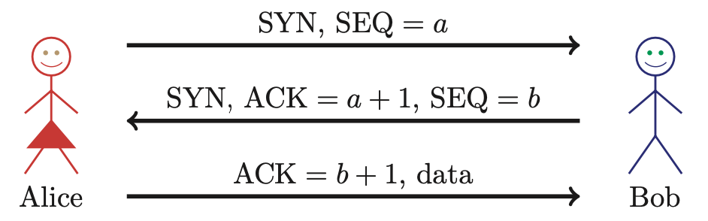
TCP 3-way Handshake
Initial sequence numbers: a and b
  Supposed to be selected at random
If not, might have problems…

Slide 54
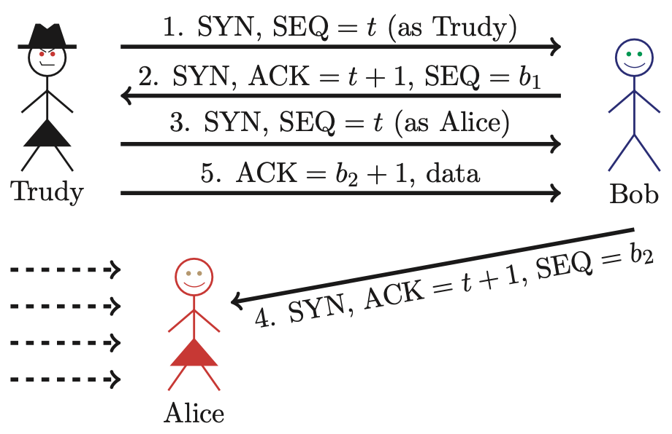
TCP Authentication Attack

Slide 55


TCP Authentication Attack
Initial SEQ numbers
Mac OS X
Random SEQ numbers
If initial SEQ numbers not very random…
…possible to guess initial SEQ number…
…and previous attack will succeed

Slide 56
TCP Authentication Attack
Trudy cannot see what Bob sends, but she can send packets to Bob, while posing as Alice
Trudy must prevent Alice from receiving Bob’s response (or else connection will terminate)
If password (or other authentication) required, this attack fails
If TCP connection is relied on for authentication, then attack might succeed
Bad idea to rely on TCP for authentication

Slide 57
Zero Knowledge Proofs

Slide 58
Zero Knowledge Proof (ZKP)
Alice wants to prove that she knows a secret without revealing any info about it
Bob must verify that Alice knows secret
  But, Bob gains no information about the secret
Process is probabilistic
  Bob can verify that Alice knows the secret to an arbitrarily high probability
An “interactive proof system”

Slide 59
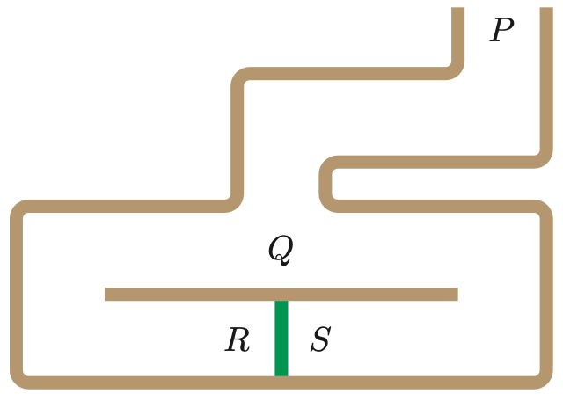
Bob’s Cave
Alice knows secret phrase to open path between R and S (“open sarsaparilla”)
Can she convince Bob that she knows the secret without revealing phrase?

Slide 60


Bob’s Cave
Alice enters cave and goes to point Q
Bob stays at entrance to cave (point P)

Slide 61
Bob’s Cave
Bob says “go!”
Alice randomly picks a side
  Either R or S
Suppose she chooses side R

Slide 62
Bob’s Cave
Bob moves to Q
Then Bob randomly choose R or S
Bob tells Alice to come out from the side he selected

Slide 63
Bob’s Cave
In this case, if Bob choose S, Alice must use the secret phrase
If Bob chooses R, then Alice does not need to know secret phrase
Not knowing secret, Trudy could come out the correct side ½ of the time!

Slide 64
Bob’s Cave
We assume that Alice knows the secret phrase, and Trudy does not
  Trudy can trick Bob with probability ½
But, suppose that Bob repeats the protocol n times
  Then, Alice will come out the correct side every time
  Trudy’s chance of of tricking Bob all n times is only 1/2^{n}

Slide 65
Fiat-Shamir Protocol
Cave-based protocols are inconvenient
  Can we achieve same effect without the cave?
Finding square roots modulo N is difficult
  Equivalent to factoring
Suppose N = pq, where p and q prime
Alice has a secret S
N and v = S² mod N are public, S is secret
Alice must convince Bob that she knows S without revealing any information about S

Slide 66
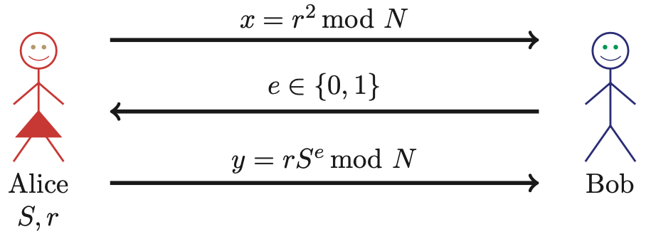
Fiat-Shamir
Public: Modulus N and v = S² mod N
Alice selects random r, Bob chooses e ∈ {0,1}
Bob verifies: y² = x ⋅ v^{e} mod N
  Note that y² = r² ⋅ S^{2e} = r² ⋅ (S²)^{e} = x ⋅ v^{e} mod N

Slide 67
Fiat-Shamir: e = 1
X
Public: Modulus N and v = S² mod N
Alice selects random r, Bob chooses e =1
If y² = x ⋅ v mod N then Bob accepts it
  And Alice passes this iteration of the protocol
Note that Alice must know S in this case

Slide 68
Fiat-Shamir: e = 0
X
X
Public: Modulus N and v = S² mod N
Alice selects random r, Bob chooses e = 0
Bob must checks whether y² = x mod N
“Alice” does not need to know S in this case!

Slide 69
Fiat-Shamir
Public: modulus N and v = S² mod N
Secret: Alice knows S
Alice selects random r and commits to r by sending x = r² mod N to Bob
Bob sends challenge e ∈ {0,1} to Alice
Alice responds with y = r ⋅ S^{e} mod N
Bob checks whether y² = x ⋅ v^{e} mod N
  Does this prove response is from Alice?

Slide 70
Does Fiat-Shamir Work?
If everyone follows protocol, math works:
  Public: v = S² mod N
  Alice send to Bob: x = r² mod N and y = r ⋅ S^{e} mod N
  Bob verifies: y² = x ⋅ v^{e} mod N
Can Trudy convince Bob she is Alice?
  If Trudy expects e = 0, she follows the protocol: send x = r² in msg 1 and y = r in msg 3
  If Trudy expects e = 1, she sends x = r² ⋅ v⁻¹ in msg 1 and y = r in msg 3
If Bob chooses e ∈ {0,1} at random, Trudy can only trick Bob with probability 1/2

Slide 71
Fiat-Shamir Facts
Trudy can trick Bob with probability 1/2, but…
  …after n iterations, the probability that Trudy can convince Bob that she is Alice is only 1/2^{n}
  Like Bob’s cave protocol!
Bob’s e ∈ {0,1} must be unpredictable
Alice must use new r each iteration, or else…
  If e = 0, Alice sends r mod N in message 3
  If e = 1, Alice sends r ⋅ S mod N in message 3
  Anyone can find S given r mod N and r ⋅ S mod N

Slide 72
Fiat-Shamir Zero Knowledge?
“Zero knowledge” means that nobody learns anything about the secret S
  Public: v = S² mod N
  Trudy sees r² mod N in message 1
  Trudy sees r ⋅ S mod N in message 3 (if e = 1)
If Trudy can find r from r² mod N, she gets S
  But that requires modular square root calculation
  If Trudy could find modular square roots, she could get S from public v
Protocol does not seem to “help” to find S

Slide 73
ZKP in the Real World
Public key certificates identify users
  No anonymity if certificates sent in plaintext
ZKP offers a way to authenticate without revealing identities
ZKP supported in MS’s Next Generation Secure Computing Base (NGSCB), where…
  …ZKP used to authenticate software “without revealing machine identifying data”
ZKP is not just pointless mathematics!

Slide 74
Best Authentication Protocol?
It depends on…
  The sensitivity of the application/data
  The delay that is tolerable
  The cost (computation) that is tolerable
  What crypto is supported (public key, symmetric key, …)
  Whether mutual authentication is required
  Whether PFS, anonymity, etc., are concern
…and possibly other factors

Slide 75
Tips for Analyzing Protocols
Put Trudy in place of Alice or Bob…
  …and assume that Trudy cheats!
Consider various attack scenarios…
  Replay attack
  Reflection attack
  Replacement attack
  Man-in-the-middle attacks
Combinations of these are possible

Slide 76
Replay Attacks
Prevented by nonce or timestamp
  But, must be used correctly!
Nonce: Alice cannot challenge herself
  Ditto for Bob
Timestamps: We ignore cases that only involve replay within clock skew
  But, if combined with something else, then it is a valid attack

Slide 77
Reflection Attacks
Trudy gets Bob/Alice to do something that Alice/Bob is supposed to do
Generally, we want Alice and Bob to do different things
If Alice and Bob do the same thing, look closely for reflection attacks
We have seen examples of this…

Slide 78
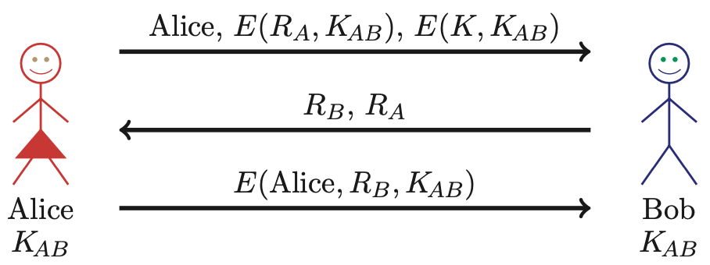
Replacement Attacks
Trudy might try replacing (part of) a message in a protocol
Consider this example…

Slide 79
Replacement Attacks
Trudy could try to replay first message (claiming to be Alice)
  With E(R_{A},K_{AB}) and E(K,K_{AB}) swapped
How to prevent such attacks?
Notes:
Such attacks are prevented by having an integrity check.

Slide 80
Man-in-the-Middle Attacks
We assume that Trudy can always be “in the middle” of a protocol
  It is only a MiM attack if Trudy breaks the authentication or gets session key
  Trudy simply passing messages back and forth does not constitute an attack
We have seen a couple examples of MiM attacks

Slide 81
Chapter 10:
Real-World Protocols
The wire protocol guys don't worry about security because that's really
a network protocol problem. The network protocol guys don't
worry about it because, really, it's an application problem.
The application guys don't worry about it because, after all,
they can just use the IP address and trust the network.
⎯ Marcus J. Ranum
In the real world, nothing happens at the right place at the right time.
It is the job of journalists and historians to correct that.
⎯ Mark Twain

Slide 82
Real-World Protocols
Next, we look at real protocols
  SSH ⎯ relatively simple & useful protocol
  SSL ⎯ practical security on the Web
  IPSec ⎯ security at the IP layer
  Kerberos ⎯ symmetric key, single sign-on
  WEP ⎯ “Swiss cheese” of security protocols
  GSM ⎯ mobile phone (in)security

Slide 83
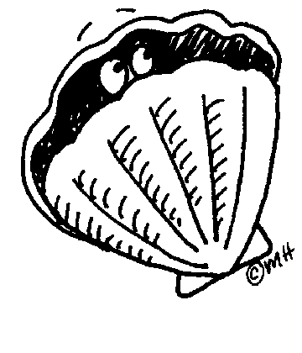
Secure Shell (SSH)

Slide 84
SSH
Creates a “secure tunnel”
Insecure command sent thru SSH “tunnel” are then secure
SSH used with things like rlogin
  Why is rlogin insecure without SSH?
  Why is rlogin secure with SSH?
SSH is a relatively simple protocol

Slide 85
SSH
SSH authentication can be based on
  Public keys, or
  Digital certificates, or
  Passwords
Here, we consider certificate mode
  For other modes, see the homework
We consider slightly simplified SSH…

Slide 86
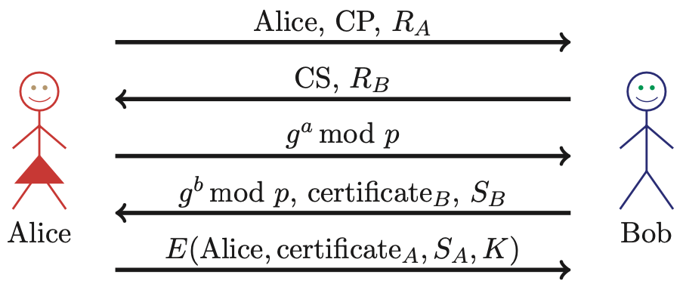
Simplified SSH
CP = “crypto proposed”, and CS = “crypto selected”
H = h(Alice,Bob,CP,CS,R_{A},R_{B},gª mod p,g^{b} mod p,g^{ab} mod p)
S_{B} = [H]_{Bob}
S_{A} = [H, Alice, certificate_{A}]_{Alice}
K = g^{ab} mod p

Slide 87
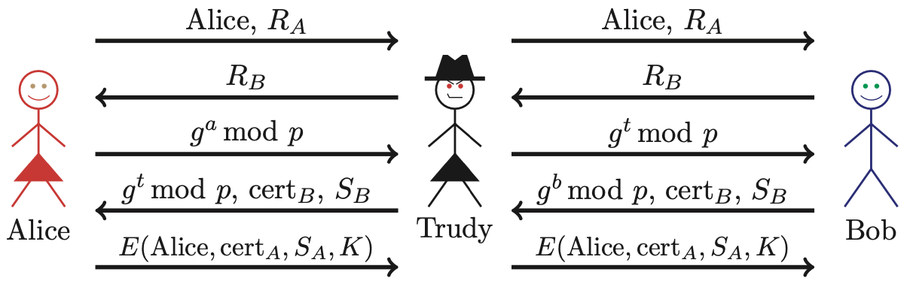
MiM Attack on SSH?
Where does this attack fail?
Alice computes
  H_{a} = h(Alice,Bob,CP,CS,R_{A},R_{B},gª mod p,g^{t} mod p,g^{at} mod p)
But Bob signs
  H_{b} = h(Alice,Bob,CP,CS,R_{A},R_{B},g^{t} mod p,g^{b} mod p,g^{bt} mod p)

Slide 88
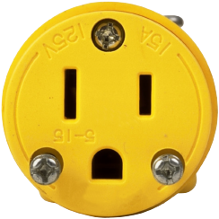
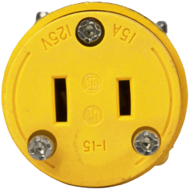
Secure Socket Layer

Slide 89
Socket layer
“Socket layer” lives between application and transport layers
SSL usually between HTTP and TCP
application
transport
network
link
physical
User
Socket
“layer”
OS
NIC

Slide 90
What is SSL?
SSL is the protocol used for majority of secure Internet transactions today
For example, if you want to buy a book at amazon.com…
  You want to be sure you are dealing with Amazon (authentication)
  Your credit card information must be protected when sent (confidentiality and integrity)
  As long as you have money, Amazon does not really care who you are…
  …so, no need for mutual authentication

Slide 91
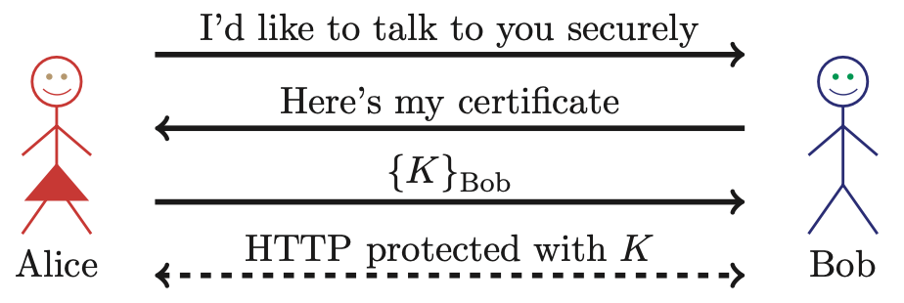
Too-Simple SSL-like Protocol
Is Alice sure she’s talking to Bob?
Is Bob sure he’s talking to Alice?

Slide 92
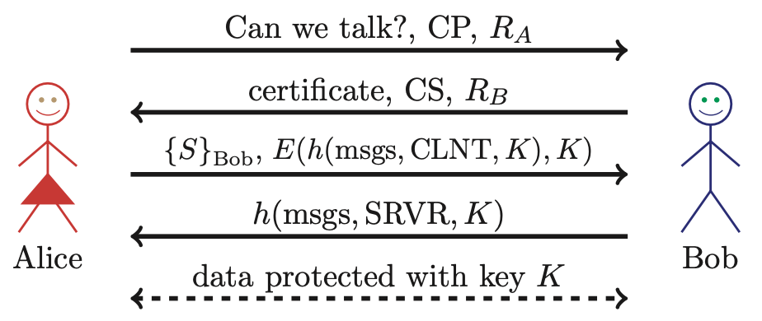
Simplified SSL Protocol
S is the so-called pre-master secret
K = h(S,R_{A},R_{B})
“msgs” means all previous messages
CLNT and SRVR are constants

Slide 93
SSL Keys
6 “keys” derived from K = h(S,R_{A},R_{B})
  2 encryption keys: client and server
  2 integrity keys: client and server
  2 IVs: client and server
  Why different keys in each direction?
Q: Why is h(msgs,CLNT,K) encrypted?
A: Apparently, it adds no security…

Slide 94
SSL Authentication
Alice authenticates Bob, not vice-versa
  How does client authenticate server?
  Why would server not authenticate client?
Mutual authentication is possible: Bob sends certificate request in message 2
  Then client must have a valid certificate
  But, if server wants to authenticate client, server could instead require password

Slide 95
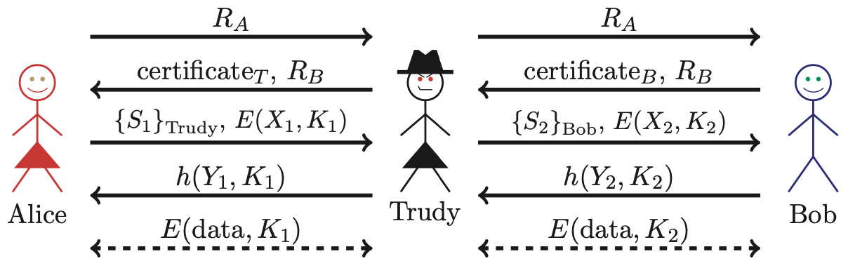
SSL MiM Attack?
Q: What prevents this MiM “attack”?
A: Bob’s certificate must be signed by a certificate authority (CA)
What does browser do if signature not valid?
What does user do when browser complains?

Slide 96
SSL Sessions vs Connections
SSL session is established as shown on previous slides
SSL designed for use with HTTP 1.0
HTTP 1.0 often opens multiple simultaneous (parallel) connections
  Multiple connections per session
SSL session is costly, public key operations
SSL has an efficient protocol for opening new connections given an existing session

Slide 97
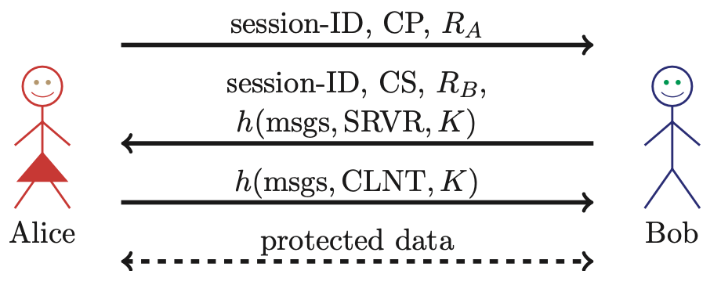
SSL Connection
Assuming SSL session exists
So, S is already known to Alice and Bob
Both sides must remember session-ID
Again, K = h(S,R_{A},R_{B})
No public key operations! (relies on known S)

Slide 98
SSL vs IPSec
IPSec ⎯ discussed in next section
  Lives at the network layer (part of the OS)
  Encryption, integrity, authentication, etc.
  Is overly complex, has some security “issues”
SSL (and IEEE standard known as TLS)
  Lives at socket layer (part of user/app space)
  Encryption, integrity, authentication, etc.
  Relatively simple and elegant specification

Slide 99
SSL vs IPSec
IPSec: OS must be aware, but not apps
SSL: Apps must be aware, but not OS
SSL built into Web early-on (Netscape)
IPSec often used in VPNs (secure tunnel)
Reluctance to retrofit applications for SSL
IPSec not widely deployed (complexity, etc.)
The bottom line?
Internet less secure than it could be!

Slide 100
IPSec

Slide 101
IPSec and SSL
IPSec lives at the network layer
IPSec is transparent to applications
application
transport
network
link
physical
User
SSL
OS
IPSec
NIC

Slide 102
IPSec and Complexity
IPSec is a complex protocol
Over-engineered
  Lots of (generally useless) features
Flawed ⎯ Some significant security issues
Interoperability can be a challenge
  Defeats the purpose of having a standard!
Complex
And, did I mention, it’s complex?

Slide 103
IKE and ESP/AH
Two parts to IPSec…
IKE: Internet Key Exchange
  Mutual authentication
  Establish session key
  Two “phases” ⎯ like SSL session/connection
ESP/AH
  ESP: Encapsulating Security Payload ⎯ for confidentiality and/or integrity
  AH: Authentication Header ⎯ integrity only

Slide 104
IKE

Slide 105
IKE
IKE has 2 phases
  Phase 1 ⎯ IKE security association
  Phase 2 ⎯ IPSec security association
Phase 1 is comparable to SSL session
Phase 2 is comparable to SSL connection
Not an obvious need for two phases in IKE
  In the context of IPSec, that is
If multiple Phase 2’s do not occur, then it is more costly to have two phases!

Slide 106
IKE Phase 1
4 different “key options”
  Public key encryption (original version)
  Public key encryption (improved version)
  Public key signature
  Symmetric key
For each of these, 2 different “modes”
  Main mode and aggressive mode
There are 8 versions of IKE Phase 1!
Need more evidence it’s over-engineered?

Slide 107
IKE Phase 1
We discuss 6 of the 8 Phase 1 variants
  Public key signatures (main & aggressive modes)
  Symmetric key (main and aggressive modes)
  Public key encryption (main and aggressive)
Why public key encryption and public key signatures?
  Always know your own private key
  May not (initially) know other side’s public key

Slide 108
IKE Phase 1
Uses ephemeral Diffie-Hellman to establish session key
  Provides perfect forward secrecy (PFS)
Let a be Alice’s Diffie-Hellman exponent
Let b be Bob’s Diffie-Hellman exponent
Let g be generator and p prime
Recall that p and g are public

Slide 109
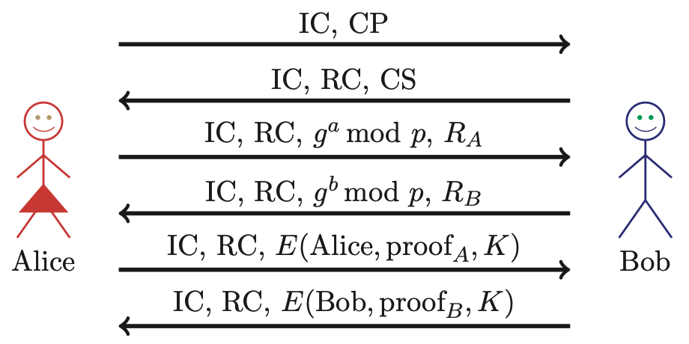
IKE Phase 1: Digital Signature (Main Mode)
CP = crypto proposed, CS = crypto selected
IC = initiator “cookie”, RC = responder “cookie”
K = h(IC,RC,g^{ab} mod p,R_{A},R_{B})
SKEYID = h(R_{A}, R_{B}, g^{ab} mod p)
proof_{A} = [h(SKEYID,gª mod p,g^{b} mod p,IC,RC,CP,“Alice”)]_{Alice}

Slide 110
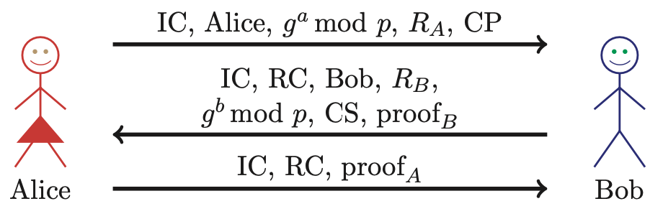
IKE Phase 1: Digital Signature (Aggressive Mode)
Main differences from main mode
  Not trying to hide identities
  Cannot negotiate g or p

Slide 111
Main vs Aggressive Modes
Main mode MUST be implemented
Aggressive mode SHOULD be implemented
  So, if aggressive mode is not implemented, “you should feel guilty about it”
Might create interoperability issues
For public key signature authentication
  Passive attacker knows identities of Alice and Bob in aggressive mode, but not in main mode
  Active attacker can determine Alice’s and Bob’s identity in main mode

Slide 112
IKE Phase 1: Symmetric Key (Main Mode)
Same as signature mode except…
  K_{AB} = symmetric key shared in advance
  K = h(IC,RC,g^{ab} mod p,R_{A},R_{B},K_{AB})
  SKEYID = h(K, g^{ab} mod p)
  proof_{A} = h(SKEYID,gª mod p,g^{b} mod p,IC,RC,CP,“Alice”)

Slide 113
Problems with Symmetric Key (Main Mode)
Catch-22
  Alice sends her ID in message 5
  Alice’s ID encrypted with K
  To find K Bob must know K_{AB}
  To get K_{AB} Bob must know he’s talking to Alice!
Result: Alice’s IP address used as ID!
  Useless mode for the “road warrior”
  Why go to all of the trouble of trying to hide identities in 6 message protocol?

Slide 114
IKE Phase 1: Symmetric Key (Aggressive Mode)
Same format as digital signature aggressive mode
Not trying to hide identities…
As a result, does not have problem(s) of main mode
Does not (pretend to) hide identities

Slide 115
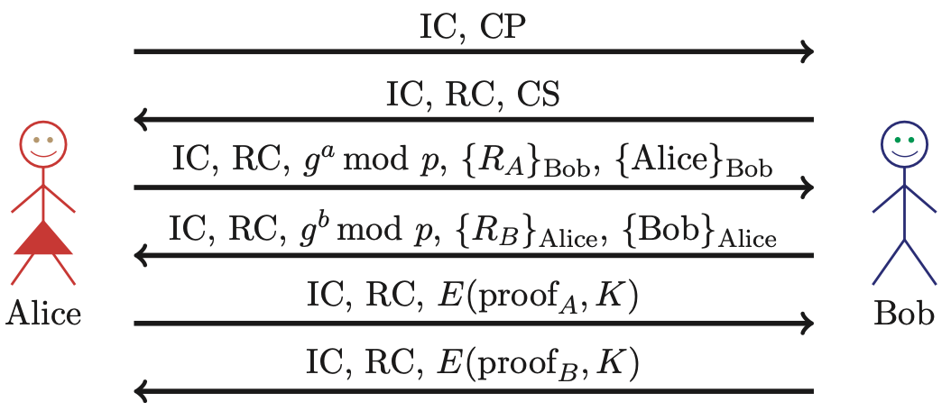
IKE Phase 1: Public Key Encryption (Main Mode)
CP = crypto proposed, CS = crypto selected
IC = initiator “cookie”, RC = responder “cookie”
K = h(IC,RC,g^{ab} mod p,R_{A},R_{B})
SKEYID = h(R_{A}, R_{B}, g^{ab} mod p)
proof_{A} = h(SKEYID,gª mod p,g^{b} mod p,IC,RC,CP,“Alice”)

Slide 116
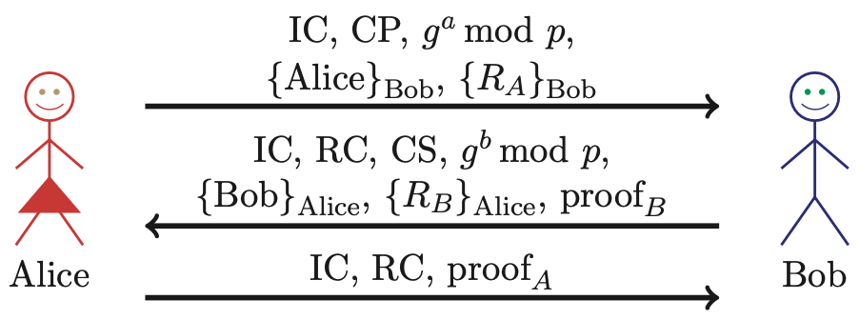
IKE Phase 1: Public Key Encryption (Aggressive Mode)
K, proof_{A}, proof_{B} computed as in main mode
Note that identities are hidden
  This is only aggressive mode to hide identities
  So, why have a main mode?

Slide 117
Public Key Encryption Issue?
In public key encryption, aggressive mode…
Suppose Trudy generates
  Exponents a and b
  Nonces R_{A} and R_{B}
Trudy can compute “valid” keys and proofs: g^{ab} mod p, K, SKEYID, proof_{A} and proof_{B}
All of this also works in main mode

Slide 118
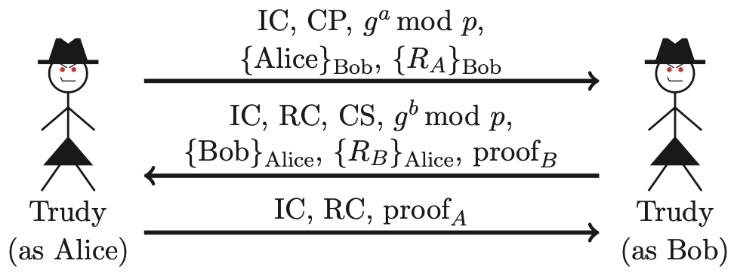
Public Key Encryption Issue?
Trudy can create messages that appears to be between Alice and Bob
Appears valid to any observer, including Alice and Bob!

Slide 119
Plausible Deniability
Trudy can create fake “conversation” that appears to be between Alice and Bob
  Appears valid, even to Alice and Bob!
A security failure ??
In IPSec public key option, it is a feature…
  Plausible deniability: Alice and Bob can deny that any conversation took place!
In some cases it might create a problem
  E.g., if Alice makes a purchase from Bob, she could later repudiate it (unless she had signed)

Slide 120
IKE Phase 1 “Cookies”
IC and RC ⎯ cookies (or “anti-clogging tokens”) supposed to prevent DoS attacks
  No relation to Web cookies
To reduce DoS threats, Bob wants to remain stateless as long as possible
But Bob must remember CP from message 1 (required for proof of identity in message 6)
Bob must keep state from 1st message on
  So, these “cookies” offer little DoS protection

Slide 121
IKE Phase 1 Summary
Result of IKE phase 1 is
  Mutual authentication
  Shared symmetric key
  IKE Security Association (SA)
But phase 1 is expensive
  Especially in public key and/or main mode
Developers of IKE thought it would be used for lots of things ⎯ not just IPSec
  Partly explains the over-engineering…

Slide 122
IKE Phase 2
Phase 1 establishes IKE SA
Phase 2 establishes IPSec SA
Comparison to SSL…
  SSL session is comparable to IKE Phase 1
  SSL connections are like IKE Phase 2
IKE could be used for lots of things, but in practice, it’s not!

Slide 123
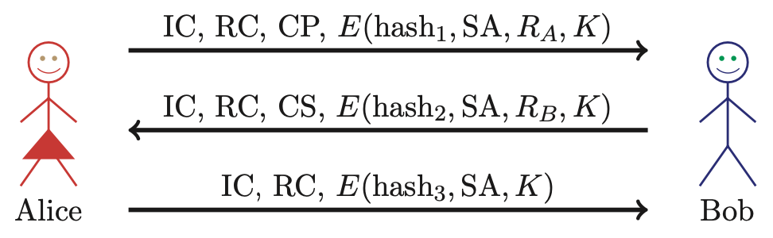
IKE Phase 2
Key K, IC, RC and SA known from Phase 1
Proposal CP includes ESP and/or AH
Hashes 1,2,3 depend on SKEYID, SA, R_{A} and R_{B}
Keys derived from KEYMAT = h(SKEYID,R_{A},R_{B},junk)
Recall SKEYID depends on phase 1 key method
Optional PFS (ephemeral Diffie-Hellman exchange)

Slide 124
IPSec
After IKE Phase 1, we have an IKE SA
After IKE Phase 2, we have an IPSec SA
Authentication completed and have a shared symmetric key (session key)
Now what?
  We want to protect IP datagrams
  But what is an IP datagram?
  From the perspective of IPSec…

Slide 125
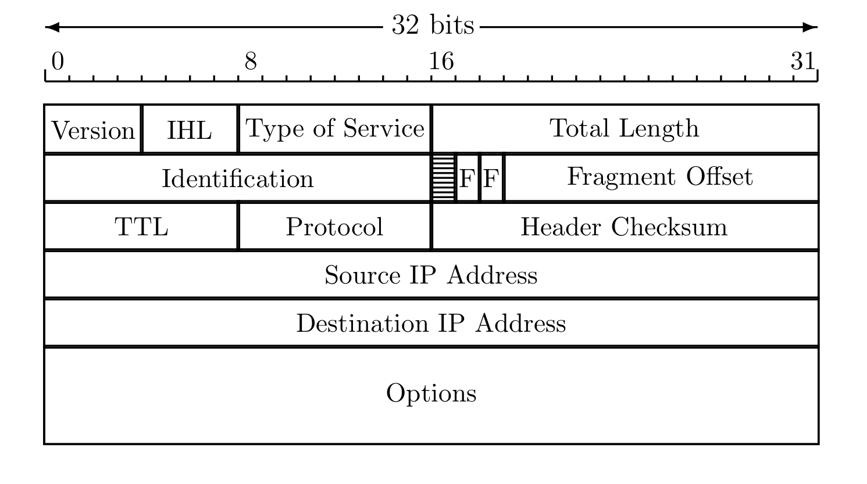
IP Review
IP datagram is of the form
IP header
data
Where IP header is

Slide 126
IP and TCP
Consider Web traffic, for example
  IP encapsulates TCP and…
  …TCP encapsulates HTTP
IP header
data
IP header
TCP hdr
HTTP hdr
app data
IP data includes TCP header, etc.

Slide 127
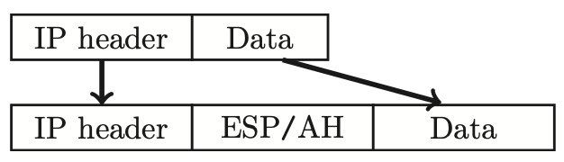
IPSec Transport Mode
IPSec Transport Mode
Transport mode designed for host-to-host
Transport mode is efficient
  Adds minimal amount of extra header
The original header remains
  Passive attacker can see who is talking

Slide 128
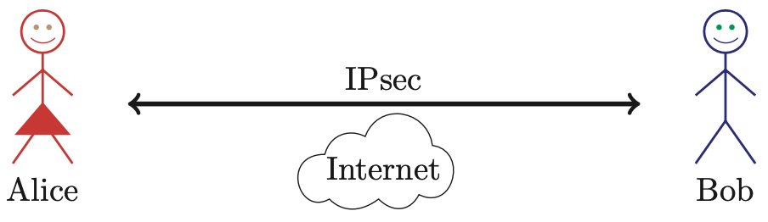
IPSec: Host-to-Host
IPSec transport mode used here
There may be firewalls in between
  If so, is that a problem?

Slide 129
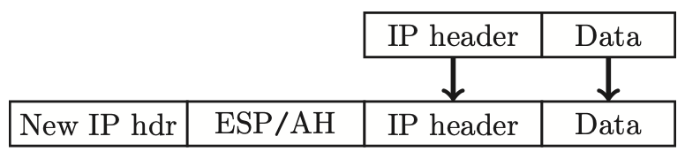
IPSec Tunnel Mode
IPSec Tunnel Mode
Tunnel mode for firewall-to-firewall traffic
Original IP packet encapsulated in IPSec
Original IP header not visible to attacker
  New IP header from firewall to firewall
  Attacker does not know which hosts are talking

Slide 130

IPSec: Firewall-to-Firewall
IPSec tunnel mode used here
Note: Local networks not protected
Is there any advantage here?

Slide 131
Comparison of IPSec Modes
Transport Mode
Transport Mode
  Host-to-host
Tunnel Mode
  Firewall-to-firewall
Transport Mode not necessary…
…but it’s more efficient
Tunnel Mode

Slide 132
IPSec Security
What kind of protection?
  Confidentiality?
  Integrity?
  Both?
What to protect?
  Data?
  Header?
  Both?
ESP/AH allow some combinations of these

Slide 133
AH vs ESP
AH ⎯ Authentication Header
  Integrity only (no confidentiality)
  Integrity-protect everything beyond IP header and some fields of header (why not all fields?)
ESP ⎯ Encapsulating Security Payload
  Integrity and confidentiality both required
  Protects everything beyond IP header
  Integrity-only by using NULL encryption

Slide 134
ESP NULL Encryption
According to RFC 2410
  NULL encryption “is a block cipher the origins of which appear to be lost in antiquity”
  “Despite rumors”, there is no evidence that NSA “suppressed publication of this algorithm”
  Evidence suggests it was developed in Roman times as exportable version of Caesar’s cipher
  Can make use of keys of varying length
  No IV is required
  Null(P,K) = P for any P and any key K
Is ESP with NULL encryption same as AH ?

Slide 135
Why Does AH Exist? (1)
Cannot encrypt IP header
  Routers must look at the IP header
  IP addresses, TTL, etc.
  IP header exists to route packets!
AH protects immutable fields in IP header
  Cannot integrity protect all header fields
  TTL, for example, will change
ESP does not protect IP header at all

Slide 136
Why Does AH Exist? (2)
ESP encrypts everything beyond the IP header (if non-null encryption)
If ESP-encrypted, firewall cannot look at TCP header in host-to-host case
Why not use ESP with NULL encryption?
  Firewall sees ESP header, but does not know whether null encryption is used
  End systems know, but not the firewalls

Slide 137
Why Does AH Exist? (3)
The real reason why AH exists:
  At one IETF meeting “someone from Microsoft gave an impassioned speech about how AH was useless…”
  “…everyone in the room looked around and said `Hmm. He’s right, and we hate AH also, but if it annoys Microsoft let’s leave it in since we hate Microsoft more than we hate AH.’ ”

Slide 138

Kerberos

Slide 139
Kerberos
In Greek mythology, Kerberos is 3-headed dog that guards entrance to Hades
  “Wouldn’t it make more sense to guard the exit?”
In security, Kerberos is an authentication protocol based on symmetric key crypto
  Originated at MIT
  Based on Needham-Schroeder protocol
  Relies on a Trusted Third Party (TTP)

Slide 140
Motivation for Kerberos
Authentication using public keys
  N users ⇒ N key pairs
Authentication using symmetric keys
  N users requires (on the order of) N² keys
Symmetric key case does not scale
Kerberos based on symmetric keys but only requires N keys for N users
  Security depends on TTP
  No PKI is needed

Slide 141
Kerberos KDC
Kerberos Key Distribution Center or KDC
  KDC acts as the TTP
  TTP is trusted, so it must not be compromised
KDC shares symmetric key K_{A} with Alice, key K_{B} with Bob, key K_{C} with Carol, etc.
And a master key K_{KDC} known only to KDC
KDC enables authentication, session keys
  Session key for confidentiality and integrity
In practice, crypto algorithm is DES

Slide 142
Kerberos Tickets
KDC issues tickets containing info needed to access network resources
KDC also issues Ticket-Granting Tickets or TGTs that are used to obtain tickets
Each TGT contains
  Session key
  User’s ID
  Expiration time
Every TGT is encrypted with K_{KDC}
  So, TGT can only be read by the KDC

Slide 143
Kerberized Login
Alice enters her password
Then Alice’s computer does following:
  Derives K_{A} from Alice’s password
  Uses K_{A} to get TGT for Alice from KDC
Alice then uses her TGT (credentials) to securely access network resources
Plus: Security is transparent to Alice
Minus: KDC must be secure ⎯ it’s trusted!
Notes:
KDC is playing a role comparable to a certificate authority (CA).

Slide 144

Kerberized Login
Key K_{A} = h(Alice’s password)
KDC creates session key S_{A}
Alice’s computer decrypts S_{A} and TGT
  Then it forgets K_{A}
TGT = E(“Alice”, S_{A}, K_{KDC})

Slide 145

Alice Requests “Ticket to Bob”
REQUEST = (TGT, authenticator)
  authenticator = E(timestamp, S_{A})
REPLY = E(“Bob”, K_{AB}, ticket to Bob, S_{A})
  ticket to Bob = E(“Alice”, K_{AB}, K_{B})
KDC gets S_{A} from TGT to verify timestamp

Slide 146

Alice Uses Ticket to Bob
ticket to Bob = E(“Alice”, K_{AB}, K_{B})
authenticator = E(timestamp, K_{AB})
Bob decrypts “ticket to Bob” to get K_{AB} which he then uses to verify timestamp

Slide 147
Kerberos
Key S_{A} used in authentication
  For confidentiality/integrity
Timestamps for authentication and replay protection
Recall, that with timestamps…
  Reduce the number of messages ⎯ like a nonce that is known in advance
  But, “time” is a security-critical parameter

Slide 148
Questions about Kerberos
When Alice logs in, KDC sends E(S_{A}, TGT, K_{A}) where TGT = E(“Alice”, S_{A}, K_{KDC})
  Q: Why is TGT encrypted with K_{A}?
  A: Enables Alice to remain anonymous when she (later) uses her TGT to request a ticket
In Alice’s “Kerberized” login to Bob, why can Alice remain anonymous?
Why is “ticket to Bob” sent to Alice?
  Why doesn’t KDC send it directly to Bob?
Notes:
Encrypting the TGT does prevent Trudy from knowing who the TGT belongs to---in subsequent use, Alice does not identify herself. So, that is probably worth the encryption; otherwise Alice would not be anonymous in the “Kerberized” login to Bob.

Slide 149
Kerberos Alternatives
Could have Alice’s computer remember password and use that for authentication
  Then no KDC required
  But hard to protect passwords
  Also, does not scale
Could have KDC remember session key instead of putting it in a TGT
  Then no need for TGT
  But stateless KDC is major feature of Kerberos

Slide 150
Kerberos Keys
In Kerberos, K_{A} = h(Alice’s password)
Could instead generate random K_{A}
  Compute K_{h} = h(Alice’s password)
  And Alice’s computer stores E(K_{A}, K_{h})
Then K_{A} need not change when Alice changes her password
  But E(K_{A}, K_{h}) must be stored on computer
This alternative approach is often used
  But not in Kerberos

Slide 151

WEP

Slide 152
WEP
WEP ⎯ Wired Equivalent Privacy
The stated goal of WEP is to make wireless LAN as secure as a wired LAN
According to Tanenbaum:
  “The 802.11 standard prescribes a data link-level security protocol called WEP (Wired Equivalent Privacy), which is designed to make the security of a wireless LAN as good as that of a wired LAN. Since the default for a wired LAN is no security at all, this goal is easy to achieve, and WEP achieves it as we shall see.”

Slide 153

WEP Authentication
Bob is wireless access point
Key K shared by access point and all users
  Key K seldom (if ever) changes
WEP has many, many, many security flaws

Slide 154
WEP Issues
WEP uses RC4 cipher for confidentiality
  RC4 can be a relatively strong cipher
  But WEP introduces a subtle flaw…
  …making cryptanalytic attacks feasible
WEP uses CRC for “integrity”
  Should have used a MAC or HMAC (or similar)
  CRC is for error detection, not crypto integrity
  Everyone should know NOT to use CRC here…

Slide 155
WEP Integrity Problems
WEP “integrity” gives no crypto integrity
  CRC is linear, so is stream cipher (XOR)
  Trudy can change ciphertext and CRC so that checksum on plaintext remains valid
  Then Trudy’s introduced changes go undetected
  Requires no knowledge of the plaintext!
CRC does not provide a cryptographic integrity check
  CRC designed to detect random errors
  Not to detect intelligent changes

Slide 156
More WEP Integrity Issues
Suppose Trudy knows destination IP
Then Trudy also knows keystream used to encrypt IP address, since
  C = destination IP address ⊕ keystream
Then Trudy can replace C with
  C′ = Trudy’s IP address ⊕ keystream
And change the CRC so no error detected
  Then what happens??
Moral: Big problems when integrity fails

Slide 157
WEP Key
Recall WEP uses a long-term key K
RC4 is a stream cipher, so each packet must be encrypted using a different key
  Initialization Vector (IV) sent with packet
  Sent in the clear, that is, IV is not secret
  Note: IV similar to MI in WWII ciphers
Actual RC4 key for packet is (IV,K)
  That is, IV is pre-pended to long-term key K

Slide 158

WEP Encryption
K_{IV} = (IV,K)
  That is, RC4 key is K with 3-byte IV pre-pended
The IV is known to Trudy

Slide 159
WEP IV Issues
WEP uses 24-bit (3 byte) IV
  Each packet gets its own IV
  Key: IV pre-pended to long-term key, K
Long term key K seldom changes
If long-term key and IV are same, then same keystream is used
  This is bad, bad, really really bad!
  Why?

Slide 160
WEP IV Issues
Assume 1500 byte packets, 11 Mbps link
Suppose IVs generated in sequence
  Since 1500 ⋅ 8/(11 ⋅ 10⁶) ⋅ 2²⁴ = 18,000 seconds, an IV repeat in about 5 hours of traffic
Suppose IVs generated at random
  Birthday problem: Some IV repeats in seconds
Again, repeated IV (with same K) is bad

Slide 161
Another Active Attack
Suppose Trudy can insert traffic and observe corresponding ciphertext
  Then she knows the keystream for some IV
  She can decrypt any packet that uses that IV
If Trudy does this many times, she can then decrypt data for lots of IVs
  Remember, IV is sent in the clear
Is such an attack feasible?

Slide 162
Cryptanalytic Attack
WEP data encrypted using RC4
  Packet key is IV with long-term key K
  3-byte IV is pre-pended to K
  Packet key is (IV,K)
Recall IV is sent in the clear (not secret)
  New IV sent with every packet
  Long-term key K seldom changes (maybe never)
So Trudy always knows IV and ciphertext
  Trudy wants to find the key K

Slide 163
Cryptanalytic Attack
3-byte IV pre-pended to key
Denote the RC4 key bytes …
  … as k₀,k₁,k₂,k₃,k₄,k₅, …
  Where IV = (k₀,k₁,k₂) , which Trudy knows
  Trudy wants to find K = (k₃,k₄,k₅, …)
Given enough IVs, Trudy can easily find key K
  Regardless of the length of the key
  Provided Trudy knows first keystream byte
  Known plaintext attack (1st byte of each packet)
  Prevent by discarding first 256 keystream bytes

Slide 164
WEP Conclusions
Many attacks are practical
Attacks have been used to recover keys and break real WEP traffic
How to prevent these attacks?
  Don’t use WEP
  Good alternatives: WPA, WPA2, etc.
How to make WEP a little better?
  Restrict MAC addresses, don’t broadcast ID, …

Slide 165

GSM (In)Security

Slide 166
Cell Phones
First generation cell phones
  Brick-sized, analog, few standards
  Little or no security
  Susceptible to cloning
Second generation cell phones: GSM
  Began in 1982 as “Groupe Speciale Mobile”
  Now, Global System for Mobile Communications
Third generation?
  3rd Generation Partnership Project (3GPP)

Slide 167



GSM System Overview
air
interface
Mobile
Base
Station
AuC
VLR
“land line”
HLR
PSTN
Internet
etc.
Base
Station
Controller
Home
Network
Visited
Network

Slide 168


GSM System Components
Mobile phone
  Contains SIM (Subscriber Identity Module)
SIM is the security module
  IMSI (International Mobile Subscriber ID)
  User key: Ki (128 bits)
  Tamper resistant (smart card)
  PIN activated (often not used)
SIM

Slide 169
GSM System Components
Visited network ⎯ network where mobile is currently located
  Base station ⎯ one “cell”
  Base station controller ⎯ manages many cells
  VLR (Visitor Location Register) ⎯ info on all visiting mobiles currently in the network
Home network ⎯ “home” of the mobile
  HLR (Home Location Register) ⎯ keeps track of most recent location of mobile
  AuC (Authentication Center) ⎯ has IMSI and Ki

Slide 170
GSM Security Goals
Primary design goals
  Make GSM as secure as ordinary telephone
  Prevent phone cloning
Not designed to resist an active attacks
  At the time this seemed infeasible
  Today such an attacks are clearly feasible…
Designers considered biggest threats to be
  Insecure billing
  Corruption
  Other low-tech attacks

Slide 171
GSM Security Features
Anonymity
  Intercepted traffic does not identify user
  Not so important to phone company
Authentication
  Necessary for proper billing
  Very, very important to phone company!
Confidentiality
  Confidentiality of calls over the air interface
  Not important to phone company…
  …except for marketing

Slide 172
GSM: Anonymity
IMSI used to initially identify caller
Then TMSI (Temporary Mobile Subscriber ID) used
  TMSI changed frequently
  TMSI’s encrypted when sent
Not a strong form of anonymity
But probably useful in many cases

Slide 173
GSM: Authentication
Caller is authenticated to base station
Authentication is not mutual
Authentication via challenge-response
  Home network generates RAND and computes XRES = A3(RAND, Ki) where A3 is a hash
  Then (RAND,XRES) sent to base station
  Base station sends challenge RAND to mobile
  Mobile’s response is SRES = A3(RAND, Ki)
  Base station verifies SRES = XRES
Note: Ki never leaves home network

Slide 174
GSM: Confidentiality
Data encrypted with stream cipher
Error rate estimated at about 1/1000
  Error rate is high for a block cipher
Encryption key Kc
  Home network computes Kc = A8(RAND, Ki) where A8 is a hash
  Then Kc sent to base station with (RAND,XRES)
  Mobile computes Kc = A8(RAND, Ki)
  Keystream generated from A5(Kc)
Note: Ki never leaves home network

Slide 175
GSM Security
1. IMSI
2. IMSI
4. RAND
3. (RAND,XRES,Kc)
5. SRES
Mobile
Base
Station
Home
Network
6. Encrypt with Kc
SRES and Kc must be uncorrelated
  Even though both are derived from RAND and Ki
Must not be possible to deduce Ki from known RAND/SRES pairs (known plaintext attack)
Must not be possible to deduce Ki from chosen RAND/SRES pairs (chosen plaintext attack)
  With possession of SIM, attacker can choose RAND’s

Slide 176
GSM Insecurity (1)
Hash used for A3/A8 is COMP128
  Broken by 160,000 chosen plaintexts
  With SIM, can get Ki in 2 to 10 hours
Encryption between mobile and base station but no encryption from base station to base station controller
  Often transmitted over microwave link
Encryption algorithm A5/1
  Broken with 2 seconds of known plaintext
Base
Station
VLR
Base
Station
Controller

Slide 177
GSM Insecurity (2)
Attacks on SIM card
  Optical Fault Induction ⎯ could attack SIM with a flashbulb to recover Ki
  Partitioning Attacks ⎯ using timing and power consumption, could recover Ki with only 8 adaptively chosen “plaintexts”
With possession of SIM, attacker could recover Ki in seconds

Slide 178


GSM Insecurity (3)
Fake base station exploits two flaws
  Encryption not automatic
  Base station not authenticated
RAND
SRES
Call to
destination
No
Mobile
Fake
Base Station
encryption
Base Station
Note: GSM bill goes to fake base station!

Slide 179
GSM Insecurity (4)
Denial of service is possible
  Jamming (always an issue in wireless)
Can replay triple: (RAND,XRES,Kc)
  One compromised triple gives attacker a key Kc that is valid forever
  No replay protection here

Slide 180
GSM Conclusion
Did GSM achieve its goals?
  Eliminate cloning? Yes, as a practical matter
  Make air interface as secure as PSTN? Perhaps…
But design goals were clearly too limited
GSM insecurities ⎯ weak crypto, SIM issues, fake base station, replay, etc.
PSTN insecurities ⎯ tapping, active attack, passive attack (e.g., cordless phones), etc.
GSM a (modest) security success?

Slide 181
3rd Generation Partnership Project (3GPP)
3G security built on GSM (in)security
3G fixed known GSM security problems
  Mutual authentication
  Integrity-protect signaling (such as “start encryption” command)
  Keys (encryption/integrity) cannot be reused
  Triples cannot be replayed
  Strong encryption algorithm (KASUMI)
  Encryption extended to base station controller

Slide 182
Protocols Summary
Generic authentication protocols
  Protocols are subtle!
SSH
SSL
IPSec
Kerberos
Wireless: GSM and WEP

Slide 183
Coming Attractions…
Software and security
  Software flaws ⎯ buffer overflow, etc.
  Malware ⎯ viruses, worms, etc.
  Software reverse engineering
  Digital rights management
  OS and security/NGSCB

