Slide 1
DATA 225 Database Systems for Analytics November 20 Class Meeting
Department of Applied Data Science San Jose State University Fall 2023 Instructor: Ron Mak
www.cs.sjsu.edu/~mak

Slide 2
This Evening
Project survey questions
NoSQL databases
benefits and disadvantages
types and brands
structured vs. semi-structured data
the document model
scalability, auto-sharding, replication
CAP theorem
Break

Slide 3
This Evening, cont’d
MongoDB
Python interface pymongo
collections and documents
school database
queries with joins and matches

Slide 4
Team Database Projects
Each project team produces:
Operational database + GUI-based Python application
Analytical database + GUI-based Python application
Demonstrate how well you can apply what you learned during the semester.
Not all technologies have to be used.
Live demos
Evaluated by the class via Canvas surveys

Slide 5
Team Database Projects, cont’d
Data for the operational database
Actual commerce or experimental data
Dataset(s) downloaded from the web
Artificially generated data (e.g., mockeroo)
The frontend GUI-based Python application for the operational database should demonstrate user queries and updates and display their results.

Slide 6
Team Database Projects, cont’d
Data for the analytical database
Extracted from the operational database.
ETL from external sources.
The frontend GUI-based Python application for the analytical database should demonstrate analytical operations and display their results.
Database projects due
Monday, December 18 @ 11:59 PM

Slide 7
Team Database Projects, cont’d
Python code (notebook or standalone)
Use a shared server (provide access)
Written report (10 – 20 pages)
What is the application?
Describe your operational and analytical databases.
What data did you use, and where did you get it?
Include:
ER diagram
Relational and star schemas
Operational and analytical queries
User scenarios with screen shots

Slide 8
Project Presentation Presentations
Monday, December 4
Maximum 15 minutes each!
We have 11 teams.
We can assume that each application has users.
Don’t waste time demonstrating registering new users
and logging in existing users.
Demonstrate the key features your
operational and analytical database applications.

Slide 9
Project Survey Questions
As each project team gives its oral presentation, each student in the rest of the class will individually evaluate the presentation by taking part in a survey on Canvas.
Rate each survey question: Poor, OK, Good, or Excellent.
Don’t do the survey for your own project team.
Completing each survey is worth 10 points (total 90 points for 9 surveys) for each student.

Slide 10
Project Survey Questions, cont’d
How well did they describe the application?
Is it clear what the application (both the operational and analytical parts) is supposed to do?
How appropriate are the data sources?
Does the data source support the operational database functionality?

Slide 11
Project Survey Questions, cont’d
How is the design of the operational database?
Did they explain it clearly?
Is the design appropriate for the application?
How is the design of the analytical database?
Did they explain it clearly?
Is the design appropriate for the application?
How well did they design the ETL process?
ETL of data into the operational database.
ETL of data into the analytical database.

Slide 12
Project Survey Questions, cont’d
What do you think of the demo of the operational database?
Does it have appropriate functionality for the application?
What do you think of the demo of the analytical database?
Does it have appropriate functionality for the application?
What is your overall impression of the presentation?

Slide 13
NoSQL
“Not only SQL”
A mechanism to store and retrieve data that uses a model other than the tabular relations used in relational databases.
Big Data and real-time web applications.
Existed since the early 1960s but the term “NoSQL” became popular with Web 2.0 companies such as Google, Facebook, and Amazon.

Slide 14
NoSQL Benefits
Simpler design.
Object-oriented programming that is easier to use and more flexible.
Data structures are more flexible than relational tables.
Data modeling closer to real-world data.
More scalable and better performance than relational databases for certain applications.
Good for large volumes of rapidly changing data.

Slide 15
NoSQL Benefits, cont’d
More suitable for agile development.
Agile sprints, quick schema iteration, and frequent code pushes.
Finer control over data availability.
Geographically distributed scale-out architecture instead of an expensive, monolithic architecture.
scale-out: Add more nodes to a distributed system to expand it horizontally rather than vertically.
scale-up: Expand a system vertically by adding more memory, processors, disk space, etc.

Slide 16
NoSQL Disadvantages
Many NoSQL databases compromise consistency in favor of availability, partition tolerance, and speed.
More on this later.
Low-level query languages instead of SQL.
Often an API callable from various languages.

Slide 17
Types of NoSQL Databases
Key-value stores
Graph stores
Wide-column stores
Document databases

Slide 18
Types of NoSQL Databases, cont’d
https://www.dotnettricks.com/learn/mongodb/what-is-mongodb-and-why-to-use-it

Slide 19
Types of NoSQL Databases: Key-Value Stores
The simplest NoSQL databases.
Store a single item in the database as an attribute name (or “key”), together with its value.
Like a giant hash table.
Some key-value stores allow each value to have a type, such as integer, which adds functionality.
Store session information, user profiles, shopping cart data, etc.

Slide 20
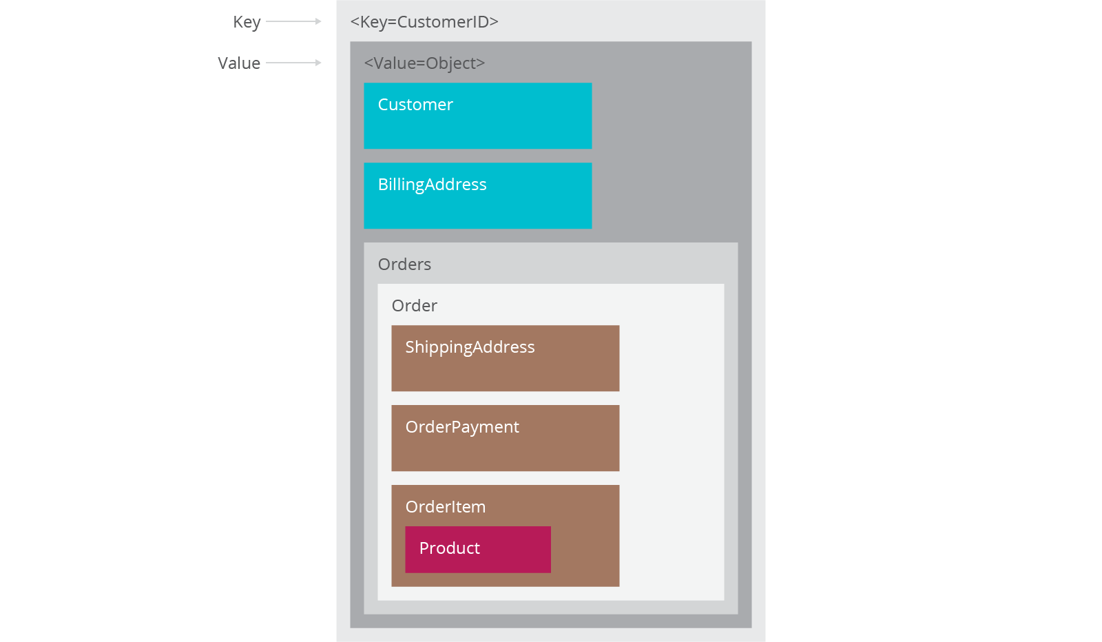
Key-Value Stores, cont’d
Key-value store
https://www.thoughtworks.com/insights/blog/nosql-databases-overview

Slide 21
Types of NoSQL Databases: Graph Stores
Store information about connected data, such as social networks, spatial data, routing information for goods and money, recommendation engines, etc.

Slide 22
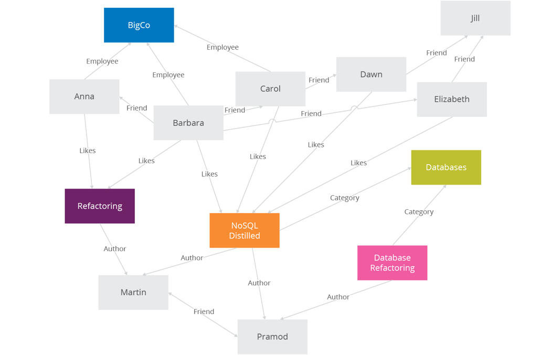
Graph Stores, cont’d
Graph store
https://www.thoughtworks.com/insights/blog/nosql-databases-overview

Slide 23
Types of NoSQL Databases: Wide-Column Stores
Optimized for queries over large datasets.
Store columns of data together, instead of rows.
The number of columns and the format of the data in a column can vary from row to row.
Useful for content management systems, blogging platforms, etc.

Slide 24
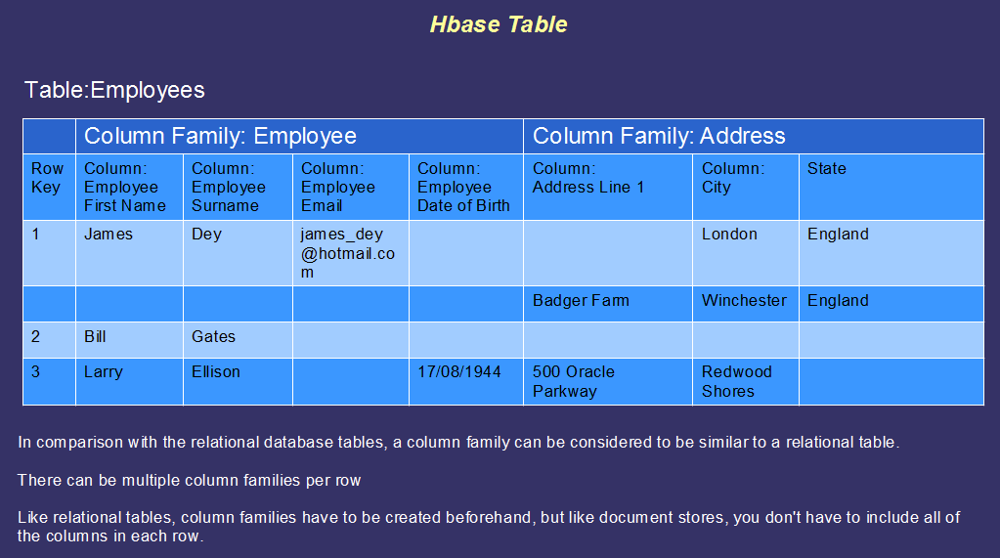
Wide-Column Stores, cont’d
Wide-column store
https://bigdatalondon.files.wordpress.com/2015/06/hbase-table2.png

Slide 25
Types of NoSQL Databases: Document Databases
Document: Each key is paired with a complex data structure.
Documents can contain many different key-value pairs, or key-array pairs, or even nested documents.
Useful for content management systems, blogging platforms, web analytics, real-time analytics, ecommerce-applications, etc.
Example: MongoDB

Slide 26
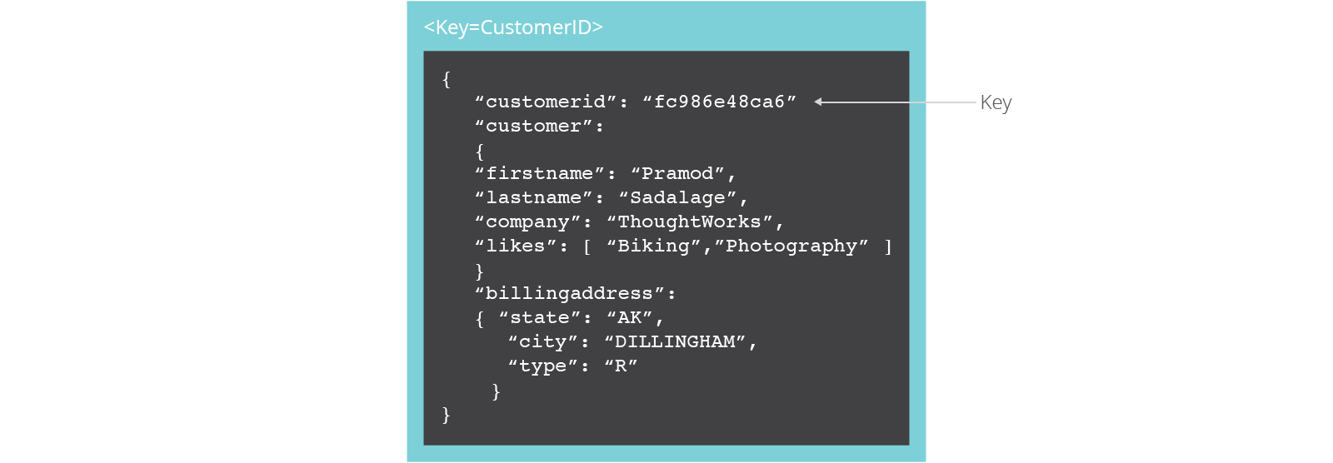
Document Databases, cont’d
Document database
https://www.thoughtworks.com/insights/blog/nosql-databases-overview

Slide 27
Structured vs. Semi-Structured Data
Structured data
Stored in tables of a relational database.
A schema describes data formats and relationships.
Semi-structured data
Data does not reside in a relational database.
Data may contain tags to separate semantic elements and enforce hierarchies of records and fields within the data (self-describing structure).
Examples: XML and JSON

Slide 28
The Document Model
Semi-structured data.
Typically, JSON (JavaScript Object Notation).
The document’s internal structure provides the metadata to use for query optimization.
Type information is embedded in the data.
Each instance of data is different from others.
https://lennilobel.wordpress.com/2015/06/01/relational-databases-vs-nosql-document-databases/

Slide 29
The Document Model, cont’d
Query on any field within a document.
Most natural and productive.
Maps directly to the objects of an object-oriented language.

Slide 30
NoSQL Agile Development
Unlike relational databases, NoSQL does not require schemas to be defined in advance.
No database downtime to update a schema.
NoSQL can effectively address data that’s completely unstructured or unknown in advance.
Insert data without a predefined schema.
Apply validation rules within the database.
Enforce governance across data.
Maintain the agility benefits of a dynamic schema.

Slide 31
Scalability
Scale-up
Relational databases scale vertically.
Increase the database server’s capabilities in order to increase performance.
Scale-out
Scale horizontally to support rapidly growing applications by adding more servers.
NoSQL databases support auto-sharding.

Slide 32
Scalability, cont’d
https://interviewbubble.com/what-is-the-difference-between-scaling-horizontally-vs-scaling-vertically-scale-up-vs-scale-out/

Slide 33
Auto-Sharding
NoSQL databases natively and automatically spread data across an arbitrary number of servers.
Applications do not need to be aware of the composition of the server pool.
Data and query load are automatically balanced across servers.
When a server goes down, it can be quickly and transparently replaced without application disruption.

Slide 34
Auto-Sharding, cont’d
https://www.digitalocean.com/community/tutorials/understanding-database-sharding

Slide 35
Cloud Computing
Auto-sharding works well with cloud computing.
Example: Amazon Web Services
Provides virtually unlimited capacity on demand.
Takes care of all the necessary infrastructure administration tasks.
Developers no longer need to construct complex, expensive platforms to support their applications.

Slide 36
NoSQL Data Replication
Automatic database replication maintains availability in the event of outages or planned maintenance events.
Automated failover and recovery.
Distribute the database across multiple geographic regions to withstand regional failures and enable data localization.
No requirement for separate applications or expensive add-ons to implement replication.

Slide 37
NoSQL Data Caching
Integrated caching capabilities.
Keep frequently-used data in system memory as much as possible.
No need for a separate caching layer.
Available fully managed, integrated in-memory database management layer.
Support workloads that demand the highest throughput and lowest latency.

Slide 38
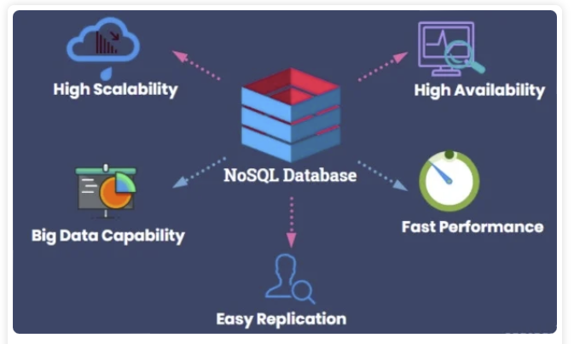
NoSQL Advantages
https://hevodata.com/learn/relational-database-vs-nosql/

Slide 39
CAP Theorem
Consistency
All nodes of a distributed system see the same data at the same time.
Availability
A guarantee that every request gets a response whether the request succeeded or failed.
Partition tolerance
The system continues to operate despite arbitrary network partitioning (splitting) due to device failures.
Relational databases have ACID properties for transactions:
Atomicity
Consistency
Isolation
Durability

Slide 40
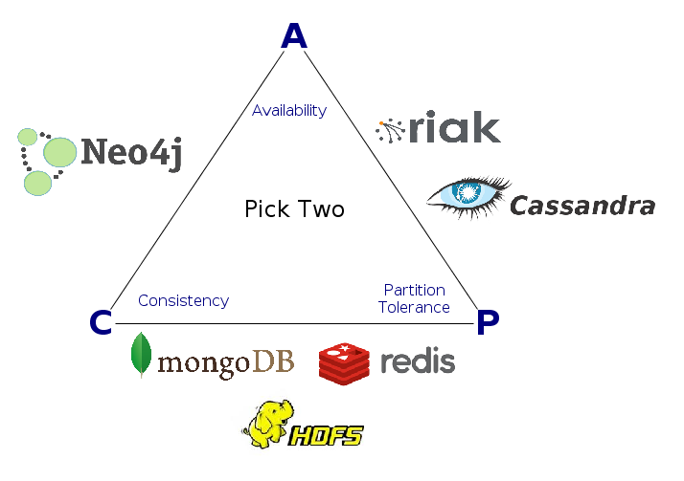
CAP Theorem, cont’d
Consistency, availability, partition tolerance: You can only choose two out of three.
Different NoSQL databases emphasize different pairs of CAP.
http://datasciencepedia.com/cap-theorem-big-data/

Slide 41
SQL vs. NoSQL
 | SQL | NoSQL
Types | SQL database | Key-value, graph, wide-column, document
Development history | Early 1970s | Late 2000s
Data model | Relational | Various
Schemas | Fixed | Dynamic
Scaling | Vertical | Horizontal
Development model | Mix of closed- and open-source | Open-source
Transaction support | Yes | At certain levels (e.g., document vs. database) depending on the application
Data manipulation | Via SQL language | Via object-oriented API
Consistency | Can be strong | Depends on the database product

Slide 42
Break

Slide 43
MongoDB
From “humongous”
Scalable
High performance
Open-source
Document-oriented
Schema-free

Slide 44
MongoDB Features
Horizontal scaling
Indexing
Replication/failover support
Documents are stored in BSON (binary JSON)
Binary serialization of JSON-like objects.
Import or query any valid JSON object.
Query syntax based on JavaScript.
Use the Python-MongoDB connector pymongo.
Queries integrated into Python code.

Slide 45
MongoDB Documents and Collections
Documents are analogous to records (rows) of a relational database.
Collections are analogous to relational tables.
A MongoDB query returns a cursor instead of records.
Use the cursor to iterate through the result set.
Better performance: More efficient than loading all the objects into memory.

Slide 46
MongoDB Consistency
The document model (and the graph model) can be consistent or eventually consistent.
Eventually consistent: Database changes are propagated to all nodes “eventually”.
Typically, within milliseconds
Stale reads: Updated data not immediately returned.
MongoDB consistency is tunable.
By default, all data is consistent.
All reads and writes access the primary data copy.
Read operations possible on the secondary copies.

Slide 47
Eventually Consistent Data
Advantages
Fast data inserts.
Disadvantages
Updates and deletes are more complex.
There can be periods of time during which not all copies of the data are synchronized.

Slide 48
MongoDB Demo
Install MongoDB Community Edition 6.0.1: https://docs.mongodb.com/master/administration/install-community/
Start and stop the MongoDB server:
Follow the online instructions for Windows and Mac OS.
Install the Python connector to MongoDB:
pip3 install pymongo

Slide 49
MongoDB Demo, cont’d
We will use MongoDB to recreate the school relational database.
tables ➔ collections
table rows ➔ documents
Example notebooks:
13-1-SchoolDatabase.ipynb
13-2-ContactCollection.ipynb
13-3-StudentCollection.ipynb
13-4-TeacherCollection.ipynb
13-5-ClassCollection.ipynb
13-6-TakesCollection.ipynb
13-7-SchoolQueries.ipynb

Slide 50
Assignment #11: MongoDB
Recreate four of your database tables (operational, analytical, or both) as MongoDB collections.
Add some sample documents to the collections.
Perform three queries with joins:
with two collections
with three collections
with four collections
Team assignment
due Monday, May 8

