Slide 1
DATA 225 Database Systems for Analytics October 23 Class Meeting
Department of Applied Data Science San Jose State University Fall 2023 Instructor: Ron Mak
www.cs.sjsu.edu/~mak

Slide 2
This Evening
Generate a bar chart
data from client-side Python
data from server-side SQL
Cleaning data prior to analysis
Replace missing or corrupt values with averages
using client-side Python code
using server-side SQL
Break
It’s time to do
data analysis!

Slide 3
This Evening, cont’d
Replace missing of corrupt values with regression
one, two, and three independent variables
using client-side Python code
using server-side SQL
What to do about outliers
Team project description

Slide 4
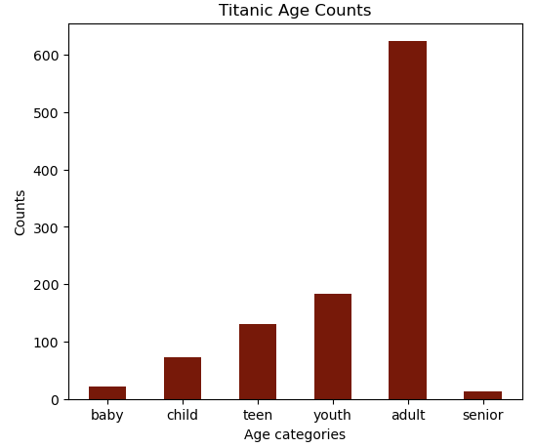
Titanic Ages Bar Chart
Create a bar chart of the passengers’ known ages from the Titanic database.
senior: age >= 65
adult: age >= 25
youth: age >= 20
teen: age >= 13
child: age >= 2
baby: age > 0
We can query and download all the data and use Python to calculate the frequencies.
TitanicBarChart-Python.ipynb

Slide 5
Recall: Client-Server Architecture
Local machine localhost
network
MySQL
database server
Python
database
application
"""
SELECT * FROM teacher
"""
Databases
results
"""
SELECT * FROM teacher
"""
Port 3306
MySQL
Workbench
"""
SELECT * FROM teacher
"""
results
results
Terminal
running
mysql
client app
"""
SELECT * FROM teacher
"""
Web apps
"""
SELECT * FROM teacher
"""
Web
Browser
Apache
web server
results
Remote machine
IES-ADS-ClassDB.sjsu.edu

Slide 6
Titanic Ages Bar Chart, cont’d
We do not want to download large amounts of data from the database and cause much network traffic and latency to perform frequency calculations on the client side.
Big Data
Instead, have the database perform the frequency calculations on the server side and only download the counts.
A much, much smaller amount of data.

Slide 7
SQL IF Function
Syntax and semantics of the SQL IF function.
Do not confuse with the IF statement used in stored procedures and functions.
Evaluate the conditional_expression
Then the value of the IF function is
value_if_true if the condition evaluates to true
value_if_false otherwise
IF ( conditional_expression, value_if_true, value_if_false )
TitanicBarCharts-SQL.ipynb

Slide 8
What Do Data Scientists Do?
Surveys show that data scientists spend an average of 80% of their time acquiring, cleaning, transforming, and loading data.
ETL (extract, transform, and load).
“Data wrangling”
The remaining time for analyzing the data?
How do we structure the data in a database to facilitate data analysis?
What if it’s “Big Data” and we want to do data mining?

Slide 9
Cleaning the Data
Missing or corrupted data values
Throw out records containing missing or corrupted data.
Replace the missing or corrupted data.
Will these tactics bias your data analysis?
Outliers
What values are outliers?
Throw out or replace the outliers?
How do we know the outlier values aren’t statistically significant?

Slide 10
Cleaning the Data, cont’d
Irrelevant data
Ignore data that is not pertinent to your analysis.
Be wary of unexpected correlations between the “irrelevant” data and the data you want to analyze.
Resolution
Data that is not at the scale that you need.
Example: Daily data but you need hourly data.
Format
You need to reformat your data to work with your analysis procedures.

Slide 11
Replace Missing or Corrupted Data Values
Some data records may have missing or corrupted field values.
You don’t want to throw out those records entirely because other fields of the records contain important values.
How can you replace the bad field values in ways that allow you to analyze all the data and won’t bias your analysis?
Replace with average values. Which averages?
Use regression to replace with approximate values.

Slide 12
A Prediction Problem
We want to analyze the Titanic data to see how well correlated are the passengers’ survival, age, sex, and passenger class.
How well does one value predict another?

Slide 13
Titanic Survival Data: Missing Ages
Problem: The Titanic Survival data contains passengers with missing ages.
Ages listed as NA
"Wilkes, Mrs. James (Ellen Needs","yes","female",47,"3rd"
"Willer, Mr. Aaron (Abi Weller","no","male",NA,"3rd"
"Willey, Mr. Edward","no","male",NA,"3rd"
"Williams, Mr. Howard Hugh Harr","no","male",NA,"3rd"
"Williams, Mr. Leslie","no","male",28.5,"3rd"
"Windelov, Mr. Einar","no","male",21,"3rd"
"Wirz, Mr. Albert","no","male",27,"3rd"
"Wiseman, Mr. Phillippe","no","male",NA,"3rd"
"Wittevrongel, Mr. Camille","no","male",36,"3rd"
"Yasbeck, Mr. Antoni","no","male",27,"3rd"
"Yasbeck, Mrs. Antoni (Selini Al","yes","female",15,"3rd"
"Youseff, Mr. Gerious","no","male",45.5,"3rd"
"Yousif, Mr. Wazli","no","male",NA,"3rd"
"Yousseff, Mr. Gerious","no","male",NA,"3rd"
"Zabour, Miss. Hileni","no","female",14.5,"3rd"
"Zabour, Miss. Thamine","no","female",NA,"3rd"
"Zakarian, Mr. Mapriededer","no","male",26.5,"3rd”

Slide 14
Replacing Missing Data
Replace a missing value with an average.
What average can we use that won’t bias or otherwise adversely affect our analysis?
Use regression to supply a replacement value.
How many independent variables?
Linear or higher order regression?
Should we perform the replacements on the client side in Python code or in the remote database using SQL?

Slide 15
Client Side vs. Server Side
We want to reduce network traffic and latencies between the client and the server.
Therefore, it is undesirable to download table rows from the database server in order to calculate averages or regression coefficients on the client side.
Especially if the table contains many rows.
Use SQL code to do the calculations in the database and download only the results.

Slide 16
Replace Missing Ages in the Titanic Data
Replace missing ages with average values.
Which averages to use?
Exploration
Perform the replacements with different averages on the client side using Python code:
Analysis
Perform the replacements in the database using SQL:
TitanicReplaceAges-Python.ipynb
TitanicReplaceAges-SQL.ipynb

Slide 17
Break

Slide 18
Use Linear Regression
If the “good” data points are linear, use linear regression analysis to compute replacement values for the missing or corrupted values.
Calculate the regression coefficients on the client side with Python code after downloading table rows.
Calculate the regression coefficients on the remote database server using SQL.

Slide 19
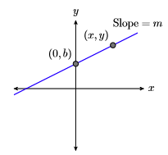
Use Linear Regression, cont’d
For a single independent variable, recall the slope-intercept form of a line:
m is the slope of the line
How much y increases when x increases by 1.
b is the y value where the line intercepts y axis (i.e., where x = 0)
If m is positive, the line rises from left to right. If m is negative, the line falls. If m = 0, the line is horizontal at y = b.
y = mx + b

Slide 20
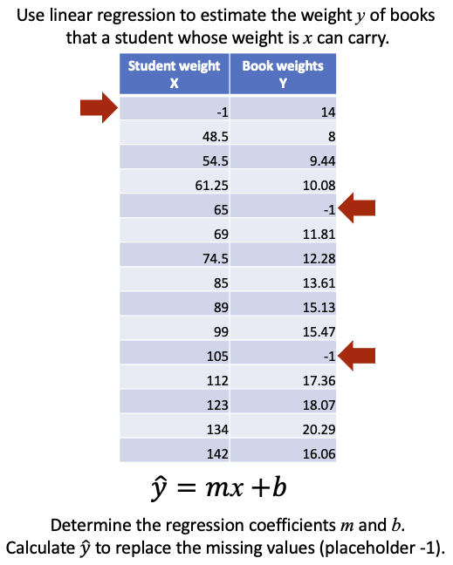
Use Linear Regression, cont’d
Single independent variable example.
Replace missing values.
Calculations on the client side with Python code and on the server side with SQL to compute m and b:
StudentBooks-Python.ipynb
StudentBooks-SQL.ipynb

Slide 21
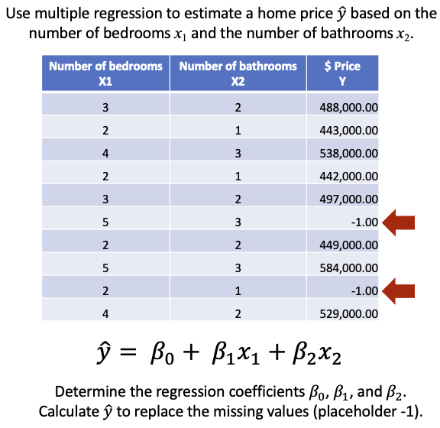
Use Linear Regression, cont’d
Multiple regression example with two independent variables.
Replace missing values.
Calculations to compute the regression coefficients $β_{0}$, $β_{1}$, and $β_{2}$
HomePrices-SQL.ipynb

Slide 22
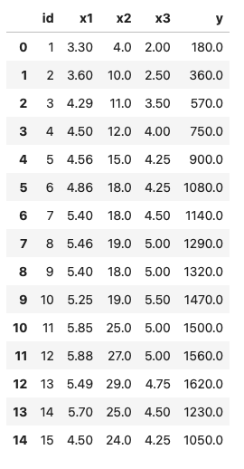
Use Linear Regression, cont’d
Multiple regression example with three independent variables.
Calculations to compute the regression coefficients $β_{0}$, $β_{1}$, $β_{2}$, and $β_{3}$
ThreeIndependents-SQL.ipynb
$$\hat{y}=β_{0}+β_{1}x_{1}+β_{2}x_{2}+β_{3}x_{3}$$

Slide 23
What are Outliers?
What data values to consider outliers depends on the application.
Example: A person’s age is negative or over 125 years.
Throwing out or replacing an outlier may cause you to miss something important in your data!
You can treat an outlier like a missing value and replace it.

Slide 24
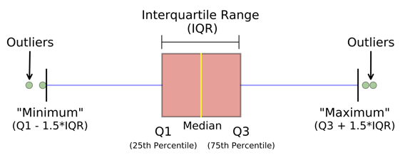
What are Outliers? cont’d
A statistical definition of outliers:
Reminder: The interquartile range (IQR) of a dataset are the values within the second (Q2) and third (Q3) quartiles
Middle values that include 25 – 75% of the values.

Slide 25
Next Several Weeks
Operational vs. analytical databases
How to structure a relational database to facilitate data analysis.
dimensional modeling
fact tables and dimension tables
star schema
Online analytical processing (OLAP)
Data warehouse
NoSQL databases

Slide 26
Team Database Projects
Each project team produces:
Operational database + GUI-based Python application
Analytical database + GUI-based Python application
Demonstrate how well you can apply what you learned during the semester.
Not all technologies have to be used.
Live demos
Evaluated by the class via Canvas surveys

Slide 27
Team Database Projects, cont’d
Data for the operational database
Actual commerce or experimental data
Dataset(s) downloaded from the web
Artificially generated data (e.g., mockeroo)
The frontend GUI-based Python application for the operational database should demonstrate user queries and updates and display their results.

Slide 28
Team Database Projects, cont’d
Data for the analytical database
Extracted from the operational database.
ETL from external sources.
The frontend GUI-based Python application for the analytical database should demonstrate analytical operations and display their results.

Slide 29
Team Database Projects, cont’d
Python code (notebook or standalone)
Use a shared server (provide access)
Written report (10 – 20 pages)
What is the application?
Describe your operational and analytical databases.
What data did you use, and where did you get it?
Include:
ER diagram
Relational and star schemas
Operational and analytical queries
User scenarios with screen shots

