Slide 1
DATA 225 Database Systems for Analytics October 16 Class Meeting
Department of Applied Data Science San Jose State University Fall 2023 Instructor: Ron Mak
www.cs.sjsu.edu/~mak

Slide 2
This Evening
Triggers and events
Object-relational mapping
Transactions
ACID properties
Break
Concurrency and locking
Data loss and recovery
Reliability and RAID

Slide 3
Unofficial Field Trip
Computer History Museum in Mt. View
http://www.computerhistory.org/
Provide your own transportation to the museum.
Saturday, October 21, 11:30 – closing time
Special free admission for my students.
Experience a fully restored IBM 1401 mainframe computer from the early 1960s in operation.
Do a self-guided tour of the Revolution exhibit.

Slide 4
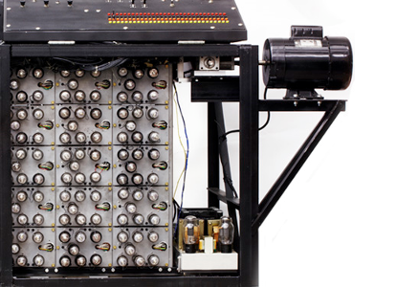
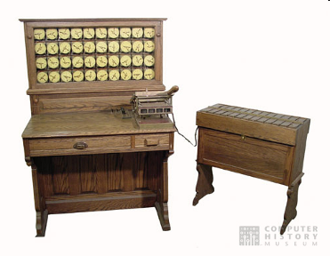
Unofficial Field Trip, cont’d
See the extensive Revolution exhibit!
Walk through a timeline of the First 2000 Years of Computing History.
Historic computer systems, data processing equipment, and other artifacts.
Small theater presentations.
Hollerith
Census
Machine
Atanasoff-Berry
Computer

Slide 5
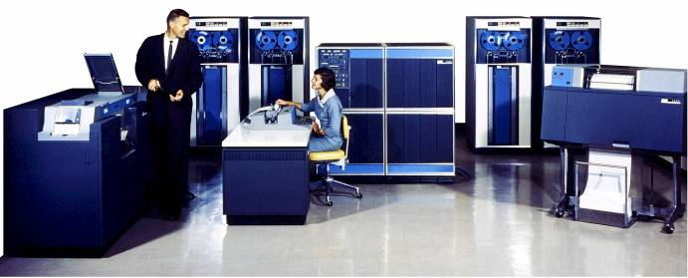
Unofficial Field Trip, cont’d
IBM 1401 computer, fully restored and operational.
A small transistor-based mainframe computer.
Extremely popular with small businesses in the late 1950s through the mid 1960s
Maximum of 16K bytes of memory.
800 card/minute card reader (wire brushes).
600 line/minute line printer (impact).
6 magnetic tape drives, no disk drives.

Slide 6
Unofficial Field Trip, cont’d
Information on the IBM 1401:
General info: http://en.wikipedia.org/wiki/IBM_1401
My summer seminar: http://www.cs.sjsu.edu/~mak/1401/
Restoration: http://ed-thelen.org/1401Project/1401RestorationPage.html

Slide 7
Triggers
A trigger is a block of SQL code that automatically fires (executes) either before or after an INSERT, UPDATE, or DELETE statement is executed on a table.
Commonly used to enforce data consistency or application-specific business rules, or for logging.

Slide 8
Trigger Examples
When we hire a new employee, we want to automatically set the employee’s salary to $1 above the minimum salary of the current employees.
Automatically calculate the new salary before inserting the employee record.
We want to log when the new employee was hired.
Automatically write a log record after inserting the employee record.
Triggers.ipynb

Slide 9
Events
A scheduled event is a block of SQL code that automatically fires according to the event scheduler.
We can schedule the event to fire only once at a specified time or to fire periodically, starting at a specified time for specified time intervals.
Commonly used to monitor the changing contents of a database table.
Events.ipynb

Slide 10
Object-Relational Mapping (ORM)
Object-relational mapping (ORM) is a set of techniques to overcome the “impedance mismatch” between objects and relational data.
object-oriented Python: classes and objects
relational database: tables and records
ORM allows us to create, load, and query database tables using only Python and without writing SQL.
Map database tables to Python classes.
Hide differences in SQL dialects.

Slide 11
Python ORM Libraries
There are several Python ORM libraries.
See https://www.fullstackpython.com/object-relational-mappers-orms.html
We will look at SQLAlchemy tonight.

Slide 12
SQLAlchemy
Install SQLAlchemy:
ORM examples:
school database
customer database
pip3 install sqlalchemy
ORM-school.ipynb
ORM-customer.ipynb

Slide 13
Disadvantages of ORM
Performance penalties.
Obfuscated Python code.
Are you confident that the ORM is performing the database operations that you expect?
“Let Python be Python and SQL be SQL.”
An extra layer of software between you and the database.

Slide 14
Transaction Management
Protect the database during transactions.
Concurrency control
Allow simultaneous use of the database without users interfering with one another.
Recovery
Restore the database to a correct state after a failure.

Slide 15
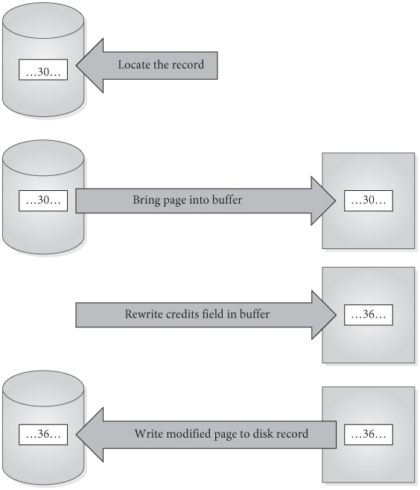
Simple Update of One Record
Locate the record to be updated.
Bring the page into the buffer
Write the update to the buffer.
Write the modified page out to disk.
Databases Illuminated, 3rd ed.
by Ricardo & Urban
Jones & Bartlett Learning, 2017
ISBN 978-1-284-05694-5

Slide 16
Steps in a Transaction
More complicated transactions may involve several updates.
A modified buffer page might not be written to disk immediately after the transaction completes.
We should assume there is a delay before the actual disk write is done.

Slide 17
Basic Ideas About Transactions
Transaction: a logical unit of work that takes the database from one consistent state to another.
Transactions can terminate successfully and commit.
Transactions can terminate unsuccessfully and be aborted.
Aborted transactions must be rolled back (undone) if they changed the database.
Committed transactions cannot be rolled back.

Slide 18
ACID Properties of Transactions
Atomicity
Consistency
Isolation
Durability

Slide 19
ACID Properties of Transactions: Atomicity
The entire set of database update operations are all carried out, or none are.
Guarantee that multiple operations that alter tables can be treated as one indivisible unit of work.
The DBMS must roll back a transaction if it changed the database but was not able to complete successfully.
The rollback process uses the database server’s log of the transaction writes.

Slide 20
ACID Properties of Transactions: Consistency
Applications are responsible for ensuring that each transaction, if executed individually, leaves the database in a consistent state.
Example inconsistency: During a transfer of $100 from Account A to Account B, subtract $100 from Account A but fail to add $100 to Account B.
The DBMS’s concurrency control subsystem ensures this for multiple transactions.
Multiple users can be updating the database at the same time.

Slide 21
ACID Properties of Transactions: Isolation
When transactions execute simultaneously, the DBMS ensures that the final effect is as if the transactions were executed serially (i.e., in isolation).
Interleaved transactions should not interfere, nor present intermediate results to one another, before having reached a committed state.

Slide 22
ACID Properties of Transactions: Durability
The effect of any committed transaction is recorded in the database.
Even if the system crashes before all its writes are made to the database.
The DBMS’s recovery subsystem guarantees durability.

Slide 23
Transaction Support in MySQL
MySQL is normally in auto-commit mode.
Each statement is committed as soon as it has executed.
Each statement is its own transaction.
MySQL Connector/Python turns auto-commit off by default.
Use the autocommit keyword to turn it on or off.
conn = MySQLConnection( ... autocommit=True ... )

Slide 24
Transaction Support in MySQL, cont’d
To perform an explicit transaction, turn off auto-commit with START TRANSACTION.
After performing operations that are part of the transaction, ROLLBACK or COMMIT the transaction.
Examples:
Transactions-commands.ipynb
Transactions-methods.ipynb

Slide 25
Break

Slide 26
Concurrency Problems
Concurrency control is needed when transactions are permitted to execute simultaneously, if at least one is an update.
Potential problems due to a lack of concurrency control:
Lost update
Uncommitted update
Inconsistent analysis

Slide 27
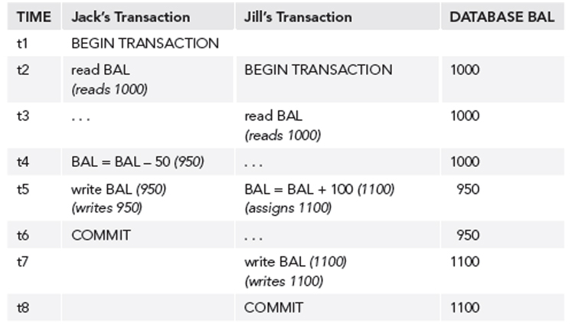
Lost Update Problem
Jack’s update is lost.
Databases Illuminated, 3rd ed.
by Ricardo & Urban
Jones & Bartlett Learning, 2017
ISBN 978-1-284-05694-5

Slide 28
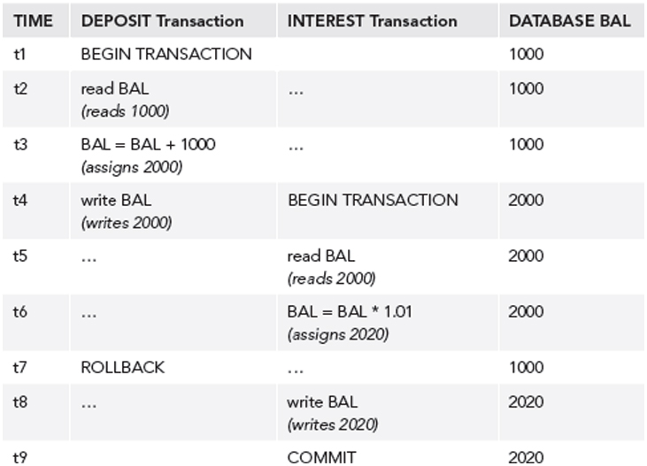
Uncommitted Update Problem
The rollback invalidates data used by the other.
Databases Illuminated, 3rd ed.
by Ricardo & Urban
Jones & Bartlett Learning, 2017
ISBN 978-1-284-05694-5

Slide 29
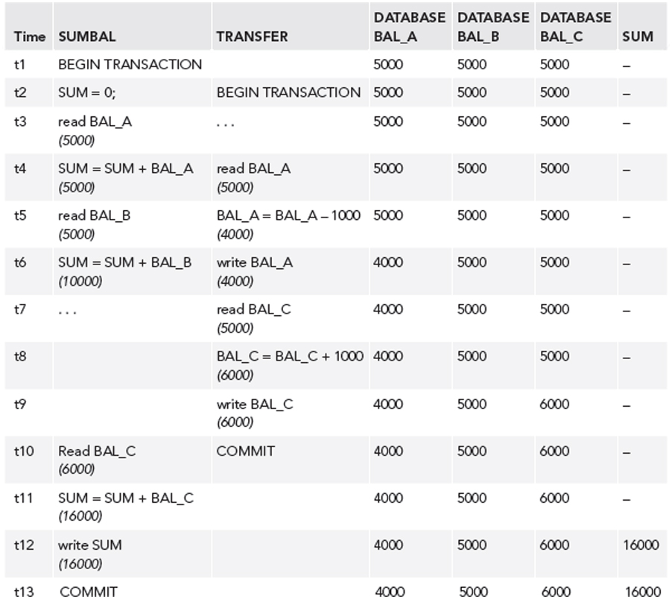
Inconsistent Analysis Problem
SUMBAL
Compute the sum
of all three balances.
TRANSFER
Move $1000 from
BAL_A to BAL_C.
Transaction SUMBAL
reads several values
to sum them.
But meanwhile,
transaction TRANSFER
updates those values.
Databases Illuminated, 3rd ed.
by Ricardo & Urban
Jones & Bartlett Learning, 2017
ISBN 978-1-284-05694-5

Slide 30
Non-Repeatable Read Problem
The first transaction reads an item.
The second transaction writes a new value for the item.
The first transaction rereads the item and gets a different value.

Slide 31
Phantom Data Problem
The transaction T1 reads a set of rows.
The transaction T2 inserts a row.
The transaction T1 reads the rows again and sees the new row.

Slide 32
Transaction Conflicts
If two transactions are only reading data items, they do not conflict, and execution order is not important.
If two transactions operate on completely separate data items, they do not conflict, and execution order is not important.
If one transaction writes to a data item and another transaction either reads or writes to the same data item, then execution order is important.

Slide 33
Transaction Conflicts, cont’d
Therefore, two operations conflict only if all of these are true:
They belong to different transactions.
They access the same data item.
At least one of them writes to the item.

Slide 34
Locking
A transaction can ask the DBMS to place locks on database objects to prevent another transaction from modifying the objects.
Locking and unlocking can be made implicitly by the DBMS when a transaction begins and commits, respectively.
The transaction manager interacts with the lock manager.
Explicit locking: SQL LOCK TABLES and UNLOCK TABLES commands.

Slide 35
Locking, cont’d
Transactions may be made to wait until locks are released before their lock requests can be granted.
Objects of various sizes (database, table, page, record, data item) can be locked.
Size determines the granularity of the lock.

Slide 36
Shared and Exclusive Locks
A transaction must acquire a lock on any item that it needs to read or write.
Shared lock
Multiple transactions can read but not update the item, if no other transaction has an exclusive lock on the item.
Exclusive lock
A single transaction can both read and update the item, if no other transaction has a shared or exclusive lock on the item.

Slide 37
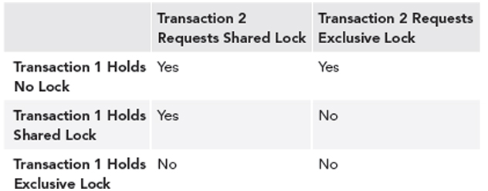
Lock Compatibility
Databases Illuminated, 3rd ed.
by Ricardo & Urban
Jones & Bartlett Learning, 2017
ISBN 978-1-284-05694-5

Slide 38
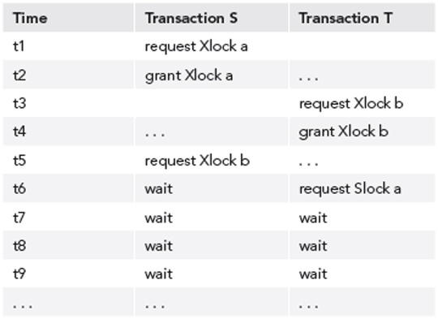
Deadlocks
Two transactions are each waiting for locks held by the other to be released.
Databases Illuminated, 3rd ed.
by Ricardo & Urban
Jones & Bartlett Learning, 2017
ISBN 978-1-284-05694-5

Slide 39
Two-Phase Locking Protocol
Guarantees serializability.
Every transaction acquires all its locks before releasing any, but not necessarily all at once.
A transaction has two phases:
Growing phase: The transaction obtains locks.
Shrinking phase: The transaction releases locks.
Once it enters its shrinking phase, a transaction cannot obtain a new lock.

Slide 40
Two-Phase Locking Protocol, cont’d
Recall:
Jack’s update is lost.
Databases Illuminated, 3rd ed.
by Ricardo & Urban
Jones & Bartlett Learning, 2017
ISBN 978-1-284-05694-5

Slide 41
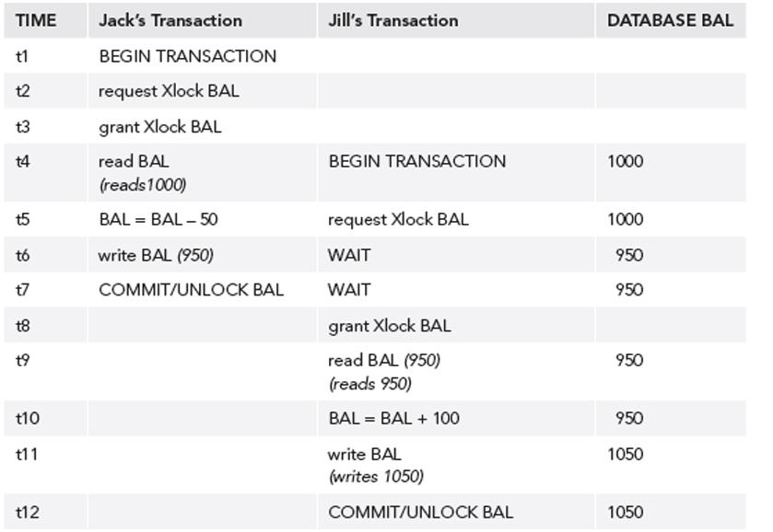
Two-Phase Locking Protocol, cont’d
After application of two-phase locking:
Databases Illuminated, 3rd ed.
by Ricardo & Urban
Jones & Bartlett Learning, 2017
ISBN 978-1-284-05694-5

Slide 42
Optimistic Techniques
AKA validation techniques.
Assume that conflicts will be rare.
Transactions proceed as if there were no concurrency problems.
Before a transaction commits, perform a check to determine whether a conflict has occurred.
If there is a conflict, must roll back the transaction.
Assume rollback will be rare.
Rollback is the price to be paid for eliminating locks.
Allow more concurrency, since no locking.

Slide 43
Need for Recovery
Many different types of failures can affect database processing:
Natural physical disasters
Sabotage
Carelessness
Disk malfunctions that result in loss of stored data.
System crashes due to hardware malfunctions that result in loss of main and cache memory
System software errors that result in abnormal termination or damage to the DBMS
Application software errors

Slide 44
Possible Effects of Failure
Loss of main memory, including database buffers.
Loss of the disk copy of the database.
Failure to write data safely to disk.
The DBMS recovery subsystem uses techniques that minimize these effects.

Slide 45
Recovery Manager
DBMS subsystem responsible for ensuring atomicity and durability for transactions in the event of failure.
Atomicity: Perform all or none of a transaction.
All the effects of committed transactions must reach the database, and that the effects of any uncommitted transactions must be undone.
Durability: Effects of a committed transaction are permanent.
All effects must survive loss of main memory, loss of disk storage, and failure to write safely to disk.

Slide 46
Loss of Disk Data
Do frequent backups.
In case of disk failure, the backup can be brought up to date using a log of transactions.
Good practices:
mirrored disks
other RAID storage
remote live backup site

Slide 47
Failure to Write
Write modified pages first to the local disk and then to the mirror or remote disk.
The output is considered done after both writes are complete.
If a data transfer error is detected, examine both copies.
If they are identical, the data is correct.
If one has an error condition, use the other copy to replace the faulty data.
If neither has an error condition but they have different values, undo the writes.

Slide 48
System Failure
If system failure occurs:
Database buffers are lost.
Disk copy of the database survives, but it may be incorrect due to partial transactions.
A transaction can commit once its writes are made to the database buffers.
Updates made to buffers are not automatically written to disk, even for committed transactions.

Slide 49
System Failure, cont’d
There may be a delay between a commit and actual disk writing.
If the system fails during this delay, we must ensure that these updates reach the disk copy of the database.

Slide 50
Recovery Log
Contains records of each transaction showing:
the start of a transaction
the write operations of a transaction
the end of a transaction
If system fails, the log is examined:
what transactions to redo
what transactions to undo
Redo: Redo writes, not re-execute the transaction.
Undo: Roll back writes.

Slide 51
Deferred Update Protocol
The DBMS does all database writes in the log, and it does not write to the database until the transaction is ready to commit.
The log protects against system failures.
Use log records to perform the updates to the database buffers.
Later, these updated pages will be written to disk.
If the transaction aborts, ignore the log records.

Slide 52
Checkpoints
After a failure, we may not know how far back in the log to search for redo of transactions.
Limit log searching by using checkpoints.
Scheduled at predetermined intervals.
Checkpoint operations
Write modified blocks in the database buffers to disk.
Write a checkpoint record to the log that contains the names of all the transactions that are active at the time of the checkpoint.
Write all log records now in main memory out to disk.
Managed internally by the MySQL server.
See: https://dev.mysql.com/doc/refman/8.0/en/innodb-checkpoints.html

Slide 53
Loss of Disk Data
Do frequent backups.
In case of disk failure, the backup can be brought up to date using a log of transactions.
Good practices:
mirrored disks
RAID storage
remote live backup site
How can we minimize data loss from disk failures?

Slide 54
RAID
Redundant Array of Independent Disks
formerly: Redundant Array of Inexpensive Disks
A data storage virtualization technology.
Combine multiple physical disk drive components into one or more logical units.
Provide data redundancy or performance improvement, or both.

Slide 55
RAID, cont’d
The term “RAID” was invented by David Patterson, Garth Gibson, and Randy Katz.
U.C. Berkeley, 1987
Claim: An array of inexpensive disk drives could beat the performance of the top mainframe disk drive at the time.
Distribute the data across the array of disk drives.
The inexpensive disk drives were developed for the growing personal computer market.

Slide 56
MTTF
Large disk arrays are highly vulnerable to disk failures.
An array of 100 disks is 100 times more likely to fail than a single disk.
Example: An MTTF (mean time to failure) of 50,000 hours for a single disk implies an MTTF of 500 hours for a disk array with 100 disks.

Slide 57
Reliability and Availability
Reliability
How well a system can work without any component failures.
Availability
How well a system a system can work despite any failures of its components.
Configure a disk array for redundancy.
The reliability of the array can far exceed that of any large single drive.
Provide fault tolerance.

Slide 58
Reliability and Availability, cont’d
With a single hard disk, high costs of a disk failure.
Time required to:
Obtain and install a replacement disk.
Reinstall the operating system.
Restore files from backup tapes.
Repeat all the data entry performed since the last backup was made.

Slide 59
Reliability and Availability, cont’d
With a disk array and redundancy, the system can stay up and running:
Despite a disk failure.
While installing a replacement disk.
While restoring data.

Slide 60
Parallel Access
If the RAID hardware and software can perform true parallel accesses on multiple drives, there will be a performance improvement over a single disk.

Slide 61
Cost-Effective RAID
For an optimal cost-effective RAID implementation, simultaneously:
Maximize the number of disks accessed in parallel.
Minimize the amount of disk space used for redundant data.
Minimize the overhead required to achieve the above goals.

Slide 62
Data Striping
Data striping improves performance.
Transparently distribute data over multiple disks.
Make the multiple disks appear as a single fast, large disk.

Slide 63
Data Striping, cont’d
Improve aggregate I/O performance by allowing multiple I/O’s to be serviced in parallel.
Multiple, independent requests can be serviced in parallel by separate disks.
Decrease the queueing time seen by I/O requests.
Single, multiple block requests can be serviced by multiple disks acting in coordination.
Increase the effective transfer rate of a single request.
The performance benefits increase with the number of disks in the array.

Slide 64
Data Redundancy
Use redundancy to overcome the decreased reliability of an array of multiple disks.
Select a method to compute the redundant information.
Most use parity.

Slide 65
Data Redundancy, cont’d
How to distribute redundant information?
Concentrate the redundant information on a small number of disks.
Distribute redundant information uniformly across all the disks.
Avoid “hot spots” and load balancing problems.

Slide 66
RAID Levels
There are several data distribution schemes, called RAID levels.
RAID levels and their associated data formats are standardized by the Storage Network Industry Association (SNIA).
Common RAID Disk Drive Format (DDF) standard.
http://www.ace-data.com/storage-consolidation/

Slide 67
RAID Level 0 (Disk Striping)
Minimum two disks.
No fault tolerance.
Lose data if a disk fails.
Do not use if data is mission critical.
Blocks striped.
Excellent performance.
No redundancy.
No mirror or parity.
http://www.maxtronic.com/index.php/techenical-briefs/raid-tutorial

Slide 68
RAID Level 1 (Disk Mirroring)
Minimum two disks.
Very high reliability.
Continued data availability.
No improvement in data access speed.
Low capacity.
Blocks mirrored.
Good performance.
100% redundancy.
http://www.maxtronic.com/index.php/techenical-briefs/raid-tutorial

Slide 69
RAID Level 3 (Striping, Dedicated Parity)
Minimum three disks.
Good for applications that require a single I/O stream with a high data transfer rate.
Large blocks of sequential data must be transferred quickly.
Examples: graphical imaging processors, CAD/CAM files
Dedicated parity disk.
http://www.maxtronic.com/index.php/techenical-briefs/raid-tutorial

Slide 70
RAID Level 5 (Striping, Distributed Parity)
Minimum three disks.
Good for applications that are heavily read-oriented.
Writes will be slow.
Use memory caching to improve write performance.
Must read all other disks to recover data from a failed disk.
Parity distributed.
Good redundancy.
http://www.maxtronic.com/index.php/techenical-briefs/raid-tutorial

Slide 71
RAID Level 6 (Striping, Double Distributed Parity)
Minimum four disks.
Can handle two disks failing.
Complex to implement.
Overhead of double parity calculations.
Blocks striped.
Double distributed parity (P+Q).
http://www.maxtronic.com/index.php/techenical-briefs/raid-tutorial

Slide 72
RAID Level 10 (Striped Mirrors)
Combines RAID Level 0 (disk striping) and RAID Level 1 (disk mirroring).
RAID 1+0
“Stripe of mirrors”
Requires at least four disks.
Excellent performance (striping) and redundancy (mirroring).
Recover from a failed disk by reading its mirror.
Best option if you can afford all the disks.

Slide 73
Hardware RAID
Dedicated hardware RAID controllers or cards.
+ Performance
No CPU cycles to manage the underlying disks.
Extensive caching.
+ Less complexity
The operating system does not need to understand RAID and can treat the disk array as a single device.
+ Availability
Available at system boot time.

Slide 74
Hardware RAID, cont’d
- Vendor lock-in
Proprietary firmware on the RAID hardware.
Must replace a failed component with an identical or a compatible model.
- Cost
High-end RAID hardware is expensive.

Slide 75
Software RAID
+ Flexibility
Managed within the operating system.
Easy to configure from available storage without reconfiguring hardware.
+ Open source
Open-source RAID software available for Linux.
Easy to port to other systems.
No specialty hardware costs.

Slide 76
Software RAID, cont’d
- Implementation-specific
Tied to a specific software implementation of RAID.
Data formats may not be compatible.
- Performance overhead
Adds additional overhead.
Uses CPU cycles and memory.

Slide 77
Data Loss
Despite striping and parity, data loss is still possible:
Double disk failures.
System crash followed by a disk failure.
Disk failure followed by an uncorrectable bit error during reconstruction.
Uncorrectable bit errors
Incorrectly written data.
Data gradually damaged as the disk media ages.
Detected only during an attempt to read the data.

Slide 78
Disk Failures
Early failures
Frequently caused by transient defects.
Not detected during the manufacturer’s burn-in process.
Late failures
A disk wears out.

Slide 79
Disk Failures, cont’d
Correlated failures
An initial disk failure closely followed by additional disk failures before recovery from the failed disk.
Failures are statistically correlated.
Many drive failures are due to mechanical issues.
Not an independent, identical rate of failure among drives.
The probability of a second failure before the first has been recovered (causing data loss) are higher than the probability of random failures.

Slide 80
Disk Recovery
Drive capacity has grown at a much faster rate than transfer speed.
But error rates have only fallen a little in comparison.
Larger-capacity drives may take hours if not days to rebuild.
During which time other drives may fail.

Slide 81
MTBF and MTTR
Individual drives’ mean time between failure (MTBF) have increased over time.
But not kept up with disks’ increased storage capacity.
MTTR is the mean time to repair a failed disk.
MTBF is the amount of time that elapses between one failure and the next.
Equals the sum of MTTF and MTTR.

Slide 82
MTBF and MTTR, cont’d
http://blog.fosketts.net/2011/07/06/defining-failure-mttr-mttf-mtbf/

Slide 83
Backups Still Needed!
RAID does not protect from multiple disk failures.
While one disk is offline for any reason, the disk array is not fully redundant.
RAID does not protect from non-disk related failures:
hardware errors
software errors
human errors

