Slide 1
DATA 225 Database Systems for Analytics October 2 Class Meeting
Department of Applied Data Science San Jose State University Fall 2023 Instructor: Ron Mak
www.cs.sjsu.edu/~mak

Slide 2
This Evening
Go over solutions to Checkpoint Exam #1
ALTER TABLE
UPDATE and DELETE
Cascading deletes and updates
Break

Slide 3
This Evening, cont’d
Windowing functions
MYSQL functions
Relational algebra
Joins: self, inner, and outer
Views
Indexing

Slide 4
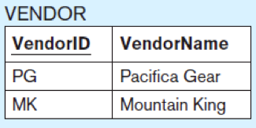
ALTER TABLE
Change the structure of an existing table.
Add a new column.
Example:
Drop a column.
Example:
ALTER TABLE vendor ADD COLUMN vendorphonenumber CHAR(11);
ALTER TABLE vendor DROP COLUMN vendorphonenumber;
Database Systems
by Jukić, Vrbsky, & Nestorov
Pearson 2014
ISBN 978-0-13-257567-6

Slide 5
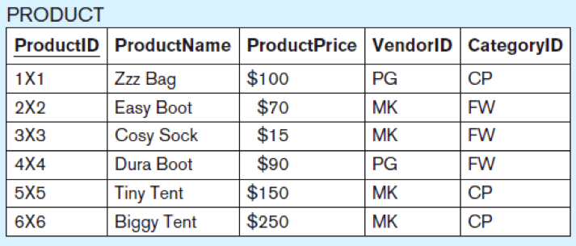
UPDATE
Database Systems
by Jukić, Vrbsky, & Nestorov
Pearson 2014
ISBN 978-0-13-257567-6
Modify data in a table.
Examples:
UPDATE product SET productprice = 100 WHERE productid = '4×4';
ALTER TABLE product ADD COLUMN discount NUMERIC(3,2);
UPDATE product SET discount = 0.2;
Set the value of the new discount column in all rows to 0.2.

Slide 6
DELETE
Delete rows from a table.
Example:
Without the WHERE clause, all the table rows will be deleted, resulting in an empty table.
DELETE FROM product WHERE productid = '4×4’;
Database Systems
by Jukić, Vrbsky, & Nestorov
Pearson 2014
ISBN 978-0-13-257567-6

Slide 7
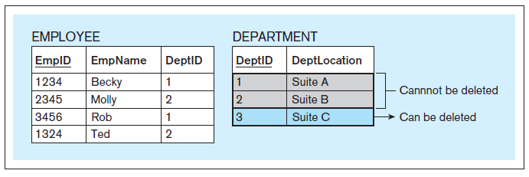
Cascading Deletes
Normally, the referential integrity constraint prevents you from deleting a record from a table if it is referred to by a record in another table.
Database Systems
by Jukić, Vrbsky, & Nestorov
Pearson 2014
ISBN 978-0-13-257567-6

Slide 8
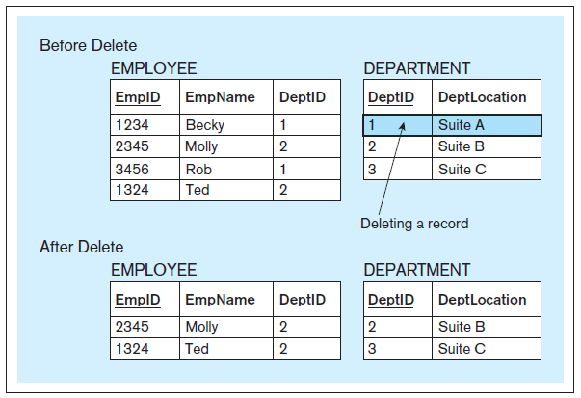
Cascading Deletes, cont’d
CREATE TABLE employee ( empid CHAR(4), empname CHAR(20), deptid CHAR(2), PRIMARY KEY (empid), FOREIGN KEY (deptid) REFERENCES department ON DELETE CASCADE
);
Database Systems
by Jukić, Vrbsky, & Nestorov
Pearson 2014
ISBN 978-0-13-257567-6

Slide 9
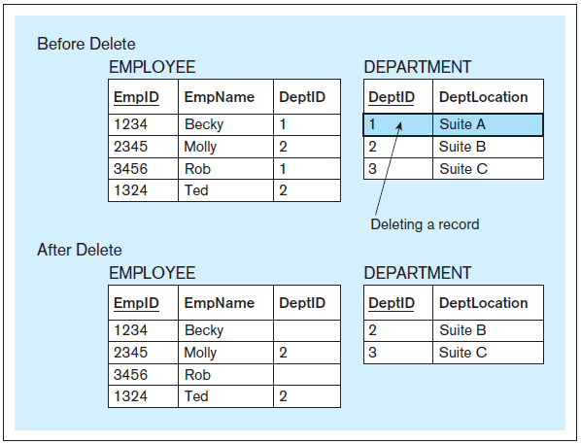
Cascading Deletes, cont’d
CREATE TABLE employee ( empid CHAR(4), empname CHAR(20), deptid CHAR(2), PRIMARY KEY (empid), FOREIGN KEY (deptid) REFERENCES department ON DELETE SET NULL
);
Database Systems
by Jukić, Vrbsky, & Nestorov
Pearson 2014
ISBN 978-0-13-257567-6

Slide 10
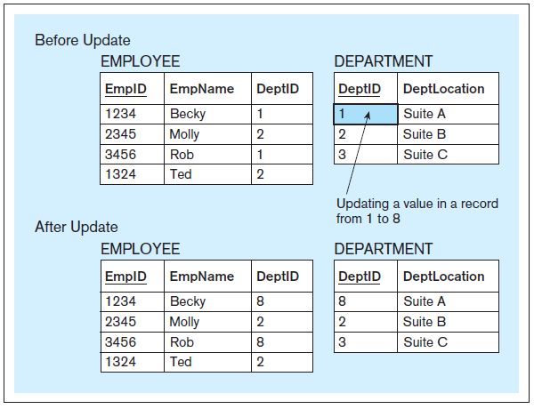
Cascading Updates
CREATE TABLE employee ( empid CHAR(4), empname CHAR(20), deptid CHAR(2), PRIMARY KEY (empid), FOREIGN KEY (deptid) REFERENCES department ON UPDATE CASCADE
);
Database Systems
by Jukić, Vrbsky, & Nestorov
Pearson 2014
ISBN 978-0-13-257567-6

Slide 11
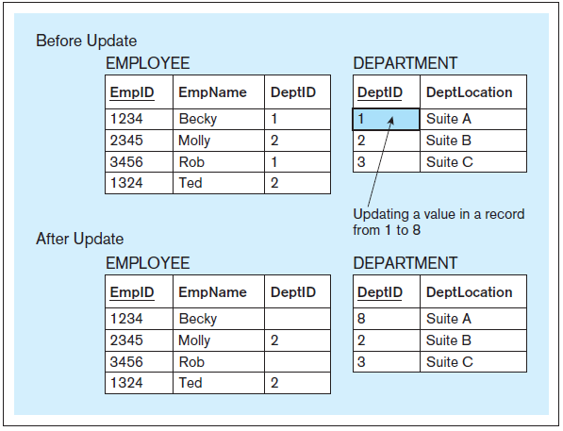
Cascading Updates
CREATE TABLE employee ( empid CHAR(4), empname CHAR(20), deptid CHAR(2), PRIMARY KEY (empid), FOREIGN KEY (deptid) REFERENCES department ON UPDATE SET NULL
);
Database Systems
by Jukić, Vrbsky, & Nestorov
Pearson 2014
ISBN 978-0-13-257567-6

Slide 12
Break

Slide 13
SQL Window Function
Perform an aggregate-type operation on a set of rows from a query result.
Produce a result for each result row.

Slide 14
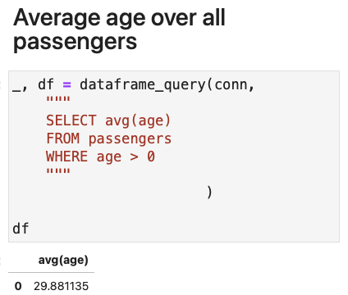
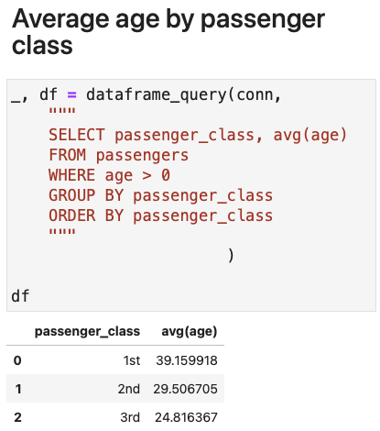
Window Function Example
Windowing.ipynb

Slide 15
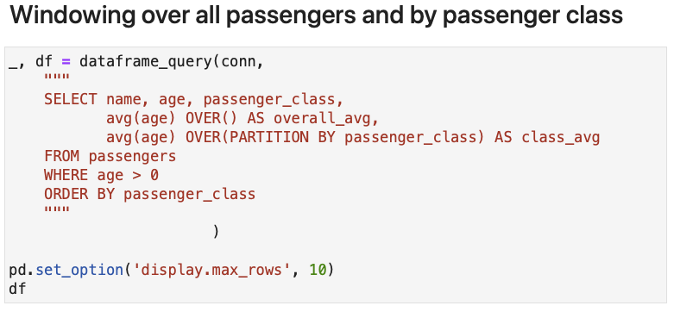
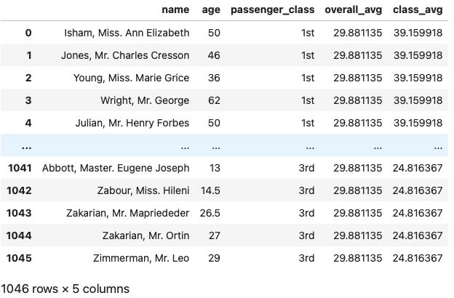
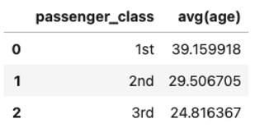
Window Function Example, cont’d
Windowing.ipynb

Slide 16
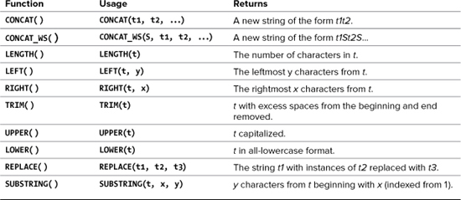
MySQL Text Functions
Also:
One-way encryption
Returns a 40-character string.
SHA1(string)
PHP and MySQL for Dynamic Web Sites, 4th ed.
by Larry Ullman
Peachpit Press, 2012
ISBN 978-0-321-78407-0

Slide 17
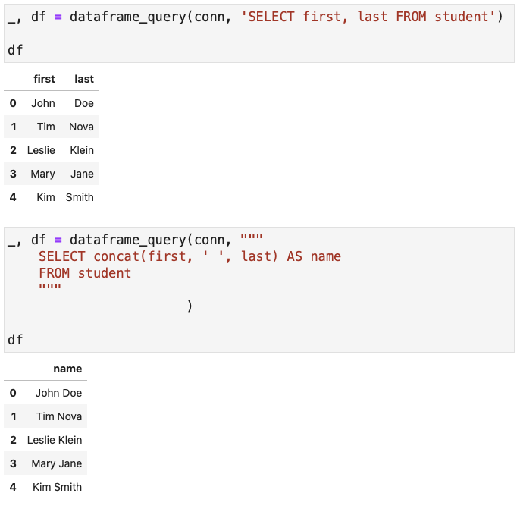
MySQL Text Functions, cont’d
StringConcat.ipynb

Slide 18
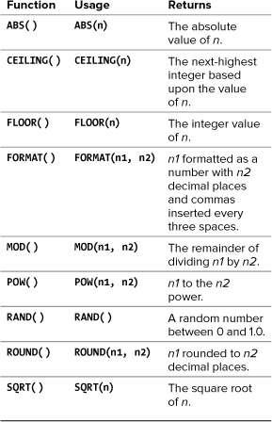
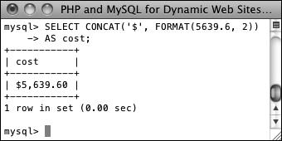
MySQL Numeric Functions
SELECT CONCAT('$', FORMAT(5639.6, 2))
AS cost;
PHP and MySQL for Dynamic Web Sites, 4th ed.
by Larry Ullman
Peachpit Press, 2012
ISBN 978-0-321-78407-0

Slide 19
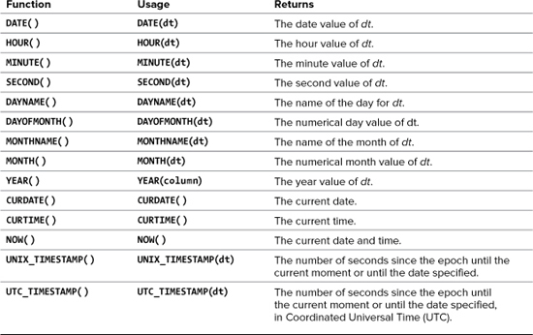
MySQL Date and Time Functions
No arguments.
PHP and MySQL for Dynamic Web Sites, 4th ed.
by Larry Ullman
Peachpit Press, 2012
ISBN 978-0-321-78407-0

Slide 20
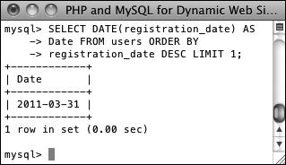
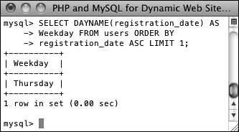
MySQL Date and Time Functions, cont’d
Data types that store both a date and time: DATETIME and TIMESTAMP
Data type that stores just the date: DATE
Data type that stores just the year: YEAR
PHP and MySQL for Dynamic Web Sites, 4th ed.
by Larry Ullman
Peachpit Press, 2012
ISBN 978-0-321-78407-0
SELECT DATE(registration_date) AS Date FROM users ORDER BY
registration_date DESC LIMIT 1;
SELECT DAYNAME(registration_date)
AS Weekday FROM users ORDER BY
registration_date ASC LIMIT 1;

Slide 21
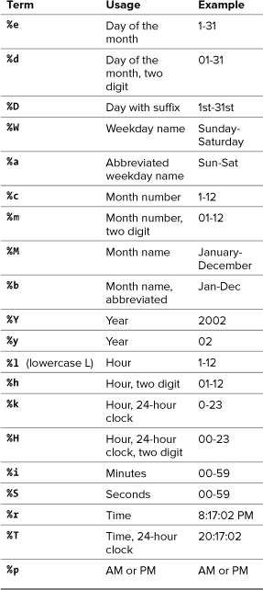
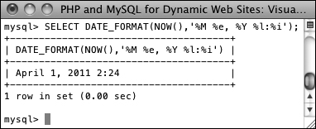
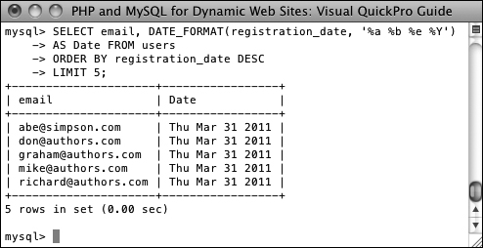
Formatting the Date and Time
Return the current date and time as Month DD, YYYY - HH:MM :
PHP and MySQL for Dynamic Web Sites, 4th ed.
by Larry Ullman
Peachpit Press, 2012
ISBN 978-0-321-78407-0
Select the email address and date registered, ordered by date registered, formatting the date as
Weekday (abbreviated) Month (abbreviated) Day Year,
for the last five registered users :

Slide 22
Relational Algebra
The mathematical theory behind database operations:
project
which columns?
listed after the SELECT keyword
select
which rows?
WHERE and HAVING clauses
join
Query multiple tables at the same time.

Slide 23
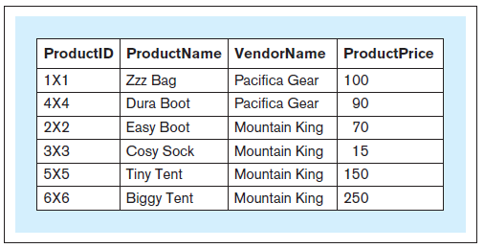
Joins
What is the id, product name, vendor name, and price of each product?
SELECT productid, productname,
vendorname, productprice FROM product, vendor WHERE product.vendorid
= vendor.vendorid;
Qualified names
Database Systems
by Jukić, Vrbsky, & Nestorov
Pearson 2014
ISBN 978-0-13-257567-6

Slide 24
Joins, cont’d
Without a join condition, you get a Cartesian product.
Each record of one table matched with every record from the other table.

Slide 25
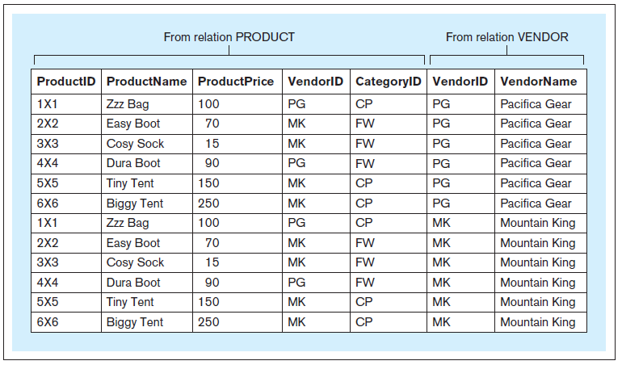
Joins, cont’d
SELECT * FROM product, vendor;
Database Systems
by Jukić, Vrbsky, & Nestorov
Pearson 2014
ISBN 978-0-13-257567-6

Slide 26
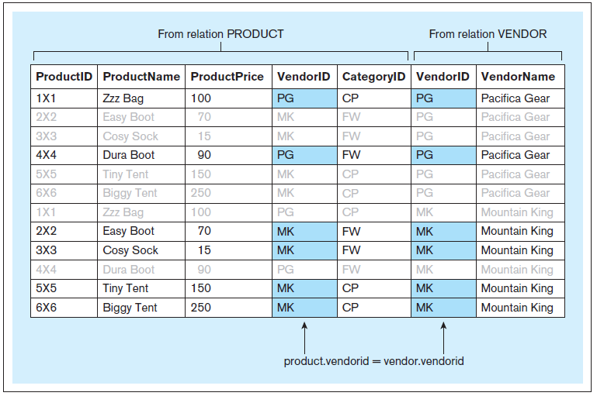
Joins, cont’d
Include the join condition
WHERE product.vendorid = vendor.vendorid

Slide 27
Join Alias
Use aliases anywhere within a query instead of the full table name.
No effect on the query itself.
Improve legibility.
SELECT productid, productname,
vendorname, productprice FROM product, vendor WHERE product.vendorid = vendor.vendorid;
SELECT p.productid, p.productname,
v.vendorname, p.productprice FROM product p, vendor v WHERE p.vendorid = v.vendorid;

Slide 28
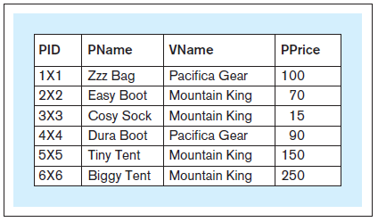
Join Alias, cont’d
Use aliases to rename columns in query results.
SELECT p.productid pid,
p.productname pname, v.vendorname vname,
p.productprice pprice FROM product p, vendor v WHERE p.vendorid = v.vendorid;
You cannot use aliased column
names in the WHERE clause.
Database Systems
by Jukić, Vrbsky, & Nestorov
Pearson 2014
ISBN 978-0-13-257567-6

Slide 29
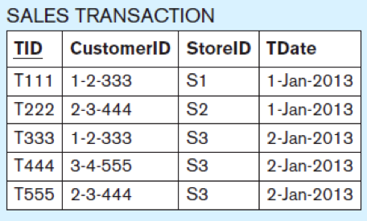
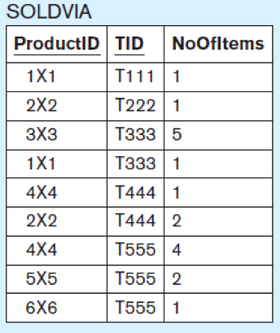
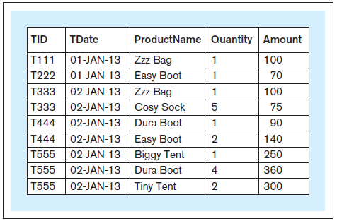
Joining Multiple Tables
SELECT t.tid, t.tdate, p.productname, sv.noofitems AS quantity, (sv.noofitems * p.productprice) AS amount FROM product AS p, salestransaction AS t, soldvia AS sv WHERE sv.productid = p.productid
AND sv.tid = t.tid ORDER BY t.tid;
You can use AS
to introduce an alias.
Database Systems
by Jukić, Vrbsky, & Nestorov
Pearson 2014
ISBN 978-0-13-257567-6
Oracle does not allow AS
for table aliases.

Slide 30
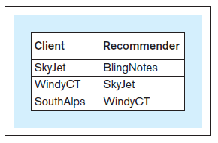
Self Join
Which corporate clients were referred by other corporate clients?
SELECT c.ccname AS client, r.ccname AS recommender FROM corpclient c, corpclient r WHERE r.ccid = c.ccidreferredby;
Database Systems
by Jukić, Vrbsky, & Nestorov
Pearson 2014
ISBN 978-0-13-257567-6
The use of aliases is
mandatory for a self join.

Slide 31
Inner and Outer Joins
Inner join
What we’ve been doing so far.
Outer join
left outer join
right outer join
full outer join

Slide 32
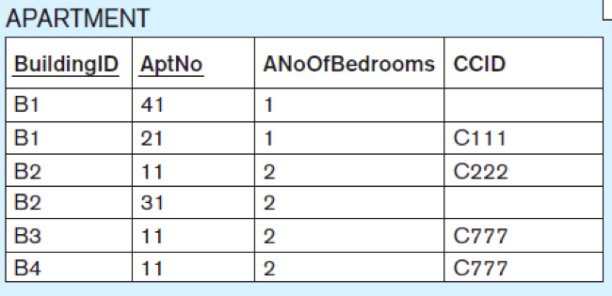
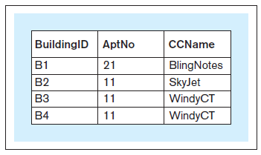
Inner Join
Which apartments are rented by which corporate clients?
SELECT a.buildingid, a.aptno, c.ccname FROM apartment a, corpclient c WHERE a.ccid = c.ccid;
Retrieve only the rows that match.
Database Systems
by Jukić, Vrbsky, & Nestorov
Pearson 2014
ISBN 978-0-13-257567-6

Slide 33
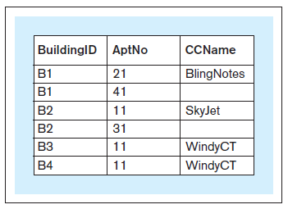
Left Outer Join
SELECT a.buildingid, a.aptno, c.ccname FROM apartment a LEFT OUTER JOIN corpclient c ON a.ccid = c.ccid;
Joins.ipynb
Include all the rows
on the left part of the
relation (apartment)
whether or not there is
a match.
No matches.
Database Systems
by Jukić, Vrbsky, & Nestorov
Pearson 2014
ISBN 978-0-13-257567-6

Slide 34
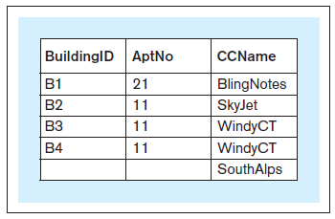
Right Outer Join
SELECT a.buildingid, a.aptno, c.ccname FROM apartment a RIGHT OUTER JOIN corpclient c ON a.ccid = c.ccid;
Joins.ipynb
Include all the rows
on the right part of the
relation (corpclient)
whether or not there is
a match.
Database Systems
by Jukić, Vrbsky, & Nestorov
Pearson 2014
ISBN 978-0-13-257567-6
No match.

Slide 35
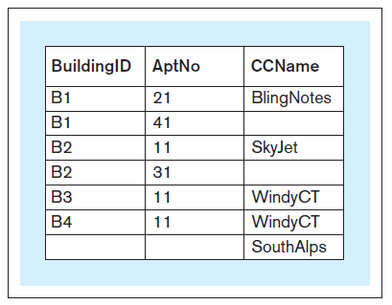
Full Outer Join
SELECT a.buildingid, a.aptno, c.ccname FROM apartment a FULL OUTER JOIN corpclient c ON a.ccid = c.ccid;
Include all the rows
from both relations
whether or not there is
a match.
FULL OUTER JOIN
is not available with
MySQL.
Database Systems
by Jukić, Vrbsky, & Nestorov
Pearson 2014
ISBN 978-0-13-257567-6

Slide 36
Full Outer Join (MySQL)
SELECT a.buildingid, a.aptno, c.ccname
FROM apartment a
LEFT OUTER JOIN corpclient c
ON a.ccid = c.ccid
UNION
SELECT a.buildingid, a.aptno, c.ccname
FROM apartment a
RIGHT OUTER JOIN corpclient c
ON a.ccid = c.ccid
Joins.ipynb
Database Systems
by Jukić, Vrbsky, & Nestorov
Pearson 2014
ISBN 978-0-13-257567-6

Slide 37
Views
A view allows the structure of a query to be saved in the database.
AKA virtual table
Not an actual table – no data is saved.
Whenever a view is invoked, it executes a query to retrieve data from the actual tables.
A view is analogous to a procedure in a programming language.
Use a view like any other table.

Slide 38
Views, cont’d
Which products have more than 3 items sold in all sales transactions?
Views.ipynb
CREATE VIEW products_more_than_3_sold AS
SELECT productid, productname, productprice FROM product WHERE productid IN (SELECT productid FROM soldvia
GROUP BY productid HAVING SUM(noofitems) > 3);

Slide 39
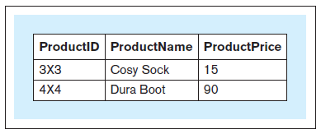
Views, cont’d
Views.ipynb
CREATE VIEW products_more_than_3_sold AS
SELECT productid, productname, productprice FROM product WHERE productid IN (SELECT productid FROM soldvia
GROUP BY productid HAVING SUM(noofitems) > 3);
SELECT * FROM products_more_than_3_sold;
Database Systems
by Jukić, Vrbsky, & Nestorov
Pearson 2014
ISBN 978-0-13-257567-6

Slide 40
Views, cont’d
CREATE VIEW products_in_multiple_trnsc AS SELECT productid, productname, productprice FROM product WHERE productid IN (SELECT productid FROM soldvia GROUP BY productid HAVING COUNT(*) > 1);
Views.ipynb
Database Systems
by Jukić, Vrbsky, & Nestorov
Pearson 2014
ISBN 978-0-13-257567-6

Slide 41
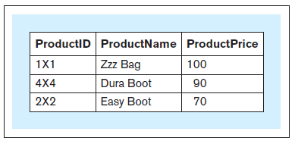
Views, cont’d
Views.ipynb
SELECT * FROM products_in_multiple_trnsc;
Dropping views
Example:
DROP VIEW products_in_multiple_trnsc;
Database Systems
by Jukić, Vrbsky, & Nestorov
Pearson 2014
ISBN 978-0-13-257567-6

Slide 42
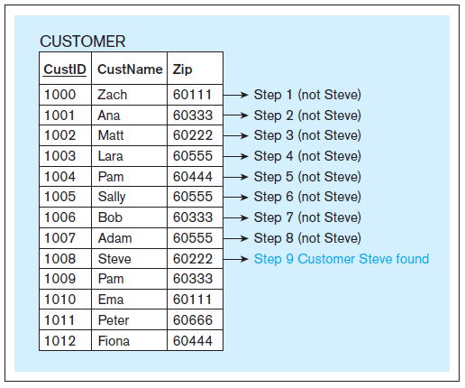
Indexing
Indexing increases the speed of retrieving table rows based on an unsorted column.
Use a binary search instead of a linear search.
Database Systems
by Jukić, Vrbsky, & Nestorov
Pearson 2014
ISBN 978-0-13-257567-6
Linear search
for “Steve”.

Slide 43
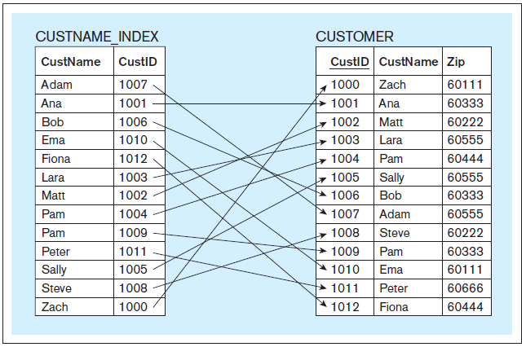
Indexing (Conceptual View)
CREATE INDEX custname_index ON customer(custname);
Database Systems
by Jukić, Vrbsky, & Nestorov
Pearson 2014
ISBN 978-0-13-257567-6

Slide 44
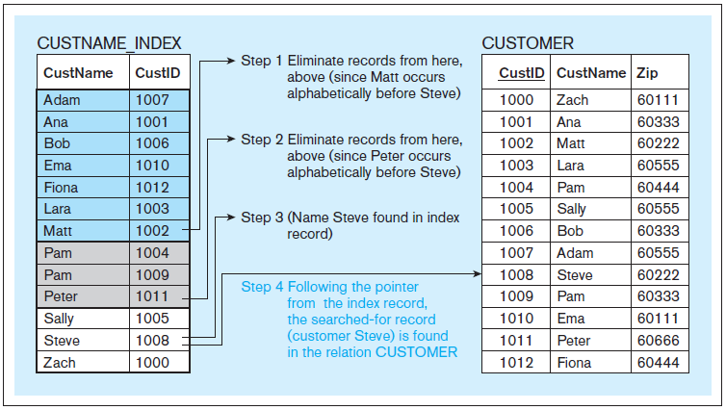
Indexing (Conceptual View), cont’d
Binary search
for “Steve”.
Database Systems
by Jukić, Vrbsky, & Nestorov
Pearson 2014
ISBN 978-0-13-257567-6

Slide 45
Indexing, cont’d
In an actual RDBMS, the index column can contain physical disk addresses.
Indexing speeds record retrieval, but it will slow record insertion, deletion, and modification.
To drop an index:
See https://www.mysqltutorial.org/mysql-index/mysql-create-index/
DROP INDEX custname_index ON customer
Indexes.ipynb

