Slide 1
DATA 225 Database Systems for Analytics September 25 Class Meeting
Department of Applied Data Science San Jose State University Fall 2023 Instructor: Ron Mak
www.cs.sjsu.edu/~mak

Slide 2
This Evening
Checkpoint exam #1
Break
SELECT command
Aggregate functions
GROUP BY and HAVING
Nested queries
SELECT IN
INSERT INTO SELECT

Slide 3
SELECT
Retrieve data from database tables.
The most common SQL command.

Slide 4
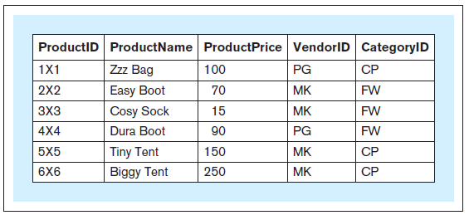
SELECT, cont’d
Retrieve the entire contents of the product table.
SELECT * FROM product
Database Systems
by Jukić, Vrbsky, & Nestorov
Pearson 2014
ISBN 978-0-13-257567-6

Slide 5
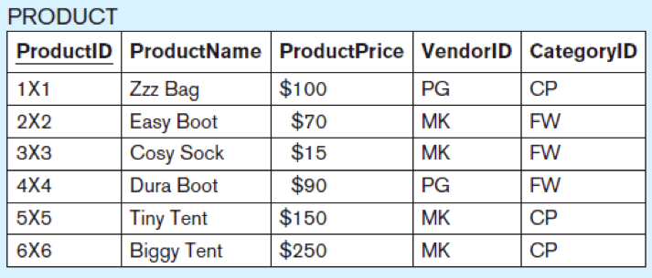
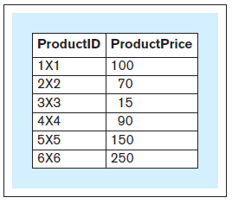
SELECT, cont’d
Retrieve only certain columns of the product table.
Projection operation
SELECT productid, productprice FROM product;
Database Systems
by Jukić, Vrbsky, & Nestorov
Pearson 2014
ISBN 978-0-13-257567-6

Slide 6
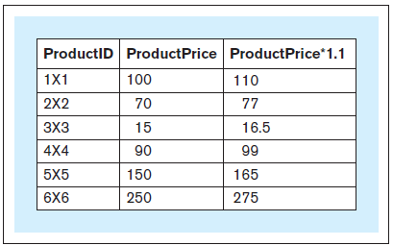
SELECT, cont’d
Calculate a column (derived attribute) from the product table.
SELECT productid, productprice,
1.1 * productprice FROM product;
Database Systems
by Jukić, Vrbsky, & Nestorov
Pearson 2014
ISBN 978-0-13-257567-6

Slide 7
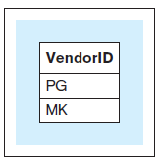
SELECT DISTINCT
Which vendor IDs are in the product table?
SELECT DISTINCT vendorid FROM product;
Database Systems
by Jukić, Vrbsky, & Nestorov
Pearson 2014
ISBN 978-0-13-257567-6

Slide 8
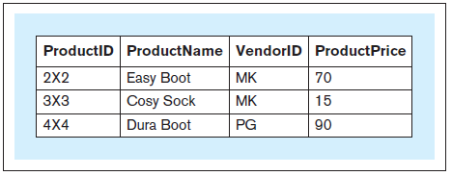
SELECT WHERE
Which products in the FW category have price less than or equal to $110?
SELECT productid, productname, vendorid, productprice FROM product WHERE productprice <= 110
AND categoryid = 'FW';
Database Systems
by Jukić, Vrbsky, & Nestorov
Pearson 2014
ISBN 978-0-13-257567-6

Slide 9
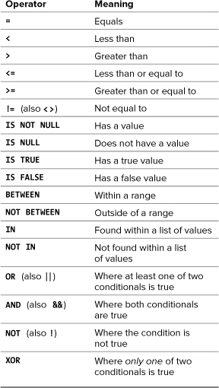
MySQL Conditional Operators
PHP and MySQL for Dynamic Web Sites, 4th ed.
by Larry Ullman
Peachpit Press, 2012
ISBN 978-0-321-78407-0

Slide 10
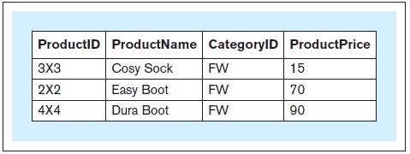
SELECT ORDER BY
Sort products by product price.
SELECT productid, productname,
categoryid, productprice FROM product WHERE categoryid = 'FW' ORDER BY productprice;
Database Systems
by Jukić, Vrbsky, & Nestorov
Pearson 2014
ISBN 978-0-13-257567-6

Slide 11
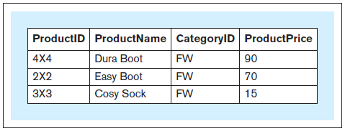
SELECT ORDER BY, cont’d
Sort products by product price in descending order.
SELECT productid, productname,
categoryid, productprice FROM product WHERE categoryid = 'FW' ORDER BY productprice DESC;
Database Systems
by Jukić, Vrbsky, & Nestorov
Pearson 2014
ISBN 978-0-13-257567-6

Slide 12
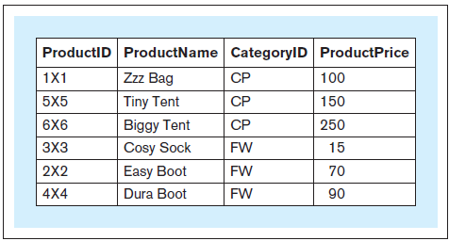
SELECT ORDER BY, cont’d
Sort products first by category ID and then by product price.
Database Systems
by Jukić, Vrbsky, & Nestorov
Pearson 2014
ISBN 978-0-13-257567-6
SELECT productid, productname,
categoryid, productprice FROM product ORDER BY categoryid,
productprice;

Slide 13
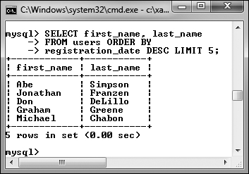
Limiting Query Results
SELECT first_name, last_name
FROM users ORDER BY
registration_date DESC
LIMIT 5;
Also:
Return n records starting with the i^{th} record.
Does not improve the query execution speed, since MySQL still must match all the records.
Reduces the number of returned records.
Useful for “paging” the results.
LIMIT i, n
PHP and MySQL for Dynamic Web Sites, 4th ed.
by Larry Ullman
Peachpit Press, 2012
ISBN 978-0-321-78407-0

Slide 14
SELECT LIKE
Which products have “Boot” in their name?
SELECT * FROM product WHERE productname LIKE '%Boot%';
Database Systems
by Jukić, Vrbsky, & Nestorov
Pearson 2014
ISBN 978-0-13-257567-6

Slide 15
SELECT LIKE, cont’d
String comparisons using wildcard characters:
_ matches any single character
% matches any zero or more characters
mysql> select * from people;
+-----+---------+---------+--------+--------+
| id | first | last | gender | salary |
+-----+---------+---------+--------+--------+
| 101 | Charles | Jones | M | 100000 |
| 103 | Mary | Adams | F | 150000 |
| 105 | Susan | Miller | F | 50000 |
| 110 | Roger | Brown | M | 75000 |
| 112 | Leslie | Adamson | F | 105000 |
+-----+---------+---------+--------+--------+
5 rows in set (0.00 sec)
mysql> select * from people
-> where last like 'Adam%';
+-----+--------+---------+--------+--------+
| id | first | last | gender | salary |
+-----+--------+---------+--------+--------+
| 103 | Mary | Adams | F | 150000 |
| 112 | Leslie | Adamson | F | 105000 |
+-----+--------+---------+--------+--------+
2 rows in set (0.02 sec)

Slide 16
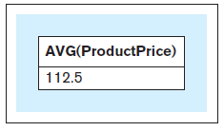
SELECT Aggregate Functions
What is the average price of all products?
SELECT AVG(productprice) FROM product;
Database Systems
by Jukić, Vrbsky, & Nestorov
Pearson 2014
ISBN 978-0-13-257567-6

Slide 17
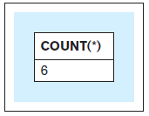
SELECT Aggregate Functions, cont’d
How many products are there?
SELECT COUNT(*)
FROM product;
Database Systems
by Jukić, Vrbsky, & Nestorov
Pearson 2014
ISBN 978-0-13-257567-6

Slide 18
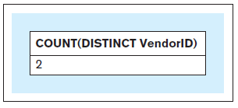
SELECT Aggregate Functions, cont’d
How many vendors supply the products?
SELECT COUNT(DISTINCT vendorid)
FROM product;
Database Systems
by Jukić, Vrbsky, & Nestorov
Pearson 2014
ISBN 978-0-13-257567-6

Slide 19
SELECT Aggregate Functions, cont’d
Aggregate functions COUNT, SUM, AVG, MIN, MAX
SELECT COUNT(*), AVG(productprice), MIN(productprice), MAX(productprice) FROM product WHERE categoryid = 'CP';
Database Systems
by Jukić, Vrbsky, & Nestorov
Pearson 2014
ISBN 978-0-13-257567-6

Slide 20
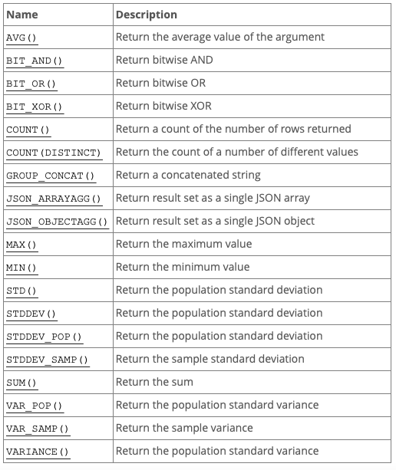
SELECT Aggregate Functions, cont’d
See https://dev.mysql.com/doc/refman/8.0/en/aggregate-functions.html

Slide 21
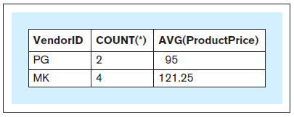
SELECT GROUP BY
What is the average price for each vendor?
SELECT vendorid, COUNT(*), AVG(productprice) FROM product GROUP BY vendorid;
Database Systems
by Jukić, Vrbsky, & Nestorov
Pearson 2014
ISBN 978-0-13-257567-6

Slide 22
SELECT GROUP BY, cont’d
When a SELECT has aggregate functions, it cannot have individual columns unless the columns are in a GROUP BY clause.
You can group by multiple columns.
SELECT vendorid, COUNT(*), AVG(productprice) FROM product GROUP BY vendorid;

Slide 23
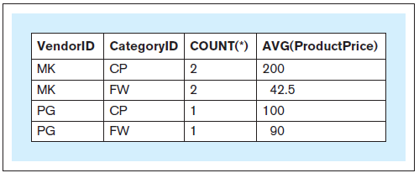
SELECT GROUP BY, cont’d
Group by vendor and then by category.
SELECT vendorid, categoryid, COUNT(*), AVG(productprice) FROM product GROUP BY vendorid, categoryid;
Database Systems
by Jukić, Vrbsky, & Nestorov
Pearson 2014
ISBN 978-0-13-257567-6

Slide 24
SELECT GROUP BY HAVING
Group products $50 or more by vendor and category.
Count and average price only if more than one per group.
SELECT vendorid, categoryid, COUNT(*), AVG(productprice) FROM product WHERE productprice >= 50 GROUP BY vendorid, categoryid HAVING COUNT(*) > 1;
Database Systems
by Jukić, Vrbsky, & Nestorov
Pearson 2014
ISBN 978-0-13-257567-6

Slide 25
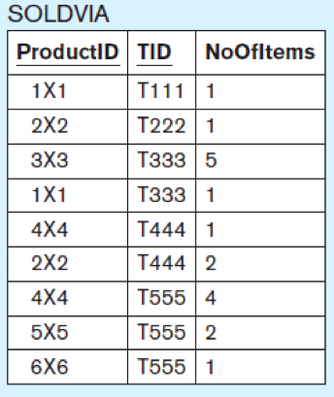
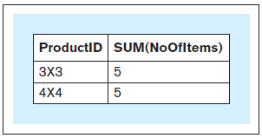
SELECT GROUP BY HAVING, cont’d
For products that sold more than 3 items in all sales transactions, what were the total number of items sold?
SELECT productid, SUM(noofitems) FROM soldvia GROUP BY productid HAVING SUM(noofitems) > 3;
The WHERE clause applies to records.
The HAVING clause
applies to groups.
Database Systems
by Jukić, Vrbsky, & Nestorov
Pearson 2014
ISBN 978-0-13-257567-6

Slide 26
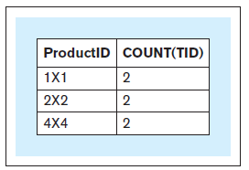
SELECT GROUP BY HAVING, cont’d
For each product that was sold in more than one sales transaction, what is the number of transactions in which the product was sold?
SELECT productid, COUNT(TID) FROM soldvia GROUP BY productid HAVING COUNT(TID) > 1;
Database Systems
by Jukić, Vrbsky, & Nestorov
Pearson 2014
ISBN 978-0-13-257567-6

Slide 27
Nested Queries
An outer query makes use of the results from a nested (inner) query.

Slide 28
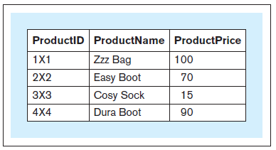
Nested Queries, cont’d
Which products sell below the average price?
SELECT productid, productname, productprice FROM product WHERE productprice < (SELECT AVG(productprice)
FROM product);
First, we need to
calculate the average.
Nested-SELECT-Sales.ipynb
Database Systems
by Jukić, Vrbsky, & Nestorov
Pearson 2014
ISBN 978-0-13-257567-6

Slide 29
Nested Queries, cont’d
Wrong:
Aggregate functions can only appear within a SELECT clause or a HAVING clause.
SELECT productid, productname, productprice FROM product WHERE productprice < AVG(productprice);
Database Systems
by Jukić, Vrbsky, & Nestorov
Pearson 2014
ISBN 978-0-13-257567-6

Slide 30
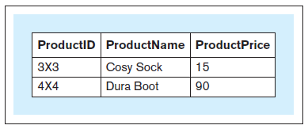
SELECT IN
Which products have more than 3 items sold in all sales transactions?
SELECT productid, productname, productprice FROM product WHERE productid IN (SELECT productid FROM soldvia
GROUP BY productid HAVING SUM(noofitems) > 3);
Database Systems
by Jukić, Vrbsky, & Nestorov
Pearson 2014
ISBN 978-0-13-257567-6

Slide 31
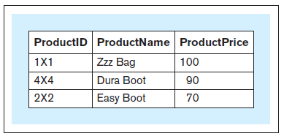
SELECT IN, cont’d
Which products were each sold in more than one sales transaction?
SELECT productid, productname, productprice FROM product WHERE productid IN (SELECT productid FROM soldvia GROUP BY productid HAVING COUNT(*) > 1);
Database Systems
by Jukić, Vrbsky, & Nestorov
Pearson 2014
ISBN 978-0-13-257567-6

Slide 32
Class Problem
Who are the classmates of Tim Novak?
SELECT-IN-School.ipynb

Slide 33
IS NULL
Which managers did not get a bonus?
SELECT * FROM manager WHERE mbonus IS NULL;
Database Systems
by Jukić, Vrbsky, & Nestorov
Pearson 2014
ISBN 978-0-13-257567-6

Slide 34
EXISTS
Follow WHERE EXISTS by a nested query.
The nested query is true if it retrieves any rows, else it is false.
If the nested query uses columns from the outer query, then the inner query is a correlated subquery.

Slide 35
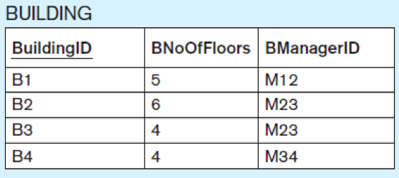
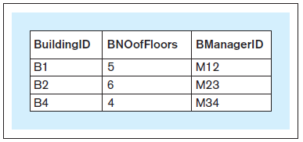
EXISTS, cont’d
Which buildings have managers living in them?
SELECT-EXISTS-Building.ipynb
SELECT * FROM building b WHERE EXISTS (SELECT * FROM manager m WHERE b.buildingid
= m.mresbuildingid);
correlated subquery

Slide 36
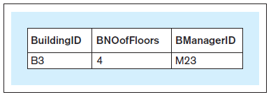
NOT
Which buildings do not have managers living in them?
SELECT * FROM building b WHERE NOT EXISTS (SELECT * FROM manager m WHERE b.buildingid
= m.mresbuildingid);

Slide 37
INSERT INTO SELECT
Use the results from a query to populate another table.
Source: Titanic passengers.
INSERT-INTO-SELECT.ipynb
CREATE TABLE young_men_survivors
(
name VARCHAR(32) NOT NULL UNIQUE,
age DOUBLE NOT NULL,
class INT NOT NULL,
PRIMARY KEY(name)
)
INSERT INTO young_men_survivors
SELECT name, age,
CASE
WHEN passenger_class = '1st' THEN 1
WHEN passenger_class = '2nd' THEN 2
WHEN passenger_class = '3rd' THEN 3
ELSE 0
END AS class
FROM passengers
WHERE sex = 'male'
AND survived = 'yes'
AND age BETWEEN 21 AND 24
mysql> select * from young_men_survivors;
+---------------------------------+-----+-------+
| name | age | class |
+---------------------------------+-----+-------+
| Asplund, Mr. Johan Charles | 23 | 3 |
| Buckley, Mr. Daniel | 21 | 3 |
| Collett, Mr. Sidney C Stuart | 24 | 2 |
| Duquemin, Mr. Joseph | 24 | 3 |
| Greenfield, Mr. William Bertram | 23 | 1 |
| Jansson, Mr. Carl Olof | 21 | 3 |
| Karlsson, Mr. Einar Gervasius | 21 | 3 |
| Leeni, Mr. Fahim (Philip Zenni | 22 | 3 |
| Madsen, Mr. Fridtjof Arne | 24 | 3 |
| Midtsjo, Mr. Karl Albert | 21 | 3 |
| Oxenham, Mr. Percy Thomas | 22 | 2 |
| Snyder, Mr. John Pillsbury | 24 | 1 |
| Vartanian, Mr. David | 22 | 3 |
| Williams, Mr. Richard Norris II | 21 | 1 |
+---------------------------------+-----+-------+

