Slide 1
DATA 220 Mathematical Methods for Data Analysis April 29 Class Meeting
Department of Applied Data Science San Jose State University Spring 2021 Instructor: Ron Mak
www.cs.sjsu.edu/~mak

Slide 2
Assignment #10
Go over solutions.

Slide 3
Augmented Matrix
We can solve a system of linear equations with an augmented matrix.
Example: Solve
Begin by eliminating x from equations b and c.
$$x − y− z= 2 \\ 3x −3y+2z=16 \\ 2x − y + z= 9$$
a
$$\left[\begin{matrix}1 & −1 & −1 \\ 3 & −3 & 2 \\ 2 & −1 & 1\end{matrix} \begin{matrix} 2 \\ 16 \\ 9\end{matrix}\right]$$
b
c

Slide 4
Solve with an Augmented Matrix
$$x − y− z= 2 \\ 3x −3y+2z=16 \\ 2x − y + z= 9$$
a
$$\left[\begin{matrix}1 & −1 & −1 \\ 3 & −3 & 2 \\ 2 & −1 & 1\end{matrix} \begin{matrix} 2 \\ 16 \\ 9\end{matrix}\right]$$
b
c
Subtract 3 times equation a from equation b:
Subtract 3 times the first row from the second row:
$$x − y− z= 2 \\ 5z=10 \\ 2x − y + z= 9$$
a
$$\left[\begin{matrix}1 & −1 & −1 \\ 0 & 0 & 5 \\ 2 & −1 & 1\end{matrix} \begin{matrix} 2 \\ 10 \\ 9\end{matrix}\right]$$
b
c
Subtract 2 times equation a from equation c:
Subtract 2 times the first row from the third row:
$$x − y− z= 2 \\ 5z=10 \\ y + 3z= 5$$
a
$$\left[\begin{matrix}1 & −1 & −1 \\ 0 & 0 & 5 \\ 0 & 1 & 3\end{matrix} \begin{matrix} 2 \\ 10 \\ 5\end{matrix}\right]$$
b
c

Slide 5
Solve with an Augmented Matrix, cont’d
$$x − y− z= 2 \\ 5z=10 \\ y + 3z= 5$$
a
$$\left[\begin{matrix}1 & −1 & −1 \\ 0 & 0 & 5 \\ 0 & 1 & 3\end{matrix} \begin{matrix} 2 \\ 10 \\ 5\end{matrix}\right]$$
b
c
Interchange the second and third rows:
Interchange equations b and c:
$$x − y− z = 2 \\ y + 3z= 5 \\ 5z=10$$
a
$$\left[\begin{matrix}1 & −1 & −1 \\ 0 & 1 & 3 \\ 0 & 0 & 5\end{matrix} \begin{matrix} 2 \\ 5 \\ 10\end{matrix}\right]$$
b
c
Now as before, we can solve for x, y, and z using back substitution.

Slide 6
Row Echelon Form
$$\left[\begin{matrix}1 & −1 & −1 \\ 0 & 1 & 3 \\ 0 & 0 & 5\end{matrix} \begin{matrix} 2 \\ 5 \\ 10\end{matrix}\right]$$
A matrix is in row echelon form if:
Any rows consisting entirely of zeros are at the bottom.
In each nonzero row, the first nonzero entry (called the leading entry) is in a column to the left of any leading entries below it.
The rank of a matrix is the number of nonzero rows in its row echelon form.

Slide 7
Gaussian Elimination
A system of linear equations is ready to be solved by back substitution if the corresponding augmented matrix is in row echelon form.
Gaussian elimination: The process of reducing a matrix to its row echelon form in order to solve a system of linear equations.
Gauss-Jordan elimination puts a matrix into reduced row echelon form: It’s in row echelon form and each leading entry is a 1 (called a leading 1), and each column containing a leading 1 has zeros elsewhere.

Slide 8
Multiple Regression Example: Home Prices
The following table of homes for sale (obviously not in California):
$$n=8 \\ \sum{x_{1}=25} \\ \sum{x_{2}=16} \\ \sum{y=\text{397}\text{,}\text{000}} \\ \sum{x_{1}y}=1,281,100$$
$$\sum{x_{2}y}=817,700 \\ \sum{x_{1}^{2}=\text{87}} \\ \sum{x_{2}^{2}=\text{36}} \\ \sum{x_{1}x_{2}=\text{55}}$$
Number of bedrooms x₁ | Number of bathrooms x₂ | $ Price y
3 | 2 | 48,800
2 | 1 | 44,300
4 | 3 | 53,800
2 | 1 | 44,200
3 | 2 | 49,700
2 | 2 | 44,900
5 | 3 | 58,400
4 | 2 | 52,900

Slide 9
Example: Home Prices, cont’d
$$n=8 \\ \sum{x_{1}=25} \\ \sum{x_{2}=16} \\ \sum{y=\text{397}\text{,}\text{000}} \\ \sum{x_{1}y}=1,281,100$$
$$\sum{x_{2}y}=817,700 \\ \sum{x_{1}^{2}=\text{87}} \\ \sum{x_{2}^{2}=\text{36}} \\ \sum{x_{1}x_{2}=\text{55}}$$
$$nβ_{0} + β_{1}\sum{x_{1} + β_{2}\sum{x_{2} =\sum{y}}}$$
$$β_{0}\sum{x_{1}} + β_{1}\sum{x_{1}^{2} + β_{2}\sum{x_{1}x_{2}=}}\sum{x_{1}y}$$
$$β_{0}\sum{x_{2}} + β_{1}\sum{x_{1}x_{2} + β_{2}\sum{x_{2}^{2} =\sum{x_{2}y}}}$$
$$8β_{0} + 25β_{1} + 16β_{2}= 397,000 \\ 25β_{0} + 87β_{1} + 55β_{2} =1,281,100 \\ 16β_{0} + 55β_{1} + 36β_{2} = 817,700$$
Solution:
$$β_{0}=35,191.67 \\ β_{1}= 4,133.33 \\ β_{2}= 758.33$$
HomePricesSolve.ipynb

Slide 10
Solution to the Home Prices System
$$8β_{0} + 25β_{1} + 16β_{2}= 397,000 \\ 25β_{0} + 87β_{1} + 55β_{2} =1,281,100 \\ 16β_{0} + 55β_{1} + 36β_{2} = 817,700$$
$$\left[\begin{matrix}8 & 25 & 16 \\ 25 & 87 & 55 \\ 16 & 55 & 36\end{matrix} \begin{matrix} 397,000 \\ 1,281,100 \\ 817,700\end{matrix}\right]$$
Eliminate $β_{0}$ from row 3:
row 3 = row 3 – 2*row 1:
HomePricesSolve.ipynb
$$\left[\begin{matrix}8 & 25 & 16 \\ 25 & 87 & 55 \\ 0 & 5 & 4\end{matrix} \begin{matrix} 397,000 \\ 1,281,100 \\ \text{23}\text{,}\text{700}\end{matrix}\right]$$
Eliminate $β_{0}$ from row 2:
row 2 = 25*row 1 – 8*row 2:
$$\left[\begin{matrix}8 & 25 & 16 \\ 0 & −71 & −40 \\ 0 & 5 & 4\end{matrix} \begin{matrix} 397,000 \\ −\text{323}\text{,}\text{800} \\ \text{23}\text{,}\text{700}\end{matrix}\right]$$

Slide 11
Solution to the Home Prices System, cont’d
$$\left[\begin{matrix}8 & 25 & 16 \\ 0 & −71 & −40 \\ 0 & 5 & 4\end{matrix} \begin{matrix} 397,000 \\ −\text{323}\text{.}\text{800} \\ \text{23}\text{,}\text{700}\end{matrix}\right]$$
Eliminate $β_{1}$ from row 3:
row 3 = 5*row 2 + 71*row 3:
$$\left[\begin{matrix}8 & 25 & 16 \\ 0 & −71 & −40 \\ 0 & 0 & 84\end{matrix} \begin{matrix} 397,000 \\ −\text{323}\text{,}\text{800} \\ \text{63}\text{,}\text{700}\end{matrix}\right]$$
The matrix is now in echelon form.
Solve by back substitution:
$β_{2}$ = $\text{63,700}$/84 = 758.33 $β_{1}$ = (323,800 - 40*β₂)/71 = 4,133.33 $β_{0}$ = (397,000 - 25*β₁ - 16*β₂)/8 = 35,191.67
$$β_{0}=35,191.67 \\ β_{1}= 4,133.33 \\ β_{2}= 758.33$$

Slide 12
Solution to the Home Prices System, cont’d
Solving a system of linear equations by hand is a real pain!
Fortunately, Python has a numpy function: np.linalg.solve().

Slide 13
Solution Using Python
$$\left[\begin{matrix}8 & 25 & 16 \\ 25 & 87 & 55 \\ 16 & 55 & 36\end{matrix} \begin{matrix} 397,000 \\ 1,281,100 \\ 817,700\end{matrix}\right]$$
$β_{2}$ = $\text{63,700}$/84 = 758.33 $β_{1}$ = (323,800 - 40*β₂)/71 = 4,133.33 $β_{0}$ = (397,000 - 25*β₁ - 16*β₂)/8 = 35,191.67
HomePricesSolve.ipynb
import numpy as np
A = np.array([[ 8, 25, 16],
[25, 87, 55],
[16, 55, 36]])
b = np.array([397_000, 1_281_100, 817_700])
solution = np.linalg.solve(A, b)
print(f'β0 = {solution[0]:9,.2f}')
print(f'β1 = {solution[1]:9,.2f}')
print(f'β2 = {solution[2]:9,.2f}')
β0 = 35,191.67
β1 = 4,133.33
β2 = 758.33

Slide 14
Matrix Representation
Matrix multiplication is performed by a series of dot products between the rows of the first matrix and the columns of the second matrix.
Therefore, the following are two ways to represent the same system of linear equations.
A is the coefficient matrix and x and b are column matrices (vectors).
$$x − y− z= 2 \\ 3x −3y+2z=16 \\ 2x − y + z= 9$$
$$\left[\begin{matrix}1 & −1 & −1 \\ 3 & −3 & 2 \\ 2 & −1 & 1\end{matrix}\right]∙\left[\begin{matrix}x \\ y \\ z\end{matrix}\right]=\left[\begin{matrix} 2 \\ 16 \\ 9\end{matrix}\right]$$
A
x
= b

Slide 15
Matrix Inverse
Recall that the n-by-n identity matrix contains ones along the diagonal and zeros elsewhere.
Example:
The product of a square matrix A and its inverse A⁻¹ (if the inverse exists) is an identity matrix.
Example: $A=\left[\begin{matrix}1 & −1 & −1 \\ 3 & −3 & 2 \\ 2 & −1 & 1\end{matrix}\right]$ , $A^{−1}=\left[\begin{matrix} 0.2 & −0.4 & 1 \\ −0.2 & −0.6 & 1 \\ −0.6 & 0.2 & 0\end{matrix}\right]$
$$I_{3}=\left[\begin{matrix}1 & 0 & 0 \\ 0 & 1 & 0 \\ 0 & 0 & 1\end{matrix}\right]$$
$$A∙A^{−1}=\left[\begin{matrix}1 & −1 & −1 \\ 3 & −3 & 2 \\ 2 & −1 & 1\end{matrix}\right]∙\left[\begin{matrix} 0.2 & −0.4 & 1 \\ −0.2 & −0.6 & 1 \\ −0.6 & 0.2 & 0\end{matrix}\right]=\left[\begin{matrix}1 & 0 & 0 \\ 0 & 1 & 0 \\ 0 & 0 & 1\end{matrix}\right]=I_{3}$$

Slide 16
Calculate a Matrix Inverse
If A is a 3-by-3 matrix, then the columns of its inverse A⁻¹ are the solutions to the following three systems of linear equations, as represented by matrix multiplication:
Therefore, $A^{−1}=\left[x_{1}{ x}_{2}{ x}_{2}\right]$
Similarly for any n-by-n matrix that has an inverse.
$$Ax_{1}=\left[\begin{matrix}1 \\ 0 \\ 0\end{matrix}\right]$$
$$Ax_{2}=\left[\begin{matrix}0 \\ 1 \\ 0\end{matrix}\right]$$
$$Ax_{3}=\left[\begin{matrix}0 \\ 0 \\ 1\end{matrix}\right]$$
The i^{th} column of an identity matrix is the unit vector e_{i}.

Slide 17
Example: Calculate a Matrix Inverse
$$A=\left[\begin{matrix}1 & −1 & −1 \\ 3 & −3 & 2 \\ 2 & −1 & 1\end{matrix}\right]$$
import numpy as np
A = np.array([[1, -1, -1],
[3, -3, 2],
[2, -1, 1]])
$$A^{−1}=\left[\begin{matrix} 0.2 & −0.4 & 1 \\ −0.2 & −0.6 & 1 \\ −0.6 & 0.2 & 0\end{matrix}\right]$$
MatrixInverse.ipynb
x1 = np.linalg.solve(A, [1, 0, 0])
x1
array([ 0.2, -0.2, -0.6])
x2 = np.linalg.solve(A, [0, 1, 0])
x2
array([-0.4, -0.6, 0.2])
x3 = np.linalg.solve(A, [0, 0, 1])
x3
array([ 1., 1., -0.]))
Ainv = np.array([x1, x2, x3]).T
Ainv
array([[ 0.2, -0.4, 1. ],
[-0.2, -0.6, 1. ],
[-0.6, 0.2, -0. ]])

Slide 18
Example: Calculate a Matrix Inverse, cont’d
Ainv = np.array([x1, x2, x3]).T
Ainv
array([[ 0.2, -0.4, 1. ],
[-0.2, -0.6, 1. ],
[-0.6, 0.2, -0. ]])
As usual, it is much easier simply to call the appropriate Python function:
import numpy as np
A = np.array([[1, -1, -1],
[3, -3, 2],
[2, -1, 1]])
Ainv = np.linalg.inv(A)
Ainv
array([[ 0.2, -0.4, 1. ],
[-0.2, -0.6, 1. ],
[-0.6, 0.2, -0. ]])
MatrixInverse.ipynb

Slide 19
Solution Using the Inverse
If the system of linear equations is Ax = b, then after algebraic manipulation, x = A⁻¹b.
Example:
$$\left[\begin{matrix}1 & −1 & −1 \\ 3 & −3 & 2 \\ 2 & −1 & 1\end{matrix}\right]∙\left[\begin{matrix}x \\ y \\ z\end{matrix}\right]=\left[\begin{matrix} 2 \\ 16 \\ 9\end{matrix}\right]$$
A
x
= b
$$x=A^{−1}b=\left[\begin{matrix} 0.2 & −0.4 & 1 \\ −0.2 & −0.6 & 1 \\ −0.6 & 0.2 & 0\end{matrix}\right]∙\left[\begin{matrix} 2 \\ 16 \\ 9\end{matrix}\right]=\left[\begin{matrix} 3 \\ −1 \\ 2\end{matrix}\right]$$
np.linalg.inv(A)@b
A⁻¹
b
= x
array([ 3., -1., 2.])

Slide 20
Solution Using the Inverse, cont’d
However, solving systems of linear equations using the inverse A⁻¹ of the coefficient matrix A is generally less efficient, especially for large systems:
%timeit np.linalg.inv(A)@b
%timeit np.linalg.solve(A, b)
31.9 µs ± 2.34 µs per loop (mean ± std. dev. of 7 runs, 10000 loops each)
30.1 µs ± 316 ns per loop (mean ± std. dev. of 7 runs, 10000 loops each)

Slide 21
Singular Matrix
Not every matrix has an inverse.
A matrix that is not invertible is singular.
A matrix that is invertible is nonsingular.
A = np.array([[4, 2],
[8, 4]])
Ainv = np.linalg.inv(A)
Ainv
MatrixInverse.ipynb
---------------------------------------------------------------------------
LinAlgError Traceback (most recent call last)
<ipython-input-18-22f30d8ba91a> in <module>
3 [8, 4]])
4
----> 5 Ainv = np.linalg.inv(A)
6 Ainv
...
LinAlgError: Singular matrix

Slide 22
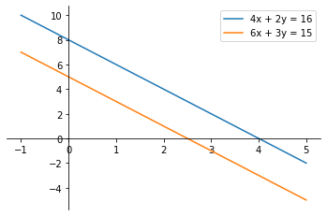
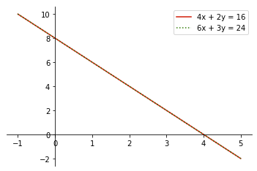
Singular System
A system of linear equations is singular if it has no solutions or an infinite number of solutions.
No solutions
Infinitely many solutions

Slide 23
Break
7:20

Slide 24
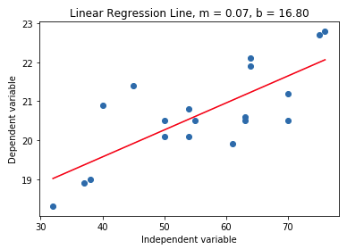
Linear Regression Revisited
Recall our linear regression example with one independent variable:
\
The equation for the least-squares regression line: where: and
 | 1 | 2 | 3 | 4 | 5 | 6 | 7 | 8 | 9 | 10 | 11 | 12 | 13 | 14 | 15 | 16 | 17 | 18 | 19
x | 32 | 37 | 38 | 40 | 45 | 50 | 50 | 54 | 54 | 55 | 61 | 63 | 63 | 64 | 64 | 70 | 70 | 75 | 76
y | 18.3 | 18.9 | 19.0 | 20.9 | 21.4 | 20.5 | 20.1 | 20.1 | 20.8 | 20.5 | 19.9 | 20.5 | 20.6 | 22.1 | 21.9 | 21.2 | 20.5 | 22.7 | 22.8
$$\hat{y}=mx+b$$
$$m=\frac{\sum{xy}−\frac{\sum{x\sum{y}}}{n}}{\sum{x^{2}}−\frac{{\left(\sum{x}\right)}^{2}}{n}}$$
$$b=\overline{y}−m\overline{x}$$
b = 16.80
m = 0.07

Slide 25
Least-Squares Solution with Matrices
There are matrix-based solutions to least-squares approximation to find the “best fit”.
If you believe that these points are related by the linear function y = b + mx, you will write:
 | 1 | 2 | 3 | 4 | 5 | 6 | 7 | 8 | 9 | 10 | 11 | 12 | 13 | 14 | 15 | 16 | 17 | 18 | 19
x | 32 | 37 | 38 | 40 | 45 | 50 | 50 | 54 | 54 | 55 | 61 | 63 | 63 | 64 | 64 | 70 | 70 | 75 | 76
y | 18.3 | 18.9 | 19.0 | 20.9 | 21.4 | 20.5 | 20.1 | 20.1 | 20.8 | 20.5 | 19.9 | 20.5 | 20.6 | 22.1 | 21.9 | 21.2 | 20.5 | 22.7 | 22.8
$$b+m\left(32\right)=18.3 \\ b+m\left(37\right)=18.9 \\ b+m\left(38\right)=19.0 \\ ⋮ \\ b+m\left(76\right)=22.8$$
$$\left[\begin{matrix}1 & 32 \\ 1 & 37 \\ 1 & 38 \\ ⋮ & ⋮ \\ 1 & 76\end{matrix}\right]∙\left[\begin{aligned}b \\ m\end{aligned}\right]=\left[\begin{aligned}18.3 \\ 18.9 \\ 19.0 \\ ⋮ \\ 22.8\end{aligned}\right]$$
or
A x = b

Slide 26
Least-Squares Solution with Matrices, cont’d
$$\left[\begin{matrix}1 & 32 \\ 1 & 37 \\ 1 & 38 \\ ⋮ & ⋮ \\ 1 & 76\end{matrix}\right]∙\left[\begin{aligned}b \\ m\end{aligned}\right]=\left[\begin{aligned}18.3 \\ 18.9 \\ 19.0 \\ ⋮ \\ 22.8\end{aligned}\right]$$
But since the points don’t actually lie on a straight line, we want to calculate a vector $\hat{x}$ such that vector $A\hat{x}$ is as close as possible to vector b.
A x = b
We can solve for $\hat{x}$ using the following a system of equations that are the normal equations for $\hat{x}$: where $A^{T}$ is the transpose of matrix A.
$$A^{T}A\hat{x}=A^{T}b \\ \hat{x}={\left(A^{T}A\right)}^{−1}A^{T}b$$
The derivation of this formula involves the concepts
of matrix orthogonality and vector projections.

Slide 27
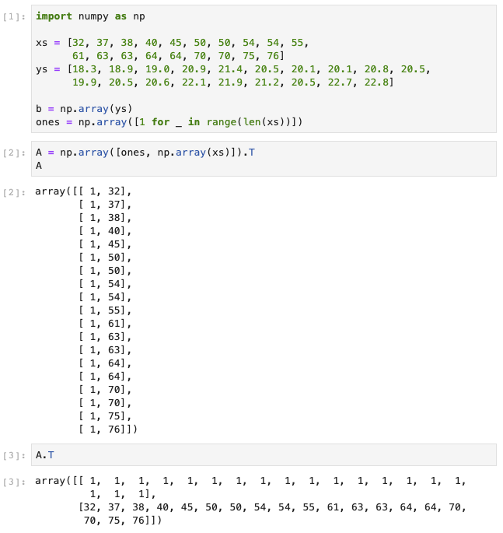
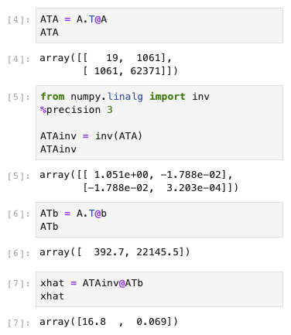
Least-Squares Solution with Matrices, cont’d
$$\hat{x}={\left(A^{T}A\right)}^{−1}A^{T}b$$
LeastSquaresMatrix.ipynb
Therefore, $\hat{x}= \left[\begin{aligned}b \\ m\end{aligned}\right]=\left[\begin{aligned}16.8 \\ 0.069\end{aligned}\right]$
b = 16.80
m = 0.07

Slide 28
Multivariate Regression Revisited
Bedrooms x₁ | Bathrooms x₂ | $ Price y
3 | 2 | 48,800
2 | 1 | 44,300
4 | 3 | 53,800
2 | 1 | 44,200
3 | 2 | 49,700
2 | 2 | 44,900
5 | 3 | 58,400
4 | 2 | 52,900
$$nβ_{0} + β_{1}\sum{x_{1} + β_{2}\sum{x_{2} =\sum{y}}}$$
$$β_{0}\sum{x_{1}} + β_{1}\sum{x_{1}^{2} + β_{2}\sum{x_{1}x_{2}=}}\sum{x_{1}y}$$
$$β_{0}\sum{x_{2}} + β_{1}\sum{x_{1}x_{2} + β_{2}\sum{x_{2}^{2} =\sum{x_{2}y}}}$$
$$\hat{y}=β_{0}+β_{1}x_{1}+β_{2}x_{2}+⋯+β_{k}x_{k}$$
$$8β_{0} + 25β_{1} + 16β_{2}= 397,000 \\ 25β_{0} + 87β_{1} + 55β_{2} =1,281,100 \\ 16β_{0} + 55β_{1} + 36β_{2} = 817,700$$
Solution:
$$β_{0}+β_{1}\left(3\right)+β_{2}\left(2\right)=48,800 \\ β_{0}+β_{1}\left(2\right)+β_{2}\left(1\right)=44,300$$
$$β_{0}+β_{1}\left(4\right)+β_{2}\left(3\right)=53,800$$
$$β_{0}+β_{1}\left(2\right)+β_{2}\left(1\right)=44,200$$
$$β_{0}+β_{1}\left(3\right)+β_{2}\left(2\right)=49,700$$
$$β_{0}+β_{1}\left(2\right)+β_{2}\left(2\right)=44,900$$
$$β_{0}+β_{1}\left(5\right)+β_{2}\left(3\right)=58,400$$
$$β_{0}+β_{1}\left(4\right)+β_{2}\left(2\right)=52,900$$
$$\left[\begin{matrix}1 & 3 & 2 \\ 1 & 2 & 1 \\ 1 & 4 & 3 \\ 1 & 2 & 1 \\ 1 & 3 & 2 \\ 1 & 2 & 2 \\ 1 & 5 & 3 \\ 1 & 4 & 2\end{matrix}\right]∙\left[\begin{aligned}β_{0} \\ β_{1} \\ β_{2}\end{aligned}\right]=\left[\begin{aligned}48,800 \\ 44,300 \\ 53,800 \\ 44,200 \\ 49,700 \\ 44,900 \\ 58,400 \\ 52,900\end{aligned}\right]$$
$$β_{0}=35,191.67 \\ β_{1}= 4,133.33 \\ β_{2}= 758.33$$
or
A x = b

Slide 29
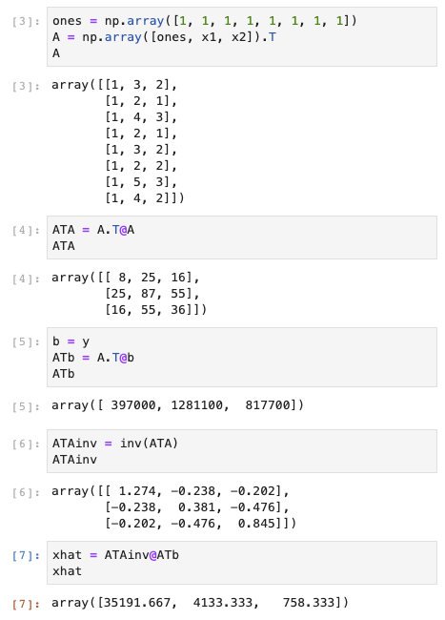
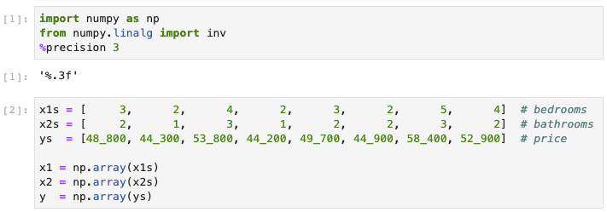
Multivariate Regression with Matrices
$$\left[\begin{matrix}1 & 3 & 2 \\ 1 & 2 & 1 \\ 1 & 4 & 3 \\ 1 & 2 & 1 \\ 1 & 3 & 2 \\ 1 & 2 & 2 \\ 1 & 5 & 3 \\ 1 & 4 & 2\end{matrix}\right]∙\left[\begin{aligned}β_{0} \\ β_{1} \\ β_{2}\end{aligned}\right]=\left[\begin{aligned}48,800 \\ 44,300 \\ 53,800 \\ 44,200 \\ 49,700 \\ 44,900 \\ 58,400 \\ 52,900\end{aligned}\right]$$
A x = b
$$\hat{x}={\left(A^{T}A\right)}^{−1}A^{T}b$$
MultivariateMatrix.ipynb
$$β_{0}=35,191.67 \\ β_{1}= 4,133.33 \\ β_{2}= 758.33$$
Therefore, $\hat{x}= \left[\begin{aligned}β_{0} \\ β_{1} \\ β_{2}\end{aligned}\right]=\left[\begin{aligned}35,191.667 \\ 4,133.33 \\ 758.333\end{aligned}\right]$

Slide 30
QR Factorization
$$\hat{x}={\left(A^{T}A\right)}^{−1}A^{T}b$$
The normal equations for a least squares problem often are ill-conditioned.
A small roundoff error during Gaussian elimination will cause a large error in the solution.
Or the matrix $\left(A^{T}A\right)$ is singular and therefore does not have an inverse ${\left(A^{T}A\right)}^{−1}$.
In such cases, a more reliable way to compute the least squares approximation of Ax = b is to use the QR factorization of A.

Slide 31
QR Factorization, cont’d
If A is an m x n matrix with linearly independent columns,
then A can be factored as A = QR, where Q is an m x n
matrix with orthonormal columns and R is an invertible
upper-triangular matrix.
linearly independent: No column of the matrix is a linear combination of other columns.
orthonormal columns: Each column is a unit vector, and the dot product of two columns is 0.
Q has the property that Q^{T}Q = I, the identity matrix.
upper-triangular matrix: A square matrix with all zeroes below the main diagonal.

Slide 32
QR Factorization, cont’d
The Gram-Schmidt Orthonormalization Process factors A into Q and R.
Jorgen Pederson Gram (1850-1916)
Danish mathematician
Erhardt Schmidt (1876-1959)
German mathematician
Somewhat tedious to do by hand, but fortunately, we have the Python function numpy.linalg.qr().

Slide 33
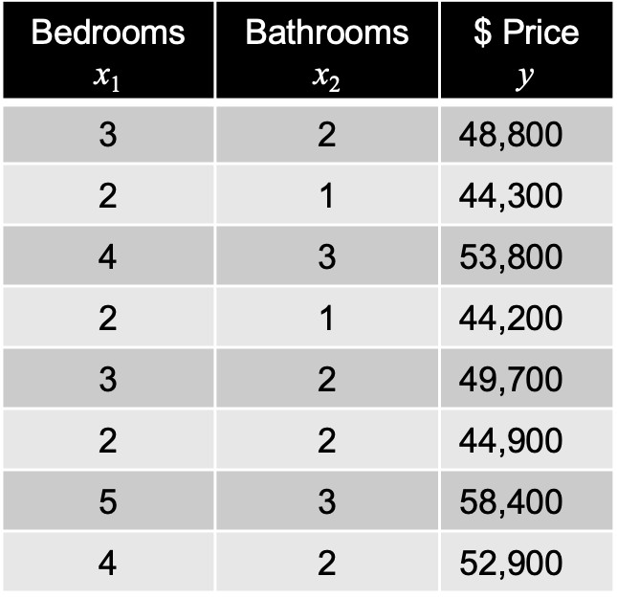
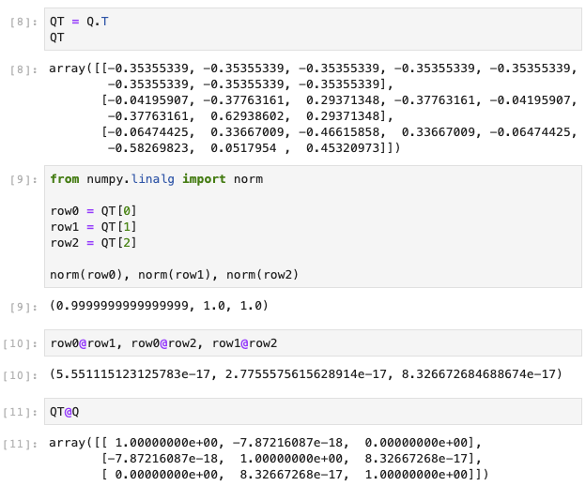
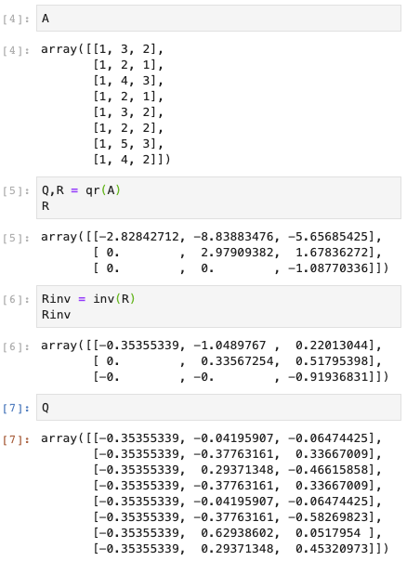
QR Factorization, cont’d
upper-triangular
unit vectors
invertible
orthogonal
Q^{T}Q = I
QR.ipynb

Slide 34
Least Squares via QR Factorization
${ A}^{T}A\hat{x}=A^{T}b$ $${\left(QR\right)}^{T}\left(QR\right)\hat{x}={(QR)}^{T}b$$ $R^{T}Q^{T}QR\hat{x}=R^{T}Q^{T}b$ $${ R}^{T}R\hat{x}=R^{T}Q^{T}b \\ R\hat{x}=Q^{T}b \\ \hat{x}=R^{−1}Q^{T}b$$
least squares normal equation
replace A by QR
(QR)^{T} = R^{T}Q^{T}
Q^{T}Q = I
remove R^{T} from both sides
multiply both sides by R⁻¹, and RR⁻¹ = I
$$β_{0}=35,191.67 \\ β_{1}= 4,133.33 \\ β_{2}= 758.33$$

Slide 35
System of Normal Equations vs. QR Factorization
$$nβ_{0} + β_{1}\sum{x_{1} + β_{2}\sum{x_{2} =\sum{y}}}$$
$$β_{0}\sum{x_{1}} + β_{1}\sum{x_{1}^{2} + β_{2}\sum{x_{1}x_{2}=}}\sum{x_{1}y}$$
$$\hat{x}={\left(A^{T}A\right)}^{−1}A^{T}b$$
vs.
$$β_{0}\sum{x_{2}} + β_{1}\sum{x_{1}x_{2} + β_{2}\sum{x_{2}^{2} =\sum{x_{2}y}}}$$
The system of normal equations is challenging if the number of independent variables is large.
The example above has two independent variables.
Matrix A will be large if there are many data points.
Use a random sample of the data to reduce the row count.

Slide 36
LU Decomposition
There are several ways to factor a matrix besides QR.
LU decomposition factors a matrix A = LU, where L is a lower-triangular matrix and U is an upper-triangular matrix.
Example: $\left[\begin{matrix}6 & 18 & 3 \\ 2 & 12 & 1 \\ 4 & 15 & 3\end{matrix}\right]=\left[\begin{matrix}3 & 0 & 0 \\ 1 & 6 & 0 \\ 2 & 3 & 1\end{matrix}\right] \left[\begin{matrix}2 & 6 & 1 \\ 0 & 1 & 0 \\ 0 & 0 & 1\end{matrix}\right]$
This non-unique decomposition can simplify certain matrix operations.
LU.ipynb

Slide 37
Singular Value Decomposition
Singular value decomposition (SVD) decomposes (factors) an m $×$ n matrix A into three matrices: A = UDV^{T}
U is m $×$ m with orthonormal columns
D is m $×$ n with non-negative real values on the diagonal and zeros elsewhere (the singular values of matrix A)
V is n $×$ n with orthonormal columns
Example: $\left[\begin{matrix}3 & 2 & 2 \\ 2 & 3 & −2\end{matrix}\right]=\left[\begin{matrix}1/{\sqrt{2}} & 1/{\sqrt{2}} \\ 1/{\sqrt{2}} & {−1}/{\sqrt{2}}\end{matrix}\right] \left[\begin{matrix}5 & 0 & 0 \\ 0 & 3 & 0\end{matrix}\right] \left[\begin{matrix}1/{\sqrt{2}} & 1/{\sqrt{2}} & 0 \\ 1/{\sqrt{18}} & {−1}/{\sqrt{18}} & 4/{\sqrt{18}} \\ 2/3 & {−2}/3 & {−1}/3\end{matrix}\right]$

Slide 38
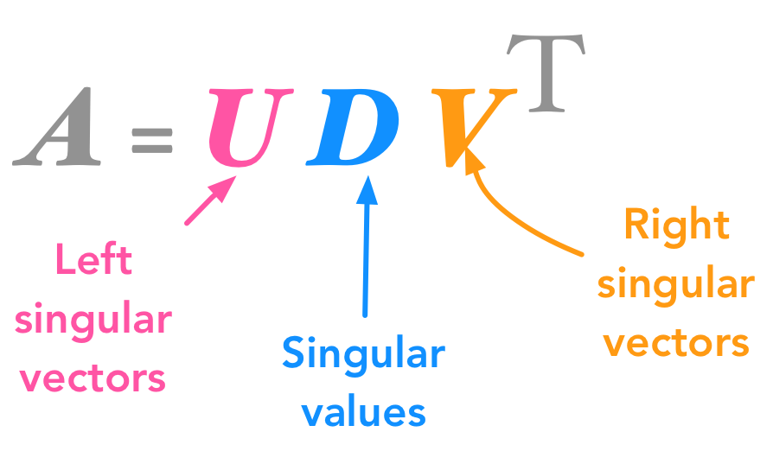
Singular Value Decomposition, cont’d
Non-unique
https://hadrienj.github.io/posts/Deep-Learning-Book-Series-2.8-Singular-Value-Decomposition/
Applications in machine learning:
dimensionality reduction
image compression
image recovery
SVD.ipynb

