Slide 1
DATA 220 Mathematical Methods for Data Analysis March 25 Class Meeting
Department of Applied Data Science San Jose State University Spring 2021 Instructor: Ron Mak
www.cs.sjsu.edu/~mak

Slide 2
Tactics for Solving Probability Problems
It’s a binomial probability problem if:
There are multiple trials of an experiment.
The trials are independent of each other.
Each trial can either succeed or fail.
Each trial has the same probability of success.
It’s a Poisson probability problem if:
You’re told the average number of event occurrences within a given interval of time.
You must determine the probability of a number of event occurrences within the same time interval.

Slide 3
Tactics for Solving Probability Problems, cont’d
It’s a job for Bayes’s Theorem if:
You start with some known probabilities, the prior probabilities.
You’re given additional information in the form of probabilities that cause you to revise your prior probabilities into new posterior probabilities.
Draw the probability tree to help you visualize!
https://luminousmen.com/post/data-science-bayes-theorem

Slide 4
Bayes’ Theorem Terminology
Prior probabilities: The probabilities that you initially know at the start.
You get addition information (in the form of probabilities) that cause you to revise your initial probabilities.
Posterior probabilities: Your revised probabilities in light of the additional information.

Slide 5
More Tactics for Solving Probability Problems
If distinct balls, toys, etc. are being put into boxes, that implies an order when it comes to counting the number of arrangements.
It doesn’t matter whether or not the boxes look identical or you received them all at the same time.

Slide 6
Midterm
Go over problems.

Slide 7
Hypothesis Testing and Experiments
When you use experiments to determine whether or not to reject a hypothesis, you should choose the level of significance α before you perform the experiments.
Wrong: Decide ahead of time whether or not to reject the hypothesis, get experimental results, and then choose a level of significance that supports your prior decision.
Experimental design is a major important topic!

Slide 8
Rejection Region for H₀
We’ve already seen how each level of significance α has a critical value C that determines the rejection region for H₀.
If the value of the test statistic lands in the rejection region, we reject H₀.
Otherwise, we fail to reject H₀.
https://saylordotorg.github.io/text_introductory-statistics/s12-testing-hypotheses.html

Slide 9
Different Significance Levels
Using a different value for α can change whether or not we reject H₀.
Example: A cigarette company claims that the average nicotine content is 1.5 mg/cigarette.
$$H_{0}: μ=1.5$$
$$H_{a}: μ>1.5$$
upper-tailed test
Level of significance α | Rejection region | Conclusion for test statistic z = 2.10 | Significance level preferred by
.05 | z₁ > 1.645 | Reject $H_{0}$ | Anti-tobacco activists
.025 | z₂ > 1.96 | Reject $H_{0}$ | Anti-tobacco activists
.01 | z₃ > 2.33 | Fail to reject $H_{0}$ | Tobacco company
.005 | z₄ > 2.58 | Fail to reject $H_{0}$ | Tobacco company

Slide 10
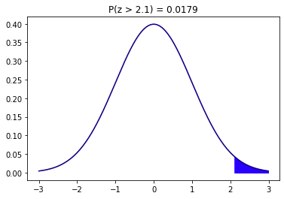
Different Significance Levels, cont’d
Level of significance α | Rejection region | Conclusion for test statistic z = 2.10 | Significance level preferred by
.05 | z₁ > 1.645 | Reject $H_{0}$ | Anti-tobacco activists
.025 | z₂ > 1.96 | Reject $H_{0}$ | Anti-tobacco activists
.01 | z₃ > 2.33 | Fail to reject $H_{0}$ | Tobacco company
.005 | z₄ > 2.58 | Fail to reject $H_{0}$ | Tobacco company
$$H_{0}: μ=1.5 \\ H_{a}: μ>1.5$$
The tobacco company
can claim that they
failed to reject $H_{0}.$
But the company
probably won’t tell you
what significance level
it used for testing.
This area 0.0179
is the smallest α
at which we can
reject $H_{0}$. Any
smaller area
would not
include 2.10
2.10
z₁
z₂
z₃
z₄

Slide 11
P-Values
Only knowing that the null hypothesis H₀ was rejected by a test at a certain level of significance doesn’t tell us how far the test statistic fell into the rejection region.
A more informative way to report a test result is to give the P-value associated with the test.
The P-value gives information about the strength of the evidence against H₀.
An individual decision maker can then draw a conclusion at any specified significance level α.

Slide 12
P-Values, cont’d
The P-value is the smallest level of significance at which H₀ can be rejected.
Therefore:
If α ≥ P-value, then reject H₀ at level α.
If α < P-value, then do not reject H₀ at level α.

Slide 13
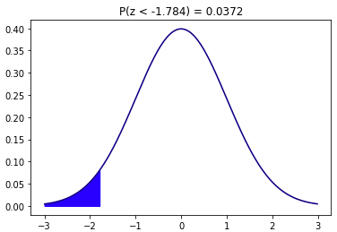
P-Value Example #1
H₀: µ = 125
H_{a}: µ < 125
Suppose:
It is reported that the P-value = 0.0372
The smallest level of significance at which we can reject H₀.
Therefore, at significance level α = 0.01, you cannot reject H₀, since 0.01 < 0.0372
lower-tailed test
P-value = 0.0372

Slide 14
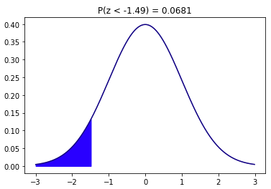
P-Value Example #2
H₀: µ = 10
H_{a}: µ < 10
Suppose that a z test for testing results in the test statistic z = -1.49.
From the table of standard normal probabilities, the desired area is 0.0681.
P-value = 0.0681
At significance level .10, reject H₀ (since 0.10 > 0.0681)
At significance level .05, fail to reject H₀.
lower-tailed
test
P-value = 0.0681
-1.49
Reject if α ≥ P-value
You choose what
significance level
to use.

Slide 15
P-Value Example #3
Do diabetics have different blood pressure than the general population?
The mean systolic blood pressure for the general population is 127.2.
Sample of 101 diabetics: $\overline{x}=130$ and $s=8$
Let µ be the mean population blood pressure.
The researcher decides on a significance level of .01
$$H_{0}: μ=127.2 \\ H_{a}: μ≠127.2$$
$$Test statistic z= \frac{\overline{x}−μ}{s/{\sqrt{n}}}=\frac{130−127.2}{8/{\sqrt{101}}}=\frac{2.80}{0.796}=3.52$$
two-tailed test

Slide 16
P-Value Example #3, cont’d
$$H_{0}: μ=127.2 \\ H_{a}: μ≠127.2$$
$$Test statistic z= \frac{\overline{x}−μ}{s/{\sqrt{n}}}=\frac{130−127.2}{8/{\sqrt{101}}}=\frac{2.80}{0.796}=3.52$$
two-tailed test
From the table of standard normal probabilities, the area under the z curve to the right of 3.52 is approximately 0.0002.
Since this is a two-tailed test, the researcher reports that the P-value = 2(0.0002) = 0.0004 which is the smallest level of significance at which we can reject $H_{0}.$
Therefore, if you also choose a significance level of 0.01, and since 0.01 > P-value, you reject $H_{0}.$

Slide 17
Break

Slide 18
Dependent and Independent Variables
A variable y is dependent on a variable x if the value of x determines the value of y.
x is the independent variable.
y is the dependent variable.
Example: Some experimental data:
If the value of x uniquely determines a value of y, then x and y are deterministically related.
Not the case above: for x = 50, y = 20.5 and 20.1
 | 1 | 2 | 3 | 4 | 5 | 6 | 7 | 8 | 9 | 10 | 11 | 12 | 13 | 14 | 15 | 16 | 17 | 18 | 19
x | 32 | 37 | 38 | 40 | 45 | 50 | 50 | 54 | 54 | 55 | 61 | 63 | 63 | 64 | 64 | 70 | 70 | 75 | 76
y | 18.3 | 18.9 | 19.0 | 20.9 | 21.4 | 20.5 | 20.1 | 20.1 | 20.8 | 20.5 | 19.9 | 20.5 | 20.6 | 22.1 | 21.9 | 21.2 | 20.5 | 22.7 | 22.8

Slide 19
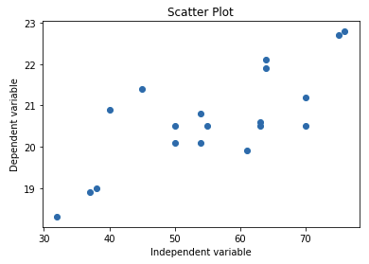
Scatter Plots
 | 1 | 2 | 3 | 4 | 5 | 6 | 7 | 8 | 9 | 10 | 11 | 12 | 13 | 14 | 15 | 16 | 17 | 18 | 19
x | 32 | 37 | 38 | 40 | 45 | 50 | 50 | 54 | 54 | 55 | 61 | 63 | 63 | 64 | 64 | 70 | 70 | 75 | 76
y | 18.3 | 18.9 | 19.0 | 20.9 | 21.4 | 20.5 | 20.1 | 20.1 | 20.8 | 20.5 | 19.9 | 20.5 | 20.6 | 22.1 | 21.9 | 21.2 | 20.5 | 22.7 | 22.8
Create a scatter plot of the x and y values.
def show_scatter_plot(title,
x_label, y_label,
x_values, y_values):
plt.scatter(x_values, y_values)
plt.title(title)
plt.ylabel(x_label)
plt.xlabel(y_label)
plt.show()
ScatterPlot.ipynb
xs = [32, 37, 38, 40, 45, 50, 50, 54, 54, 55,
61, 63, 63, 64, 64, 70, 70, 75, 76]
ys = [18.3, 18.9, 19.0, 20.9, 21.4, 20.5, 20.1, 20.1, 20.8, 20.5,
19.9, 20.5, 20.6, 22.1, 21.9, 21.2, 20.5, 22.7, 22.8]
show_scatter_plot('Scatter Plot', 'Dependent variable',
'Independent variable', xs, ys )

Slide 20
Regression Analysis
The general objective of regression analysis is to use the x values to draw some conclusion about the y values.
Given an x value, can we infer (predict) the corresponding y value?
This scatter plot exhibits a linear pattern.
Increases in x values appear to have proportional increases in y values.

Slide 21
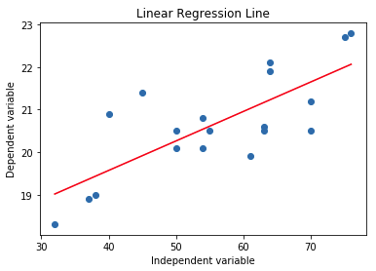
Regression Line
We can draw a regression line that best shows the linear relationship between x and y:
How do we draw this line?
How do we draw the “best possible” line?

Slide 22
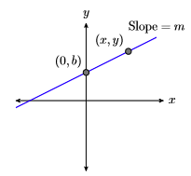
The Slope-Intercept Form of a Line
Recall the slope-intercept form of a line:
m is the slope of the line
How much y increases when x increases by 1.
b is the y value where the line intercepts y axis (i.e., where x = 0)
If m is positive, the line rises from left to right. If m is negative, the line falls. If m = 0, the line is horizontal at y = b.
y = mx + b
https://math.libretexts.org/Bookshelves/Algebra/Book%3A_Elementary_Algebra_(Arnold)/3%3A_Introduction_to_Graphing/3.4%3A_Slope-Intercept_Form_of_a_Line

Slide 23
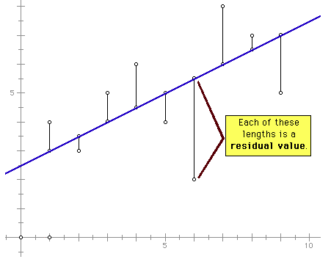
Residual Values
Whenever we draw a linear regression line, there will be a residual value at each x.
Each residual value is the difference between the actual y value and the predicted y value.
If the actual y value is above the line, it’s a positive residual. Otherwise, it’s a negative residual.
https://math.illinoisstate.edu/day/courses/old/312/notes/twovar/twovar04.html

Slide 24
Residuals Values, cont’d
Intuitively, the best regression line is one that minimizes the sum of all the residual values.
Such a line would therefore have the “best fit”.

Slide 25
The Least-Squares Line
Add up the squares all the residual values:
Squaring minimizes differences < 1 and magnifies differences > 1.
The best-fit line that minimizes this sum is the least-squares line.
Rather than performing all these calculations, algebraic manipulation yields better formulas.
$$\sum{{\left[y−(mx+b)\right]}^{2}}={\left[y_{1}−(mx_{1}+b)\right]}^{2}$$
$$+{ \left[y_{2}−(mx_{2}+b)\right]}^{2} +⋯+{\left[y_{n}−(mx_{n}+b)\right]}^{2}$$

Slide 26
The Least-Squares Line, cont’d
The slope of the least-squares line is $$m=\frac{\sum{xy}−\frac{\sum{x\sum{y}}}{n}}{\sum{x^{2}}−\frac{{\left(\sum{x}\right)}^{2}}{n}}$$
and the y-intercept is
$$b=\overline{y}−m\overline{x}$$
and the equation of the least-squares line is
$$\hat{y}=mx+b$$
where $\hat{y}$ is the predicted value of y given a value of x.

Slide 27
The Least-Squares Line, cont’d
LeastSquaresLine.ipynb
$$m=\frac{\sum{xy}−\frac{\sum{x\sum{y}}}{n}}{\sum{x^{2}}−\frac{{\left(\sum{x}\right)}^{2}}{n}}$$
$$b=\overline{y}−m\overline{x}$$
$$\hat{y}=mx+b$$
import numpy as np
def calculate_slope_intercept(x_values, y_values):
x = np.array(x_values)
y = np.array(y_values)
n = len(x)
sum_x = np.sum(x)
sum_y = np.sum(y)
sum_xx = np.sum(x*x)
sum_xy = np.sum(x*y)
mean_x = np.mean(x)
mean_y = np.mean(y)
numerator = sum_xy - (sum_x*sum_y)/n
denominator = sum_xx - ((sum_x*sum_x)/n)
m = numerator/denominator
b = mean_y - m*mean_x
return m, b # slope and intercept
Numpy implicitly loops
over the x values.

Slide 28
The Least-Squares Line, cont’d
LeastSquaresLine.ipynb
$$m=\frac{\sum{xy}−\frac{\sum{x\sum{y}}}{n}}{\sum{x^{2}}−\frac{{\left(\sum{x}\right)}^{2}}{n}}$$
$$b=\overline{y}−m\overline{x}$$
$$\hat{y}=mx+b$$
import matplotlib.pyplot as plt
def show_least_squares_line(title, x_label, y_label,
x_values, y_values):
# First show the scatter plot.
plt.scatter(x_values, y_values)
# Now show the least squares line.
m, b = calculate_slope_intercept(xs, ys)
reg_line = [m*x + b for x in xs] # regression line
plt.plot(xs, reg_line, color='red')
plt.title(f'{title}, m = {m:.2f}, b = {b:.2f}')
plt.ylabel(x_label)
plt.xlabel(y_label)
plt.show()

Slide 29
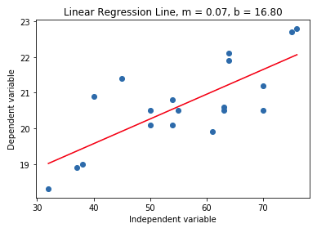
The Least-Squares Line, cont’d
LeastSquaresLine.ipynb
xs = [32, 37, 38, 40, 45, 50, 50, 54, 54, 55,
61, 63, 63, 64, 64, 70, 70, 75, 76]
ys = [18.3, 18.9, 19.0, 20.9, 21.4, 20.5, 20.1, 20.1, 20.8, 20.5,
19.9, 20.5, 20.6, 22.1, 21.9, 21.2, 20.5, 22.7, 22.8]
show_least_squares_line('Linear Regression Line', 'Dependent variable',
'Independent variable', xs, ys)

Slide 30
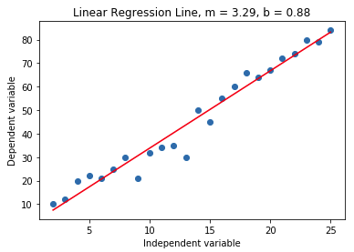
The Least-Squares Line, cont’d
LeastSquaresLine.ipynb
xs = range(2, 26)
ys = [10,12,20,22,21,25,30,21,32,34,35,30,50,45,55,60,66,64,67,72,74,80,79,84]
show_least_squares_line('Linear Regression Line', 'Dependent variable',
'Independent variable', xs, ys)

Slide 31
The Coefficient of Determination
Can we assess how good is the fit of a least-squares line?
How well does the line summarize the relationship between x and y?

Slide 32
The Coefficient of Determination, cont’d
To arrive at a quantitative measure of the fit, first calculate two values:
Residual sum of squares (AKA residual sum of errors):
$${{SS}_{residual}=SS}_{error}=\sum{{\left(y−\hat{y}\right)}^{2}=\sum{y^{2}}−b\sum{y}−m\sum{xy}}$$
Total sum of squares:
$${SS}_{total}=\sum{{\left(y−\overline{y}\right)}^{2}=\sum{y^{2}}−\frac{{\left(\sum{y}\right)}^{2}}{n}}$$

Slide 33
The Coefficient of Determination, cont’d
The residual sum of squares measures the deviations from the regression line.
The total sum of squares does not involve x and measures the deviations from the mean.
https://www.geeksforgeeks.org/ml-r-squared-in-regression-analysis/

Slide 34
The Coefficient of Determination, cont’d
SS_{residual} measures the amount of variation in y that cannot be attributed to the linear relationship between x and y.
The larger the value of SS_{residual}, the greater the amount of “unexplained” variation.
SS_{total} measures the total variation.
The larger the value of SS_{total}, the greater the amount of variation in the y values.
The ratio SS_{residual} / SS_{total} is the fraction of the total variation unexplained by a linear relationship.

Slide 35
The Coefficient of Determination, cont’d
The coefficient of determination, denoted by r², is
$r^{2}=\frac{{SS}_{total}−{SS}_{residual}}{{SS}_{total}}=1−$ $\frac{{SS}_{residual}}{{SS}_{total}}$
It measures the proportion of variation in y that can be attributed to a linear relationship between x and y in a sample.

Slide 36
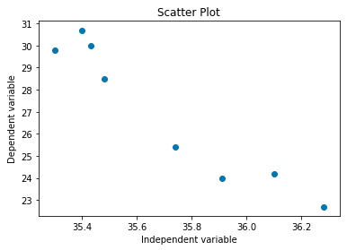
Example: Coefficient of Determination
x | 35.43 | 36.10 | 35.74 | 35.30 | 35.40 | 35.91 | 35.48 | 36.28
y | 30.0 | 24.2 | 25.4 | 29.8 | 30.7 | 24.0 | 28.5 | 22.7
CoeffOfDet.ipynb
Computed r² = 0.913

Slide 37
Correlation
Rather than using values of x to infer values of y, correlation measures how strongly the values of x and y are related to one another.
Pearson’s sample correlation coefficient, denoted by r, is
$$r=\frac{\sum{\left(x−\overline{x}\right)\left(y−\overline{y}\right)}}{\sqrt{\sum{{\left(x−\overline{x}\right)}^{2}}}\sqrt{\sum{{\left(y−\overline{y}\right)}^{2}}}}=\frac{\sum{xy}−\frac{\sum{x}\sum{y}}{n}}{\sqrt{\sum{x^{2}}−\frac{{\left(\sum{x}\right)}^{2}}{n}}\sqrt{\sum{y^{2}}−\frac{{\left(\sum{y}\right)}^{2}}{n}}}$$
measures the extent to which x and y are linearly related.

Slide 38
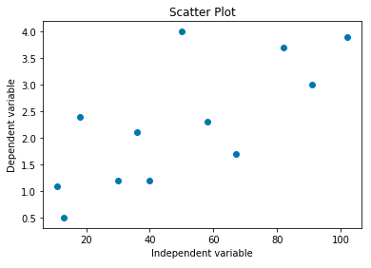
Example: Correlation Coefficient
 | 1 | 2 | 3 | 4 | 5 | 6 | 7 | 8 | 9 | 10 | 11 | 12
x | 11 | 13 | 18 | 30 | 36 | 40 | 50 | 58 | 67 | 82 | 91 | 102
y | 1.1 | 0.5 | 2.4 | 1.2 | 2.1 | 1.2 | 4.0 | 2.3 | 1.7 | 3.7 | 3.0 | 3.9
Correlation.ipynb
Computed r = 0.732

Slide 39
Properties of the Correlation Coefficient r
The value of r does not depend on the unit of measurement of either x or y.
The value of r does not depend on which of x or y is designated the dependent variable.
The value of r is between -1 and +1.
Close to +1: very strong positive linear relationship
Close to -1: very strong negative linear relationship
Either ≥ +0.8 or ≤ -0.8: strong relationship
Either +0.5 < r < 0.8 or -0.8 < r < -0.5: moderate
-0.5 ≤ r ≤ +0.5: weak relationship

Slide 40
Correlation and Causation
A value of r close to ±1 indicates a very strong linear relationship between x and y.
Strong correlation does not imply causation.
It’s possible that both x and y are each strongly related to a third variable.
Example: Among a random group of children, a child’s height is strongly correlated the size of his or her vocabulary.
Actually, both height and vocabulary size are each strongly correlated to the child’s age.

Slide 41
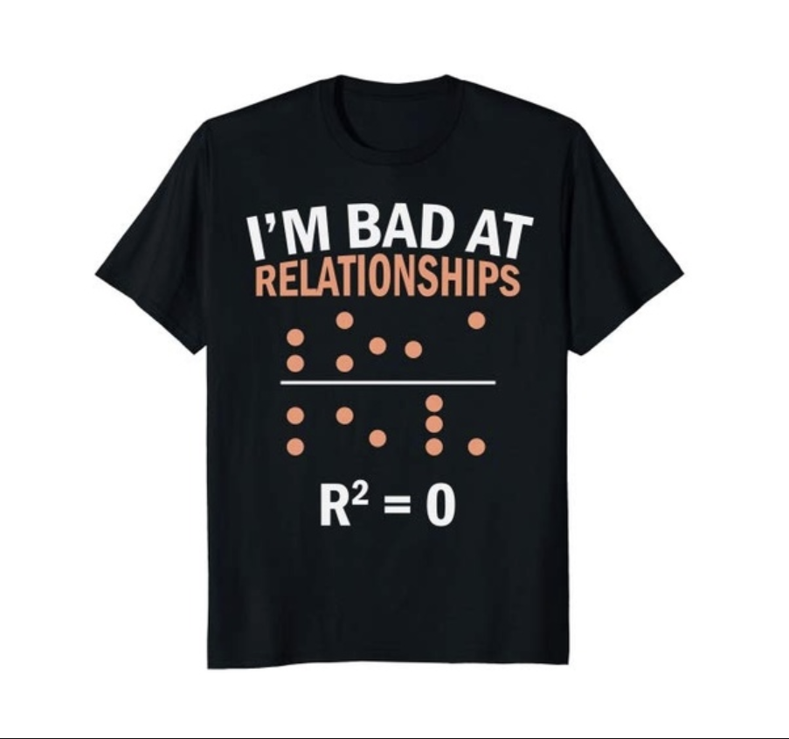
Nerdy T-Shirt

Slide 42
Assignment #7: Regression Analysis
Find two datasets each of which has two variables which we’ll call x and y, but they can have any names.
You should have a suspicion or intuition that in each dataset, variable y is linearly dependent on variable x.
For each dataset:
Create a scatter plot of the data.
Draw the least-squares regression line through the scatter plot.
Calculate and print the coefficient of determination and the correlation coefficient.
Are the y values caused
by the x values?

