Slide 1
DATA 220 Mathematical Methods for Data Analysis March 11 Class Meeting
Department of Applied Data Science San Jose State University March 2021 Instructor: Ron Mak
www.cs.sjsu.edu/~mak

Slide 2
Discrete Random Variables
The set of possible values of a discrete random variable is a collection of isolated points on the number line.
Examples: uniformly distributed integers (such as die faces), binomial distribution, Poisson distribution
You want to know the probability of the number of occurrences of a particular value.
Example: What’s the probability that 5 customers will arrive in the next hour? (Poisson)
Example: What’s the probability that 3 students will get A’s? (binomial)

Slide 3
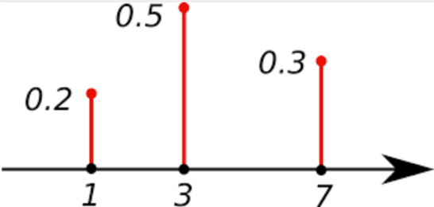
Discrete Random Variables, cont’d
A probability mass function gives the probability that a discrete random variable is exactly equal to some value.
The sum of all the probabilities must equal 1.
Example:
As you discovered from your lab assignment, Python has pmf functions for the various discrete distributions.
https://www.quora.com/What-is-the-full-form-of-PMF

Slide 4
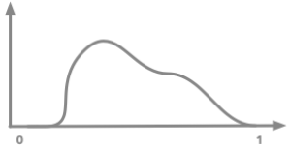
Continuous Random Variables
A continuous random variable can have any value within an interval of the number line.
The value (not the probability) of a continuous random variable is given by its probability density function (PDF)
The graph of a density function f(x) is a smooth curve such that f(x) ≥ 0
The curve cannot dip below the horizontal axis.
Example:
https://hadrienj.github.io/posts/Probability-Mass-and-Density-Functions/

Slide 5
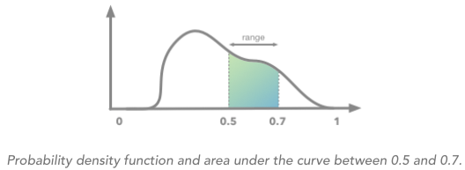
Probability as the Area under the Curve
If you graph a probability density function, the probability that the continuous random variable x has a value a ≤ x ≤ b is the area under the curve in the interval of a to b.
Example: a = 0.5 and b = 0.7
The total area
under the curve must equal 1.

Slide 6
The Normal Probability Distribution
The normal distribution has the probability density function whose graph is a normal curve: where:
$$f\left(x\right)=\frac{1}{σ\sqrt{2π}}∙e^{\left[− \frac{{(x−μ)}^{2}}{2σ^{2}}\right]}$$
Oh, my!
That quantity in the square brackets is the power to raise e.
$μ$ (mu) is the mean of the distribution $σ$ (sigma) is its standard deviation
$σ$² is its variance π (pi) is 3.1415926... e (special math constant) is 2.71828...

Slide 7
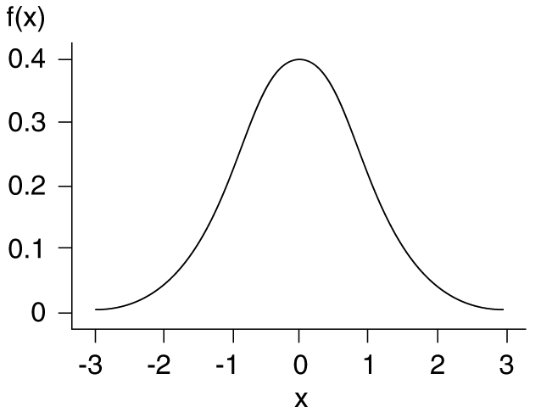
Properties of the Normal Distribution
The PDF of a normal distribution has these properties:
Its range is $−∞$ to +$∞$ although values far out in the “tails” are usually small enough to ignore.
Its mean, median, and single mode are equal.
It is symmetrical about the mean.
https://abaqus-docs.mit.edu/2017/English/SIMACAEMODRefMap/simamod-c-probdensityfunc.htm

Slide 8
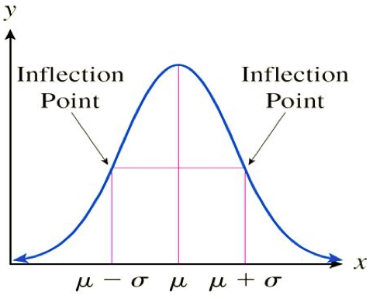
Properties of the Normal Distribution, cont’d
Two values of the PDF,$f(μ−σ)$ and $f(μ+σ)$ are inflection points where the curve changes direction.
https://mat117.wisconsin.edu/3-the-normal-distribution/

Slide 9
Properties of the Normal Distribution, cont’d
The total area must equal 1.
The probability that a normal random value is within one standard deviation $σ$ of the mean $μ$ is 68.27%.
The probability is 95.45% that it’s within two standard deviations of the mean.
The probability is 99.74% that it’s within three standard deviations of the mean.
Have you heard of
6-Sigma (6$σ$) for
process improvement?
That’s 99.99966%
https://towardsdatascience.com/understanding-the-68-95-99-7-rule-for-a-normal-distribution-b7b7cbf760c2

Slide 10
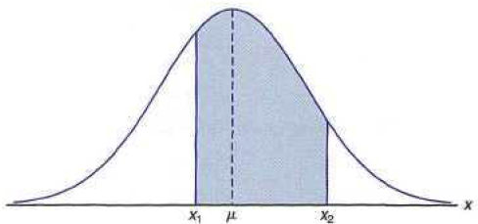
Probabilities and the Normal Distribution
To calculate the probability that a normal random variable has a value in the interval x₁ to x₂, we must calculate the area under its normal curve within that interval.
$$P\left(x_{1}≤x≤x_{2}\right)=\frac{1}{σ\sqrt{2π}}\int_{x_{1}}^{x_{2}}{e^{\left[− \frac{{(x−μ)}^{2}}{2σ^{2}}\right]}dx}$$
Oh, no.
Not calculus!
http://wongsumurpecung.blogspot.com/2013/05/areas-under-normal-curve.html

Slide 11
The Standard Normal Distribution
Fortunately, you do not need to use integral calculus to compute those probabilities.
First, convert your normal distribution of x values with mean $μ$ and standard deviation$σ$to the standard normal distribution of z values.
The standard normal distribution has mean 0 and standard deviation 1.
$$z=\frac{x−μ}{σ}$$
z scores

Slide 12
Standard Normal Distribution Probabilities
P(z ≤ 0.35) = 0.6368
Cumulative distribution function F(x)
The probability that a random value will be less than or equal to x.
Therefore, for the standard normal
distribution: F(x) = P(z ≤ x)
Example: F(0.35) = 0.6368
https://i.warosu.org/data/sci/img/0068/75/1415929799464.png

Slide 13
Standard Normal Distribution Probabilities, cont’d
The z values of a standard normal distribution are called z scores.
For a standard normal distribution table, see
https://www.math.arizona.edu/~rsims/ma464/standardnormaltable.pdf

Slide 14
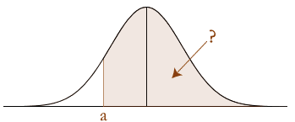
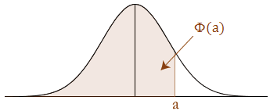
Standard Normal Distribution Probabilities, cont’d
Use the fact that the
standard normal curve
is ß about 0.
Some tables only
show positive values
of z.
-a
P(z > -a) = P(z < a)
https://statistics.laerd.com/statistical-guides/normal-distribution-calculations.php

Slide 15
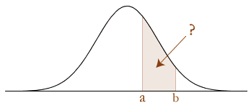
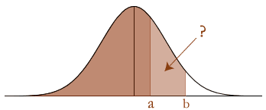
Standard Normal Distribution Probabilities, cont’d
P(a < z < b) = P(z < b) – P(z < a)
https://statistics.laerd.com/statistical-guides/normal-distribution-calculations.php

Slide 16
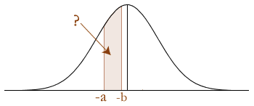
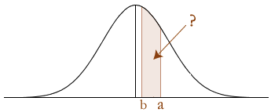
Standard Normal Distribution Probabilities, cont’d
P(-a < z < -b) = P(b < z < a) = P(z < a) – P(z < b)
https://statistics.laerd.com/statistical-guides/normal-distribution-calculations.php

Slide 17
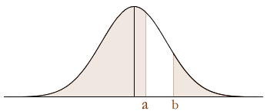
Standard Normal Distribution Probabilities, cont’d
Remember that the total area under the curve equals 1.
P(z < a) + P(z > b) = 1 - P(a < z < b)
StandardNormal.ipynb
https://statistics.laerd.com/statistical-guides/normal-distribution-calculations.php

Slide 18
Confidence Interval
We use random sampling to estimate the mean of a population.
This estimate is unlikely to be exactly $μ.$
How confident are we that our estimate is “close” to $μ$?

Slide 19
Confidence Interval, cont’d
Instead of a point estimate, can we instead specify an interval and claim that we are 95% confident that the interval contains the value of $μ$?
We can construct a confidence interval at the 95% confidence level for each sample.
In the long run, we will succeed 95% of the time to “capture” $μ$ within our confidence intervals.
Other common confidence levels are 90% and 99%.

Slide 20
Confidence Interval, cont’d
If the sample size n is large enough for the Central Limit Theorem to apply, the sampling distribution of $\overline{x}$ approaches a normal curve with mean $μ_{\overline{x}}=μ$ and standard deviation $σ_{\overline{x}}=σ/\sqrt{n}$.
The latter is the standard error.
For the 95% confidence level, from the table of standard normal curve areas, we find that P(-z < 1.96) = 0.025.
0.025 is half of 1 – 0.95
lower
tail
upper
tail

Slide 21
Confidence Interval, cont’d
Therefore, 95% of the values for any normal distribution are within 1.96 standard deviations of the mean.
For 95% of all possible samples:
This does not say that there is a 95% chance that $μ$ is in each range. Instead, what it says that if we take multiple samples and construct the 95% confidence interval for each, 95% of the intervals will capture $μ$.
$$\overline{x}−1.96∙\frac{σ}{\sqrt{n}}< μ<\overline{x}+1.96∙\frac{σ}{\sqrt{n}}$$

Slide 22
Confidence Interval, cont’d
95% of the
confidence
intervals we
create from
the samples
will capture μ.
Statistics, 3rd ed.
by Bob Donnelly, Jr.
and Fatma Abdel-Raouf
Alpha, 2016
ISBN 978-1-4654-5166-8

Slide 23
Confidence Interval, cont’d
The value 1.96 is the critical value for z at the 95% confidence level.
Usually, we do not know the standard deviation $σ$ of the population.
When the sample size n is sufficiently large (n > 30), we can replace $σ$ with the standard deviation s of the sample:
See how the confidence interval narrows (the estimate becomes more accurate) as the sample size n increases.
90%: z = 1.645
95%: z = 1.96
99%: z = 2.58
$$\overline{x}±(z critical value)∙\frac{s}{\sqrt{n}}$$

Slide 24
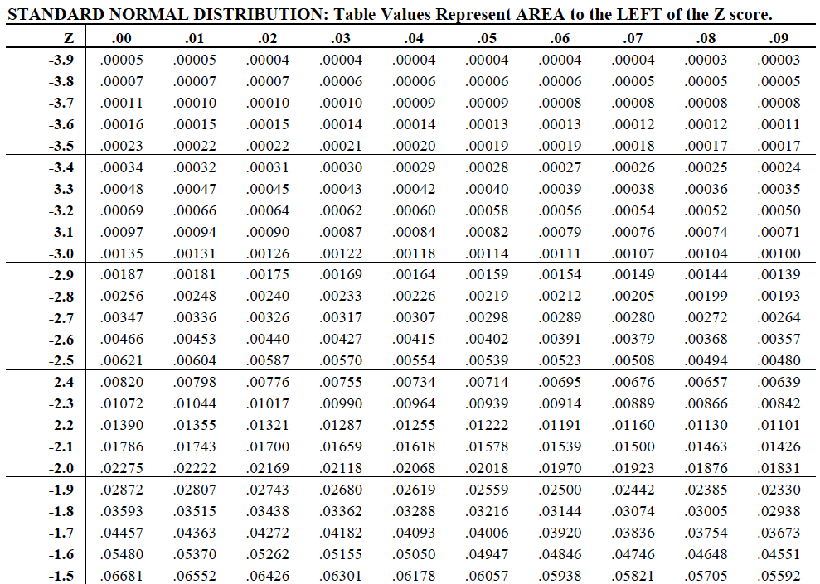
Critical Values for z
At the 99% confidence level, the area in the tails should each be 0.01 / 2 = 0.005.
The critical z value is 2.58.
At the 95% confidence level, the area in the tails should each be 0.05 / 2 = 0.025. The critical z value is 1.96.
At the 90% confidence level, the area in the tails should each be 0.10 / 2 = 0.05.
The critical z value is 1.645.

Slide 25
Confidence Interval Example
A study involved 44 individuals whose work exposed them to loud noises, causing hearing loss. Each person was asked to identify the loudness level in dB of a 10 kHz signal.
A 90% confidence interval for µ is or (26.5, 37.5).
sample size n =
sample average loudness level $\overline{x}$ =
sample standard deviation s =
critical value at 90% z =
44
32.0 dB
22.0 dB
1.645
$$\overline{x}±z∙\frac{s}{\sqrt{n}}=32.0±1.645∙\frac{22.0}{\sqrt{44}}=32.0±5.5$$

Slide 26
The Confidence Interval Compromise
Why settle for 90% confidence when 95% or even 99% is possible?
Higher confidence levels have wider confidence intervals.
The cost of higher reliability is less precision.
The 95% confidence interval is a good compromise between reliability and precision.

Slide 27
Level of Significance
The level of significance α is defined to be
α is the probability of making a Type I error.
More about Type I (and Type II) errors later!
You don’t like the quaint process of looking up critical values in a table?
If so, check out the Python function scipy.stats.norm.ppf for a given $α$ value.
$$α=1 −confidence level$$

Slide 28
Level of Significance, cont’d
Statistics, 3rd ed.
by Bob Donnelly, Jr.
and Fatma Abdel-Raouf
Alpha, 2016
ISBN 978-1-4654-5166-8

Slide 29
Margin of Error
A confidence interval is a range of value used to estimate a population parameter.
It’s associated with a specific confidence level.
The margin of error (ME) determines the width of the confidence interval
It’s the amount of sampling error in the results of a survey or poll.
$$ME=critical value × standard error=z_{α/2}∙σ_{\overline{x}}$$

Slide 30
Margin of Error Example
Collect a random sample of 30 bowls of cereals to calculate a 95% confidence interval for the average amount of carbohydrates in a bowl.
sample size n =
sample average carbohydrates $\overline{x}$ =
population standard deviation σ =
critical value z_{α/2} = z_{0.5/2} = z_{0.025} =
30
29 grams
8.74 grams
1.96
$$σ_{\overline{x}}=\frac{σ}{\sqrt{n}}=\frac{8.74}{\sqrt{30}}=1.5957$$
$$ME=z_{α/2}σ_{\overline{x}}=1.96∙1.5957=3.13$$
$$\overline{x}±ME=29±3.13=(25.87, 32.13)$$
Statistics, 3rd ed.
by Bob Donnelly, Jr.
and Fatma Abdel-Raouf
Alpha, 2016
ISBN 978-1-4654-5166-8

Slide 31
Break
7:??
Cats do not like calculus.

Slide 32
Small Sample Estimates of µ
If the sample size n is small, say n ≤ 30, then the Central Limit Theorem does not apply.
We can use sampling to estimate the population mean µ if the population is normal.
Even when n is small, the $\overline{x}$ distribution is normal if the population distribution is normal.
We estimate the population standard deviation $σ$ with the sample standard deviation s to obtain the standardized variable
$$t=\frac{\overline{x}−μ}{s/{\sqrt{n}}}$$

Slide 33
Student’s t Distribution
The standardized variable t has the Student’s t distribution.
When n is small, the value of s may not be close to $σ$, so that introduces extra variability.
There will be greater variability in both $\overline{x}$ and s across different samples.
There are many t distributions which are indexed by their degrees of freedom (df).
A df is a whole number 1, 2, 3, etc.

Slide 34
Properties of the t Distribution
The t curve corresponding to a given degree of freedom df is bell-shaped and centered at 0.
Similar to the standard normal z curve.
Any t curve is more spread out than the z curve.
It gives less accurate estimates.
As the df increases, the spread of the corresponding t curve decreases.
The t curves approach the z curve.

Slide 35
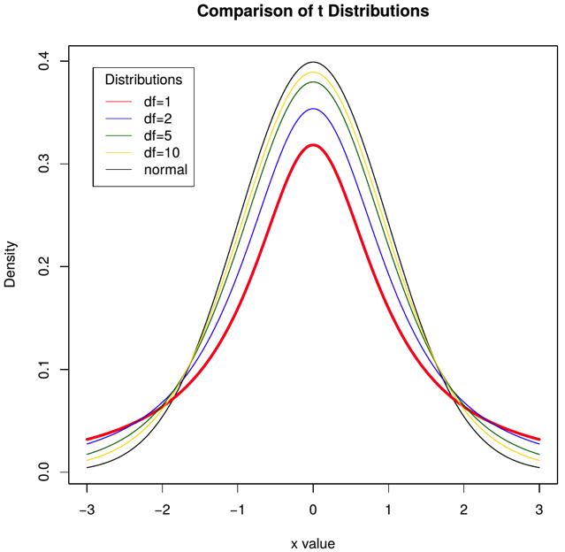
Properties of the t Distribution, cont’d
https://stackoverflow.com/questions/49236741/plot-student-s-t-distribution-with-degrees-of-freedom

Slide 36
Student’s t Distribution, cont’d
William Sealy Gosset (1876-1937) was an English statistician, chemist, and brewer.
He pioneered small sample experimental design and analysis and developed the t distribution.
He published under the pen name “Student”.
See https://en.wikipedia.org/wiki/William_Sealy_Gosset

Slide 37
The t Confidence Interval
Let x₁, x₂, ... x_{n} be a random sample from a normal population distribution. Then the sampling distribution of the standardized variable
is the t distribution with n – 1 degrees of
freedom.
$$t=\frac{\overline{x}−μ}{s/{\sqrt{n}}}$$

Slide 38
The t Confidence Interval, cont’d
Let x₁, x₂, ... x_{n} be a random sample from a normal population distribution with mean µ. Then the t confidence interval for µ is
where the critical value is based on n – 1 degrees of freedom.
$$\overline{x}±(t critical value)∙\frac{s}{\sqrt{n}}$$
Table of t critical values: https://www.oreilly.com/library/view/statistical-thinking-improving/9781118094778/OEBPS/9781118094778_epub_bm_09.htm

Slide 39
Table of t Critical Values
https://www.oreilly.com/library/view/statistical-thinking-improving/ 9781118094778/OEBPS/9781118094778_epub_bm_09.htm
The t critical value for a 99% confidence interval based on 19 df.

Slide 40
Example: The t Confidence Interval
Consider these 20 random values:
Assume the population distribution is normal.
The t critical value for a 99% confidence interval based on 19 df is 2.86. The interval is
.95 | .85 | .92 | .95 | .93 | .86 | 1.00 | .92 | .85 | .81
.78 | .93 | .93 | 1.00 | .93 | 1.06 | 1.06 | .96 | .81 | .96
sample mean:
$$\overline{x}=0.926$$
$$s^{2}=\frac{\sum{{\left(x−\overline{x}\right)}^{2}}}{n−1}=0.006552$$
sample variance:
sample standard deviation:
$$s=\sqrt{0.006552}=0.0809$$
$$\overline{x}±2.86∙\frac{s}{\sqrt{n}}=0.929±2.86∙\frac{0.0809}{\sqrt{20}}=0.926±0.052=(0.874, 0.978)$$

Slide 41
Interpretation of Confidence Intervals
There isn’t a standard way to report estimates:
confidence interval
estimate $±$ standard error
estimate $±$ bound on error
estimate $±$ margin of error
mean $±$ standard deviation

Slide 42
Interpretation of Confidence Intervals, cont’d
If estimating the population µ, be careful with
To convert this information to a useful interval estimate of the population µ:
Convert the sample standard deviation to the standard error of the sample mean (SEM) by dividing by $\sqrt{n}$
Use the standard error and an appropriate critical value to construct a confidence interval.
sample mean $±$ sample standard deviation

Slide 43
Interpretation of Confidence Intervals, cont’d
Questions to ask when reading about interval estimates in research reports:
Is it a confidence interval, mean $±$ bound on error, mean $±$ standard error, or mean $±$ standard deviation? If it’s not a confidence interval, can you construct an interval from the given information?
What confidence level was chosen for the given interval? Was that choice reasonable?
Is the reported interval relatively narrow or wide? Was the population parameter estimated precisely?

Slide 44
Example Interpretation of Confidence Intervals
A research paper compared the lung capacities of Tibetans living at high altitudes to the lung capacities of Han residents living at sea level:
Intervals are in the form estimate $±$ standard error.
Because n > 30, we can use the large-scale confidence interval formula
We studied 38 Tibetans and 43 Han residents. ... The Tibetans compared with the Han subjects had a larger total lung capacity [6.80 $±$ 0.19 (mean $±$ SEM) vs. 6.24 $±$ 0.18 liters].
“Increased Vital and Total Lung Capacity in Tibetan Compared to Han Residents of Lhasa” (Amer. J. of Physical Antro. (1991): 341–351)
mean $±$ (z critical value)(standard deviation of the mean)

Slide 45
Example Interpretation, cont’d
At the 95% confidence level:
Based on the information provided in the sample of the Tibetan residents, their mean total lung capacity is between 6.43 and 7.17 liters.
Based on the information provided in the sample of the Han residents, their mean total lung capacity is between 5.89 and 6.59 liters.
The relatively wide intervals indicate that the value of the population mean was not precisely estimated, due to the low sample sizes.
The overlapping intervals cast doubt on the conclusion that the Tibetan residents had higher lung capacities than the Han residents.
Tibetan residents:
$$6.80 ±1.96∙0.19=6.80 ±0.37=(6.43, 7.17)$$
Han residents:
$$6.24 ±1.96∙0.18=6.24 ±0.35=(5.89, 6.59)$$

Slide 46
Hypothesis Testing
A hypothesis is a claim or statement about the value of a single population parameter or about the values of several population parameters.
Not claims or statements about sample statistics.
A hypothesis testing problem considers two contradictory hypotheses, H₀ and H_{a}.
H₀ is the null hypothesis, the claim that is initially assumed to be true.
H_{a} is the alternative hypothesis.

Slide 47
Hypothesis Testing Example #1
A tobacco company claims that its cigarettes each contains 1.5 mg nicotine. A cancer patient is suing the company claiming that the amount of nicotine is higher. This is a serious claim against the company, and the patient must present strong evidence.
H₀: µ = 1.5 mg nicotine per cigarette
H_{a}: µ > 1.5 mg nicotine per cigarette

Slide 48
Hypothesis Testing, cont’d
The form of a null hypothesis is
H₀ : population parameter = hypothesized value
where the hypothesized value is a specific number determined by the problem context. The alternative hypothesis has one of the following forms:
H_{a} : population parameter > hypothesized value H_{a} : population parameter < hypothesized value H_{a} : population parameter ≠ hypothesized value

Slide 49
Hypothesis Test Procedure
State the null and alternative hypotheses.
Determine the level of significance.
Do this before doing the experiment or otherwise analyzing the data.
Calculate the test statistic.
Determine the critical value(s).
State your decision or finding.

Slide 50
Hypothesis Test Procedure, cont’d
Once H₀ and H_{a} have been formulated, the test procedure uses sample data to determine whether H₀ should be rejected.
The test is only capable of demonstrating strong support for the alternative hypothesis by rejection of the null hypothesis.
When the null hypothesis is not rejected, it does not mean strong support for H₀, only lack of strong evidence against it.
We only have
statistics from
sample data.

Slide 51
Type I and Type II Errors
Hypothesis testing involves making an inference about a population from sample data.
Similar to estimating a population parameter.
There are two types of errors that can happen when making a decision based on hypothesis testing.
Type I error: Reject H₀ when H₀ is true.
Type II error: Don’t reject H₀ when H₀ is false.

Slide 52
Example of Type I and Type II Errors
Nicotine example, cont’d:
H₀: µ = 1.5 mg nicotine per cigarette
H_{a}: µ > 1.5 mg nicotine per cigarette
Type I error
Reject H₀ when it is in fact true.
The tobacco company may be forced to pay the cancer patient’s medical bills unnecessarily.
Type II error
Fail to reject H₀ when it is in fact false.
The tobacco company gets away with selling a cigarette with higher than stated nicotine content.

Slide 53
Level of Significance of Hypothesis Testing
The level of significance of a hypothesis test is the probability of a Type I error, and it is denoted by α (alpha).
A test with α = .01 is said to have a significance of .01, or to be a level .01 test.
The probability of a type II error is denoted by β (beta).
Decision | H₀ true | H₀ false
Reject H₀ | Type I error | Correct
 | α | 1 – β
Accept H₀ | Correct | Type II error
 | 1 – α | β

Slide 54
Level of Significance, cont’d
Think about the consequences of Type I and Type II errors.
Identify the largest α that is tolerable.
Employ a test procedure that uses this maximum acceptable value rather than anything smaller.
Using a smaller α increases β.

Slide 55
Test Statistic
A test statistic is calculated from sample data that is used as a basis to reach a decision in a hypothesis test.
When a sample is large (n > 30), to test
H₀ : µ = hypothesized population value
the appropriate test statistic is
The test statistic has approximately a normal distribution when H₀ is true.
$$z=\frac{\overline{x}−hypothesized value}{s/{\sqrt{n}}}$$

Slide 56
H₀ Rejection Regions
H₀ : µ = µ₀
α = 0.05
Lower-tail
test
Upper-tail
test
.05
.05
Critical value C = -1.645
Critical value C’ = 1.645
Two-tailed
test
.025
.025
Critical values C = -1.96 C’ = 1.96
https://saylordotorg.github.io/text_introductory-statistics/s12-testing-hypotheses.html

Slide 57
Hypothesis Testing Example #2
High schools in Asia place a heavier emphasis on testing than high schools in the U.S. Is it true that Asian students have greater test anxiety than U.S. students?
Test anxiety scores were measured for 277 Asian students:
The test anxiety score for U.S. students is thought to be 41.0.
Does the sample data show that Asian students have more test anxiety?
$$n=277 \overline{x}=50.0 s=12.7$$

Slide 58
Hypothesis Testing Example #2, cont’d
$$n=277 \overline{x}=50.0 s=12.7$$
Do a hypothesis test at the .05 level of significance.
Population parameter of interest:
µ = true mean of Asian students’ test anxiety score
Null hypothesis
H₀ : µ = 41
Alternate hypothesis
H_{a} : µ > 41
Test statistic:
The null hypotheses
always has the equality.
$$z=\frac{\overline{x}−μ}{s/{\sqrt{n}}}=\frac{50−41}{{12.7}/{\sqrt{277}}}=\frac{9}{0.763}=11.80$$

Slide 59
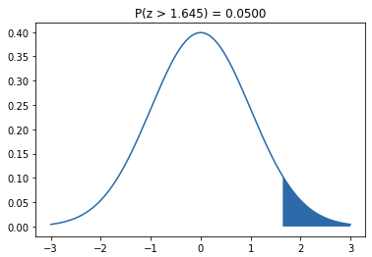
Hypothesis Testing Example #2, cont’d
H_{a} : µ > 41
Upper-tail test
α = 0.05
H₀ : µ = 41
H_{a} : µ > 41
1.645
$$z=11.80$$
Since 11.80 > 1.645, we must reject H₀ at the .05 level of significance. Therefore, we conclude that the mean test-anxiety score of Asian students is indeed higher than the mean score of 41 for U.S. students.

Slide 60
Midterm Next Week!
Covers all material through today.
Understand the material in the lecture slides.
Understand the concepts of the lab assignments.
Know how to use Python to solve problems.
There will be a Jupyter notebook.
You will have 2 hours to complete it.
Open book, notes, internet ...
But not open neighbor. No messaging of any kind.
Sample: Fall 2020 midterm with solutions.
Short lecture afterward.

Slide 61
Midterm Format
Some multiple-choice and short-answer questions.
A Jupyter notebook containing problems.
Use a standard browser to access Canvas.
Open book, notes, laptop, internet.
No communication with anyone else during the exam.
Turn on your camera during the exam for proctoring.
The exam will be recorded.

