Slide 1
CS 235: User Interface Design May 5 Class Meeting
Department of Computer Science San Jose State University Spring 2015 Instructor: Ron Mak
www.cs.sjsu.edu/~mak

Slide 2
Types of Analyses
Time series
Ranking and Part-to-Whole
Deviation
Distribution
Correlation
Multivariate
Ultimate goal:
Provide insight
for the user.
Users want
actionable
knowledge.

Slide 3
Time Series Analysis
Visualize how data changes through time.
Time provides an important context for understanding data.
Six basic patterns:
Trend
Variability
Rate of change
Co-variation
Cycles
Exceptions

Slide 4
Time Series: Trend
Trend: The overall tendency of a series of values to increase, decrease, or remain relatively stable during a particular period of time.
Show trend with a trend line.
Now You See It
by Stephen Few
Analytics Press, 2009

Slide 5
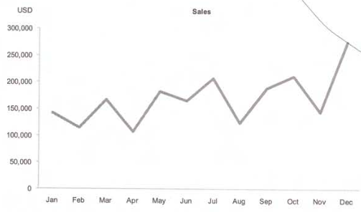
Time Series: Variability
Variability: The average degree of change from one point in time to the next during a particular period of time.
Now You See It
by Stephen Few
Analytics Press, 2009

Slide 6
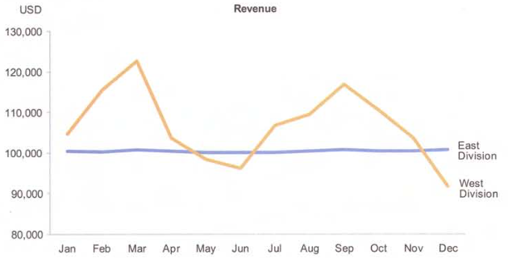
Time Series: Variability, cont’d
Compare two sets of data:
Now You See It
by Stephen Few
Analytics Press, 2009

Slide 7
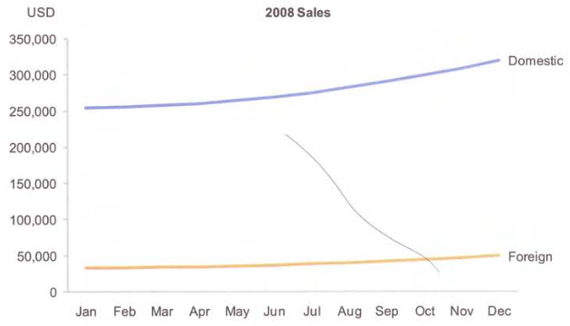
Time Series: Rate of Change
Express the rate of change between two values as a percentage difference.
Original
graph:
Now You See It
by Stephen Few
Analytics Press, 2009

Slide 8
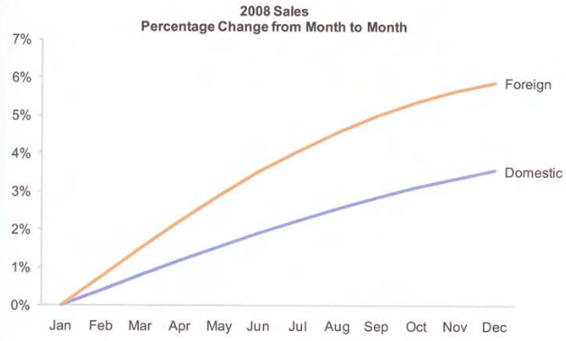
Time Series: Rate of Change, cont’d
Now You See It
by Stephen Few
Analytics Press, 2009

Slide 9
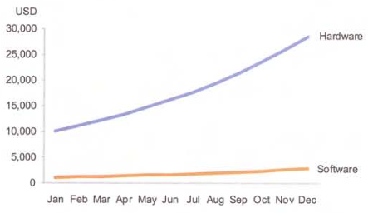
Time Series: Rate of Change, cont’d
Use logarithmic scales.
Original
graph:
Now You See It
by Stephen Few
Analytics Press, 2009

Slide 10
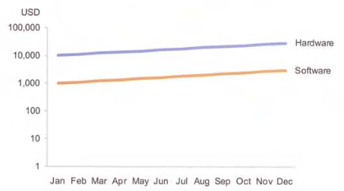
Time Series: Rate of Change, cont’d
Logarithmic
graph:
Now You See It
by Stephen Few
Analytics Press, 2009

Slide 11
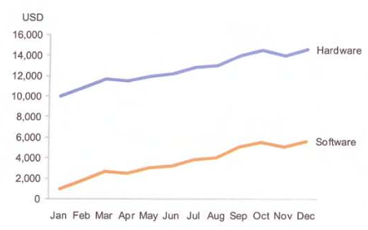
Time Series: Rate of Change, cont’d
Same rate
of change?
Original
graph:
Now You See It
by Stephen Few
Analytics Press, 2009

Slide 12
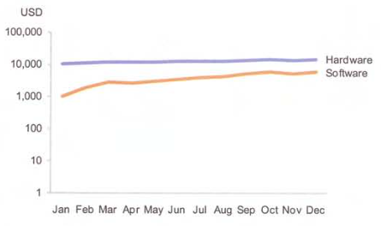
Time Series: Rate of Change, cont’d
Logarithmic
graph:
Now You See It
by Stephen Few
Analytics Press, 2009

Slide 13
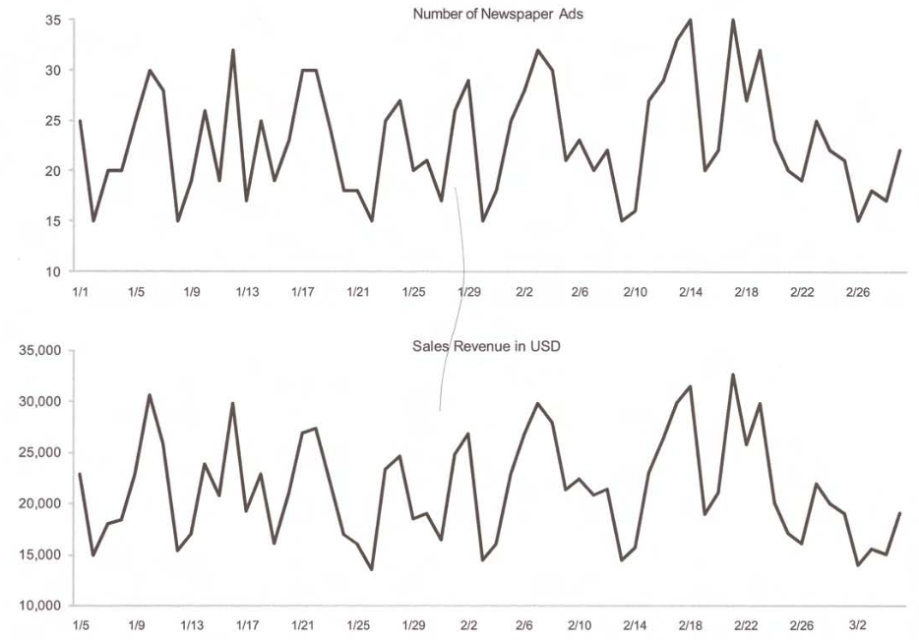
Time Series: Co-variation
Co-variation: Two time series relate to each other, even if they move in opposite directions.
Now You See It
by Stephen Few
Analytics Press, 2009

Slide 14
Time Series: Co-variation, cont’d
Leading and lagging indicators: A time series leads (or lags) a co-varying series by a fixed amount of time.
Shift one of the time scales to align the graphs.

Slide 15
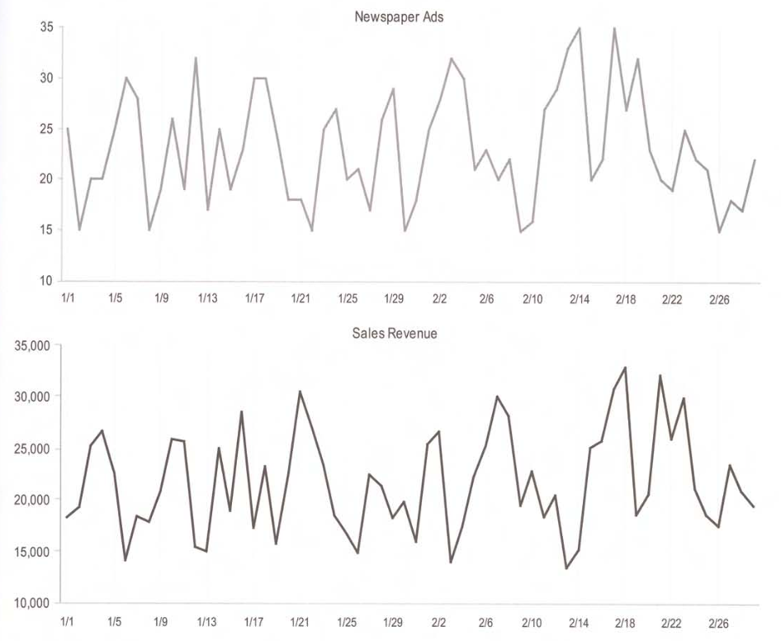
Time Series: Co-variation, cont’d
Newspaper ads
are a leading
indicator of sales:
A greater number
of ads results in
increased sales
four days later.
Now You See It
by Stephen Few
Analytics Press, 2009

Slide 16
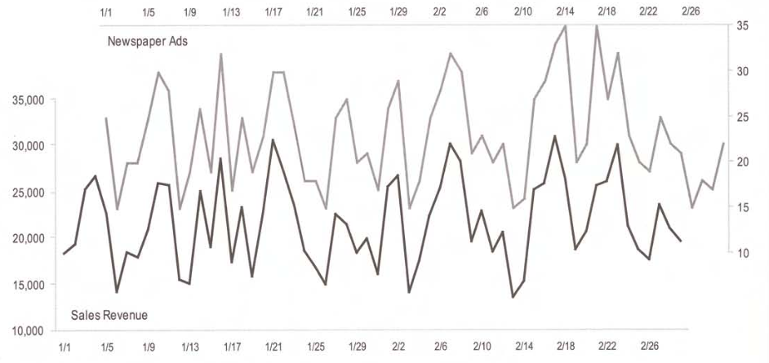
Time Series: Co-variation, cont’d
Now You See It
by Stephen Few
Analytics Press, 2009

Slide 17
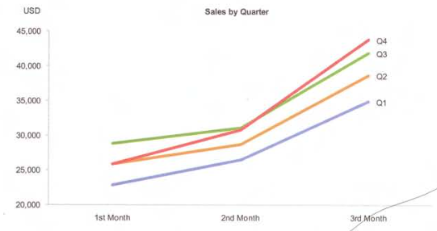
Time Series: Cycles
Cycles: Patterns that repeat at regular time intervals.
Insight:
Salespersons
receive bonuses
for meeting
quarterly goals.
Now You See It
by Stephen Few
Analytics Press, 2009

Slide 18
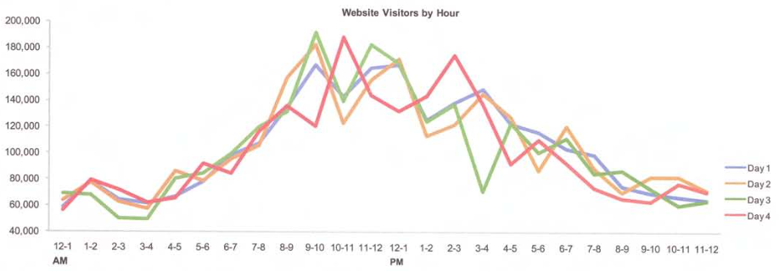
Time Series: Cycles, cont’d
Now You See It
by Stephen Few
Analytics Press, 2009

Slide 19
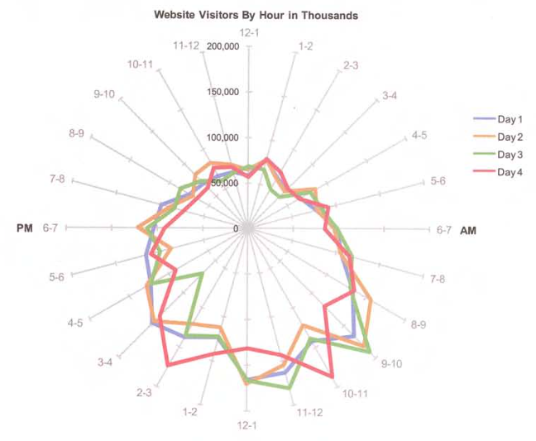
Time Series: Cycles, cont’d
Show the same cyclical data with a radar graph.
Now You See It
by Stephen Few
Analytics Press, 2009

Slide 20
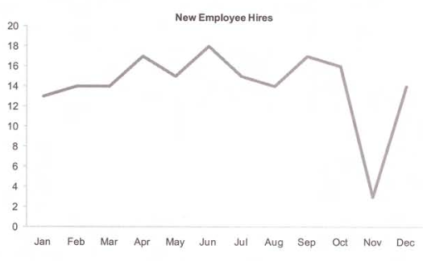
Time Series: Exceptions
Exceptions: Values that fall outside the norm (in the rough).
Now You See It
by Stephen Few
Analytics Press, 2009

Slide 21
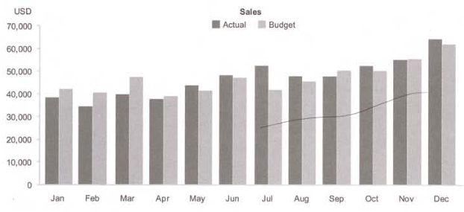
Time Series with Bar Charts
Now You See It
by Stephen Few
Analytics Press, 2009

Slide 22
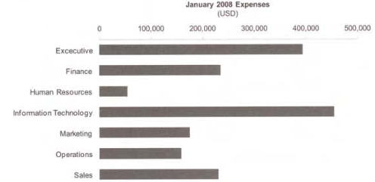
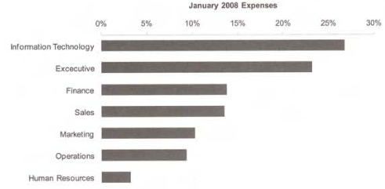
Part-to-Whole and Ranking Analysis
Compare parts to the whole and to each other.
Rank the parts by value.
Now You See It
by Stephen Few
Analytics Press, 2009

Slide 23
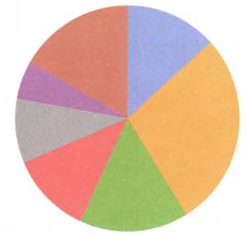
Part-to-Whole and Ranking: Pie Charts
Use pie charts carefully: We cannot easily or accurately compare areas of pie slices.
Now You See It
by Stephen Few
Analytics Press, 2009

Slide 24
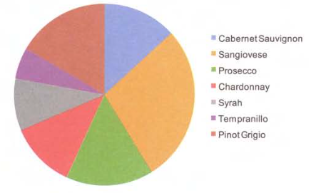
Part-to-Whole and Ranking: Pie Charts, cont’d
Now You See It
by Stephen Few
Analytics Press, 2009

Slide 25
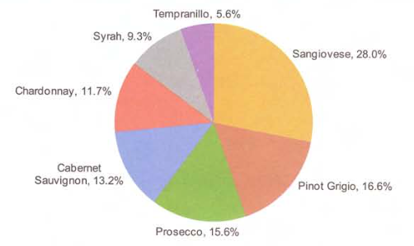
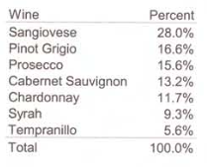
Part-to-Whole and Ranking: Pie Charts, cont’d
Now You See It
by Stephen Few
Analytics Press, 2009

Slide 26
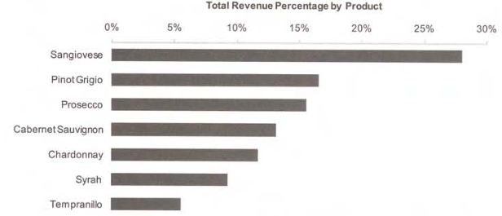
Part-to-Whole and Ranking: Bar Charts
Bar graphs are generally better than pie charts.
Now You See It
by Stephen Few
Analytics Press, 2009

Slide 27
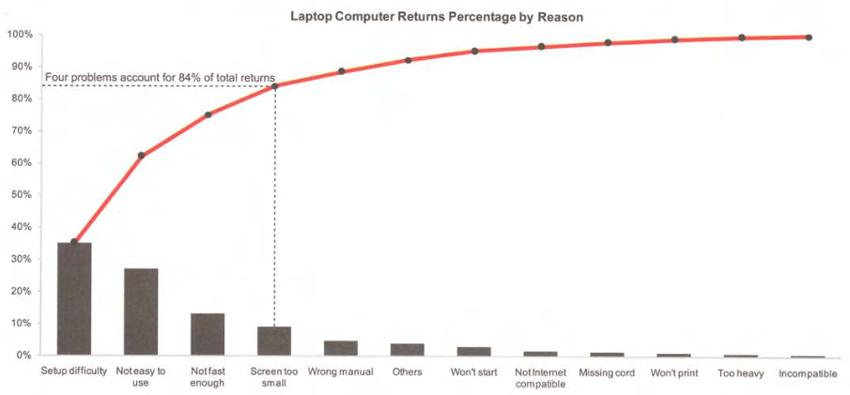
Part-to-Whole and Ranking: Pareto Charts
Show items ranked by size from smallest to largest with a bar chart.
Show cumulative values as a line graph.
Now You See It
by Stephen Few
Analytics Press, 2009

Slide 28
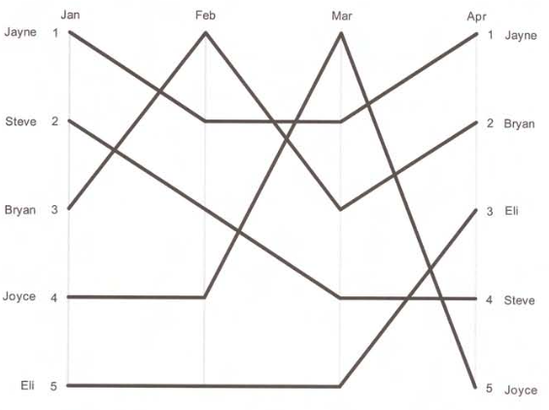
Changes in Ranking through Time
Show how the ranking relationship changes over time.
Now You See It
by Stephen Few
Analytics Press, 2009

Slide 29
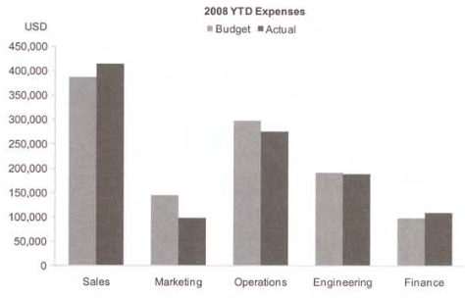
Deviation Analysis
Compare how one or more sets of data deviate from a reference set of values.
Now You See It
by Stephen Few
Analytics Press, 2009

Slide 30
Deviation Analysis: Bar Charts
Deviations from a reference line.
Now You See It
by Stephen Few
Analytics Press, 2009

Slide 31
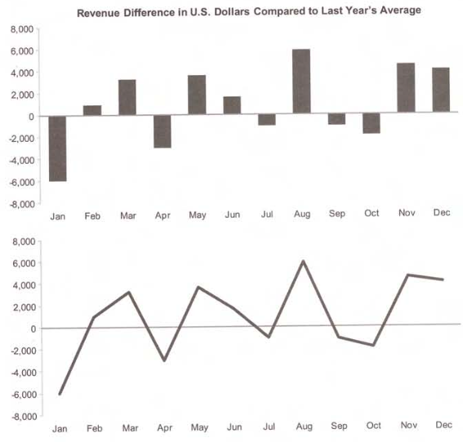
Deviation Analysis: Line Graphs
Now You See It
by Stephen Few
Analytics Press, 2009

Slide 32
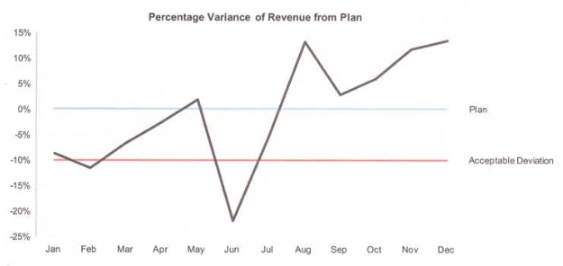
Deviation Analysis: Line Graphs, cont’d
Deviations from other points of reference:
Now You See It
by Stephen Few
Analytics Press, 2009

Slide 33
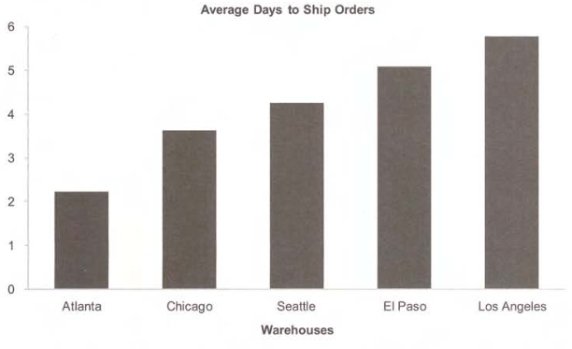
Distribution Analysis
Examine quantitative values:
How they are distributed from smallest to largest.
Compare and contrast multiple sets of values.
Now You See It
by Stephen Few
Analytics Press, 2009

Slide 34
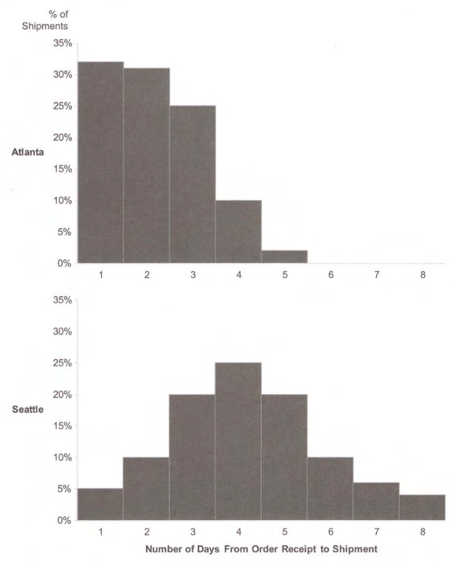
Distribution Analysis: Bar Charts
Now You See It
by Stephen Few
Analytics Press, 2009

Slide 35
Distribution Analysis, cont’d
Key visual aspects of distributions
Spread
Center
Shape
5-value summation of distribution:
Now You See It
by Stephen Few
Analytics Press, 2009

Slide 36
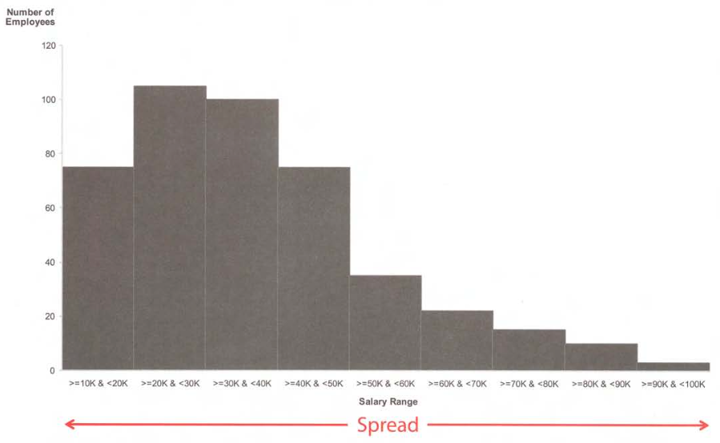
Distribution: Spread
Now You See It
by Stephen Few
Analytics Press, 2009

Slide 37
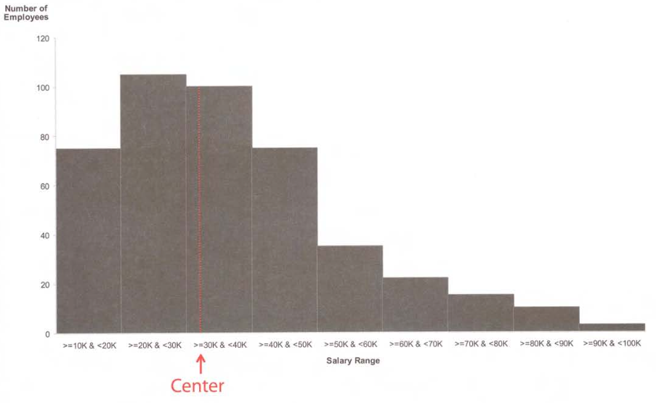
Distribution: Center
Now You See It
by Stephen Few
Analytics Press, 2009

Slide 38
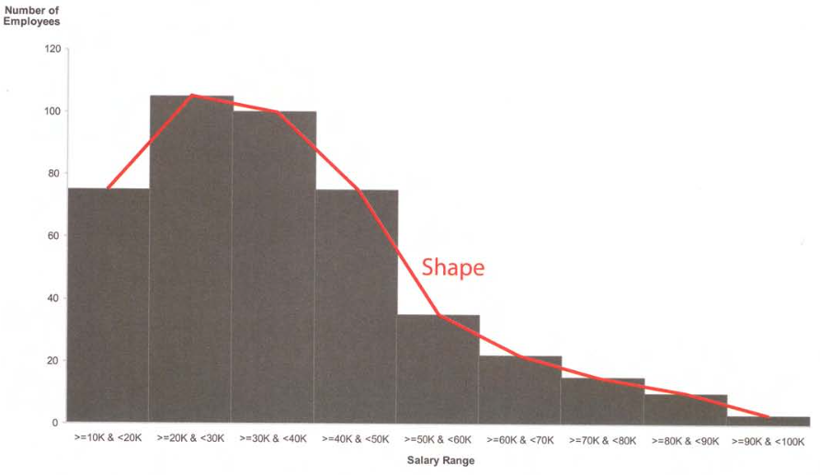
Distribution: Shape
Now You See It
by Stephen Few
Analytics Press, 2009

Slide 39
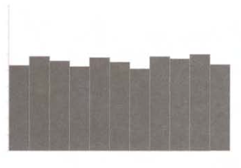
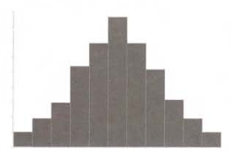
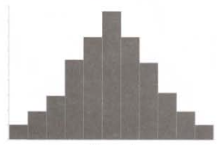
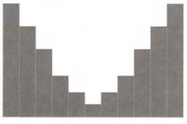
Distribution: Shape, cont’d
Curved
Flat
Curved upward
Curved downward
Now You See It
by Stephen Few
Analytics Press, 2009

Slide 40
Distribution: Shape, cont’d
Single peak
Multiple peaks
Now You See It
by Stephen Few
Analytics Press, 2009

Slide 41
Distribution: Shape, cont’d
Symmetrical
Skewed to the left
(negative skew)
Skewed to the right
(positive skew)
Now You See It
by Stephen Few
Analytics Press, 2009

Slide 42
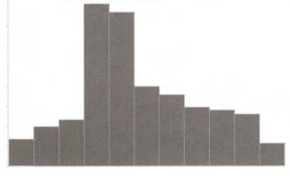
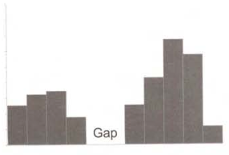
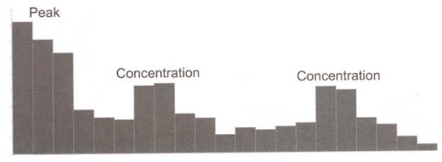
Distribution: Shape, cont’d
Concentration
Gap
Now You See It
by Stephen Few
Analytics Press, 2009

Slide 43
Distribution: Stem and Leaf Plots
A histogram using multi-digit values.
Stem: first digits of each value
Leaf: remaining digits
Distribution of Employee Ages
Age 18: one employee
Age 19: three employees
Age 20: two employees
Age 21: two employees
etc.
Now You See It
by Stephen Few
Analytics Press, 2009

Slide 44
Distribution: Stem and Leaf Plots, cont’d
Now You See It
by Stephen Few
Analytics Press, 2009

Slide 45
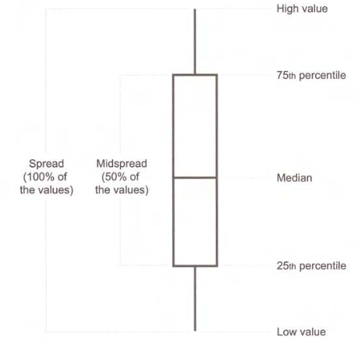
Distribution: Box and Whisker Plots
Whisker
Box
Whisker
Now You See It
by Stephen Few
Analytics Press, 2009

Slide 46
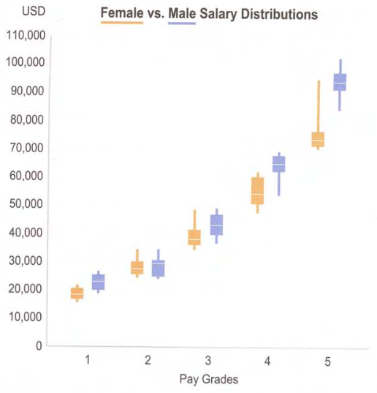
Distribution: Box and Whisker Plots, cont’d
Insights:
Women are typically paid less than men in all pay grades.
The pay disparity increases with the pay grades.
Pay varies the most for women in the higher pay grades.
Now You See It
by Stephen Few
Analytics Press, 2009

Slide 47
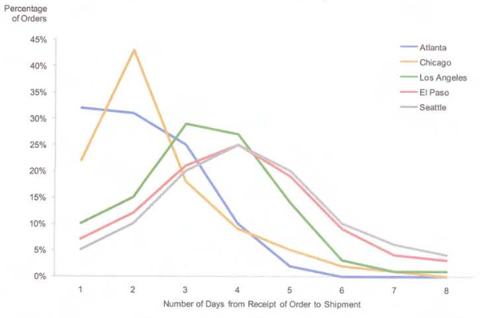
Multiple Distributions
Now You See It
by Stephen Few
Analytics Press, 2009

Slide 48
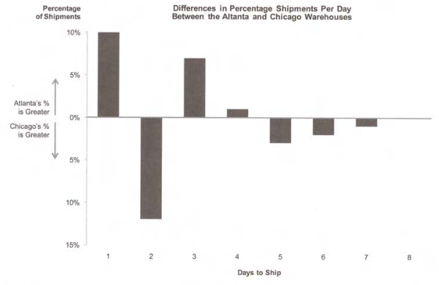
Distribution Deviation Graphs
Show how two distributions differ:
Now You See It
by Stephen Few
Analytics Press, 2009

Slide 49
Correlation Analysis
Characteristics of correlation:
Direction
Strength
Shape

Slide 50
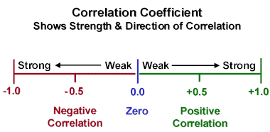
Linear Correlation Coefficient
All values are between -1 and +1.
0 = no correlation.
+1 = perfect positive linear correlation
-1 = perfect negative linear correlation
The closer the value is to -1 or +1, the stronger the linear correlation.

Slide 51
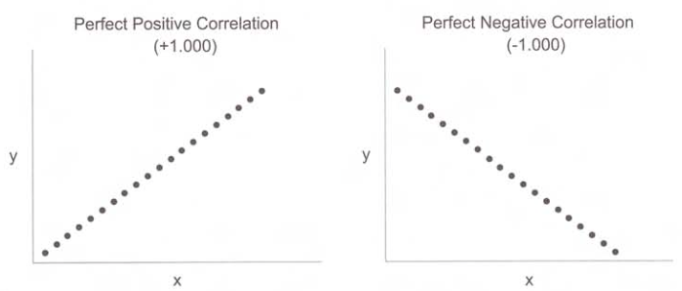
Linear Correlation Coefficient, cont’d
Show Me the Numbers, 2nd ed.
by Stephen Few
Analytics Press, 2012

Slide 52
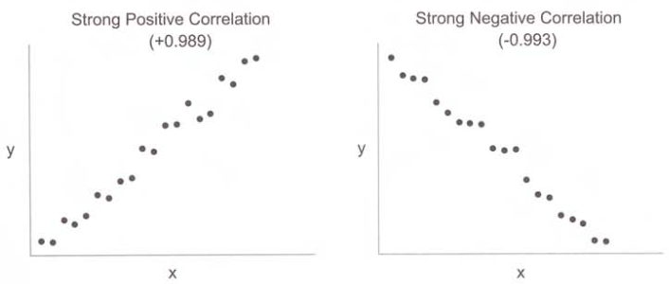
Linear Correlation Coefficient, cont’d
Show Me the Numbers, 2nd ed.
by Stephen Few
Analytics Press, 2012

Slide 53
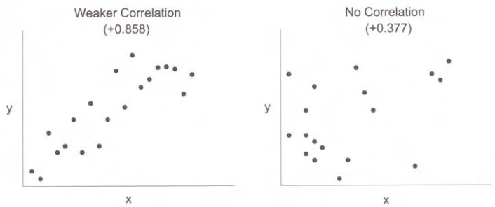
Linear Correlation Coefficient, cont’d
Show Me the Numbers, 2nd ed.
by Stephen Few
Analytics Press, 2012

Slide 54
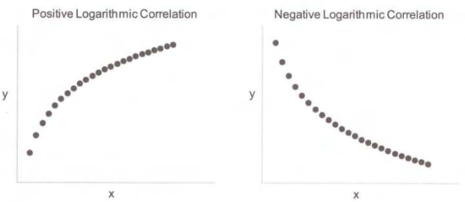
Logarithmic Correlation
Now You See It
by Stephen Few
Analytics Press, 2009

Slide 55
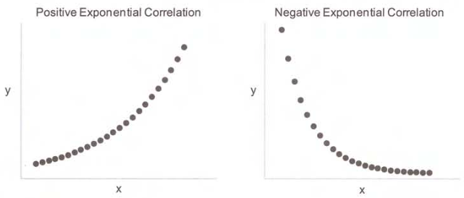
Exponential Correlation
Now You See It
by Stephen Few
Analytics Press, 2009

Slide 56
Polynomial Correlation
Show Me the Numbers, 2nd ed.
by Stephen Few
Analytics Press, 2012

Slide 57
Correlation Does Not Imply Causation!
A strong correlation between two variables does not imply that one causes the other.
Further statistical tests are necessary to calculate the likelihood of true causation.
See http://en.wikipedia.org/wiki/Correlation_does_not_imply_causation

Slide 58
Correlation Does Not Imply Causation! cont’d
Invalid insight:
Eating ice cream causes crime.
(Actually, both are caused
by warmer weather.)
See http://en.wikipedia.org/wiki/Correlation_does_not_imply_causation

Slide 59
Correlation Does Not Imply Causation! cont’d
Highly correlated: Infants sleeping with the lights on and the development of myopia (near sightedness).
Invalid insight: Sleeping with the lights on causes a child to become near-sighted.
True causation: Parents who are near-sighted have more lights on. Children inherit near-sightedness from their parents.

Slide 60
Beware of False Correlations!
See:
http://www.tylervigen.com
http://www.dailymail.co.uk/sciencetech/article-2640550/Does-sour-cream-cause-bike-accidents-No-looks-like-does-Graphs-reveal-statistics-produce-false-connections.html
http://www.buzzfeed.com/kjh2110/the-10-most-bizarre-correlations

Slide 61
Multivariate Analysis
Compare multiple instances of several variables at once.
Identify similarities and differences among items that are each characterized by a common set of variables.
Which items are most alike?
Which items are most exceptional?
How can items be grouped based on similarity?
What multivariate profile corresponds best to a particular outcome?

Slide 62
Multivariate Displays
Glyphs
Whiskers and stars
Multivariate heatmaps
Parallel coordinate plots

Slide 63
Multivariate Displays: Glyphs
Variable | Visual attribute
Body temperature | Color
Blood type | Head shape
Body mass index | Torso thickness
Heart rate | Position of the arms
Blood sugar level | Position of the legs
Now You See It
by Stephen Few
Analytics Press, 2009

Slide 64
Multivariate Displays: Glyphs, cont’d
Chernoff faces
http://mathworld.wolfram.com/ChernoffFace.html

Slide 65
Multivariate Displays: Whiskers and Stars
Each line represents a different variable.
The line length encodes the variable’s value.
Now You See It
by Stephen Few
Analytics Press, 2009

Slide 66
Multivariate Displays: Heatmaps
Now You See It
by Stephen Few
Analytics Press, 2009

Slide 67
Multivariate Displays: Parallel Plots
Now You See It
by Stephen Few
Analytics Press, 2009

Slide 68
Multivariate Displays: Parallel Plots, cont’d
Look for patterns!
Now You See It
by Stephen Few
Analytics Press, 2009

