Slide 1
CS 235: User Interface Design February 5 Class Meeting
Department of Computer Science San Jose State University Spring 2015 Instructor: Ron Mak
www.cs.sjsu.edu/~mak

Slide 2
Organization Design Patterns
Feature, Search, and Browse
News Stream
Picture Manager
Dashboard
Canvas + Palette
Wizard
Settings Editor
Alternate Views
Multiple Workspaces
Multilevel Help

Slide 3
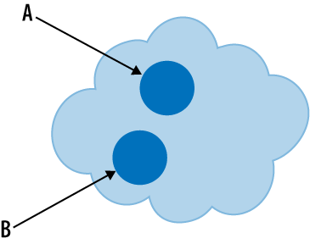
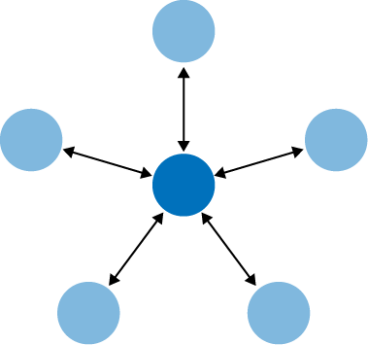
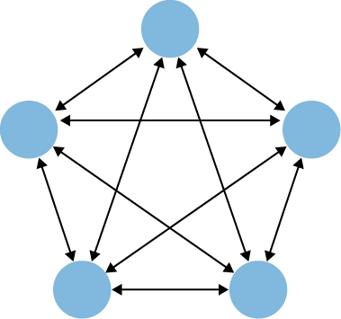
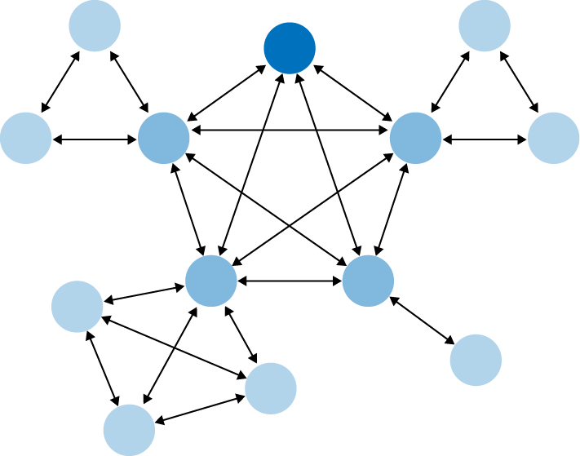
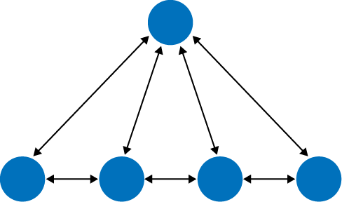
Navigation Design Patterns
Clear entry points
Hub and spoke
Fully connected
Sequential
Multilevel
Pyramid
Designing Interfaces, 2nd ed.
by Jenifer Tidwell
O’Reilly Media, 2011

Slide 4
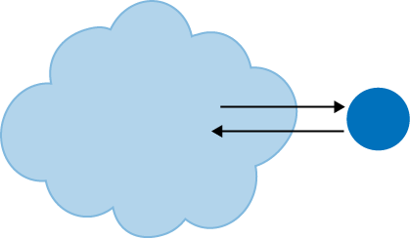
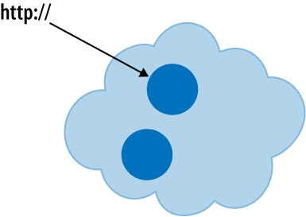
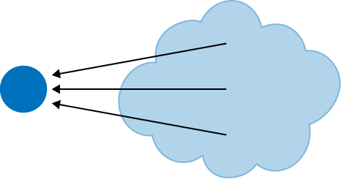
Navigational Design Patterns, cont’d
Pan and zoom
Modal dialog
Escape hatch
Bookmark
Designing Interfaces, 2nd ed.
by Jenifer Tidwell
O’Reilly Media, 2011

Slide 5
Page Layout
Manipulate page attention to convey
meaning
sequence
points of interaction
Visual hierarchy:
What’s important?
What’s related?

Slide 6
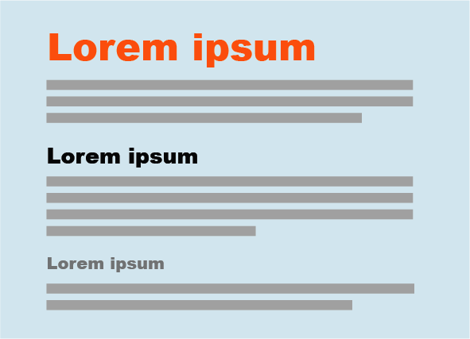
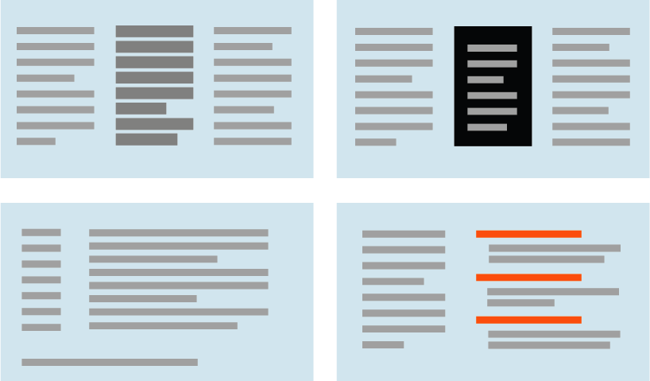
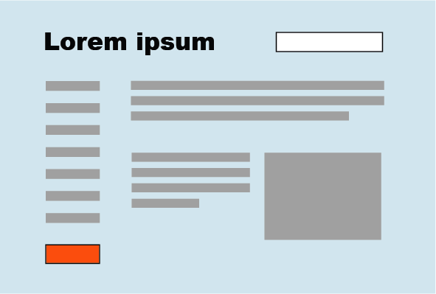
How to Show Importance
Text sizes to show hierarchy
Text density
Background color
Visual rhythm
Position and size
Emphasize small items
Designing Interfaces, 2nd ed.
by Jenifer Tidwell
O’Reilly Media, 2011

Slide 7
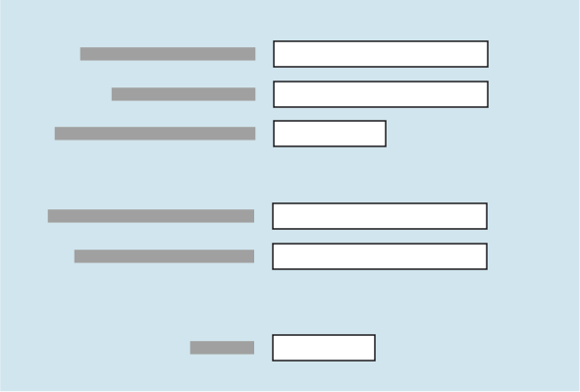
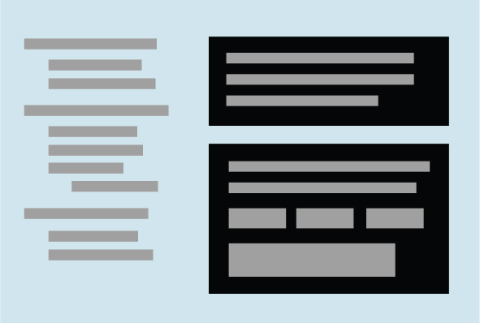
How to Show Relationships
Grouped related items
List of items
Captions and comments
Peer items
One distinguished item
Containment
Designing Interfaces, 2nd ed.
by Jenifer Tidwell
O’Reilly Media, 2011

Slide 8
Four Gestalt Principles
gestalt: An organized whole that is perceived
as more than the sum of its parts.
Proximity
Viewers will associate together items that are placed close together.
Similarity
Viewers will associate two things that have the same shape, size, orientation, etc. _

Slide 9
Four Gestalt Principles, cont’d
Continuity
Viewers’ eyes want to see continuous lines and curves formed by the alignment of items.
Closure
Viewers’ eyes want to see implicit simple closed forms such as rectangles. _

Slide 10
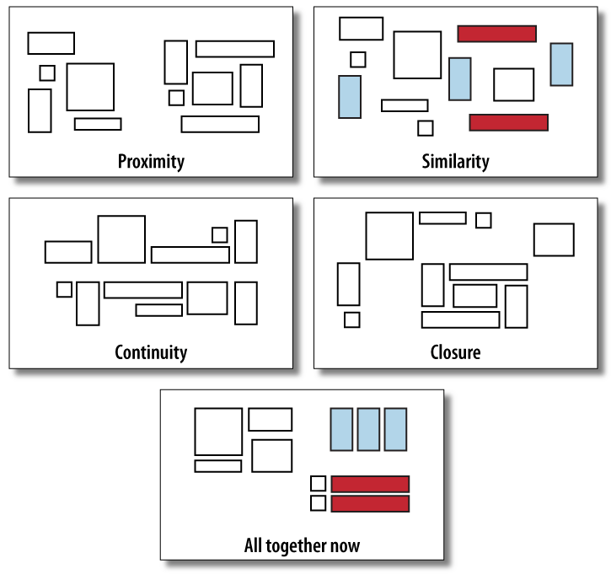
Four Gestalt Principles, cont’d
Designing Interfaces, 2nd ed.
by Jenifer Tidwell
O’Reilly Media, 2011

Slide 11
Page Layout Design Patterns
Page layout design patterns provide specific ways to incorporate the layout concepts and principles.
Solve layout problems.

Slide 12
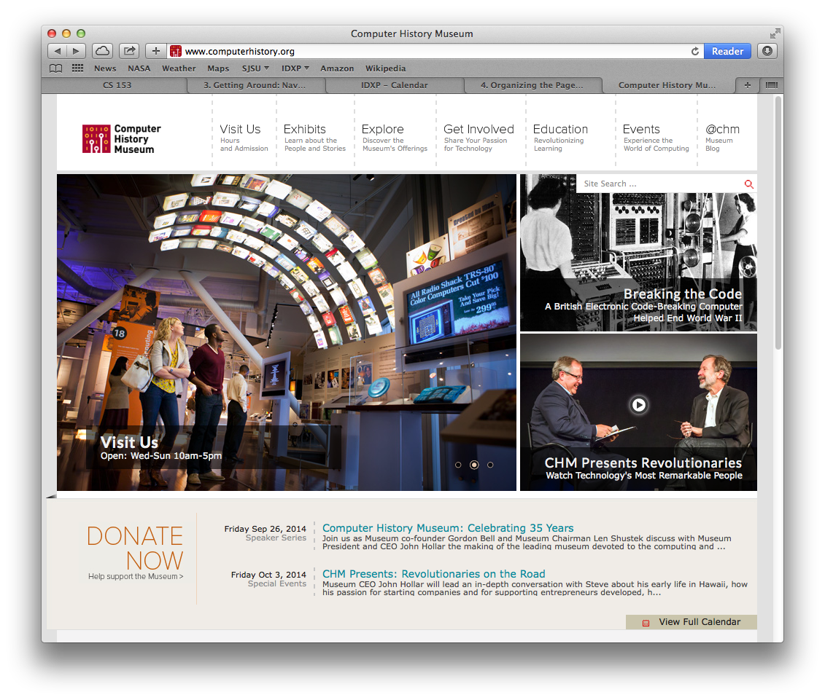
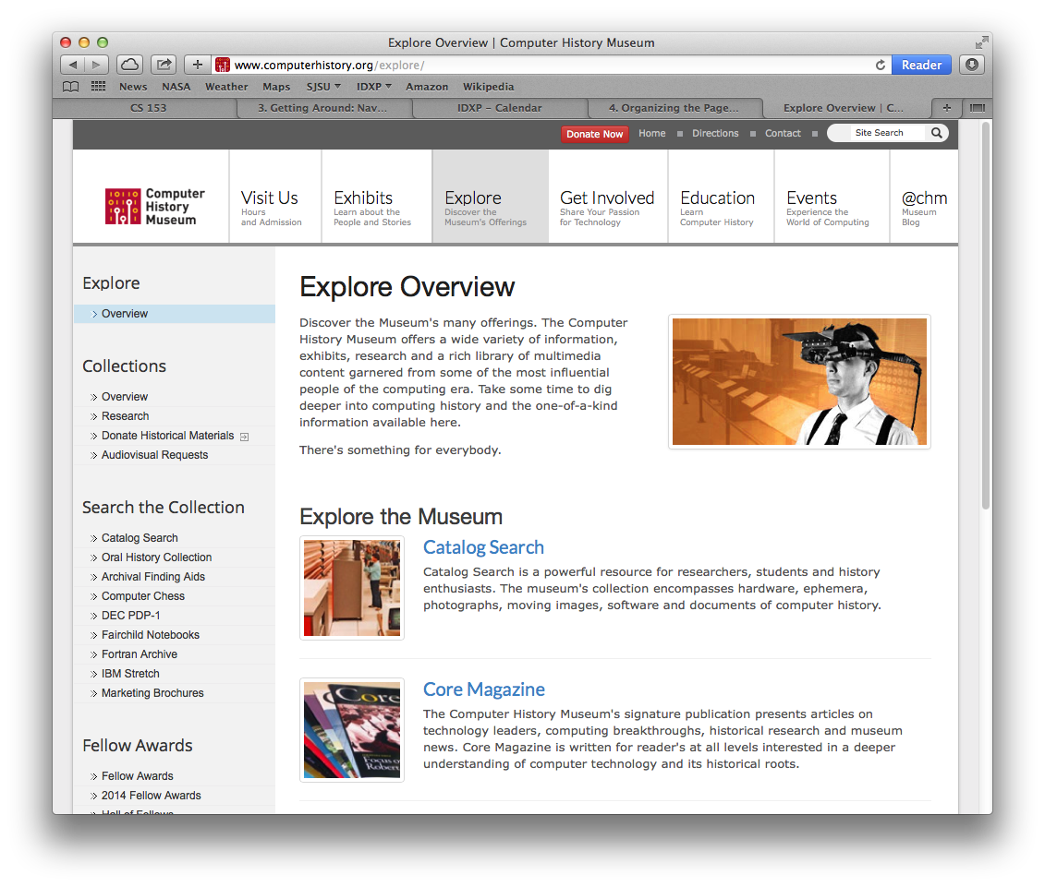
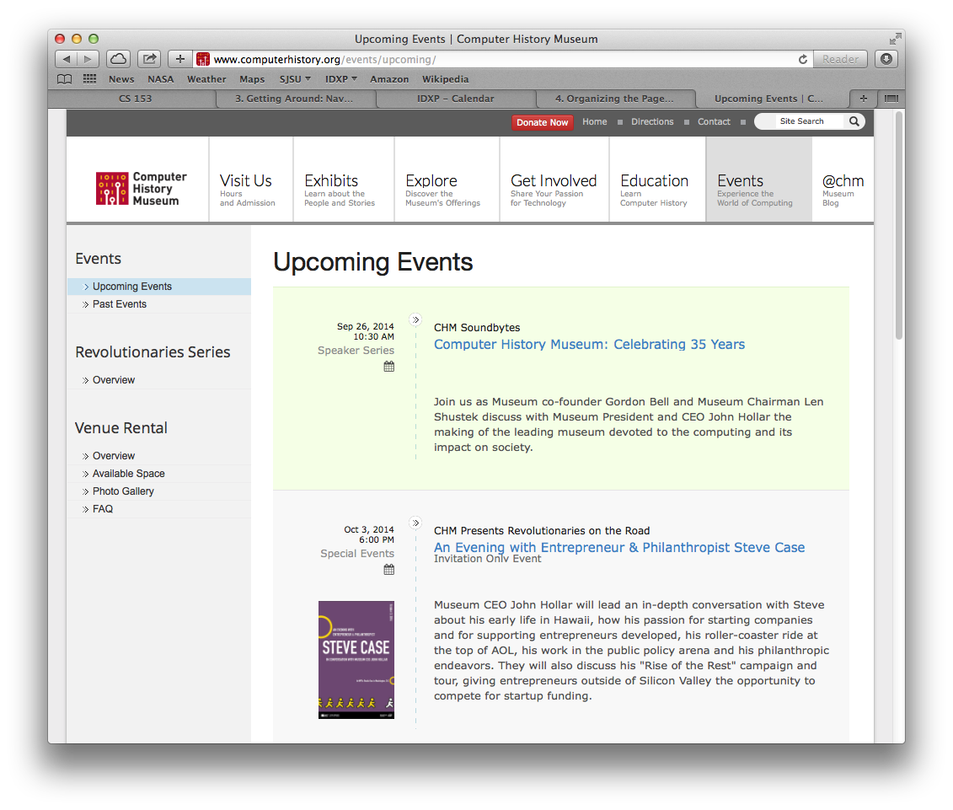
Layout: Visual Framework
What
A common framework for all application pages but which allows flexibility to handle varying page content
When
Designing an application with multiple pages
You want the pages to appear to belong together
Why
Provide consistency
Help page content stand out

Slide 13
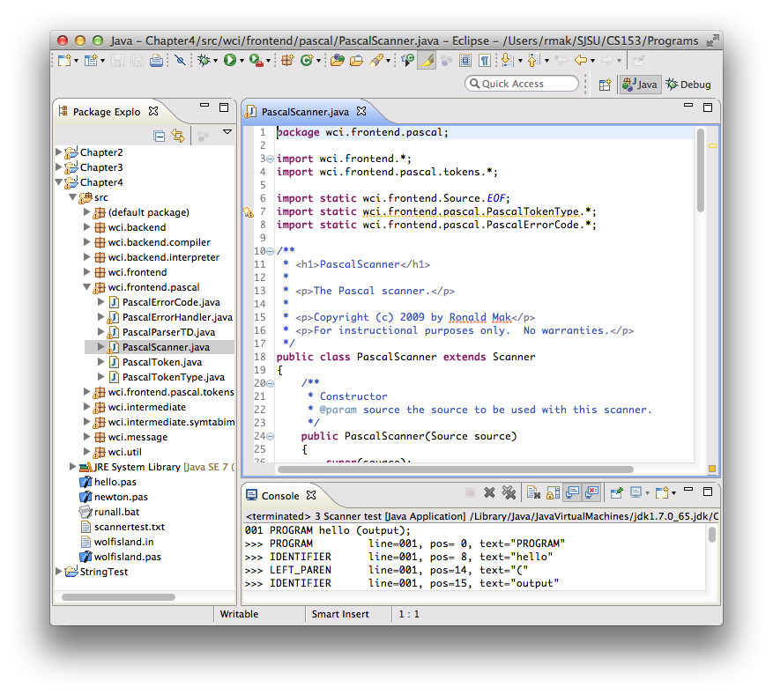
Layout: Center Stage
What
The most important part of the UI has the largest subsection of the page
Secondary windows cluster around in smaller subpanels
When
The page’s primary job is to show a single unit of information or to permit a single task
Why
Guide the user to the most important part

Slide 14
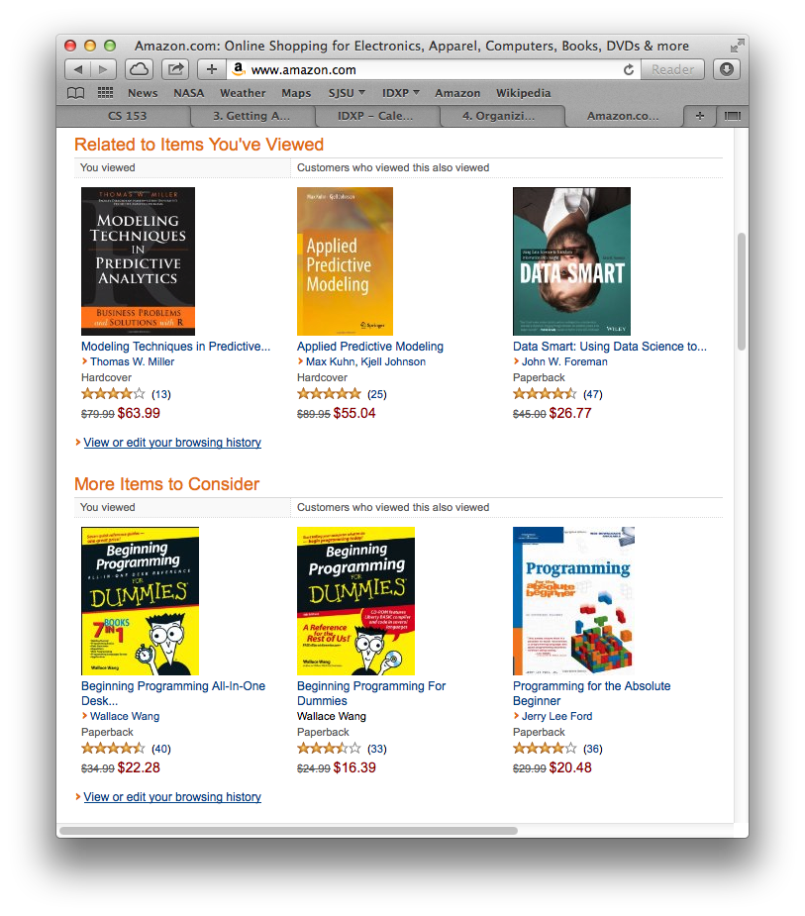
Layout: Grid of Equals
What
Arrange equally important items in a grid, each with equal visual weight
When
Many items have similar style and importance
Allow the user to preview
Why
Give each item equal importance
Tell the user the items are similar
Neat and orderly

Slide 15
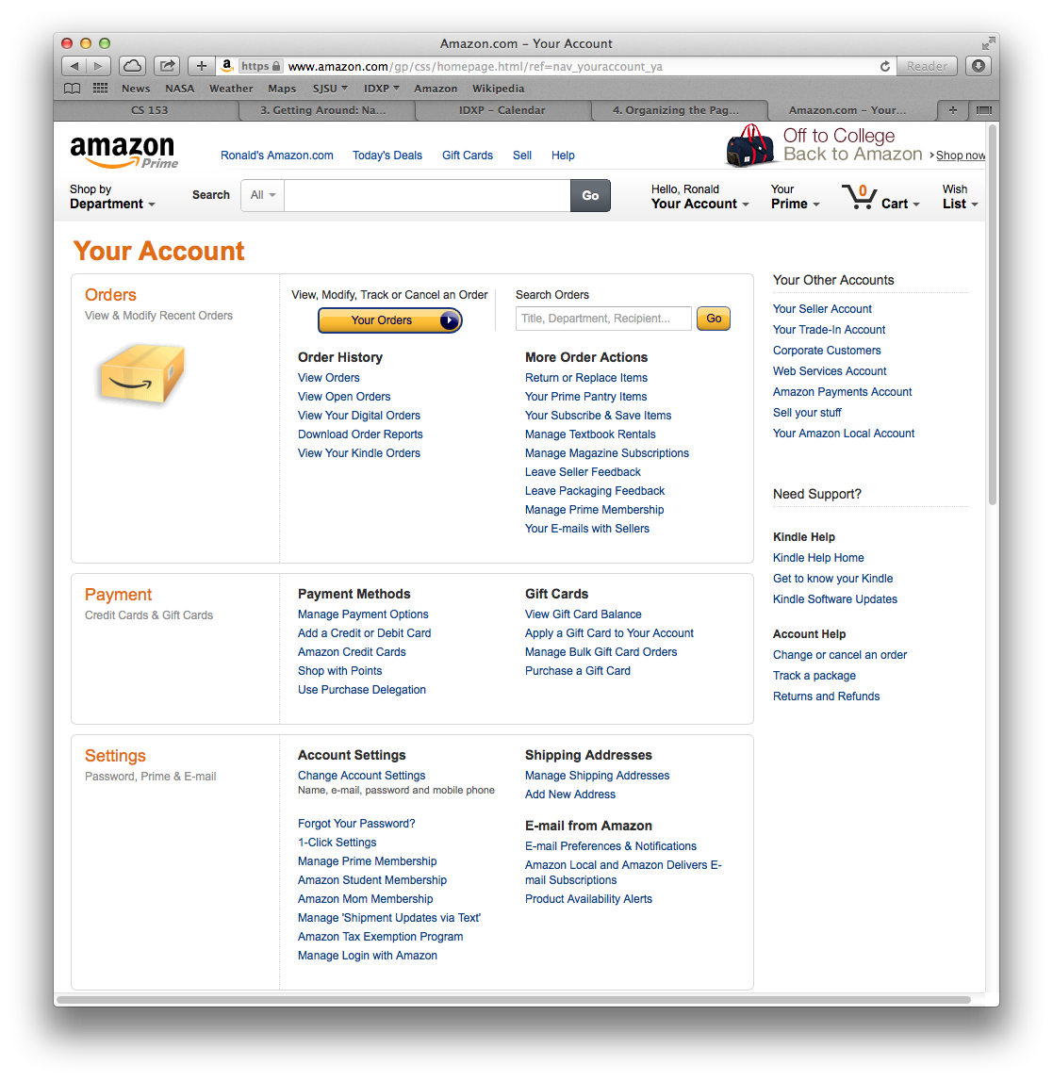
Layout: Tiled Sections
What
Visually separate sections of content
Each section has a strong title
When
Make the page easy to scan with grouped content
Why
Content is structured into easily digestible chunks
Obvious information architecture

Slide 16
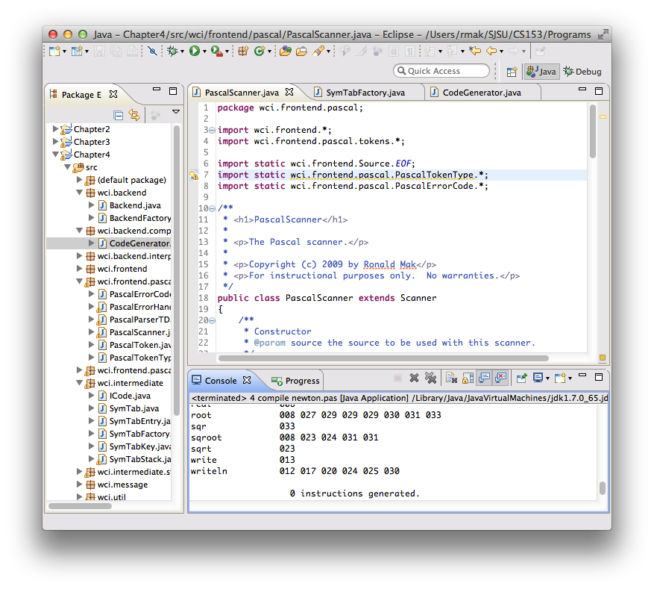
Layout: Module Tabs
What
Put content modules into separate tabs
Only one tab is visible at a time
When
Multiple content types
Users only need to see one type at a time
Why
Tabs have a familiar physical model
Less cluttered user interface

Slide 17
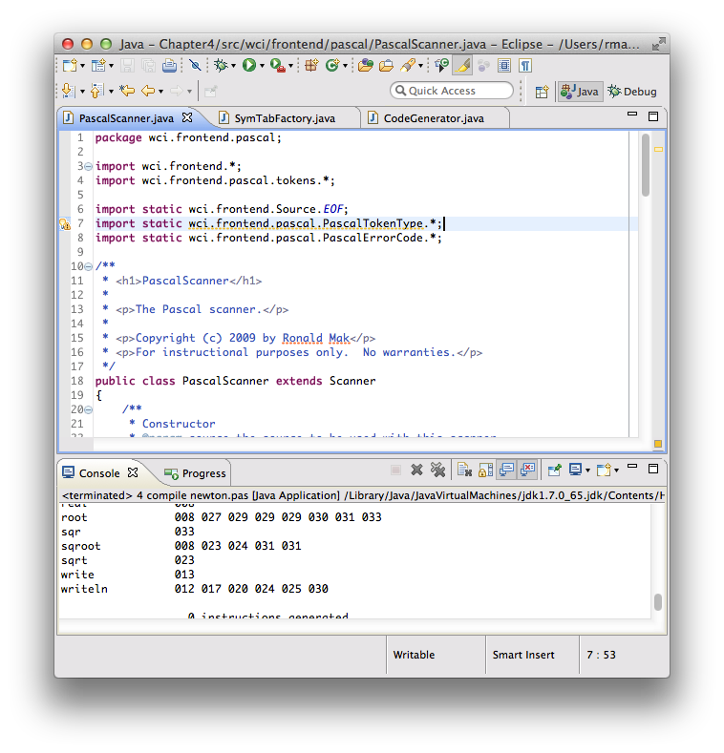
Layout: Collapsible Panel
What
The user can open and close secondary content panels
When
Not enough room to show all content panels
Different users have different needs
Why
Allow the user to choose what to see

Slide 18
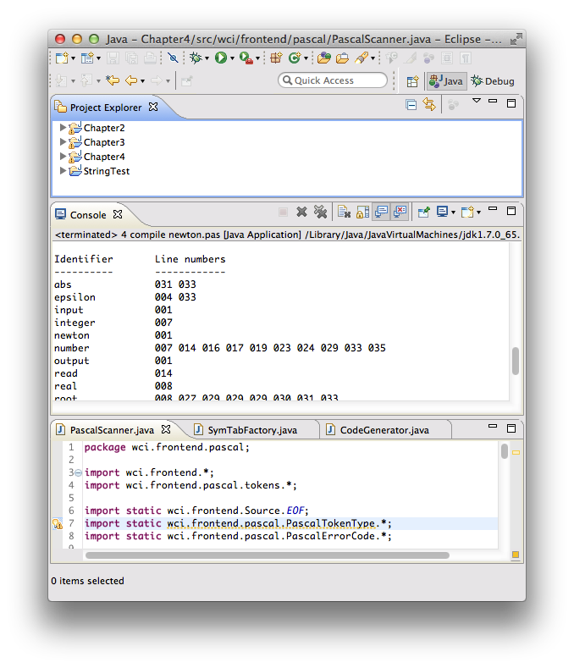
Layout: Movable Panels
What
The user can rearrange content panels
When
Different arrangements for different purposes
Different users have different needs
Why
Allow the user to arrange the panels to suit his needs and preferences

Slide 19
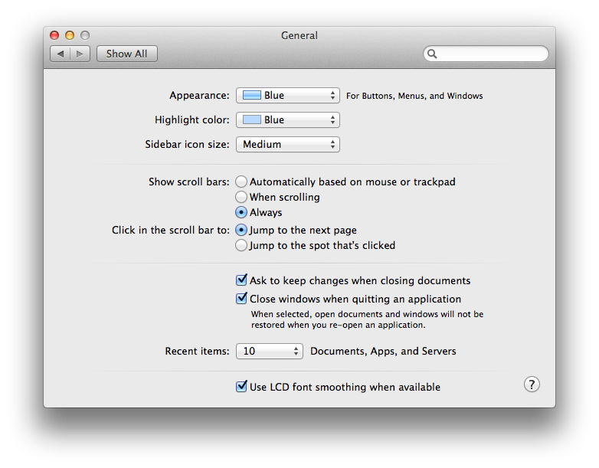
Layout: Left-Right Alignment
What
A two-column arrangement
Right-aligned labels on the left
Left-aligned items on the right
When
An input form or any other set of labeled items
Why
Neat with strong perceptual grouping

Slide 20
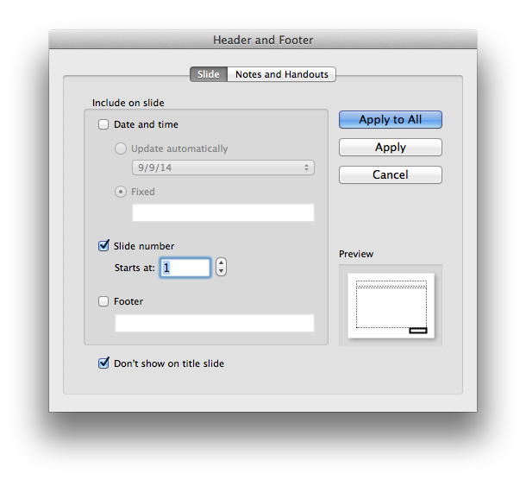
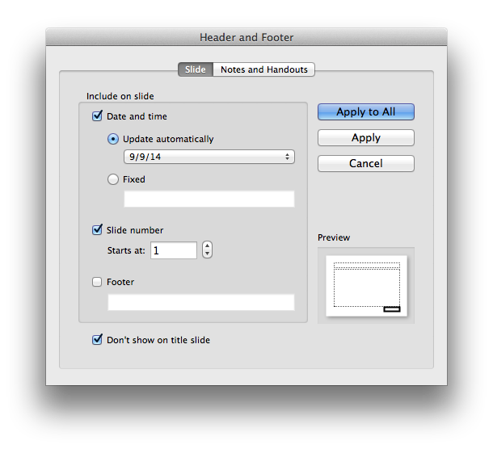
Layout: Responsive Enabling
What
Progressively enable UI components as the user selects options
When
Lead a user through a complex task step by step.
The user can easily change his mind
Why
The user can see all the options
Only the required options are enabled

Slide 21
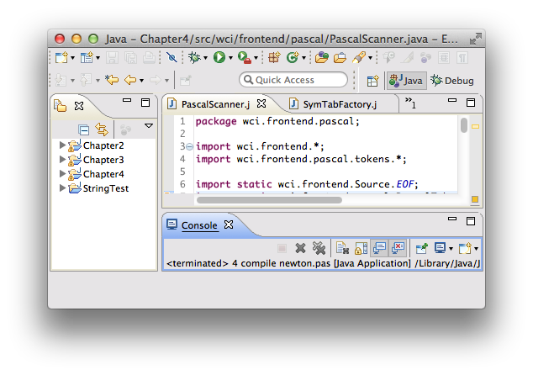
Layout: Self-Adjusting Layout
What
The page contents automatically resize to maintain the same arrangement for a different window size and aspect ratio
When
Users can resize windows as desired
Why
Users choose window sizes and aspect ratios unpredictably

Slide 22
Application Prototype
Create a prototype of your web application.
Use organization, navigation, and page layout design patterns.
Your choice of prototyping tool.
A prototype should look and act like the real application.
But it doesn’t have to really work.
It can use hardcoded data.
Not all execution paths need to be enabled.

Slide 23
Application Prototype, cont’d
Your prototype should enable you to demonstrate at least 2 of your use cases.
We will use your prototypes to perform usability testing as part of Assignment #2.
Details of the assignment to be provided later.

Slide 24
Application Prototype, cont’d
Be able to explain:
The purpose of the application.
What benefits does it provide the user?
What were the requirements?
Highlight the ones that your prototype meets.
Which use cases does your prototype enable?

Slide 25
Why Display Lists of Items?
Get an overview of all items
Browse item by item
Search for a specific item
Sort and filter items
Rearrange, add, delete, or recategorize items _

Slide 26
Information Architecture for Lists
Length of the list
Order of the items
Item grouping
Item types
User interaction with the list
Dynamic behavior of the list

Slide 27
Questions about Displaying Lists
How to show the details of an item that the user selected from a list?
How to display a list that has graphical items?
How to manage a very long list?
How to display list that is organized into categories or hierarchies?

Slide 28
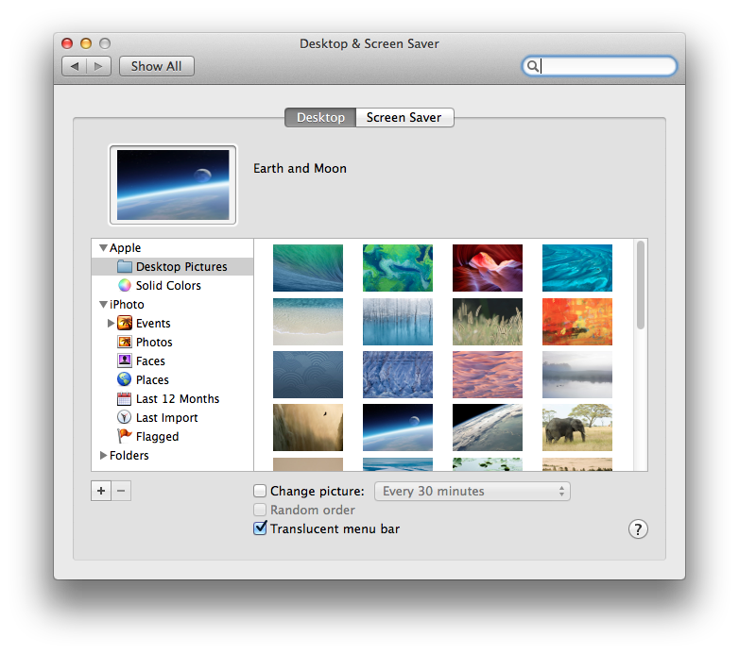
Lists: Two-Panel Selector
What
Two panels side-by-side
First panel show a list of selectable items
Second panel shows the selected item’s content
When
Show the entire list of items
Each item has content
Why
Reduced physical effort
Reduced visual cognitive load
Less user memory burden

Slide 29
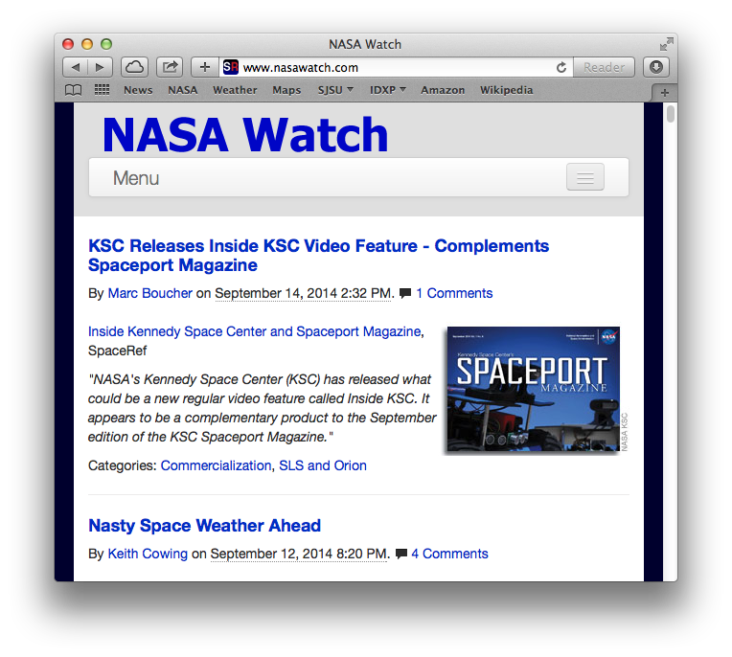
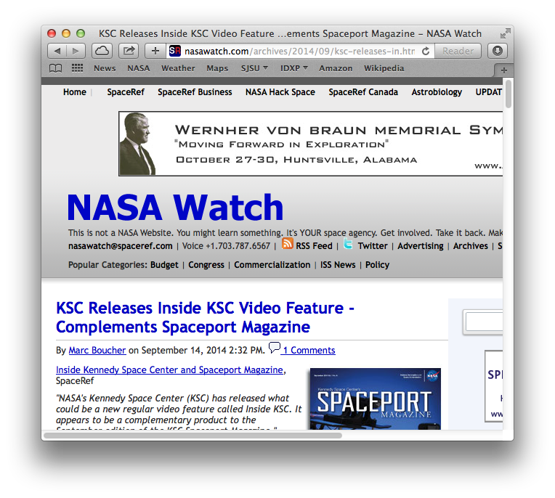
Lists: One-Window Drilldown
What
A list of selectable items in a single window
When the user selects an item, replace the list with the item details
When
Each item has content
Limited available space
Large list and large content
Why
Only option when space is tight

Slide 30
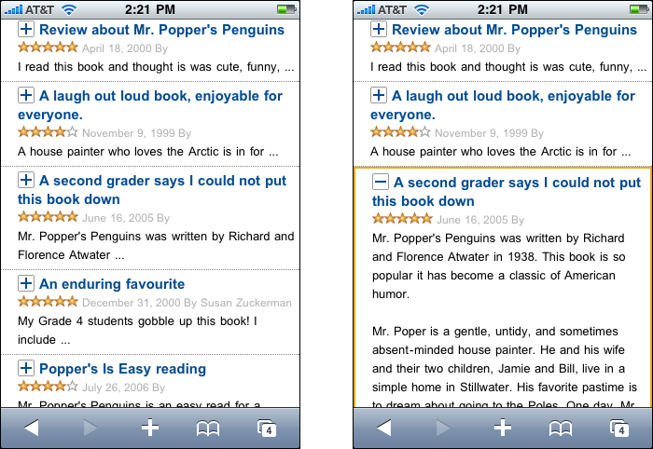
Lists: List Inlay
What
Display a list of items as a column
When the user selects an item, show the item details in place within the list
The user can independently open and close item details
When
Each item has a small amount of content
Insufficient space to show all the items’ contents
Why
User can choose what to view
Designing Interfaces, 2nd ed.
by Jenifer Tidwell
O’Reilly Media, 2011

Slide 31
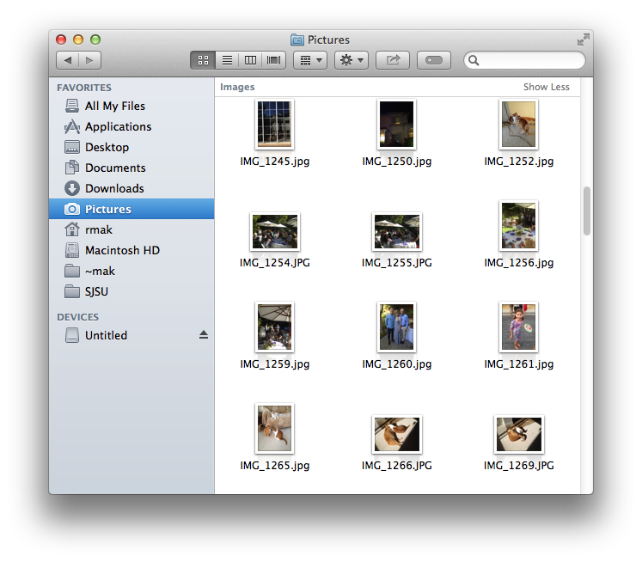
Lists: Thumbnail Grid
What
Arrange a list of items as a grid of thumbnail images
Each thumbnail is labeled
Show the larger sized content of a selected item
When
Items have content representable and recognizable in a smaller format
Why
Attractive way to display a large list of items
Thumbnails are easy targets

Slide 32
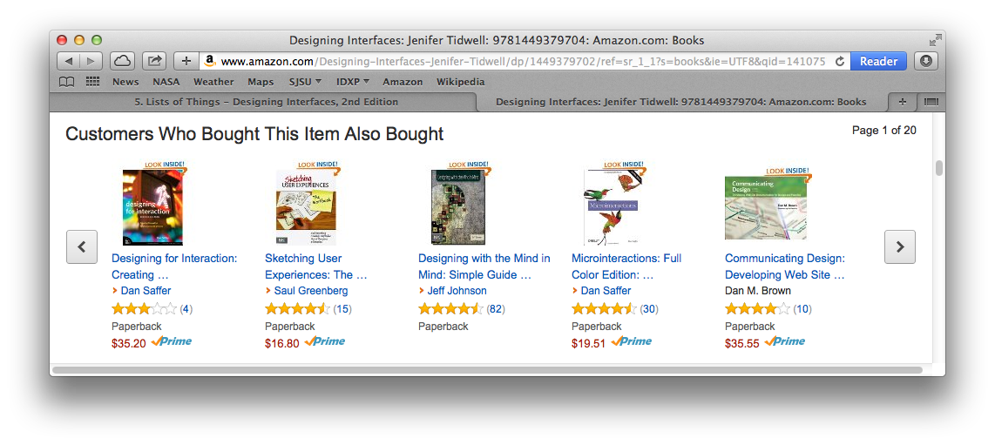
Lists: Carousel
What
List items arranged in a scrollable horizontal strip.
When
Insufficient space for a thumbnail grid
Why
Encourage users to scroll and browse.

Slide 33
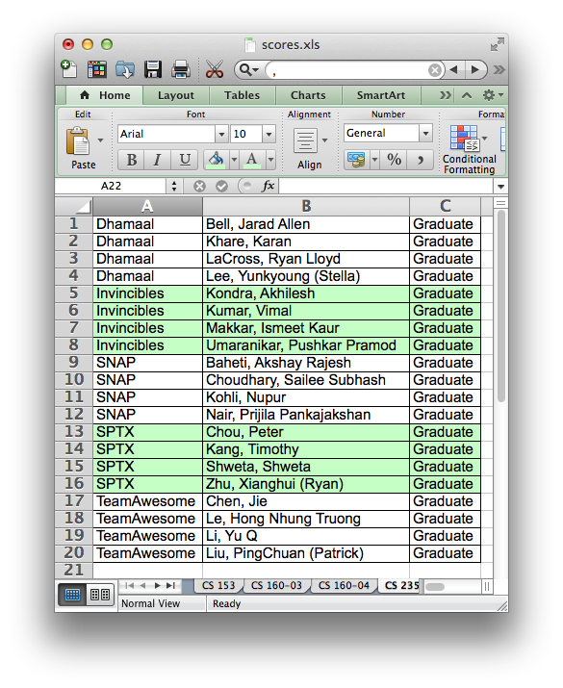
Lists: Striped Rows
What
Table rows are striped with alternating colors.
When
Need to group rows
Why
Easy to see groups
Easy for a user’s eyes to track row contents from left to right

Slide 34
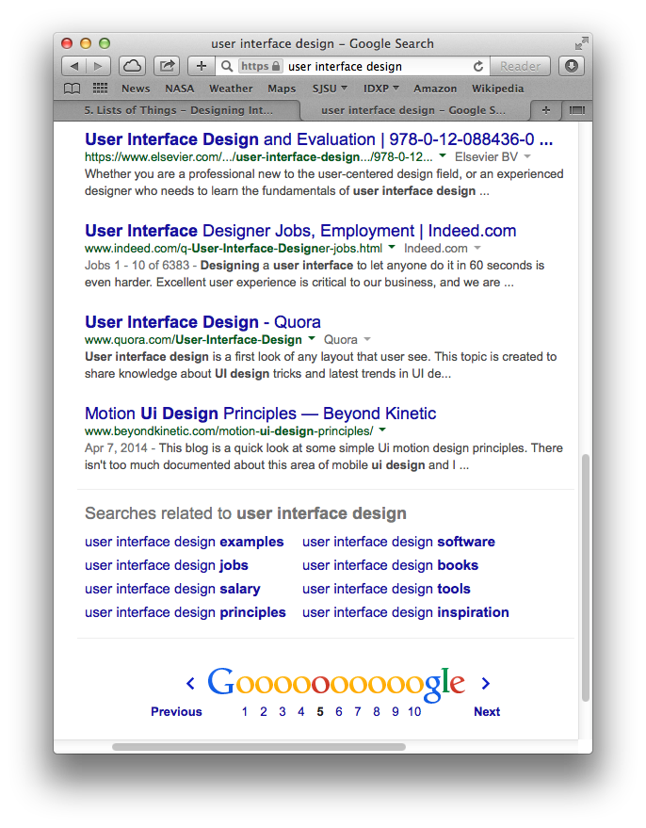
Lists: Pagination
What
Break a long list into pages
Display one page at a time
Navigation controls: first, last, next, previous
When
A very long list of items
Too much time to load and render the entire list all at once
Why
Break the list into manageable chunks
The paging metaphor is well known

Slide 35
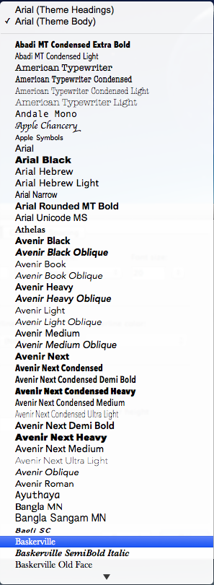
Lists: Jump to Item
What
A scrollable list of text items
When the user starts to type the text content of an item, jump to that item and select it
When
A long list of text items
Only a portion of the list is visible
Scrolling may be tedious
Why
User already knows what to look for
Quick and direct access by the user
Takes advantage of the computer’s fast searching
User
types
“Bas”

Slide 36
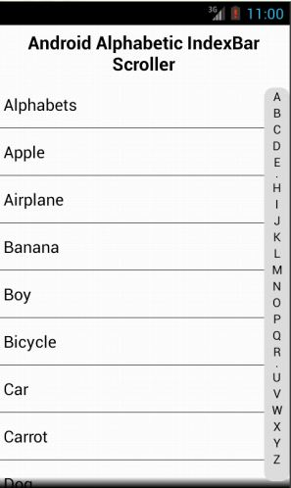
Lists: Alphabet Scroller
What
An alphabetized list
Display the letters of the alphabet
Users can select a letter to jump-scroll to the part of the list that begins with the selected letter
When
Users are searching for an item in an alphabetized list
Why
Users don’t have to scroll sequentially through the list from the beginning
Selecting a letter takes a user close to where the desired item is located
http://www.codeproject.com/Tips/548592/Android-Alphabetic-IndexBar-Scroller

Slide 37
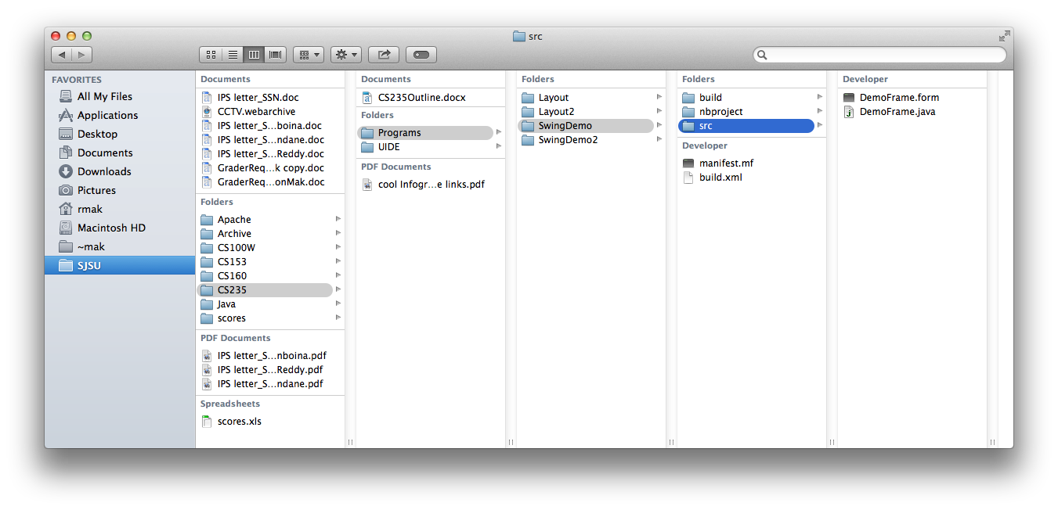
Lists: Cascading Lists
What
Display a hierarchy of selectable lists at each level
Select an item to display that item’s children in the next list
When
A list of items arranged in a possibly deep hierarchy
Why
Display more of the hierarchy be spreading it out over several lists
The user can more easily keep track of which level she’s on

Slide 38
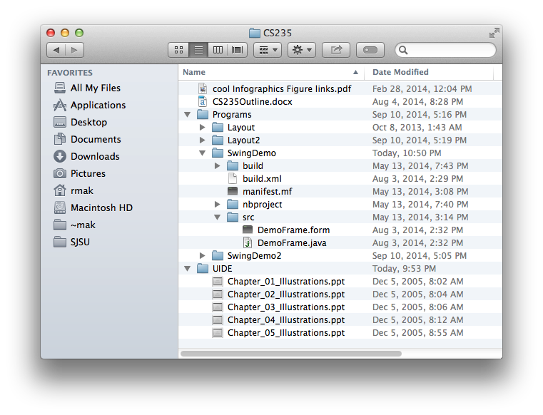
Lists: Tree Table
What
Display items in a single column
Use an outline structure to show hierarchy
Users can expand or collapse items independently
When
A list of items arranged in a possibly deep hierarchy
Why
Users can choose whether or not to view an item’s descendants and to what level

Slide 39
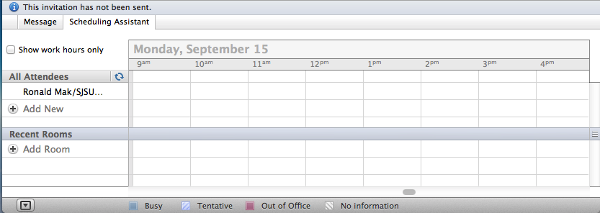
Lists: New-Item Row
What
Use the last item of a list to create a new item in place
When
Users need to create new items at the end of a list
Why
Add the new item at its final position in the list.

