Slide 1
CS 235: User Interface Design February 3 Class Meeting
Department of Computer Science San Jose State University Spring 2015 Instructor: Ron Mak
www.cs.sjsu.edu/~mak

Slide 2
Example Use Case Alternate Sequence
User Action | System Response
1. Select “Withdraw cash” | Prompt for amount
2. Enter amount | Check bank account balance
 | Dispense cash
3. Take cash
User Action | System Response
1. Select “Withdraw cash” | Prompt for amount
2. Enter amount | Check bank account balance
 | Display “Insufficient bank balance”
2.1 Enter another amount | Check bank account balance
 | Dispense cash
3. Take cash

Slide 3
Design Patterns
A design pattern is
A description of a problem.
A solution that you can apply to many programming situations.
Design patterns show you how to build good user interfaces.
Design patterns are proven design experience.
Design patterns describe best practices.
Design patterns capture structural and behavioral features of an interface.

Slide 4
Design Patterns
Design patterns are not code, but are general solutions to design problems.
You apply them to your specific application.
Design patterns give programmers a very high-level pattern language and a short-cut vocabulary to discuss design issues.
Independent of specific implementations.
“We should use the canvas+palette pattern here.”
“The wizard pattern will simplify this code.” _

Slide 5
Design Patterns
Each design pattern should have:
A short name
What: a brief description of the pattern
When to use: a brief description of the context
Why: a description of the problem that it solves
How: a prescription for a solution _

Slide 6
Design Patterns, cont’d
The building architect Christopher Alexander formulated over 250 patterns for architectural design for physical buidings.
Co-authored A Pattern Language: Towns, Buildings, Construction, published in 1977. _

Slide 7
Organization Design Patterns
Design patterns for the high-level overall layout of an application’s user interface.
Information architecture
How to organize an information space.
Interaction model
Determines how users navigate.
Establishes consistency.

Slide 8
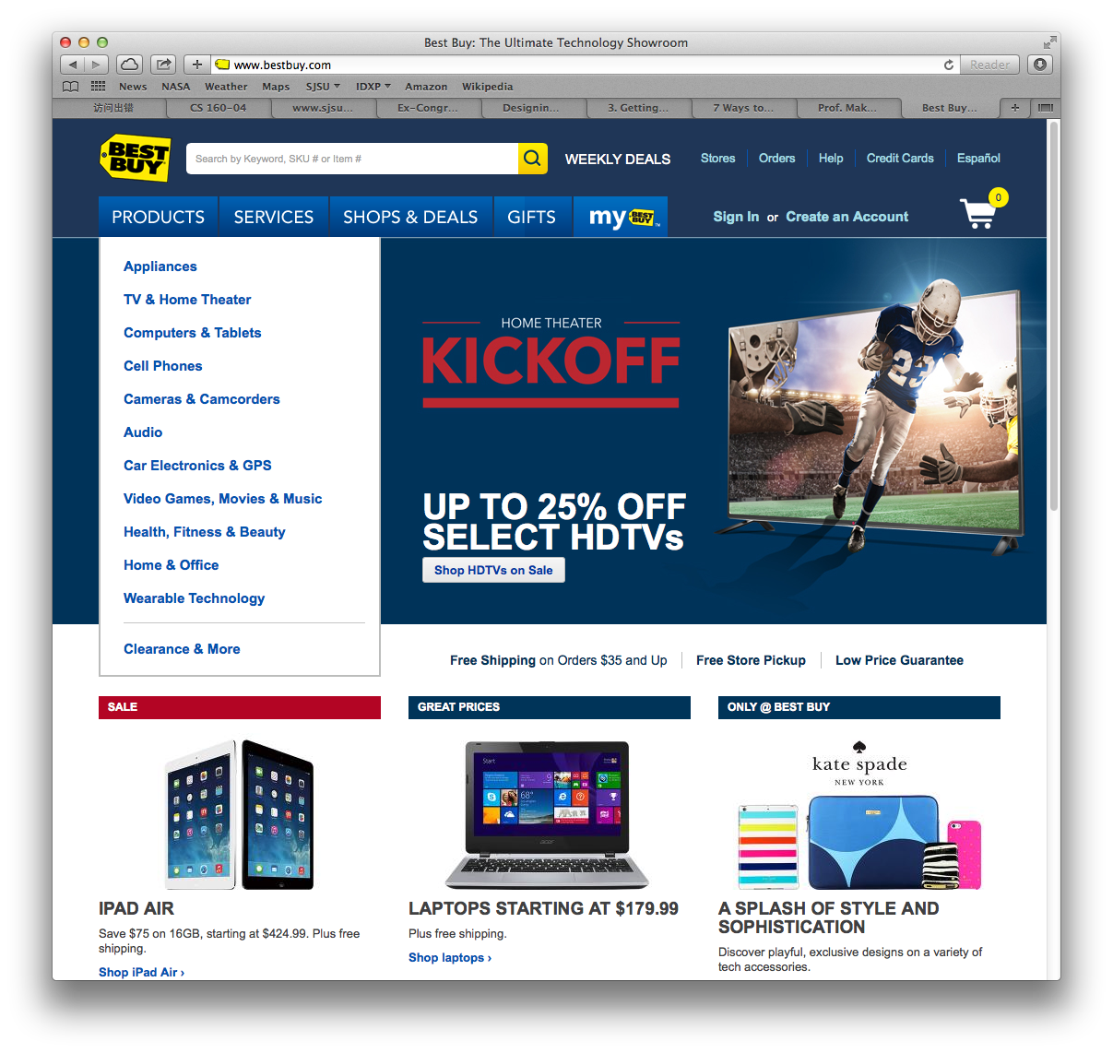
Organization: Feature, Search, and Browse
What
A featured item
A search box
A list to browse
When
Engage the user
Provide other options
Enable searching
Why
Browsing and searching are common
Hook the user with the featured item

Slide 9
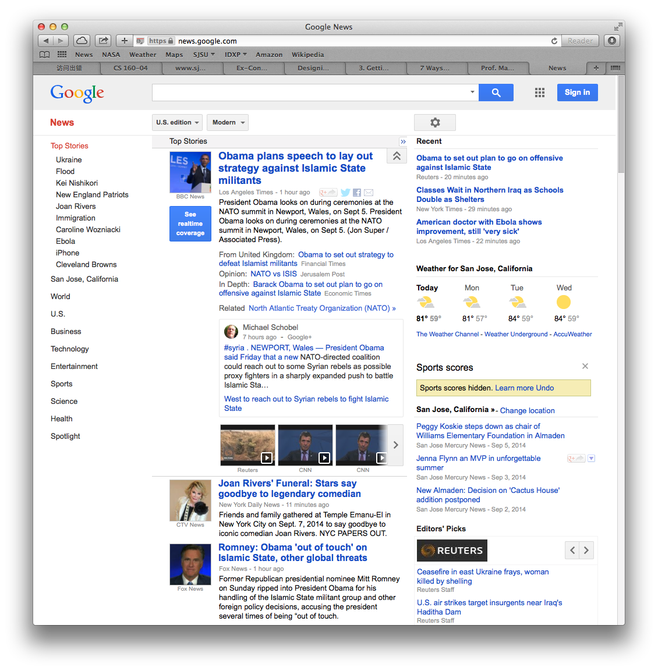
Organization: News Stream
What
Time-sensitive items
Reverse chronological order
Frequent updates
When
Communications channels
Timely content
Why
Allow users to keep up with news streams
Users can check often

Slide 10
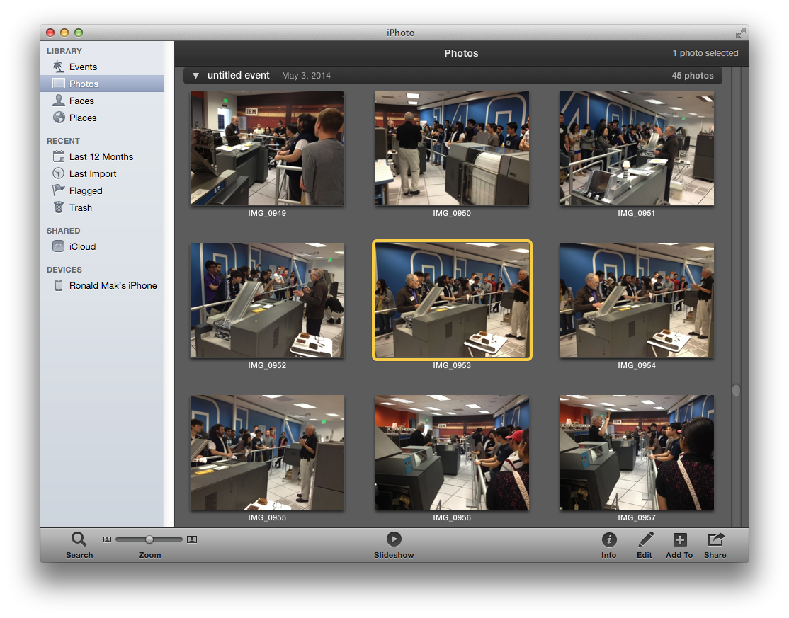
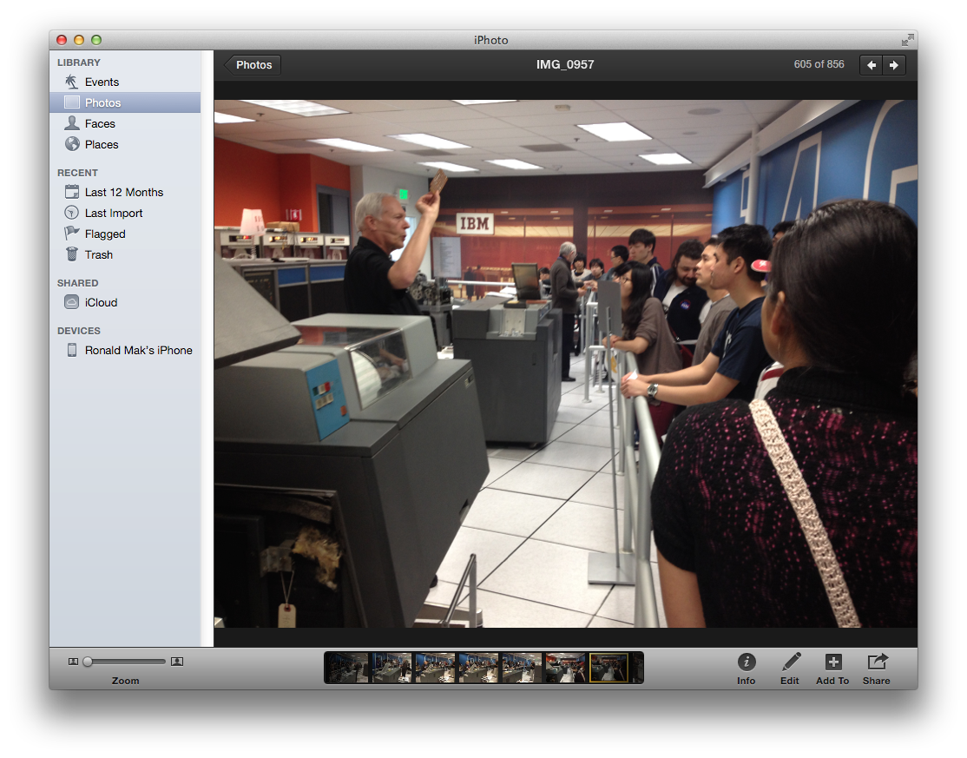
Organization: Picture Manager
What
Thumbnails of pictures for browsing
Feature one picture
When
A collection of pictures to organize
Why
A natural way for users to organize and browse a picture collection

Slide 11
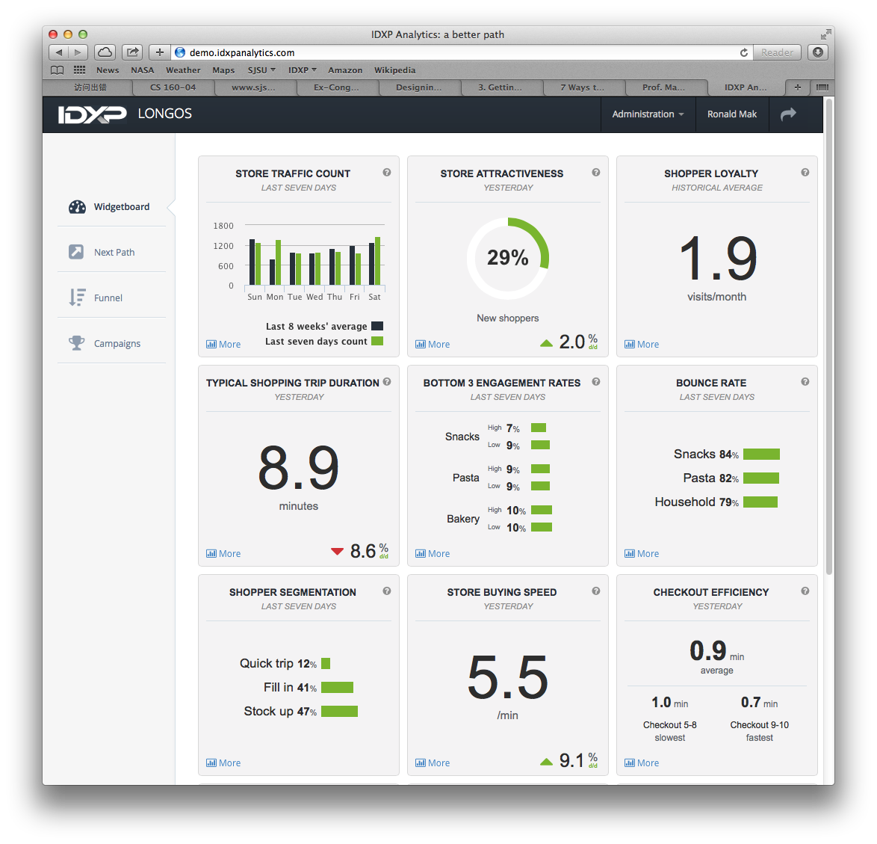
Organization: Dashboard
What
Single information-dense page
Information widgets frequently updated
When
An incoming flow of information
Why
Users need to monitor the information
See what’s important at a glance

Slide 12
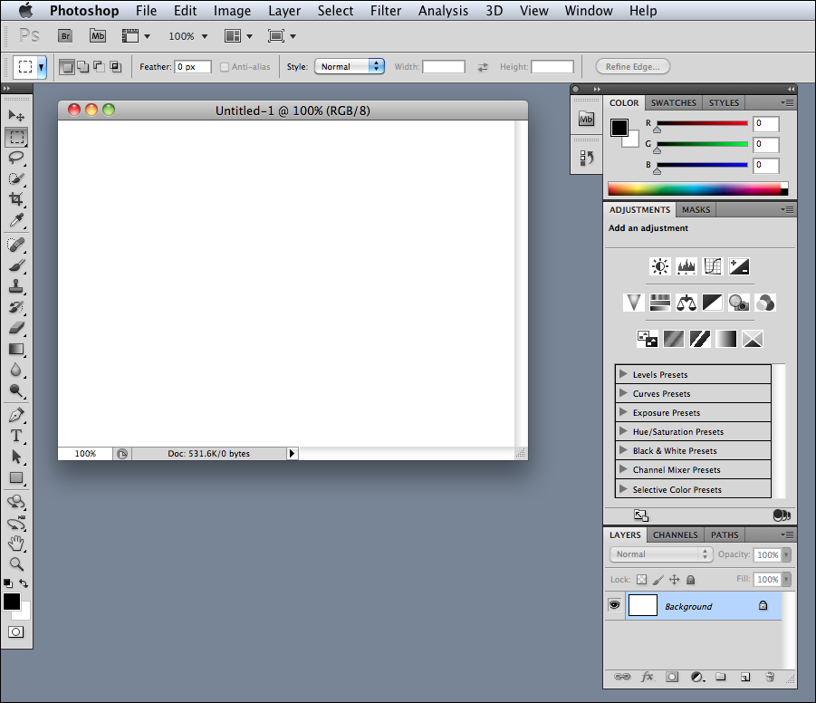
Organization: Canvas + Palette
What
Palette of drawing tools
Canvas for drawing
When
A graphics editor
Create new objects
Arrange object in virtual space
Why
Closely matches a user’s mental model of how to create some artwork
Designing Interfaces, 2nd ed.
by Jenifer Tidwell
O’Reilly Media, 2011

Slide 13
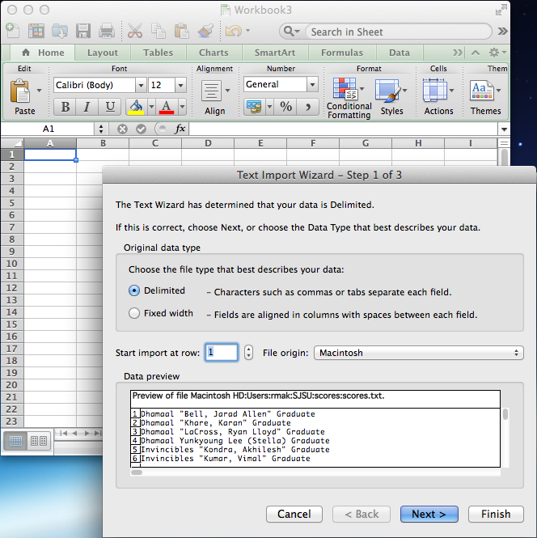
Organization: Wizard
What
Steps to accomplish a specific task
When
A complicated task
“Don’t make me think. Just tell me what to do next.”
Why
Handholding for the beginning user
But can be frustrating for experienced users

Slide 14
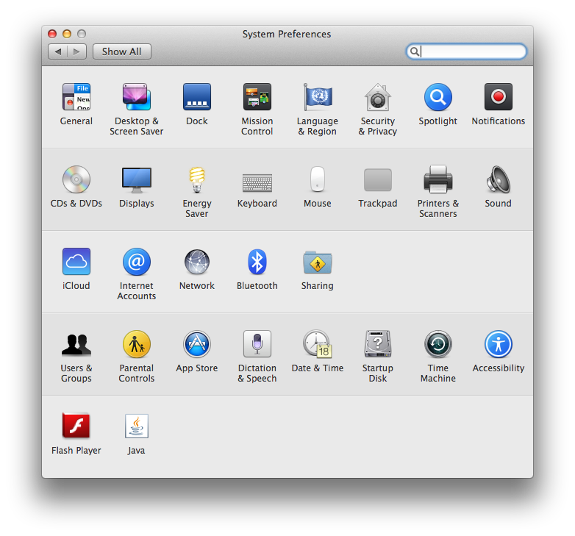
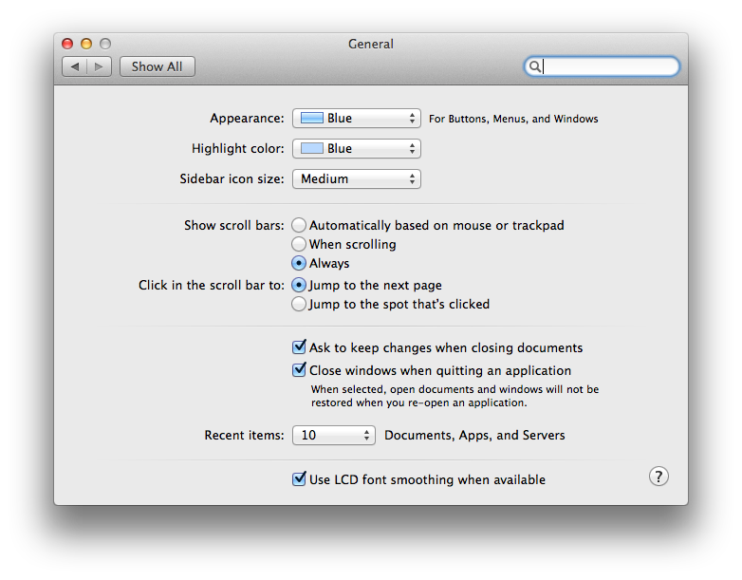
Organization: Settings Editor
What
One place to change settings, preferences, or properties
Group content
When
Users have many choices to create a profile for an application
Why
Easy to find and use
See all choices in one place

Slide 15
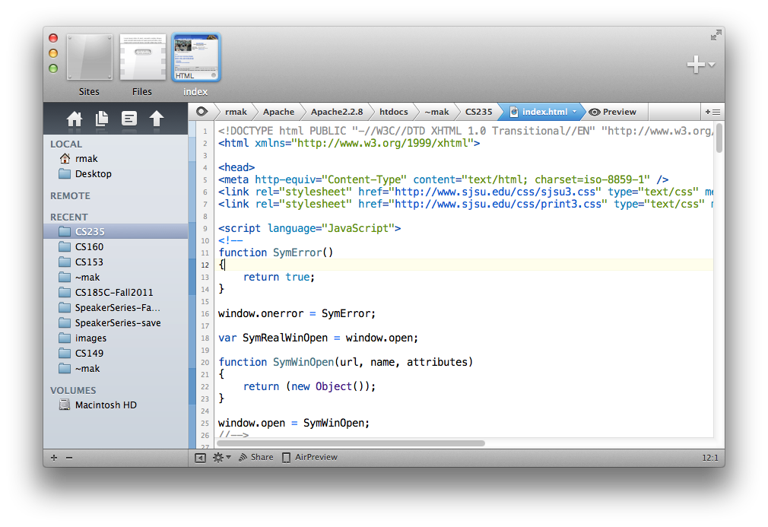
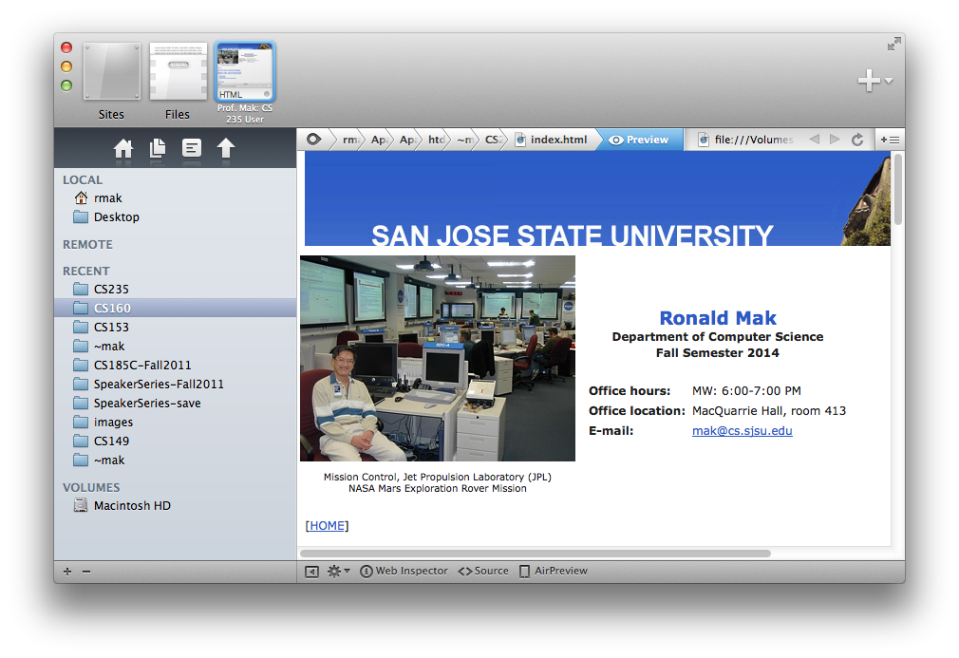
Organization: Alternative Views
What
Show multiple views of the same data in different formats
When
A single view is insufficient
Users can choose views
Why
Different views show different aspects of the data
Different users may prefer different views

Slide 16
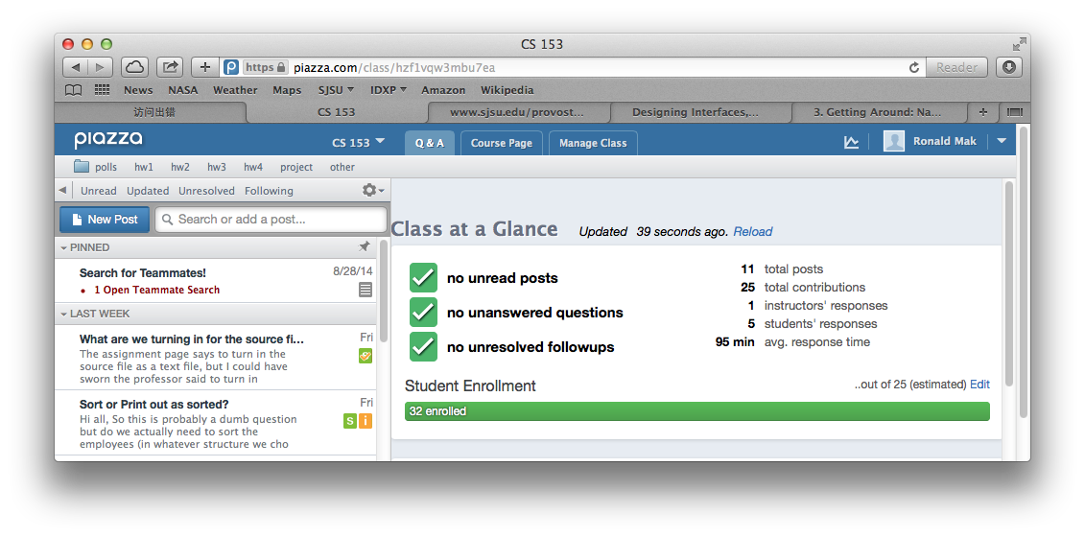
Organization: Multiple Workspaces
What
Multiple tabs or windows to view different pages, one at a time.
When
An application can manage multiple pages of content
Each page is separately managed
Why
Users want to multitask
Don’t want to open multiple copies of the application

Slide 17
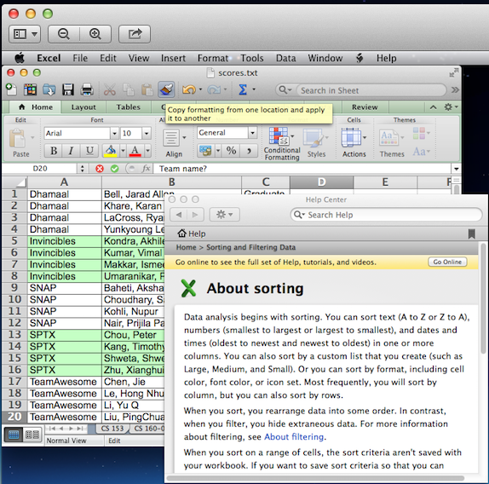
Organization: Multilevel Help
What
A variety of ways to provide help to the user
When
A complex application
Users need with specific features or tasks
Why
Provide help when and where needed
Help can be light- or heavyweight
Reminders, tips, or tutorials as necessary

Slide 18
Navigation Design Patterns
Design patterns for how a user navigates within an application.
Can a user achieve a goal without wandering off course?
Where am I?
How did I get here?
Where do I go from here?
How much farther to go?
Signposts
Features that help a user determine where he is.

Slide 19
Navigation Basics
Navigation errors are frustrating for users and can be costly.
Each new page requires a context switch.
Waste time on wrong paths.
Keep low the number of page jumps required to achieve a goal.

Slide 20
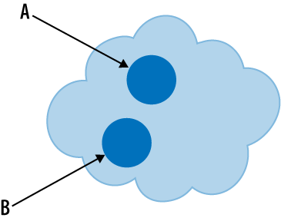
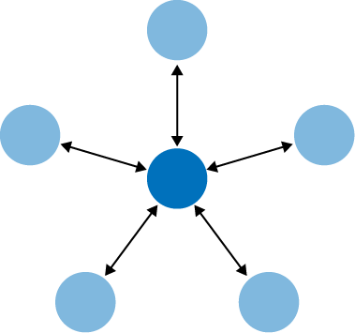
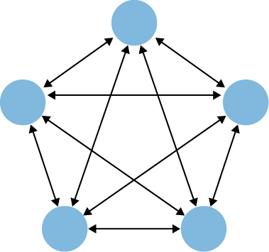
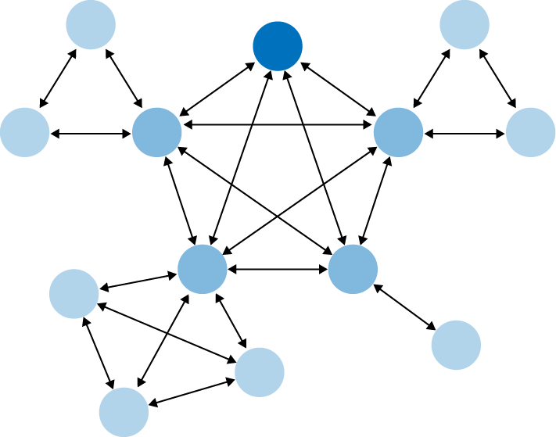
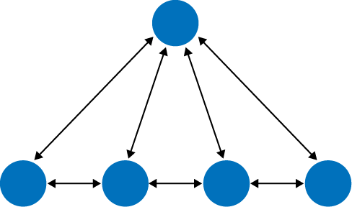
Navigational Models
Clear entry points
Hub and spoke
Fully connected
Sequential
Multilevel
Pyramid
Designing Interfaces, 2nd ed.
by Jenifer Tidwell
O’Reilly Media, 2011

Slide 21
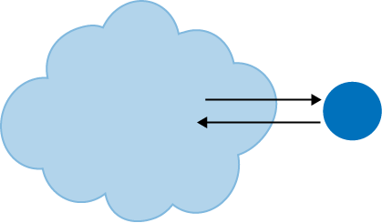
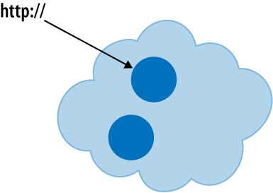
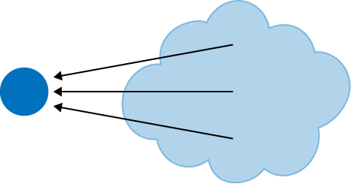
Navigational Models, cont’d
Pan and zoom
Modal dialog
Escape hatch
Bookmark
Designing Interfaces, 2nd ed.
by Jenifer Tidwell
O’Reilly Media, 2011

Slide 22
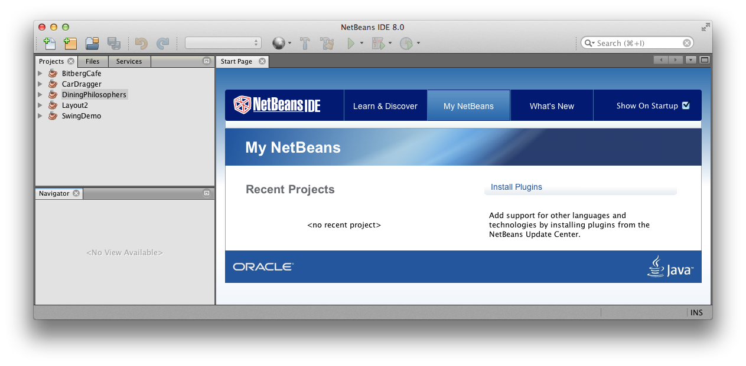
Navigational: Clear Entry Points
What
Only a few main entry points into the interface
Task oriented, clear calls to action
When
Ideal for first-time or infrequent users
Can be bypassed by experienced users
Why
Avoid too much clutter when an application is first opened
Do not over- whelm a novice user

Slide 23
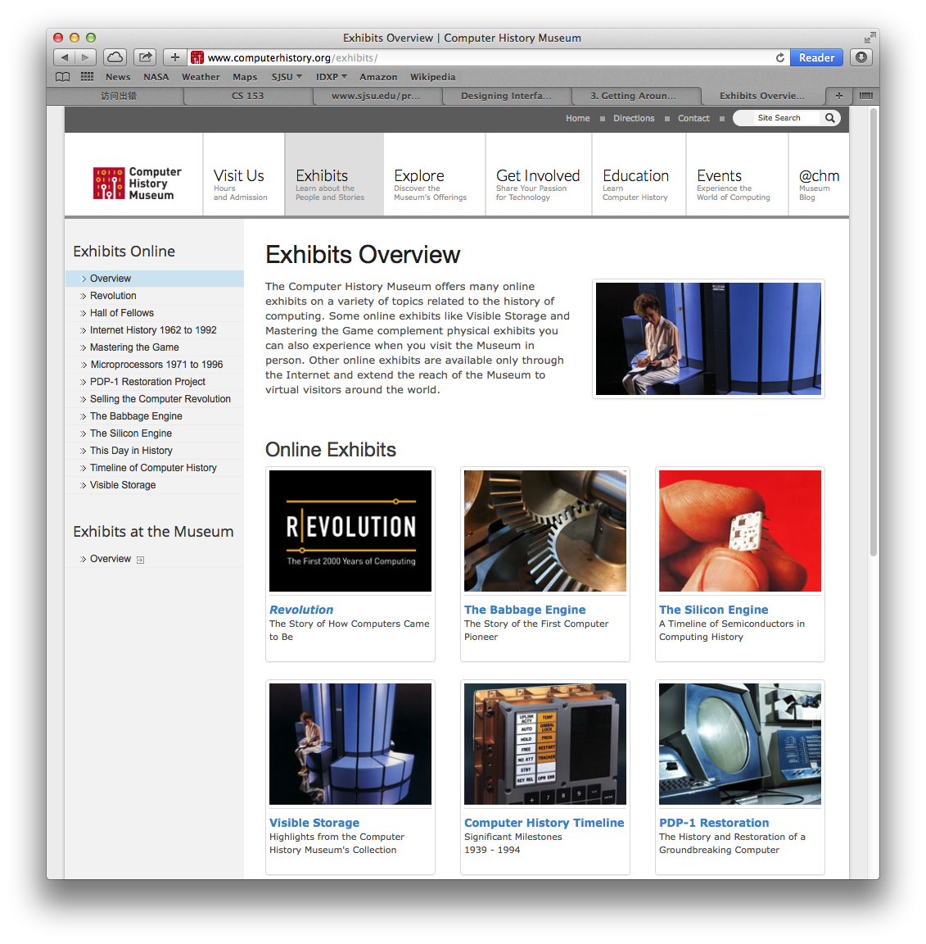
Navigational: Hub and Spoke
What
A page filled with links to other pages
When
A table of contents or a portal to show the user where to go from here
Why
The user can decide where to go
Return to this page to go elsewhere

Slide 24
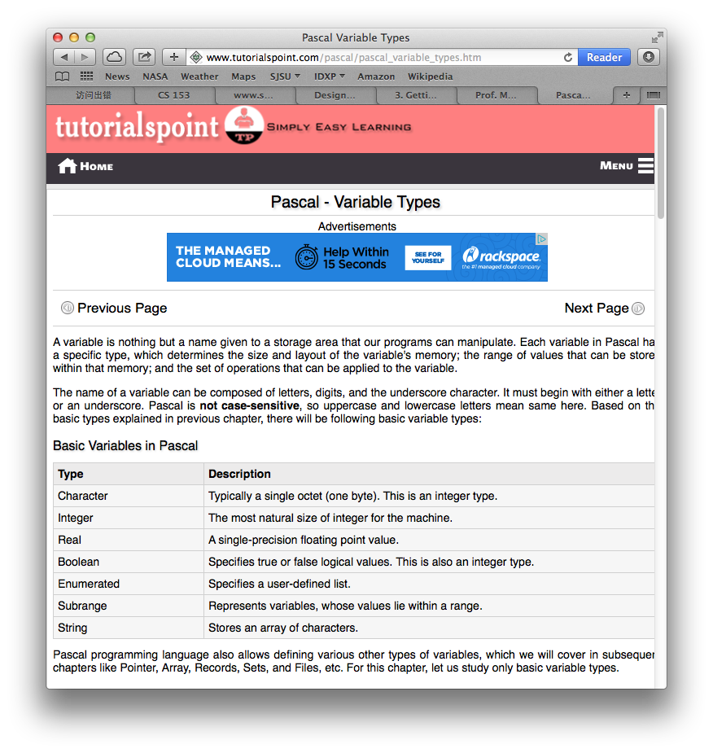
Navigational: Pyramid
What
Sequential pages with back and next links
A link to return to the top
When
Sequential text organized by chapters
Return to the table of contents at the top to pick another chapter
Why
Matches a user’s mental model of a tutorial

Slide 25
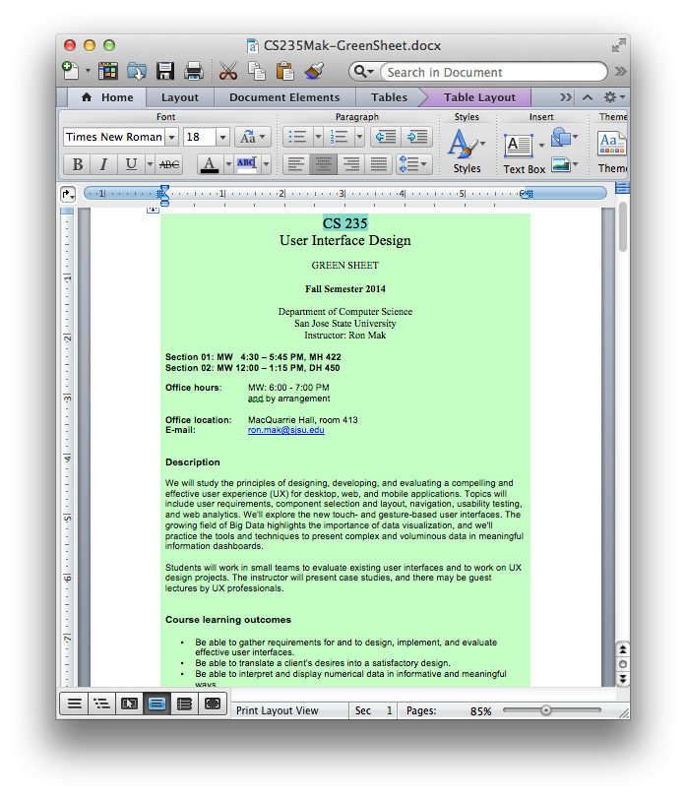
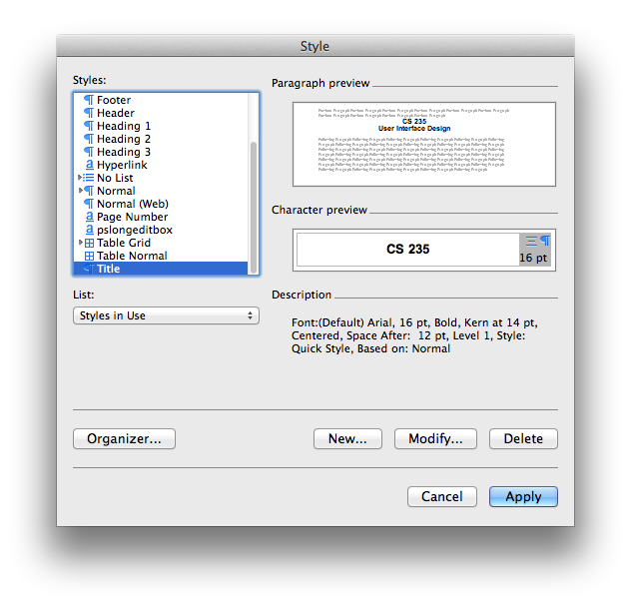
Navigational: Modal Dialog
What
Show only one page with no navigation options
The user must complete the page’s task
When
The application can’t proceed without user input
Why
The user can’t ignore the page and must provide input
Can be disruptive and annoying to the user

Slide 26
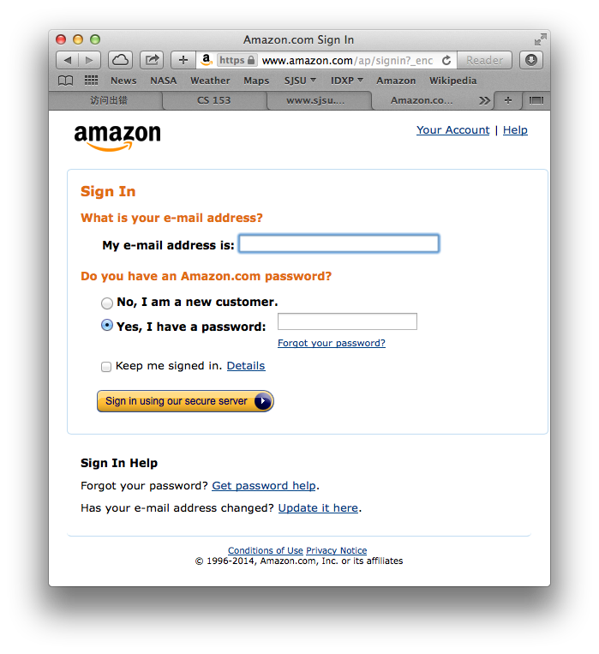
Navigational: Escape Hatch
What
The user can abort a task
When
The application takes the user down a path but the user may want to back out
Why
The user changes his mind or recognizes that he is going down the wrong path

Slide 27
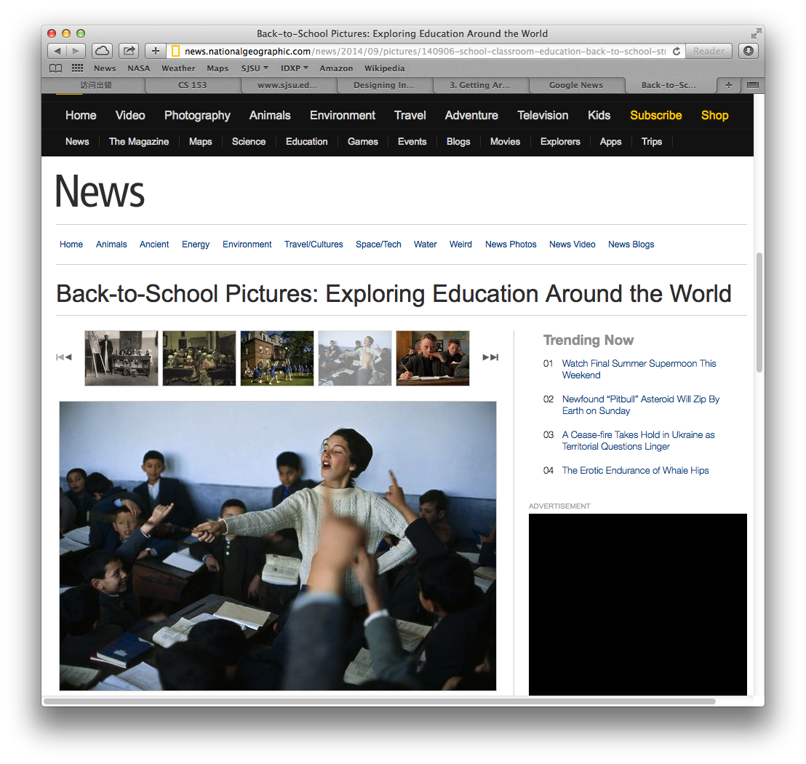
Navigational: Sequence Map
What
Show a map of pages in sequence
Include “you are here”
When
The application takes the user along a linear path
Why
The map tells the user how far he has gone and how much farther he has to go

Slide 28
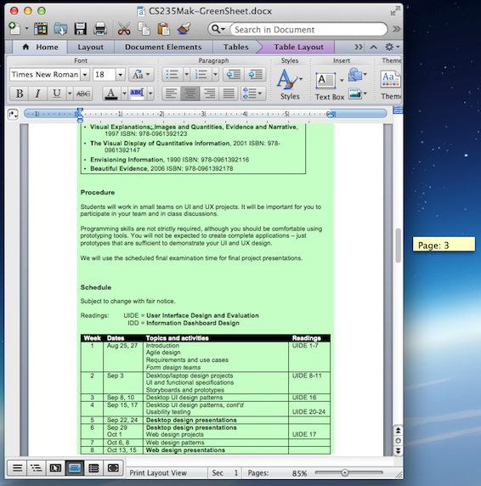
Navigational: Annotated Scrollbar
What
The scrollbar says “you are here”.
When
The application is document-centric or allows pan-and-zoom
Why
While manipulating the scrollbars, the user needs to know what part of content is being displayed

Slide 29
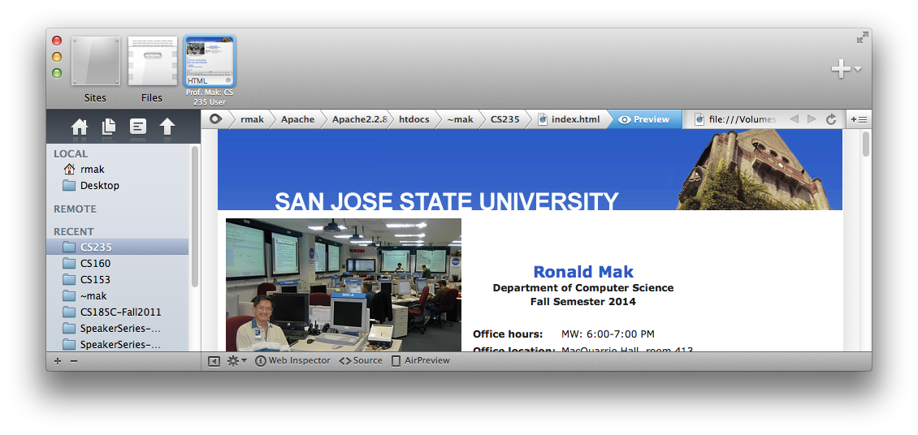
Navigational: Breadcrumbs
What
On each page in a deep hierarchy, show a list of the parent pages in order
When
In a deep hierarchy, users need help to keep track of where they are.
A user can go back up to any point in the hierarchy.
Why
Allow a user to move forward and back through a deep hierarchy
The user knows where he is in the hierarchy

Slide 30
Link to Design Video
https://www.youtube.com/watch?v=BKorP55Aqvg

