Slide 1
CS 160 and CMPE/SE 131 Software Engineering April 12 Class Meeting
Department of Computer Science Department of Computer Engineering San José State University Spring 2016 Instructor: Ron Mak
www.cs.sjsu.edu/~mak

Slide 2
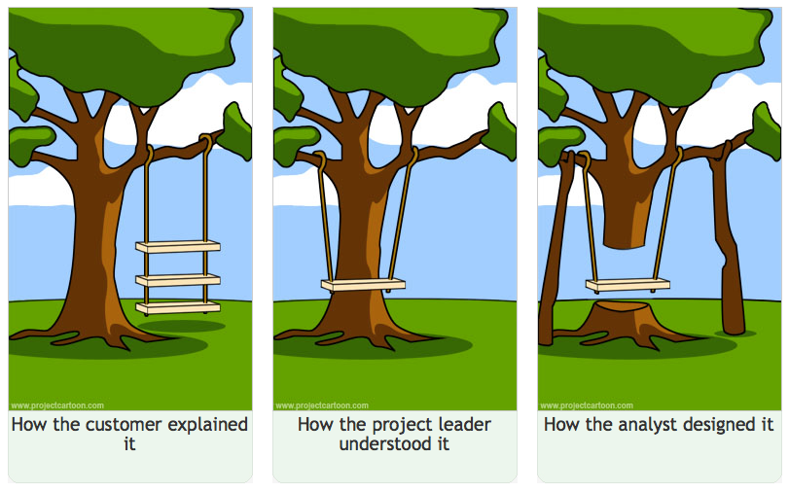
“Swing Project” Cartoon

Slide 3
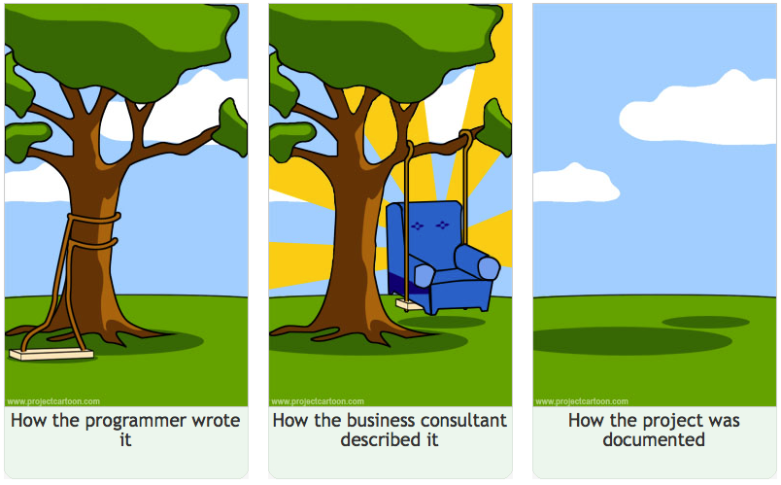
“Swing Project” Cartoon, cont’d

Slide 4
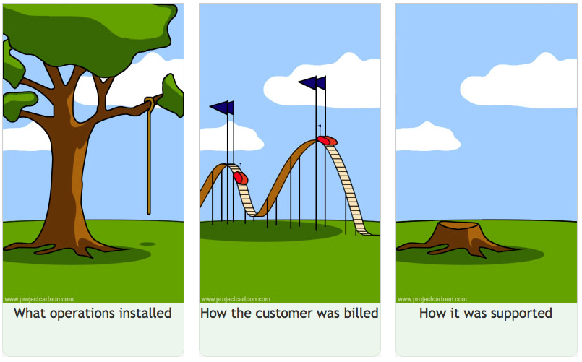
“Swing Project” Cartoon, cont’d

Slide 5
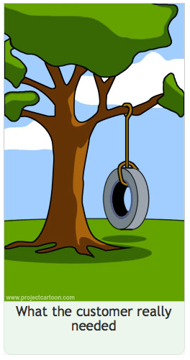
“Swing Project” Cartoon, cont’d
http://projectcartoon.com/about/

Slide 6
Millions of Lines of Code
See http://cdn.makeuseof.com/wp-content/uploads/2014/01/million-lines-of-code-large.jpg?f7c509

Slide 7
One Month to Go!
Review your project schedule.
Prioritize tasks and put off lower priority ones.
Agree upon a release candidate (RC) and make that your primary goal.
Define the next RC when you’ve achieved the current one.
Each RC should be something you can turn in.
It’s better to turn in a working application, even if it doesn’t have all the features, than one that doesn’t work at all.

Slide 8
One Month to Go! cont’d
Stability is critical.
Do frequent builds.
Be wary of major last-minute changes.
Your final project documentation can include release notes that describe any missing features.

Slide 9
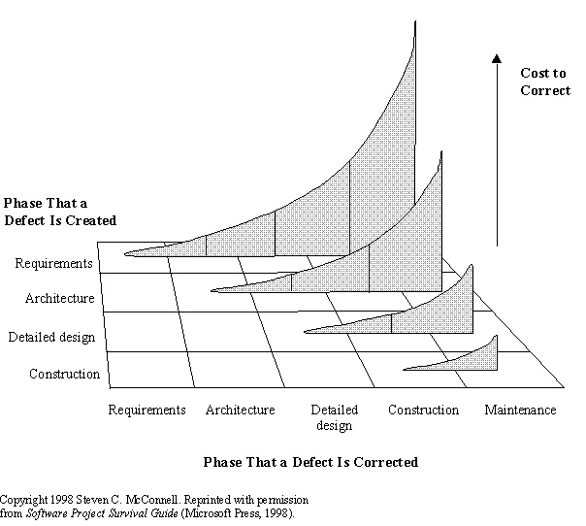
The Cost of Correcting Defects
The cost to correct a defect increases the later it is corrected.
50 to 200 times more expensive to correct later than sooner
An iterative (agile) process catches defects soon after they’re made.

Slide 10
Make Small Mistakes Early
Make a carefully planned series of small mistakes early to avoid making unplanned large mistakes later.
Example: Create four conceptual design alternatives in the beginning and throw three of them away = 3 small early mistakes.
Example: Fail to do adequate design in the beginning and later rewrite the code three times = 3 large expensive mistakes.
Make and correct early mistakes because they cost much less than late mistakes.

Slide 11
Software Validation and Verification (V&V)
Validation
Work with the client to make sure that the product requirements are complete and correct.
Make sure that the proposed product meets all the requirements.
“Are we building the right product?”
Verification
Work with the developers to make sure that the product is being developed with high quality standards.
“Are we building the product right?”

Slide 12
Software Reliability
Reliable software has a low probability of failure while operating for a specified period of time under specified operating conditions.
The specified time period and the specified operating conditions are part of the nonfunctional requirements.
For some applications, reliability may be more important than the other requirements.
mission-critical applications
medical applications

Slide 13
Software Reliability, cont’d
Reliable software is the result of good software quality assurance (SQA) throughout an application’s life cycle.
Design
Good requirements elicitation
Good object-oriented design and analysis
Good architecture

Slide 14
Software Reliability, cont’d
Development
Good management (e.g., source control, reasonable schedules)
Good coding practices (e.g., design patterns)
Good testing practices
Deployment
Preventive maintenance (e.g., training)
Performance monitoring
Failure analysis (when failures do occur)

Slide 15
Software Testing
What is testing?
What is a successful test?
Who does testing?
When does testing occur?
What are the different types of testing?
What testing tools are available?
How do you know your tests covered everything?
When can you stop testing?

Slide 16
What is testing?
Testing is a systematic procedure to discover faults in software in order to prevent failure.
Failure: A deviation of the software’s behavior from its specified behavior, according to its requirements.
Can be minor to major (such as a crash).

Slide 17
What is testing?
Erroneous state: A state that the operating software is in that will lead to a failure.
Example: low on memory
Fault: What caused the software to enter an erroneous state.
AKA: defect, bug
Example: a memory leak
fault ➔ erroneous state ➔ failure

Slide 18
What is a successful test?
A successful test is one that finds faults (bugs).
Testing is the opposite of coding.
Coding: Create software and try to get it to work.
Testing: Break the software and demonstrate that it doesn’t work.

Slide 19
Testing Mindset
Testing and coding require different mindsets.
It can be very difficult for developers to test their own code.
If you wrote the code, you psychologically want it to work and not see it break.
Since you know how the code should be used, you may not think to try using it in ways other than as you intended.

Slide 20
Who does testing?
Developers
As difficult as it may be, you must test your own code.
unit testing
Test each other’s code
peer testing
Testers
Members of the quality assurance (QA) department.
Software engineers who did not write the code.
Manual writers and trainers who create examples and demos.

Slide 21
Who does testing? cont’d
Users
As beta testers
As customers

Slide 22
When does testing occur?
XXX
Recall the Old Waterfall Model:
Requirements
Design
Implementation
Testing
In the new Agile Methodology, testing is part of each and every iteration.
Testing occurs throughout development, not just at the end.

Slide 23
When does testing occur? cont’d

Slide 24
What are the different types of testing?
Functional testing
Does the code do what it’s supposed to do?
Tests derived from use cases.
Unit testing
Developers test an individual “unit”.
Unit: A small set of related components.
Regression testing
Rerun previous tests to ensure that the latest code changes didn’t break something.
Often run automatically from scripts.

Slide 25
Different types of testing, cont’d
Integration testing
Developers test how well their units work together with other units.
Usability testing
Is the user interface easy to use?

Slide 26
Different types of testing, cont’d
System testing
Test how an entire system works.
Performance testing
How quickly does the system respond?
Stress testing
How much can the system tolerate before breaking?

Slide 27
Alpha Testing vs. Beta Testing
Alpha testing
Usability and system testing of a nearly complete application in the development environment.
Beta testing
Usability and system testing of a complete or nearly complete application in the user’s environment.
It is not uncommon for software companies to release an application to the public for beta testing.
New releases of web-based applications are put “into beta” by software companies.

Slide 28
Black Box Testing vs. White Box Testing
Black box testing
Deals only with the input/output behavior of the unit.
Calling parameters
Return values
The internals of the unit are not considered.
Commonly known as functional testing.
White box testing
Tests the internal behavior of the unit.
execution paths
state transitions
Part of each developer’s unit testing.

Slide 29
Unit Testing
Each unit test focuses on components created by a developer.
Done by the developer before committing the code to the source repository.
Easier to find and fix bugs when there are fewer components.
Bottom-up testing.
Developers create test cases to do unit tests.

Slide 30
Unit Testing: Test Cases
Test case: A set of input values for the unit and a corresponding set of expected results.
A test case can be run within a testing framework (AKA test bed, test harness) consisting of a test driver and one or more test stubs.

Slide 31
Unit Testing: Test Cases, cont’d
Test driver
Simulates the part of the system that calls the unit.
Calls the unit and passes in the input values.
Test stub
Simulates the components that the unit depends on.
When called by the unit, a test stub responds in a correct or “reasonable” manner in order to allow the unit to continue operating.

Slide 32
Unit Testing: Testing Framework
TEST
STUB
calls
UNIT
(What’s
being tested)
TEST
DRIVER
calls
calls
TEST
STUB
calls
TEST
STUB

Slide 33
Writing and Running Unit Tests
Developers are responsible for writing unit tests during each iteration.
Whenever you design and write a new class, write a unit test that tests that class.
Developers are responsible for running the unit tests.

Slide 34
Rails Support for Testing
Chapter 10 of Rails Crash Course
Switch from the Rails development environment to the Rails test environment.
Preconfigured for testing
Uses a separate database for running tests.
Automatically recreated before each test run.
Ensures that tests don’t depend on data already in the database.
Run all the tests in file test/models/user_test.rb:
bin/rake test test/models/user_test.rb

Slide 35
Integration Testing
After your code has passed all the unit tests, you must do integration testing to see how your unit works with other units.
Other units written either by you or by other developers.
Not too hard to do if you’ve been doing continuous integration all along.

Slide 36
Stress Testing
AKA load testing
How well does the application behave under stress?
Will its performance be acceptable?

Slide 37
Stress Testing, cont’d
Add a test driver that pushes your application beyond what is possible with manual testing.
Input values at or just beyond their limits
Large number of input values or large database tables
Number of clients.
Number of requests.
Number of concurrent requests.
Frequency of requests.
Types of requests.

Slide 38
Stress Testing, cont’d
Push your application until it breaks.
Know what the breaking point is.
If you don’t find out before deployment, the users will!
Understand the behavior of your application under stress.
Recognize when it’s about to break so you have time to mitigate.

Slide 39
Stress Testing, cont’d
Use a multi-threaded test program to simulate a large number of simultaneous users of a web application.
Measure the response time of each simulated user as the number of users increases.

Slide 40
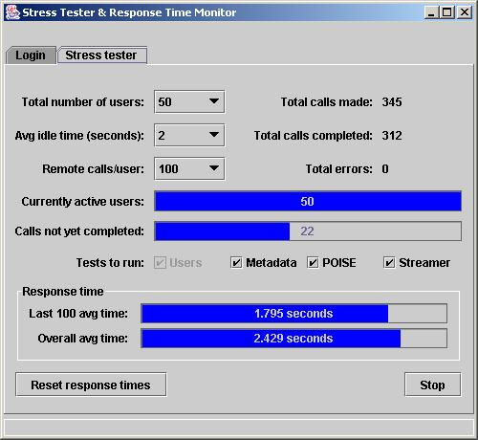
Stress Testing Example: Mars Rover Mission
Simulate multiple users performing client operations simultaneously.
Can the server handle a heavy load?

Slide 41
Regression Testing
Make a collection of unit tests.
Run all the tests whenever you make a code change.
Make sure your application did not lose functionality or “regress”.
Make sure a bug fix did not introduce new bugs.
Programmers are much less reluctant to improve their code if they can run regression tests to verify their changes.

