Slide 1
CS/SE 157B Database Management Systems II Midterm Solution
Department of Computer Science San Jose State University Spring 2018 Instructor: Ron Mak
www.cs.sjsu.edu/~mak

Slide 2
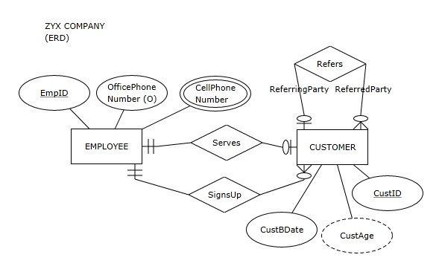
Question 1
Which of the following statements is true?
An employee can serve many customers, and he or she has to serve at least one customer.
An employee can serve one customer, or he or she does not have to serve any customers.
Each employee serves exactly one customer.
Employees do not serve customers.

Slide 3
Question 2
Which of the following statements, if any, is false?
Each customer has a unique CustID.
Each employee is serving a unique customer.
Each customer has a unique employee serving him or her.
None of the statements is false.

Slide 4
Question 3
Which of the following statements is true?
A customer can be served by many employees, and he or she has to be served by at least one employee.
A customer can be served by one employee, or he or she does not have to be served by any employees.
Each customer is served by exactly one employee.
Customers are not served by employees.

Slide 5
Question 4
Which of the following statements is true?
An employee can sign up many customers, and he or she has to sign up at least one customer.
An employee can sign up many customers, but he or she does not have to sign up any customers.
Each employee signs up exactly one customer.
Each employee signs up many customers.

Slide 6
Question 5
Which of the following statements is true?
A customer can be signed up by many employees, and he or she has to be signed up by at least one employee.
A customer can be signed up by one employee, or he or she does not have to be signed up by any employees.
Each customer is signed up by exactly one employee
Customers are not signed up by employees.

Slide 7
Question 6
Which of the following statements is true?
A customer cannot be referred by another customer.
A customer can be referred by at most one customer.
A customer can be referred by many customers.
A customer must be referred by another customer.

Slide 8
Question 7
Which of the following statements is true?
A customer cannot refer another customer
A customer can refer either only one customer or no customers at all
A customer can refer many customers
A customer must refer many customers

Slide 9
Question 8
Which of the following statements is true?
We will store CustomerBDate value for each customer.
We will store OfficePhoneNumber value for each employee.
We will store CustomerAge value for each customer.
All of the above.

Slide 10
Question 9
Which of the following statements is true?
We cannot keep track of employees who do not sign up any customers.
We cannot keep track of employees who do not serve any customers.
We cannot keep track of employees who serve multiple customers.
We cannot keep track of employees who sign up multiple customers.

Slide 11
Question 10
Which of the following statements is true?
We can keep track of customers who are not served by any employees.
We can keep track of customers who are not signed up by any employees.
We can keep track of customers who are served by multiple employees.
We can keep track of customers who are not referred by any customers.

Slide 12
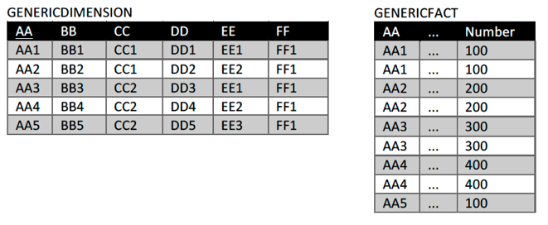
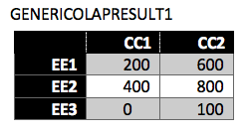
Question 11
Slice and dice
Pivot
Drill-up
Drill-down

Slide 13
Question 12
Slice and dice
Pivot
Drill-up
Drill-down

Slide 14
Question 13
Slice and dice
Pivot
Drill-up
Drill-down

Slide 15
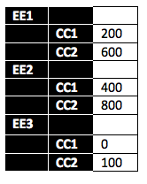
Question 14
Slice and dice
Pivot
Drill-up
Drill-down

Slide 16
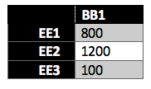
Question 15
Slice and dice
Pivot
Drill-up
Drill-down

Slide 17
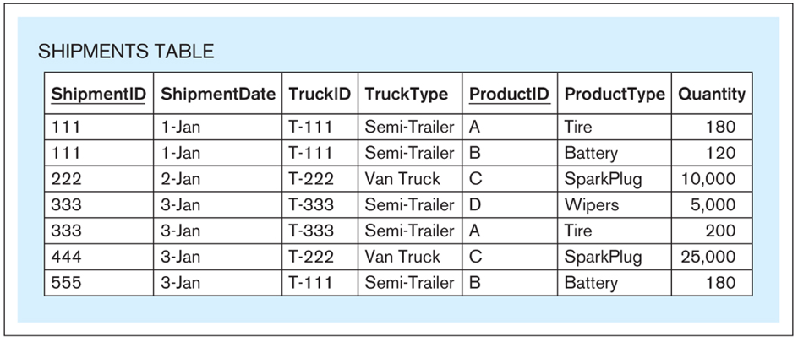
Question 16.a.
Show functional dependencies.

Slide 18
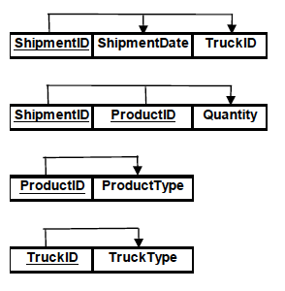
Question 16.b.
Normalize to third normal form (3NF).

Slide 19
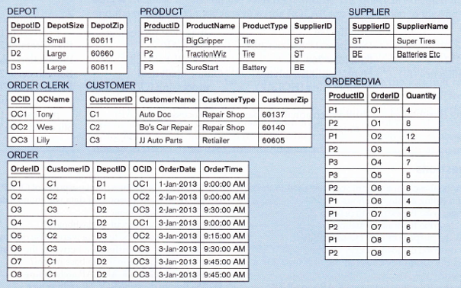
Question 17

Slide 20
Question 17, cont’d
date, including:
full date
day of week
day of month
month
quarter
year
time
product, including:
product ID
product name
product type
product supplier name
customer, including:
customer ID
customer name
customer type
customer zip
depot, including:
depot ID
depot size
depot zip
order clerk, including:
order clerk ID
order clerk name
order clerk title
order clerk education level
order clerk year of hire

Slide 21
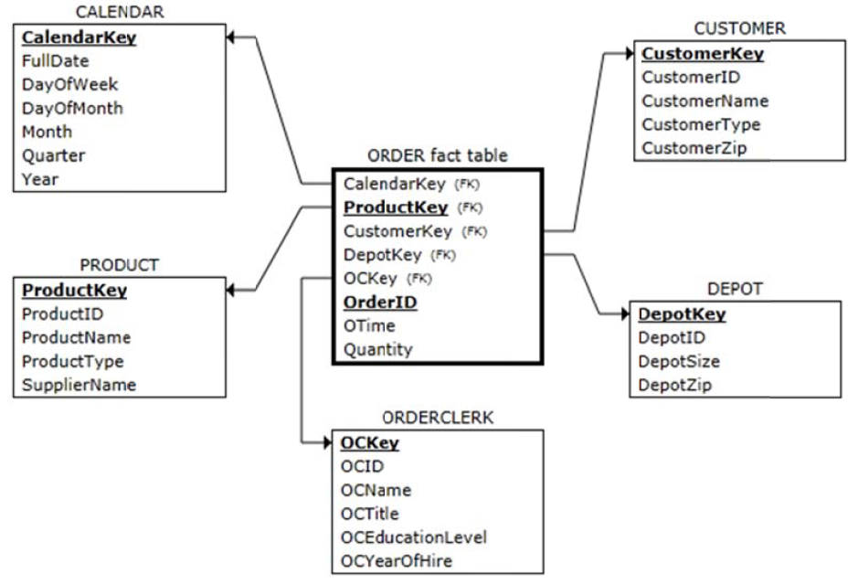
Question 17, cont’d

