Slide 1
CS/SE 157B Database Management Systems II May 8 Class Meeting
Department of Computer Science San Jose State University Spring 2018 Instructor: Ron Mak
www.cs.sjsu.edu/~mak

Slide 2
Data Mining
The analysis step of the overall process of “Knowledge Discovery in Databases” (KDD)
We are data rich but information poor.
Make predictions based on current data.
Discover (“mine”) knowledge from large data sets.
Discover patterns hidden in the data.
Two types of data mining:
descriptive
predictive
Key word:
DISCOVER
Find something new!

Slide 3
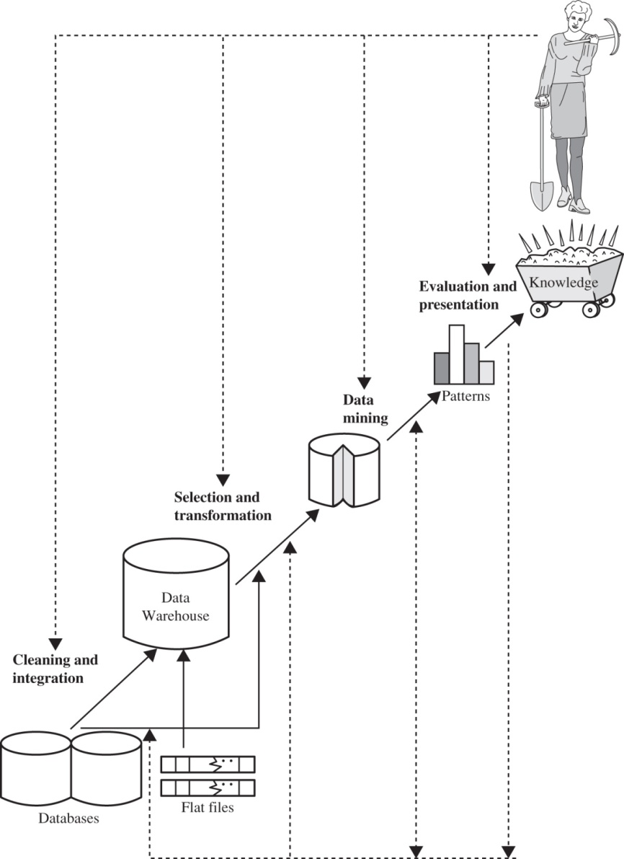
Knowledge Discovery
To be defined: knowledge
Data Mining: Concepts and Techniques
by Jiawei Han, Micheline Kamber, and Jian Pei
Elsevier, 2011

Slide 4
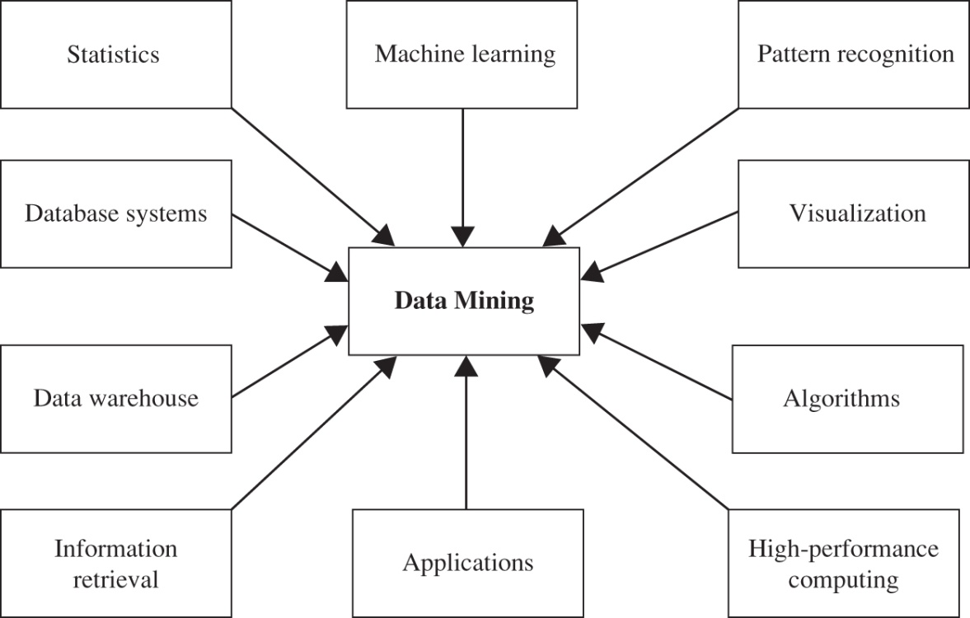
Data Mining Techniques
Integrates techniques from multiple disciplines:
database technology
statistics
machine learning (AI)
high-performance computing
pattern recognition
fuzzy set theory
neural networks
data visualization
information retrieval
knowledge representation
image and signal processing
spatial data analysis
One of the most important frontiers in database systems.
One of the most promising interdisciplinary developments in the information industry.
Data Mining: Concepts and Techniques
by Jiawei Han, Micheline Kamber, and Jian Pei
Elsevier, 2011

Slide 5
Uses of Data Mining
Market segmentation
Identify the common characteristics of customers who buy the same products from your company.
Customer churn
Predict which customers are likely to leave your company and go to a competitor.
Fraud detection
Identify which transactions are most likely to be fraudulent.
http://www.laits.utexas.edu/~anorman/BUS.FOR/course.mat/Alex/

Slide 6
Uses of Data Mining, cont’d
Direct marketing
Identify which prospects should be included in a mailing list to obtain the highest response rate.
Interactive marketing
Predict what each individual accessing a website is most likely interested in seeing.
Market basket analysis
Discover which products or services are commonly purchased together; e.g., beer and diapers.
http://www.laits.utexas.edu/~anorman/BUS.FOR/course.mat/Alex/

Slide 7
New Business Opportunities from Data Mining
Trend analysis
Reveal the difference between a typical customer this month and last.
Automated prediction of trends and behaviors
Automate the process of finding predictive information in a large database.
Questions that traditionally required extensive hands-on analysis can now be directly answered from the data.
http://www.laits.utexas.edu/~anorman/BUS.FOR/course.mat/Alex/

Slide 8
New Business Opportunities, cont’d
Automated prediction of trends and behaviors, cont’d
Example: Targeted marketing
Use data on past promotional mailings to identify the targets most likely to maximize return on investment in future mailings.
Example: Forecast bankruptcy and other forms of default.

Slide 9
New Business Opportunities, cont’d
Automated discovery of previously unknown patterns.
Sweep through databases and identify previously hidden patterns.
Example: Analyze retail sales data to identify seemingly unrelated products that are often purchased together.
Example: Detect fraudulent credit card transactions.
Example: Identify anomalous data that could represent data entry keying errors.
http://www.laits.utexas.edu/~anorman/BUS.FOR/course.mat/Alex/

Slide 10
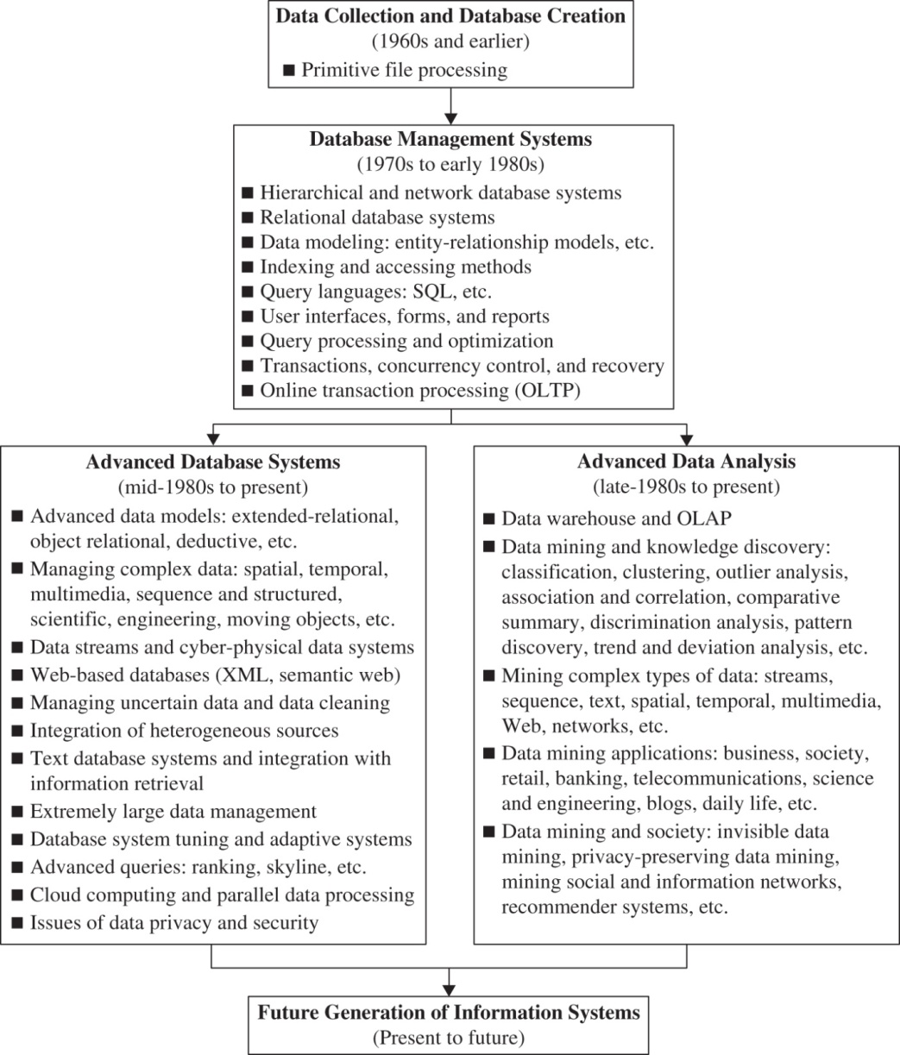
History of Data Mining
Data Mining: Concepts and Techniques
by Jiawei Han, Micheline Kamber, and Jian Pei
Elsevier, 2011

Slide 11
Types of Database Queries
“Standard” query
Extract data that’s in the database.
Example: What was the revenue from a certain product at a particular store on a given date?
OLAP
Slice, dice, drill up, drill down, pivot
Generate views using aggregation and “group by”.
Example: What revenue did we get during Q3 from our northeastern stores?

Slide 12
Types of Database Queries, cont’d
Predictive analytics (data mining)
Use statistical methods to forecast based on existing data.
Example: What are the predicted revenue figures for next quarter?
Finding patterns (data mining)
What interesting patterns exist in the data?
You may not even know ahead of time what questions to ask!

Slide 13
Data Mining Examples
Transactional data
Market basket data analysis
What product items sell well together?
Spatial data
What characteristics do houses have that are located near a park?
What climates are found in mountainous areas at various altitudes?
How does the poverty rate change with distance from major highways?

Slide 14
Data Mining Examples, cont’d
Temporal and time-series data
How should we schedule bank tellers based on customer volume?
What patterns are there in the price of a certain stock over a period of time?
Web data
What patterns are there in path traversals?
What patterns are there in social networks?

Slide 15
Mining Patterns in Data
Characterization
Summarize the general characteristics or features of a target class of data.
Example: What is the profile of a customer who spends over $1000/year at our store?

Slide 16
Mining Patterns in Data, cont’d
Discrimination
Compare the general characteristics or features of a target class of data with those of another class of data.
Example: How do the features of software products whose sales increased by 10% last year compare with those products whose sales decreased by 10%?

Slide 17
Mining Patterns in Data, cont’d
Associations
Discover association rules among attributes and values for frequently occurring conditions.
Example: Amazon recommends books to you based on books you’ve previously looked at or purchased.
Example: Customers aged 20-29 with incomes $30-50K/year will purchase Priuses with 60% probability.
Rules of the form X → Y
age(X, 20...29) && income(X, 30K...50K) → buys(X, Prius) confidence = 60%

Slide 18
Mining Patterns in Data, cont’d
Classification and prediction
Discover a set of models that describe the classes that objects belong to.
Use the models to predict which classes objects belong to.
Implement with:
IF-THEN rules
decision trees
neural networks

Slide 19
Mining Patterns in Data, cont’d
Classification and prediction, cont’d
Example: You want to label certain products in your store as poor sellers, good sellers, or best sellers. Discover a model that uses a product’s characteristics, such as price, color, size, etc. to predict which label to attach to each product.

Slide 20
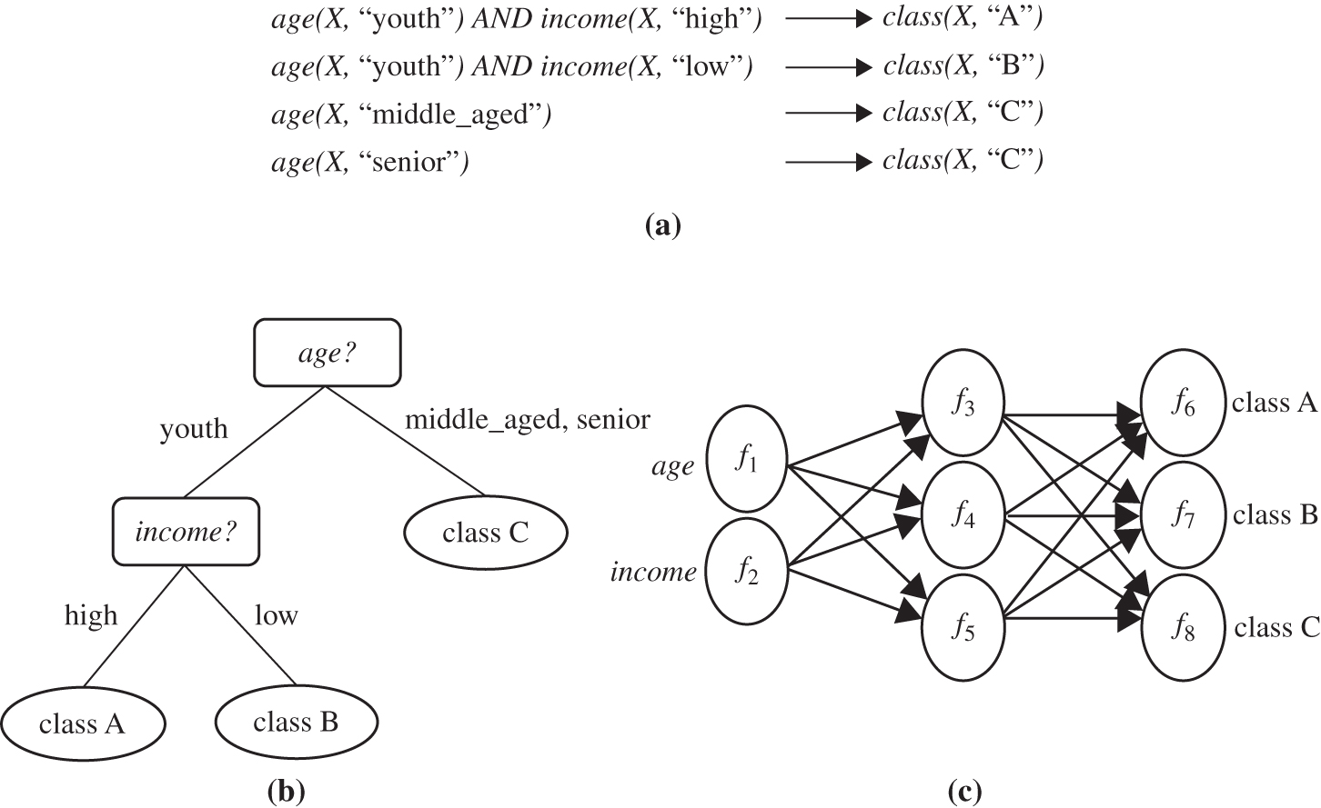
Classification
Data Mining: Concepts and Techniques
by Jiawei Han, Micheline Kamber, and Jian Pei
Elsevier, 2011
A classification model can be represented in various forms:
(a) IF-THEN rules, (b) a decision tree, or (c) a neural network.

Slide 21
Mining Patterns in Data, cont’d
Clusters
Cluster or group objects based on the principle of:
maximize intraclass similarity (similarity within a class)
minimize interclass similarity (separation between classes)
In other words, you want clusters that are separate and distinct.
Cluster analysis is often used to generate labels for subsequent classification and prediction.

Slide 22
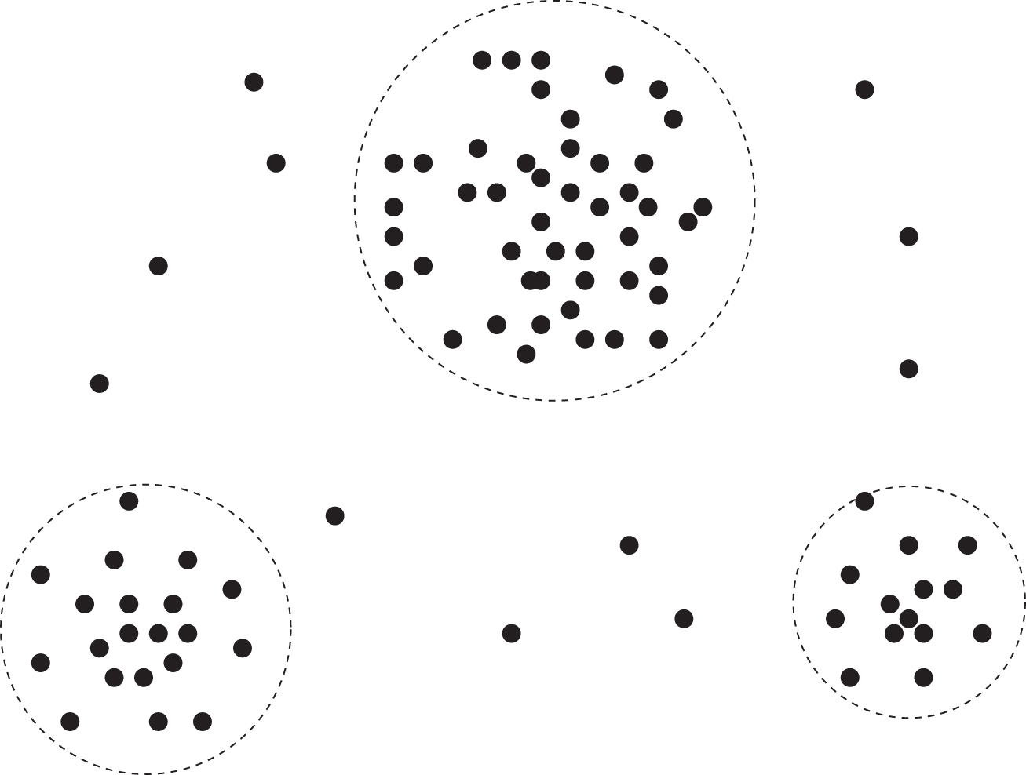
Clusters
Data Mining: Concepts and Techniques
by Jiawei Han, Micheline Kamber, and Jian Pei
Elsevier, 2011
A 2-D plot of customer data with respect to customer locations in a city, showing three data clusters.

Slide 23
Mining Patterns in Data, cont’d
Outliers
Discover data objects that do not comply with the general behavior or model of the data.
Use statistical tests and distance measures.
Do not always discard as noise!
Example: Uncover fraudulent credit card usage.

Slide 24
Mining Patterns in Data, cont’d
Evolution
Discover regularities or trends for data objects whose behavior changes over time.
Analysis can include time-series data analysis, sequence, or periodicity pattern matching, etc.
Example: Look for patterns in the behavior of stocks.

Slide 25
Interesting Patterns
Generally, only a small percentage of patterns discovered by data mining are “interesting”.
A pattern is interesting for a given application if it:
is easily understood by humans
is valid on new data with some degree of certainty
is potentially useful
is novel or unexpected
validates a hypothesis the user wishes to confirm

Slide 26
Interesting Patterns, cont’d
An interesting pattern represents knowledge.
Do not expect a data mining system to:
generate all patterns
generate only interesting patterns

Slide 27
Measuring Interest
Objective measures
Let X → Y be an association rule where X and Y are item-sets.
Let T be a set of transactions of a database.
The support value of X with respect to T is the proportion of transactions in the database that contains the item-set X.
The confidence value of the rule X → Y with respect to T is the proportion of the transactions that contain X and also contain Y.
An application
sets thresholds
for support and
confidence.

Slide 28
Measuring Interest, cont’d
Subjective measures are based on user beliefs in the data.
unexpected patterns
patterns that offer strategic information (“actionable patterns”)
A good data mining system discovers knowledge (interesting patterns) at all levels of data abstraction.

Slide 29
Major Data Mining Issues
Methodology
Diverse data types
User interactions
data mining languages
ad hoc data mining
presentation and visualization of results
handling noisy or incomplete data
evaluating how interesting are the discovered patterns

Slide 30
Major Data Mining Issues
Performance
Ethics, privacy, social impacts
Big Brother is watching you.
Big Brother knows everything about you.
Still a new field!

Slide 31
Big Data
Massive volumes of data.
diverse
rapidly growing
mostly unstructured
Diversity and heterogeneity not adequately handled by relational and dimensional models.
How to handle Big Data:
NoSQL databases
massively parallel databases
MapReduce framework

Slide 32
Hadoop
A set of open source programs and procedures for Big Data analytics.
Four major modules
Hadoop Distributed File System (HDFS)
Store data in a large number of networked storage devices.
MapReduce
Hadoop Common
Java tools to read data from the Hadoop file system.
YARN
Manages resources for data storage and analysis.

Slide 33
MapReduce
Invented by Google in 2004.
Uses a cluster of compute nodes to perform tasks in parallel.

Slide 34
MapReduce, cont’d
Map phase
Map original data records to key-value pairs.
Mapping can be distributed among compute nodes.
Reduce step
Collect all records with the same key.
Generate a single record for every key.
Can also be distributed among the compute nodes, based on the keys.

Slide 35
MapReduce Example
Convert the set of written tennis racket reviews (unstructured data) to quantitative ratings of certain features. The output is the average of all numeric ratings of the tennis racket feature.
Review 1: The X tennis racket is very flexible, with ample power, but provides average control.
Review 2: The Y tennis stick provides medium power and outstanding control.
Review 3: Using the Y racket gives you great control, but you have to generate most of your power. The frame is not very flexible.
Database Systems
by Jukić, Vrbsky, & Nestorov
Pearson 2014
ISBN 978-0-13-257567-6

Slide 36
MapReduce Example, cont’d
Map function output:
Reduce function result
map(R1) -> (<X, flexibility>, 9), (<X, power>, 8), (<X, control>, 5)
map(R2) -> (<Y, power>, 5), (<Y, control>, 10)
map(R3) -> (<Y, control>, 9), (<Y, power>, 3), (<Y, flexibility>, 2)
reduce((<X, flexibility>)) -> (<X, flexibility>, 9)
reduce((<X, power>)) -> (<X, power>, 8)
reduce((<X, control>)) -> (<X, control>, 5)
reduce((<Y, power>)) -> (<Y, power>, 4)
reduce((<Y, control>)) -> (<Y, control>, 9.5)
reduce((<Y, flexibility>)) -> (<Y, flexibility>, 2)
Database Systems
by Jukić, Vrbsky, & Nestorov
Pearson 2014
ISBN 978-0-13-257567-6

Slide 37
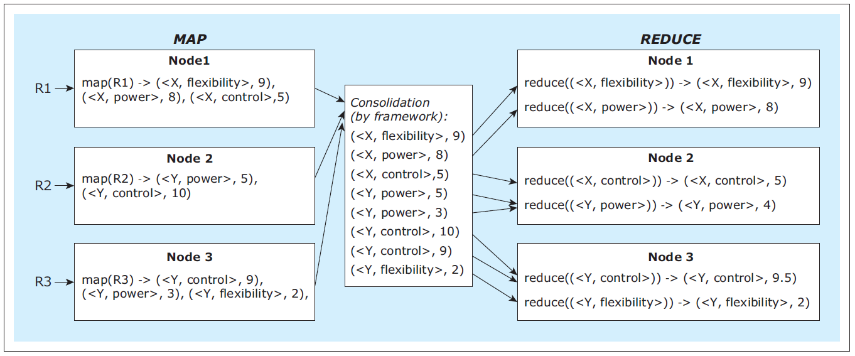
MapReduce Example, cont’d
Distributed computation:
Database Systems
by Jukić, Vrbsky, & Nestorov
Pearson 2014
ISBN 978-0-13-257567-6

Slide 38
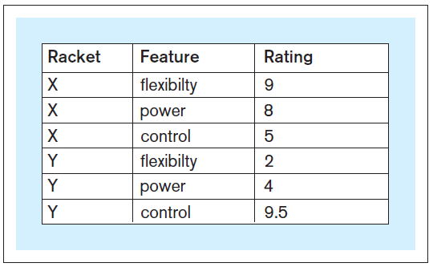
MapReduce Example, cont’d
Output:
The output results are structured.
Loadable into a data warehouse for further analysis.
Database Systems
by Jukić, Vrbsky, & Nestorov
Pearson 2014
ISBN 978-0-13-257567-6

