Slide 1


CS/SE 157B
Database Management Systems II
May 3 Class Meeting
Department of Computer Science
San Jose State University
Spring 2018
Instructor: Ron Mak
www.cs.sjsu.edu/~mak

Slide 2
Unofficial Field Trip
Computer History Museum in Mt. View
  http://www.computerhistory.org/
  Provide your own transportation to the museum.
Saturday, May 5, 11:30 – closing time
  Special free admission.
  Experience a fully restored IBM 1401 mainframe computer from the early 1960s in operation.
  Do a self-guided tour of the Revolution exhibit.
  50 tickets: first come, first served.

Slide 3
Object-Oriented Database (OODB)
An OODB is a database system based on object-oriented concepts.
  OODBMS: object-oriented database management system
Combines features of
  database systems
  object-oriented programming languages
Addresses the limitations of traditional database systems, such as a relational systems.

Slide 4
Applications of OOBDMS
Complex applications that require storing and manipulating objects.
  Require more than typical relational operations.
Objects that don’t fit well into rows and columns.
  Examples: images, maps, video
Example applications:
  Multimedia
  Geographical information systems (GIS)
  Computer-aided design and
  computer-aided manufacturing (CAD/CAM)

Slide 5
Object-Oriented Concepts
An OODB object relates to a real-world object.
  Contains object attributes
  Has object operations (AKA methods)
Similar objects are groups into classes.
  An object is a class instance.

Slide 6
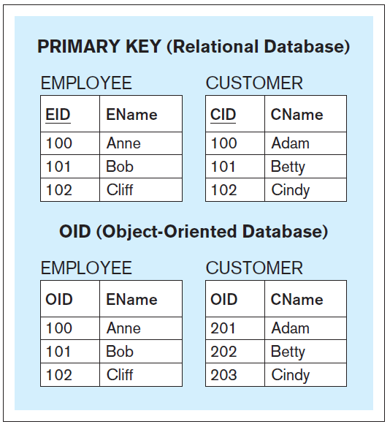
Object Identifier (OID)
Each object of an OODB has
an object identifier (OID).
  System-generated.
  Unique among
  all the objects
  of an OOBD,
  not just the objects
  within a single table.
  Immutable.
  Not considered to be
  an object attribute.
Database Systems
by Jukić, Vrbsky, & Nestorov
Pearson 2014
ISBN 978-0-13-257567-6

Slide 7
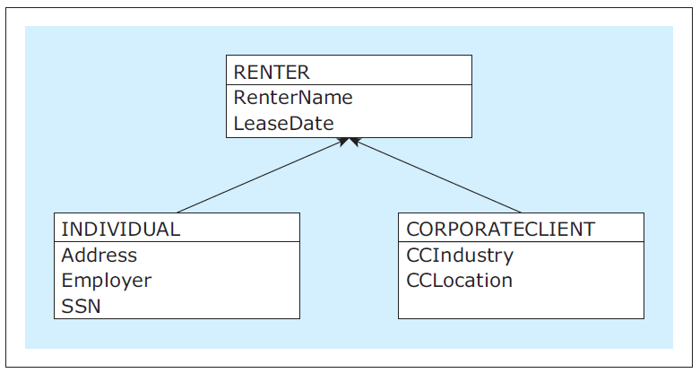
Class Hierarchy
AKA specialization hierarchy
Similar concepts to those in an object-oriented programming language.
  Classes and subclasses
  Inheritance
  “Is-a” relationships
Database Systems
by Jukić, Vrbsky, & Nestorov
Pearson 2014
ISBN 978-0-13-257567-6

Slide 8
User-Defined Type (UDT)
OODB developers can define their own data types to supplement the built-in types.
  Example:
CREATE TYPE renter_type AS
( rentername VARCHAR(25),
leasedate DATE
);
CREATE TYPE individual_type
UNDER renter_type AS
( address VARCHAR(25),
employer VARCHAR(20),
ssn CHAR(9)
);
CREATE TYPE corporateclient_type
UNDER renter_type AS
( ccindustry VARCHAR(25),
cclocation VARCHAR(25)
);
Database Systems
by Jukić, Vrbsky, & Nestorov
Pearson 2014
ISBN 978-0-13-257567-6

Slide 9
Nested Types
CREATE TYPE name_type AS
( firstname VARCHAR(10),
minitial CHAR(1),
lastname VARCHAR (10)
);
CREATE TYPE mgr_type AS
( managerid CHAR(4),
mname name_type,
msalary NUMERIC(9,2)
);
CREATE TYPE bldg_type_nest AS
( buildingid CHAR(3),
bnooffloors INT,
bmanager mgr_type
);

Slide 10
Reference Type
An object can reference (have a pointer to)
another object.
  Indicated by the REF keyword.
  A reference is usually implemented as the
  unique object ID of the object being pointed to.
  Example:
A nested object contains the actual value.
A reference is only the OID.
CREATE TYPE bldg_type_ref AS
( buildingid CHAR(3),
bnooffloors INT,
bmanager REF mgr_type)

Slide 11
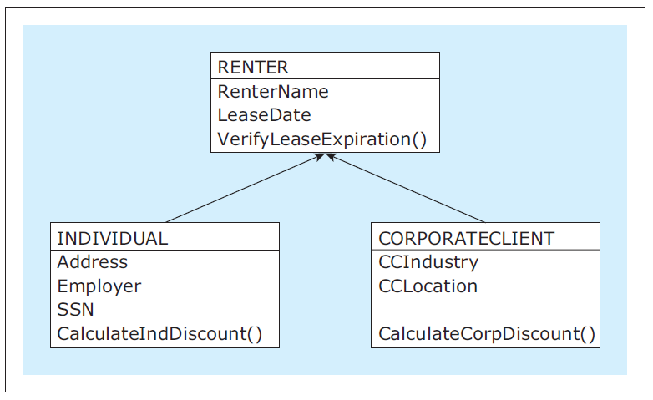
Methods of a Class
A class can define operations (methods)
on its objects as functions.
  Methods can also be inherited from a superclass.
  Example:
Database Systems
by Jukić, Vrbsky, & Nestorov
Pearson 2014
ISBN 978-0-13-257567-6

Slide 12
Object Query Language (OQL)
Designed by the Object Database Management Group (ODMG).
  Complex, hard-to-use language.
  Not fully implemented by any commercial OODBMS.
Operations:
  Create classes
  Insert data into objects
  Update data in objects
  Query objects

Slide 13
OQL, cont’d
Object-oriented:
Relational:
CREATE TYPE name_type AS
( firstname VARCHAR(10),
minitial CHAR(1),
lastname VARCHAR (10)
);
CREATE TYPE mgr_type AS
( managerid CHAR(4),
mname name_type,
msalary NUMERIC(9,2)
);
CREATE TYPE bldg_type_nest AS
( buildingid CHAR(3),
bnooffloors INT,
bmanager REF mgr_type
);
CREATE TABLE manager AS mgr_type;
CREATE TABLE building AS bldg_type_nest;
CREATE TABLE manager
( managerid CHAR(4),
mfirstname VARCHAR(10),
minitial CHAR (1),
mlastname VARCHAR (10)),
msalary NUMERIC (9,2),
PRIMARY KEY (managerid)
);
CREATE TABLE building
( buildingid CHAR (3),
bnooffloors INT,
bmanagerid CHAR(4)
PRIMARY KEY (buildingid),
FOREIGN KEY (bmanagerid)
REFERENCES manager(managerid)
);

Slide 14
OQL, cont’d
Query: List the building ID and the
name of the manager of each building.
Relational query:
OQL query:
  No WHERE clause needed since each
  building object points to its manager object.
SELECT buildingid, mfirstname, minitial, mlastname
FROM manager, building
WHERE managerid = bmanagerid;
SELECT buildingid,
bmanager.firstname, bmanager.minitial, bmanager.lastname
FROM building;

Slide 15
Object-Relational Database (ORDB)
A relational database that contains some
object-oriented features as an extension.
  More common than OODBMS.
  Example: Oracle
Implements the most widely used
object-oriented features.
  OIDs, inheritance, user-defined data types,
  nested objects, reference objects, methods.

Slide 16
ORDB, cont’d
Advantages
  Convenient for users already familiar with RDBMS.
  Gain the additional features of an OODBMS.
Performance penalties
  Object-oriented features are implemented
  on top of the relational data management system.
  Difficult to optimize for performance.

Slide 17
Database Administration
Principle tasks of the database administrator (DBA):
  Monitor and maintain the database system.
  Secure the database against unauthorized access.
  Do database backup and recovery.
  Ensure database integrity.
  Optimize database performance.
  Develop and implement database
  policies and standards.

Slide 18
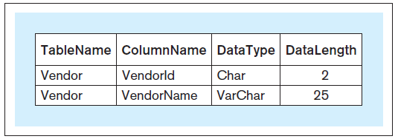
Monitor and Maintain
Monitor which tables are frequently used.
  Denormalize tables that are often joined.
  Materialize views.
Data dictionary
  Metadata repository (data about data).
  Names of tables, names and types of columns, primary keys, referential constraints, etc.
  Example entries:
Database Systems
by Jukić, Vrbsky, & Nestorov
Pearson 2014
ISBN 978-0-13-257567-6

Slide 19
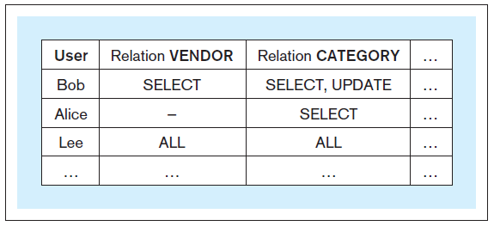
Security
Authenticate users.
Grant and revoke access rights.
  SELECT, UPDATE, ALTER, DELETE, INSERT
Maintain the authorization matrix.
  Example:
GRANT SELECT, UPDATE ON vendor TO alice;
REVOKE UPDATE ON vendor FROM alice;
Database Systems
by Jukić, Vrbsky, & Nestorov
Pearson 2014
ISBN 978-0-13-257567-6

Slide 20
Security, cont’d
Role-based access control.
  Example:
Use data encryption.
  Encrypt passwords and sensitive data.
  Provide the decryption key only to selected users.
CREATE ROLE accountant;
GRANT SELECT ON payroll TO accountant;
GRANT accountant TO brian;

Slide 21
Encryption Primer
Slides presented to high school teachers
as an introduction to data security.

Slide 22



Security
Sending data such as email messages
to each other via the Internet …
… is like sending postcards
via the U.S. mail system.
Anyone can read the
message along the way!
We plan to manufacture 7 million widgets next quarter.
John
Jill

Slide 23

Security, cont’d
We plan to manufacture 7 million widgets next quarter.
John
Jill
Bart
How can we keep the nefarious Bart
from reading confidential messages that
Jill and John are sending each other?

Slide 24
The Shared Secret
Jill needs to send a message containing the confidential data 7 to John.
John and Jill can agree ahead of time to a shared secret – the number 12.
Then Jill can encrypt the data by adding 12
to the confidential data 7.
John decrypts the data by subtracting 12.
19
John
Shared
secret 12
Jill
Shared
secret 12

Slide 25
The Shared Secret, cont’d
19
John
Shared
secret 12
Jill
Shared
secret 12
X
Bart
Because Bart doesn’t know the shared secret 12, he won’t be able to decrypt the message and obtain the confidential data 7.

Slide 26
The Shared Secret, cont’d
19
John
Shared
secret 12
Jill
Shared
secret 12
But this shared secret solution has problems.
  Jill and John must arrange beforehand
  to share the secret 12.
  What if Jill doesn’t already know John?
  What if Jill wants to send the confidential data
  to all her vice presidents at the same time?
How can Jill and all her recipients share a secret?

Slide 27
Public Key Cryptography, cont’d
How can Jill and her recipients share a secret number in order to encrypt the confidential data?
A security scheme called public key cryptography was invented just for this purpose.
In this simplified introduction, let’s pretend
that multiplication is a one-way operation.
  Once you’ve multiplied two numbers, say 4x5=20,
  you can’t recover the original numbers by dividing.
  In other words, you can’t do 20÷4=5 or 20÷5=4

Slide 28
Public Key Cryptography, cont’d
Jill chooses a private key.
  Let’s suppose Jill chooses 10.
Each person to whom she wants to send confidential data also chooses a private key.
  Let’s suppose John chooses 8.
Private
key 10
Jill
John
Private
key 8

Slide 29
Public Key Cryptography, cont’d
Private
key 10
Jill
John
Private
key 8
Public
key 5
Bart
Now Jill announces a public key.
  Let’s suppose the public key is 5.
Everyone can see the public key.
  Including the nefarious Bart.

Slide 30
Public Key Cryptography, cont’d
Jill’s
public-private
key 50
John’s
public-private
key 40
Private
key 10
Jill
John
Private
key 8
Public
key 5
Now Jill can create her public-private key.
  Multiply the public key by her private key: 5x10=50.
John creates his public-private key.
  Multiply the public key by his private key: 5x8=40.

Slide 31
Public Key Cryptography, cont’d
Jill’s
public-private
key 50
John’s
public-private
key 40
Private
key 10
Jill
John
Private
key 8
Public
key 5
Remember that we’re pretending that multiplication is a one-way operation.
  We cannot discover Jill’s private key 10 by dividing her public-private key 50 by the public key 5.
  We cannot discover John’s private key 8 by dividing his public-private key 40 by the public key 5.

Slide 32
Public Key Cryptography, cont’d
Jill’s
public-private
key 50
John’s
public-private
key 40
Private
key 10
Jill
John
Private
key 8
Public
key 5
What is the goal of all this?
  To create a shared secret between Jill and John.
Jill multiplies John’s public-private key by her private key: 40x10=400
John multiplies Jill’s public-private key by his private key: 50x8=400

Slide 33
Public Key Cryptography, cont’d
Shared
secret 400
Jill’s
public-private
key 50
John’s
public-private
key 40
Shared
secret 400
Private
key 10
Jill
John
Private
key 8
Public
key 5
407
Now Jill and John have a shared secret 400.
Jill can encrypt the confidential data 7
by adding the shared secret 400 to obtain 407.
John can decrypt the confidential data 7
by subtracting the shared secret 400 from 407.

Slide 34
Public Key Cryptography, cont’d
407
John
Shared
secret 400
Jill
Shared
secret 400
X
Bart
Bart can’t decrypt the 407 because he
doesn’t know the shared secret 400.

Slide 35
Public Key Cryptography, cont’d
Public key encryption works
with multiple recipients.
Jill needs to send confidential data
to both John and his
twin brother Mark.
Each picks a private key.
Mark
Private
key 2
Private
key 10
Jill
John
Private
key 8

Slide 36
Public Key Cryptography, cont’d
Jill announces the public key 5, and everyone generates his or her public-private key.
  Jill: 5x10=50
  John: 5x8=40
  Mark: 5x2=10
Mark’s
public-private
key 10
Mark
Private
key 2
Public
key 5
Jill’s
public-private
key 50
John’s
public-private
key 40
Private
key 10
Jill
John
Private
key 8

Slide 37
Public Key Cryptography, cont’d
Jill will have a shared secret with each recipient.
  Jill and John will share 400 between them, as before.
  Jill and Mark will have a different shared secret.
    Jill: Multiply Mark’s
    public-private key by
    her private key:
    10x10=100.
    Mark: Multiply Jill’s
    public-private key by
    his private key:
    50x2=100
Mark’s
public-private
key 10
Shared secret
with Jill: 100
Mark
Private
key 2
Public
key 5
Shared secret
with Mark: 100
Jill’s
public-private
key 50
John’s
public-private
key 40
Shared secret
with Jill: 400
Shared secret
with John: 400
Private
key 10
Jill
John
Private
key 8

Slide 38
Public Key Cryptography, cont’d
Jill sends to each recipient.
  Bart can’t decrypt the messages to recover the confidential data 7 because he doesn’t know
  the shared secrets.
Shared secret
with Jill: 100
Mark
107
Shared secret
with John: 400
407
Shared secret
with Jill: 400
Jill
John
Shared secret
with Mark: 100
X
Bart

Slide 39
Cryptography in the Real World
Of course, in the real world, we can’t use simple operations like multiplication and addition to generate keys and to encrypt data.
  Multiplication and addition are
  not one-way operations.
Real-world encryption uses very large
prime numbers and modulo arithmetic.
  Not even the most powerful supercomputer
  can undo such operations.

Slide 40
The Diffie-Hellman Protocol
Public key cryptography is a key exchange protocol first published by Whitfield Diffie
and Martin Hellman in 1976.
  It was actually invented earlier in 1970 by the
  British government, but it was classified.
Whenever you visit a secure website, you are using the Diffie-Hellman protocol or a variant.
  A secure website has a URL that
  starts with https: instead of http:

