Slide 1
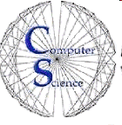
CS/SE 157B Database Management Systems II May 1 Class Meeting
Department of Computer Science San Jose State University Spring 2018 Instructor: Ron Mak
www.cs.sjsu.edu/~mak

Slide 2
Assignment #8
Now due Friday, May 4
Studio now can run on the Mac and Linux.

Slide 3
Distributed Databases
Distributed database system (DDBS)
Distribute the database among separate computers.
Shared data.
Local database control and autonomy.
Reflect the organizational structures that are naturally distributed.

Slide 4
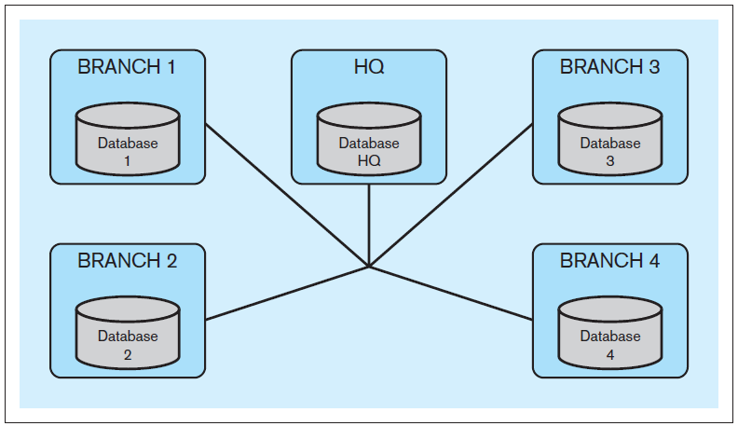
Distributed Databases, cont’d
Example: Bank headquarters and branches.
Each branch maintains data about its customers.
Each branch can access data from other branches.
Each branch can access administrative HQ data.
HQ can access branch data.
Database Systems
by Jukić, Vrbsky, & Nestorov
Pearson 2014
ISBN 978-0-13-257567-6

Slide 5
Distributed Databases, cont’d
Computers that run the DDBS do not share processing or storage devices.
The computers are connected by a network.
The computers can reside in the same building or they may be located in different continents.
Key property: distribution transparency

Slide 6
Distribution Transparency
End users of the DDBS should not be concerned about the distributed nature of the system.
End users of the DDBS should not know if the data they are accessing is stored locally or remotely at a different geographic location.
End users can use the DDBS in the same way as if the data were not distributed.

Slide 7
Homogeneous vs. Heterogeneous
Homogeneous DDBS
The same database management system runs on all computers.
Example: All Oracle or all DB2
Heterogeneous DDBS
Different DBMS’s run on different computers.
Legacy systems
Company merger

Slide 8
DDBS Performance Improvements
Users can access different parts of the database simultaneously.
Without interfering with each other.
Most frequently accessed data at a particular location can be stored locally.
Decreased access time.
Fewer queries per computer.
Increased reliability.
Replicated data.

Slide 9
DDBS Complexities
A DDBS is more complex than a non-distributed database.
Additional functions required:
Keep track of the locations of data and replicas.
Determine which copy to use for queries.
Know which queries are local and which are remote.
Combine results of local and remote queries.
Make sure data remains consistent after updates.

Slide 10
Database Fragmentation
Different strategies to distribute data in a DDBS:
horizontal fragmentation
vertical fragmentation
mixed fragmentation

Slide 11
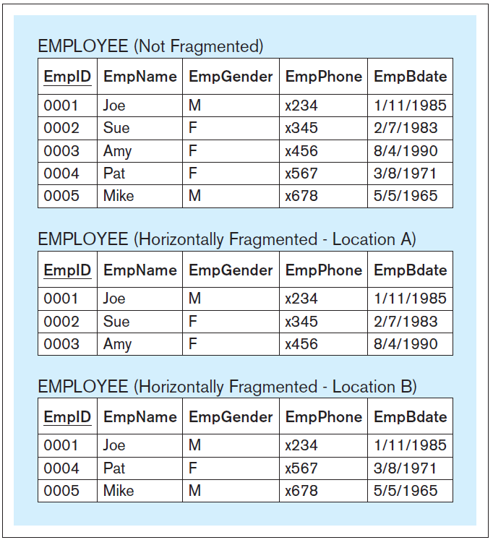
Horizontal Fragmentation
Store subsets of the rows of a table at different locations.
Standard query:
SELECT * FROM employee_location_A
UNION
SELECT * FROM employee_location_B;
Transparent DDBS query:
SELECT * FROM employee
Database Systems
by Jukić, Vrbsky, & Nestorov
Pearson 2014
ISBN 978-0-13-257567-6

Slide 12
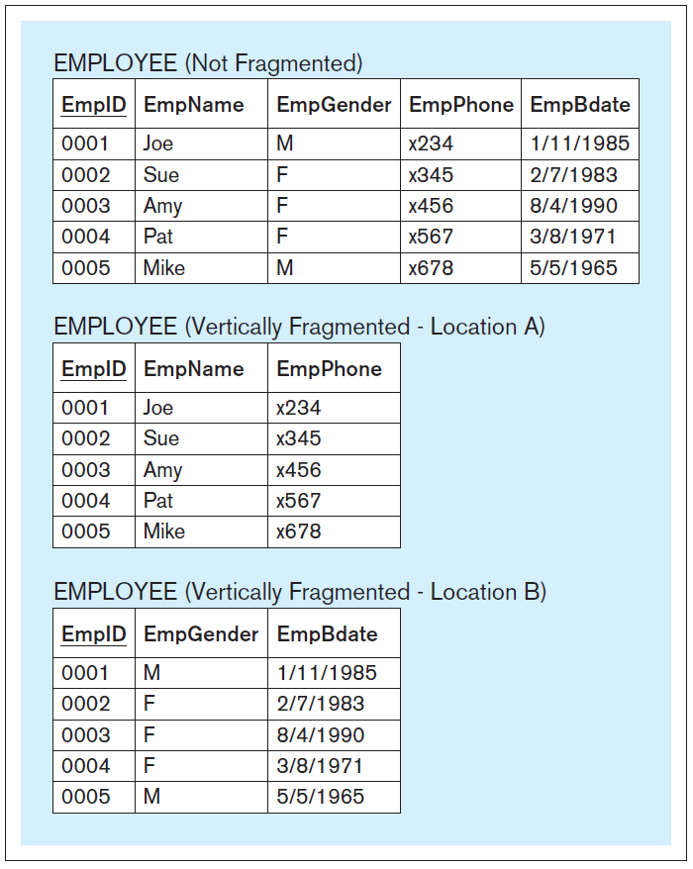
Vertical Fragmentation
Store subsets of the columns of a table at different locations.
Standard query:
SELECT a.empid, a.empname,
b.empgender, a.empphone,
b.empbdate
FROM employee_location_a a,
employee_location_b b
WHERE a.empid = b.empid;
Transparent DDBS query:
SELECT * FROM employee
Database Systems
by Jukić, Vrbsky, & Nestorov
Pearson 2014
ISBN 978-0-13-257567-6

Slide 13
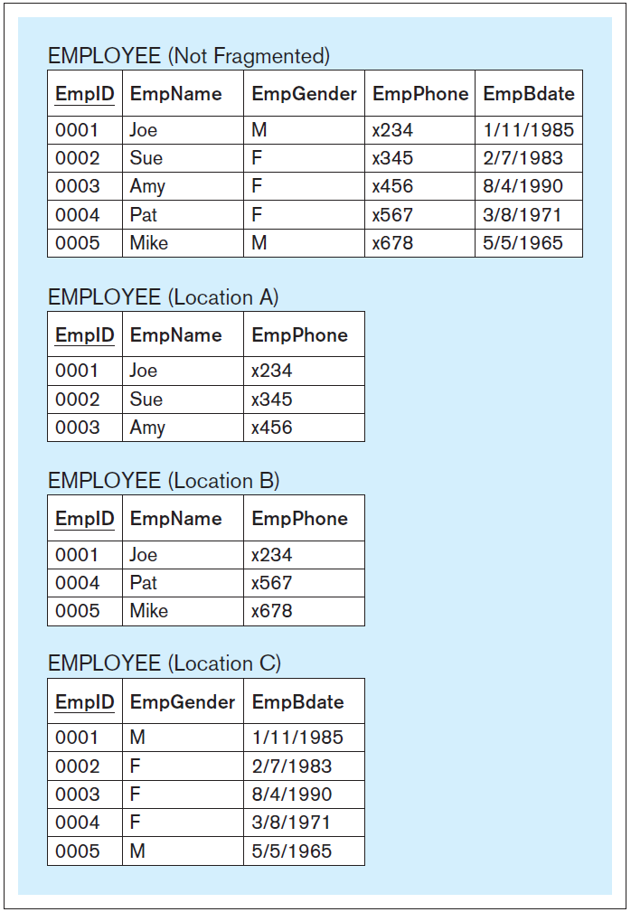
Mixed Fragmentation
A combination of horizontal and vertical fragmentation.
Standard query:
SELECT a.empid, a.empname,
c.empgender, a.empphone,
c.empbdate
FROM employee_location_a a,
employee_location_c c
WHERE a.empid = c.empid
UNION
SELECT b.empid, b.empname,
c.empgender, b.empphone,
c.empbdate
FROM employee_location_b b,
employee_location_c c
WHERE b.empid = c.empid;
Transparent DDBS query:
SELECT * FROM employee
Database Systems
by Jukić, Vrbsky, & Nestorov
Pearson 2014
ISBN 978-0-13-257567-6

Slide 14
Data Replication
Store more than one copy of the data at different locations in a distributed database.
Fully replicated DDBS
The entire database is replicated at each location in the DDBS.
Partially replicated DDBS
Only some parts of database are replicated at multiple locations.

Slide 15
Federated Databases
Connect a collection of preexisting databases into one system.
Use a data federation tool.
Provide data virtualization.
Example: Cisco Information Server

Slide 16
Parallel Databases
Multiple computers perform the same operations simultaneously on different portions of the same database.
Massively parallel processing (MPP)
A large number of separate computer processors run in parallel to execute a single program.
Shared-nothing MPP architecture
A parallel system in which each processor has its own memory and disk storage

Slide 17
Databases and Cloud Computing
Data storage, management, and processing services delivered in the “cloud”.
Hosted by an Internet service provider (ISP).
Create databases in the ISP’s storage.
The ISP provides backup and recovery services.
Connect to and access database data via the Internet.
Computing resources on demand.
Users increase or decrease resources as needed.

Slide 18
Advantages of Cloud Computing
Can be cost-effective for an organization.
No computer hardware and software investment.
Reduced or no IT support staff.
Elasticity
On-demand access to computing resources
Scale up or down based on dynamic workloads
Pay-per-use model
Distributed computing
Multiple data centers geographically distributed
Highly parallelized computing.

Slide 19
Advantages of Cloud Computing, cont’d
Virtualization
Multiple users can use the same computing resource simultaneously.
A single server can emulate different physical machines and run different operating systems.
Reliability and availability
Replicated processes and data can transparently and quickly take over from a failed machine.

Slide 20
Problems of Cloud Computing
Security and privacy risks
Store an organization’s data off premises in a third-party vendor’s servers.
Must trust the cloud host.
Government regulations
Distributed data can be stored on servers that are located in foreign countries.
Different laws regarding government access to data.

Slide 21
Categories of Cloud Services
Infrastructure as a Service (IaaS)
Platform as a Service (PaaS)
Software as a Service (SaaS)
Database as a Service (DaaS)

Slide 22
Infrastructure as a Service (IaaS)
Provide hardware as standardized services over the network.
Customer rent resources.
server space
network equipment
processing cycles
storage space

Slide 23
Platform as a Service (PaaS)
Provide all the resources a customer needs to build applications.
Platform consists of:
operating system
middleware
application software
development environment
Interact with the platform via an interface.
The platform scales itself according to the customer’s needs.

Slide 24
Software as a Service (SaaS)
A software application offered as an on-demand service.
The application is hosted by the ISP and operated by customers over the Internet.
Multitenant
Multiple clients simultaneously use a single instance of the application that is running in the cloud.

Slide 25
Database as a Service (DaaS)
Database management in the cloud.
A specialized version of SaaS.
Cloud-based databases solve some key difficulties of large-scale data processing.
Automatically scale up and down based on dynamic workloads.
Well-suited for analytical databases.
Few or no updates.
Harder for operational databases due to update complexities and performance penalties.

