Slide 1
CS/SE 157B Database Management Systems II April 24 Class Meeting
Department of Computer Science San Jose State University Spring 2018 Instructor: Ron Mak
www.cs.sjsu.edu/~mak

Slide 2
Unofficial Field Trip
Computer History Museum in Mt. View
http://www.computerhistory.org/
Provide your own transportation to the museum.
Saturday, May 5, 11:30 – closing time
Special free admission.
Experience a fully restored IBM 1401 mainframe computer from the early 1960s in operation.
Do a self-guided tour of the Revolution exhibit.
50 tickets: first come, first served.

Slide 3
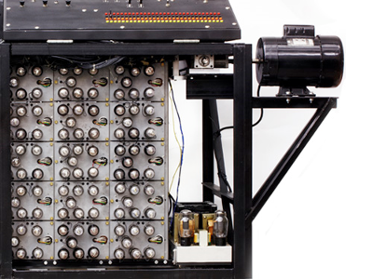
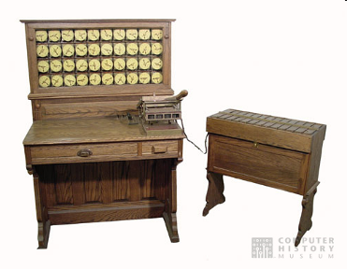
Unofficial Field Trip, cont’d
See the extensive Revolution exhibit!
Walk through a timeline of the First 2000 Years of Computing History.
Historic computer systems, data processing equipment, and other artifacts.
Small theater presentations.
Hollerith
Census
Machine
Atanasoff-Berry
Computer

Slide 4
Unofficial Field Trip, cont’d
IBM 1401 computer, fully restored and operational.
A small transistor-based mainframe computer.
Extremely popular with small businesses in the late 1950s through the mid 1960s
Maximum of 16K bytes of memory.
800 card/minute card reader (wire brushes).
600 line/minute line printer (impact).
6 magnetic tape drives, no disk drives.

Slide 5
Unofficial Field Trip, cont’d
Information on the IBM 1401:
General info: http://en.wikipedia.org/wiki/IBM_1401
My summer seminar: http://www.cs.sjsu.edu/~mak/1401/
Restoration: http://ed-thelen.org/1401Project/1401RestorationPage.html

Slide 6
How to Improve Query Performance
Three ways to improve query performance:
You can write better queries.
You can use smarter indexing.
The database server does query optimization.

Slide 7
Better Queries: Minimize Data Retrieval
Write queries that retrieve only the data that you need.
more data = more disk I/O
more data = more network traffic
Instead of SELECT *, specify the columns that you want.
Include only the columns that you need.

Slide 8
Better Queries: Limit Results
Add the LIMIT or TOP clauses to queries to set a maximum number of rows for the result set.
ROWNUM is equivalent to LIMIT.
SELECT driverslicensenr, name FROM Drivers LIMIT 2;
SELECT TOP 3 driverslicensenr, name FROM Drivers;
SELECT driverslicensenr, name
FROM Drivers
WHERE driverslicensenr = 123456 AND ROWNUM <= 3;
https://www.datacamp.com/community/tutorials/sql-tutorial-query

Slide 9
Better Queries: DISTINCT
SELECT DISTINCT returns only distinct values.
Avoid if possible.
Increases execution time.

Slide 10
Better Queries: LIKE
LIKE operator in a query:
Prevents the index (if it exists) from being used if the pattern starts with % or _.
Can retrieve more records than necessary to satisfy your query goal.

Slide 11
Better Queries: Data Types
Always use the smallest data type possible.
Avoid doing data conversions.
Slows down queries.

Slide 12
Better Queries: OR Operator
Try to use alternatives to the OR operator.
The operator can prevent the index from being used.
Therefore, queries are slower.
Instead of:
Write instead:
SELECT driverslicensenr, name
FROM Drivers
WHERE driverslicensenr = 123456
OR driverslicensenr = 678910
OR driverslicensenr = 345678;
SELECT driverslicensenr, name
FROM Drivers
WHERE driverslicensenr IN (123456, 678910, 345678);
https://www.datacamp.com/community/tutorials/sql-tutorial-query

Slide 13
Better Queries: AND Operator
Try to use alternatives to the AND operator.
The operator can prevent the index from being used.
Therefore, queries are slower.
Instead of:
Write instead:
SELECT driverslicensenr, name
FROM Drivers
WHERE year >= 1960
AND year <= 1980;
SELECT driverslicensenr, name
FROM Drivers
WHERE year BETWEEN 1960 AND 1980;
https://www.datacamp.com/community/tutorials/sql-tutorial-query

Slide 14
Better Queries: NOT Operator
Try to use alternatives to the NOT operator.
The operator can prevent the index from being used.
Therefore, queries are slower.
Instead of:
Write instead:
SELECT driverslicensenr, name
FROM Drivers
WHERE NOT (year > 1980);
SELECT driverslicensenr, name
FROM Drivers
WHERE year <= 1980;
https://www.datacamp.com/community/tutorials/sql-tutorial-query

Slide 15
Better Queries: Use De Morgan’s Set Laws
The clause
Is equivalent to
Therefore, write
WHERE NOT ( (salary < 75000)
OR (salary > 90000))
WHERE (NOT salary < 75000)
AND (NOT salary > 90000)
WHERE (salary >= 75000)
AND (salary <= 90000)
WHERE salary BETWEEN 75000 AND 90000

Slide 16
Better Queries: UNION Operator
Avoid SELECT with two UNION operators.
Requires going through the data multiple times.
Therefore, queries are slower.
Reformulate the query:
Put all the conditions into one SELECT statement.
Or use an OUTER JOIN instead of a UNION.

Slide 17
Better Queries: EXISTS
In a correlated subquery with EXISTS, try to use a constant in the SELECT statement of that subquery instead of selecting the value of an actual column.
Handy when checking for existence only.
correlated subquery: a subquery that uses values from the outer query.
SELECT driverslicensenr, name
FROM Drivers
WHERE EXISTS (SELECT '1’
FROM Fines
WHERE fines.driverslicensenr = drivers.driverslicensenr)
https://www.datacamp.com/community/tutorials/sql-tutorial-query

Slide 18
Better Queries: EXISTS, cont’d
SELECT driverslicensenr, name
FROM Drivers
WHERE EXISTS (SELECT '1’
FROM Fines
WHERE fines.driverslicensenr = drivers.driverslicensenr)
Even better: Get rid of the correlated subquery by replacing it with an inner join:
SELECT driverslicensenr, name
FROM drivers
INNER JOIN fines
ON fines.driverslicensenr = drivers.driverslicensenr;
SELECT driverslicensenr, name
FROM drivers, fines
WHERE fines.driverslicensenr = drivers.driverslicensenr;
https://www.datacamp.com/community/tutorials/sql-tutorial-query

Slide 19
Better Queries: GROUP BY HAVING
HAVING is typically used with the GROUP BY clause to restrict the groups of returned rows to only those that meet certain conditions.
The WHERE clause determines which table records will be part of the result and which will not.
The HAVING clause determines which groups will be part of the result and which will not.
HAVING results in the index not being used.

Slide 20
Better Queries: GROUP BY HAVING, cont’d
Don’t write:
This query sums up all the rows in the table and then HAVING throws away calculated sums.
Instead write:
The WHERE clause limits the number of rows to sum.
SELECT state, COUNT(*)
FROM Drivers
GROUP BY state
HAVING state IN ('GA', 'TX’)
ORDER BY state
SELECT state, COUNT(*) FROM Drivers
WHERE state IN ('GA', 'TX’)
GROUP BY state
ORDER BY state
Goal: Minimize the number of intermediate rows.

Slide 21
Better Queries: Aggregation Operators
Aggregation functions: SUM, AVG, MIN, MAX, etc.
Aggregating over many rows can result in a long-running query.
Try to minimize the number of rows.
Or pre-calculate the values.

Slide 22
Better Queries: Isolate Columns in Conditions
A column used in a calculation or in a scalar function:
The index isn’t used.
Isolate the specific column so that it is no longer a part of the calculation or the function.
Instead of:
Write instead:
SELECT driverslicensenr, name
FROM Drivers
WHERE year + 10 = 1980;
SELECT driverslicensenr, name
FROM Drivers
WHERE year = 1970;

Slide 23
Better Queries: Joins
The order of the tables in a join can be important.
If one table of the join is much larger than the others, put the largest tables last.
Do not have too many conditions in a join.
Too many conditions limits what the query optimizer (discussed later) can do.

Slide 24
Query Optimization
Whenever you submit an SQL query to the database management server, the DBMS first parses it in order to build a parse tree.
Parsing means to break the SQL statement into its constituent parts.
A parse tree is a tree-structured representation of the statement as constructed from its parts.
The DBMS then passes the parse tree to the rewrite engine.

Slide 25
Optimal Execution Plan
The rewrite engine invokes the query optimizer.
The optimizer finds the optimal execution plan for the given query.
AKA query plan
The execution plan defines exactly what algorithm is used for each operation, and how the execution of the operations is coordinated.

Slide 26
Optimal Execution Plan, cont’d
The optimizer enumerates all possible execution plans.
In order to choose the most optimal plan, the optimizer must:
Analyze the current state of the database.
Determine the cost of each plan.

Slide 27
Current State of the Database
The database’s current state is determined by a set of statistics about the data model.
Stored in the system catalog.
Any change in the set of statistics can affect which plan the DBMS chooses as most optimal.

Slide 28
Cost of an Execution Plan
Cost is the amount of resources consumed during the execution of an SQL statement.
Cost factors:
The number of disk I/O’s that are required to evaluate the execution plan.
The plan’s CPU usage.
The plan’s total execution time.

Slide 29
Cost of an Execution Plan, cont’d
Cost calculation:
One CPU unit is the amount of time needed to execute one operation.
One I/O unit is the amount of time needed to read or write one page = 1000 CPU units.
One Com unit is the amount of time needed to send one network message = 1.5 I/O units.

Slide 30
Query Execution
Database administrators may need to manually examine and tune the plans produced by the optimizer to further improve performance.
The optimizer uses heuristics to make an educated guess.
https://www.datacamp.com/community/tutorials/sql-tutorial-query

Slide 31
EXPLAIN
The MySQL/MariaDB EXPLAIN command provides information about how the DBMS executes statements.

Slide 32
EXPLAIN Example
SELECT salesperson.id AS pid, salesperson.name AS pname,
-> customer.id AS cid, customer.name AS cname,
-> customer.gender AS cgender,
-> transaction.id AS tid, vin, make, model_year, price
-> FROM salesperson, transaction, car, customer
-> WHERE transaction.salesperson_id = salesperson.id
-> AND transaction.id = car.tid
-> AND transaction.customer_id = customer.id
-> AND transaction.month_num = 9
-> ORDER BY pid, make, gender;
+-----+--------+-----+--------+---------+-----+-------+------------+------------+-------+
| pid | pname | cid | cname | cgender | tid | vin | make | model_year | price |
+-----+--------+-----+--------+---------+-----+-------+------------+------------+-------+
| 11 | Sarah | 333 | Tom | m | 2 | 12345 | chevy | 1975 | 8000 |
| 11 | Sarah | 777 | Arnold | m | 10 | 77777 | honda | 2005 | 12000 |
| 11 | Sarah | 333 | Tom | m | 2 | 88888 | toyota | 2015 | 25000 |
| 11 | Sarah | 777 | Arnold | m | 10 | 98765 | volkswagen | 1965 | 2000 |
| 22 | Leslie | 444 | Susan | f | 1 | 66666 | honda | 2014 | 22000 |
| 22 | Leslie | 222 | Mara | f | 4 | 33333 | volvo | 2015 | 30000 |
| 22 | Leslie | 444 | Susan | f | 1 | 44444 | volvo | 1996 | 25000 |
| 22 | Leslie | 222 | Mara | f | 11 | 45678 | volvo | 1983 | 10000 |
| 33 | Steve | 666 | Max | m | 5 | 11111 | ford | 2016 | 30000 |
| 44 | Judy | 333 | Tom | m | 7 | 99999 | ford | 2012 | 15000 |
| 44 | Judy | 333 | Tom | m | 7 | 22222 | ford | 2016 | 20000 |
| 55 | Bruno | 111 | Ron | m | 6 | 55555 | volvo | 2014 | 30000 |
+-----+--------+-----+--------+---------+-----+-------+------------+------------+-------+
12 rows in set (0.00 sec)

Slide 33
EXPLAIN Example, cont’d
EXPLAIN SELECT salesperson.id AS pid, salesperson.name AS pname,
-> customer.id AS cid, customer.name AS cname,
-> customer.gender AS cgender,
-> transaction.id AS tid, vin, make, model_year, price
-> FROM salesperson, transaction, car, customer
-> WHERE transaction.salesperson_id = salesperson.id
-> AND transaction.id = car.tid
-> AND transaction.customer_id = customer.id
-> AND transaction.month_num = 9
-> ORDER BY pid, make, gender;
+------+-------------+-------------+--------+------------------------------------+
| id | select_type | table | type | possible_keys |
+------+-------------+-------------+--------+------------------------------------+
| 1 | SIMPLE | car | ALL | tid |
| 1 | SIMPLE | transaction | eq_ref | PRIMARY,customer_id,salesperson_id |
| 1 | SIMPLE | customer | eq_ref | PRIMARY |
| 1 | SIMPLE | salesperson | ALL | PRIMARY |
+------+-------------+-------------+--------+------------------------------------+
4 rows in set (0.01 sec)

Slide 34
EXPLAIN Example, cont’d
+---------+---------+---------------------------------------+------+
| key | key_len | ref | rows |
+---------+---------+---------------------------------------+------+
| NULL | NULL | NULL | 12 |
| PRIMARY | 4 | cardealership.car.tid | 1 |
| PRIMARY | 4 | cardealership.transaction.customer_id | 1 |
| NULL | NULL | NULL | 5 |
+---------+---------+---------------------------------------+------+
+-------------------------------------------------+
| Extra |
+-------------------------------------------------+
| Using temporary; Using filesort |
| Using where |
| |
| Using where; Using join buffer (flat, BNL join) |
+-------------------------------------------------+

Slide 35
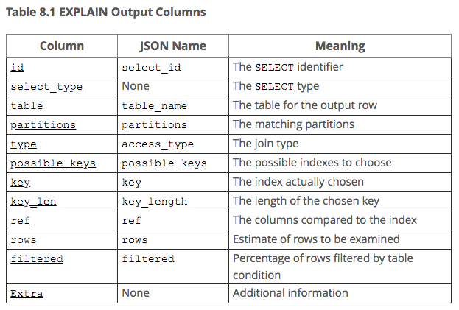
EXPLAIN Example, cont’d
https://dev.mysql.com/doc/refman/5.7/en/explain-output.html

Slide 36
Time Complexity
Time complexity measures how a query scales.
How does the query time change as the size N of the table changes?
Example: Does doubling the table size also double the query time?
Time complexity uses “big O” notation.
That’s the capital letter O.
Example: O(1), O(log₂ N), O(N²)

Slide 37
O(1): Constant Time
A query runs in constant time if it doesn’t matter how large the table is.
Example:
SELECT TOP 1 t.*
FROM t

Slide 38
O(N): Linear Time
A query runs in linear time if its execution time is directly proportional to the table size.
Double the table size, double the time, etc.
Example: The entire table must be scanned to count the rows.
However, if the row count is stored for the table, then the time complexity is O(1).
SELECT COUNT(*)
FROM Teachers;

Slide 39
O(log N): Logarithmic Time
A query runs in logarithmic time if its execution time is proportional to the logarithm of the table size.
Example: If the table is indexed on teacher_id, then the DBMS can use a binary search, and the time complexity is O(log₂ N).
However, if there is no index, then the time complexity is O(N).
SELECT teacher_name FROM teachers WHERE teacher_id = 12345

Slide 40
O(N²): Quadratic Time
A query runs in quadratic time if its execution time is proportional to the square of the table size.
Example: For each row of the students table, every row of the teachers table must be checked.
SELECT student_name, teacher_name FROM students, teachers WHERE students_advisor_id = teacher_id

Slide 41
Time Complexities Compared
https://www.datacamp.com/community/tutorials/sql-tutorial-query

