Slide 1
CS/SE 157B Database Management Systems II April 19 Class Meeting
Department of Computer Science San Jose State University Spring 2018 Instructor: Ron Mak
www.cs.sjsu.edu/~mak

Slide 2
Transaction Management
Protect the database during transactions.
Concurrency control
Allow simultaneous use of the database without users interfering with one another.
Recovery
Restore the database to a correct state after a failure.

Slide 3
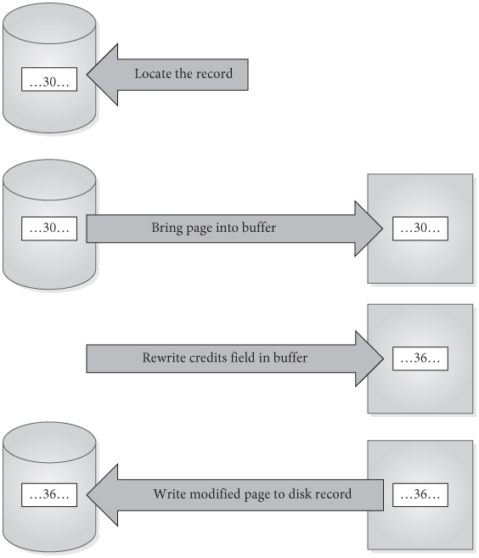
Simple Update of One Record
Locate the record to be updated.
Bring the page into the buffer
Write the update to the buffer.
Write the modified page out to disk.
Databases Illuminated, 3rd ed.
by Ricardo & Urban
Jones & Bartlett Learning, 2017
ISBN 978-1-284-05694-5

Slide 4
Steps in a Transaction
More complicated transactions may involve several updates.
A modified buffer page might not be written to disk immediately after transaction terminates.
There could be a delay before the actual disk write is done.

Slide 5
Basic Ideas About Transactions
Transaction: a logical unit of work that takes the database from one consistent state to another.
Transactions can terminate successfully and commit.
Transactions can terminate unsuccessfully and be aborted.
Aborted transactions must be rolled back (undone) if they changed the database.
Committed transactions cannot be rolled back.

Slide 6
ACID Properties of Transactions: Atomicity
The entire set of database update operations are all carried out, or none are.
The DBMS must roll back transactions if they have changed the database but will not be able to complete successfully.
The rollback process uses the log of the transaction writes.

Slide 7
ACID Properties of Transactions: Consistency
Users are responsible for ensuring that each transaction, if executed individually, leaves the database in a consistent state.
The concurrency control subsystem must ensure this for multiple transactions.

Slide 8
ACID Properties of Transactions: Isolation
When transactions execute simultaneously, the DBMS ensures that the final effect is as if the transactions were executed serially.

Slide 9
ACID Properties of Transactions: Durability
The effect of any committed transaction is recorded in the database.
Even if the system crashes before all its writes are made to the database.
The recovery subsystem guarantees durability.

Slide 10
Transaction Support in MySQL
MySQL is normally in auto-commit mode.
Each statement is committed as soon as it has executed.
Each statement is its own transaction.
To perform an explicit transaction, turn off auto-commit with START TRANSACTION.
ROLLBACK or COMMIT a transaction.

Slide 11
MySQL Transaction Example
> use superhakerz;
> create table test (fld int);
> select * from test;
Empty set (0.00 sec)
> insert into test (fld) values (10);
> select * from test;
+------+
| fld |
+------+
| 10 |
+------+
> start transaction;
> insert into test (fld) values (20);
> insert into test (fld) values (30);
> select * from test;
+------+
| fld |
+------+
| 10 |
| 20 |
| 30 |
+------+

Slide 12
MySQL Transaction Example, cont’d
> insert into test (foo) values (40);
ERROR 1054 (42S22): Unknown column 'foo' in 'field list'
> select * from test;
+------+
| fld |
+------+
| 10 |
| 20 |
| 30 |
+------+
> rollback;
> select * from test;
+------+
| fld |
+------+
| 10 |
+------+

Slide 13
MySQL Transaction Example, cont’d
> start transaction;
> insert into test (fld) values (40);
> insert into test (fld) values (50);
> commit;
> select * from test;
+------+
| fld |
+------+
| 10 |
| 40 |
| 50 |
+------+
> start transaction;
> insert into test (fld) values (60);
> select * from test;
+------+
| fld |
+------+
| 10 |
| 40 |
| 50 |
| 60 |
+------+

Slide 14
MySQL Transaction Example, cont’d
> insert into test (foo) values (70);
ERROR 1054 (42S22): Unknown column 'foo' in 'field list’
> rollback;
> select * from test;
+------+
| fld |
+------+
| 10 |
| 40 |
| 50 |
+------+

Slide 15
Concurrency Problems
Concurrency control is needed when transactions are permitted to execute simultaneously, if at least one is an update.
Potential problems due to lack of concurrency control:
Lost update
Uncommitted update
Inconsistent analysis

Slide 16
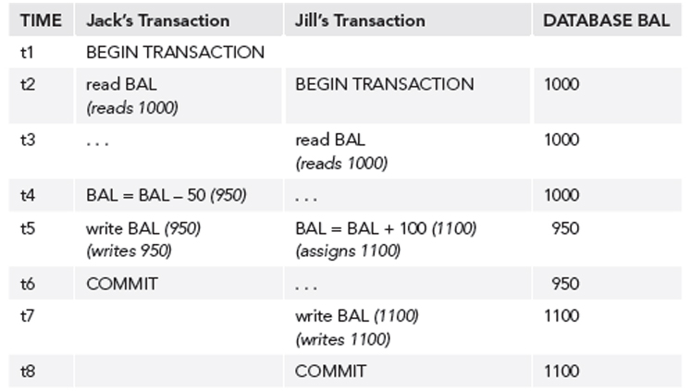
Lost Update Problem
Jack’s update is lost.

Slide 17
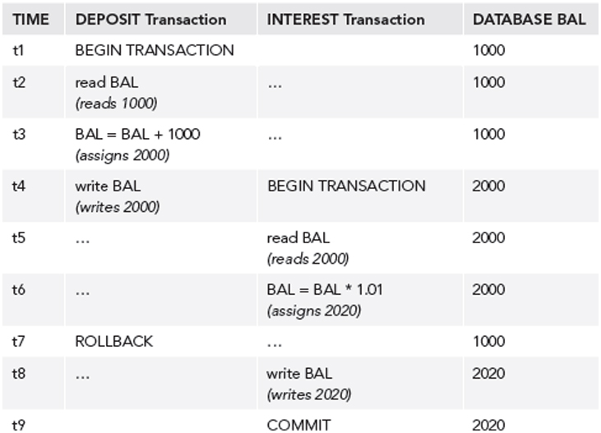
Uncommitted Update Problem
The rollback invalidates data used by the other.

Slide 18
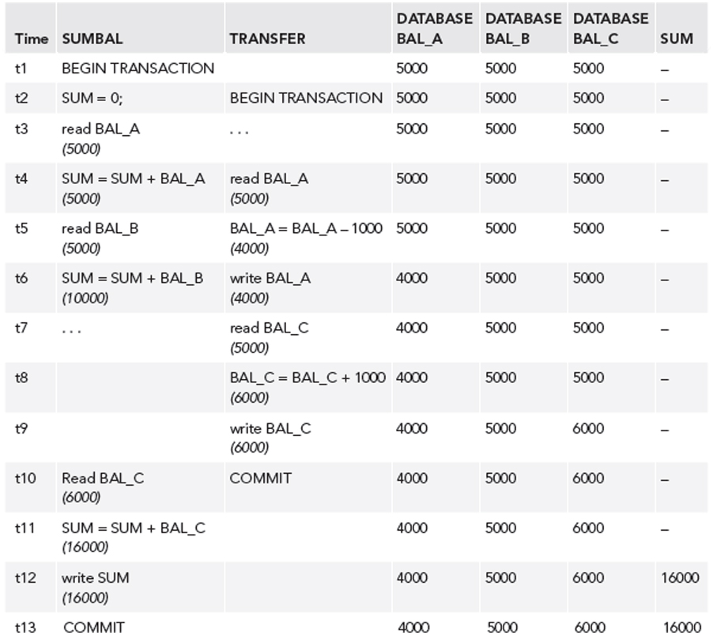
Inconsistent Analysis Problem
Transaction SUMBAL
reads several values
to sum them.
But meanwhile,
transaction TRANSFER
updates those values.

Slide 19
Non-Repeatable Read Problem
The first transaction reads an item.
The second transaction writes a new value for the item.
The first transaction rereads the item and gets a different value.

Slide 20
Phantom Data Problem
The transaction T1 reads a set of rows.
The transaction T2 inserts a row.
The transaction T1 reads the rows again and sees the new row.

Slide 21
Transaction Conflicts
If two transactions are only reading data items, they do not conflict and order is not important.
If two transactions operate on completely separate data items, they do not conflict and order is not important.

Slide 22
Transaction Conflicts, cont’d
If one transaction writes to a data item and another either reads or writes to the same data item, then the order of execution is important.
Therefore, two operations conflict only if all of these are true:
They belong to different transactions.
They access the same data item.
At least one of them writes the item.

Slide 23
Locking
A transaction can ask the DBMS to place locks on database objects to prevent another transaction from modifying the objects.
Transactions may be made to wait until locks are released before their lock requests can be granted.
Objects of various sizes (DB, table, page, record, data item) can be locked.
Size determines the granularity of the lock.

Slide 24
Shared and Exclusive Locks
A transaction must acquire a lock on any item that it needs to read or write.
Shared lock
Can read but not update the item.
Exclusive lock
Can both read and update the item.

Slide 25
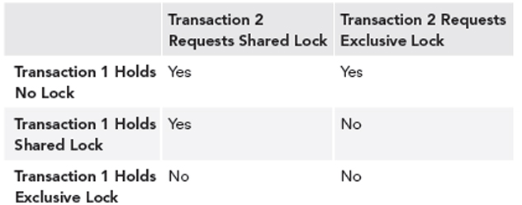
Lock Compatibility

Slide 26
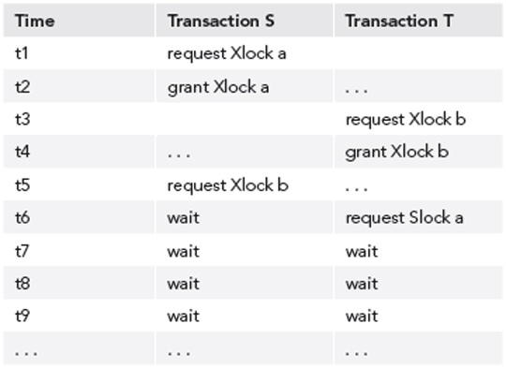
Deadlocks
Two transactions are each waiting for locks held by the other to be released.

Slide 27
Two-Phase Locking Protocol
Guarantees serializability.
Every transaction acquires all its locks before releasing any, but not necessarily all at once.
A transaction has two phases:
Growing phase: The transaction obtains locks.
Shrinking phase: The transaction releases locks.
Once it enters its shrinking phase, a transaction can never obtain a new lock.

Slide 28
Two-Phase Locking Protocol, cont’d
Recall:

Slide 29
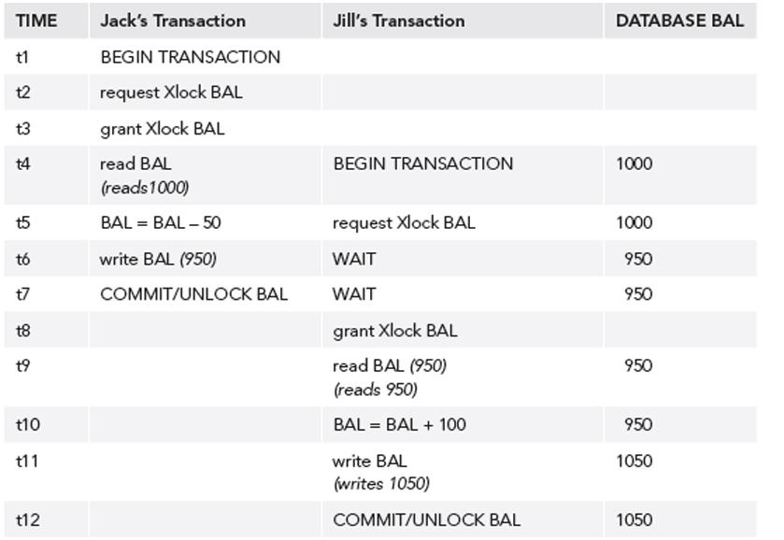
Two-Phase Locking Protocol, cont’d
After application of two-phase locking:

Slide 30
Optimistic Techniques
AKA validation techniques.
Assume that conflicts will be rare.
Transactions proceed as if there were no concurrency problems.
Before a transaction commits, perform a check to determine whether a conflict has occurred.
If there is a conflict, must roll back the transaction.
Assume rollback will be rare
Rollback is the price to be paid for eliminating locks.
Allow more concurrency, since no locking.

Slide 31
Need for Recovery
Many different types of failures can affect database processing:
Natural physical disasters
Sabotage
Carelessness
Disk malfunctions that result in loss of stored data.
System crashes due to hardware malfunctions that result in loss of main and cache memory
System software errors that result in abnormal termination or damage to the DBMS
Application software errors

Slide 32
Possible Effects of Failure
Loss of main memory, including database buffers.
Loss of the disk copy of the database.
Failure to write data safely to disk.
The DBMS recovery subsystem uses techniques that minimize these effects.

Slide 33
Recovery Manager
DBMS subsystem responsible for ensuring atomicity and durability for transactions in the event of failure.
Atomicity: Perform all or none of a transaction.
All the effects of committed transactions must reach the database, and that the effects of any uncommitted transactions must be undone.
Durability: Effects of a committed transaction are permanent.
All effects must survive loss of main memory, loss of disk storage, and failure to write safely to disk.

Slide 34
Loss of Disk Data
Do frequent backups.
In case of disk failure, the backup can be brought up to date using a log of transactions.
Good practices:
mirrored disks
RAID storage
remote live backup site

Slide 35
Failure to Write
Write modified pages first to the local disk and then to the mirror or remote disk.
The output is considered done after both writes are complete.
If a data transfer error is detected, examine both copies.
If they are identical, the data is correct.
If one has an error condition, use the other copy to replace the faulty data.
If neither has an error condition but they have different values, undo the writes.

Slide 36
System Failure
If system failure occurs:
Database buffers are lost.
Disk copy of the database survives, but it may be incorrect due to partial transactions.
A transaction can commit once its writes are made to the database buffers.
Updates made to buffers are not automatically written to disk, even for committed transactions.

Slide 37
System Failure, cont’d
There may be a delay between a commit and actual disk writing.
If the system fails during this delay, we must ensure that these updates reach the disk copy of the database.

Slide 38
Recovery Log
Contains records of each transaction showing:
the start of a transaction
the write operations of a transaction
the end of a transaction
If system fails, the log is examined:
what transactions to redo
what transactions to undo
Redo: Redo writes, not re-execute the transaction.
Undo: Roll back writes.

Slide 39
Deferred Update Protocol
The DBMS does all database writes in the log, and does not write to the database until the transaction is ready to commit.
The log protects against system failures.
Use log records to perform the updates to the database buffers.
Later, these updated pages will be written to disk.
If the transaction aborts, ignore the log records.

Slide 40
Checkpoints
After a failure, we may not know how far back in the log to search for redo of transactions.
Limit log searching by using checkpoints.
Scheduled at predetermined intervals.
Checkpoint operations
Write modified blocks in the database buffers to disk.
Write a checkpoint record to the log that contains the names of all the transactions that are active at the time of the checkpoint.
Write all log records now in main memory out to disk.

