Slide 1
CS/SE 157B Database Management Systems II April 12 Class Meeting
Department of Computer Science San Jose State University Spring 2018 Instructor: Ron Mak
www.cs.sjsu.edu/~mak

Slide 2
Final Project
This will be your final Assignment #9.
Yes, there will be an Assignment #8.
Put your emphasis on data management.
How you manage the data are you are using.
Fancy client-side GUI not required.

Slide 3
Final Project, cont’d
Required data models:
Operational tables
MySQL and/or MongoDB
Extra credit: Data virtualization with CIS
Analytical tables
MySQL
Data operations:
Queries and updates of the operational tables.
How the analytical tables are loaded.
Queries of the analytical tables for data analysis.

Slide 4
Final Project, cont’d
A user application that invokes the data operations.
RESTful API for the operational database.
How well did you use the technologies you learned during the semester?
RDBM, DW, XML, NoSQL, Express, REST, data virtualization with CIS
Not all technologies have to be used.

Slide 5
Final Project, cont’d
Written report
What is the application?
What data did you use, and where did you get it?
Overview of your data models (in words).
ER diagram
Relational schemas
Star schemas
Example user actions and screen shots of results.

Slide 6
Sample Datasets
There are many datasets available online.
Google “sample datasets”
Examples
https://www.kaggle.com/datasets
https://catalog.data.gov/dataset?res_format=CSV
https://perso.telecom-paristech.fr/eagan/class/igr204/datasets
Generate fake but realistic data
Example: https://www.mockaroo.com/

Slide 7
Server Host 130.65.159.87
Each student has an individual account.
Account name is your last name.
Password is your student id without leading zeros.
baglin do jun lir nguyenh ron soe
bhargava fidel kuroshima liu nguyenq ruan song
chan gandhi lai liw ou ruvalcaba torres
chik hong lau luong parikh salom zheng
cmpeadmin hu liang mei polangcos shin

Slide 8
Server Host 130.65.159.87, cont’d
Log in using the secure shell command.
Example:
Each student belongs to a group based on his or her team name.
One word, all lower case.
Team members can share files by enabling group read/write/execute access:
ssh brown@130.65.159.87
acedb
caby
dropthatdb
ez
name404
six
tngf
watercats
chmod g+rwx foo.txt

Slide 9
MySQL Team Accounts on the Server
MySQL is running on the server.
Each team has a MySQL account.
Your username is based on your team name (same as the group names).
Your initial password is the same as your username.
Each team has access to a database with the same name as the team name:
$ /opt/lampp/bin/mysql -u name404 -pname404
mysql>

Slide 10
MySQL Team Accounts, cont’d
mysql> show databases;
+--------------------+
| Database |
+--------------------+
| information_schema |
| name404 |
| test |
+--------------------+
3 rows in set (0.00 sec)

Slide 11
Uploading Files to the Server
Use the secure copy command on your local machine to upload a file to your home directory on the server:
Local
~: ls *.txt
HomeSiteSerialNos.txt greeting.txt profile.txt
bash_profile.txt hello.txt ron.txt
bashrc.txt lorem.txt svnlist.txt
foo.txt phpInfo.txt
~: scp foo.txt ron@130.65.159.87:
ron@130.65.159.87's password:
foo.txt 100% 0 0.0KB/s 00:00
Upload local ➔ server
[ron@coe-cmpe-cis ~]$ ls *.txt
bar.txt foo.txt
Server

Slide 12
Downloading Files from the Server
Use the same command on your local machine to download files from your home directory on the server to the current directory (or any other directory) of your local machine.
Local
~: scp ron@130.65.159.87:bar.txt .
ron@130.65.159.87's password:
bar.txt 100% 0 0.0KB/s 00:00
~: ls *.txt
HomeSiteSerialNos.txt foo.txt phpInfo.txt
bar.txt greeting.txt profile.txt
bash_profile.txt hello.txt ron.txt
bashrc.txt lorem.txt svnlist.txt
Download server ➔ local

Slide 13
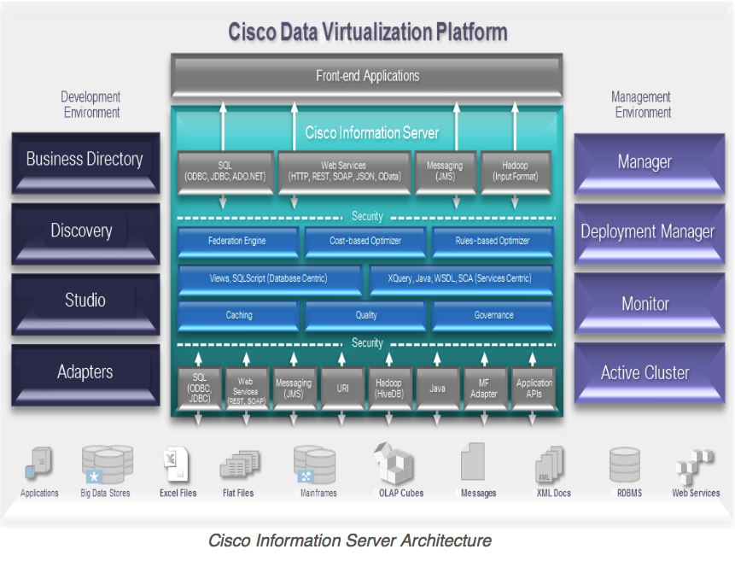
Cisco Information Server (CIS)
The Cisco Information Server (CIS) forms the core of the Cisco Data Virtualization Platform.
http://www.compositesw.com/data-virtualization/

Slide 14
Install the CIS Studio
Studio is the client-side application that connects to the CIS server.
As delivered, it runs only on Windows.
It’s a Java app, so it should be able to run on Mac and Linux.
Can someone convert the studio.bat DOS script to a studio.sh bash script for the Mac and Linux?

Slide 15
Install the CIS Studio
Download and install Studio.
http://www.cs.sjsu.edu/~mak/CS157B/cis/Studio-7.0.5-windows-x64-installer.exe
If necessary, see the Installation Guide.
http://www.cs.sjsu.edu/~mak/CS157B/cis/InstallationGuide.pdf

Slide 16
CIS Team Accounts
Each team has a CIS account.
Your username is based on your team name (same as the username for your MySQL account).
Your password is the same as your username.
However, CIS requires passwords to be at least 6 characters, so I padded short team names with x’s.
Example: ezxxxx

Slide 17
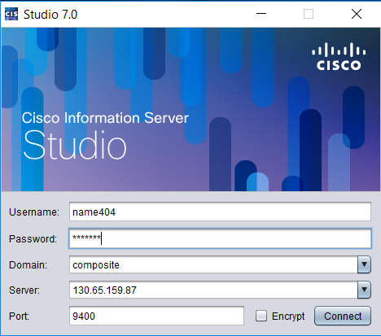
Log into CIS
To log in, start the client-side Studio application.
Username: Same as group name
Password: Same as username. If less than 6 characters, pad with x’s to 6 characters.
Domain: composite
Server: 130.65.159.87
Port: 9400

Slide 18
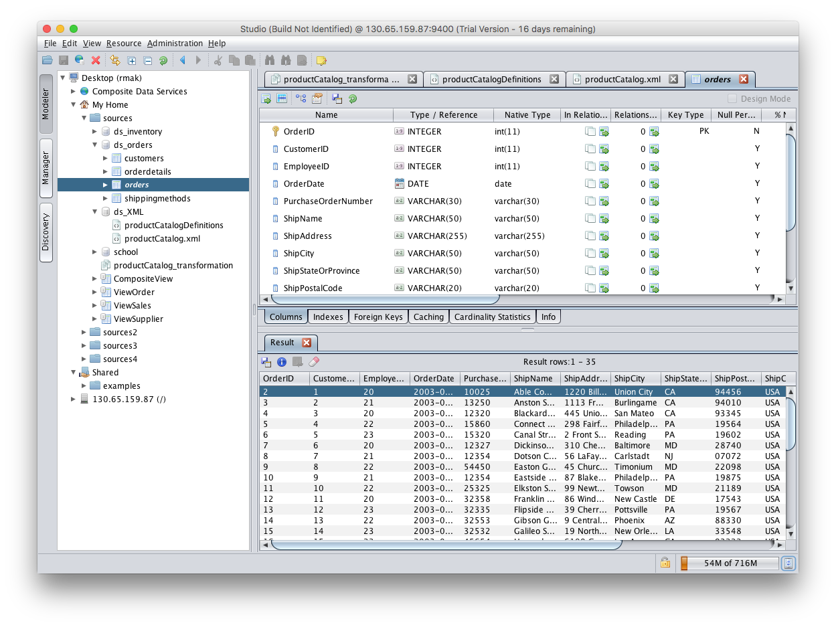
Browse Database Sources

Slide 19
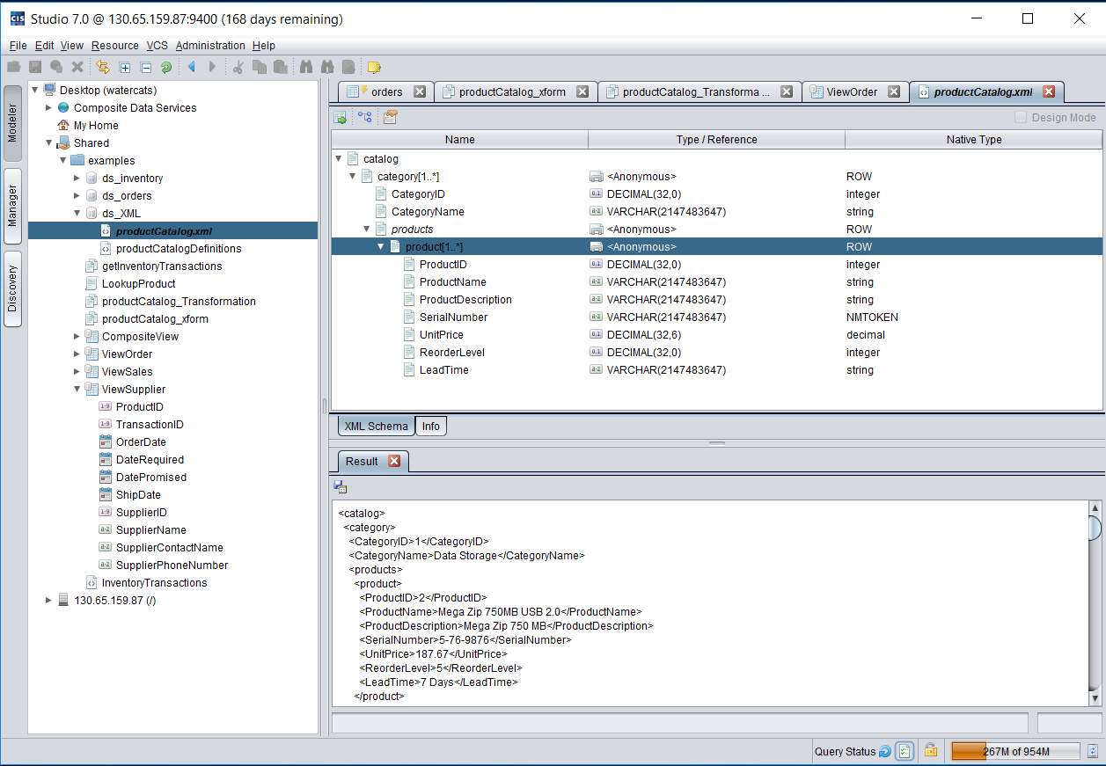
Browse XML Data Sources

Slide 20
XML Data ➔ Database Table
First define a transformation that maps an XML file to a relational database table.
Then CIS can dynamically load the XML data into the database table.

Slide 21
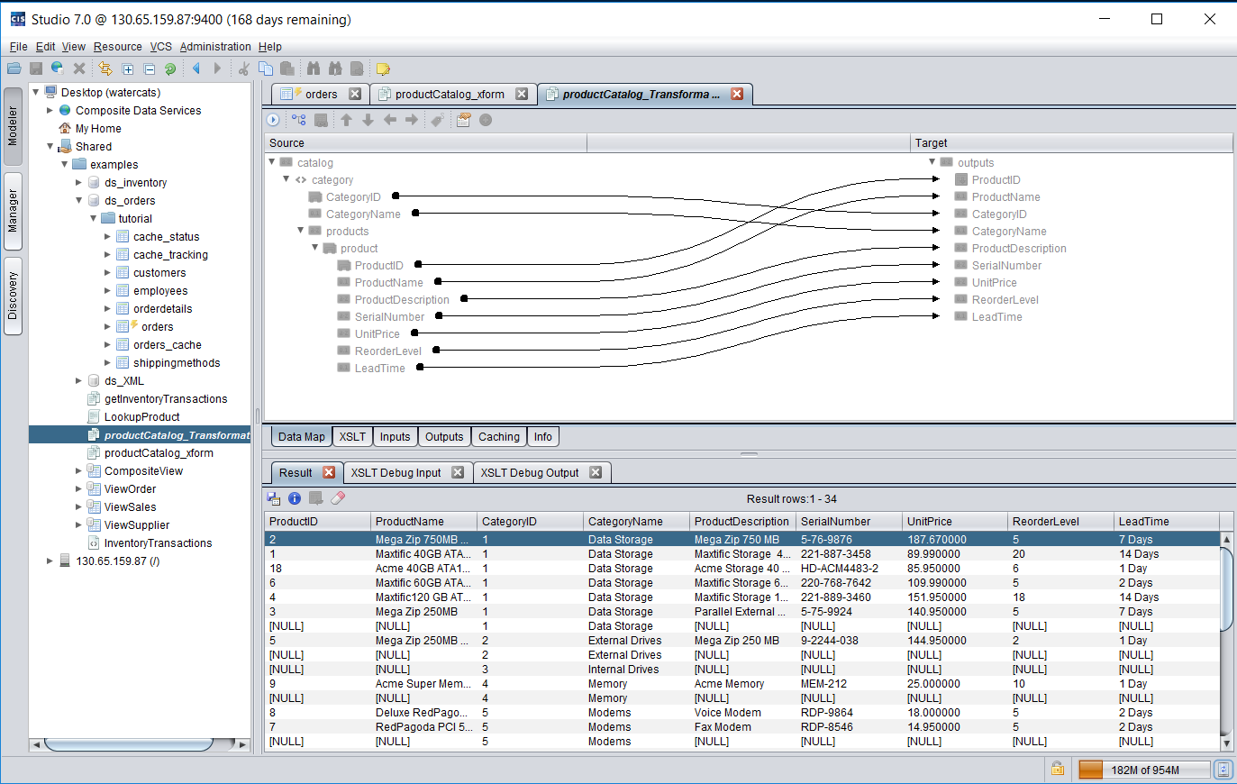
XML Data ➔ Database Table, cont’d

Slide 22
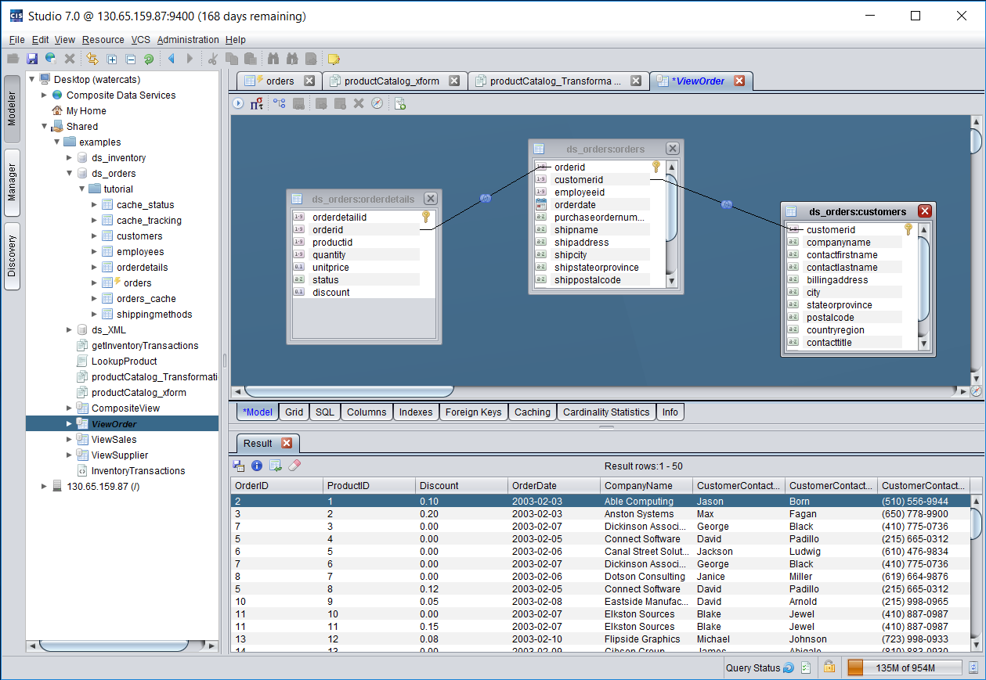
Create Views by Joining Tables

Slide 23
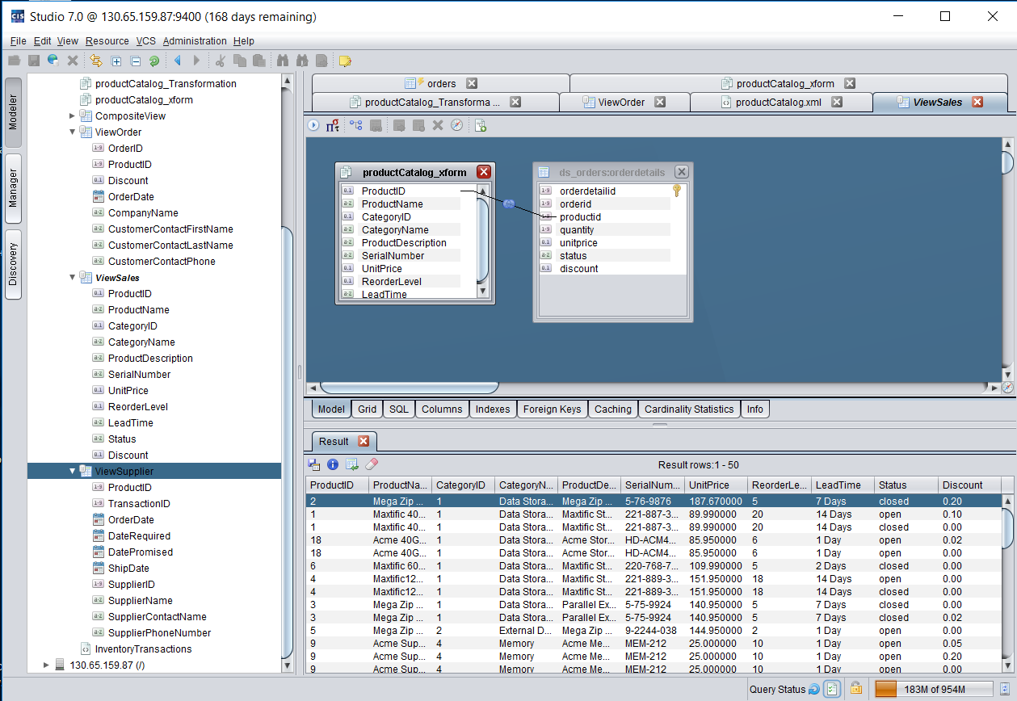
Join Relational Tables to Transformed XML

Slide 24
Publish the Results
“Publish” the transformations and views.
Applications can then access them as if they were actual relational database tables.
Cisco provides a JDBC driver for Java programs.
Also various ODBC drivers.

Slide 25
Assignment #8
Do the demo described in the Getting Started Guide.
Upload a relational database and an XML file to the server.
Do a database dump on the client.
Upload the dump to the server.
Start MySQL on the server and “source” the dump.
Use Studio to import your data into CIS.
Import into My Home, not the Shared folder.

Slide 26
Assignment #8, cont’d
Do table joins graphically.
Display the results.
Transform your XML data to a relational table.
Graphically join the transformed XML data to a relational table.
Display the results.

Slide 27
Assignment #8, cont’d
A short report describing:
What you uploaded and imported into CIS.
Your CIS operations with Studio screen shots.
Due Friday, April 27.

