Slide 1
CS/SE 157B Database Management Systems II April 12 Class Meeting
Department of Computer Science San Jose State University Spring 2018 Instructor: Ron Mak
www.cs.sjsu.edu/~mak

Slide 2
The Dangers of URL Auto-Completion
Why did deleting a user in Tuesday’s Express-MongoDB demo fail to behave properly?
The problem was Apple Safari browser’s auto-completion feature for the URL address.
Watch the demo again carefully!

Slide 3
The Dangers of URL Auto-Completion, cont’d
Moral: GET requests should not make changes to the model (i.e., the backend database).
How would you fix this problem?
Note that when you enter a URL into the browser’s address field, or click on a link, that generates a GET request.

Slide 4
Routing (Old Version)
var express = require('express');
var router = express.Router();
var ctrlMain = require("../controllers/cntrlMain");
var modelMain = require("../models/modelMain");
console.log("Router:"); console.log(router);
router.get('/', ctrlMain.home);
router.get('/newuser', ctrlMain.get_newuser);
router.get('/userlist', modelMain.get_userlist);
router.get('/userlist/:username', modelMain.get_showuser);
router.post('/adduser', modelMain.post_adduser);
router.get('/deleteuser/:username', modelMain.get_deleteuser);
module.exports = router;

Slide 5
Delete a User (Old Version)
models/modelMain.js
module.exports.get_deleteuser = function(req, res)
{
var uname = req.params.username;
var db = req.db;
var collection = db.get('usercollection');
// Submit to the database.
collection.remove( { "username" : uname },
function (err, doc)
{
if (err) {
res.send("Delete failed.");
}
else {
res.send("Successfully deleted " + uname);
}
});
};

Slide 6
Routing (New Version)
routes/index.js
var express = require('express');
var router = express.Router();
var ctrlMain = require("../controllers/cntrlMain");
var modelMain = require("../models/modelMain");
console.log("Router:"); console.log(router);
router.get('/', ctrlMain.home);
router.get('/newuser', ctrlMain.get_newuser);
router.get('/deleteuser/:username', ctrlMain.get_deleteuser);
router.get('/userlist', modelMain.get_userlist);
router.get('/userlist/:username', modelMain.get_showuser);
router.post('/adduser', modelMain.post_adduser);
router.post('/deleteuser/:username', modelMain.post_deleteuser);
module.exports = router;

Slide 7
Delete a User (New Version)
controllers/cntrlMain.js
module.exports.get_deleteuser = function(req, res)
{
var uname = req.params.username;
res.render('deleteuser', { "username" : uname} );
};
views/deleteuser.jade
extends layout
block content
h1 Delete User
p OK to delete #{username}?
form#formDeleteUser(name="adduser",method="post",action="/deleteuser/#{username}")
button#btnSubmit(type="submit") Delete

Slide 8
Delete a User (New Version), cont’d
models/modelMain.js
module.exports.post_deleteuser = function(req, res)
{
var uname = req.params.username;
var db = req.db;
var collection = db.get('usercollection');
// Submit to the database.
collection.remove( { "username" : uname },
function (err, doc)
{
if (err) {
res.send("Delete failed.");
}
else {
res.send("Successfully deleted " + uname);
}
});
};
Demo

Slide 9
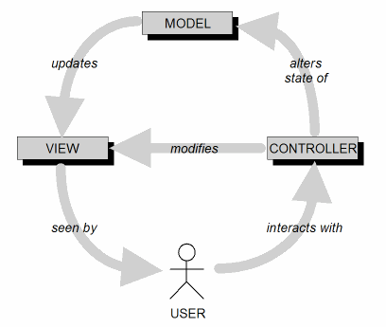
Model-View-Controller Architecture (MVC)
Design goal: Identify which objects are model, view, or controller.
A user cannot directly modify the model.

Slide 10
Routes
A route is a mapping from an incoming HTTP request to the appropriate controller code.
Associates a URI plus an HTTP method (get or post) with a particular controller action.
HTTP method also called HTTP verb
Most widely used HTTP methods in web apps are GET, POST, PUT, and DELETE.
Defined by the HTTP standard.

Slide 11
REST
Representational State Transfer
First developed by Roy Fielding in his Ph.D. dissertation in 2000.
An architectural style that defines a set of constraints and properties based on HTTP.
RESTful web services provide interoperability between computer systems on the Internet.
Requesting systems can access and manipulate textual representations of web resources by using a uniform and predefined set of stateless operations.

Slide 12
REST Resources
Entities manipulated by a web app are resources.
Originally files identified by URLs.
Now defined more generically and abstractly.
Described often with XML or JSON.
Think of a web application primarily as a collection of resources accessible via RESTful APIs.

Slide 13
REST Routes
Design routes such that any HTTP request contains all the information necessary to identify both a resource and the action to perform on it.
“Expose RESTful APIs”
Engineering Software as a Service
by Armando Fox & David Patterson
self-published, 2014-2016

Slide 14
REST Guiding Principles
Client-server
Separate the user interface from the web and database servers.
Stateless
Each request from client to server must contain all of the information necessary to understand the request.
Cannot use any stored context on the server.
Cacheable
A client cache can reuse cacheable response data for later, equivalent requests.

Slide 15
REST Guiding Principles, cont’d
Uniform interface
Simplify overall system architecture.
Need multiple architectural constraints to guide the behavior of components.
Layered system
Hierarchical layers.
Each layer has specific functionality and responsibility.
Code on demand (optional)
Extend functionality by downloading and executing applet or script code.

Slide 16
Database Actions and HTTP Verbs
Mapping between database CRUD actions and HTTP verbs:
A web browser is only able to issue GET and POST requests.
Therefore, Express “fakes” the PUT and DELETE requests with framework logic.
Database action | HTTP verb
Create | POST
Read (list or show) | GET
Update (edit) | PUT
Delete | DELETE

Slide 17
Default RESTful Actions
Express uses REST, which expands the read database action (HTTP GET) into four RESTful actions:
RESTful action | HTTP verb | Description
list | GET | Read (list) all documents.
show | GET | Read (show) one document.
new | GET | Show a form to create a new document.
edit | GET | Show a form to update (edit) an existing document.
create | POST | Create a new document.
update | PUT | Update an existing document.
destroy | DELETE | Delete a document.

Slide 18
RESTful App Example, cont’d
RESTful action | HTTP verb | Browser method and URL | Operation on resource
list | GET | GET /userlist | Read (list) all users
show | GET | GET /userlist/:username | Read (show) a user
new | GET | GET /newuser | Display form to create a new user
edit | GET | GET /edituser/:username | Display form to update (edit) a user
create | POST | POST /adduser | Create a new user from form data
update | PUT | POST /userlist/:username | Update a user from form data
destroy | DELETE | POST /deleteuser/:username | Delete a user
routes/index.js
router.get('/userlist', ctrlMain.get_userlist);
router.get('/userlist/:username', ctrlMain.get_showuser);
router.get('/newuser', ctrlMain.get_newuser);
router.get('/edituser/:username', ctrlMain.get_edituser);
router.post('/adduser', ctrlMain.post_adduser);
router.post('/userlist/:username', ctrlMain.post_updateuser);
router.post('/deleteuser/:username', ctrlMain.get_deleteuser);

Slide 19
Assignment #7. MongoDB, Express, and REST
Create a simple web application that uses node.js, Express, and your MongoDB database.
You can use your database from Assignment #6 or create a new one.
This application can be part of your final project or it can be a separate app just for this assignment.
Expose a RESTful API that implements the CRUD operations on your database.
Implement each of the list, show, new, edit, create, update, and delete RESTful actions.

Slide 20
Assignment #7, cont’d
Include a zip file of your project.
Do not include the node_modules folder.
Instructions on how to run the application.
Include any required user names and passwords.
Write a short report:
What is your MongoDB database? What data?
Copy from Assignment #6 if it’s the same database.
What do each of the RESTful actions do?
Show screen shots.
Indicate where in your Express JavaScript files each action is implemented (file names and function names).

Slide 21
Assignment #7, cont’d
Due Friday, April 20.
Write-up and assignment available soon in Canvas.

Slide 22
Data Virtualization
An approach to data management that allows an application to retrieve and manipulate data without requiring technical details about the data, such as how it is formatted or where it is physically located.
An agile data integration approach that organizations use to gain more insight from their data, respond faster to ever changing analytics and BI needs and save 50-75% over data replication and consolidation.
https://en.wikipedia.org/wiki/Data_virtualization
http://www.compositesw.com/data-virtualization/

Slide 23
Data Virtualization, cont’d
Differs from traditional ETL.
The original data remains in place.
A real-time process accesses the data sources.
Reduces the risk of data errors.
Reduces the workload of extracting, transforming, and loading data that may never be used by an application.
Provides applications a “virtual view” of the data.
Applications can treat the disparate and heterogeneous data as a single relational database.

Slide 24
Data Virtualization Functionality
Abstraction
Abstract the technical aspects of stored data, such as location, storage structure, API, access language, and storage technology.
Virtualized data access
Connect to different data sources and make them accessible from a common logical data access point.
Transformation
Transform, improve quality, reformat, etc. source data for consumer use.
https://en.wikipedia.org/wiki/Data_virtualization

Slide 25
Data Virtualization Functionality, cont’d
Data federation
Combine result sets from across multiple source systems.
Data delivery
Publish result sets as views and/or data services executed by client applications or users when requested.
https://en.wikipedia.org/wiki/Data_virtualization

Slide 26
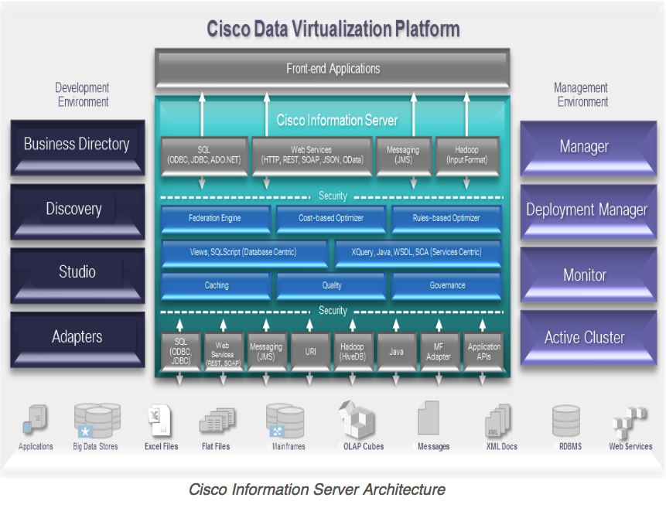
Cisco Information Server (CIS)
The Cisco Information Server (CIS) forms the core of the Cisco Data Virtualization Platform.
http://www.compositesw.com/data-virtualization/

