Slide 1
CS/SE 157B Database Management Systems II April 10 Class Meeting
Department of Computer Science San Jose State University Spring 2018 Instructor: Ron Mak
www.cs.sjsu.edu/~mak

Slide 2
Client-Server Web Apps
Client Side
Web Browser
Chrome
Firefox
Safari
Microsoft Edge
Server Side
Web Server
node.js + Express
HTTP request
HTTP response
HTTP request
User’s form data
HTTP response
Dynamically generated HTML page

Slide 3
Three-Tier Web Application Architecture
Client-side web browser
Form data
Server-side web server
(.html .js
images, etc.)
Static (.html)
or
dynamically
generated (.js)
web pages
Queries
Back-end database server, e.g.
MongoDB
Data

Slide 4
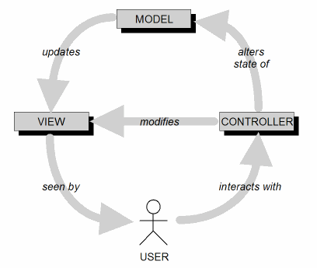
Model-View-Controller Architecture (MVC)
Design goal: Identify which application components are model, view, or controller.
A user cannot directly modify the model.

Slide 5
Routes and HTTP Methods
A route is a mapping from an incoming HTTP request to the appropriate controller code.
Associates a URI plus an HTTP method with a particular controller action.
An HTTP method is also called an HTTP verb.
Most widely used HTTP methods in web apps are GET, POST, PUT, and DELETE.
Defined by the HTTP standard.

Slide 6
Suggested Ways to Use GET and POST
Use GET to request a form from the web server.
The web server responds by sending the web page containing the form.
Use POST to send form data to the web server.
The web server processes the data and responds with a dynamically generated web page.

Slide 7
node.js
The Apache web server is very popular.
It’s the A in LAMP (Linux, Apache, MySQL, PHP).
Programmed with PHP.
Now we will switch to the node.js web server.
A lean and fast web server.
Created in 2009 as an alternative to the Apache web server.
Programmed with JavaScript.
Traditionally, JavaScript is a client-side language for programming web browsers.
Created by NetScape in 1995.

Slide 8
node.js and Express
Install node.js: https://nodejs.org/en/
node.js relies on packages for functionality.
Install packages with npm, the node package manager.
We will use the Express framework.
Supports the MVC architecture.
Install at the Linux/Mac OS/DOS command line:
npm install -S express –g
npm install -S nodeunit -g

Slide 9
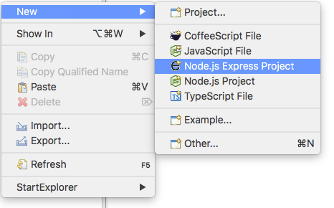
The Eclipse Node.js Plug-in
To install the node.js plug-in for Eclipse:
Start Eclipse
Latest version is Oxygen.
Help ➔ Eclipse Marketplace
Find: node.js
Install: Enide Studio 2014
Node.js, JavaScript, Java and Web Tools 1.0.1
Create a new Node.js Express project

Slide 10
MongoDB
From “humongous”
Scalable
High performance
Open-source
Document-oriented
Schema-free

Slide 11
Express/MongoDB Example
A very simple example of Express on the server side accessing a MongoDB database.
We will display some user documents that each contains a user name and an email address.
Recall that a document is analogous to a record in a relational database.
Recall that a collection is analogous to to a relational table.
We will add new documents.

Slide 12
Initialize the MongoDB Database
Start the MongoDB driver and the MongoDB shell.
Use the shell to insert the first document:
/usr/local/Cellar/mongodb/3.2.10: mongo
MongoDB shell version: 3.2.10
connecting to: test
Server has startup warnings:
2017-10-19T02:30:02.649-0700 I CONTROL [initandlisten]
2017-10-19T02:30:02.649-0700 I CONTROL [initandlisten] ** WARNING: soft rlimits too low. Number of files is 256, should be at least 1000
> use nodetest1
switched to db nodetest1
> db.usercollection.insert({ "username" : "testuser1", "email" : "testuser1@testdomain.com" })
WriteResult({ "nInserted" : 1 })
Create database nodetest1.
Collection usercollection
is automatically created the
first time we insert into it.

Slide 13
Initialize the MongoDB Database, cont’d
> db.usercollection.find().pretty()
{
"_id" : ObjectId("59e8711733b5f794be534cda"),
"username" : "testuser1",
"email" : "testuser1@testdomain.com"
}
Yes, it was successfully inserted.
So insert two more documents.

Slide 14
Initialize the MongoDB Database, cont’d
> newstuff = [{ "username" : "testuser2", "email" : "testuser2@testdomain.com" },
{ "username" : "testuser3", "email" : "testuser3@testdomain.com" }]
[
{
"username" : "testuser2",
"email" : "testuser2@testdomain.com"
},
{
"username" : "testuser3",
"email" : "testuser3@testdomain.com"
}
]
> db.usercollection.insert(newstuff)
BulkWriteResult({
"writeErrors" : [ ],
"writeConcernErrors" : [ ],
"nInserted" : 2,
"nUpserted" : 0,
"nMatched" : 0,
"nModified" : 0,
"nRemoved" : 0,
"upserted" : [ ]
})

Slide 15
Initialize the MongoDB Database, cont’d
> db.usercollection.find().pretty()
{
"_id" : ObjectId("59e8711733b5f794be534cda"),
"username" : "testuser1",
"email" : "testuser1@testdomain.com"
}
{
"_id" : ObjectId("59e8715233b5f794be534cdb"),
"username" : "testuser2",
"email" : "testuser2@testdomain.com"
}
{
"_id" : ObjectId("59e8715233b5f794be534cdc"),
"username" : "testuser3",
"email" : "testuser3@testdomain.com"
}

Slide 16
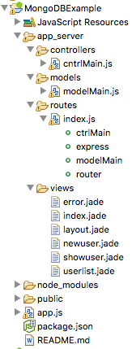
Eclipse Express Project MongoDBExample
We introduce the use of page templates.
The .jade template files are views.
Express uses the Jade template engine to dynamically generate HTML pages from the page templates.

Slide 17
Project Dependencies
package.json
{
"name": "MongoDBExample",
"version": "0.0.0",
"private": true,
"scripts": {
"start": "node app.js"
},
"dependencies": {
"body-parser": "~1.18.2",
"debug": "~2.6.9",
"express": "~4.15.5",
"jade": "~1.11.0",
"mongodb": "^2.2.25",
"monk": "^4.0.0",
"morgan": "~1.9.0",
"nodeunit": "^0.11.2"
}
}
Monk: “A tiny layer that provides
simple yet substantial usability
improvements for MongoDB
usage within Node.JS.”
https://www.npmjs.com/package/monk

Slide 18
Connect to the MongoDB Database
app.js
var mongo = require('mongodb');
var monk = require('monk');
var db = monk('localhost:27017/nodetest1');
Use Monk to connect to the database nodetest1 at the default MongoDB port 27017.
Make the database accessible to the controller and model code:
app.use(function(req, res, next)
{
req.db = db;
next();
});

Slide 19
Routing
routes/index.js
var express = require('express');
var router = express.Router();
var ctrlMain = require("../controllers/cntrlMain");
var modelMain = require("../models/modelMain");
console.log("Router:"); console.log(router);
router.get('/', ctrlMain.home);
router.get('/newuser', ctrlMain.get_newuser);
router.get('/userlist', modelMain.get_userlist);
router.get('/userlist/:username', modelMain.get_showuser);
router.post('/adduser', modelMain.post_adduser);
router.get('/deleteuser/:username', modelMain.get_deleteuser);
module.exports = router;

Slide 20
Display all the Users
models/modelMain.js
module.exports.get_userlist = function(req, res)
{
var db = req.db;
var collection = db.get('usercollection');
collection.find({}, {},
function(err, docs)
{
res.render('userlist', { "userlist" : docs });
});
};
views/userlist.jade
block content
h1.
User List
ul
each user in userlist
li
a(href="mailto:#{user.email}")= user.username

Slide 21
Show a User
models/modelMain.js
module.exports.get_showuser = function(req, res)
{
var uname = req.params.username;
var db = req.db;
var collection = db.get('usercollection');
collection.find( { username : uname },
function(err, doc)
{
if (err) {
res.send("Find failed.");
}
else {
res.render('showuser',
{ title: 'Show User: ' + uname,
mail: doc[0].email })
}
});
};

Slide 22
Show a User, cont’d
views/showuser.jade
block content
h1= title
p Email: #{mail}

Slide 23
Display the New User Form
controllers/ctrlMain.js
module.exports.get_newuser = function(req, res)
{
res.render('newuser', { title: 'Add New User' });
};
views/newuser.jade
extends layout
block content
h1= title
form#formAddUser(name="adduser",method="post",action="/adduser")
input#inputUserName(type="text", placeholder="username", name="username")
input#inputUserEmail(type="text", placeholder="useremail", name="useremail")
button#btnSubmit(type="submit") submit

Slide 24
Add a New User
models/modelMain.js
module.exports.post_adduser = function(req, res)
{
// Set our internal DB variable
var db = req.db;
// Get our form values. These rely on the "name" attributes.
var userName = req.body.username;
var userEmail = req.body.useremail;
// Set our collection.
var collection = db.get('usercollection’);
...

Slide 25
Add a New User, cont’d
models/modelMain.js
...
// Submit to the database.
collection.insert( { "username" : userName,
"email" : userEmail },
function (err, doc)
{
if (err) {
res.send("Insert failed.");
}
else {
// Forward to success page
res.redirect("userlist");
}
});
};

Slide 26
Delete a User
models/modelMain.js
module.exports.get_deleteuser = function(req, res)
{
var uname = req.params.username;
var db = req.db;
var collection = db.get('usercollection');
// Submit to the database.
collection.remove( { "username" : uname },
function (err, doc)
{
if (err) {
res.send("Delete failed.");
}
else {
res.send("Successfully deleted " + uname);
}
});
};

