Slide 1


CS/SE 157B
Database Management Systems II
April 5 Class Meeting
Department of Computer Science
San Jose State University
Spring 2018
Instructor: Ron Mak
www.cs.sjsu.edu/~mak

Slide 2
Assignment #6: MongoDB
Create a MongoDB database and use its JavaScript API to perform CRUD operations.
  At least 4 different create operations.
    Create (insert) documents into collections.
    Note that the first time you insert a document into a collection, that operation also creates the collection.
  At least 8 different read (find) operations.
    Output with “pretty” format.
  At least 4 different update operations.
  At least 4 different delete operations.
Due Friday, April 12
  Official write-up coming soon.

Slide 3
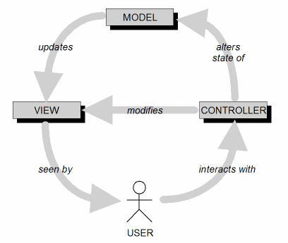
Model-View-Controller Architecture (MVC)
Design goal: Identify which application components are model, view, or controller.
A user cannot directly modify the model.

Slide 4
Client-Server Web Apps
Client Side
Web Browser
Chrome
Firefox
Safari
Microsoft Edge
Server Side
Web Server
node.js
+ Express
HTTP request
HTTP response
HTTP request
  User’s form data
HTTP response
  Dynamically generated HTML page

Slide 5
Routes
A route is a mapping from an incoming HTTP request to the appropriate controller code.
  Associates a URI plus an HTTP method
  with a particular controller action.
A URI (Uniform Resource Identifier) identifies
a resource your application provides.
  Example resource: a web page.
  The most common form of URI is a URL.

Slide 6
HTTP Methods
A route is a mapping from an incoming HTTP request to the appropriate controller code.
  Associates a URI plus an HTTP method
  with a particular controller action.
An HTTP method is also called an HTTP verb.
Most widely used HTTP methods in web apps are GET, POST, PUT, and DELETE.
  Defined by the HTTP standard.

Slide 7
Serving Web Pages
A web server serves web pages.
  Displayed on the client side by web browsers.
  Web pages can be static or dynamic.
Static web pages: .html
  HTML files that the web server reads from disk.
  A static page always displays the same content.
Dynamic web pages: .js
  Generated by JavaScript code on the server.
  Contains dynamic content.

Slide 8
node.js
The Apache web server is very popular.
  It’s the A in LAMP (Linux, Apache, MySQL, PHP).
  Programmed with PHP.
Now we will switch to the node.js web server.
  A lean and fast web server.
  Created in 2009 as an alternative to
  the Apache web server.
  Programmed with JavaScript.
    Traditionally, JavaScript is a client-side language
    for programming web browsers.
    Created by NetScape in 1995.

Slide 9
node.js, cont’d
Uses the open-source Google Chrome V8 JavaScript engine.
  Just-in-time compilation, automatic inlining,
  dynamic code optimization, etc.
Single-threaded event loop handles connections.
Each connection invokes a JavaScript
callback function.
  Handle non-blocking I/O.
  Spawn threads from a thread pool.

Slide 10
node.js and Express
Install node.js: https://nodejs.org/en/
node.js relies on packages for functionality.
  Install packages with npm,
  the node package manager.
We will use the Express framework.
  Supports the MVC architecture.
  Install at the Linux/Mac OS/DOS command line:
npm install -S express –g
npm install -S nodeunit -g

Slide 11
Form Data
A user can input data into an HTML form displayed on a client-side web browser.
When the user presses a Submit button, the browser sends to form data to a specified
JavaScript program running on the web server.
The JavaScript program can use the data to
  Query the back-end database.
  Generate a new HTML page to send
  to the user’s client-side web browser.

Slide 12
Ways to Send Form Data
A browser sends form data to a JavaScript program on the web server when the user presses the Submit button.
The action attribute of the <FORM> tag indicates where to send the form data.
Two HTTP methods to send form data:
GET and POST.

Slide 13
Suggested Ways to Use GET and POST
Use GET to request a form
from the web server.
  The web server responds by sending the web page containing the form.
Use POST to send form data
to the web server.
  The web server processes the data and responds with a dynamically generated web page.

Slide 14
Three-Tier Web Application Architecture
Client-side web browser
Form data
Server-side web server
(.html .js
images, etc.)
Static (.html)
or
dynamically
generated (.js)
web pages
Queries
Back-end database server, e.g.
MongoDB
Data

Slide 15
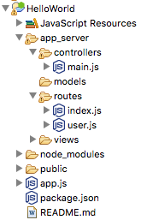
Hello, World Application
The initial Hello, World application
using node.js and Express.
  Refer to online node.js and Express tutorials.
  Example:
Use the node.js
plug-in for Eclipse.
  Create the HelloWorld
  node.js project:
https://www.tutorialspoint.com/expressjs/index.htm

Slide 16
Hello, World Application, cont’d
The main application file.
  Mostly boiler-plate code for now.
app.js
var express = require('express');
var path = require('path');
var bodyParser = require('body-parser');
var session = require('express-session');
var index = require('./app_server/routes/index');
var app = express();
//View engine setup
app.set('views', path.join(__dirname,'app_server','views'));
app.set('view engine','jade');
app.use(bodyParser.json());
app.use(bodyParser.urlencoded({ extended:true}));
app.use(express.static(path.join(__dirname,'public')));
app.use(session( {secret:"String for encrypting cookies."} ));
app.use('/', index);
module.exports = app;
app.listen(3000);
Before running the server:
npm install -S body-parser
npm install -S line-reader
-S to enter into package.json
We’ll learn about the
Jade template engine later.
The web server will
listen to port 3000.

Slide 17
Hello, World Application, cont’d
Recall that a route is a mapping from an incoming HTTP request to the appropriate controller code:
  The URL is / and the HTTP method is GET.
  Route to controller code ctrlMain.index.
var express = require('express');
var router = express.Router();
var ctrlMain = require("../controllers/main");
/*
* GET home page.
*/
router.get('/', ctrlMain.index);
module.exports = router;
app_server/routes/index.js

Slide 18
Hello, World Application, cont’d
Here’s the controller code.
app_server/controllers/main.js
/*
* GET home page.
*/
module.exports.index = function(req, res)
{
var html = '<!DOCTYPE html>\n'
+ '<html lang="en-US">\n'
+ '<head>\n'
+ ' <meta charset="UTF-8">\n'
+ ' <title>Hello, world</title>\n'
+ '</head>\n'
+ '<body>\n'
+ ' <h1>Hello, world!</h1>\n'
+ '</body>\n'
+ '</html>\n';
res.send(html);
};
In response,
a simple
dynamically
generated
web page!
Demo

Slide 19
Hello, World Application, cont’d
Application dependencies:
  A default file is created when you create
  the Express project.
package.json
{
"name":"HelloWorld",
"version":"0.0.1",
"private":true,
"scripts": {
"start":"node app.ps"
},
"dependencies": {
"body-parser":"^1.18.2",
"debug":"^2.6.9",
"express":"^4.15.5"
}
}

Slide 20
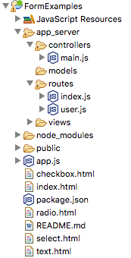
Form Examples
Process HTML form data using node.js
and Express.
GET to request a form.
POST request to process
form data.
  Express dynamically
  generates a web page in
  response that incorporates
  data from the form.

Slide 21
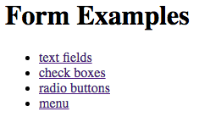
Form Examples: Home Page
index.html
<!DOCTYPEhtml>
<html lang="en-US">
<head>
<meta charset="UTF-8">
<title>Forms Examples</title>
</head>
<body>
<h1>Form Examples</h1>
<ul>
<li><a href="textfields">text fields</a></li>
<li><a href="checkboxes">check boxes</a></li>
<li><a href="radiobuttons">radio buttons</a></li>
<li><a href="menu">menu</a></li>
</ul>
</body>
</html>
Request this form:
localhost:3000/

Slide 22
Form Examples: Home Page, cont’d
Router:
Controller:
app_server/routes/index.js
/*
* GET home page.
*/
router.get('/', ctrlMain.home);
app_server/controllers/main.js
/*
* GET home page.
*/
module.exports.home = function(request, result)
{
sendPage('index.html', result);
};

Slide 23
Form Examples: Home Page, cont’d
Controller, cont’d
  Instead of hard-coding the contents of file index.html in the controller as we did in the Hello World example, function sendPage reads and sends the file to the client.
function sendPage(fileName, result)
{
var html = '';
// Read the file one line at a time.
lineReader.eachLine(fileName,
function(line, last)
{
html += line + '\n';
if (last)
{
result.send(html);
return false;
}
else
{
return true;
}
});
}
Callback
function
app_server/controllers/main.js
Demo

Slide 24
Form Examples: Text Input Fields, cont’d
Router:
Controller:
app_server/routes/index.js
router.get('/textfields', ctrlMain.get_textfields);
router.post('/textfields', ctrlMain.post_textfields);
module.exports.get_textfields = function(request, result)
{
sendPage('text.html', result);
};
module.exports.post_textfields = function(request, result)
{
var text = ' Hello, ' + getName(request);
sendBody(text, result);
};
app_server/controllers/main.js

Slide 25
Form Examples: Text Input Fields, cont’d
Controller, cont’d
app_server/controllers/main.js
/**
* Extract the first and last names from the request.
* @param request the HTTP request.
* @returns a string containing the first and last names.
*/
function getName(request)
{
var firstName = request.param('firstName');
var lastName = request.param('lastName');
return firstName + ' ' + lastName + '!';
}

Slide 26
Form Examples: Text Input Fields, cont’d
app_server/controllers/main.js
/**
* Send the contents of an HTML page to the client
* with an inserted body text.
* @param text the body text.
* @param result the HTTP result.
*/
function sendBody(text, result)
{
var html = '<!DOCTYPE html>\n'
+ '<html lang="en-US">\n'
+ '<head>\n'
+ ' <meta charset="UTF-8">\n'
+ ' <title>Form Examples</title>\n'
+ '</head>\n'
+ '<body>\n'
+ ' ' + text + '\n' // insert the body text
+ '</body>\n'
+ '</html>\n';
result.send(html);
}
Demo

Slide 27
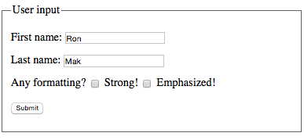
Form Examples: Check Boxes
checkbox.html
<body>
<form action="checkboxes"
method="post">
<fieldset>
...
<p>
<label>Any formatting?</label>
<input type="checkbox"
name="strong"
value="strong" /> Strong!
<input type="checkbox"
name="em"
value="em" /> Emphasized!
</p>
...
</fieldset>
</form>
</body>
Request this form:
GET localhost:3000/checkboxes
Process this form:
POST localhost:3000/checkboxes

Slide 28
Form Examples: Check Boxes, cont’d
Router:
Controller:
app_server/routes/index.js
router.get('/checkboxes', ctrlMain.get_checkboxes);
router.post('/checkboxes', ctrlMain.post_checkboxes);
module.exports.get_checkboxes = function(request, result)
{
sendPage('checkbox.html', result);
};
module.exports.post_checkboxes = function(request, result)
{
var text = ' Hello, ' + getName(request);
text = modify(text, request);
sendBody(text, result);
};
app_server/controllers/main.js

Slide 29
Form Examples: Check Boxes, cont’d
/**
* Extract the strong and emphasized values from the request.
* Surround the text with<strong>or<em>tags.
* @param text the text to surround.
* @param request the HTTP request.
* @returns a string containing the surrounded text.
*/
function modify(text, request)
{
if (request.body.strong)
{
text = '<strong>' + text + '</strong>';
}
if (request.body.em)
{
text = '<em>' + text + '</em>';
}
return text;
}
Demo
app_server/controllers/main.js

Slide 30
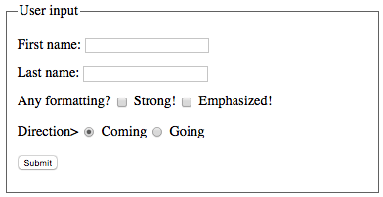
Form Examples: Radio Buttons
<body>
<form action="radiobuttons"
method="post">
<fieldset>
...
<p>
<label>Direction></label>
<input type="radio"
name="direction"
value="coming"
checked /> Coming
<input type="radio"
name="direction"
value="going" /> Going
</p>
...
</fieldset>
</form>
</body>
Every radio button
in the same group
must have the
same name
(e.g., direction).
Request this form:
GET localhost:3000/radiobuttons
Process this form:
POST localhost:3000/radiobuttons
radio.html

Slide 31
Form Examples: RadioButtons, cont’d
Router:
Controller:
app_server/routes/index.js
router.get('/radiobuttons', ctrlMain.get_radiobuttons);
router.post('/radiobuttons', ctrlMain.post_radiobutton);
module.exports.get_radiobuttons = function(request, result)
{
sendPage('radio.html', result);
};
module.exports.post_radiobuttons = function(request, result)
{
var direction = request.body.direction;
var text = direction === 'coming' ? 'Hello’ : 'Goodbye';
text = text + ', ' + getName(request);
text = modify(text, request);
sendBody(text, result);
};
Demo
app_server/controllers/main.js

Slide 32
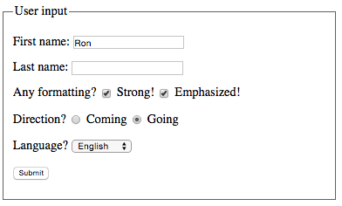
Form Examples: Menu
<body>
<form action="menu"
method="post">
<fieldset>
...
<p>
<label>Language?</label>
<select name="language">
<option value="english" selected>English</option>
<option value="french">Français</option>
<option value="german">Deutsch</option>
</selct>
</p>
<p>
<input type="submit" value="Submit" />
</p>
</fieldset>
</form>
</body>
Request this form:
GET localhost:3000/menu
Process this form:
POST localhost:3000/menu
select.html

Slide 33
Form Examples: Menu, cont’d
Router:
Controller:
app_server/routes/index.js
router.get('/menu', ctrlMain.get_menu);
router.post('/menu', ctrlMain.post_menu);
module.exports.get_menu = function(request, result)
{
sendPage('select.html', result);
};
app_server/controllers/main.js

Slide 34
Form Examples: Menu, cont’d
module.exports.post_menu = function(request, result)
{
var direction = request.body.direction;
var language = request.body.language;
vartext;
// Process language and direction.
if(direction === "coming")
{
switch(language)
{
case "english":
text = "Hello";
break;
case "french":
text = "Bonjour";
break;
case "german":
text = "Guten tag";
break;
default:
text ="";
}
}
app_server/controllers/main.js

Slide 35
Form Examples: Menu, cont’d
else if (direction === "going")
{
switch (language)
{
case "english":
text = "Goodbye";
break;
case "french":
text = "Au revoir";
break;
case "german":
text = "Auf wiedersehen";
break;
default:
text ="";
}
}
text = text +', ' + getName(request);
text = modify(text, request);
sendBody(text, result);
};
app_server/controllers/main.js
Demo

