Slide 1
CS/SE 157B Database Management Systems II March 13 Class Meeting
Department of Computer Science San Jose State University Spring 2018 Instructor: Ron Mak
www.cs.sjsu.edu/~mak

Slide 2
March 20 and 22
Semi-structured data and XML
Oxygen XML Editor
XPath and XQuery
FLWOR expressions
Moved up from after Spring Break

Slide 3
After Spring Break (March 26-30)
April 3 and 5
NoSQL databases and web applications
MongoDB
Documents and collections
CAP theorem vs. ACID
April 10 and 12
The Express server-side framework
Database CRUD actions and HTTP verbs
The REST API and RESTful web services

Slide 4
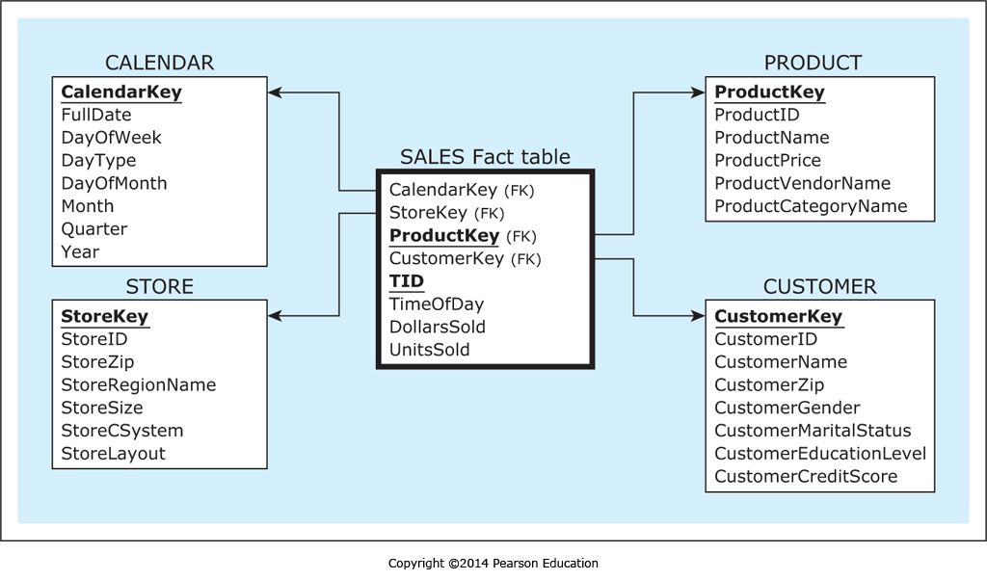
Extract, Transform, and Load (ETL) Example
The star schema for the dimensional model to analyze sales:
Database Systems
by Jukić, Vrbsky, & Nestorov
Pearson 2014
ISBN 978-0-13-257567-6

Slide 5
ETL Example, cont’d
Three data sources for the dimensional model:
Sales Department database
Facilities Department database
External customer demographic data table

Slide 6
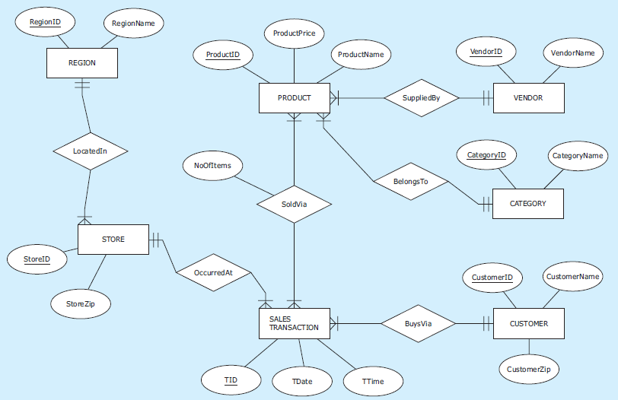
ETL Example, cont’d
Source 1: Sales Department database

Slide 7
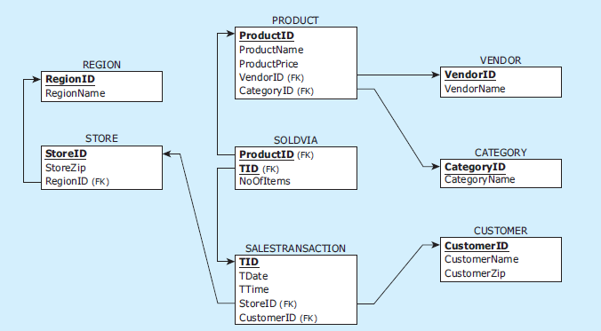
ETL Example, cont’d
Source 1: Sales Department database, cont’d

Slide 8
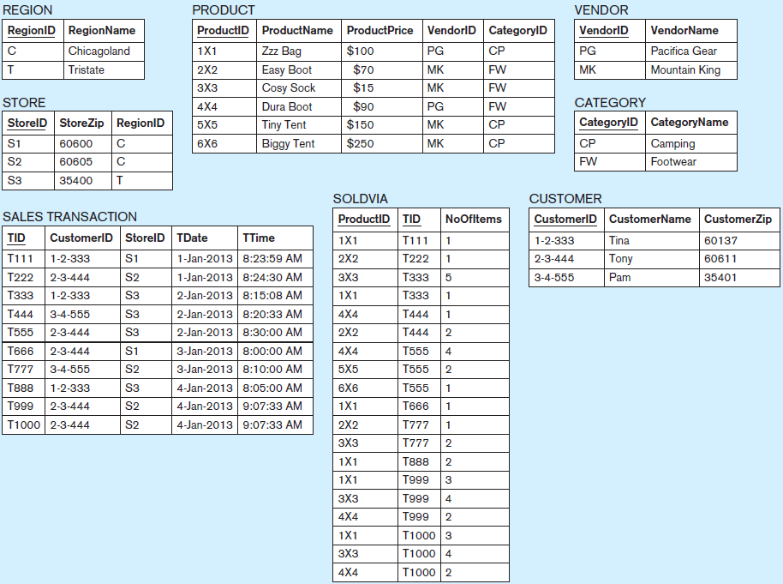
ETL Example, cont’d
Source 1: Sales Department database, cont’d

Slide 9
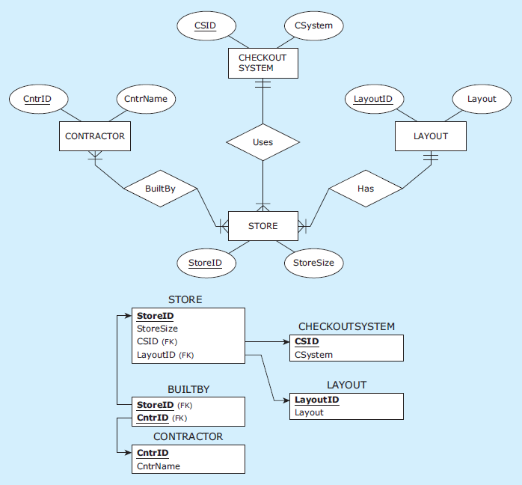
ETL Example, cont’d
Source 2: Facilities Department database

Slide 10
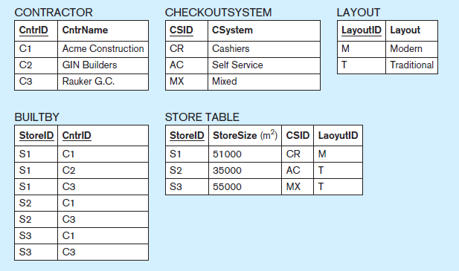
ETL Example, cont’d
Source 2: Facilities Department database, cont’d

Slide 11
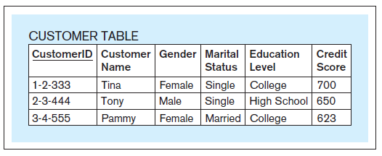
ETL Example, cont’d
Source 3: External customer demographic data table

Slide 12
ETL Example: Extraction
Retrieve analytically useful data.
Decide during the design of the dimensional model.
What meets the requirements for analyzing sales.
All of Source 1 and Source 3.
Some of Source 2.
Not CONTRACTOR
Not BUILDBY

Slide 13
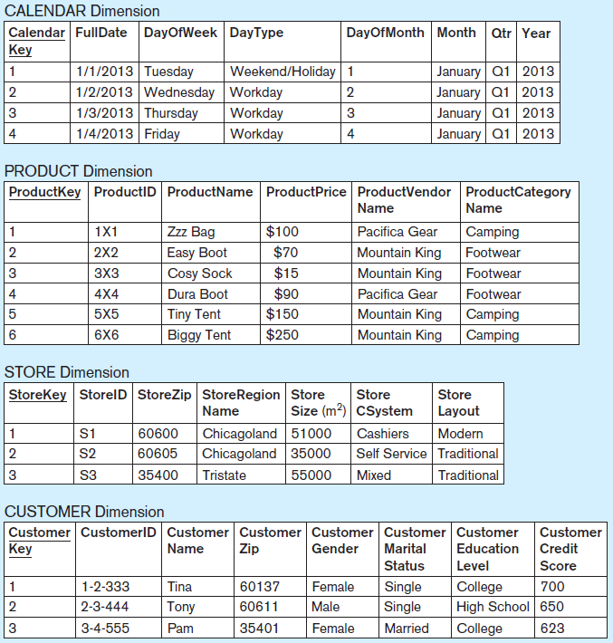
ETL Example: Extraction, cont’d

Slide 14
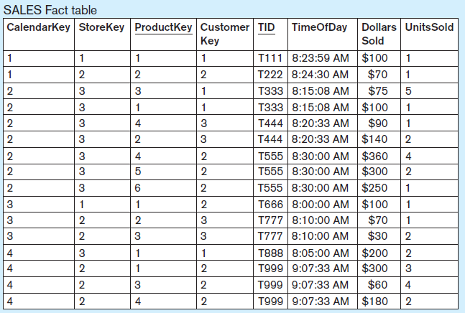
ETL Example: Extraction, cont’d

Slide 15
ETL Example: Transformation
Merge records from the Source 1 CUSTOMER database table and the external Source 3 customer demographic table.
Transform to fit the CUSTOMER dimension table.
Perform data cleansing (scrubbing).
Last record of Source 1 SALES TRANSACTION database table duplicates the previous record but with a different transaction ID.
Therefore, the last three records of Source 1 SOLDVIA database table are erroneous.

Slide 16
ETL Example: Transformation, cont’d
Resolve inconsistent data.
In the Source 1 CUSTOMER database table, the customer with ID 3-4-555 has first name “Pam” but the same customer in Source 3 customer demographic table has first name “Pammy”.
Choose “Pam” for the dimensional model.

Slide 17
ETL Example: Load
Batch process that automatically inserts data into the data warehouse tables.
No human involvement.
First load
Initial load into an empty data warehouse.
Refresh load
Every subsequent load.
Refresh cycle
Determined by the analytical needs.
Example: once a day, every few hours, etc.

Slide 18
ETL Infrastructure
Creating the ETL infrastructure is often the most time- and resource-consuming part of developing a data warehouse.
Labor intensive.
Predetermined by the results of requirements collection and data warehouse modeling processes that specify the sources and target.

Slide 19
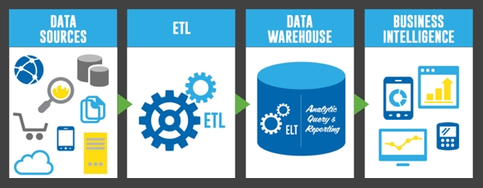
Extract, Transform, and Load (ETL)
http://uploads.webflow.com/54e3cc87305a0f0a0665f71f/5537351f5f1065d401cde83c_etl-elt-architecture.jpg

Slide 20
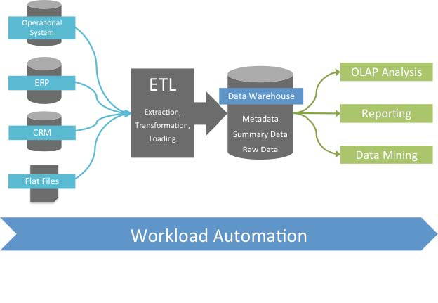
Extract, Transform, and Load (ETL), cont’d
http://www.stonebranch.com/common/images/etl-tipping-point.jpg

Slide 21
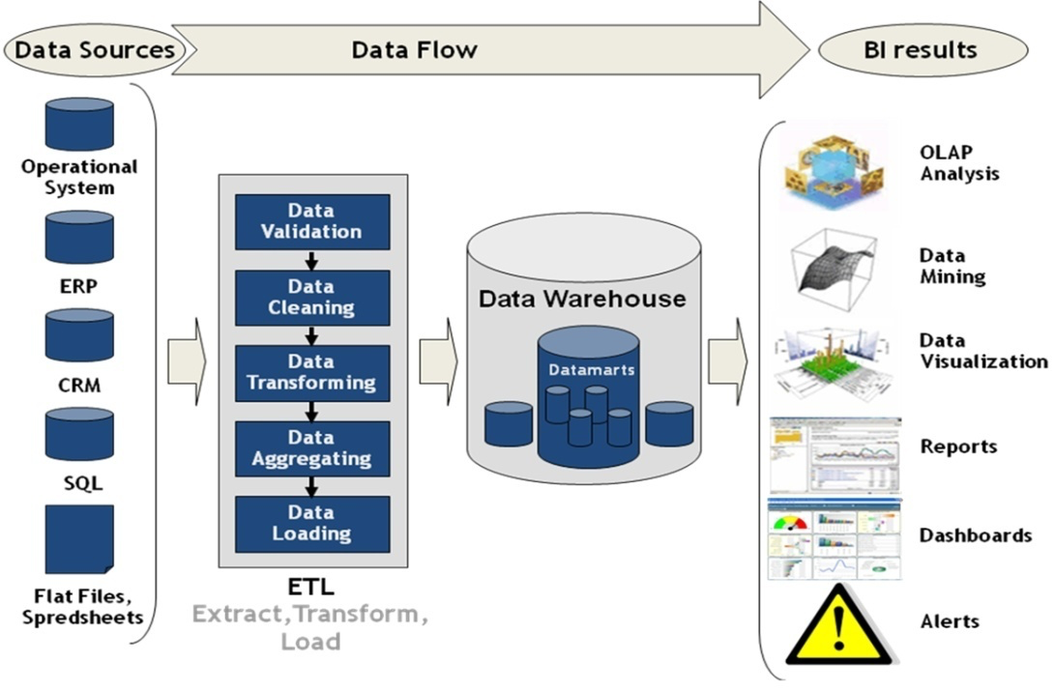
Extract, Transform, and Load (ETL), cont’d
http://superdevelop.com/wp-content/themes/shopperpress/thumbs/ETL.jpeg

Slide 22
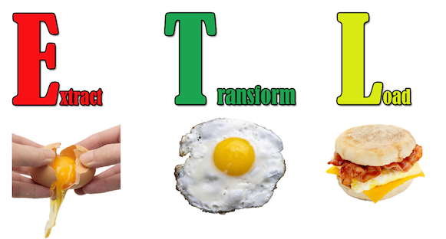
Extract, Transform, and Load (ETL), cont’d
http://edpflager.com/wp-content/uploads/2014/05/ETL.png

Slide 23
Review for the Midterm
Data models
Conceptual: entity-relationship (ER) diagrams
Logical: relational schema
Physical: MySQL/MariaDB database
Cardinalities: 1:1, 1:M, M:N
Entity integrity constraint
Referential integrity constraint
Normalization
Full key, partial, and transitive functional dependencies
1NF, 2NF, and 3NF

Slide 24
Review for the Midterm, cont’d
Web applications
Basic HTML elements and forms
PHP and PDO
Object-relational mapping
Data warehousing
Operational vs. analytical databases
Dimensional modeling and star schema
Dimension tables and fact tables
BI and OLAP: slice and dice, drill up and down, pivot
ETL

Slide 25
Review for the Midterm, cont’d
Content management
WordPress
Be sure to understand
lectures and lecture slides
assignments
Midterm format
multiple choice
short answer
operational and analytical database design

Slide 26
Example Midterm Questions
MovieCode | MovieName | ActorId | ActorName | AssistantId | AssistantName | ActorPay
M100 | Le Film Noir | A11 | Jean Wayne | AA01 | Julia | $2,200,000
M100 | Le Film Noir | A22 | G. Autré | AA01 | Julia | $1,500,000
M100 | Le Film Noir | A33 | C. Westwood | AA02 | Rob | $2,000,000
M100 | Le Film Noir | A44 | Barbara Stan | AA02 | Rob | $2,500,000
M200 | Horse Opera | A11 | Jean Wayne | AA03 | Leslie | $1,900,000
M200 | Horse Opera | A33 | C. Westwood | AA01 | Julia | $2,100,000
M200 | Horse Opera | A55 | R.W. Raygun | AA02 | Rob | $1,200,000
Describe an insertion anomaly with the table.
You cannot add an actor or an assistant into the table without adding a movie.
Describe a deletion anomaly with the table.
If Jean Wayne decides not to star in Horse Opera and therefore the fifth row of the table is deleted, we lose the id and name of assistant Leslie.

Slide 27
Example Midterm Questions
MovieCode | MovieName | ActorId | ActorName | AssistantId | AssistantName | ActorPay
M100 | Le Film Noir | A11 | Jean Wayne | AA01 | Julia | $2,200,000
M100 | Le Film Noir | A22 | G. Autré | AA01 | Julia | $1,500,000
M100 | Le Film Noir | A33 | C. Westwood | AA02 | Rob | $2,000,000
M100 | Le Film Noir | A44 | Barbara Stan | AA02 | Rob | $2,500,000
M200 | Horse Opera | A11 | Jean Wayne | AA03 | Leslie | $1,900,000
M200 | Horse Opera | A33 | C. Westwood | AA01 | Julia | $2,100,000
M200 | Horse Opera | A55 | R.W. Raygun | AA02 | Rob | $1,200,000
Describe a modification anomaly with the table.
If assistant Julia retires and is replaced by another person, three rows of the table need to be modified. Also, three rows need to be modified if assistant Rob retires.

Slide 28
Example Midterm Questions
MovieCode | MovieName | ActorId | ActorName | AssistantId | AssistantName | ActorPay
M100 | Le Film Noir | A11 | Jean Wayne | AA01 | Julia | $2,200,000
M100 | Le Film Noir | A22 | G. Autré | AA01 | Julia | $1,500,000
M100 | Le Film Noir | A33 | C. Westwood | AA02 | Rob | $2,000,000
M100 | Le Film Noir | A44 | Barbara Stan | AA02 | Rob | $2,500,000
M200 | Horse Opera | A11 | Jean Wayne | AA03 | Leslie | $1,900,000
M200 | Horse Opera | A33 | C. Westwood | AA01 | Julia | $2,100,000
M200 | Horse Opera | A55 | R.W. Raygun | AA02 | Rob | $1,200,000
Draw a diagram showing full key, partial, and transitive functional dependencies of the table. Clearly label the type of functional dependency.

Slide 29
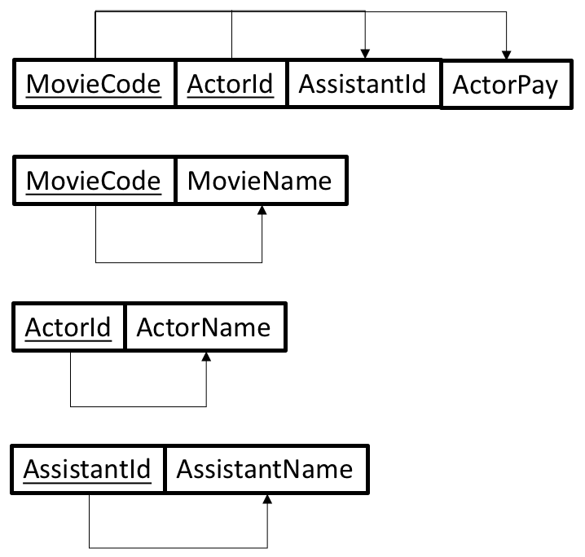
Example Midterm Questions
MovieCode | MovieName | ActorId | ActorName | AssistantId | AssistantName | ActorPay
M100 | Le Film Noir | A11 | Jean Wayne | AA01 | Julia | $2,200,000
M100 | Le Film Noir | A22 | G. Autré | AA01 | Julia | $1,500,000
M100 | Le Film Noir | A33 | C. Westwood | AA02 | Rob | $2,000,000
M100 | Le Film Noir | A44 | Barbara Stan | AA02 | Rob | $2,500,000
M200 | Horse Opera | A11 | Jean Wayne | AA03 | Leslie | $1,900,000
M200 | Horse Opera | A33 | C. Westwood | AA01 | Julia | $2,100,000
M200 | Horse Opera | A55 | R.W. Raygun | AA02 | Rob | $1,200,000
What is the result of normalizing the table to 3NF?

