Slide 1
WordPress Development
Applications Versus Websites
Web applications reside on websites, and websites need to be managed, updated, and maintained.
Any web application you develop will be deployed within the context of a website.

Slide 2
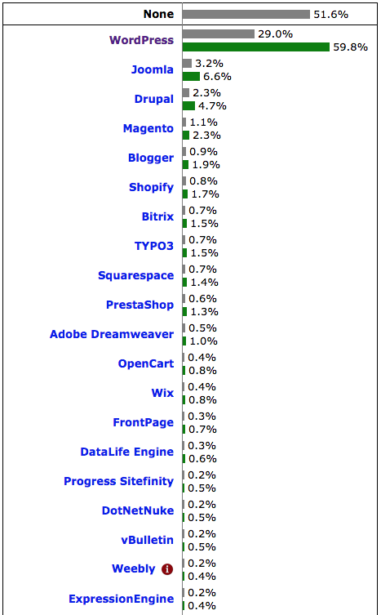
Why WordPress?
Most business websites today are built on a Content Management System (CMS).
The most popular CMS is WordPress. It is used on more websites than all other CMS’s put together! (Other systems include Joomla, Drupal, and Magento.)

Slide 3
What We Will Cover
What WordPress can do
WordPress structure
Extending WordPress websites
Ways to add web applications
We will not get down to the code level in class
“skeleton” code examples can be downloaded

Slide 4
WordPress Basics
WordPress lets site operators log in to a Dashboard to manage:
Pages
Blog posts
Media
Menus
User accounts

Slide 5
Dashboard Tutorial
Managing Your Site with WordPress – Using the WordPress Dashboard www.learningjack-online-training-courses.com/catalog/courses/managing-your-site-with-wordpress/ (a one hour online course)

Slide 6
WordPress Basics
WordPress is built with php, JavaScript and MySQL.
WordPress can be extended in two ways:
Themes can change the look and feel of the site.
Plugins can add functionality to the site.
WordPress is not a development framework, but it does provide an API, an event model, and a structure.
It can be combined with frameworks such as angular, node, etc. to build apps on a website.

Slide 7
Example
dogspotters.com
dog breed selector app – a single page application on a WordPress site.

Slide 8
Extending Wordpress
Themes – determine appearance & behavior
Plugins – add functionality
[shortcodes] – insert code into content
Widgets – insert content / features into specific widget-ready places on the page
wp-config.php and .htaccess files

Slide 9
WordPress File Structure
.htaccess
wp-config.php
wp-admin
wp-includes
wp-xxxx.php
wp-content
plugins
themes
uploads

Slide 10
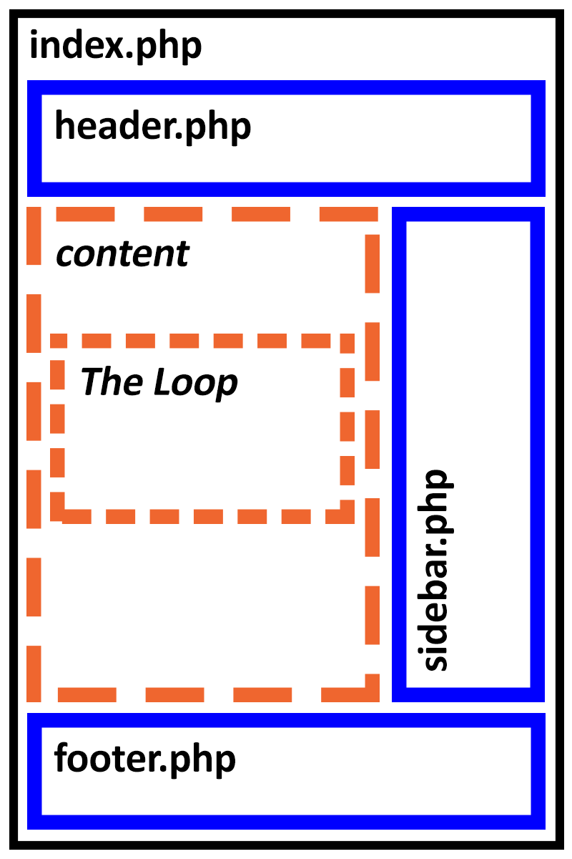
Building a Theme
A Theme is a Page Template
theme-name folder
style.css (theme header)
index.php (template)
header.php
sidebar.php
footer.php
screenshot.png
The Loop

Slide 11
The WordPress Loop
Used to display pages, blog indexes, individual blog posts, and custom post types
For each item, retrieve and display:
the_title
the_excerpt
the_content
the_category
the_author
the_date

Slide 12
Additional Theme Files
single.php
comments.php
page.php
page-pagetype.php
header-pagetype.php
footer-pagetype.php
category.php
archive.php and more…
functions.php

Slide 13
Functions.php Theme File
Adds functionality to a theme
Admin screens
[shortcodes]
Widgets
Event hooks (drag & drop)
Filters and more…

Slide 14
Example
skeleton-theme

Slide 15
Pre-Built Themes
Pro
Attractive design
Customizable
Feature-rich
Free or low cost
Child Themes
style.css
additional override files
Con
Inflexible / Complicated
Lock-In
Quality issues ???
Security
Support

Slide 16
Plugins
Plugins extend and add to the functionality that already exists in WordPress.
Google Maps
Slideshows
Forms
Media Management *
Business Directories
Discussion Forums
E-commerce / Shopping Carts (WooCommerce)
There are over 50,000 WordPress plugins

Slide 17
Building a Plugin
plugin-name folder
plugin-name.php
Go to Dashboard and Activate

Slide 18
Example
skeleton-shortcode
[skeletonbody]

Slide 19
Pre-Built Plugins
Pro
Lots of Functionality
Customizable
Feature-rich
Free or low cost
Choosing a Plugin
Lots of installations
Good reviews
Documentation & Support
Con
Inflexible / Complicated
Lock-In
Quality issues ???
Security
Support

Slide 20
Widgets
A widget is a small block that can be dragged into a widget-ready area (typically a sidebar or footer) in a WordPress theme.
Search box
Custom menu
Calendar
Weather
Blog archives

Slide 21
Building a Widget
Widget code can be added to your WordPress website in two ways:
Upload the widget code as a plugin, or
Add the widget code to the functions.php file in a theme

Slide 22
Example
skeleton-widget

Slide 23
Integrating a Web App
There are several ways to add a web application to a WordPress website:
Write a plugin to add [shortcodes] or widgets
Admin pages in Dashboard
Create a custom page type in a theme
Embed JavaScript in the page content area
Include libraries in the header.php file

Slide 24
WordPress API
WordPress API allows you to:
Add shortcodes, widgets, admin screens, etc.
Action Hooks (callbacks)
Filter Hooks (callbacks)
Retrieve content and other data
Access the database and file system
AJAX and REST APIs
https://developer.wordpress.org/reference/
https://codex.wordpress.org/WordPress_APIs

Slide 25
Administering WordPress
Install a caching plugin
Make regular (automated) backups
Install a Security plugin
Keep WordPress up to date
Keep Plugins & Themes up to date
Separate development site

Slide 26
Questions?

