Slide 1
CS/SE 157B Database Management Systems II March 1 Class Meeting
Department of Computer Science San Jose State University Spring 2018 Instructor: Ron Mak
www.cs.sjsu.edu/~mak

Slide 2
Dimensional Modeling
A type of data model used for data warehouses and data marts.
Subject-oriented analytical databases
The dimensional model is commonly based on the relational data model.
Two types of tables:
dimension tables
fact tables

Slide 3
Dimension Tables
Dimensions are the attributes to which the subject of analysis belongs.
Dimension table columns contain descriptive information that is often textual.
Examples: time, location, experiment type, advertising campaign, product brand, product color, customer gender, customer education level, etc.
Descriptive information can also be numeric:
Examples: product weight, customer age, etc.

Slide 4
Dimension Tables, cont’d
Dimension information form the basis for the analysis of the subject.
Example: Analyze sales by product brand, customer gender, customer age, etc.
Example: Analyze cancer incidents by patient age, patient gender, patient race, income level, city, etc.

Slide 5
Fact Tables
Facts are measures related to the subject of analysis.
Typically numerical for computation and quantitative analysis.
Commerce examples: sales, revenues, profits
Science examples: temperature, mass, voltage
Medical examples: blood pressure, cancer incidents
Fact tables contain measures and the foreign keys that associate the facts with the dimensions tables.

Slide 6
Star Schema
Star schema: A dimensional relational schema.
Contains dimension tables and fact tables.
Each dimension table contains
a primary key
attributes that are used for the analysis of the measures in the fact tables
Each fact table contains
fact-measures
foreign keys to the dimension tables

Slide 7
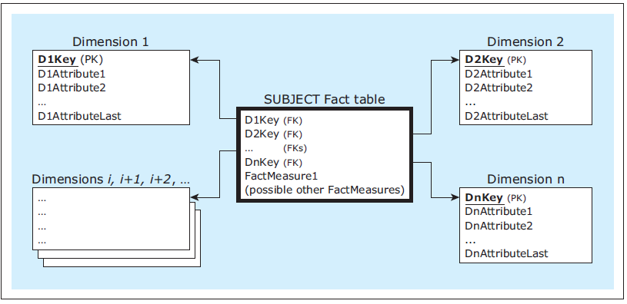
Star Schema, cont’d
A dimensional model
Database Systems
by Jukić, Vrbsky, & Nestorov
Pearson 2014
ISBN 978-0-13-257567-6

Slide 8
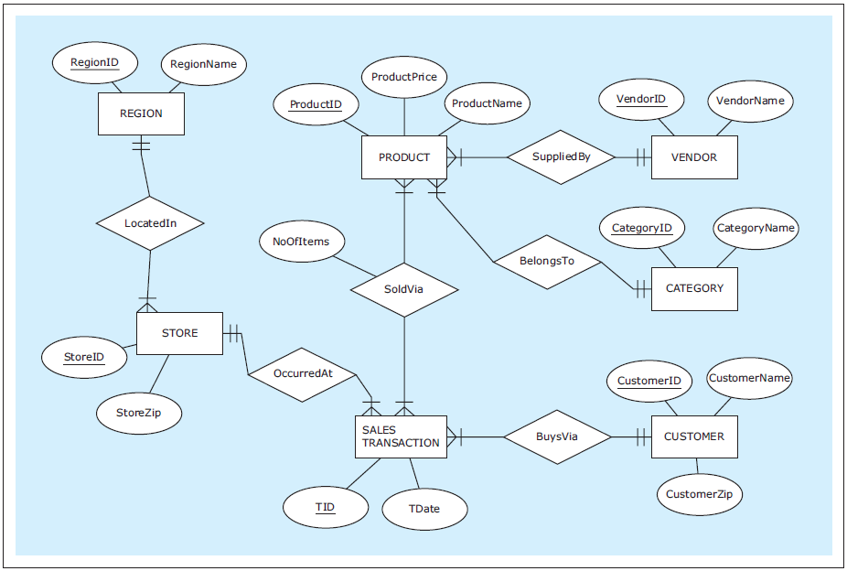
Dimensional Model Example
Database Systems
by Jukić, Vrbsky, & Nestorov
Pearson 2014
ISBN 978-0-13-257567-6

Slide 9
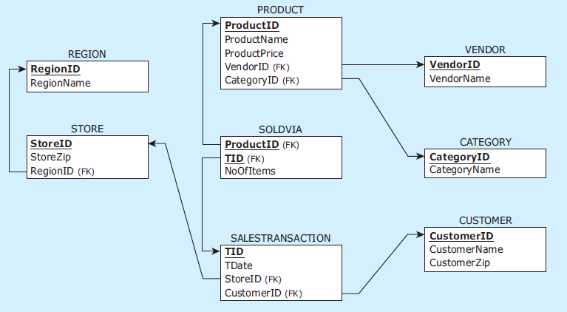
Dimensional Model Example, cont’d
The relational schema
Database Systems
by Jukić, Vrbsky, & Nestorov
Pearson 2014
ISBN 978-0-13-257567-6

Slide 10
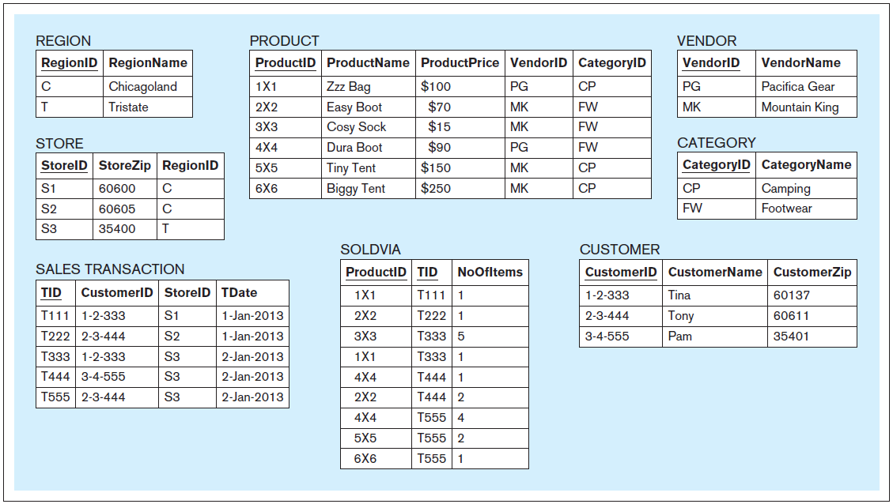
Dimensional Model Example, cont’d
Operational tables
Database Systems
by Jukić, Vrbsky, & Nestorov
Pearson 2014
ISBN 978-0-13-257567-6

Slide 11
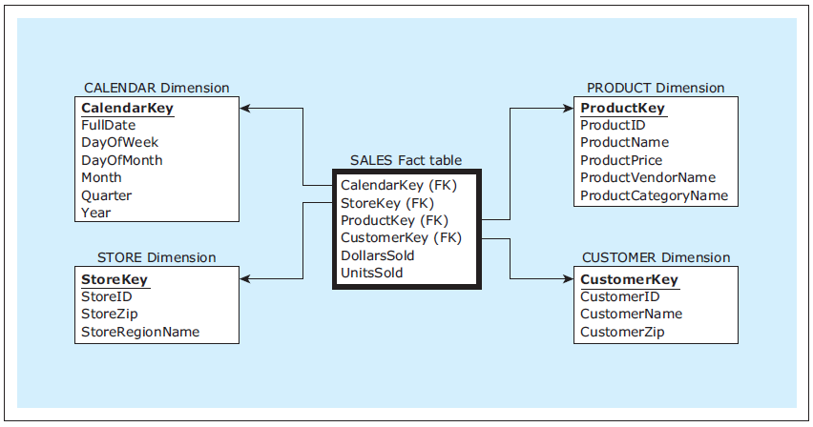
Dimensional Model Example, cont’d
Nearly every star schema includes
a date-related dimension.
The dimensional model
Database Systems
by Jukić, Vrbsky, & Nestorov
Pearson 2014
ISBN 978-0-13-257567-6

Slide 12
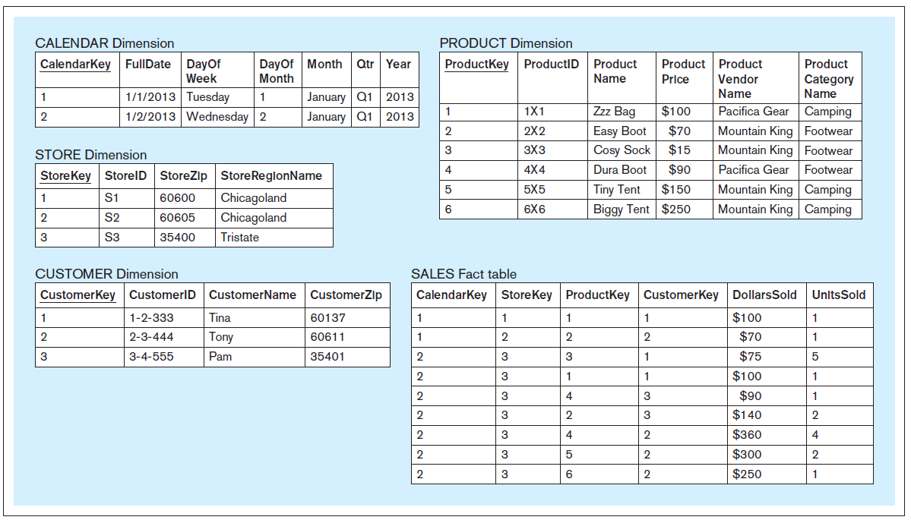
Dimensional Model Example, cont’d
Analytical tables
Database Systems
by Jukić, Vrbsky, & Nestorov
Pearson 2014
ISBN 978-0-13-257567-6

Slide 13
Characteristics of Dimension Tables
The number of rows in any dimension table is relatively small compared to the number of rows in a fact table.
A dimension table contains relatively static data.
To improve performance, rows of a dimension table can contain seemingly excessive fields or fields that can be derived.
Example: A Calendar table row can contain a full date, day of the week, day of the month, month, week of the year, quarter, year.

Slide 14
Characteristics of Fact Tables
A typical fact table has records continually added to it and grows rapidly in size.
A fact table can have orders of magnitude more rows than a dimension table.
You can consider all the foreign keys to constitute the composite primary key.
You might not need to make a query to access a particular fact record.

Slide 15
Surrogate Keys
Each dimension table is typically given a simple non-composite system-generated surrogate key.
Use a surrogate key as the primary key rather than the operational key.
Example: The Product dimension table uses the surrogate key ProductKey rather than the operational key ProductID.
Use a surrogate key to handle slowly changing dimensions (discussed later).
Other than serving
as the primary key
of a dimension table,
a surrogate key has
no other meaning.

Slide 16
Queries against a Star Schema
Analytical queries are simpler using a dimensional model vs. the original relational model.
Example query: How do the quantities of sold products on Saturdays in the Camping category provided by vendor Pacific Gear within the Tristate region during the first quarter of 2017 compare to the second quarter of 2017?

Slide 17
Example Star Schema Query
SELECT SUM(SA.UnitsSold)‚ P.ProductCategoryName‚
P.ProductVendorName‚ C.DayofWeek‚ C.Qtr
FROM Calendar C‚ Store S‚ Product P‚ Sales SA
WHERE C.CalendarKey = SA.CalendarKey
AND S.StoreKey = SA.StoreKey
AND P.ProductKey = SA.ProductKey
AND P.ProductVendorName = 'Pacifica Gear'
AND P.ProductCategoryName = 'Camping'
AND S.StoreRegionName = 'Tristate'
AND C.DayofWeek = 'Saturday'
AND C.Year = 2017
AND C.Qtr IN ('Q1', 'Q2')
GROUP BY P.ProductCategoryName,
P.ProductVendorName,
C.DayofWeek,
C.Qtr;
Join the Sales fact table SA with the
three dimension tables Calendar C,
Store S, and Product P.
How do the quantities of sold products
on Saturdays in the Camping category
provided by vendor Pacific Gear
within the Tristate region
during the first quarter of 2017
compare to the second quarter of 2017?

Slide 18
Equivalent Non-Dimensional Query
SELECT SUM(SV.NoOfItems), C.CategoryName, V.VendorName,
EXTRACTWEEKDAY(ST.Date), EXTRACTQUARTER(ST.Date)
FROM Region R, Store S, SalesTransaction ST, SoldVia SV,
Product P, Vendor V, Category C
WHERE R.RegionID = S.RegionID
AND S.StoreID = ST.StoreID
AND ST.Tid = SV.Tid
AND SV.ProductID = P.ProductID
AND P.VendorID = V.VendorID
AND P.CateoryID = C.CategoryID
AND V.VendorName = 'Pacifica Gear'
AND C.CategoryName = 'Camping'
AND R.RegionName = 'Tristate'
AND EXTRACTWEEKDAY(St.Date) = 'Saturday'
AND EXTRACTYEAR(ST.Date) = 2013
AND EXTRACTQUARTER(ST.Date) IN ('Q1', 'Q2')
GROUP BY C.CategoryName,
V.VendorName,
EXTRACTWEEKDAY(ST.Date),
EXTRACTQUARTER(ST.Date);
Join all seven tables.
Use date-extraction
functions.

Slide 19
Transaction ID and Time
Besides the measure and foreign keys, a fact table can contain other attributes.
For a retailer, useful additional attributes are transaction ID and time of day.
A transaction ID can provide business insight derived from market basket analysis.
Which products do customers often buy together?
AKA association rule mining or affinity grouping

Slide 20
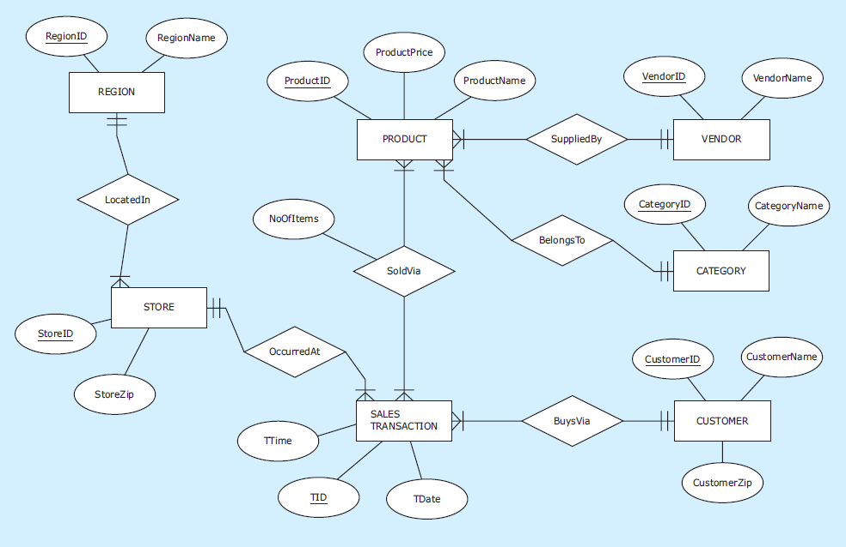
Transaction ID and Time, cont’d
Database Systems
by Jukić, Vrbsky, & Nestorov
Pearson 2014
ISBN 978-0-13-257567-6

Slide 21
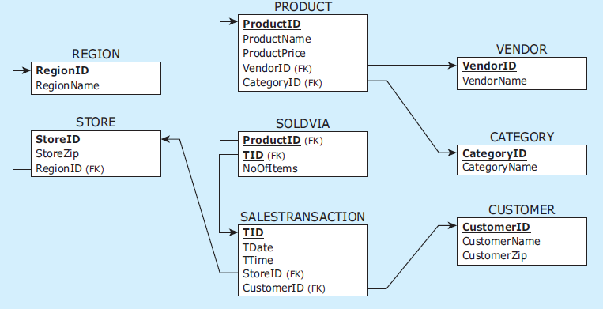
Transaction ID and Time, cont’d
The relational schema
Database Systems
by Jukić, Vrbsky, & Nestorov
Pearson 2014
ISBN 978-0-13-257567-6

Slide 22
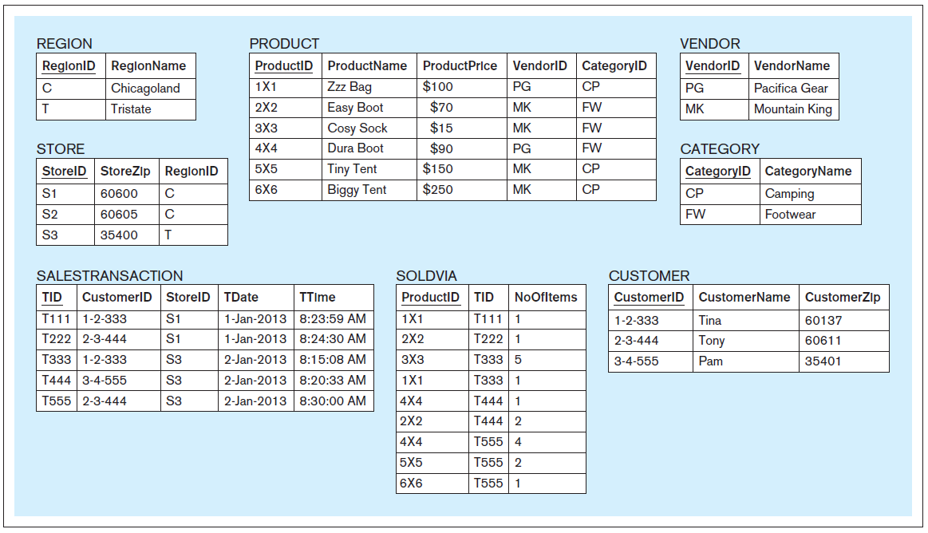
Transaction ID and Time, cont’d
Operational tables
Database Systems
by Jukić, Vrbsky, & Nestorov
Pearson 2014
ISBN 978-0-13-257567-6

Slide 23
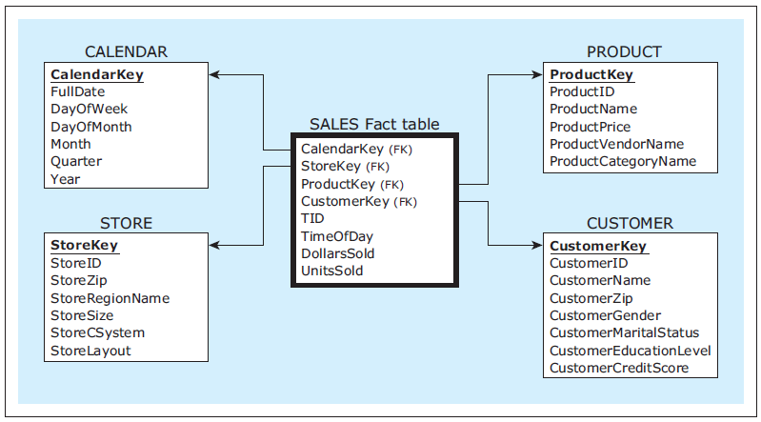
Transaction ID and Time, cont’d
The dimensional model
Database Systems
by Jukić, Vrbsky, & Nestorov
Pearson 2014
ISBN 978-0-13-257567-6

Slide 24
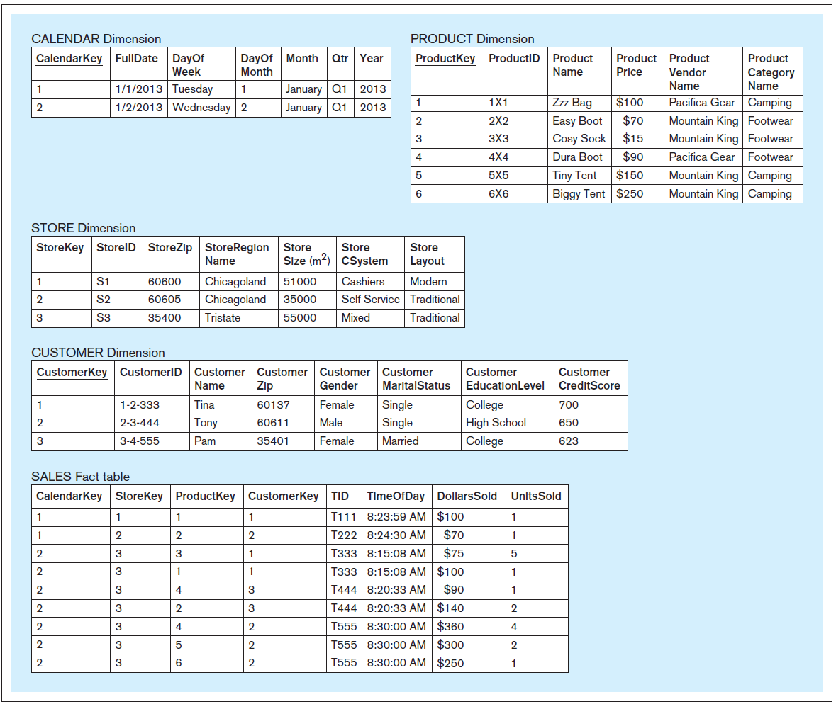
Transaction ID and Time, cont’d
Analytical tables
Database Systems
by Jukić, Vrbsky, & Nestorov
Pearson 2014
ISBN 978-0-13-257567-6

Slide 25
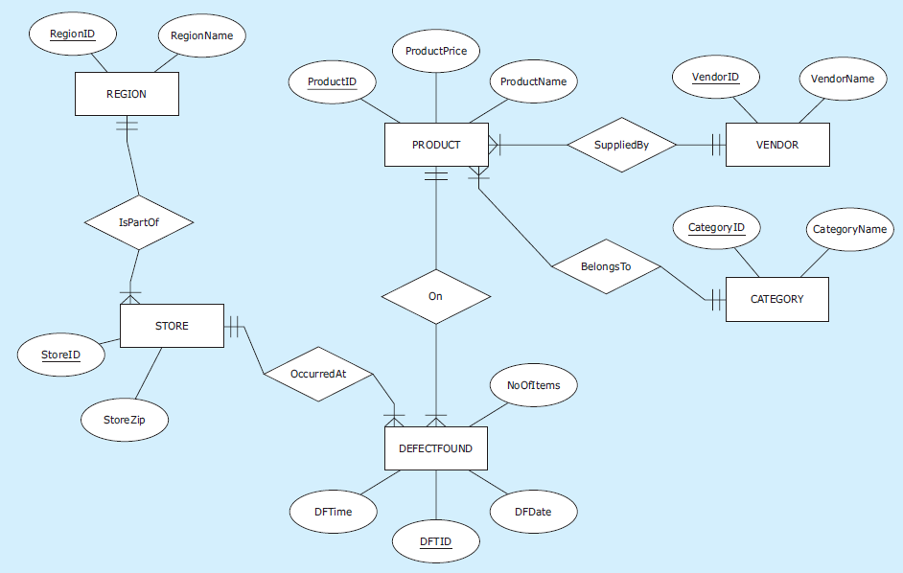
Multiple Fact Tables
Database Systems
by Jukić, Vrbsky, & Nestorov
Pearson 2014
ISBN 978-0-13-257567-6

Slide 26
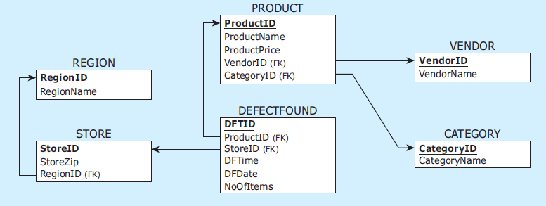
Multiple Fact Tables, cont’d
The relational schema
Database Systems
by Jukić, Vrbsky, & Nestorov
Pearson 2014
ISBN 978-0-13-257567-6

Slide 27
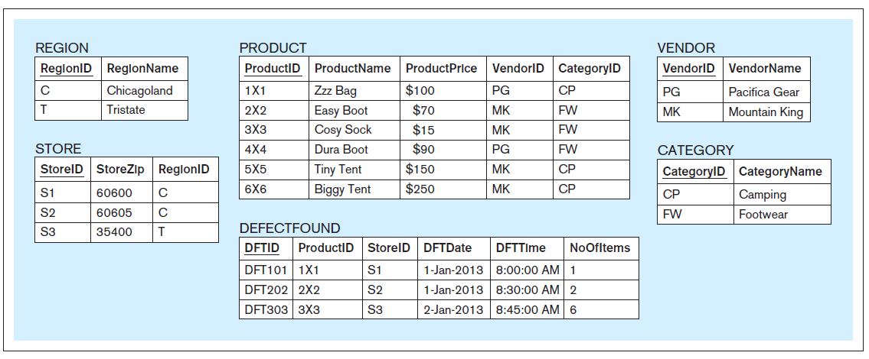
Multiple Fact Tables, cont’d
Operational tables
Database Systems
by Jukić, Vrbsky, & Nestorov
Pearson 2014
ISBN 978-0-13-257567-6

Slide 28
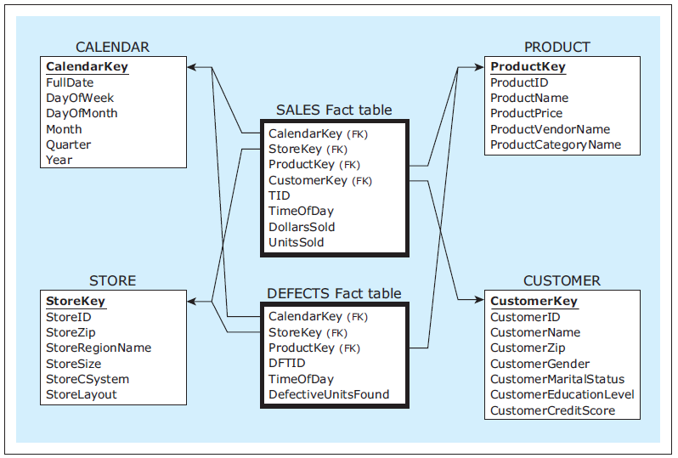
Multiple Fact Tables, cont’d
The dimensional model
Database Systems
by Jukić, Vrbsky, & Nestorov
Pearson 2014
ISBN 978-0-13-257567-6

Slide 29
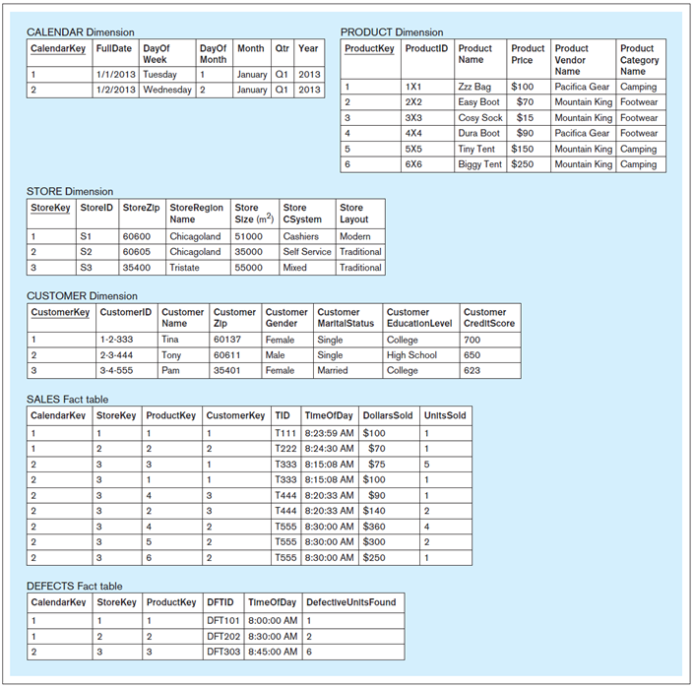
Multiple Fact Tables, cont’d
Database Systems
by Jukić, Vrbsky, & Nestorov
Pearson 2014
ISBN 978-0-13-257567-6
Analytical tables

Slide 30
Detailed vs. Aggregated Fact Tables
In a detailed fact table, each row contains data about a single fact.
In an aggregated fact table, each row contains a summary of multiple facts.
Example: A sum (aggregation) of all sales of a product in a particular store during a single day.

Slide 31
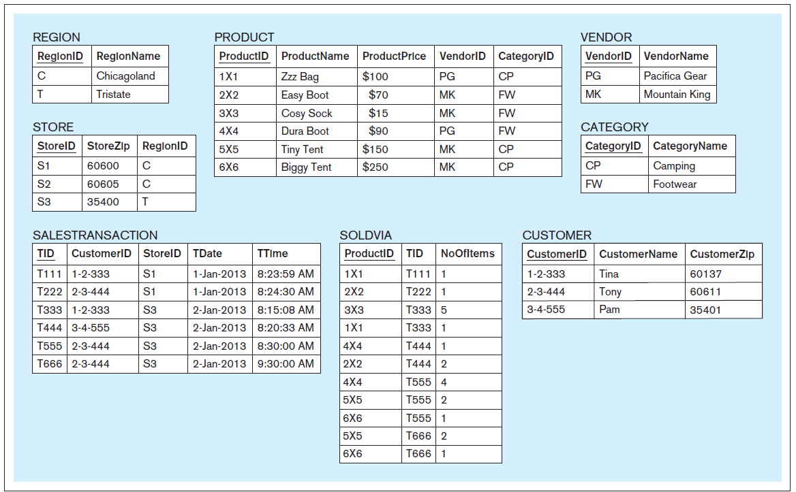
Detailed Fact Table Example
Operational tables
Database Systems
by Jukić, Vrbsky, & Nestorov
Pearson 2014
ISBN 978-0-13-257567-6

Slide 32
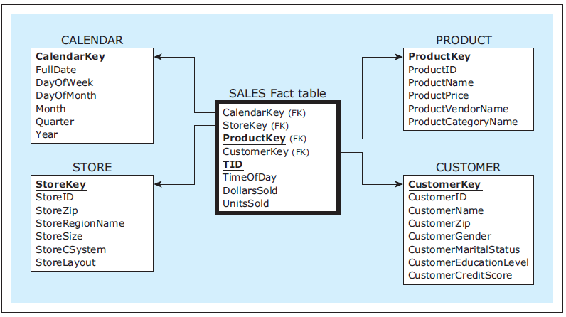
Detailed Fact Table Example, cont’d
Detailed fact table
Database Systems
by Jukić, Vrbsky, & Nestorov
Pearson 2014
ISBN 978-0-13-257567-6

Slide 33
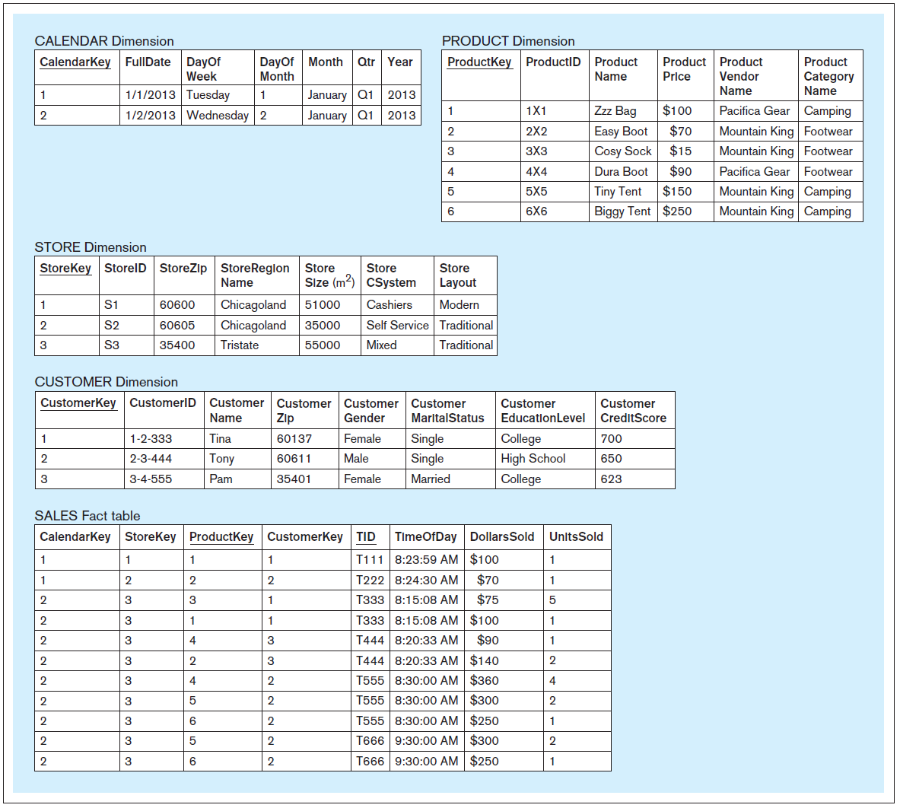
Detailed Fact Table Example, cont’d
Analytical tables
Database Systems
by Jukić, Vrbsky, & Nestorov
Pearson 2014
ISBN 978-0-13-257567-6
Each fact table record
contains data about
one sales fact.

Slide 34
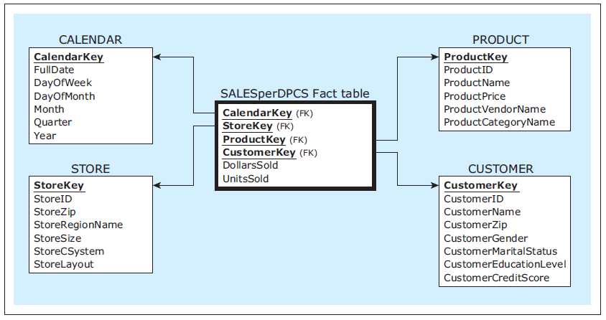
Aggregated Fact Table Example #1
Aggregated fact table DPCS:
Total amount sold
in dollars and units
on a particular day
for a particular product
for a particular customer
for a particular store.
Database Systems
by Jukić, Vrbsky, & Nestorov
Pearson 2014
ISBN 978-0-13-257567-6

Slide 35
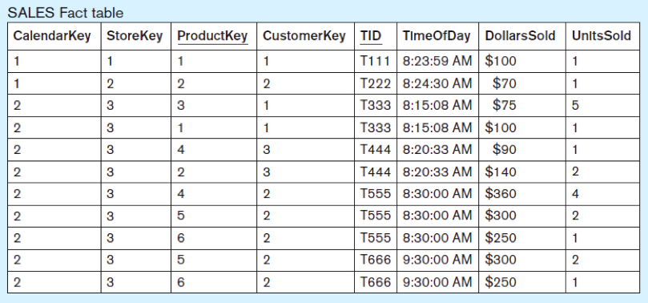
Aggregated Fact Table Example #1, cont’d
Database Systems
by Jukić, Vrbsky, & Nestorov
Pearson 2014
ISBN 978-0-13-257567-6

Slide 36
Aggregated Fact Table Example #1, cont’d
Database Systems
by Jukić, Vrbsky, & Nestorov
Pearson 2014
ISBN 978-0-13-257567-6

Slide 37
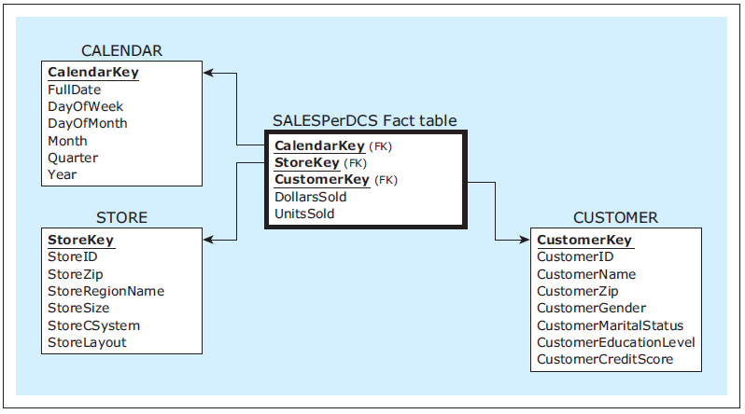
Aggregated Fact Table Example #2
Aggregated fact table DCS:
Total amount sold
in dollars and units
on a particular day
for a particular customer
for a particular store
across all products.
Database Systems
by Jukić, Vrbsky, & Nestorov
Pearson 2014
ISBN 978-0-13-257567-6

Slide 38
Aggregated Fact Table Example #2, cont’d
Database Systems
by Jukić, Vrbsky, & Nestorov
Pearson 2014
ISBN 978-0-13-257567-6

Slide 39
Aggregated Fact Table Example #2, cont’d
Database Systems
by Jukić, Vrbsky, & Nestorov
Pearson 2014
ISBN 978-0-13-257567-6

Slide 40
Aggregated Fact Table Example #2, cont’d
Database Systems
by Jukić, Vrbsky, & Nestorov
Pearson 2014
ISBN 978-0-13-257567-6

Slide 41
Granularity of the Fact Table
Aggregated fact tables have a coarser level of granularity than detailed fact tables.
Quicker to query than detailed fact tables.
Coarser granularity tables are limited in what information can be retrieved from them.
Aggregation is application requirement-specific.
Detailed granularity provides unlimited possibilities for analysis.
You can always obtain aggregation from fine grain.
The reverse is not true.

Slide 42
Granularity of the Fact Table, cont’d
For maximum flexibility, combine in a single dimensional model:
Maximum query performance provided by aggregated fact tables.
Maximum analytical power provided by detailed fact tables.

Slide 43
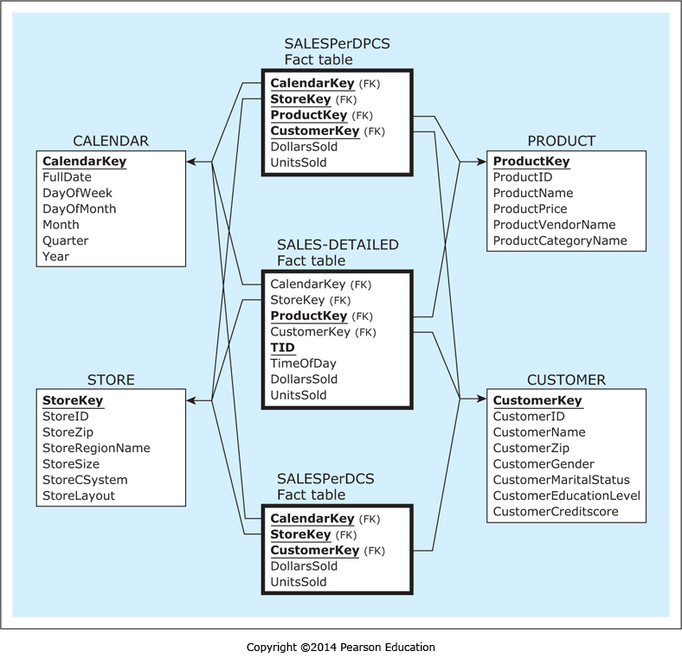
Granularity of the Fact Table, cont’d
Database Systems
by Jukić, Vrbsky, & Nestorov
Pearson 2014
ISBN 978-0-13-257567-6

Slide 44
Line-Item Detailed Fact Table
Each row is a single line item of a particular transaction.
There can be multiple line item rows per transaction.
Database Systems
by Jukić, Vrbsky, & Nestorov
Pearson 2014
ISBN 978-0-13-257567-6

Slide 45
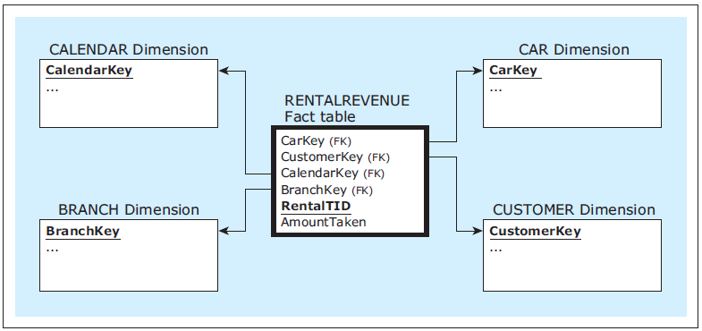
Transaction-Level Detailed Fact Table
Each row is a single transaction.
No line items.
Database Systems
by Jukić, Vrbsky, & Nestorov
Pearson 2014
ISBN 978-0-13-257567-6

Slide 46
Assignment #3
Create a dimensional model with a star schema based on your project’s relational schema.
Draw the dimensional model (star schema) using ERDPlus.
At least 4 dimension tables and 2 fact tables.
At least one fact table should be fine grained.
At least one fact table should be aggregated.

Slide 47
Assignment #3
Include your relational schema and describe in a short report how your dimension and fact tables are populated from your operational tables.
For this assignment, your dimensional model can contain data that don’t all come from your operational tables.

Slide 48
Assignment #3, cont’d
Put some sample data into your dimension and fact tables.
Provide at least one query per fact table.
Describe the query in English.
Write and execute the SQL.
Include a text file containing the query outputs.
Due Friday, March 9.

