Slide 1
CS/SE 157B Database Management Systems II February 27 Class Meeting
Department of Computer Science San Jose State University Spring 2018 Instructor: Ron Mak
www.cs.sjsu.edu/~mak

Slide 2
The Data Deluge
90% of all the data ever created was created in the past two years.
2.5 quintillion bytes of data per day is being created.
2.5 x 10¹⁸
80% of the data is “dark data”
i.e., unstructured data

Slide 3
A Transformation
collect values
Data
Often together
simply called “data”
add metadata
Information
add context
Knowledge
add insight
Wisdom

Slide 4
Operational Data
Support a company’s day-to-day operations.
A company can have multiple operational data sources.
Contains operational information.
AKA transactional information.
Example operational data:
sales transactions
ATM withdrawals
airline ticket purchases

Slide 5
Analytical Data
Collected for decision support and data analysis.
Example analytical information:
patterns of ATM usage during the day
sales trends over the past year
Analytical information is based on operational information.

Slide 6
Operational vs. Analytical Data
Create a data warehouse as a separate analytical database.
Don’t slow down the performance of the operational database by also making it support analytical operations.
It’s often impossible to structure a single database that is optimal for both operational and analytical operations.

Slide 7
Time Horizon
Operational data
Shorter time horizon: typically 60 to 90 days.
Most queries are for a short time horizon.
Archive data after 60 to 90 days.
Don’t penalize the performance of typical queries for the sake of an occasional atypical query.
Analytical data
Much longer time horizon.
Look for patterns and trends over many years.

Slide 8
Level of Data Detail
Operational data
Detailed data about each transaction.
Summarized data are not stored but are derived attributes calculated with formulas.
Summary data is subject to frequent changes.
Analytical data
Summarized data is physically stored.
Summarized data is often precomputed.
Summarized data is historical and unchanging.

Slide 9
Data Time Representation
Operational data
Contains the current state of affairs.
Frequently updated.
Analytical data
Current situation plus snapshots of the past.
Snapshots are calculated once and physically stored for repeated use.

Slide 10
Data Amounts and Query Frequency
Operational data
Frequent queries by more users.
Small amounts of data per query.
Analytical data
Fewer queries by fewer users.
Can have large amounts of data per query.
Difficult to optimize for both:
Frequent queries + small amounts of data
Less frequent queries + large amounts of data

Slide 11
Data Updates
Operational data
Regularly updated by end users.
Insert, modify, and delete data.
Analytical data
End users can only retrieve data.
Updates by end users not allowed.

Slide 12
Data Redundancy
Operational data
Goal is to reduce data redundancy.
Eliminate update anomalies.
Analytical data
Updates by end users not allowed.
No danger of update anomalies.
Eliminating data redundancies not as critical.

Slide 13
Data Audience
Operational data
Support day-to-day operations.
Used by all types of employees, customers, etc. for various tactical purposes.
Analytical data
Used by a more narrow set of users for decision-making purposes.

Slide 14
Data Orientation
Operational data
Application-oriented
Created to support an application that serves one or more business operations and processes.
Enable the efficient functioning of the application that it supports.
Analytical data
Subject-oriented
Created for the analysis of one or more business subject areas such as sales, returns, cost, profit, etc.

Slide 15
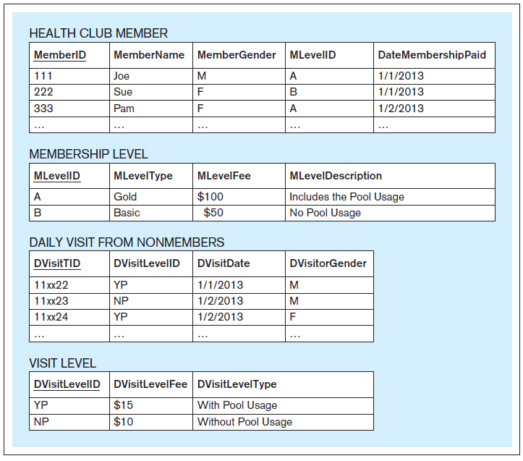
An Application-Oriented Operational Database
Support the
Visits and Payments application
of a health club.
Database Systems
by Jukić, Vrbsky, & Nestorov
Pearson 2014
ISBN 978-0-13-257567-6

Slide 16
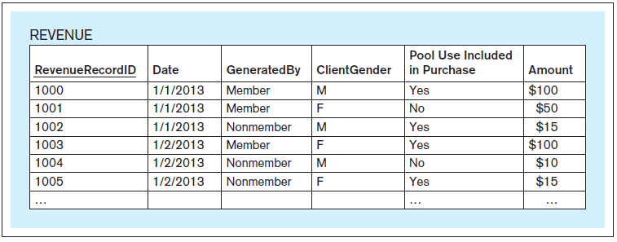
A Subject-Oriented Analytical Database
Support the analysis of the
subject of revenue
for a health club.
The data comes from
the operational database.
Database Systems
by Jukić, Vrbsky, & Nestorov
Pearson 2014
ISBN 978-0-13-257567-6

Slide 17
Operational vs. Analytical Data, cont’d
Operational Data | Analytical Data
Data Makeup
Typical time horizon: days/months | Typical time horizon: years
Detailed | Summarized (and/or detailed)
Current | Values over time (snapshots)
Technical Differences
Small amounts used in a process | Large amounts used in a process
High frequency of access | Low/Modest frequency of access
Can be updated | Read (and append) only
Non-redundant | Redundancy not an issue
Functional Differences
Used by all types of employees for tactical purposes | Used by fewer employees for decision making
Application oriented | Subject oriented

Slide 18
What is a Data Warehouse?
The data warehouse is a structured repository of integrated, subject-oriented, enterprise-wide, historical, and time-variant data.
The purpose of the data warehouse is the retrieval of analytical information.
A data warehouse can store detailed and/or summarized data.

Slide 19
Structured Repository
A data warehouse is a database that contains analytically useful information.
Any database is a structured repository.

Slide 20
Integrated
The data warehouse integrates analytically useful data from existing operational databases in the organization.
Copy the data from the operational databases into the data warehouse.

Slide 21
Subject-Oriented
Operational database
Support a specific business operation.
Data warehouse
Analyze specific business subject areas.

Slide 22
Enterprise-Wide
The data warehouse provides an enterprise-wide view of analytical data.
Example subject: Cost
Bring into the data warehouse all analytically useful cost data.

Slide 23
Historical
The data warehouse has a longer time horizon than in operational databases.
Operational database: typically 60-90 days
Data warehouse: typically multiple years

Slide 24
Time-Variant
The data warehouse contains slices or snapshots of data from different periods of time across its time horizon.
Example: Analyze and compare the cost for the first quarter of last year vs. the cost for the first quarter from two years ago.

Slide 25
Retrieval of Analytical Data
Users can only retrieve from a data warehouse.
Periodically load data from the operational databases into the data warehouse.
Automatically append the new data to the existing data.
Data that has been loaded into the data warehouse is not subject to changes.
Nonvolatile, static, read-only data warehouse.

Slide 26
Detailed and/or Summarized Data
Detailed data
AKA atomic data, transaction-level data
Example: An ATM transaction
Summarized data
Each record represents calculations based on multiple instances of transaction-level data.
Example: The total amount of ATM withdrawals during one month for one account.
Coarser level of detail than transaction data.
A data warehouse that contains the data at the finest level of detail is the most powerful.

Slide 27
Data Warehouse Components
Source systems
Extract-transform-load (ETL) infrastructure
Data warehouse
Front-end applications
Business Intelligence (BI) applications

Slide 28
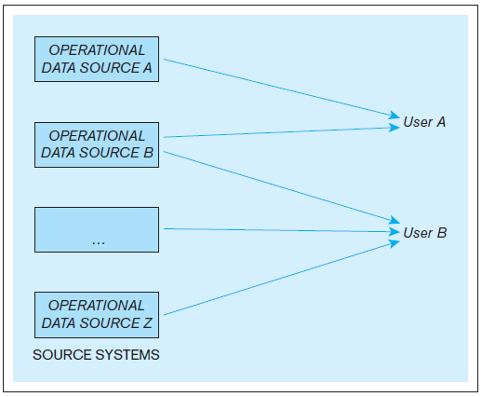
Data Warehouse Components, cont’d
Example: An organization where users use multiple operational data stores for daily operational purposes.
Database Systems
by Jukić, Vrbsky, & Nestorov
Pearson 2014
ISBN 978-0-13-257567-6

Slide 29
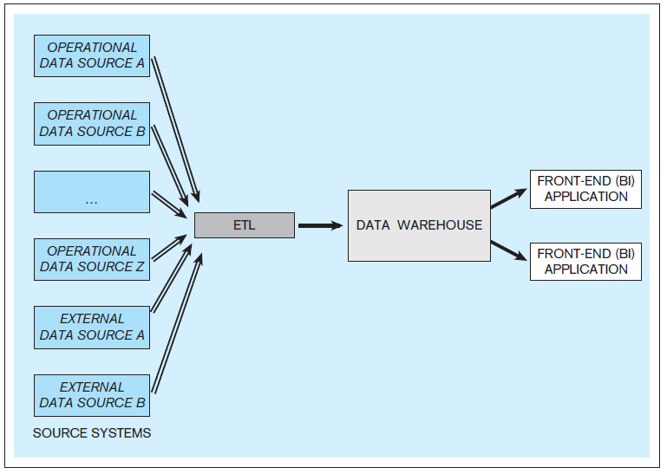
Data Warehouse Components, cont’d
Example: A data warehouse with multiple internal and external data sources.
Database Systems
by Jukić, Vrbsky, & Nestorov
Pearson 2014
ISBN 978-0-13-257567-6

Slide 30
Source Systems
Operational databases and other operational data repositories that provide analytically useful information for the data warehouse.
Therefore, each such operational data store has two purposes:
The original operational purpose.
A source for the data warehouse.
Both internal and external data sources.
Example external: third-party market research data

Slide 31
Extract-Transform-Load (ETL)
Extract analytically useful data from the operational data sources.
Transform the source data
Make it conform to the structure of the subject-oriented data warehouse.
Ensure data quality through processes such as data cleansing and scrubbing.
Load the transformed and quality-assured data into the target data warehouse.

Slide 32
Data Warehouse
Typically, an ETL occurs periodically for the target data warehouse.
Common: Perform ETL nightly.
Active data warehouse: retrieval of data from the operational data sources is continuous.

Slide 33
Business Intelligence (BI)
A technology-driven process to analyze data and present actionable knowledge to help corporate executives, business managers and other end users make more informed business decisions.
Tools, applications and methodologies to collect data, prepare it for analysis, query the data, and create reports, dashboards, and other data visualizations.

Slide 34
Business Intelligence (BI) Applications
Front-end applications that allow users who are analysts to access the data and functions of the data warehouse.

Slide 35
Data Marts
Same principles as a data warehouse.
More limited scope: one subject only.
Not necessarily an enterprise-wide focus.
Database Systems
by Jukić, Vrbsky, & Nestorov
Pearson 2014
ISBN 978-0-13-257567-6

Slide 36
Independent Data Marts
Standalone
Created the same way as a data warehouse.
Have their own data sources and ETL infrastructure.

Slide 37
Dependent Data Marts
Does not have its own data sources.
Data comes from the data warehouse.
Provide users with a subset of the data.
User get only the data they need or want or allowed to have access to.

Slide 38
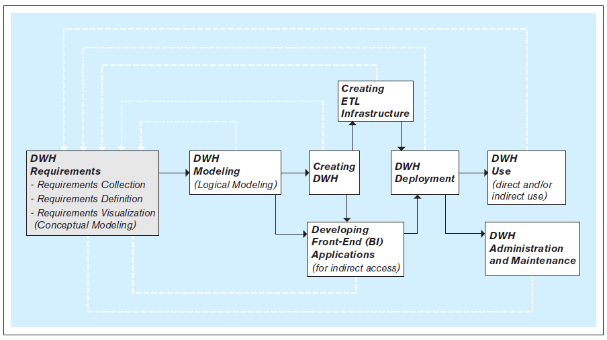
Steps to Create a Data Warehouse
An iterative process!
Database Systems
by Jukić, Vrbsky, & Nestorov
Pearson 2014
ISBN 978-0-13-257567-6

Slide 39
Create the ETL Infrastructure
Design and code the procedures to:
Automatically extract data from the operational data sources.
Transform the extracted data to assure its quality and to conform it to the model of the data warehouse.
Seamlessly load the transformed data into the data warehouse.

Slide 40
Create the ETL Infrastructure, cont’d
The ETL infrastructure must reconcile all the differences between the multiple operational sources and the target data warehouse.
Decide how to bring in information without creating misleading duplicates.
Creating the ETL infrastructure is often the most time- and resource-consuming part of developing a data warehouse.

Slide 41
Develop the BI Applications
Front-end BI applications enable users to analyze the data in the data warehouse.
Typical business intelligence functions:
Query the data.
Perform ad hoc analyses on the fly.
Generate reports and graphs.
Control a dashboard, often in real time.
Create data visualizations.
Advanced: data mining.

Slide 42
Develop the BI Applications
For examples of data visualizations, see the work of my CS 235 grad students: http://cs61.cs.sjsu.edu/CS235Projects/
The primary goal of BI is to provide useful business insights and actionable knowledge for the decision makers.
New field: Data Science
“A data scientist is a statistician who works at a start-up.”

