Slide 1
CS/SE 157B Database Management Systems II February 22 Class Meeting
Department of Computer Science San Jose State University Spring 2018 Instructor: Ron Mak
www.cs.sjsu.edu/~mak

Slide 2
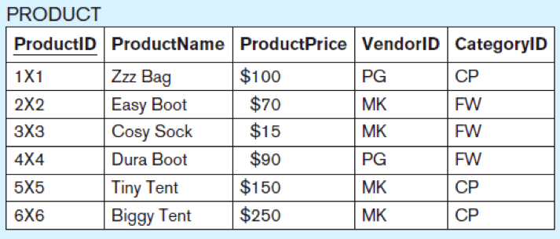
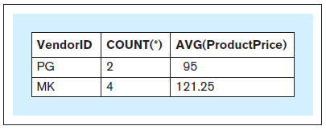
SELECT GROUP BY
What is the average price for each vendor?
SELECT vendorid, COUNT(*), AVG(productprice) FROM product GROUP BY vendorid;
Database Systems
by Jukić, Vrbsky, & Nestorov
Pearson 2014
ISBN 978-0-13-257567-6

Slide 3
SELECT GROUP BY, cont’d
When a SELECT has aggregate functions, it cannot have individual columns unless the columns are in a GROUP BY clause.
You can group by multiple columns.
SELECT vendorid, COUNT(*), AVG(productprice) FROM product GROUP BY vendorid;

Slide 4
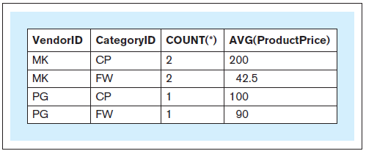
SELECT GROUP BY, cont’d
Group by vendor, and then by category.
SELECT vendorid, categoryid, COUNT(*), AVG(productprice) FROM product GROUP BY vendorid, categoryid;
Database Systems
by Jukić, Vrbsky, & Nestorov
Pearson 2014
ISBN 978-0-13-257567-6

Slide 5
SELECT GROUP BY HAVING
The WHERE clause applies to records.
The HAVING clause
applies to groups.
Group products $50 or more by vendor and category.
Count and average price only if more than one per group.
SELECT vendorid, categoryid, COUNT(*), AVG(productprice) FROM product WHERE productprice >= 50 GROUP BY vendorid, categoryid HAVING COUNT(*) > 1;
Database Systems
by Jukić, Vrbsky, & Nestorov
Pearson 2014
ISBN 978-0-13-257567-6

Slide 6
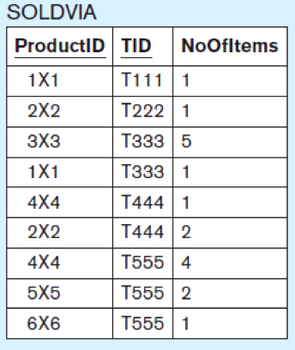
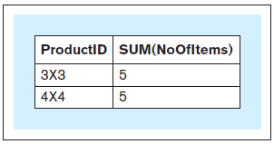
SELECT GROUP BY HAVING, cont’d
For products that sold more than 3 items in all sales transactions, what were the total number of items sold?
SELECT productid, SUM(noofitems) FROM soldvia GROUP BY productid HAVING SUM(noofitems) > 3;
Database Systems
by Jukić, Vrbsky, & Nestorov
Pearson 2014
ISBN 978-0-13-257567-6

Slide 7
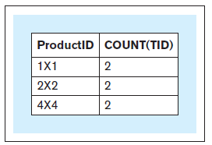
SELECT GROUP BY HAVING, cont’d
For each product that was sold in more than one sales transaction, what is the number of transactions in which the product was sold?
SELECT productid, COUNT(TID) FROM soldvia GROUP BY productid HAVING COUNT(TID) > 1;
Database Systems
by Jukić, Vrbsky, & Nestorov
Pearson 2014
ISBN 978-0-13-257567-6

Slide 8
Views
A view allows the structure of a query to be saved in the database.
AKA virtual table
Not an actual table – no data is saved.
Whenever a view is invoked, it executes a query to retrieve data from the actual tables.
A view is analogous to a procedure in a programming language.
Use a view like any other table.

Slide 9
Views, cont’d
Which products have more than 3 items sold in all sales transactions?
CREATE VIEW products_more_than_3_sold AS
SELECT productid, productname, productprice FROM product WHERE productid IN (SELECT productid FROM soldvia
GROUP BY productid HAVING SUM(noofitems) > 3);

Slide 10
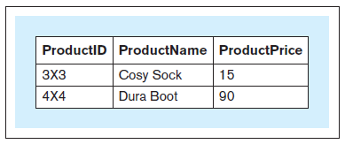
Views, cont’d
CREATE VIEW products_more_than_3_sold AS
SELECT productid, productname, productprice FROM product WHERE productid IN (SELECT productid FROM soldvia
GROUP BY productid HAVING SUM(noofitems) > 3);
SELECT * FROM products_more_than_3_sold;
Database Systems
by Jukić, Vrbsky, & Nestorov
Pearson 2014
ISBN 978-0-13-257567-6

Slide 11
Views, cont’d
CREATE VIEW products_in_multiple_trnsc AS SELECT productid, productname, productprice FROM product WHERE productid IN (SELECT productid FROM soldvia GROUP BY productid HAVING COUNT(*) > 1);
Database Systems
by Jukić, Vrbsky, & Nestorov
Pearson 2014
ISBN 978-0-13-257567-6

Slide 12
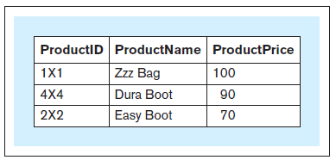
Views, cont’d
SELECT * FROM products_in_multiple_trnsc;
Dropping views
Example:
DROP VIEW products_in_multiple_trnsc;
Database Systems
by Jukić, Vrbsky, & Nestorov
Pearson 2014
ISBN 978-0-13-257567-6

Slide 13
Database Design Example
Design a database for the sales manager of Lemonade Used Car Dealership to keep track of which salesperson sold which cars to which customers during each month.
Each car is sold by one salesperson to one customer. A salesperson can sell multiple cars to different customers, and a customer can buy multiple cars from one or more salespersons.

Slide 14
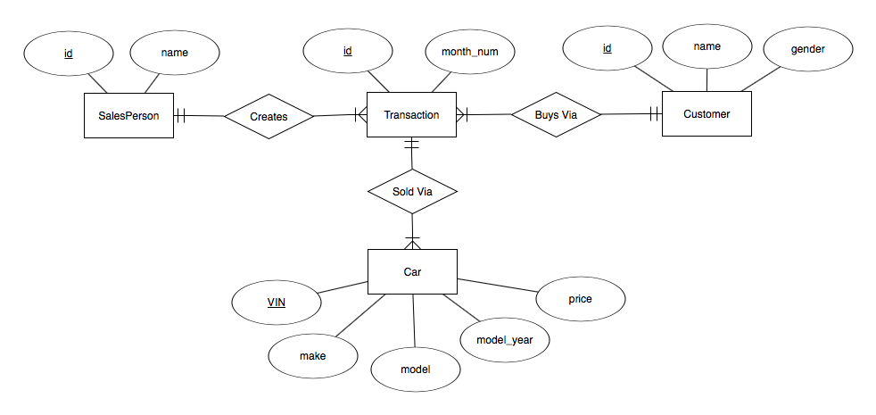
Database Design Example, cont’d

Slide 15
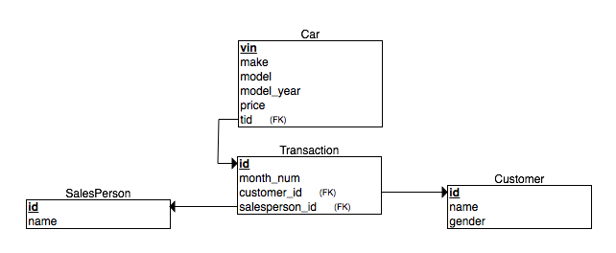
Database Design Example, cont’d

Slide 16
Table SalesPerson
MariaDB [midtermdb]> SELECT * FROM salesperson;
+----+--------+
| id | name |
+----+--------+
| 11 | Sarah |
| 22 | Leslie |
| 33 | Steve |
| 44 | Judy |
| 55 | Bruno |
+----+--------+
5 rows in set (0.00 sec)

Slide 17
Table Customer
MariaDB [midtermdb]> SELECT * FROM customer;
+-----+--------+--------+
| id | name | gender |
+-----+--------+--------+
| 111 | Ron | m |
| 222 | Mara | f |
| 333 | Tom | m |
| 444 | Susan | f |
| 555 | Marsha | f |
| 666 | Max | m |
| 777 | Arnold | m |
+-----+--------+--------+
7 rows in set (0.00 sec)

Slide 18
Table Transaction
MariaDB [midtermdb]> SELECT * FROM transaction;
+----+-----------+-------------+----------------+
| id | month_num | customer_id | salesperson_id |
+----+-----------+-------------+----------------+
| 1 | 9 | 444 | 22 |
| 2 | 9 | 333 | 11 |
| 3 | 9 | 444 | 55 |
| 4 | 9 | 222 | 22 |
| 5 | 9 | 666 | 33 |
| 6 | 9 | 111 | 55 |
| 7 | 9 | 333 | 44 |
| 8 | 9 | 222 | 44 |
| 9 | 9 | 555 | 22 |
| 10 | 9 | 777 | 11 |
| 11 | 9 | 222 | 22 |
+----+-----------+-------------+----------------+
11 rows in set (0.00 sec)

Slide 19
Table Car
MariaDB [midtermdb]> SELECT * FROM car;
+-------+------------+--------+------------+-------+-----+
| vin | make | model | model_year | price | tid |
+-------+------------+--------+------------+-------+-----+
| 11111 | ford | taurus | 2016 | 30000 | 5 |
| 12345 | chevy | nova | 1975 | 8000 | 2 |
| 22222 | ford | fiesta | 2016 | 20000 | 7 |
| 33333 | volvo | x90 | 2015 | 30000 | 4 |
| 44444 | volvo | 850 | 1996 | 25000 | 1 |
| 45678 | volvo | 240 DL | 1983 | 10000 | 11 |
| 55555 | volvo | s60 | 2014 | 30000 | 6 |
| 66666 | honda | accord | 2014 | 22000 | 1 |
| 77777 | honda | civic | 2005 | 12000 | 10 |
| 88888 | toyota | prius | 2015 | 25000 | 2 |
| 98765 | volkswagen | beetle | 1965 | 2000 | 10 |
| 99999 | ford | focus | 2012 | 15000 | 7 |
+-------+------------+--------+------------+-------+-----+
12 rows in set (0.00 sec)

Slide 20
Database Design Example, cont’d
Which salesperson sold the most cars in the month of September?
Before we can tell who has sold the most cars, we must know how many cars each salesperson sold in September.

Slide 21
Everything
SELECT salesperson.id AS pid, salesperson.name AS pname,
-> customer.id AS cid, customer.name AS cname,
-> customer.gender AS cgender,
-> transaction.id AS tid, vin, make, model_year, price
-> FROM salesperson, transaction, car, customer
-> WHERE transaction.salesperson_id = salesperson.id
-> AND transaction.id = car.tid
-> AND transaction.customer_id = customer.id
-> AND transaction.month_num = 9
-> ORDER BY pid, make, gender;
+-----+--------+-----+--------+---------+-----+-------+------------+------------+-------+
| pid | pname | cid | cname | cgender | tid | vin | make | model_year | price |
+-----+--------+-----+--------+---------+-----+-------+------------+------------+-------+
| 11 | Sarah | 333 | Tom | m | 2 | 12345 | chevy | 1975 | 8000 |
| 11 | Sarah | 777 | Arnold | m | 10 | 77777 | honda | 2005 | 12000 |
| 11 | Sarah | 333 | Tom | m | 2 | 88888 | toyota | 2015 | 25000 |
| 11 | Sarah | 777 | Arnold | m | 10 | 98765 | volkswagen | 1965 | 2000 |
| 22 | Leslie | 444 | Susan | f | 1 | 66666 | honda | 2014 | 22000 |
| 22 | Leslie | 222 | Mara | f | 4 | 33333 | volvo | 2015 | 30000 |
| 22 | Leslie | 444 | Susan | f | 1 | 44444 | volvo | 1996 | 25000 |
| 22 | Leslie | 222 | Mara | f | 11 | 45678 | volvo | 1983 | 10000 |
| 33 | Steve | 666 | Max | m | 5 | 11111 | ford | 2016 | 30000 |
| 44 | Judy | 333 | Tom | m | 7 | 99999 | ford | 2012 | 15000 |
| 44 | Judy | 333 | Tom | m | 7 | 22222 | ford | 2016 | 20000 |
| 55 | Bruno | 111 | Ron | m | 6 | 55555 | volvo | 2014 | 30000 |
+-----+--------+-----+--------+---------+-----+-------+------------+------------+-------+
12 rows in set (0.00 sec)

Slide 22
Project Only What We Need
SELECT salesperson.name AS name
-> FROM salesperson, transaction, car
-> WHERE salesperson_id = salesperson.id
-> AND transaction.id = car.tid
-> AND transaction.month_num = 9;
+--------+
| name |
+--------+
| Sarah |
| Sarah |
| Sarah |
| Sarah |
| Leslie |
| Leslie |
| Leslie |
| Leslie |
| Steve |
| Judy |
| Judy |
| Bruno |
+--------+
12 rows in set (0.00 sec)

Slide 23
Grouped with Counts
SELECT salesperson.name,
-> count(name) AS cars_sold
-> FROM salesperson, transaction, car
-> WHERE salesperson_id = salesperson.id
-> AND transaction.id = car.tid
-> AND transaction.month_num = 9
-> GROUP BY name;
+--------+-----------+
| name | cars_sold |
+--------+-----------+
| Bruno | 1 |
| Judy | 2 |
| Leslie | 4 |
| Sarah | 4 |
| Steve | 1 |
+--------+-----------+
5 rows in set (0.00 sec)

Slide 24
Database Design Example, cont’d
How can we query against the number of cars sold by each salesperson in September?
We can make the previous query a nested query.
But the code is simpler if we make it a view.

Slide 25
Create a View
CREATE view soldview AS
-> SELECT salesperson.name,
-> count(name) AS cars_sold
-> FROM salesperson, transaction, car
-> WHERE salesperson_id = salesperson.id
-> AND transaction.id = car.tid
-> AND transaction.month_num = 9
-> GROUP BY name;
Query OK, 0 rows affected (0.02 sec)
MariaDB [midtermdb]> SELECT * FROM soldview;
+--------+-----------+
| name | cars_sold |
+--------+-----------+
| Bruno | 1 |
| Judy | 2 |
| Leslie | 4 |
| Sarah | 4 |
| Steve | 1 |
+--------+-----------+
5 rows in set (0.00 sec)

Slide 26
Maximum Cars Sold
MariaDB [midtermdb]> SELECT max(cars_sold) FROM soldview;
+----------------+
| max(cars_sold) |
+----------------+
| 4 |
+----------------+
1 row in set (0.01 sec)
SELECT *
-> FROM soldview
-> WHERE cars_sold = (SELECT max(cars_sold) FROM soldview);
+--------+-----------+
| name | cars_sold |
+--------+-----------+
| Leslie | 4 |
| Sarah | 4 |
+--------+-----------+
2 rows in set (0.00 sec)

Slide 27
Solution: Most Cars Sold
CREATE view soldview AS
SELECT salesperson.name,
count(name) AS cars_sold
FROM salesperson, transaction, car
WHERE salesperson_id = salesperson.id
AND transaction.id = car.tid
AND transaction.month_num = 9
GROUP BY name;
SELECT *
FROM soldview
WHERE cars_sold = (SELECT max(cars_sold) FROM soldview);

Slide 28
Database Design Example, cont’d
Which salespersons in September sold fewer than the average number of cars sold per salesperson during that month?

Slide 29
Average Cars Sold
MariaDB [midtermdb]> SELECT avg(cars_sold) FROM soldview;
+----------------+
| avg(cars_sold) |
+----------------+
| 2.4000 |
+----------------+
1 row in set (0.00 sec)
SELECT *
-> FROM soldview
-> WHERE cars_sold < (SELECT avg(cars_sold) FROM soldview);
+-------+-----------+
| name | cars_sold |
+-------+-----------+
| Bruno | 1 |
| Judy | 2 |
| Steve | 1 |
+-------+-----------+
3 rows in set (0.00 sec)

Slide 30
Solution: Fewer Than Average Cars Sold
CREATE view soldview AS
SELECT salesperson.name,
count(name) AS cars_sold
FROM salesperson, transaction, car
WHERE salesperson_id = salesperson.id
AND transaction.id = car.tid
AND transaction.month_num = 9
GROUP BY name;
SELECT *
FROM soldview
WHERE cars_sold < (SELECT avg(cars_sold) FROM soldview);

Slide 31
Database Design Example, cont’d
What is the number and average price of cars sold by each salesperson of each make (Ford, Chevy, etc.) to male and female customers in September? Only consider groups of more than two cars sold.

Slide 32
Makes, Genders, and Prices
SELECT salesperson.name AS name,
-> make, gender as cgender, price
-> FROM salesperson, transaction, car, customer
-> WHERE salesperson_id = salesperson.id
-> AND transaction.id = car.tid
-> AND transaction.customer_id = customer.id
-> AND transaction.month_num = 9;
+--------+------------+---------+-------+
| name | make | cgender | price |
+--------+------------+---------+-------+
| Sarah | chevy | m | 8000 |
| Sarah | honda | m | 12000 |
| Sarah | toyota | m | 25000 |
| Sarah | volkswagen | m | 2000 |
| Leslie | volvo | f | 30000 |
| Leslie | volvo | f | 25000 |
| Leslie | volvo | f | 10000 |
| Leslie | honda | f | 22000 |
| Steve | ford | m | 30000 |
| Judy | ford | m | 20000 |
| Judy | ford | m | 15000 |
| Bruno | volvo | m | 30000 |
+--------+------------+---------+-------+
12 rows in set (0.00 sec)

Slide 33
Group by Name, Make, Gender
SELECT salesperson.name AS name,
-> make, gender as cgender,
-> count(make) as count, avg(price)
-> FROM salesperson, transaction, car, customer
-> WHERE salesperson_id = salesperson.id
-> AND transaction.id = car.tid
-> AND transaction.customer_id = customer.id
-> AND transaction.month_num = 9
-> GROUP BY name, make, cgender;
+--------+------------+---------+-------+------------+
| name | make | cgender | count | avg(price) |
+--------+------------+---------+-------+------------+
| Bruno | volvo | m | 1 | 30000.0000 |
| Judy | ford | m | 2 | 17500.0000 |
| Leslie | honda | f | 1 | 22000.0000 |
| Leslie | volvo | f | 3 | 21666.6667 |
| Sarah | chevy | m | 1 | 8000.0000 |
| Sarah | honda | m | 1 | 12000.0000 |
| Sarah | toyota | m | 1 | 25000.0000 |
| Sarah | volkswagen | m | 1 | 2000.0000 |
| Steve | ford | m | 1 | 30000.0000 |
+--------+------------+---------+-------+------------+
9 rows in set (0.00 sec)

Slide 34
Group by Having
SELECT salesperson.name AS name,
-> make, gender as cgender,
-> count(make) as count, avg(price)
-> FROM salesperson, transaction, car, customer
-> WHERE salesperson_id = salesperson.id
-> AND transaction.id = car.tid
-> AND transaction.customer_id = customer.id
-> AND transaction.month_num = 9
-> GROUP BY name, make, cgender
-> HAVING count > 2;
+--------+-------+---------+-------+------------+
| name | make | cgender | count | avg(price) |
+--------+-------+---------+-------+------------+
| Leslie | volvo | f | 3 | 21666.6667 |
+--------+-------+---------+-------+------------+
1 row in set (0.00 sec)

Slide 35
Solution: Number and Average Price
SELECT salesperson.name AS name,
make, gender as cgender,
count(make) as count, avg(price)
FROM salesperson, transaction, car, customer
WHERE salesperson_id = salesperson.id
AND transaction.id = car.tid
AND transaction.customer_id = customer.id
AND transaction.month_num = 9
GROUP BY name, make, cgender
HAVING count > 2;

