Slide 1


CS/SE 157B
Database Management Systems II
February 20 Class Meeting
Department of Computer Science
San Jose State University
Spring 2018
Instructor: Ron Mak
www.cs.sjsu.edu/~mak

Slide 2
PHP Input Filtering
An optional third parameter specifies either a sanitizing filter or a validation filter.
  Example:
A sanitizing filter strips off certain characters.
A validating filter checks the input for validity.
if (filter_input(INPUT_GET, "email", FILTER_VALIDATE_EMAIL)) {
echo("Email is valid");
}
else {
echo("Email is not valid");
}

Slide 3
PHP Input Filtering, cont’d
http://www.w3schools.com/php/php_ref_filter.asp
Filter constant | ID | Description
FILTER_VALIDATE_BOOLEAN | 258 | Validates a boolean
FILTER_VALIDATE_EMAIL | 274 | Validates an e-mail address
FILTER_VALIDATE_FLOAT | 259 | Validates a float
FILTER_VALIDATE_INT | 257 | Validates an integer
FILTER_VALIDATE_IP | 275 | Validates an IP address
FILTER_VALIDATE_REGEXP | 272 | Validates a regular expression
FILTER_VALIDATE_URL | 273 | Validates a URL
FILTER_SANITIZE_EMAIL | 517 | Removes all illegal characters from an e-mail address
FILTER_SANITIZE_ENCODED | 514 | Removes/Encodes special characters
FILTER_SANITIZE_MAGIC_QUOTES | 521 | Apply addslashes()
FILTER_SANITIZE_NUMBER_FLOAT | 520 | Remove all characters, except digits, +- and optionally .,eE
FILTER_SANITIZE_NUMBER_INT | 519 | Removes all characters except digits and + -
FILTER_SANITIZE_SPECIAL_CHARS | 515 | Removes special characters
FILTER_SANITIZE_STRING | 513 | Removes tags/special characters from a string
FILTER_SANITIZE_STRIPPED | 513 | Alias of FILTER_SANITIZE_STRING
FILTER_SANITIZE_URL | 518 | Removes all illegal character from s URL
FILTER_UNSAFE_RAW | 516 | Do nothing, optionally strip/encode special characters
FILTER_CALLBACK | 1024 | Call a user-defined function to filter data
Default

Slide 4
PHP is Object-Oriented
The object-oriented features and syntax
of PHP resemble those of Java:
  classes and objects
  abstract classes
  inheritance
  interfaces
PHP also has traits.
  Add functionality to a class without inheritance.

Slide 5
PHP Classes
oo/Pet.php
class Pet
{
public $name;
function __construct($pet_name)
{
$this->name = $pet_name;
}
function eat() { /* ... */ }
function sleep() { /* ... */ }
function play() { /* ... */ }
}
The constructor
is always named
__construct
(two underscores).

Slide 6
PHP Inheritance
As with Java, a PHP class can inherit
from at most one superclass.
class Cat extends Pet
{
function play()
{
parent::play();
}
}
Scope resolution
operator ::
oo/Pet.php

Slide 7
PHP Objects
$cat = new Cat('Eliza');
$pet = new Pet('Norska');
$cat->eat();
$pet->sleep();
// Delete the objects
unset($cat, $pet);
oo/Pet.php

Slide 8
PHP Abstract Classes
abstract class Shape
{
abstract public function getArea();
abstract public function getPerimeter();
}
oo/Shape.php
require('Shape.php');
class Triangle extends Shape
{
private $_sides = array();
private $_perimeter = NULL;
function __construct($s0 = 0, $s1 = 0, $s2 = 0)
{
/* ... */
}
public function getArea() { /* ... */ }
public function getPerimeter() { /* ... */ }
}
oo/Triangle.php

Slide 9
PHP Interfaces
interface Crud
{
public function create($data);
public function read();
public function update($data);
public function delete();
}
oo/Crud.php
class User implements Crud
{
/* ... */
function create($data) { /* ... */ }
function read() { /* ... */ }
function update($data) { /* ... */ }
public function delete() { /* ... */ }
}
oo/Crud.php

Slide 10
PHP Traits
Traits add functionality to a class
without class inheritance.
  They help overcome some of the
  restrictions of single inheritance.
A class can use several traits.
Several classes can share traits.

Slide 11
PHP Traits, cont’d
trait Debug
{
public function dumpObject()
{
$class = get_class($this);
$attributes = get_object_vars($this);
$methods = get_class_methods($this);
echo "<h2>Information about the $class object</h2>";
echo '<h3>Attributes</h3><ul>';
foreach ($attributes as $k => $v) {
echo "<li>$k: $v</li>";
}
echo '</li></ul>';
echo '<h3>Methods</h3><ul>';
foreach ($methods as $v) {
echo "<li>$v</li>";
}
echo '</li></ul>';
}
}
oo/Debug.php

Slide 12
PHP Traits, cont’d
oo/Rectangle.php
require('Shape.php');
class Rectangle extends Shape
{
use Debug;
public $width;
public $height;
function __construct($w, $h)
{
$width = $w;
$height = $h;
}
function getArea() { return $width * $height; }
function getPerimeter() { return 2*($width + $height); }
}

Slide 13
PHP Traits, cont’d
oo/traittest.php
require('Debug.php');
require('Rectangle.php');
$r = new Rectangle(42, 37);
$r->dumpObject();

Slide 14
Object-Relational Mapping (ORM)
Object-relational mapping (ORM) is a
set of techniques to overcome the mismatch between objects and relational data.
  objects: PHP data
  relational data: database query results
PHP Data Objects (PDO) can fetch data from database tables in the form of objects.

Slide 15
Object-Relational Mapping (ORM), cont’d
orm/people1.php
class Person
{
private $id;
private $first;
private $last;
private $gender;
private $salary;
public function getId() { return $this->id; }
public function getFirst() { return $this->first; }
public function getLast() { return $this->last; }
public function getGender() { return $this->gender; }
public function getSalary() { return $this->salary; }
}

Slide 16
Object-Relational Mapping (ORM), cont’d
$ps = $con->prepare($query);
...
// Fetch the matching database table rows.
$ps->execute();
$ps->setFetchMode(PDO::FETCH_CLASS, "Person");
// Construct the HTML table row by row.
while ($person = $ps->fetch()) {
print " <tr>\n";
print " <td>" . $person->getId() . "</td>\n";
print " <td>" . $person->getFirst() . "</td>\n";
print " <td>" . $person->getLast() . "</td>\n";
print " <td>" . $person->getGender() . "</td>\n";
print " <td>" . $person->getSalary() . "</td>\n";
print " </tr>\n";
}
orm/people1.php
Demo

Slide 17
Type Hinting
If you’ve defined a PHP class, you can “hint”
the class type in a function header.
PHP will generate a fatal error if you
pass a value with a type that doesn’t
match the type hint.
You cannot hint simple types
such as integer or string.

Slide 18
Type Hinting, cont’d
function createTableRow(Person $p)
{
print " <tr>\n";
print " <td>" . $p->getId() . "</td>\n";
print " <td>" . $p->getFirst() . "</td>\n";
print " <td>" . $p->getLast() . "</td>\n";
print " <td>" . $p->getGender() . "</td>\n";
print " <td>" . $p->getSalary() . "</td>\n";
print " </tr>\n";
}
// Construct the HTML table row by row.
while ($person = $ps->fetch()) {
createTableRow($person);
}
Demo

Slide 19
Namespaces
A PHP namespace is similar to a Java package.
  Separate nested namespace names
  with \ instead of .
  By convention, namespace names
  are also source directory names.
namespace Shapes\Simple;
class Rectangle …
class Square …
class Circle …
require('Shapes/Simple/Circle.php');
…
new Shapes\Simple\Circle(…);
require('Shapes/Simple/Circle.php');
use Shapes\Simple
…
new Circle(…);

Slide 20
PHP Error Reporting
Run phpInfo() and check that flag display_errors is on during development.
Set in the PHP configuration file
XAMPP/xamppfiles/etc/php.ini
Set at run time:
  0: off
  1: on
display_errors=On
ini_set('display_errors', 1);

Slide 21
PHP Error Reporting, cont’d
errors/display.php
<body>
<h1>Display Errors</h1>
<?php
ini_set('display_errors', 1);
// Create errors
foreach ($var as $v) {}
$result = 1/0;
?>
</body>
Demo

Slide 22
PHP Error Reporting, cont’d
Set the error-reporting level.
errors/levels.php
<body>
<h1>Error Levels</h1>
<?php
ini_set('display_errors', 1);
// Adjust error reporting
error_reporting(E_ALL | E_STRICT);
// Create errors
foreach ($var as $v) {}
$result = 1/0;
?>
</body>
Demo

Slide 23
PHP Error Reporting, cont’d
http://www.w3schools.com/php/php_ref_error.asp
Value | Constant | Description
1 | E_ERROR | Fatal run-time errors. Errors that cannot be recovered from. Execution of the script is halted
2 | E_WARNING | Run-time warnings (non-fatal errors). Execution of the script is not halted
4 | E_PARSE | Compile-time parse errors. Parse errors should only be generated by the parser
8 | E_NOTICE | Run-time notices. The script found something that might be an error, but could also happen when running a script normally
16 | E_CORE_ERROR | Fatal errors at PHP startup. This is like E_ERROR, except it is generated by the core of PHP
32 | E_CORE_WARNING | Non-fatal errors at PHP startup. This is like E_WARNING, except it is generated by the core of PHP
64 | E_COMPILE_ERROR | Fatal compile-time errors. This is like E_ERROR, except it is generated by by the Zend Scripting Engine
128 | E_COMPILE_WARNING | Non-fatal compile-time errors. This is like E_WARNING, except it is generated by by the Zend Scripting Engine
256 | E_USER_ERROR | Fatal user-generated error. This is like E_ERROR, except it is generated in PHP code by using the PHP function trigger_error()
512 | E_USER_WARNING | Non-fatal user-generated warning. This is like E_WARNING, except it is generated in PHP code by using the PHP function trigger_error()
1024 | E_USER_NOTICE | User-generated notice. This is like E_NOTICE, except it is generated in PHP code by using the PHP function trigger_error()
2048 | E_STRICT | Enable to have PHP suggest changes to your code which will ensure the best interoperability and forward compatibility of your code (Since PHP 5 but not included in E_ALL until PHP 5.4)
4096 | E_RECOVERABLE_ERROR | Catchable fatal error. Indicates that a probably dangerous error occurred, but did not leave the Engine in an unstable state. If the error is not caught by a user defined handle, the application aborts as it was an E_ERROR (Since PHP 5.2)
8192 | E_DEPRECATED | Run-time notices. Enable this to receive warnings about code that will not work in future versions (Since PHP 5.3)
16384 | E_USER_DEPRECATED | User-generated warning message. This is like E_DEPRECATED, except it is generated in PHP code by using the PHP function trigger_error() (Since PHP 5.3)
32767 | E_ALL | Enable all PHP errors and warnings (except E_STRICT in versions < 5.4)

Slide 24
PHP Error Suppression
Suppress individual errors with @
  Example: Don’t report a missing file error:
  Example: Don’t report a division by zero:
@include 'testbedstart.inc.php';
$result = @(1/0);
errors/suppress.php
Demo

Slide 25
Custom PHP Error Handler
Write a custom error handler with the signature:
Then tell PHP to use it:
functionName($level, $message, $file, $line, $context)
set_error_handler ('functionName');

Slide 26
Custom PHP Error Handler, cont’d
errors/custom.php
define('LIVE', FALSE);
function myErrorHandler ($number, $message, $file, $line, $vars)
{
if (!LIVE) {
$message = "<hr /><strong>An error occurred in file '$file' " .
"on line $line: $message</strong>\n<pre>\n" .
print_r($vars, 1) . "</pre>";
echo "$message\n";
echo "<br /><strong>Backtrace:</strong><br />\n";
debug_print_backtrace();
echo "<hr />";
}
else {
echo '<div class="error">'.
' A system error occurred. ' .
' We apologize for the inconvenience.' .
'</div><br />';
}
}
set_error_handler ('myErrorHandler');
Demo

Slide 27
Assignment #2
You can use your database from Assignment #1,
or you can start with a new database.
Use object-oriented PHP and
object-relational mapping (ORM)
to retrieve data from the database
as objects.
Use functions with type hinting.
Due Monday, February 26.

Slide 28
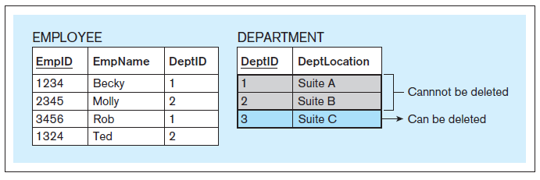
Cascading Deletes
Normally, the referential integrity constraint prevents you from deleting a record from a table if it is referred to by a record in another table.
Database Systems
by Jukić, Vrbsky, & Nestorov
Pearson 2014
ISBN 978-0-13-257567-6

Slide 29
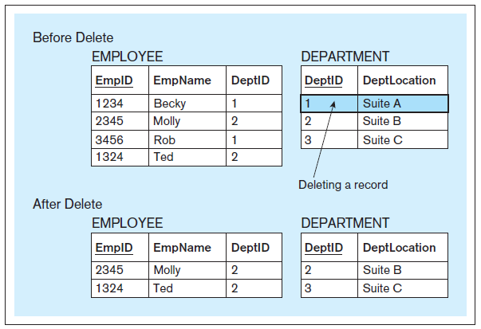
Cascading Deletes, cont’d
      CREATE TABLE employee
      ( empid CHAR(4),
      empname CHAR(20),
      deptid CHAR(2),
      PRIMARY KEY (empid),
      FOREIGN KEY (deptid) REFERENCES department
      ON DELETE CASCADE
      );
Database Systems
by Jukić, Vrbsky, & Nestorov
Pearson 2014
ISBN 978-0-13-257567-6

Slide 30
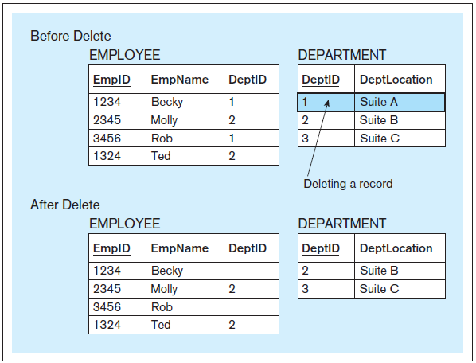
Cascading Deletes, cont’d
      CREATE TABLE employee
      ( empid CHAR(4),
      empname CHAR(20),
      deptid CHAR(2),
      PRIMARY KEY (empid),
      FOREIGN KEY (deptid) REFERENCES department
      ON DELETE SET NULL
      );
Database Systems
by Jukić, Vrbsky, & Nestorov
Pearson 2014
ISBN 978-0-13-257567-6

Slide 31
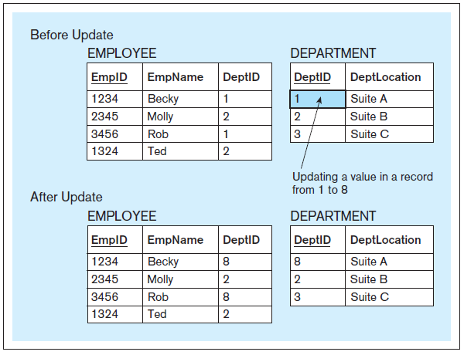
Cascading Updates
      CREATE TABLE employee
      ( empid CHAR(4),
      empname CHAR(20),
      deptid CHAR(2),
      PRIMARY KEY (empid),
      FOREIGN KEY (deptid) REFERENCES department
      ON UPDATE CASCADE
      );
Database Systems
by Jukić, Vrbsky, & Nestorov
Pearson 2014
ISBN 978-0-13-257567-6

Slide 32
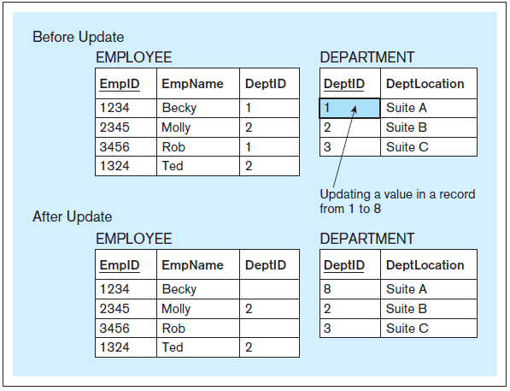
Cascading Updates
      CREATE TABLE employee
      ( empid CHAR(4),
      empname CHAR(20),
      deptid CHAR(2),
      PRIMARY KEY (empid),
      FOREIGN KEY (deptid) REFERENCES department
      ON UPDATE SET NULL
      );
Database Systems
by Jukić, Vrbsky, & Nestorov
Pearson 2014
ISBN 978-0-13-257567-6

Slide 33
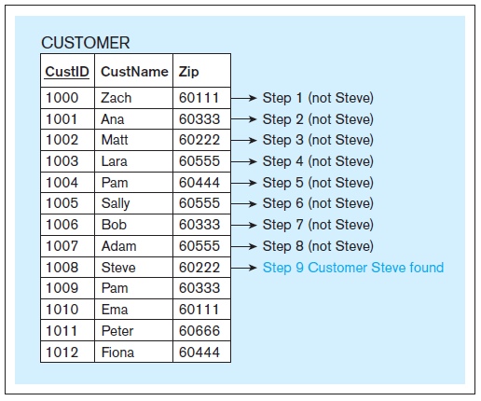
Indexing
Indexing increases the speed of retrieving table rows based on an unsorted column.
  Use a binary search instead of a linear search.
Database Systems
by Jukić, Vrbsky, & Nestorov
Pearson 2014
ISBN 978-0-13-257567-6
Linear search

Slide 34
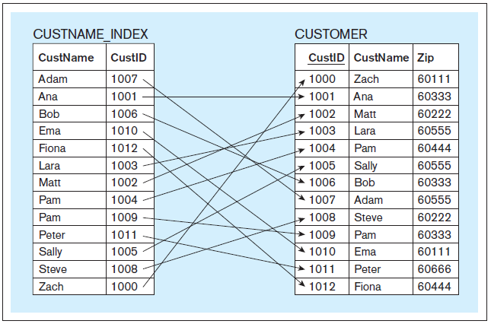
Indexing (Conceptual View)
  CREATE INDEX custname_index ON customer(custname);
Database Systems
by Jukić, Vrbsky, & Nestorov
Pearson 2014
ISBN 978-0-13-257567-6

Slide 35
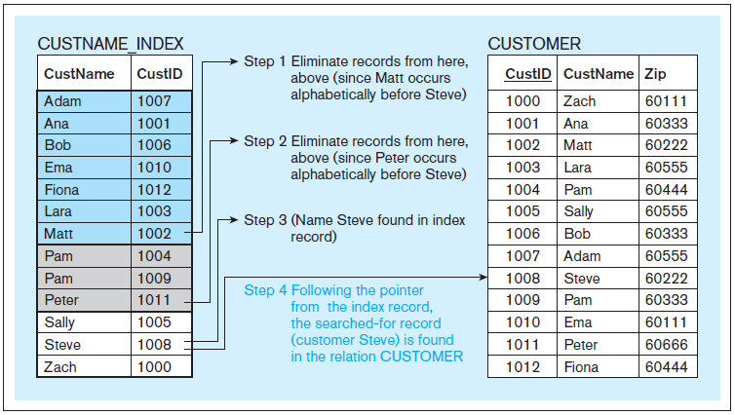
Indexing (Conceptual View), cont’d
Binary search
Database Systems
by Jukić, Vrbsky, & Nestorov
Pearson 2014
ISBN 978-0-13-257567-6

Slide 36
Indexing, cont’d
In an actual RDBMS, the index column can contain physical disk addresses.
Indexing speeds record retrieval,
but it will slow record insertion,
deletion, and modification.
To drop an index:
  DROP INDEX custname_index;

Slide 37
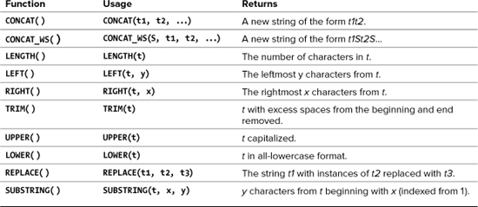
MySQL Text Functions
Also:
  One-way encryption
  Returns a 40-character string.
SHA1(string)
PHP and MySQL for
Dynamic Web Sites, 4th ed.
by Larry Ullman
Peachpit Press, 2012
ISBN 978-0-321-78407-0

Slide 38
MySQL Text Functions, cont’d
mysql> select concat(first, ' ', last)
-> from people;
+--------------------------+
| concat(first, ' ', last) |
+--------------------------+
| Charles Jones |
| Mary Adams |
| Susan Miller |
| Roger Brown |
| Leslie Adamson |
+--------------------------+
5 rows in set (0.00 sec)
mysql> select concat(first, ' ', last) as name
-> from people;
+----------------+
| name |
+----------------+
| Charles Jones |
| Mary Adams |
| Susan Miller |
| Roger Brown |
| Leslie Adamson |
+----------------+
5 rows in set (0.00 sec)

Slide 39
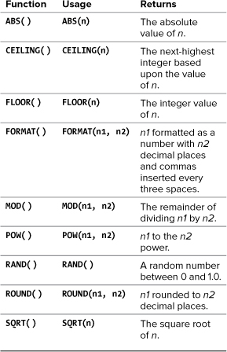
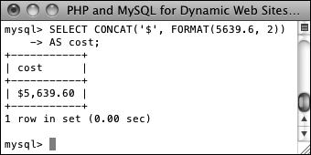
MySQL Numeric Functions
SELECT CONCAT('$', FORMAT(5639.6, 2))
AS cost;
PHP and MySQL for
Dynamic Web Sites, 4th ed.
by Larry Ullman
Peachpit Press, 2012
ISBN 978-0-321-78407-0

Slide 40
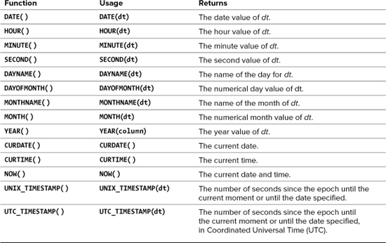
MySQL Date and Time Functions
No arguments.
PHP and MySQL for
Dynamic Web Sites, 4th ed.
by Larry Ullman
Peachpit Press, 2012
ISBN 978-0-321-78407-0

Slide 41
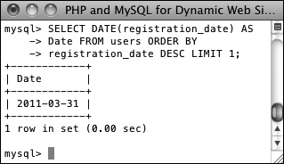
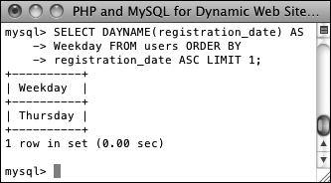
MySQL Date and Time Functions, cont’d
Data types that store both a date and time:
DATETIME and TIMESTAMP
Data type that stores just the date: DATE
Data type that stores just the year: YEAR
PHP and MySQL for
Dynamic Web Sites, 4th ed.
by Larry Ullman
Peachpit Press, 2012
ISBN 978-0-321-78407-0
SELECT DATE(registration_date)
AS Date FROM users ORDER BY
registration_date DESC LIMIT 1;
SELECT DAYNAME(registration_date)
AS Weekday FROM users ORDER BY
registration_date ASC LIMIT 1;

Slide 42
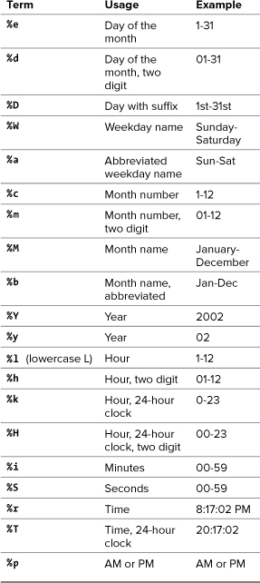
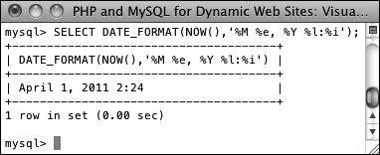
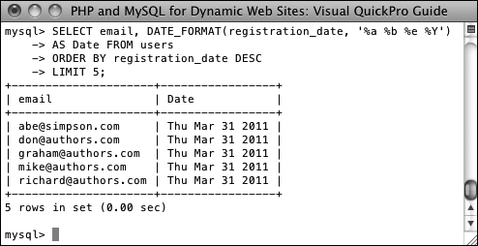
Formatting the Date and Time
Return the current date and time as Month DD, YYYY - HH:MM :
PHP and MySQL for
Dynamic Web Sites, 4th ed.
by Larry Ullman
Peachpit Press, 2012
ISBN 978-0-321-78407-0
Select the email address and date registered,
ordered by date registered, formatting the date as
Weekday (abbreviated) Month (abbreviated) Day Year,
for the last five registered users :

