Slide 1
CS/SE 157B Database Management Systems II February 8 Class Meeting
Department of Computer Science San Jose State University Spring 2018 Instructor: Ron Mak
www.cs.sjsu.edu/~mak

Slide 2
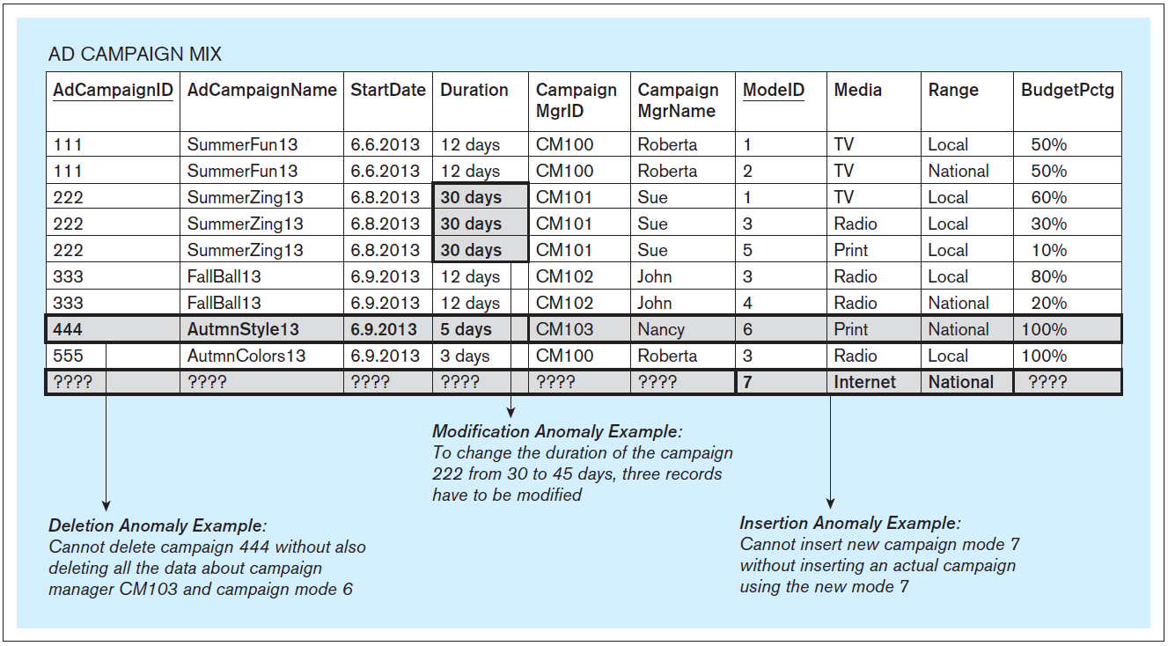
Update Anomalies, cont’d
Database Systems
by Jukić, Vrbsky, & Nestorov
Pearson 2014
ISBN 978-0-13-257567-6

Slide 3
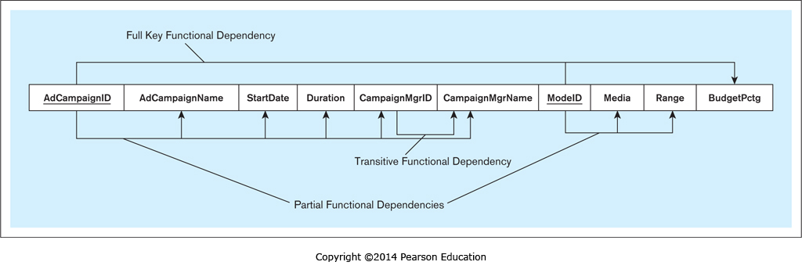
Partial Functional Dependency
A table column is functionally dependent on a component of a composite primary key.
(Set 2) ModeID → Media, Range
(Set 3) AdCampaignID → AdCampaignName, StartDate, Duration,
CampaignMgrId, CampaignMgrName
Database Systems
by Jukić, Vrbsky, & Nestorov
Pearson 2014
ISBN 978-0-13-257567-6

Slide 4
Full Key Functional Dependency
A table column is functionally dependent on the primary key and not partially dependent on any separate component of the primary key.
(Set 5) AdCampaignID, ModeID→ BudgetPctg
Database Systems
by Jukić, Vrbsky, & Nestorov
Pearson 2014
ISBN 978-0-13-257567-6

Slide 5
Transitive Functional Dependency
A nonkey column is functionally dependent on another nonkey column.
CampaignMgrID → CampaignMgrName
Database Systems
by Jukić, Vrbsky, & Nestorov
Pearson 2014
ISBN 978-0-13-257567-6

Slide 6
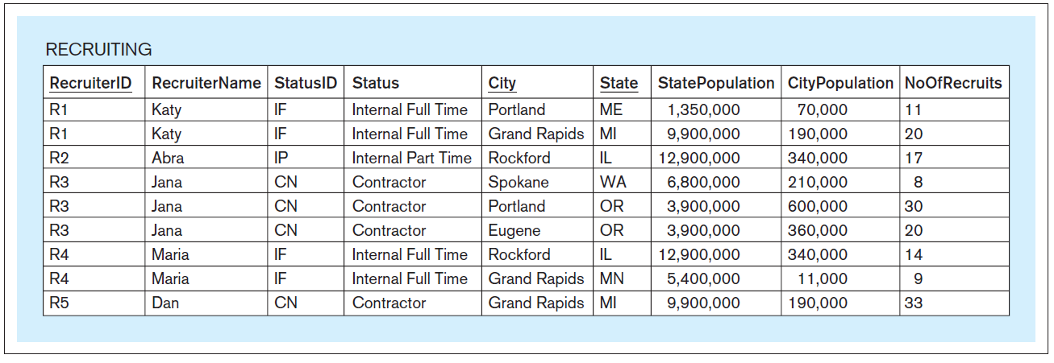
Another Functional Dependencies Example
Database Systems
by Jukić, Vrbsky, & Nestorov
Pearson 2014
ISBN 978-0-13-257567-6

Slide 7
Normalization
Improve the design of database tables.
Eliminate update anomalies.
Three normal forms.
First normal form (1NF)
Second normal form (2NF)
Third normal form (3NF)
From lower to higher, each normal form has increasingly stricter conditions.
Even higher normal forms mostly of theoretical value.
Boyce-Codd (BCNF), 4NF, 5NF, domain key (DKNF).

Slide 8
First Normal Form (1NF)
A table is in 1NF if:
Each row is unique.
All values in a column must be from the same predefined domain.
No column in any row contains multiple values.
In other words, any valid relational table is, by definition, in 1NF.

Slide 9
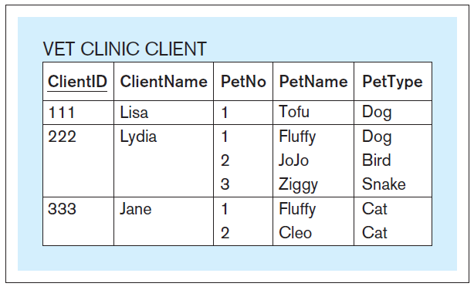
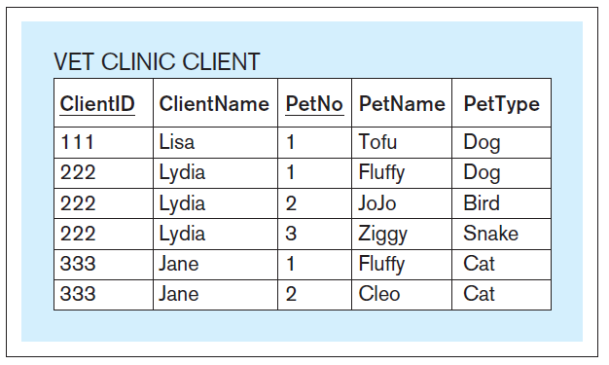
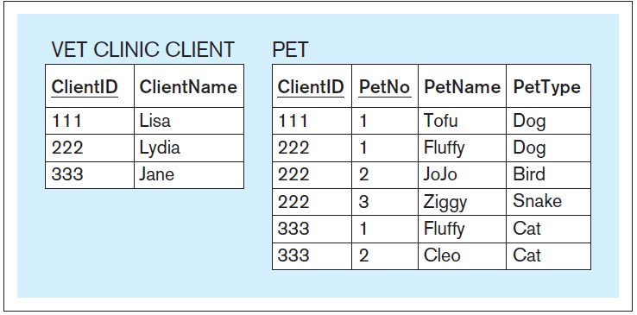
First Normal Form (1NF), cont’d
Database Systems
by Jukić, Vrbsky, & Nestorov
Pearson 2014
ISBN 978-0-13-257567-6

Slide 10
Second Normal Form (2NF)
A table is in 2NF if:
It is in 1NF.
It does not contain partial functional dependencies.

Slide 11
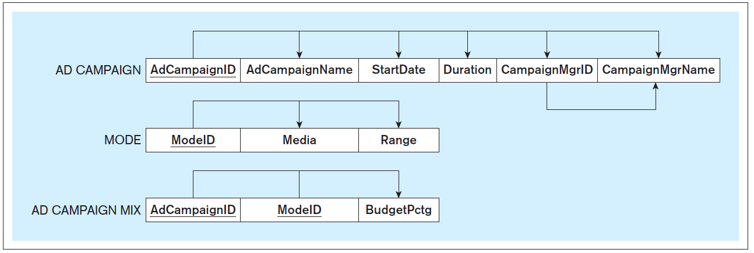
Second Normal Form (2NF), cont’d
Database Systems
by Jukić, Vrbsky, & Nestorov
Pearson 2014
ISBN 978-0-13-257567-6

Slide 12
Third Normal Form (3NF)
A table is in 3NF if:
It is in 2NF.
It does not contain transitive functional dependencies.

Slide 13
Third Normal Form (3NF), cont’d
Database Systems
by Jukić, Vrbsky, & Nestorov
Pearson 2014
ISBN 978-0-13-257567-6

Slide 14
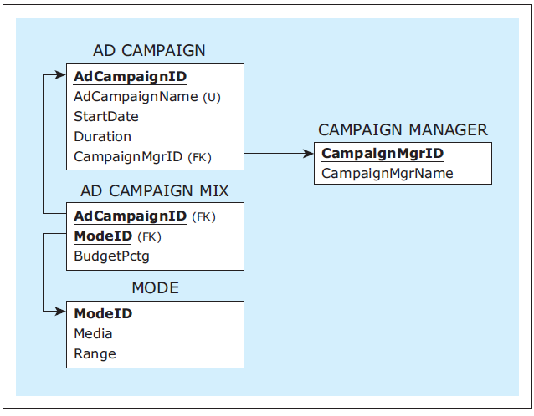
Third Normal Form (3NF), cont’d
Database Systems
by Jukić, Vrbsky, & Nestorov
Pearson 2014
ISBN 978-0-13-257567-6

Slide 15
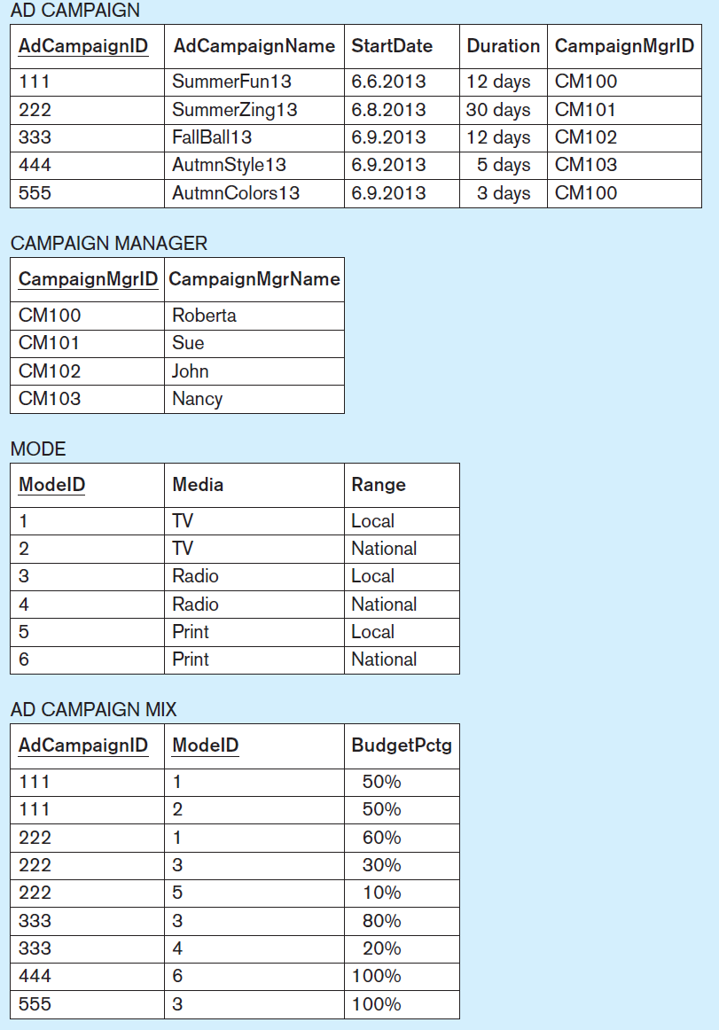
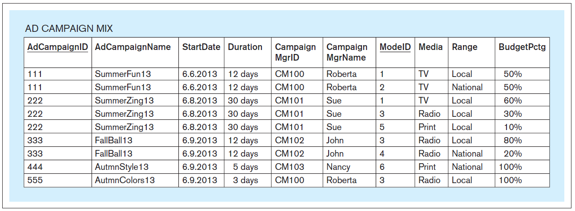
Third Normal Form (3NF), cont’d
Database Systems
by Jukić, Vrbsky, & Nestorov
Pearson 2014
ISBN 978-0-13-257567-6

Slide 16
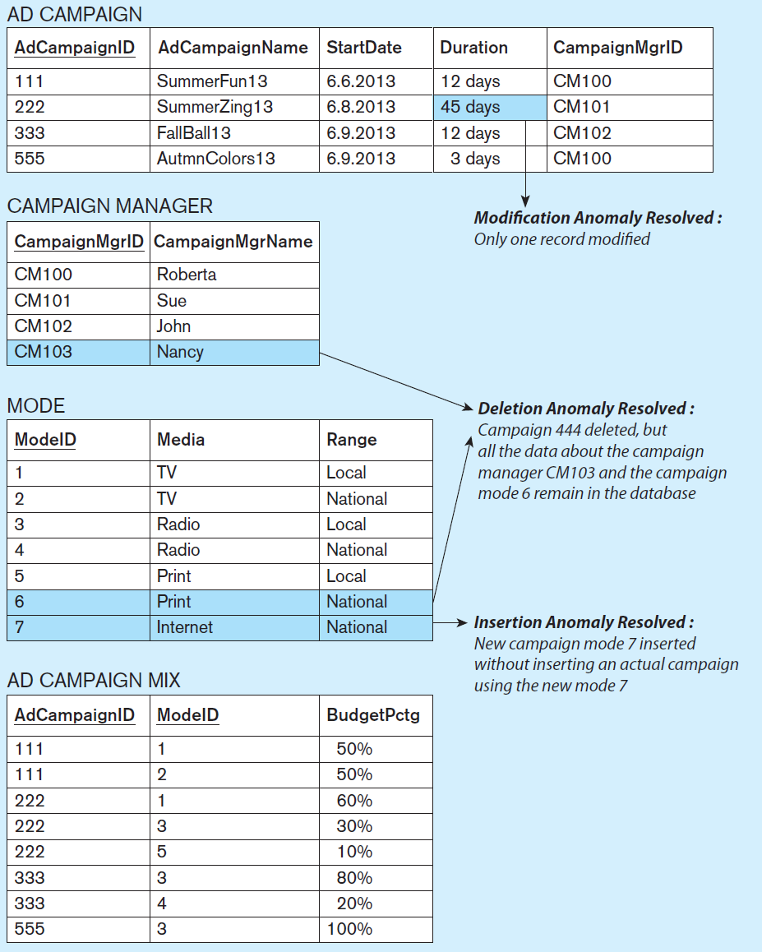
Third Normal Form (3NF), cont’d
Database Systems
by Jukić, Vrbsky, & Nestorov
Pearson 2014
ISBN 978-0-13-257567-6

Slide 17
Another Normalization Example
Original table
Database Systems
by Jukić, Vrbsky, & Nestorov
Pearson 2014
ISBN 978-0-13-257567-6

Slide 18
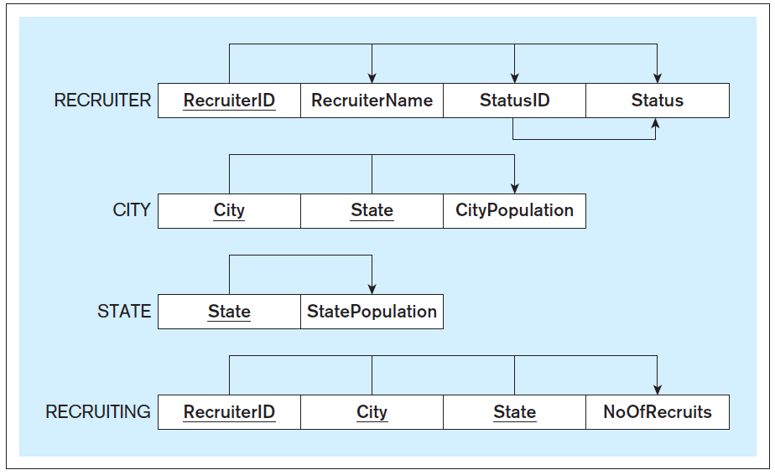
Another Normalization Example, cont’d
2NF
Database Systems
by Jukić, Vrbsky, & Nestorov
Pearson 2014
ISBN 978-0-13-257567-6

Slide 19
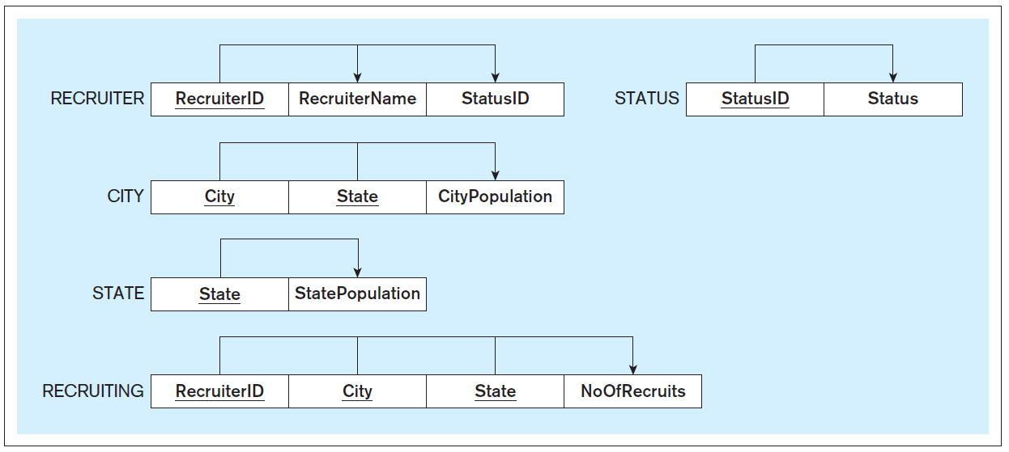
Another Normalization Example, cont’d
3NF
Database Systems
by Jukić, Vrbsky, & Nestorov
Pearson 2014
ISBN 978-0-13-257567-6

Slide 20
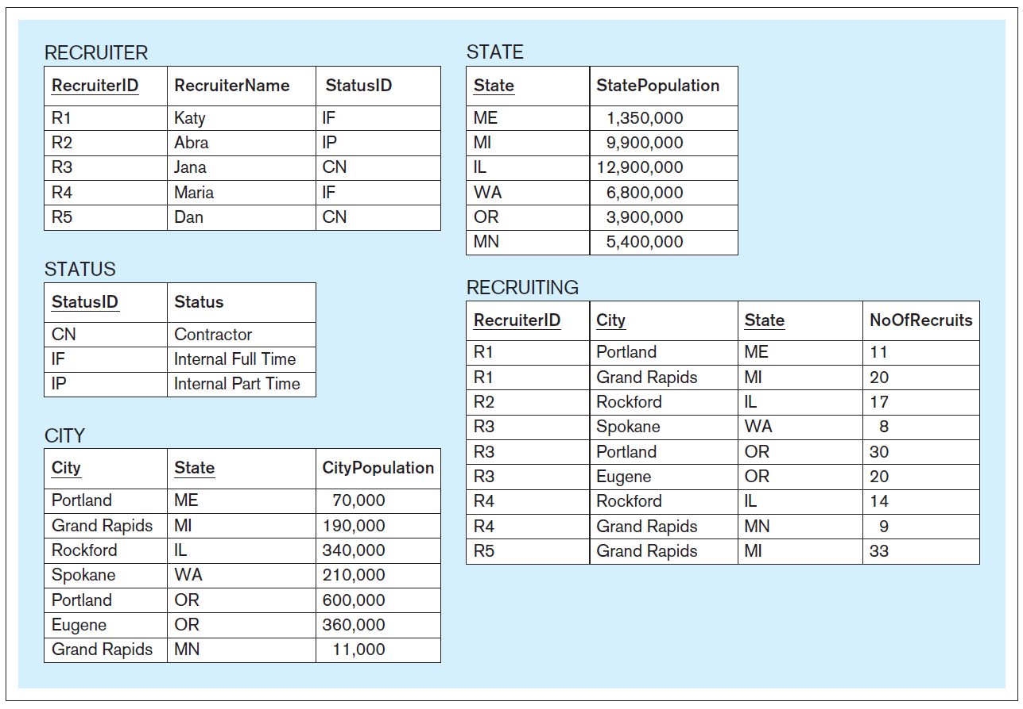
Another Normalization Example, cont’d
Normalized
tables
Database Systems
by Jukić, Vrbsky, & Nestorov
Pearson 2014
ISBN 978-0-13-257567-6

Slide 21
Normalization vs. Denormalization
Normalization spreads data out over more tables.
The result is slower performance.
Sometimes it make sense to denormalize in order to improve performance.
Reduce the number of expensive joins.

Slide 22
Normalization vs. Denormalization, cont’d
Original table
Database Systems
by Jukić, Vrbsky, & Nestorov
Pearson 2014
ISBN 978-0-13-257567-6

Slide 23
Normalization vs. Denormalization, cont’d
Suppose the query is to retrieve for each campaign: AdCampaignID, AdCampaignName, CampaignMgrID, CampaignMgrName, ModeID, Media, Range, and BudgetPctg.
It is more efficient to retrieve this data from the original table than from the several normalized tables.

Slide 24
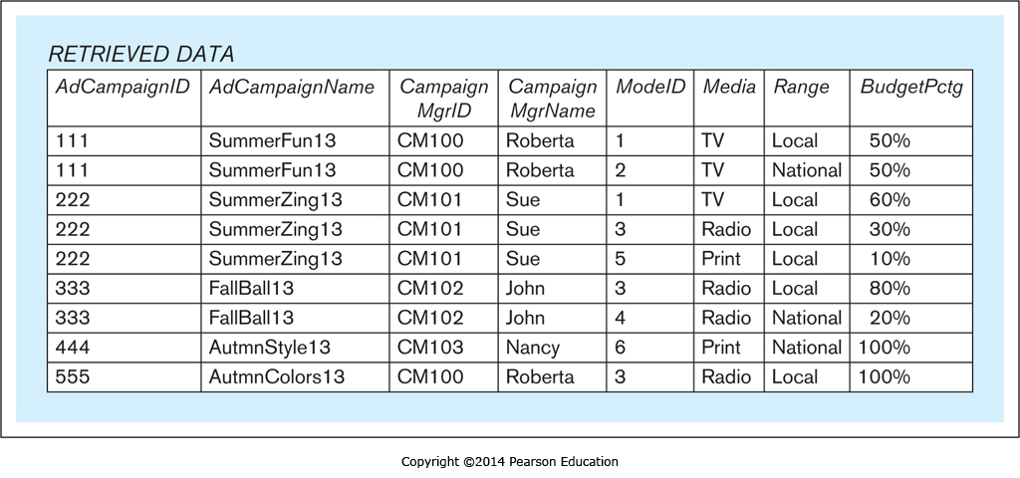
Normalization vs. Denormalization, cont’d
Database Systems
by Jukić, Vrbsky, & Nestorov
Pearson 2014
ISBN 978-0-13-257567-6

Slide 25
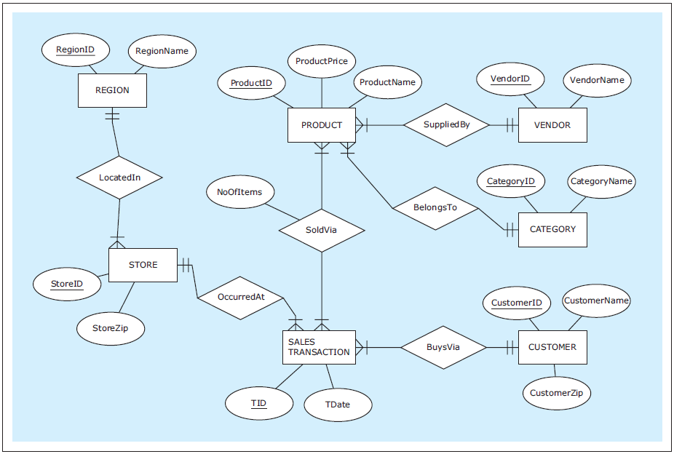
CREATE TABLE Examples
Database Systems
by Jukić, Vrbsky, & Nestorov
Pearson 2014
ISBN 978-0-13-257567-6

Slide 26
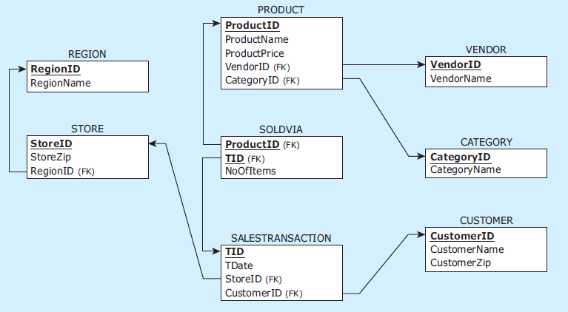
CREATE TABLE Examples, cont’d
Database Systems
by Jukić, Vrbsky, & Nestorov
Pearson 2014
ISBN 978-0-13-257567-6

Slide 27
CREATE TABLE Examples, cont’d
CREATE TABLE vendor
( vendorid CHAR(2) NOT NULL,
vendorname VARCHAR(25) NOT NULL,
PRIMARY KEY (vendorid)
);
CREATE TABLE category
( categoryid CHAR(2) NOT NULL,
categoryname VARCHAR(25) NOT NULL,
PRIMARY KEY (categoryid)
);
CREATE TABLE product
( productid CHAR(3) NOT NULL,
productname VARCHAR(25) NOT NULL,
productprice NUMERIC(7,2) NOT NULL,
vendorid CHAR(2) NOT NULL,
categoryid CHAR(2) NOT NULL,
PRIMARY KEY (productid),
FOREIGN KEY (vendorid) REFERENCES vendor(vendorid),
FOREIGN KEY (categoryid) REFERENCES category(categoryid)
);
data types
column constraints
table constraints

Slide 28
CREATE TABLE Examples, cont’d
CREATE TABLE region
( regionid CHAR(1) NOT NULL,
regionname VARCHAR(25) NOT NULL,
PRIMARY KEY (regionid)
);
CREATE TABLE store
( storeid VARCHAR(3) NOT NULL,
storezip CHAR(5) NOT NULL,
regionid CHAR(1) NOT NULL,
PRIMARY KEY (storeid),
FOREIGN KEY (regionid) REFERENCES region(regionid)
);
CREATE TABLE customer
( customerid CHAR(7) NOT NULL,
customername VARCHAR(15) NOT NULL,
customerzip CHAR(5) NOT NULL,
PRIMARY KEY (customerid)
);

Slide 29
CREATE TABLE Examples, cont’d
CREATE TABLE salestransaction
( tid VARCHAR(8) NOT NULL,
customerid CHAR(7) NOT NULL,
storeid VARCHAR(3) NOT NULL,
tdate DATE NOT NULL,
PRIMARY KEY (tid),
FOREIGN KEY (customerid) REFERENCES customer(customerid),
FOREIGN KEY (storeid) REFERENCES store(storeid)
);
CREATE TABLE soldvia
( productid CHAR(3) NOT NULL,
tid VARCHAR(8) NOT NULL,
noofitems INT NOT NULL,
PRIMARY KEY (productid, tid),
FOREIGN KEY (productid) REFERENCES product(productid),
FOREIGN KEY (tid) REFERENCES salestransaction(tid)
);
composite key

Slide 30
DROP TABLE
Referential integrity prevents deletion of a primary key that is referenced by foreign keys.
Invalid sequence:
DROP TABLE region;
DROP TABLE store;
DROP TABLE salestransaction;
DROP TABLE product;
DROP TABLE vendor;
DROP TABLE category;
DROP TABLE customer;
DROP TABLE soldvia;
Database Systems
by Jukić, Vrbsky, & Nestorov
Pearson 2014
ISBN 978-0-13-257567-6

Slide 31
DROP TABLE, cont’d
Valid sequence:
DROP TABLE soldvia;
DROP TABLE salestransaction;
DROP TABLE store;
DROP TABLE product;
DROP TABLE vendor;
DROP TABLE region;
DROP TABLE category;
DROP TABLE customer;
Database Systems
by Jukić, Vrbsky, & Nestorov
Pearson 2014
ISBN 978-0-13-257567-6

Slide 32
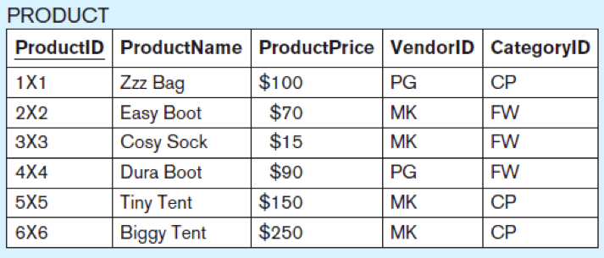
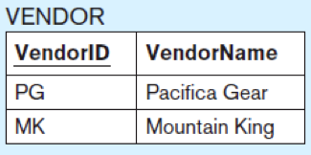
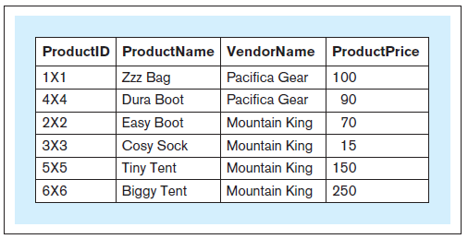
Joins
What is the id, product name, vendor name, and price of each product?
SELECT productid, productname,
vendorname, productprice FROM product, vendor WHERE product.vendorid
= vendor.vendorid;
Database Systems
by Jukić, Vrbsky, & Nestorov
Pearson 2014
ISBN 978-0-13-257567-6

Slide 33
Joins, cont’d
Without a join condition, you get a Cartesian product.
Each record of one table matched with every record from the other table.

Slide 34
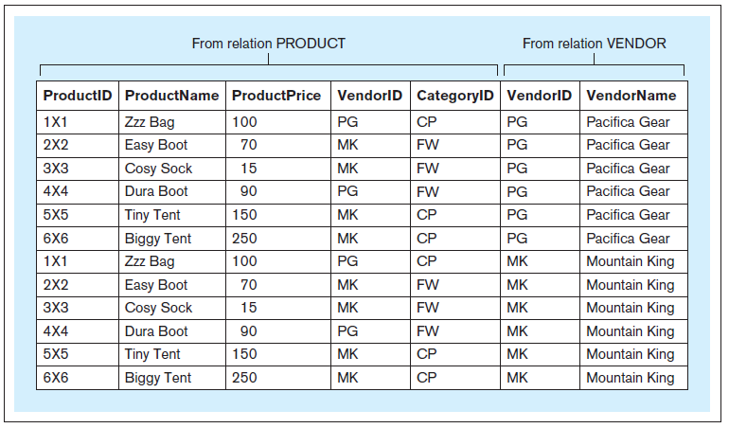
Joins, cont’d
SELECT * FROM product, vendor;
Database Systems
by Jukić, Vrbsky, & Nestorov
Pearson 2014
ISBN 978-0-13-257567-6

Slide 35
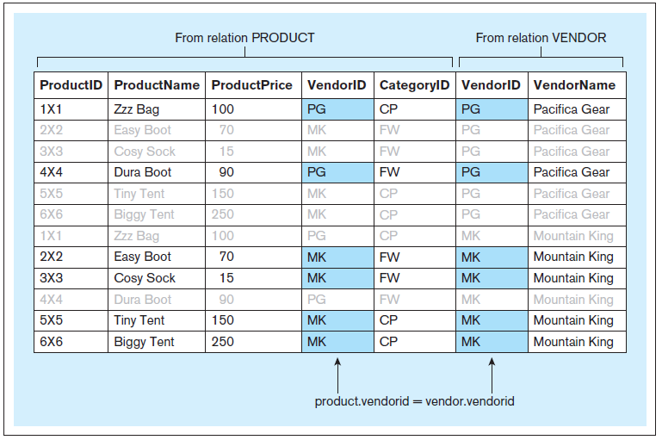
Joins, cont’d
Include the join condition
WHERE product.vendorid = vendor.vendorid

