Slide 1
CS/SE 157B Database Management Systems II February 6 Class Meeting
Department of Computer Science San Jose State University Spring 2018 Instructor: Ron Mak
www.cs.sjsu.edu/~mak

Slide 2
Teams

Slide 3
Three-Tier Web Application Architecture
Client-side web browser
Form data
Server-side web server
(.html .php
images, etc.)
Static (.html)
or
dynamically
generated (.php)
web pages
Queries
Back-end database server, e.g.
MariaDB
Data

Slide 4
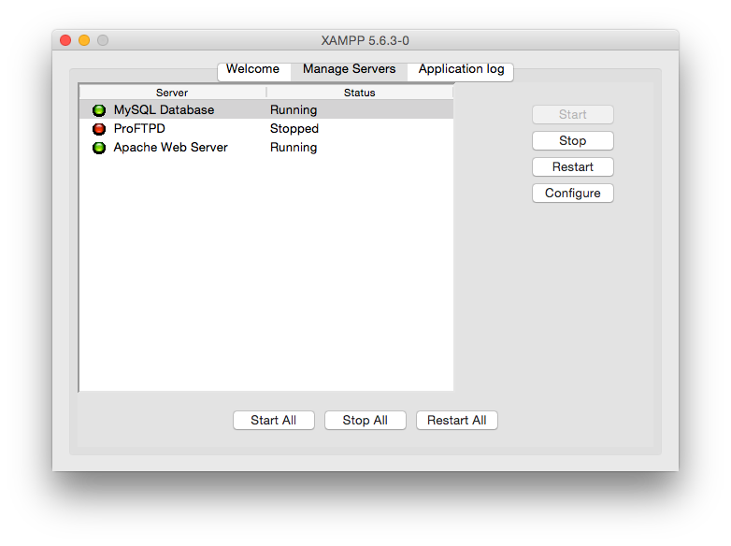
Start the MariaDB Database Server

Slide 5
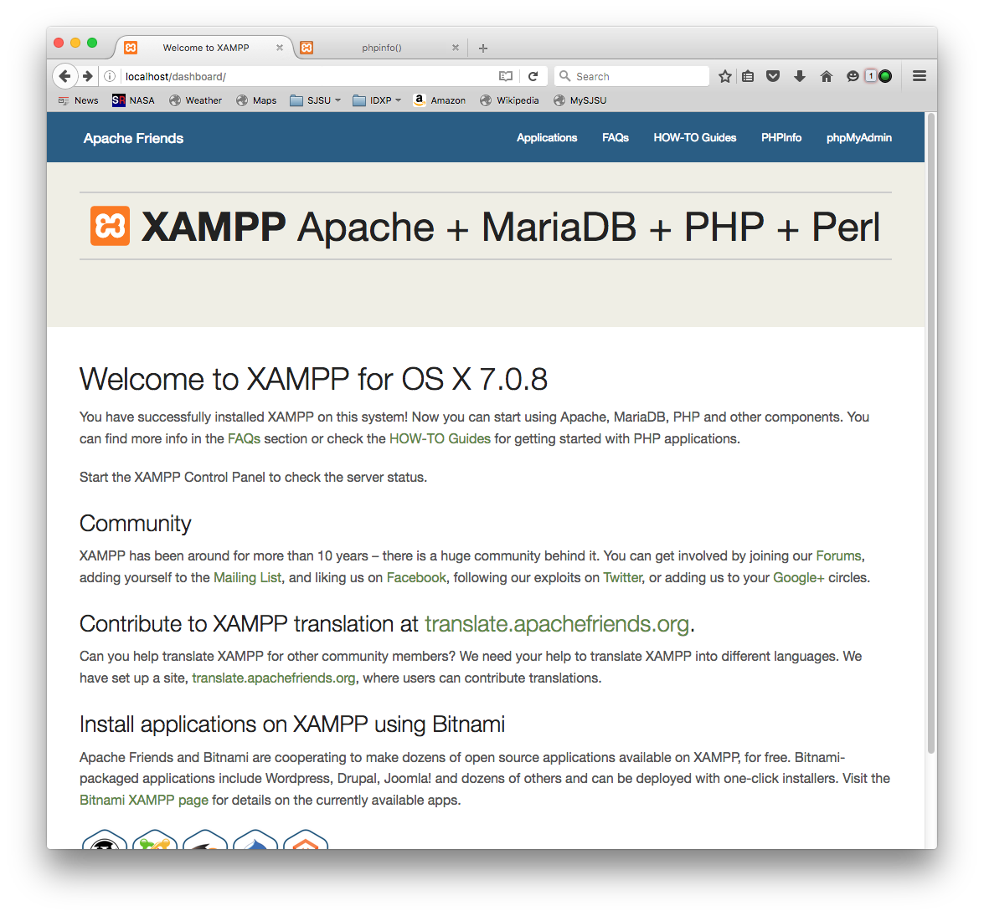
XAMPP Home Page
phpMyAdmin
is a PHP-based GUI interface
to the MariaDB database server.

Slide 6
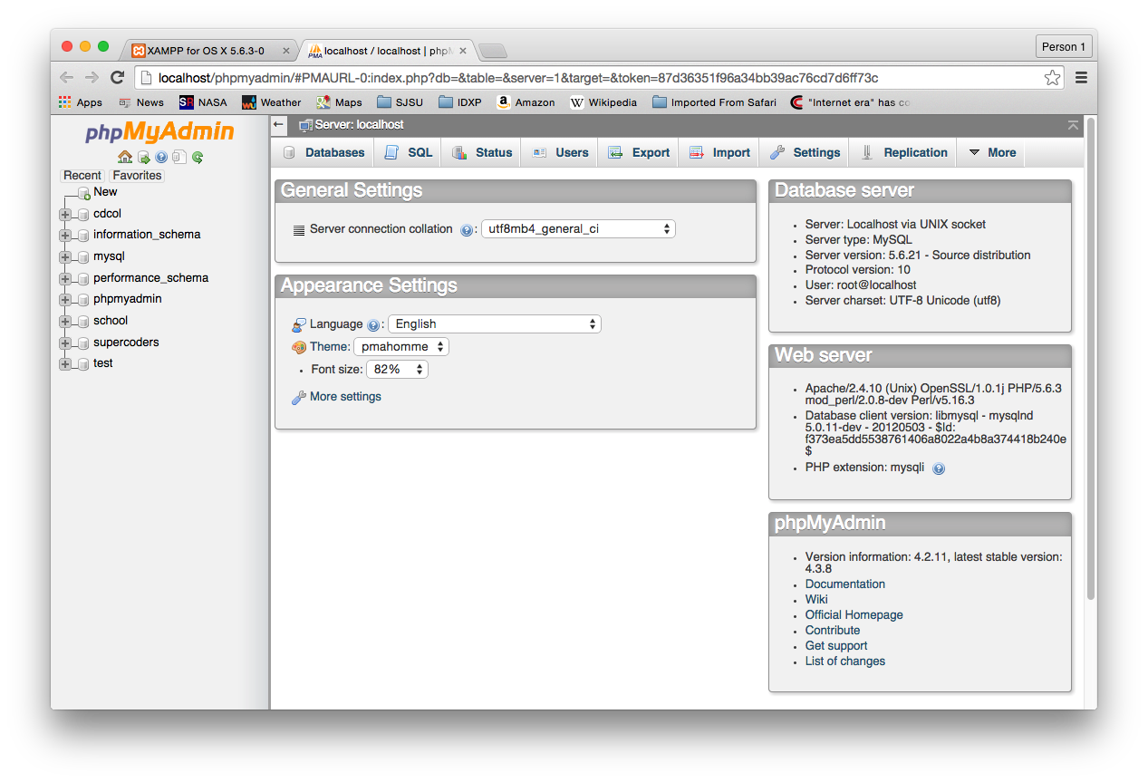
phpMyAdmin Home Page

Slide 7
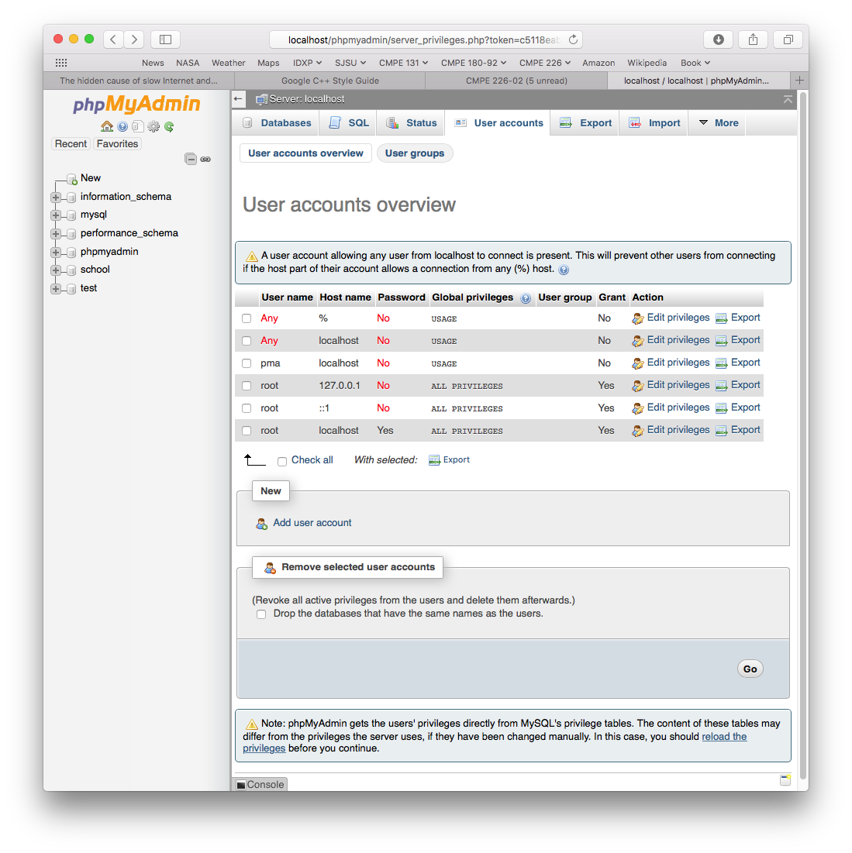
Database Server Root Password
By default, there is no root password.
Set the root password using phpMyAdmin.
Go to the Users accounts tab.
Edit the root user at localhost to change its password.

Slide 8
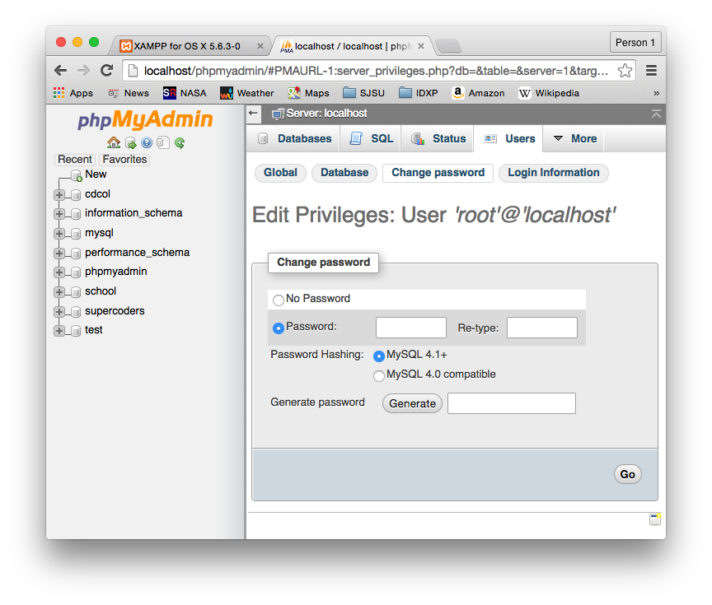
Database Server Root Password, cont’d

Slide 9
Enable phpMyAdmin to Connect
phpMyAdmin connects to the MariaDB database server as the root user.
Now you must tell phpMyAdmin what the new root password is.
Edit the configuration file XAMPP/xamppfiles/phpmyadmin/config.inc.php
Edit the line $cfg['Servers'][$i]['password'] = 'root password';
For this class, use the database password sesame

Slide 10
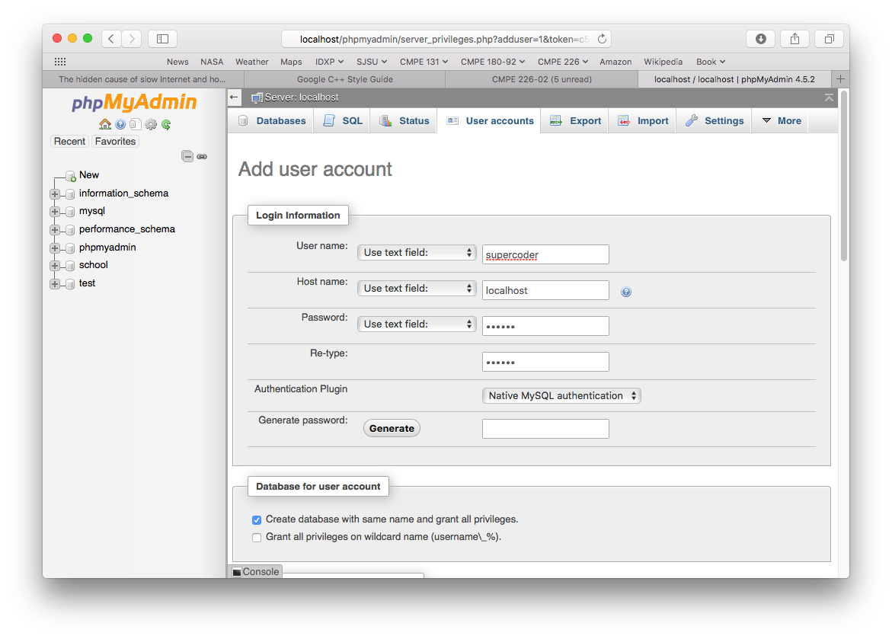
Add a New Database User
Name the user after yourself or your team.
Click “Add user” on the Users tab.
Use “localhost” for the host.
Tick the checkbox to create a database with the same name.

Slide 11
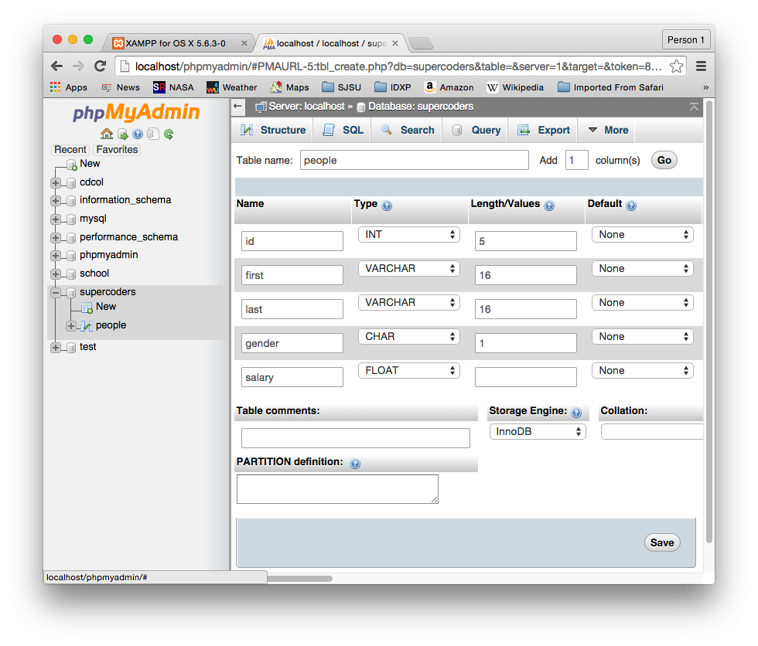
Create a Table in the New Database

Slide 12
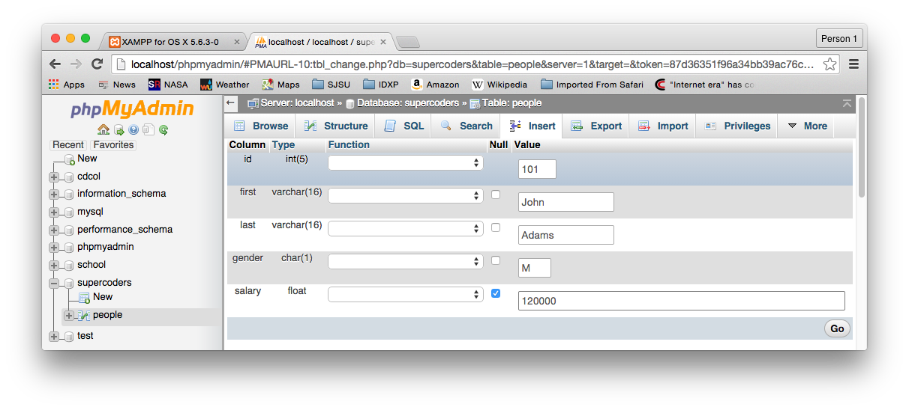
Insert Data into the Table

Slide 13
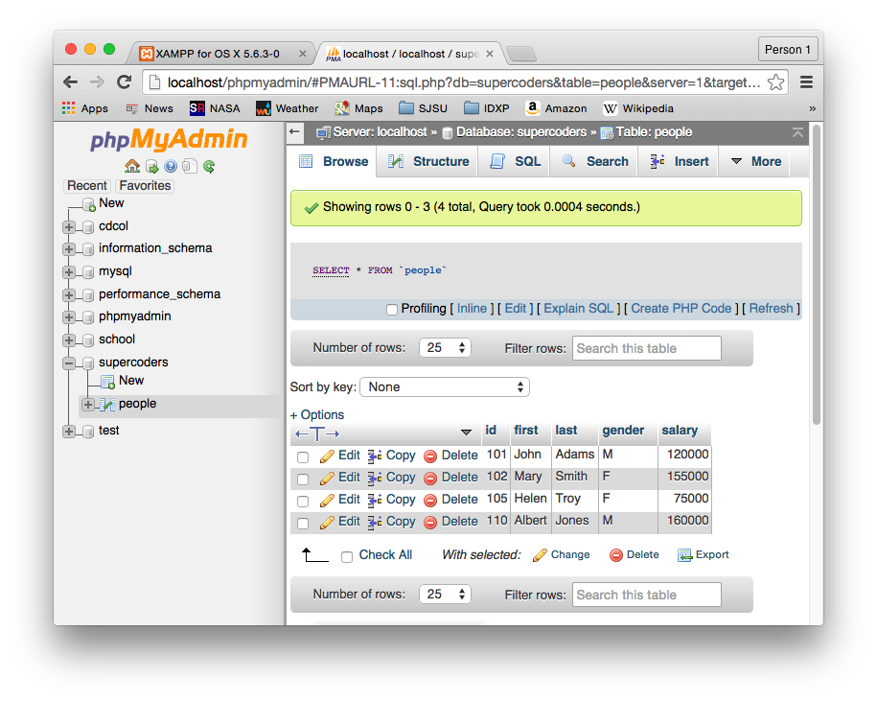
Browse the Table Contents

Slide 14
MySQL Command Line Interface
~: /Applications/XAMPP/xamppfiles/bin/mysql -u supercoders -p
Enter password:
mysql> show databases;
+--------------------+
| Database |
+--------------------+
| information_schema |
| supercoders |
+--------------------+
2 rows in set (0.00 sec)
mysql> use supercoders
Database changed
mysql> show tables;
+-----------------------+
| Tables_in_supercoders |
+-----------------------+
| people |
+-----------------------+
1 row in set (0.00 sec)

Slide 15
MySQL Command Line Interface, cont’d
mysql> select * from people;
+-----+--------+-------+--------+--------+
| id | first | last | gender | salary |
+-----+--------+-------+--------+--------+
| 101 | John | Adams | M | 120000 |
| 102 | Mary | Smith | F | 155000 |
| 105 | Helen | Troy | F | 75000 |
| 110 | Albert | Jones | M | 160000 |
+-----+--------+-------+--------+--------+
4 rows in set (0.00 sec)
mysql> select * from people
-> where first = 'Helen'
-> and last = 'Troy';
+-----+-------+------+--------+--------+
| id | first | last | gender | salary |
+-----+-------+------+--------+--------+
| 105 | Helen | Troy | F | 75000 |
+-----+-------+------+--------+--------+
1 row in set (0.00 sec)
mysql>

Slide 16
The MySQL Workbench
MySQL Workbench features
Manage databases and database connections.
Edit, execute, and save SQL scripts.
Open-source version of some very expensive commercial database design and management tools (such as ERWin Data Modeler).
Download from http://dev.mysql.com/downloads/

Slide 17
The MySQL Workbench
Generates extended ER (EER) diagrams
A cross between standard ER diagrams and relational schemas.
Forward- and reverse-engineering
Generate an EER diagram from an existing database.
Manually create an ER diagram.
Automatically generate a database from the diagram.
Demo

Slide 18
Assignment #1
Design and implement a relational database.
You choose the application and data.
List 5 database requirements.
What entities need to be in the database?
What major attributes will the entities have?
What relationships will be between entities?

Slide 19
Assignment #1, cont’d
Conceptual model
Use ERDPlus to draw an ER diagram.
At least 5 entities including at least one weak entity
Different types of relationships (1-1, 1-M, M-N)
A hierarchical relationship (e.g., university ➔ school ➔ department)
Optional and derived attributes
Multivalued attributes (e.g., phone numbers)
Composite attributes (e.g., address)

Slide 20
Assignment #1, cont’d
Logical model: relational schema
Map your ER diagram to a relational schema.
Tables must be in 3rd normal form.
You may use ERDPlus’s mapping feature.
Good table arrangement with few crossing lines.
Physical model: MariaDB database
Create a MariaDB/MySQL database.
Populate the tables with sample data (use phpMyAdmin).

Slide 21
Assignment #1, cont’d
A short report
Describe your application in a few paragraphs.
ER diagram
Relational schema
Sample data
Either select * output from each table, or screenshots of each table in phpMyAdmin
How will the application use the database?
Describe (in words or SQL code) what types of queries.
Team assignment
Due Monday, February 19

Slide 22
Database Update Operations
Insert operation
Enter new data into a table.
Delete operation
Remove data from a table.
Modify operation
Change existing data in a table.

Slide 23
Update Anomalies
Insertion anomaly
Deletion anomaly
Modification anomaly

Slide 24
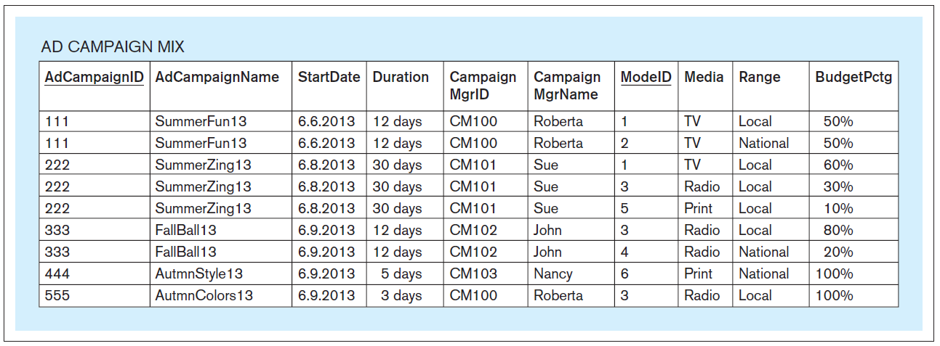
A Table Containing Redundant Data
Can you spot the data redundancies?
Database Systems
by Jukić, Vrbsky, & Nestorov
Pearson 2014
ISBN 978-0-13-257567-6

Slide 25
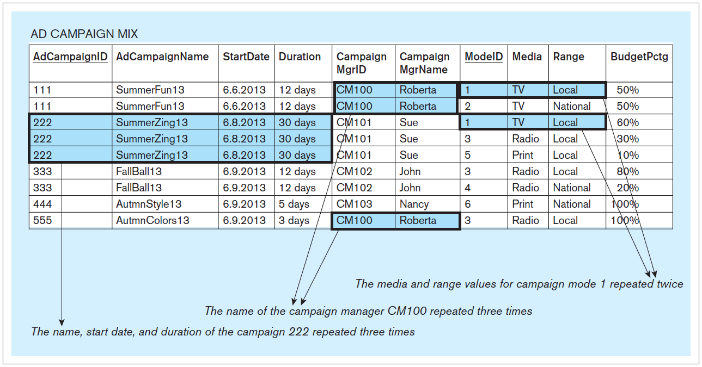
A Table Containing Redundant Data, cont’d
Database Systems
by Jukić, Vrbsky, & Nestorov
Pearson 2014
ISBN 978-0-13-257567-6

Slide 26
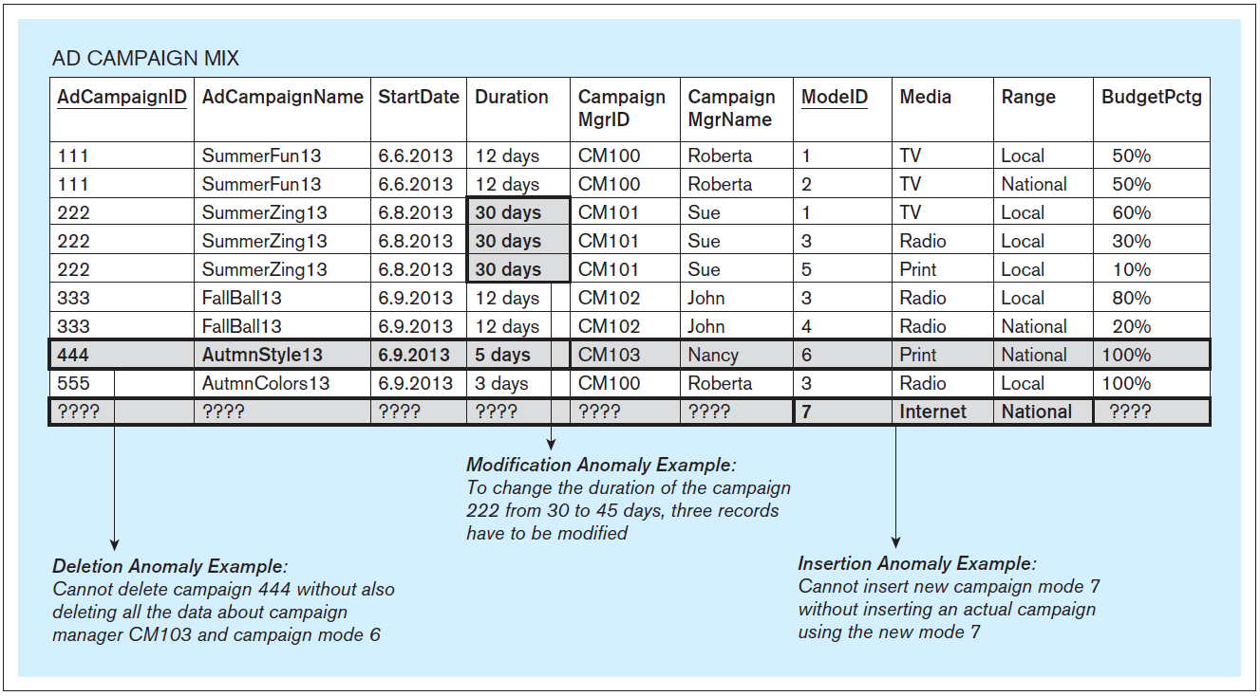
Update Anomalies, cont’d
Database Systems
by Jukić, Vrbsky, & Nestorov
Pearson 2014
ISBN 978-0-13-257567-6

Slide 27
Normalization
Normalize tables to eliminate update anomalies.
Normalization is based on the concept of functional dependencies.

Slide 28
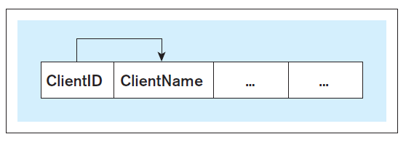
Functional Dependencies
Functional dependency: The value of one or more columns in each row of a table determines the value of another column in the same row.
Write A → B
Column(s) A functionally determines column(s) B.
ClientId → ClientName
Database Systems
by Jukić, Vrbsky, & Nestorov
Pearson 2014
ISBN 978-0-13-257567-6

Slide 29
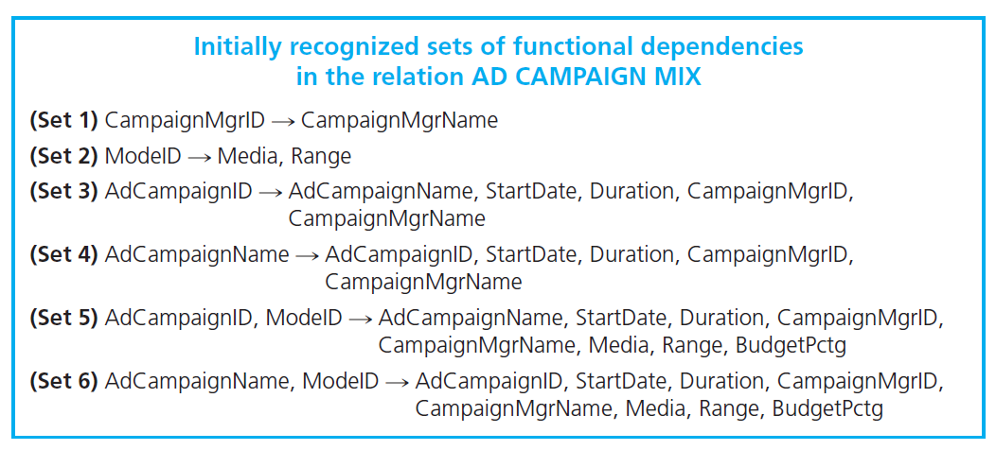
Functional Dependencies, cont’d
Database Systems
by Jukić, Vrbsky, & Nestorov
Pearson 2014
ISBN 978-0-13-257567-6

Slide 30
Functional Dependencies, cont’d
(Set 1) CampaignMgrID → CampaignMgrName
But not the reverse!
Database Systems
by Jukić, Vrbsky, & Nestorov
Pearson 2014
ISBN 978-0-13-257567-6

Slide 31
Functional Dependencies, cont’d
(Set 2) ModeID → Media, Range
But neither Media nor Range determine ModeID.
Database Systems
by Jukić, Vrbsky, & Nestorov
Pearson 2014
ISBN 978-0-13-257567-6

Slide 32
Functional Dependencies, cont’d
(Set 3) AdCampaignID → AdCampaignName, StartDate, Duration,
CampaignMgrId, CampaignMgrName
Database Systems
by Jukić, Vrbsky, & Nestorov
Pearson 2014
ISBN 978-0-13-257567-6

Slide 33
Functional Dependencies, cont’d
(Set 4) AdCampaignName → AdCampaignID, StartDate, Duration,
CampaignMgrID, CampaignMgrName
Database Systems
by Jukić, Vrbsky, & Nestorov
Pearson 2014
ISBN 978-0-13-257567-6

Slide 34
Functional Dependencies, cont’d
(Set 5) AdCampaignID, ModeID → AdCampaignName, StartDate, Duration,
CampaignMgrID, CampaignMgrName,
Media, Range, BudgetPctg
Database Systems
by Jukić, Vrbsky, & Nestorov
Pearson 2014
ISBN 978-0-13-257567-6

Slide 35
Functional Dependencies, cont’d
(Set 6) AdCampaignName, ModeID → AdCampaignID, StartDate, Duration,
CampaignMgrID, CampaignMgrName,
Media, Range, BudgetPctg
Database Systems
by Jukić, Vrbsky, & Nestorov
Pearson 2014
ISBN 978-0-13-257567-6

Slide 36
Trivial Functional Dependencies
Remove trivial function dependencies (FDs):
A → A
A, B → A, B
A, B → A

Slide 37
Augmented Functional Dependencies
If A → B, then remove augmented FDs such as A, C → B
Because replace with
(Set 2) ModeID → Media, Range
(Set 3) AdCampaignID → AdCampaignName, StartDate, Duration,
CampaignMgrId, CampaignMgrName
(Set 5) AdCampaignID, ModeID → AdCampaignName, StartDate, Duration,
CampaignMgrID, CampaignMgrName,
Media, Range, BudgetPctg
(Set 5) AdCampaignID, ModeID → BudgetPctg

Slide 38
Equivalent Functional Dependencies
Equivalent FDs:
A → B B → A
A → B, X B → A, X
Y, A → B, X Y, B → A, X
Remove all but one from each equivalence set.

Slide 39
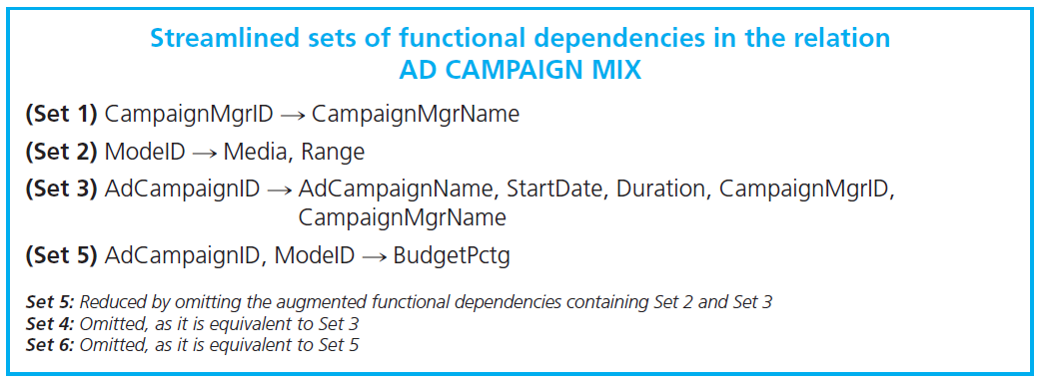
Equivalent Functional Dependencies
Because are equivalent:
FD Sets 3 and 4 are equivalent: Remove Set 4
FD Sets 5 and 6 are equivalent: Remove Set 6
AdCampaignID → AdCampaignName AdCampaignName → AdCampaignID
Database Systems
by Jukić, Vrbsky, & Nestorov
Pearson 2014
ISBN 978-0-13-257567-6

Slide 40
Streamlined Functional Dependencies
Database Systems
by Jukić, Vrbsky, & Nestorov
Pearson 2014
ISBN 978-0-13-257567-6

Slide 41
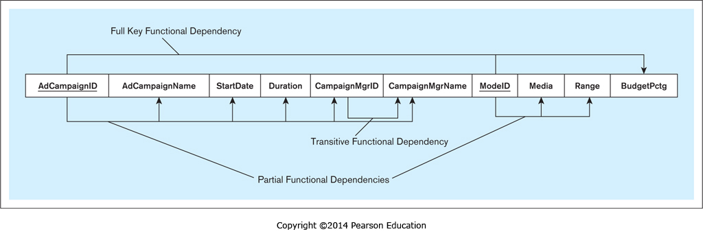
Partial Functional Dependency
A table column is functionally dependent on a component of a composite primary key.
(Set 2) ModeID → Media, Range
(Set 3) AdCampaignID → AdCampaignName, StartDate, Duration,
CampaignMgrId, CampaignMgrName
Database Systems
by Jukić, Vrbsky, & Nestorov
Pearson 2014
ISBN 978-0-13-257567-6

Slide 42
Full Key Functional Dependency
A table column is functionally dependent on the primary key and not partially dependent on any separate component of the primary key.
(Set 5) AdCampaignID, ModeID→ BudgetPctg
Database Systems
by Jukić, Vrbsky, & Nestorov
Pearson 2014
ISBN 978-0-13-257567-6

Slide 43
Transitive Functional Dependency
A nonkey column is functionally dependent on another nonkey column.
CampaignMgrID → CampaignMgrName
Database Systems
by Jukić, Vrbsky, & Nestorov
Pearson 2014
ISBN 978-0-13-257567-6

Slide 44
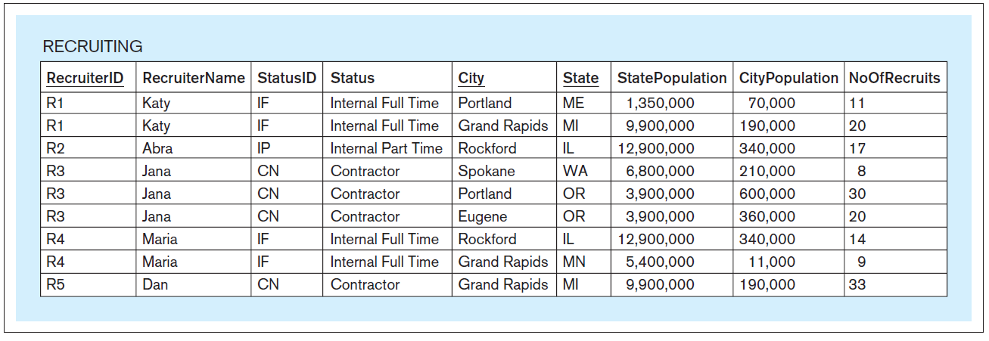
Another Functional Dependencies Example
Database Systems
by Jukić, Vrbsky, & Nestorov
Pearson 2014
ISBN 978-0-13-257567-6

