Slide 1
CS/SE 157B Database Management Systems II February 1 Class Meeting
Department of Computer Science San Jose State University Spring 2018 Instructor: Ron Mak
www.cs.sjsu.edu/~mak

Slide 2
Online Database Diagramming Tool
See http://erdplus.com
Free online drawing tool for:
entity-relationship diagram (ERD)
relational schema
star schema
Automatic mapping from ERD to relational schema.
Create a personal account to be able to save diagrams.

Slide 3
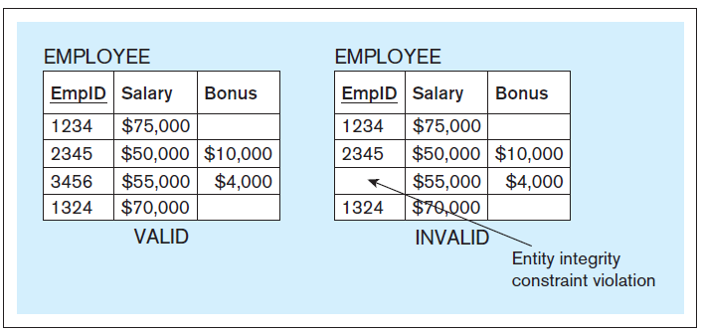
Entity Integrity Constraint
No primary key column of a relational table can have null (empty) values.
Database Systems
by Jukić, Vrbsky, & Nestorov
Pearson 2014
ISBN 978-0-13-257567-6

Slide 4
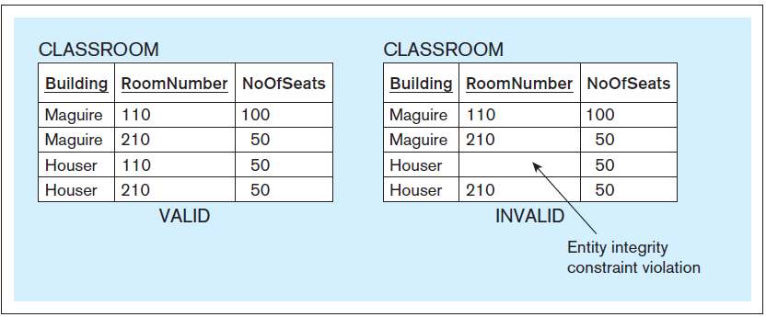
Entity Integrity Constraint, cont’d
Database Systems
by Jukić, Vrbsky, & Nestorov
Pearson 2014
ISBN 978-0-13-257567-6

Slide 5
Foreign Keys
A foreign key is a column in a table that refers to a primary key column in another table.
In a relational schema, draw an arrow from the foreign key to the corresponding primary key.

Slide 6
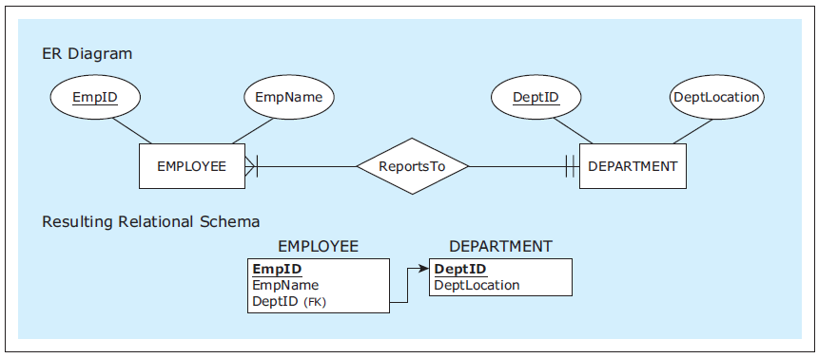
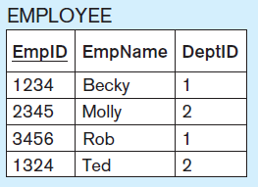
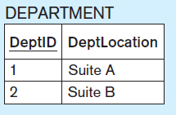
Mapping 1:M Relationships
Mandatory
participation
on both sides.
The foreign key belongs on the
M side of the 1:M relationship.
It corresponds to the primary key
on the 1 side.
Database Systems
by Jukić, Vrbsky, & Nestorov
Pearson 2014
ISBN 978-0-13-257567-6

Slide 7
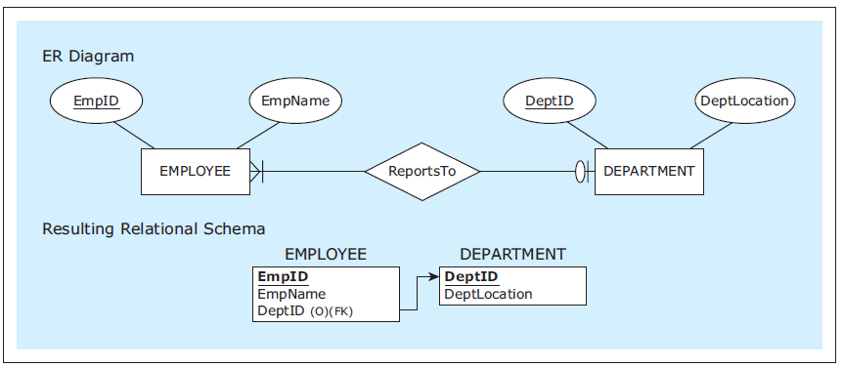
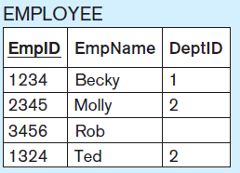
Mapping 1:M Relationships, cont’d
Optional participation
on the 1 side.
Database Systems
by Jukić, Vrbsky, & Nestorov
Pearson 2014
ISBN 978-0-13-257567-6

Slide 8
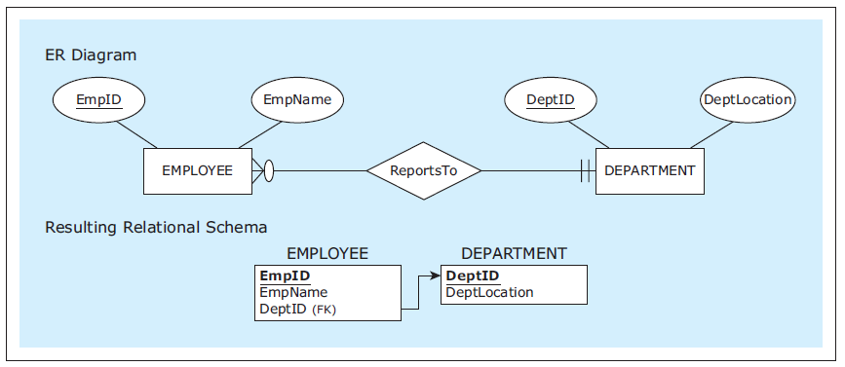
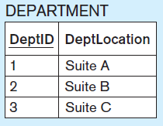
Mapping 1:M Relationships, cont’d
Optional participation
on the M side.
Database Systems
by Jukić, Vrbsky, & Nestorov
Pearson 2014
ISBN 978-0-13-257567-6

Slide 9
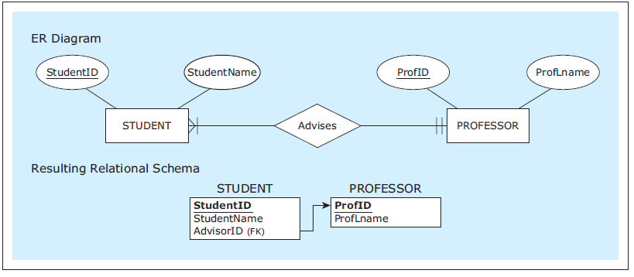
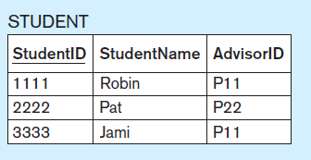
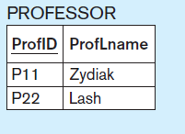
Mapping 1:M Relationships, cont’d
Rename a foreign key
to better reflect the
role of a relationship.
Database Systems
by Jukić, Vrbsky, & Nestorov
Pearson 2014
ISBN 978-0-13-257567-6

Slide 10
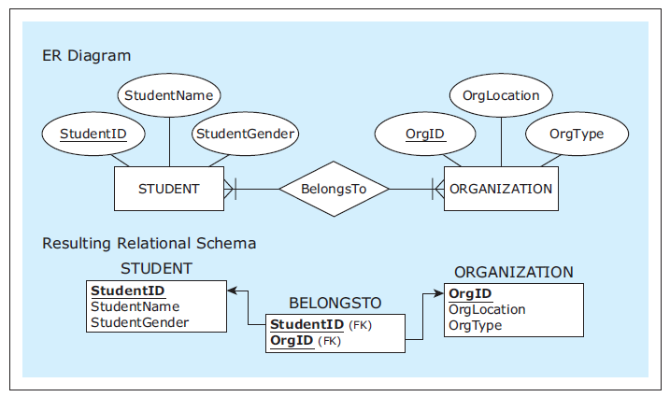
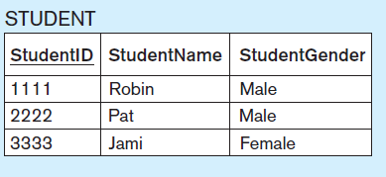
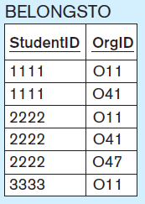
Mapping M:N Relationships
Use the
bridge relation
BELONGSTO
with two
foreign keys.
AKA:
linking table
or join table
Database Systems
by Jukić, Vrbsky, & Nestorov
Pearson 2014
ISBN 978-0-13-257567-6

Slide 11
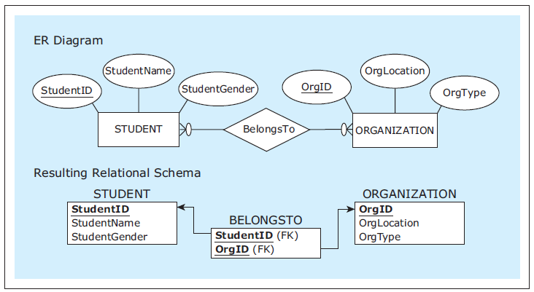
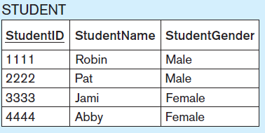
Mapping M:N Relationships, cont’d
Optional
participation
on both sides.
Database Systems
by Jukić, Vrbsky, & Nestorov
Pearson 2014
ISBN 978-0-13-257567-6

Slide 12
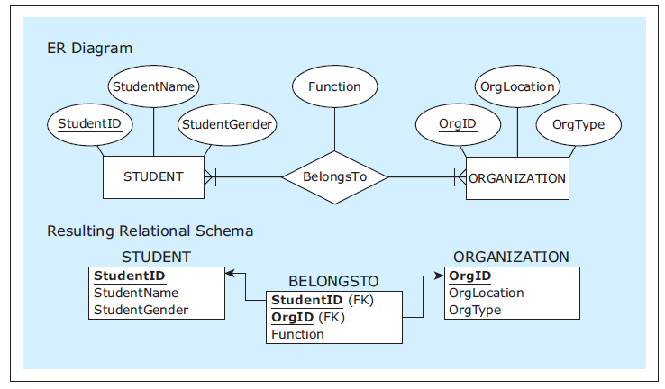
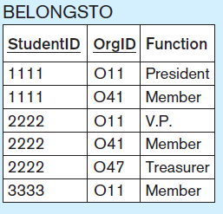
Mapping M:N Relationships, cont’d
Relationship
with an
attribute.
Database Systems
by Jukić, Vrbsky, & Nestorov
Pearson 2014
ISBN 978-0-13-257567-6

Slide 13
Mapping 1:1 Relationships
Map 1:1 relationships similarly to 1:M relationships.
One table will have a foreign key pointing to the primary key of the other table.
It can be an arbitrary choice of which table has the foreign key.
Make the choice that is most intuitive or efficient.

Slide 14
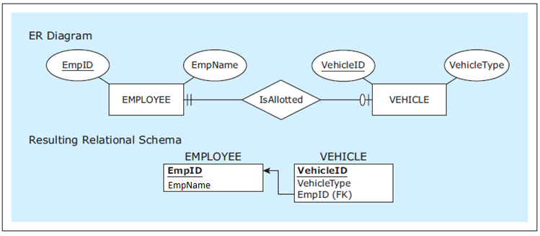
Mapping 1:1 Relationships, cont’d
Table VEHICLE has the foreign key.
Database Systems
by Jukić, Vrbsky, & Nestorov
Pearson 2014
ISBN 978-0-13-257567-6

Slide 15
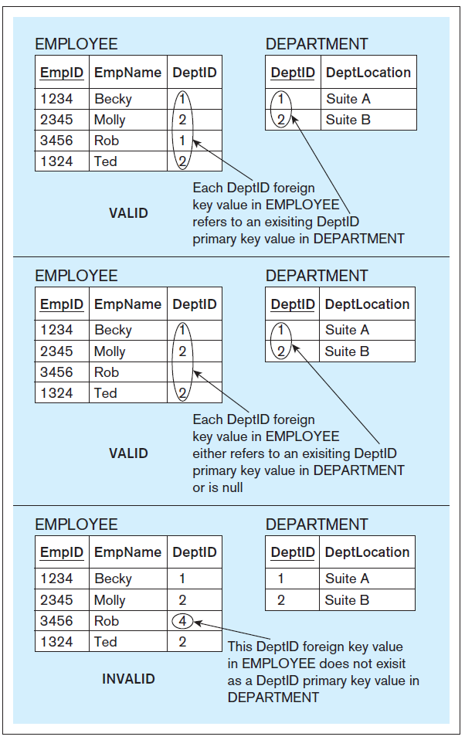
Referential Integrity Constraint
The value of a foreign key must either:
Match one of the values of the primary key in the referred table.
Be null.
Database Systems
by Jukić, Vrbsky, & Nestorov
Pearson 2014
ISBN 978-0-13-257567-6

Slide 16
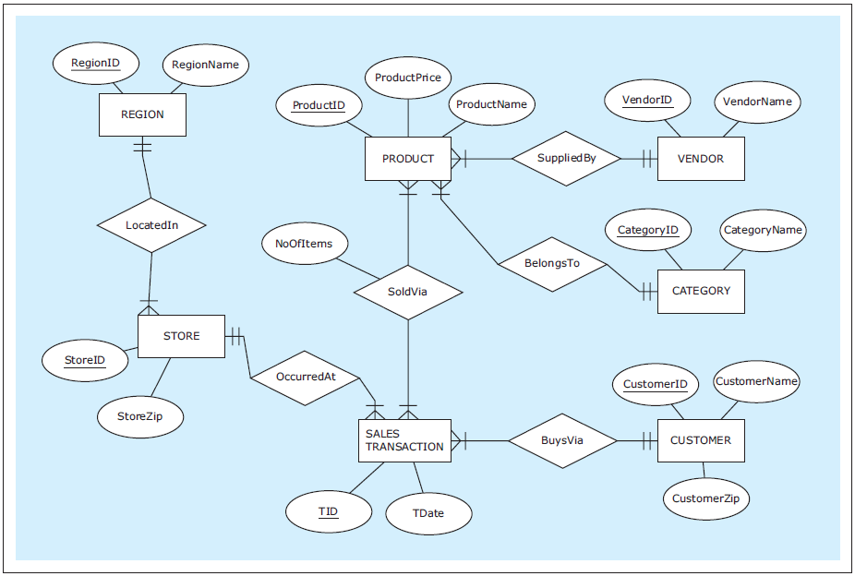
Mapping Example #1: ER Diagram
Database Systems
by Jukić, Vrbsky, & Nestorov
Pearson 2014
ISBN 978-0-13-257567-6

Slide 17
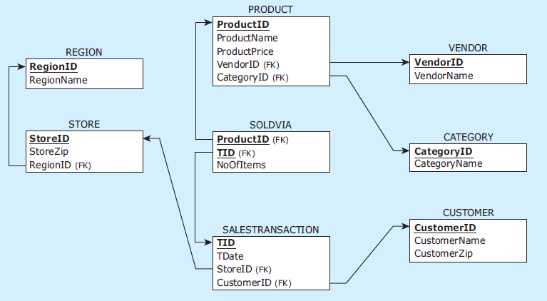
Mapping Example #1: Relational Schema
Database Systems
by Jukić, Vrbsky, & Nestorov
Pearson 2014
ISBN 978-0-13-257567-6

Slide 18
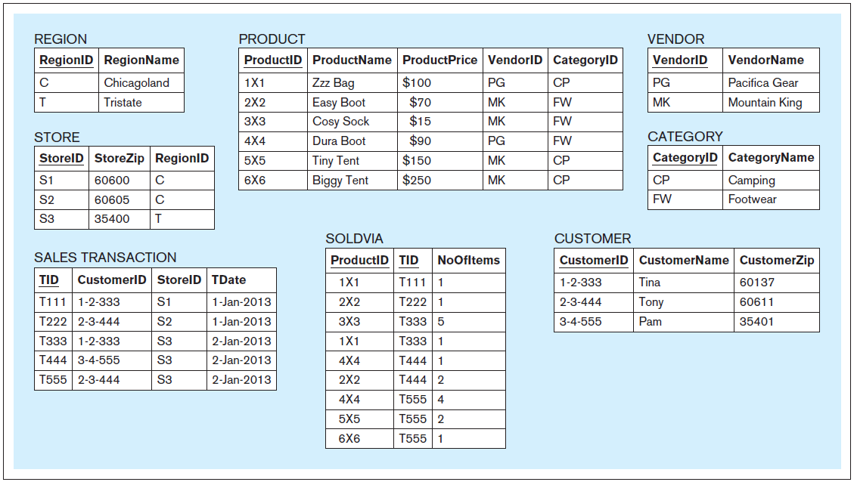
Mapping Example #1: Sample Data
Database Systems
by Jukić, Vrbsky, & Nestorov
Pearson 2014
ISBN 978-0-13-257567-6

Slide 19
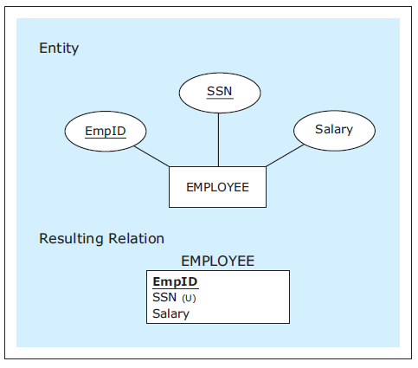
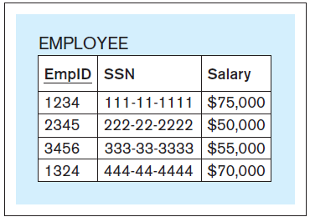
Mapping Candidate Keys
Choose one of the
candidate keys
to be the primary key.
Map the other
candidate keys
as non-primary.
Database Systems
by Jukić, Vrbsky, & Nestorov
Pearson 2014
ISBN 978-0-13-257567-6

Slide 20
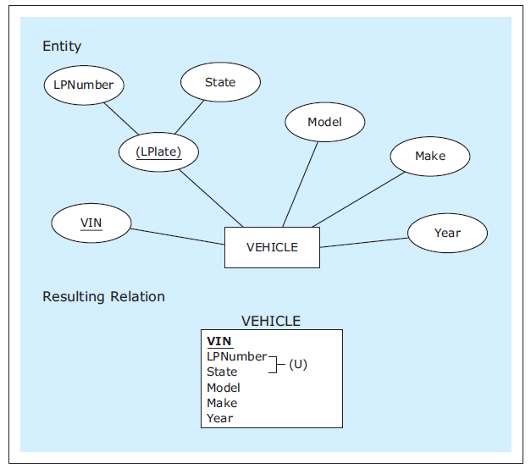
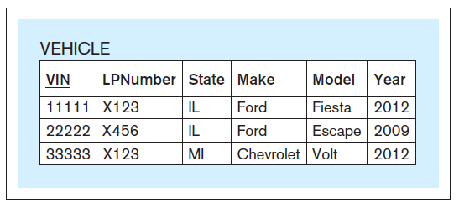
Mapping Candidate Keys, cont’d
Generally choose
a non-composite
candidate key to be
the primary key.
Database Systems
by Jukić, Vrbsky, & Nestorov
Pearson 2014
ISBN 978-0-13-257567-6

Slide 21
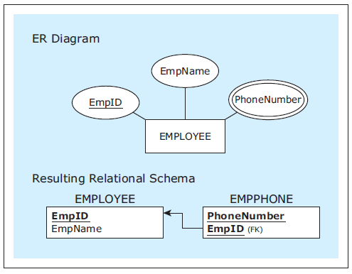
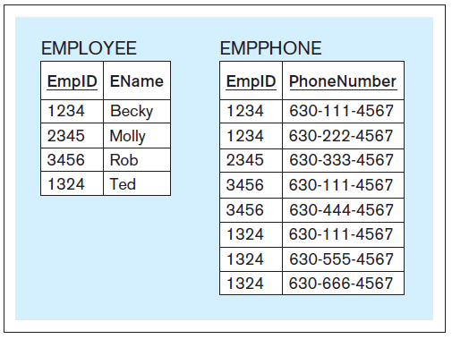
Mapping Multivalued Attributes
Map the multivalued
attribute as a new table.
This becomes a 1:M
relationship with the
new table on the M side.
Database Systems
by Jukić, Vrbsky, & Nestorov
Pearson 2014
ISBN 978-0-13-257567-6

Slide 22
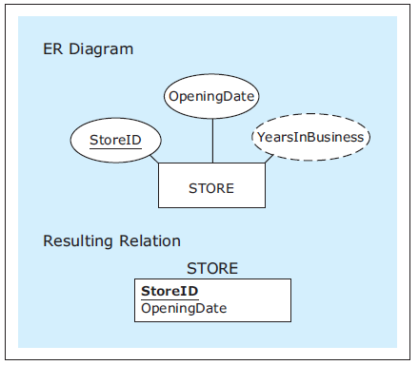
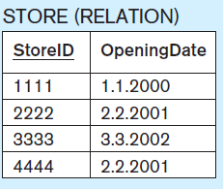
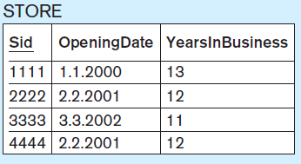
Mapping Derived Attributes
Do not map derived attributes.
Sample data records.
Database Systems
by Jukić, Vrbsky, & Nestorov
Pearson 2014
ISBN 978-0-13-257567-6
As seen by the front-end application.

Slide 23
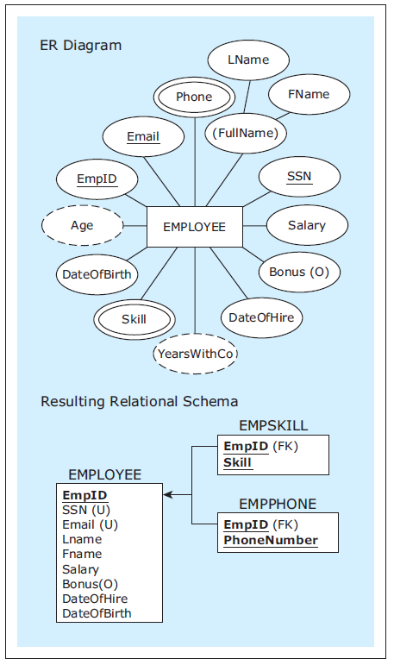
Mapping Example #2: Attributes
Database Systems
by Jukić, Vrbsky, & Nestorov
Pearson 2014
ISBN 978-0-13-257567-6

Slide 24
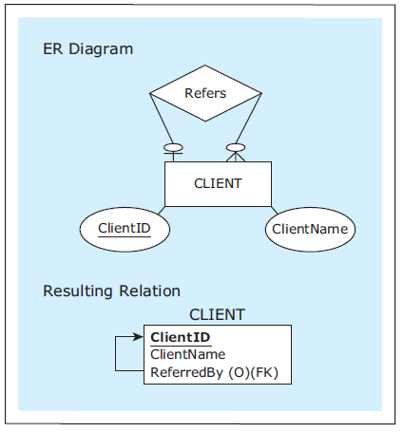
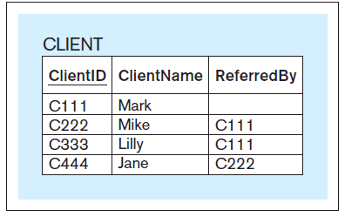
Mapping Unary 1:M Relationships
The table contains a
foreign key that
corresponds to its
own primary key.
Database Systems
by Jukić, Vrbsky, & Nestorov
Pearson 2014
ISBN 978-0-13-257567-6

Slide 25
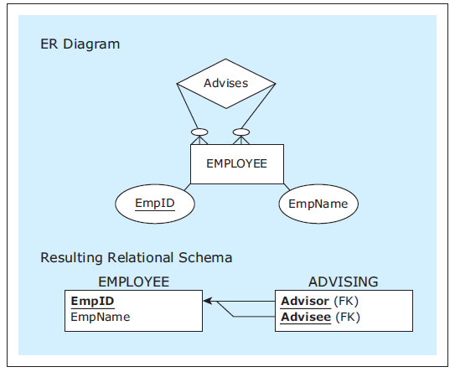
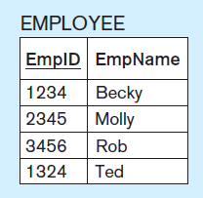
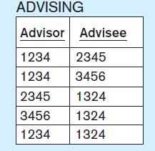
Mapping Unary M:N Relationships
Use a bridge relation
where both foreign keys
refer to the primary
key of the same table.
Database Systems
by Jukić, Vrbsky, & Nestorov
Pearson 2014
ISBN 978-0-13-257567-6

Slide 26
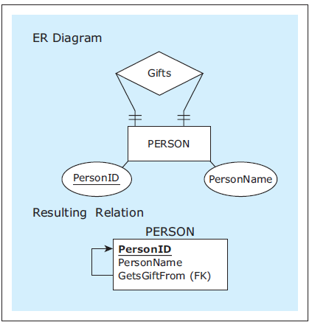
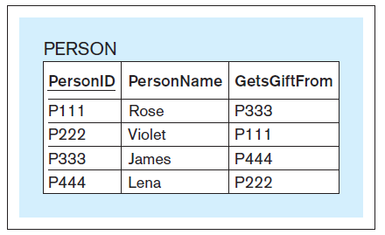
Mapping Unary 1:1 Relationships
Map similarly
to a unary 1:M
relationship.
Database Systems
by Jukić, Vrbsky, & Nestorov
Pearson 2014
ISBN 978-0-13-257567-6

Slide 27
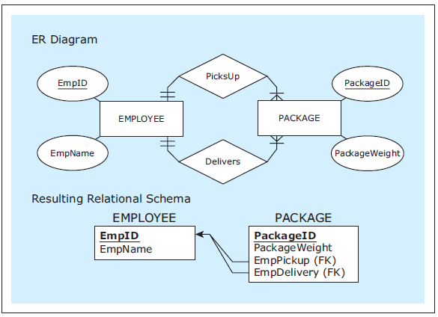
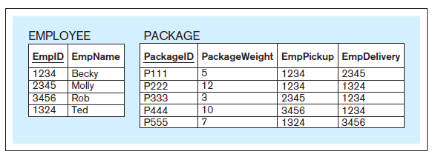
Mapping Multiple Relationships
Map each
relationship.
Database Systems
by Jukić, Vrbsky, & Nestorov
Pearson 2014
ISBN 978-0-13-257567-6

Slide 28
Mapping Weak Entities
Map weak entities the same way you map regular entities.
The resulting table has a composite primary key that is composed of:
The partial identifier of the table.
The foreign key corresponding to the primary key of the owner table.

Slide 29
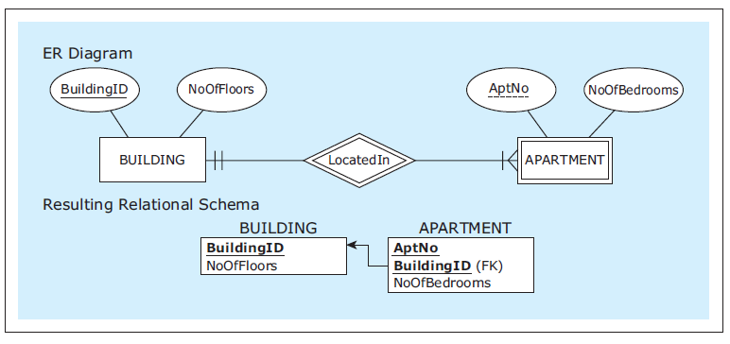
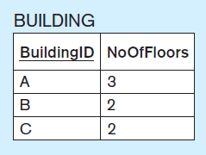
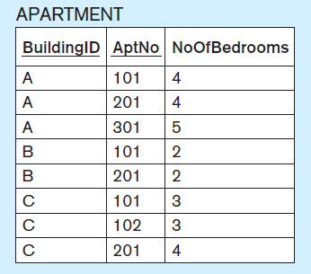
Mapping Weak Entities, cont’d
Database Systems
by Jukić, Vrbsky, & Nestorov
Pearson 2014
ISBN 978-0-13-257567-6
The APARTMENT table’s composite primary key
consists of AptNo (the partial key)
and BuildingID (the foreign key
corresponding the the primary key
of the owner BUILDING table).

Slide 30
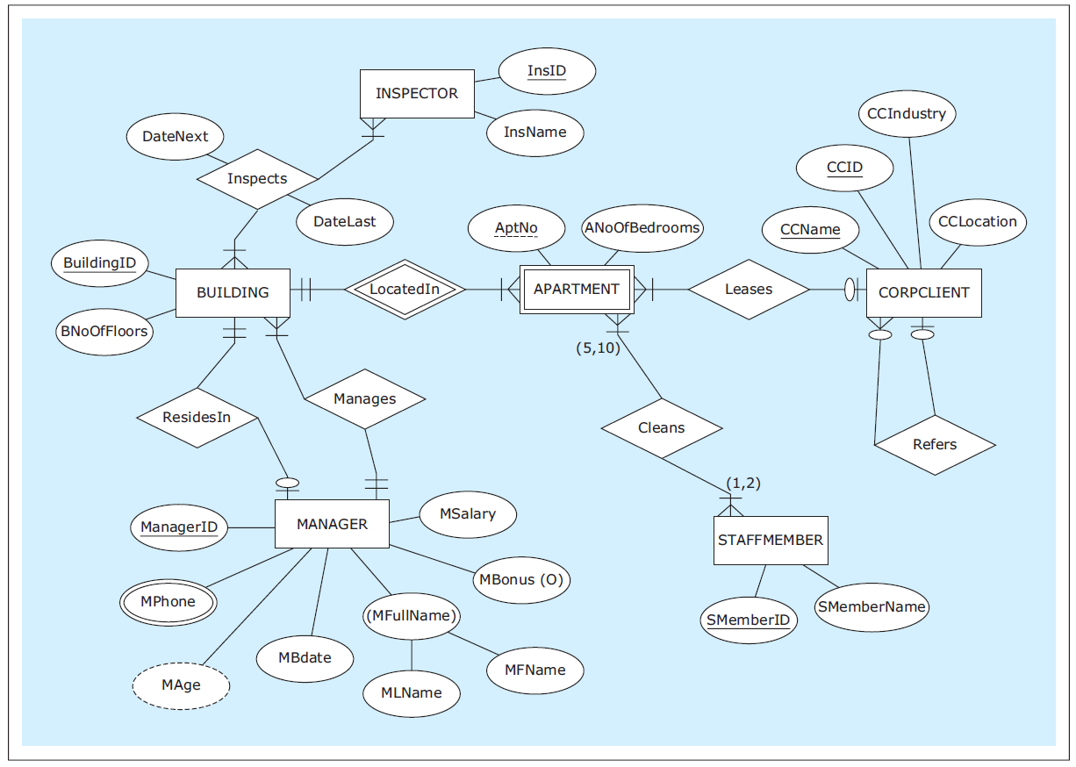
Mapping Example #3: ER Diagram
Database Systems
by Jukić, Vrbsky, & Nestorov
Pearson 2014
ISBN 978-0-13-257567-6

Slide 31
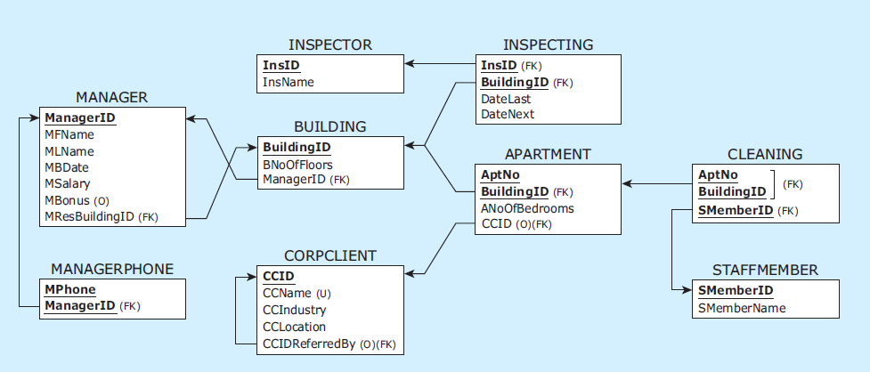
Mapping Example #3: Relational Schema
Database Systems
by Jukić, Vrbsky, & Nestorov
Pearson 2014
ISBN 978-0-13-257567-6

Slide 32
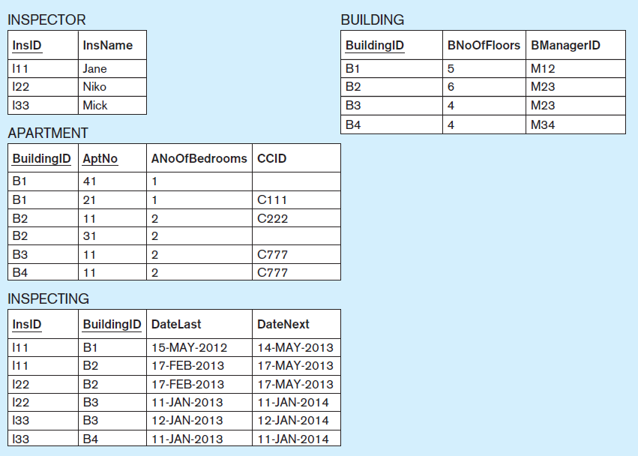
Mapping Example #3: Sample Data
Database Systems
by Jukić, Vrbsky, & Nestorov
Pearson 2014
ISBN 978-0-13-257567-6

Slide 33
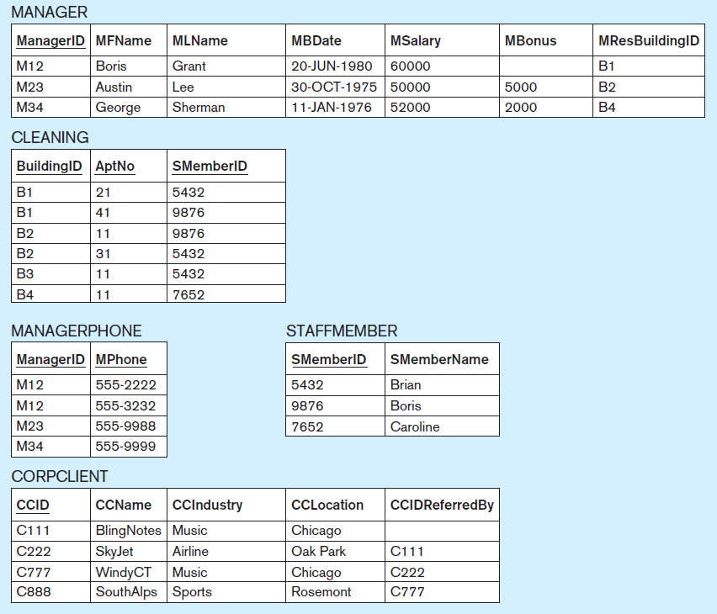
Mapping Example #3: Sample Data, cont’d
Database Systems
by Jukić, Vrbsky, & Nestorov
Pearson 2014
ISBN 978-0-13-257567-6

Slide 34
Relational Database Constraints
A constraint is a rule that a relational database must satisfy in order to be valid.
Two types of constraints:
implicit constraints
user-defined constraints

Slide 35
Implicit RDB Constraints
Each relation (table) in a relational schema must have a unique name.
For each relation:
Each column name must be unique.
Each row must be unique.
Each column of each row must be single-valued.
Domain constraint: All values in a column must be from the same predefined domain.
The column order is irrelevant.
The row order is irrelevant.

Slide 36
Implicit RDB Constraints, cont’d
Primary key constraint: Each relation must have a primary key (a column or set of columns) whose value is unique for each row.
Entity integrity constraint: No primary key column can have a null value.
Referential integrity constraint: In each row containing a foreign key, either the value of the foreign key must match one of the values of the primary key of the referred table, or the foreign key is null.

Slide 37
User-Defined RDB Constraints
Optional attributes
Mandatory foreign key
Example: Each employee must report to a department.
Exact cardinalities
Example: A student can take at most 5 classes.
Business rules
Usually enforced by front-end applications.
Example: Each organization must have both male and female students.

Slide 38
User-Defined RDB Constraints, cont’d
Database Systems
by Jukić, Vrbsky, & Nestorov
Pearson 2014
ISBN 978-0-13-257567-6

Slide 39
ER Modeling and Relational Modeling
Why not skip ER modeling and go directly to logical modeling (creating relational schemas)?
ER modeling is better for visualizing requirements.
Certain concepts can be visualized graphically only in an ER diagram.
Every attribute appears only once in an ER diagram.
A conceptual model (ER diagram) is better for communication and documentation.

