Slide 1
CS/SE 157B Database Management Systems II January 25 Class Meeting
Department of Computer Science San Jose State University Spring 2018 Instructor: Ron Mak
www.cs.sjsu.edu/~mak

Slide 2
Basic Info
Office hours
TuTh 3:00 – 4:00 PM
ENG 250
Website
Faculty webpage: http://www.cs.sjsu.edu/~mak/
Class webpage: http://www.cs.sjsu.edu/~mak/CS157B/index.html
Syllabus
Assignments
Lecture notes

Slide 3
Permission Numbers
Go to the Computer Science Department website: http://www.sjsu.edu/cs/
Click the link in the first paragraph: CS Spring 2018 Permission Number Request
Fill out the Google form.

Slide 4
Project Teams
Projects will be done by small project teams.
Assignments will advance work on the projects.
Form your own teams of 4 members each.
Choose your team members wisely!
Be sure you’ll be able to meet and communicate with each other and work together well.
No moving from team to team.
Each team member will receive the same score on each team assignment and the team project.

Slide 5
Project Teams, cont’d
Each team email to ron.mak@sjsu.edu by Wednesday, January 31:
Your team name
A list of team members and email addresses
Subject: CS 157B Team Team Name
Example: CS 157B Team Hyper Hackers

Slide 6
Take roll!

Slide 7
Online Database Diagramming Tool
See http://erdplus.com
Free online drawing tool for:
entity-relationship diagram (ERD)
relational schema
star schema
Automatic mapping from ERD to relational schema.
Create a personal account to be able to save diagrams.

Slide 8
Entities and Attributes
Entity
Represents a real-world concept.
Examples: customer, product, store, event, etc.
Data that the database stores.
Attribute
Characteristic of an entity that the database stores.
Examples (for a customer): name, address, id, etc.
A unique attribute of an entity has a value that is different for each entity instance.

Slide 9
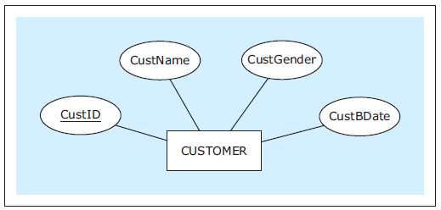
Entities and Attributes, cont’d
In an ER diagram (ERD), show an entity with a rectangle and its attributes with ovals.
Underline the unique attribute.
Database Systems
by Jukić, Vrbsky, & Nestorov
Pearson 2014
ISBN 978-0-13-257567-6

Slide 10
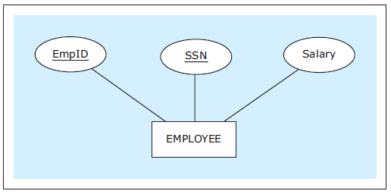
Entities and Attributes, cont’d
An entity can have multiple unique attributes.
Each one is called a candidate key.
Database Systems
by Jukić, Vrbsky, & Nestorov
Pearson 2014
ISBN 978-0-13-257567-6

Slide 11
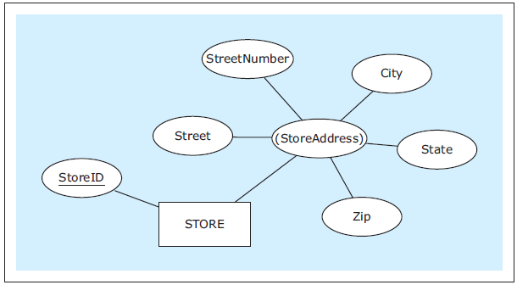
Composite Attributes
A composite attribute is composed of several attributes.
Parenthesize the name of the composite attribute.
Database Systems
by Jukić, Vrbsky, & Nestorov
Pearson 2014
ISBN 978-0-13-257567-6

Slide 12
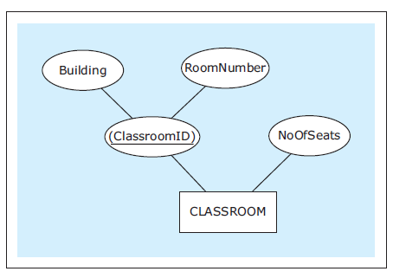
Composite Attributes, cont’d
An entity’s unique attribute can be composite.
Database Systems
by Jukić, Vrbsky, & Nestorov
Pearson 2014
ISBN 978-0-13-257567-6

Slide 13
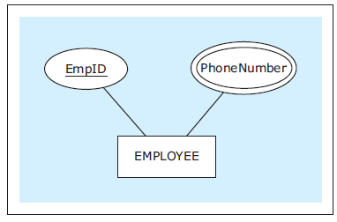
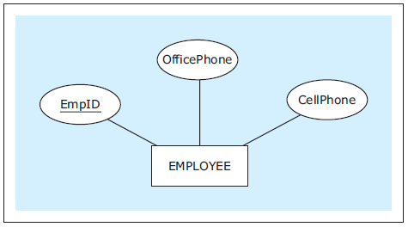
Multivalued Attributes
An entity instance can have multiple values for an attribute.
If the number of values is fixed, we can use separate attributes instead.
Database Systems
by Jukić, Vrbsky, & Nestorov
Pearson 2014
ISBN 978-0-13-257567-6

Slide 14
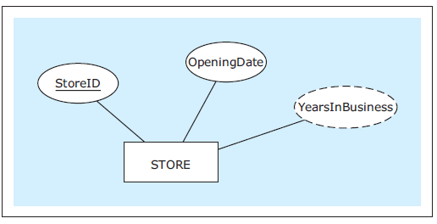
Derived Attributes
The value of a derived attribute is not stored.
It’s calculated from the values of the other attributes and additional data such as the current date.
Show with a dashed oval.
Database Systems
by Jukić, Vrbsky, & Nestorov
Pearson 2014
ISBN 978-0-13-257567-6

Slide 15
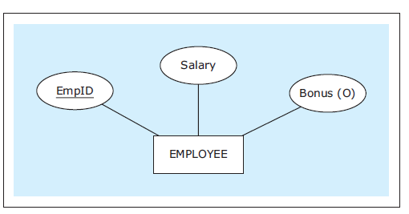
Optional Attributes
An optional attribute does not always have to have a value.
Indicate with (O).
Database Systems
by Jukić, Vrbsky, & Nestorov
Pearson 2014
ISBN 978-0-13-257567-6

Slide 16
Relationships
Each entity in an ER diagram must be related to at least one other entity.
Show a relationship with a diamond and connect the diamond to the entities that are part of the relationship.
Database Systems
by Jukić, Vrbsky, & Nestorov
Pearson 2014
ISBN 978-0-13-257567-6

Slide 17
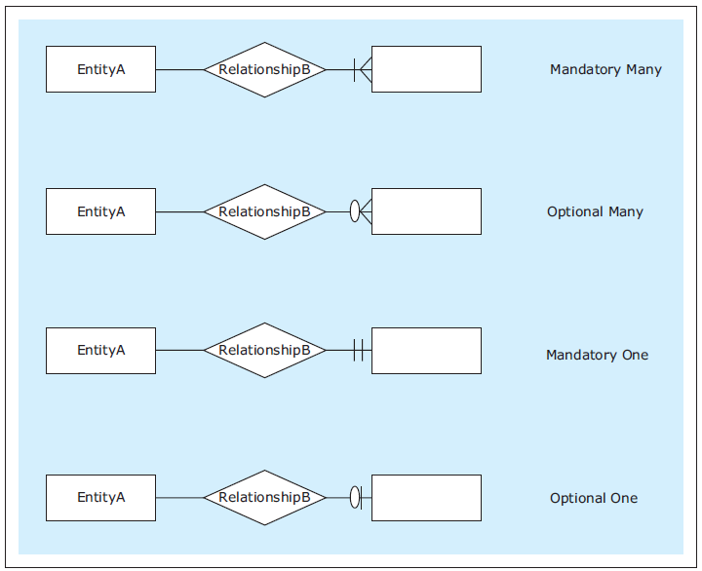
Relationship Cardinality
Show cardinality (how many instances of an entity) with symbols at the end of the relationship lines.
Maximum symbol closest to the entity.
Minimum symbol further away.
Zero, one, many
Database Systems
by Jukić, Vrbsky, & Nestorov
Pearson 2014
ISBN 978-0-13-257567-6

Slide 18
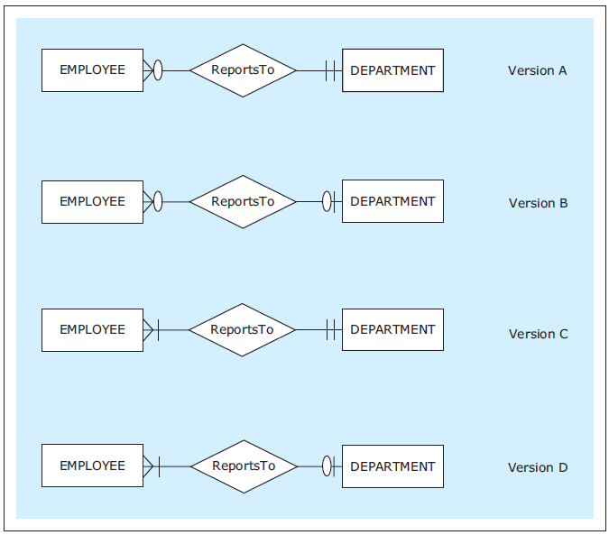
Relationship Cardinality, cont’d
Read each relationship in both directions in this order:
rectangle
diamond
cardinality
rectangle
Database Systems
by Jukić, Vrbsky, & Nestorov
Pearson 2014
ISBN 978-0-13-257567-6

Slide 19
Types of Relationships
One-to-one (1:1)
One-to-many (1:M)
Each employee is allotted at most one vehicle.
Each vehicle is allotted to exactly one employee.
Each region has located in it at least one (i.e., many) stores.
Database Systems
by Jukić, Vrbsky, & Nestorov
Pearson 2014
ISBN 978-0-13-257567-6

Slide 20
Types of Relationships, cont’d
Many-to-many (M:N)
Each employee is assigned to no or several (i.e., many) projects.
Each project has assigned to it at least one (i.e., many) employee.
Database Systems
by Jukić, Vrbsky, & Nestorov
Pearson 2014
ISBN 978-0-13-257567-6

Slide 21
Exact Cardinalities
Indicate exact cardinalities with parenthesized minimum and maximum values.
Example: (2, 6)
Use M for a non-specific minimum or maximum.
Database Systems
by Jukić, Vrbsky, & Nestorov
Pearson 2014
ISBN 978-0-13-257567-6

Slide 22
Relationship Attributes
An relationship can also have attributes.
Database Systems
by Jukić, Vrbsky, & Nestorov
Pearson 2014
ISBN 978-0-13-257567-6

Slide 23
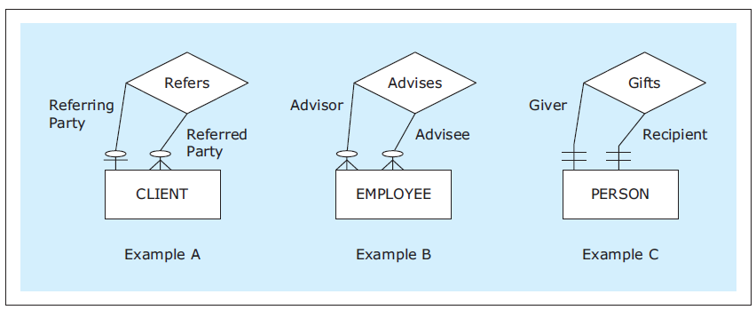
Unary Relationships
In a unary relationship, an entity is involved in a relationship with itself.
One instance has a relationship with another instance of the same entity.
You can indicate the relationship role.
Database Systems
by Jukić, Vrbsky, & Nestorov
Pearson 2014
ISBN 978-0-13-257567-6

Slide 24
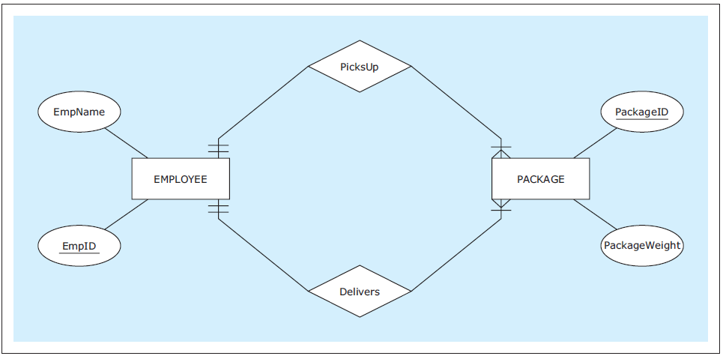
Multiple Relationships
Two entities can have multiple relationships with each other.
Database Systems
by Jukić, Vrbsky, & Nestorov
Pearson 2014
ISBN 978-0-13-257567-6

Slide 25
Weak Entities
A weak entity does not have its own unique attribute.
It only has a partial key.
Underline the partial key with dashes.
Therefore, it must be associated with an owner entity via an identifying relationship.
Indicate the weak entity and the identifying relationship with double borders.
The partial key and the owner attribute’s unique attribute uniquely identifies the weak entity.

Slide 26
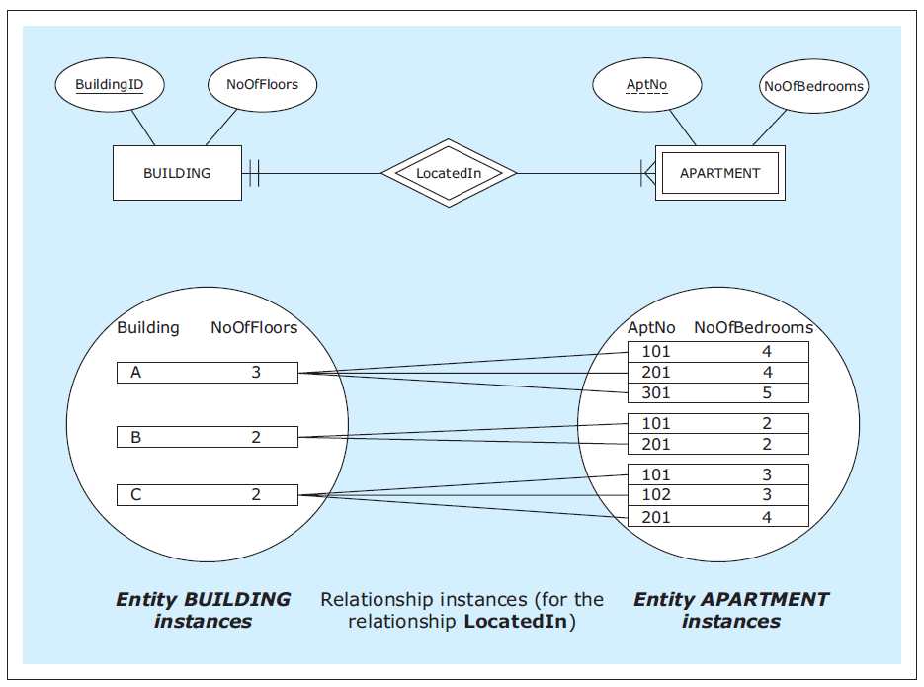
Weak Entities, cont’d
Database Systems
by Jukić, Vrbsky, & Nestorov
Pearson 2014
ISBN 978-0-13-257567-6

Slide 27
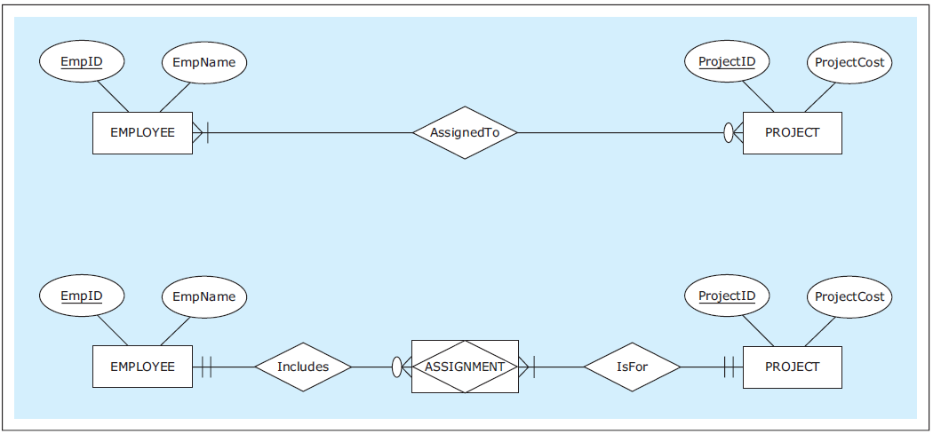
Associative Entities
An associative entity is an alternate way to depict a many-to-many (M:N) relationship.
Database Systems
by Jukić, Vrbsky, & Nestorov
Pearson 2014
ISBN 978-0-13-257567-6

Slide 28
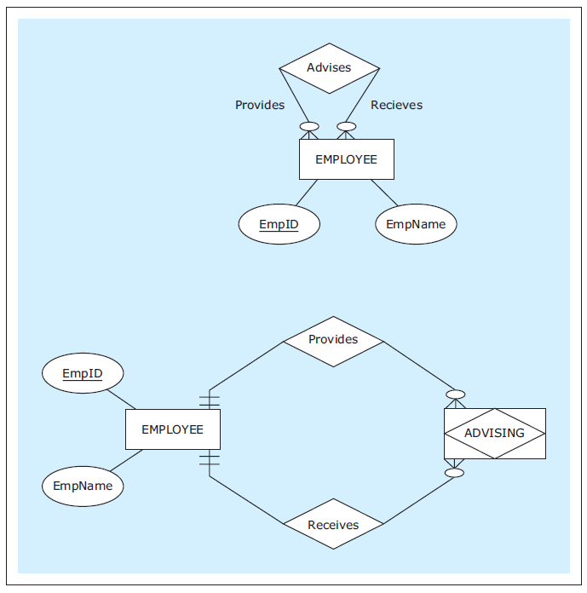
Associative Entities, cont’d
Associative entity for a unary M:N relationship.
Database Systems
by Jukić, Vrbsky, & Nestorov
Pearson 2014
ISBN 978-0-13-257567-6

Slide 29
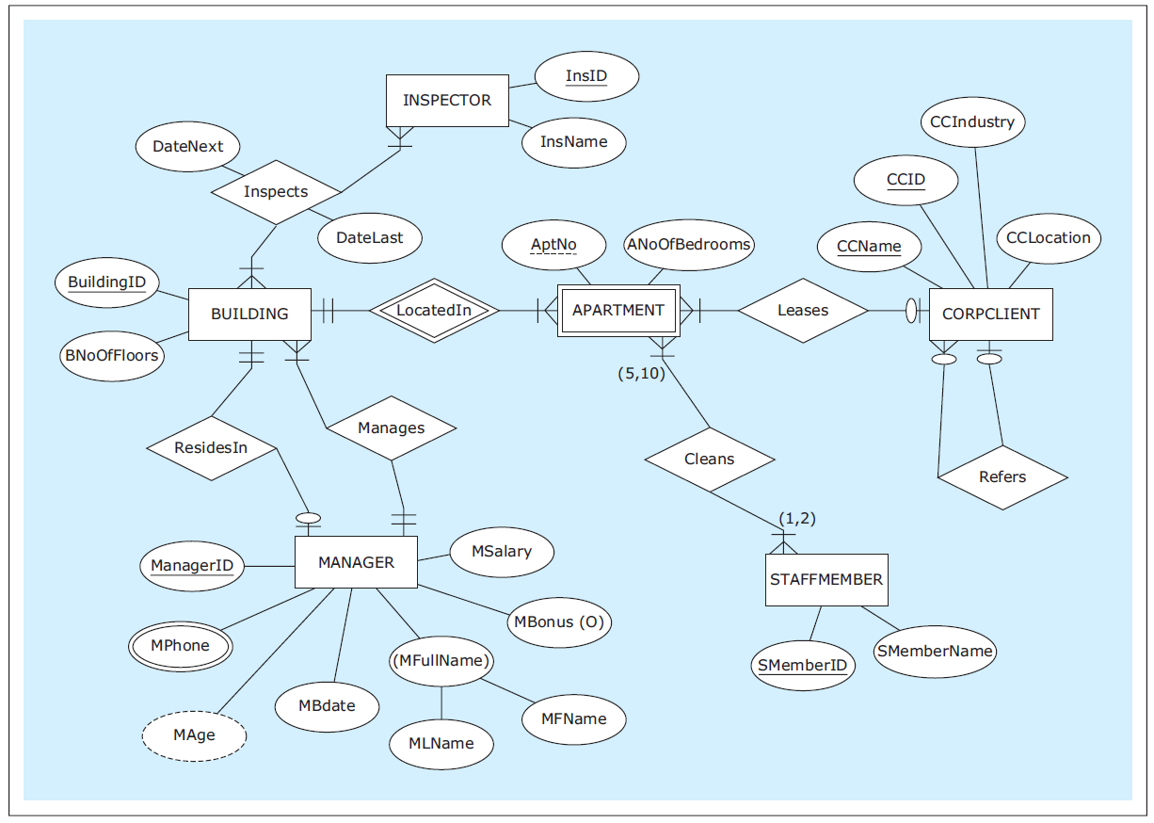
ER Diagram Example
Database Systems
by Jukić, Vrbsky, & Nestorov
Pearson 2014
ISBN 978-0-13-257567-6

Slide 30
Logical Database Model
Map the ER diagram to a logical model represented as a relational schema.
Database Systems
by Jukić, Vrbsky, & Nestorov
Pearson 2014
ISBN 978-0-13-257567-6

Slide 31
Conditions for a Table to be a Relation
Each column must have a name.
Within a table, each column name must be unique.
All values in each column must be from the same (predefined) domain.
Within a table, each row must be unique.
Within each row, each value in each column must be single-valued.
Multiple values of the content represented by the column are not allowed in any rows of the table.

Slide 32
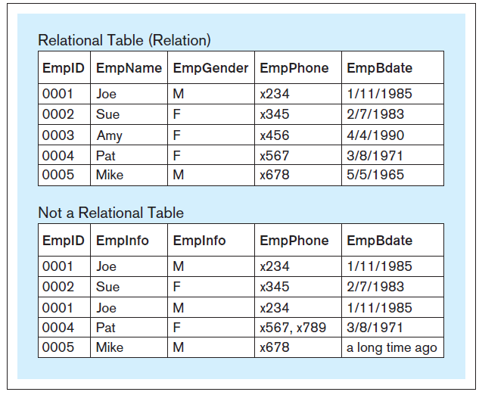
Relational vs. Non-Relational Tables
Database Systems
by Jukić, Vrbsky, & Nestorov
Pearson 2014
ISBN 978-0-13-257567-6

Slide 33
Additional Properties for a Relational Table
The order of columns is irrelevant.
The order of rows is irrelevant.

Slide 34
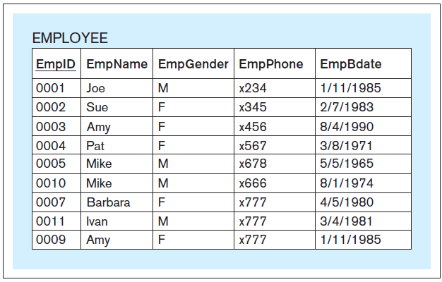
Primary Key
Each relation must have a primary key.
A column or set of columns whose value uniquely identifies each row.
Underline the primary key of the relational table.
Database Systems
by Jukić, Vrbsky, & Nestorov
Pearson 2014
ISBN 978-0-13-257567-6

Slide 35
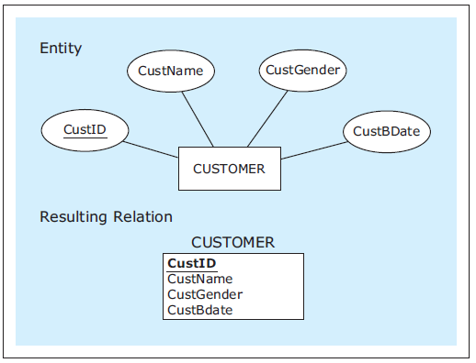
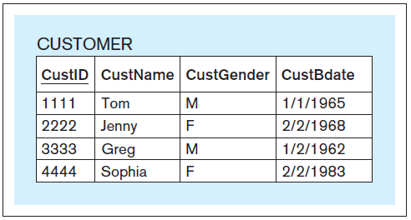
Mapping Entities
Database Systems
by Jukić, Vrbsky, & Nestorov
Pearson 2014
ISBN 978-0-13-257567-6

Slide 36
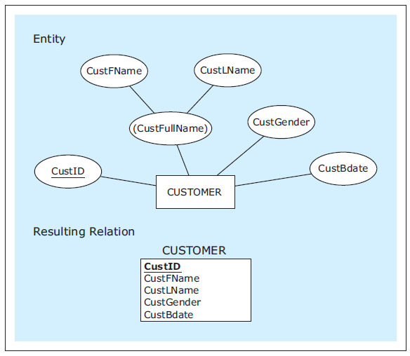
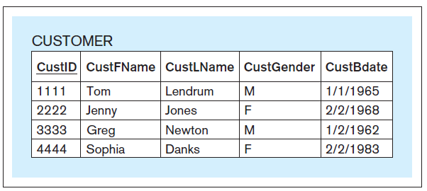
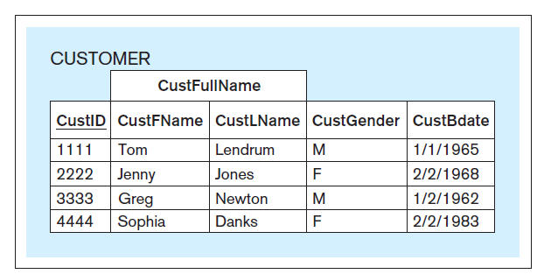
Mapping Entities, cont’d
As mapped.
Entity with a composite attribute.
As seen by a front-end application.
Database Systems
by Jukić, Vrbsky, & Nestorov
Pearson 2014
ISBN 978-0-13-257567-6

Slide 37
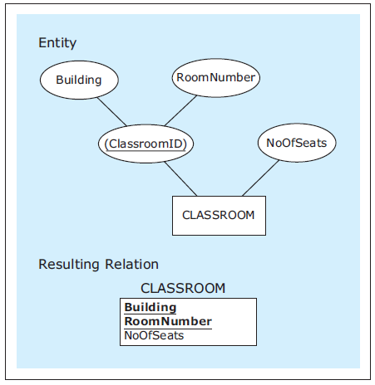
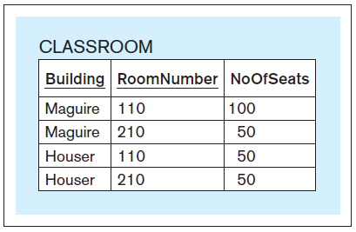
Mapping Entities, cont’d
Attribute with a
composite primary key.
Database Systems
by Jukić, Vrbsky, & Nestorov
Pearson 2014
ISBN 978-0-13-257567-6

Slide 38
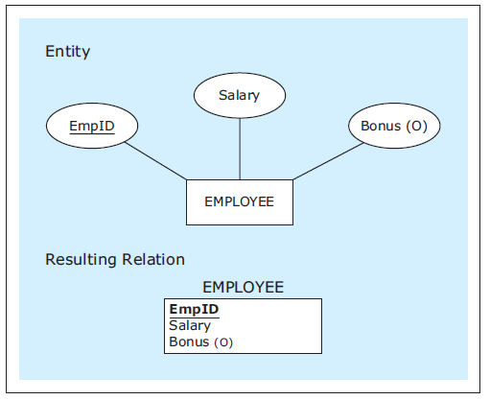
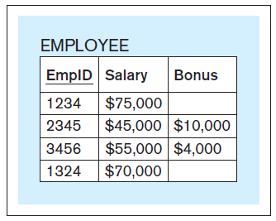
Mapping Entities, cont’d
Entity with an optional attribute.
Database Systems
by Jukić, Vrbsky, & Nestorov
Pearson 2014
ISBN 978-0-13-257567-6

Slide 39
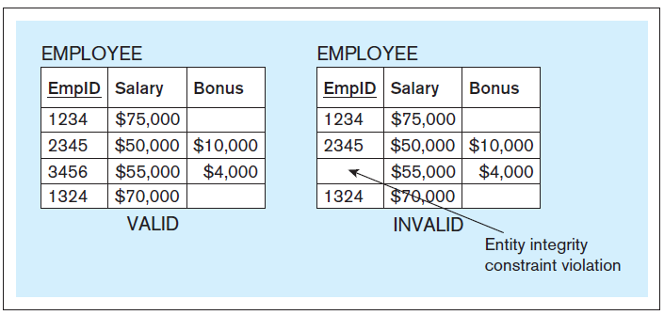
Entity Integrity Constraint
No primary key column of a relational table can have null (empty) values.
Database Systems
by Jukić, Vrbsky, & Nestorov
Pearson 2014
ISBN 978-0-13-257567-6

Slide 40
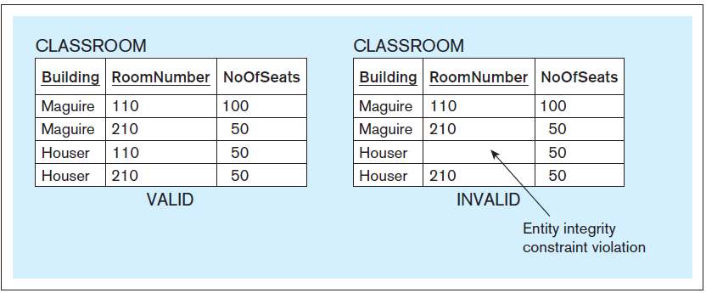
Entity Integrity Constraint, cont’d
Database Systems
by Jukić, Vrbsky, & Nestorov
Pearson 2014
ISBN 978-0-13-257567-6

