Slide 1
CS/SE 157B Database Management Systems II January 25 Class Meeting
Department of Computer Science San Jose State University Spring 2018 Instructor: Ron Mak
www.cs.sjsu.edu/~mak

Slide 2
Basic Info
Office hours
TuTh 3:00 – 4:00 PM
ENG 250
Website
Faculty webpage: http://www.cs.sjsu.edu/~mak/
Class webpage: http://www.cs.sjsu.edu/~mak/CS157B/index.html
Syllabus
Assignments
Lecture notes

Slide 3
Permission Numbers
Go to the Computer Science Department website: http://www.sjsu.edu/cs/
Click the link in the first paragraph: CS Spring 2018 Permission Number Request
Fill out the Google form.

Slide 4
Topics
Practical aspects of database management systems as currently practiced by industry:
Relational and NoSQL databases for web apps
Data warehousing and online analytical processing (OLAP)
XML data processing
Data virtualization and data federation servers
Introduction to some key data science topics:
Cloud computing
Big Data
Data mining

Slide 5
Not Course Topics
Deep expertise in any one topic
Database theory
How to implement a database management system (DBMS)
Database administration (DBA)

Slide 6
Course Learning Outcomes
CLO 1: Incorporate relational and NoSQL databases into web applications.
CLO 2: Design and deploy operational databases for OLTP (online transaction processing).
CLO 3: Design and deploy analytical databases for OLAP (online analytical processing).
CLO 4: Implement dimensional modeling, star schemas, and ETL (extract-transform-load) for a data warehouse.

Slide 7
Course Learning Outcomes, cont’d
CLO 5: Understand semi-structured data and know how to process XML data.
CLO 6: Understand basic concepts of data virtualization and know how to program a commercial data federation server.
CLO 7: Understand some key concepts of data science.
This is a computer science deep course.

Slide 8
Take roll!

Slide 9
Project Teams
Projects will be done by small project teams.
Assignments will advance work on the projects.
Form your own teams of 4 members each.
Choose your team members wisely!
Be sure you’ll be able to meet and communicate with each other and work together well.
No moving from team to team.
Each team member will receive the same score on each team assignment and the team project.

Slide 10
Project Teams, cont’d
Each team email to ron.mak@sjsu.edu by Wednesday, January 31:
Your team name
A list of team members and email addresses
Subject: CS 157B Team Team Name
Example: CS 157B Team Hyper Hackers

Slide 11
Project Assignments
Student teams will work on a series of short project assignments during the semester.
Each project will each take one to three weeks.
Each student on a team will receive the same score for each team project assignment.

Slide 12
Project Assignments
Each project involves:
Research on an assigned technique or technology.
A working application that uses the technique or technology.
A short report that describes the application, how it uses the technique or technology, and how to run it.
Each project is worth a maximum of 100 points.
Each team member gets the same score.
Late projects lose 20 points plus an additional 20 points for each 24 hours after the due date.

Slide 13
Individual Responsibilities
You are personally responsible for participating and contributing to your team’s work, and for understanding each part of the work for every assignment whether or not you worked on that part.

Slide 14
Postmortem Assessment Report
At the end of the semester, each student will individually turn in a short (one page) report:
A brief description of what you learned in the course.
An assessment of your personal accomplishments for your project team.
An assessment of the contributions of each of your project team members.
This report will be seen only by the instructor.

Slide 15
Your Individual Overall Class Grade
65% projects*
15% midterm**
20% final**
* team score
** individual score
During the semester, keep track of your progress in Canvas.
At the end of the semester, students with the median score will get the B grade.
Higher and lower grades will then be assigned based on how the scores cluster above and below the median.
Therefore, your final class grade will be based primarily on your performance relative to the other students in the class.
Your final class grade will be adjusted up or down depending on your
level and quality of participation,
as reported by your
teammates’ postmortem reports.

Slide 16
Recommended Texts
Database Systems: Introduction to Databases and Data Warehouses
Authors: Nenad Jukic, Susan Vrbsky, and Svetlozar Nestorov
Publisher: Prospect Press, 2017
Paperback ISBN: 978-1-943153-19-0 (available from Redshelf.com)
eTextbook ISBN: 978-1-943153-18-3 (available from Redshelf.com and VitalSource.com)
These are much less expensive versions of the textbook originally published in 2014 by Pearson.
Pearson ISBN: 978-0-13-257567-6

Slide 17
Recommended Texts, cont’d
The Kimball Group Reader: Relentlessly Practical Tools for Data Warehousing and Business Intelligence, 2nd edition
Authors: Ralph Kimball and Margy Ross
Publisher: Wiley, 2015
ISBN: 978-1119216315

Slide 18
Recommended Texts, cont’d
Database Systems: The Complete Book, 2nd edition
Authors: Hector Garcia-Molina, Jeffrey D. Ullman, and Jennifer Windom
Publisher: Pearson Prentice Hall, 2009
ISBN: 978-0-13-187325-4

Slide 19
Software to Install
Download and install XAMPP
https://www.apachefriends.org/index.html
Available for Mac, Windows, Linux
Contents:
Apache Web Server
PHP
MariaDB database server (compatible with MySQL)

Slide 20
Data Independence
Goal: Loose coupling between applications and the data repository.
Manage complexity.
Manage change.
Applications should not need to know
Where the data is stored (location of the repository).
How it is stored (file formats and organizations, etc.).
Access mechanisms.

Slide 21
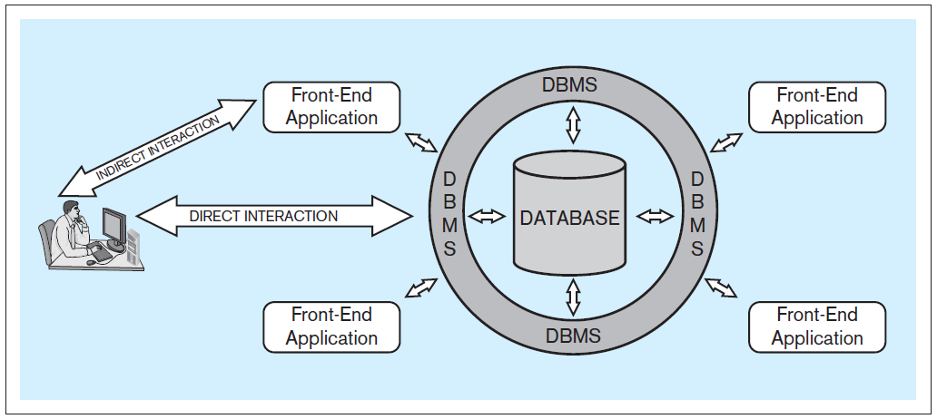
Database System Architecture
Database system: A computer-based system that enables efficient interaction between users and information stored in a database.
Database Systems
by Jukić, Vrbsky, & Nestorov
Pearson 2014
ISBN 978-0-13-257567-6

Slide 22
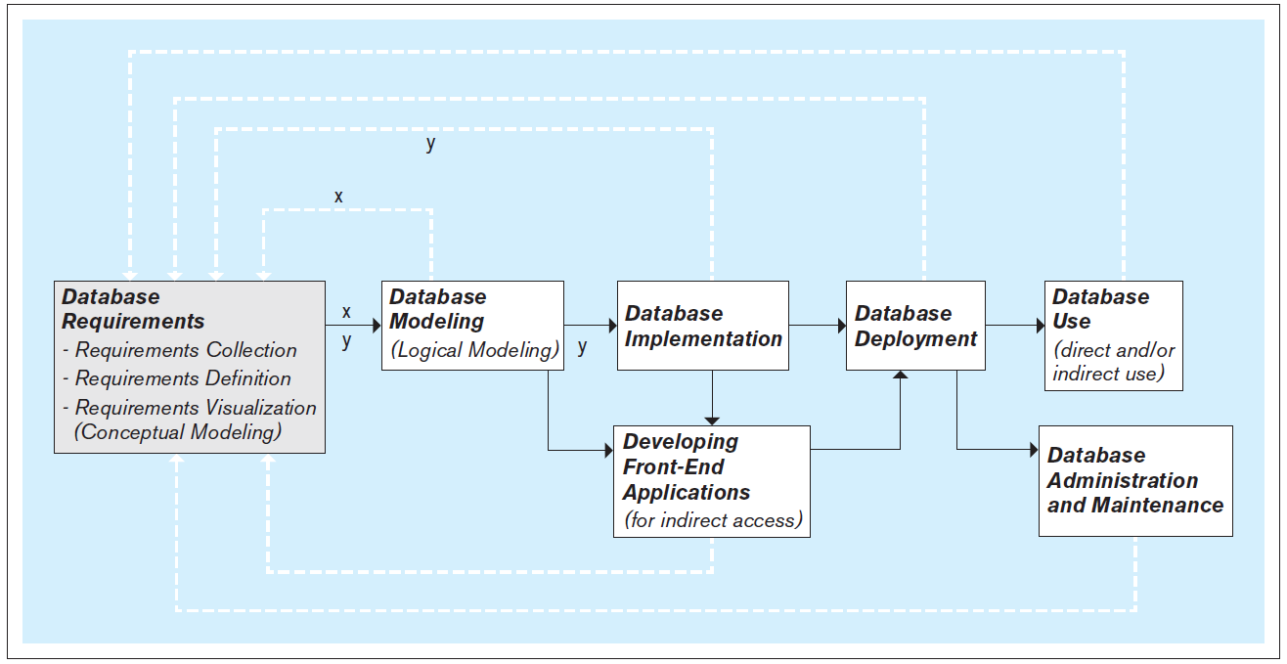
Steps to Develop a Database
It’s an iterative process!
Database Systems
by Jukić, Vrbsky, & Nestorov
Pearson 2014
ISBN 978-0-13-257567-6

Slide 23
Database Requirements
First and most critical step: Collect, define, and visualize the requirements.
What data will the database hold and how?
What will be the capabilities and functionalities of the database?
Reliability, performance, and security issues?
Use the requirements to create data models.
Use the models to implement the database and to create the front-end applications.

Slide 24
Data Models
A data model is a diagram that shows
What data an application works with
How the data is used
Attributes and constraints of the data
The relationships among the data
Create models of data that will be persisted.
Written to and read from a data repository.

Slide 25
Data Models, cont’d
We can model data at three abstraction levels:
conceptual
logical
physical

Slide 26
Conceptual Database Model
Visualize the requirements.
Use a conceptual data modeling technique.
Example: Entity-relationship (ER) modeling
Implementation independent: No dependencies on the logic of a particular database management system (DBMS).
Example DBMS: Oracle, MySQL, etc.
Blueprint for the logical model.

Slide 27
Logical Database Model
Create the relational database model.
Later: Non-relational NoSQL models.
It’s usually straightforward to map an ER model to a relational model.

Slide 28
Physical Database Model
The physical model is the actual database implementation.
Use relational DBMS (RDBMS) software.
Later: NoSQL systems
Structured Query Language (SQL) commands to create, delete, modify, and query database structures.

Slide 29
Front-End Application Development
End users generally do not access the database directly.
Front-end applications
Access the database directly.
Provide end users with safe application-oriented interfaces to query and manipulate the data.
Fulfill the end user’s requirements.

Slide 30
Operational vs. Analytical Databases
Operational database
Supports day-to-day operational business needs.
Contains operational (transactional) information.
Example: sales transactions
Analytical database
Supports analytical business tasks.
Contains analytical information.
Examples: usage patterns, sales trends, etc.
Derived from operational information.
Often associated with data warehousing.

