Slide 1
CS 154 Formal Languages and Computability April 26 Class Meeting
Department of Computer Science San Jose State University Spring 2016 Instructor: Ron Mak
www.cs.sjsu.edu/~mak

Slide 2
Review of Grammars We’ve Seen
Regular grammar
Right-linear:
Context-free grammar:
Context-sensitive grammar:
or left-linear:

Slide 3
Unrestricted Grammars
A grammar G = (V, T, S, P) is unrestricted if all its productions are of the form where and .
No conditions on either side of a rule.
Any number of variables and terminals in any order.
Except: Cannot have λ on the left side.

Slide 4
Unrestricted and Recursively Enumerable
An unrestricted grammar defines a procedure to enumerate all the strings of its language L.
First list all strings w in L derived from S in one step:
Then list all strings w in L derived from S in two steps:
etc.
A Turing machine can simulate these derivations.
Therefore, any language generated by an unrestricted grammar is recursively enumerable.

Slide 5
Unrestricted and Recursively Enumerable, cont’d
Conversely, an unrestricted grammar can mimic a Turing machine.
For every recursively enumerable language L, there exists an unrestricted grammar G, such that L = L(G).
Therefore, the family of languages associated with unrestricted grammars is identical to the family of recursively enumerable languages.
A very long discourse
in the textbook followed by Example 11.1.

Slide 6
Context-Sensitive Grammars
A grammar G = (V, T, S, P) is context-sensitive if all its productions are of the form where and .
The grammar is noncontracting.
The length of successive sentential forms can never decrease.

Slide 7
Context-Sensitive Grammars, cont’d
All context-sensitive grammars can be written in the form
You can apply the production only where A is in the context of string x on the left and string y on the right.

Slide 8
Context-Sensitive Grammars, cont’d
Example: In many programming languages, an identifier is parsed as a variable only in the context of its appearance in a type declaration.
Context-sensitive grammars are very difficult for compiler writers to use.
Instead, they use context-free grammars.
Use auxiliary data structures such as symbol tables to record type declarations so that when an identifier is later encountered, parse it without the context.

Slide 9
Context-Sensitive Languages
A language L is context-sensitive if there exists a context-sensitive grammar G such that or .
Include the empty string in the definition of the language (but not in the grammar) so that the family of context-free languages is a subset of the family of context-sensitive languages.

Slide 10
Context-Sensitive Languages and LBA
For every context-sensitive language L not including λ, there exists some linear bounded automaton M such that L = L(M).
If a language L is accepted by some linear bounded automaton M, then there exists a context-sensitive grammar that generates L.

Slide 11
Recursive and Context-Sensitive Languages
Every context-sensitive language is recursive.
But there exists a recursive language that is not context-sensitive.
Therefore, linear bounded automata are less powerful than Turing machines.
LBAs accept only a proper subset of the recursive languages.

Slide 12
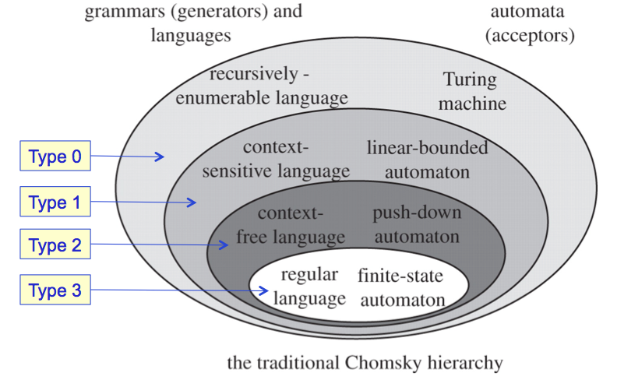
Hierarchy of Languages

Slide 13
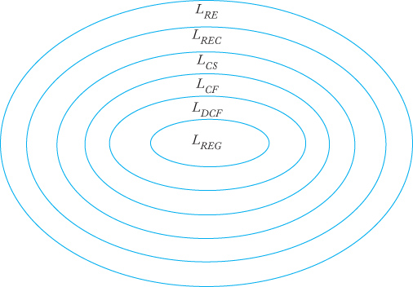
Hierarchy of Languages, cont’d
With the addition of
deterministic context-free languages L_{DCF} and recursive languages L_{REC}.
Formal Languages
and Automata, 5th ed.
Peter Linz
Jones & Bartlett, 2012

Slide 14
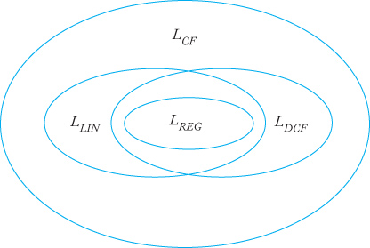
Hierarchy of Languages, cont’d
The complex relationships among
nondeterministic context-free languages L_{CF},
deterministic context-free languages L_{DCF},
linear languages L_{LIN},
and regular languages L_{REG}.
Formal Languages
and Automata, 5th ed.
Peter Linz
Jones & Bartlett, 2012

Slide 15
The Limits of Algorithmic Computation
There are problems for which no algorithms exist to solve.
Example: Determine whether a context-free grammar is ambiguous or unambiguous.
Therefore, there are things that Turing machines cannot do.

Slide 16
Computable Functions
Recall that a function f is computable if there exists a Turing machine that computes the value of f for all arguments in its domain.

Slide 17
Decidable Problems
If the value of function f is always either yes or no, then we can discuss whether the problem is decidable or undecidable.
A problem is decidable if there exists a Turing machine that always gives the correct yes/no answer for every statement in the domain of the problem.

Slide 18
Decidable Problems, cont’d
Example problem statement: If G is some context-free grammar, is it ambiguous?
Domain = the set of all context-free grammars.
This problem is undecidable because there isn’t a Turing machine that can give the correct yes/no answer for every problem statement in the domain.
To determine decidability or undecidability, we must be clear what the problem domain is.

Slide 19
The Halting Problem
Let M be the description of a Turing machine.
Let w be an input string to M.
Suppose M is in its initial configuration q₀w.
Problem: Will M halt or not halt when given w?
Domain: the set of all Turing machines and all strings w.

Slide 20
The Halting Problem, cont’d
Is there a Turing machine that can predict whether or not the computation of M on w will halt?
We cannot use a universal TM M_{u} to simulate the computation of M on input string w.
M might not halt on some particular input string w.
There is no algorithm that can analyze the description of M to determine whether or not M will halt on any input string w.
Therefore, the halting problem is undecidable.

Slide 21
A Proof of the Halting Problem
Assume TM H exists that, given any description of TM M and input w, can predict whether or not M will accept w.
Define a new TM D that, when given input w:
Determines the TM S that w encodes.
Runs H on S and w.
D rejects if H accepts (i.e., H predicts that S will accept w), and D accepts if H rejects (i.e., H predicts that S will reject w).
Now suppose D is given input w that happens to encode D.
D runs H on D and w.
D rejects if H accepts (i.e., H predicts that D will accept w), and D accepts if H rejects (i.e., H predicts that D will reject w).
Contradictions: Therefore, H cannot exist.

Slide 22
Halting Problem and Recursively Enumerable
The halting problem is closely related to the membership problem for recursively enumerable languages.
Recall that a recursively enumerable language is accepted by a Turing machine, but the machine might not halt.

Slide 23
Reducing Undecidable Problems
Problem A is reduced to a problem B if the decidability of A follows from the decidability of B.
Decidability of B → decidability of A
If A is undecidable, then B is also undecidable.

Slide 24
The State-Entry Problem
Let M be a Turing machine and q one of its states.
If M is applied to input string w, is it decidable whether or not state q is ever entered?
Reduce the halting problem to this problem.
Introduce a new state q_{new} so that a transition leading to a final state q_{final} leads to q_{new} instead.
Knowing whether M enters q_{new} on w is equivalent to knowing whether M halts and accepts w.
Which is undecidable.

Slide 25
The Blank-Tape Halting Problem
If M is a Turing machine, can we determine whether or not M will halt on a blank tape?
Construct a new TM M_{w} that starts with a blank tape and writes w on it, and then enters the configuration q₀w.
After that, M_{w} acts like M.
We know whether M_{w} halts on a blank tape if and only if we know whether M halts on w.
Which is undecidable.
The blank-tape halting problem is undecidable.

Slide 26
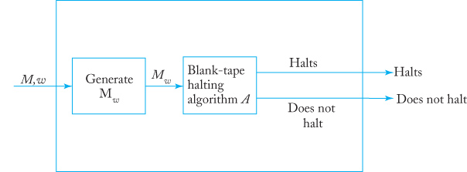
The Blank-Tape Halting Problem, cont’d
First transform (M, w) into M_{w}.
Assume algorithm A exists to solve the blank-tape halting problem.
Together, it’s a solution to the halting problem.
Which doesn’t exist, and so algorithm A cannot exist.

