Slide 1
CS 154 Formal Languages and Computability April 21 Class Meeting
Department of Computer Science San Jose State University Spring 2016 Instructor: Ron Mak
www.cs.sjsu.edu/~mak

Slide 2
Turing Machines are Countable
The set of all Turing machines, though infinite, is countable.
The enumeration procedure:
Encode each Turing machine using 0 and 1.
Generate all strings in {0, 1} in proper order.
Check each generated string to see if it defines a Turing machine.
If yes, write down the string. If not, ignore the string.
Eventually, every Turing machine will be generated.

Slide 3
Recursively Enumerable Languages
A language L is recursively enumerable if there exists a Turing machine that accepts it.
For every string w in L, there exists a Turing machine that will read w and halt in a final state.
What happens if w is not in L is unspecified.
The Turing machine can halt in a nonfinal state.
The Turing machine can go into an infinite loop and never halt.

Slide 4
Recursive Languages
A language L is recursive if there exists a Turing machine that accepts it and the machine will halt on every input string w, whether or not w is in L.

Slide 5
Membership Algorithm
A membership algorithm for a language L determines whether or not a string w is in L.
A Turing machine that accepts a language L does not necessarily represent a membership algorithm for L.
The TM might not halt.
A TM that always halts can represent a membership algorithm for a language L.
Therefore, a language L is recursive if and only if there exists a membership algorithm for it.

Slide 6
Construct an Enumeration Procedure
Let language L over Σ be recursive.
Then there is a TM M that determines membership in L.
Construct another TM that generates all strings in Σ⁺ in proper order: w₁, w₂, …
Make each output string w_{i} from an input to M.
Program M to write w_{i} on its tape only if it is in L.
Therefore, the combination of and M constitute an enumeration procedure for L.

Slide 7
Construct an Enumeration Procedure, cont’d
Let language L be recursively enumerable.
We cannot construct an enumeration procedure the same way as for a recursive language.
If M doesn’t halt on w_{j}, it won’t test subsequent strings.
generates w₁.
M executes the first move on w₁.
generates w₂.
M executes the first move on w₂ and the second move on w₁.

Slide 8
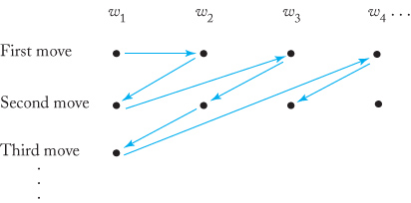
Construct an Enumeration Procedure, cont’d
generates w₃.
M executes the first move on w₃, the second move on w₂, and the third move on w₁.
etc.
M will never get into an infinite loop.
Any w in L is generated by and accepted by M in a finite number of steps.
Every string in L is eventually output by M and is therefore an enumeration procedure for L.

Slide 9
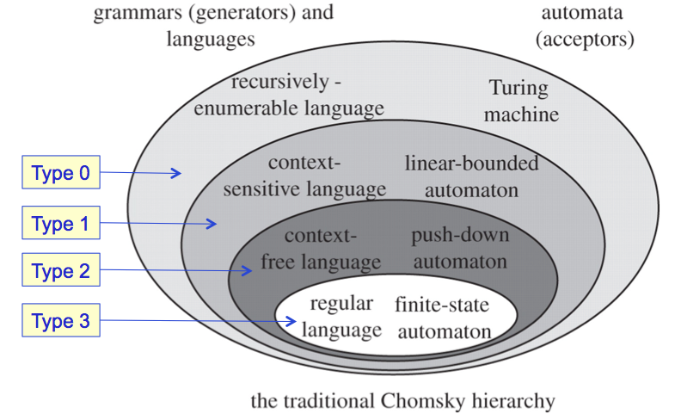
Burning Questions
Are there languages that are recursively enumerable but not recursive?
Are there languages that are not even recursively enumerable?
How would you describe them?

Slide 10
The Powerset 2^{S} is not Countable
Let S be an infinite countable set of elements s₁, s₂, ...
Represent each element of the powerset 2^{S} by a binary string where a 1 is in position i if and only if element s_{i} is in the subset.
Powerset: set of all subsets
Example: Subset {s₂, s₃, s₆} is 01100100…

Slide 11
The Powerset 2^{S} is not Countable, cont’d
Assume that 2^{S} is countable.
Then we can list its elements in some order:
“Flip” each diagonal value.
Then the subset represented by the diagonal values cannot appear anywhere in this list.
Therefore, the powerset is not countable.
1 | 0 | 0 | 0 | 0 | …
1 | 1 | 0 | 0 | 1 | …
0 | 1 | 0 | 1 | 0 | …
0 | 1 | 1 | 1 | 1 | …
… | … | … | … | …
0 | 0 | 0 | 0 | 0 | …
1 | 0 | 0 | 0 | 1 | …
0 | 1 | 1 | 1 | 0 | …
0 | 1 | 1 | 0 | 1 | …
… | … | … | … | …
Cantor diagonalization,
after Georg Cantor,
German mathematician,
1845-1918.

Slide 12
Non-Recursively Enumerable Languages
Let S = Σ*, the infinite set of all strings on Σ.
A language is a subset of S, and so the set of all languages is 2^{S}.
We’ve proven that 2^{S} is not countable.
Every recursively enumerable language is accepted by a Turing machine.
We’ve proven that the set of all TMs is countable.
Therefore, if the set of all languages is not countable, but the set of all recursively enumerable languages is countable, then there must exist some languages on Σ that are not recursively enumerable.

Slide 13
A Non-Recursively Enumerable Language
Let S = the set of all Turing machines M_{i} with the input alphabet Σ = {a}.
The TMs are countable: M₁, M₂, …
Each TM M_{i} corresponds to a recursively enumerable language L(M_{i}).

Slide 14
A Non-Recursively Enumerable Language, cont’d
Define a new language L where string if and only if .
Is L recursively enumerable?
Given a^{i}, count the a’s in order to find TM M_{i}.
Feed the description of M_{i} and string a^{i} to a universial TM M_{u} that simulates the action of M_{i} on a^{i}.
If a^{i} is in L, then M_{u} will eventually halt.
So M_{u} simulating M_{i} is a TM that accepts every .
Therefore, L is recursively enumerable.

Slide 15
A Non-Recursively Enumerable Language, cont’d
Assume that the complement is recursively enumerable.
Then there must be a TM M_{k} such that
Is the string a^{k} in L or ?
Too many contradictions! Therefore, is not recursively enumerable.

Slide 16
A Language L and its Complement
Suppose L and are both recursively enumerable.
Let TM M and be enumeration procedures for L and , respectively.
For any and i = 1, 2, …
Let M generate w_{i} and compare it to w. If unequal,
Let generate and compare it to w.
Eventually, or , and so or .
Therefore, we have a membership algorithm for both, and L and are both recursive.

Slide 17
A Language L and its Complement, cont’d
Suppose L on Σ⁺ is recursive.
Then L has a membership algorithm.
This is also the membership algorithm for if you simply reverse its conclusion.
Therefore, is also recursive.
Since a recursive language is also recursively enumerable, both L and are recursively enumerable.

Slide 18
A Language L and its Complement, cont’d
IF both L and are recursively enumerable, THEN both are also recursive.
IF L is recursive, THEN is also recursive, and both are recursively enumerable.
Consider again language L where string if and only if .
L is recursively enumerable, but is not.
Since p → q implies that !q → !p, we conclude that L is not recursive.
p
q
!q
!p

Slide 19
Recursively Enumerable but Not Recursive
There are recursively enumerable languages that are not recursive.
The family of recursive languages is a proper subset of recursively enumerable languages.
There are well-defined languages for which you cannot construct a membership algorithm.

Slide 20
Assignment #7
Problems involving recursively enumerable and recursive languages.
Due Friday, April 29.

