Slide 1
CS 154 Formal Languages and Computability April 19 Class Meeting
Department of Computer Science San Jose State University Spring 2016 Instructor: Ron Mak
www.cs.sjsu.edu/~mak

Slide 2
Unofficial Field Trip
Computer History Museum in Mt. View
http://www.computerhistory.org/
Provide your own transportation to the museum.
Saturday, May 14, 11:30 – closing time
Special free admission (for my students only).
Experience a fully restored IBM 1401 mainframe computer from the early 1960s in operation.
Do a self-guided tour of the Revolution exhibit.

Slide 3
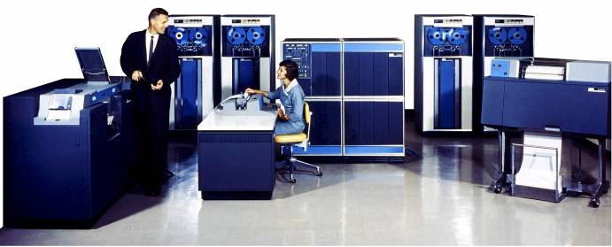
Unofficial Field Trip, cont’d
IBM 1401 computer, fully restored and operational.
A small transistor-based mainframe computer.
Extremely popular with small businesses in the late 1950s through the mid 1960s
Maximum of 16K bytes of memory.
800 card/minute card reader (wire brushes).
600 line/minute line printer (impact).
6 magnetic tape drives, no disk drives.

Slide 4
Unofficial Field Trip, cont’d
Information on the IBM 1401:
General info: http://en.wikipedia.org/wiki/IBM_1401
My summer seminar: http://www.cs.sjsu.edu/~mak/1401/
Restoration: http://ed-thelen.org/1401Project/1401RestorationPage.html

Slide 5
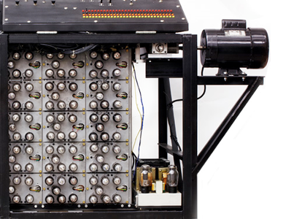
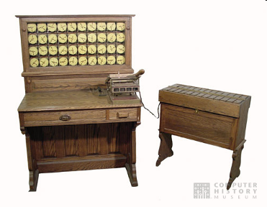
Unofficial Field Trip, cont’d
See the extensive Revolution exhibit!
Walk through a timeline of the First 2000 Years of Computing History.
Historic computer systems, data processing equipment, and other artifacts.
Small theater presentations.
Hollerith
Census
Machine
Atanasoff-Berry
Computer

Slide 6
Unofficial Field Trip, cont’d
There may be extra credit if you participate in the visit to the Computer History Museum.
If I find the time to put together a Canvas quiz.
Correct answers will be found among the museum exhibits and presentations.
You will have to read the exhibit labels, listen to the audio, and watch the videos.
Each correct answer adds one point to your midterm score.

Slide 7
A Universal Turing Machine
A Turing machine is not just a special-purpose computer that, once defined, can carry out only one type of computation.
A Turing machine is equivalent to a modern general-purpose computer.
A universal Turing machine M_{u} is reprogrammable.
An M_{u} takes another TM as input and simulates the other TM.

Slide 8
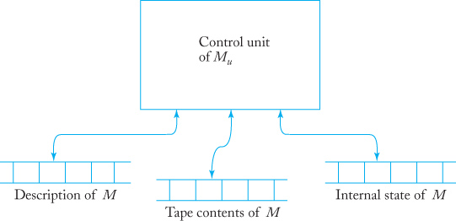
A Universal Turing Machine, cont’d
Given another TM M and an input string w, a universal TM M_{u} can simulate the computation of M on w.
TM M must be properly encoded.
Example: Encode δ(q₁, a₂) = (q₂, a₃, L) as 10110110111010

Slide 9
A Universal Turing Machine, cont’d
Now we can claim the existence of a Turing machine that, given any program, can carry out the computations specified by that program and is therefore a proper model for a general-purpose computer.

Slide 10
Countable Sets
An infinite set is countable if there is a one-to-one correspondence between its elements and the positive integers.
We can list the elements of the set in some order.
Example:
The set of all even integers is countable.
You can write them in the order 0, 2, 4, … and each element 2n corresponds to n+1.

Slide 11
Countable Sets, cont’d
The set of all rational numbers p/q are countable, where p and q are positive integers.
Generates the order:
1 1 | 1 2 | 1 3 | …
2 1 | 2 2 | 2 3 | …
3 1 | 3 2 | 3 3 | …
. : | . : | . :
1 1 | 1 2 | 2 1 | 3 1 | 2 2 | …

Slide 12
Countable Sets, cont’d
A set is countable if we can specify an enumeration procedure by which we can list its elements in some sequence.
An enumeration procedure is a mechanical process that can be carried out by a Turing machine.
A proper order is a sequence of strings from an infinite set where the length of the strings is the first criterion.

Slide 13
Proper Order
Let S be an infinite set of strings over {a, b, c}.
We cannot simply sort the strings alphabetically.
There are an infinite number of a words.
We would never get to the b words.
The proper order uses the string length as the first sorting criterion.
Then the sequence is
Therefore, S is countable.
a, b, c, aa, ab, ac, ba, bb, bc, ca, cb, cc, aaa, …

Slide 14
Turing Machines are Countable
The set of all Turing machines, though infinite, is countable.
The enumeration procedure:
Encode each Turing machine using 0 and 1.
Generate all strings in {0, 1} in proper order.
Check each generated string to see if it defines a Turing machine.
If yes, write down the string. If not, ignore the string.
Eventually, every Turing machine will be generated.

Slide 15
Limited Forms of Turing Machines
We cannot build a more powerful Turing machine, but we can limit its power.
A pushdown automaton is a limited form of Turing machine.
The input tape can only be used as a stack.
A linear bounded automaton (LBA) is another limited form of Turing machine.
The machine can only use the part of the tape occupied by the input.
More space is available for longer input strings.

Slide 16
Linear Bounded Automata
Bracket he input of an LBA with the end marker symbols [ and ].
For input string w, the initial configuration is q₀[w].
The read-write head cannot move to the left of [ or to the right of ].
The head bounces off the end markers.
LBAs are more powerful than pushdown automata.
LBAs can accept languages that are not context-free.

Slide 17
Recursively Enumerable Languages
A language L is recursively enumerable if there exists a Turing machine that accepts it.
For every string w in L, there exists a Turing machine that will read w and halt in a final state.
What happens if w is not in L is unspecified.
The Turing machine can halt in a nonfinal state.
The Turing machine can go into an infinite loop and never halt.

Slide 18
Recursive Languages
A language L is recursive if there exists a Turing machine that accepts it and the machine will halt on every input string w, whether or not w is in L.

