Slide 1
CS 154 Formal Languages and Computability March 1 Class Meeting
Department of Computer Science San Jose State University Spring 2016 Instructor: Ron Mak
www.cs.sjsu.edu/~mak

Slide 2
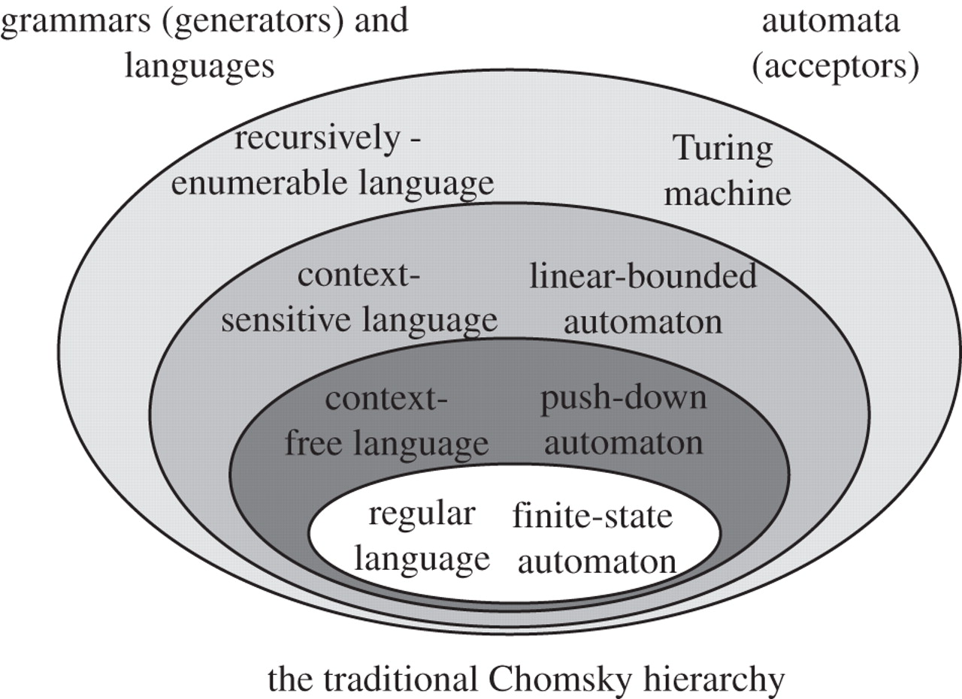
Chomsky Hierarchy of Languages
Type 0
Type 1
Type 2
Type 3
http://rstb.royalsocietypublishing.org/content/367/1598/1933

Slide 3
Context-Free Languages
A grammar G = (V, T, S, P) is context-free if all productions in P have the form where and
It’s context-free because any time the variable on the left of a production appears in a sentential form, you can make the substitution.
A language L is context-free if and only if there is a context-free grammar such that L = L(G).

Slide 4
Context-Sensitive Languages
A grammar G = (V, T, S, P) is context-sensitive if all productions in P have the form where and and
In other words, you can make the substitution in a sentential form only within the context of α and β.

Slide 5
Regular Expressions for Tokens
Regular expressions can define the syntax of the tokens of a programming language.
Tokens are the low-level language elements, such as numbers, strings, and identifiers.
Example: An identifier is a single letter optionally followed by letters and digits.
a
alpha
ab123c
But not: 3abc
[a-z]([a-z]|[0-9])*

Slide 6
Regular Expressions for Tokens, cont’d
An number token can be an unsigned integer constant:
12 123 6789
But not: -12
Or it can be an unsigned real constant:
12.34 12e3 12e+45 0.123e4 123.45e-12
But not: +12.34 12. .34
([0-9])⁺
([0-9])⁺.([0-9])⁺
| ([0-9])⁺(e|E)([0-9])⁺
| ([0-9])⁺(e|E)(+|-)([0-9])⁺
| ([0-9])⁺.([0-9])⁺(e|E)([0-9])⁺
| ([0-9])⁺.([0-9])⁺(e|E)(+|-)([0-9])⁺

Slide 7
Compiler-Compilers
Professional compiler writers generally do not write scanners and parsers from scratch.
A compiler-compiler is a tool for writing compilers.
It can include:
A scanner generator
A parser generator
Parse tree utilities

Slide 8
Compiler-Compilers, cont’d
Feed a compiler-compiler a grammar written in a textual form such as BNF.
The compiler-compiler outputs code written in a high-level language that implements a scanner, parser, and a parse tree.

Slide 9
Scanners and Parsers
A compiler’s scanner reads the source program and breaks it apart into tokens.
AKA lexical analyzer or tokenizer
The parser figures out the structure of the statements and what they mean.
The parser repeatedly calls the scanner to fetch the next token from the source as it analyzes the source program’s statements.

Slide 10
JavaCC Compiler-Compiler
Feed JavaCC the grammar for a source language and it will automatically generate a scanner and a parser.
Specify the source language’s tokens with regular expressions ➔ JavaCC generates a scanner for the source language.
Specify the source language’s productions with BNF ➔ JavaCC generates a parser for the source language.

Slide 11
JavaCC Compiler-Compiler, cont’d
The generated scanner and parser are written in Java.
Note: JavaCC calls the scanner the “tokenizer”.

Slide 12
Download and Install
Download and install JavaCC 6.0 http://javacc.java.net/
Read the JavaCC tutorial
http://www.engr.mun.ca/~theo/JavaCC-Tutorial/javacc-tutorial.pdf
Other tutorials that may be helpful:
http://www.ibm.com/developerworks/data/library/techarticle/dm-0401brereton/index.html
http://www.ibm.com/developerworks/xml/library/x-javacc1.html

Slide 13
The JavaCC Eclipse Plug-in
How to install the plug-in:
Start Eclipse.
Help ➔ Install New Software ...
Click the Add button
Name: SF Eclipse JavaCC Location: http://eclipse-javacc.sourceforge.net/
Click the OK button.
Select “SF JavaCC Eclipse Plug-in”
Or visit http://sourceforge.net/projects/eclipse-javacc/

Slide 14
JavaCC Regular Expressions
Literals
<HELLO : "hello">
Character classes
<SPACE_OR_COMMA : [" ", ","]>
Character ranges
<LOWER_CASE : ["a"-"z"]>
Alternates
<UPPER_OR_LOWER : ["A"-"Z"] | ["a"-"z"]>
Token
name
Token
string

Slide 15
JavaCC Regular Expressions, cont’d
Negation
<NO_DIGITS : ~["0"-"9"]>
Repetition
<THREE_A : ("a"){3}>
<TWO_TO_FOUR_A : ("a"){2,4}>
Quantifiers
<ONE_OR_MORE_A : ("a")+>
<ZERO_OR_ONE_SIGN : (["+","-"])?>
<ZERO_OR_MORE_DIGITS : (["0"-"9"])*>

Slide 16
Example: helloworld1.jj
options {
BUILD_PARSER=false;
}
PARSER_BEGIN(HelloWorld)
public class HelloWorld {}
PARSER_END(HelloWorld)
TOKEN_MGR_DECLS : {
public static void main(String[] args)
{
java.io.StringReader sr = new java.io.StringReader(args[0]);
SimpleCharStream scs = new SimpleCharStream(sr);
HelloWorldTokenManager mgr = new HelloWorldTokenManager(scs);
for (Token t = mgr.getNextToken(); t.kind != EOF; t = mgr.getNextToken()) {
debugStream.println("Found token: " + t.image);
}
}
}
TOKEN : {
<HELLO : "hello">
| <WORLD : "world">
}
Recognize tokens “hello” and “world”.
Main Java method of the tokenizer
Literals
Demo

Slide 17
Example: helloworld2.jj
options {
BUILD_PARSER=false;
IGNORE_CASE=true;
}
PARSER_BEGIN(HelloWorld)
public class HelloWorld {}
PARSER_END(HelloWorld)
TOKEN_MGR_DECLS : {
public static void main(String[] args)
{
java.io.StringReader sr = new java.io.StringReader(args[0]);
SimpleCharStream scs = new SimpleCharStream(sr);
HelloWorldTokenManager mgr = new HelloWorldTokenManager(scs);
while (mgr.getNextToken().kind != EOF) {}
}
}
SKIP : {
<IGNORE : [" ", ","]>
}
TOKEN : {
<HELLO : "hello">
{ debugStream.println("HELLO token: " + matchedToken.image); }
| <WORLD : "world">
{ debugStream.println("WORLD token: " + matchedToken.image); }
}
Recognize tokens “hello” and “world”
Ignore case.
Ignore spaces and commas between tokens.
Use lexical actions.
Character class
Demo
Lexical
actions

Slide 18
Example: helloworld3.jj
options {
BUILD_PARSER=false;
IGNORE_CASE=true;
}
PARSER_BEGIN(HelloWorld)
public class HelloWorld {}
PARSER_END(HelloWorld)
TOKEN_MGR_DECLS : {
public static void main(String[] args)
{
...
}
}
SKIP : {
<IGNORE : [" ", ","]>
}
TOKEN : {
<HELLO : "hello">
{ debugStream.println("HELLO token: " + matchedToken.image); }
| <WORLD : "world">
{ debugStream.println("WORLD token: " + matchedToken.image); }
| <IDENTIFIER : ["a"-"z"](["a"-"z", "0"-"9", "_"])*>
{ debugStream.println("IDENTIFIER token: " + matchedToken.image); }
}
Recognize words other than “hello” and “world” as identifiers.
Why aren’t “hello” and “world”
recognized as identifiers?
Demo

Slide 19
Example: helloworld4.jj
options {
BUILD_PARSER=false;
IGNORE_CASE=true;
}
PARSER_BEGIN(HelloWorld)
public class HelloWorld {}
PARSER_END(HelloWorld)
TOKEN_MGR_DECLS : {
public static void main(String[] args)
{
...
}
}
SKIP : {
<IGNORE : [" ", ","]>
}
TOKEN : {
<HELLO : "hello">
{ debugStream.println("HELLO token: " + matchedToken.image); }
| <WORLD : "world">
{ debugStream.println("WORLD token: " + matchedToken.image); }
| <IDENTIFIER : <LETTER> (<LETTER> | <DIGIT> | "_")*>
{ debugStream.println("IDENTIFIER token: " + matchedToken.image); }
| <#DIGIT : ["0"-"9"]>
| <#LETTER : ["a"-"z"]>
}
Use private tokens DIGIT and LETTER.
Demo
Private tokens

Slide 20
Example: helloworld5.jj
options {
BUILD_PARSER=false;
IGNORE_CASE=true;
DEBUG_TOKEN_MANAGER=true;
}
PARSER_BEGIN(HelloWorld)
public class HelloWorld {}
PARSER_END(HelloWorld)
TOKEN_MGR_DECLS : {
public static void main(String[] args)
{
...
}
}
SKIP : {
<IGNORE : [" ", ","]>
}
TOKEN : {
<HELLO : "hello">
{ debugStream.println("HELLO token: " + matchedToken.image); }
| <WORLD : "world">
{ debugStream.println("WORLD token: " + matchedToken.image); }
| <IDENTIFIER : <LETTER> (<LETTER> | <DIGIT> | "_")*>
{ debugStream.println("IDENTIFIER token: " + matchedToken.image); }
| <#DIGIT : ["0"-"9"]>
| <#LETTER : ["a"-"z"]>
}
What’s the tokenizer doing?
Turn on debugging output.
Demo

Slide 21
Example: numbers.jj
Integer constant:
Real constant:
([0-9])⁺
([0-9])⁺.([0-9])⁺ | ([0-9])⁺(e|E)([0-9])⁺ | ([0-9])⁺(e|E)(+|-)([0-9])⁺ | ([0-9])⁺.([0-9])⁺(e|E)([0-9])⁺ | ([0-9])⁺.([0-9])⁺(e|E)(+|-)([0-9])⁺
TOKEN : {
<INTEGER : (<DIGIT>)+>
| <REAL1 : (<DIGIT>)+ "." (<DIGIT>)+>
| <REAL2 : (<DIGIT>)+ <E> (<SIGN>)? (<DIGIT>)+>
| <REAL3 : (<DIGIT>)+ "." (<DIGIT>)+ <E> (<SIGN>)? (<DIGIT>)+>
| <#DIGIT : ["0"-"9"]>
| <#SIGN : ["+","-"]>
| <#E : ["e","E"]>
}
Demo

Slide 22
S-Grammar
A simple grammar or s-grammar is a context-free grammar where all its productions are of the form where , and and any pair (A, a) occurs at most once.
Example s-grammar:
Example non-s-grammar:

Slide 23
Programming Languages
Many features of common programming languages are defined by s-grammars.
Write the productions of an s-grammar in BNF.

Slide 24
BNF for Statement Syntax
BNF for the syntax of some Java-like statements:
These productions say nothing about data types, such as the if and while expressions must be type boolean.
<stmt> ::= <assign_stmt> | <while_stmt> | <if_stmt>
<assign_stmt> ::= <variable> = <expr>
<while_stmt> ::= while ( <expr> ) <stmt>
<if_stmt> ::= if ( <expr> ) <stmt> | if ( <expr> ) <stmt> else <stmt>

