Slide 1
CS 154 Formal Languages and Computability February 25 Class Meeting
Department of Computer Science San Jose State University Spring 2016 Instructor: Ron Mak
www.cs.sjsu.edu/~mak

Slide 2
The Pumping Lemma for Regular Languages
Discovered by Yehoshua Bar-Hillel, Micha A. Perles, and Eliahu Shamir in 1961.
It’s a theorem but called a lemma because it’s used as a tool to prove other results.

Slide 3
The Pumping Lemma for RLs, cont’d
Every regular language has some repetitiveness.
If a transition graph has n vertices, then any walk of length n or longer must repeat some vertex. (It must contain a cycle.)
Let L be an infinite regular language.
Every sufficiently long string w in L can be broken into three parts, w = xyz, such that an arbitrary number of repetitions of the middle part y yields another string in L.
The middle part is pumped.

Slide 4
The Pumping Lemma for RLs, cont’d
Let L be an infinite regular language.
Then there exists a positive integer m such that for any w = xyz in L with |w| ≥ m such that
|xy| ≤ m
|y| ≥ 1
w_{i} = xy^{i}z is also in L for all i = 0, 1, 2, …
In particular, when i = 0, the string xz is in L
y
x
z

Slide 5
The Pumping Lemma for RLs, cont’d
The pumping lemma can be used to prove that a given language L is not regular.
It’s always a proof by contradiction.
Good online tutorial video: https://www.youtube.com/watch?v=g4e2RElzCSQ

Slide 6
Example Proof Using the Pumping Lemma
Prove that L = {a^{n}b^{n} : n ≥ 0} is not regular.
Assume L is regular, and so the pumping lemma must be true for L.
Recall that w = xyz with |xy| ≤ m for some positive m and |y| ≥ 1.
The string w = xyz = a^{m}b^{m} is in L
Therefore, y is composed entirely of a’s.
But then the string xz can’t be in L, because it will have fewer a’s than b’s.
Therefore, the pumping lemma must not be true for L, and so L cannot be regular.
We don’t know what the value of m is, but
it must exist if L is regular.
A finite state machine cannot remember the number a’s!

Slide 7
The Pumping Lemma is not Easy to Use!
If L is a regular language, then for any string w in L,
there exists some positive integer m with |w| ≥ m,
w = xyz and |xy| ≤ m, and |y| ≥ 1 such that
w_{i} = xy^{i}z is also in L for all i = 0, 1, 2, …
For a regular language L, we know that m and the decomposition w = xyz exist subject to the constraints, but we don’t know what they are.
But if we can find just a single w or a single value of i where w = xy^{i}z is not in L, then we’ve proven that L is not regular.

Slide 8
Another Pumping Lemma Proof
Prove that L = {a^{p}: p is prime} is not regular.
Assume L is regular.
Let w = xyz = a^{p}, where |w| ≥ m, |xy| ≤ m, |y| ≥ 1.
y must be all a’s. Let y = a^{m} and let i = p + 1.
Then
And so xy^{i}z is not in L, a contradiction.
Therefore, L cannot be regular.
|xy^{i}z| must be prime for
all values of i.
since xyz = a^{p} and y = a^{m}
since i = p + 1
which is not a prime number

Slide 9
Assignment #3
Problem Set B, mostly about the pumping lemma.
Due Wednesday, March 2.

Slide 10
Not All Languages are Regular
For example, we used the pumping lemma to prove that some languages are not regular.

Slide 11
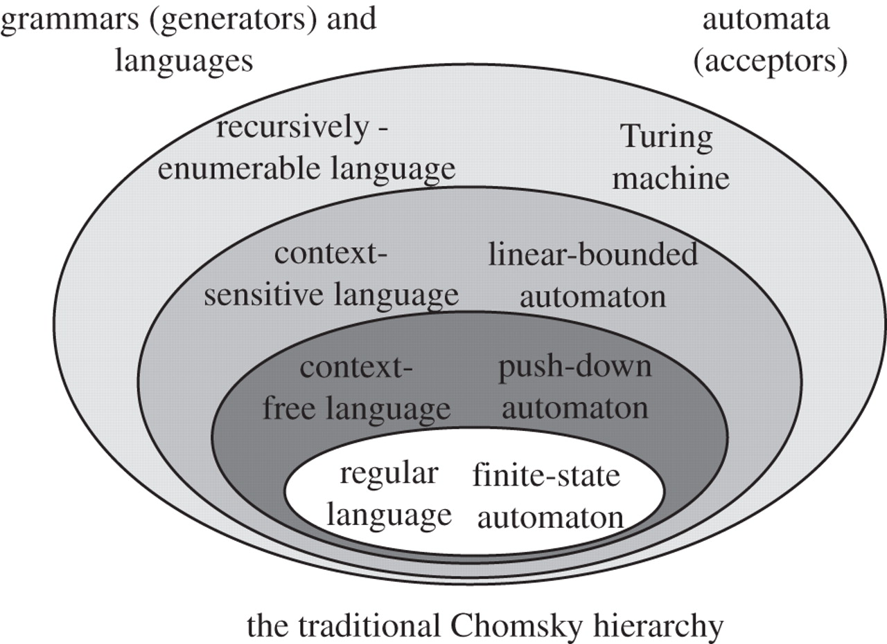
Chomsky Hierarchy of Languages
http://rstb.royalsocietypublishing.org/content/367/1598/1933

Slide 12
Regular Grammars
Recall that a regular grammar has an important restriction. It must be either:
Right linear with productions
Left linear with productions

Slide 13
Context-Free Languages
A context-free grammar G = (V, T, S, P) has a more relaxed grammar than a regular grammar.
All productions in P have the form where and
A language L is context-free if and only if there is a context-free grammar such that L = L(G).

Slide 14
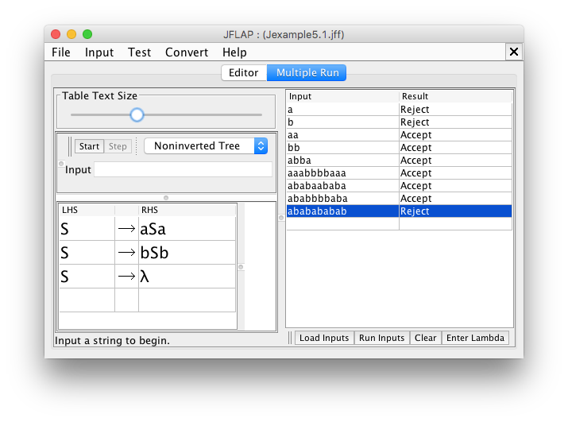
Context-Free Grammar Example #1
Example 5.1

Slide 15
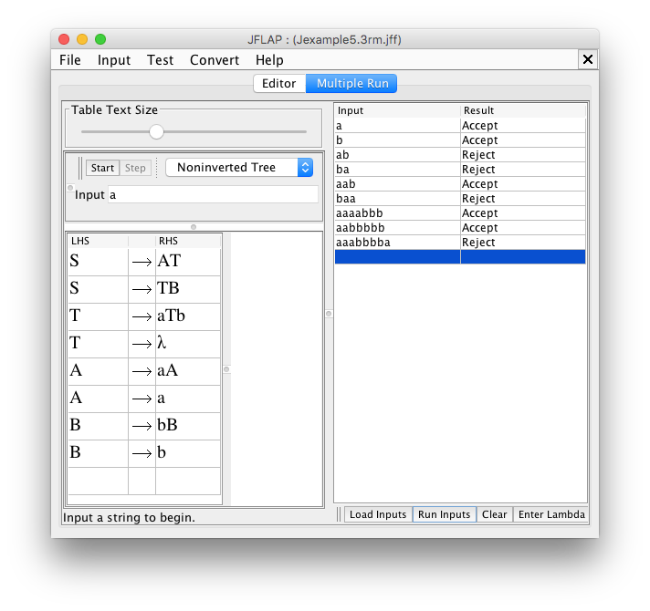
Context-Free Grammar Example #2
Example 5.3

Slide 16
Leftmost and Rightmost Derivations
Let G = ({A, B, S}, {a, b}, S, P) with productions
Two derivations of the string abb:
Leftmost:
Rightmost:
Every w in L(G) has both a leftmost and a rightmost derivation.
S → aAB
A → bBb
B → A | λ
S ⇒ aAB ⇒ abBbB ⇒ abbB ⇒ abb
S ⇒ aAB ⇒ aA ⇒ abBb ⇒ abb

Slide 17
An Expression Grammar
Suppose we have a context-free grammar G for simple arithmetic expressions.
Given a string w, can we determine whether or not it is in L(G)?
Is the expression a syntactically correct arithmetic expression?
We parse w in order to find a sequence of productions to determine whether w is in L(G).
In a compiler, that’s the job of the parser.

Slide 18
An Expression Grammar, cont’d
<expr> ::= <digit>
| <expr> <op> <expr>
| ( <expr> )
<digit> ::= 0|1|2|3|4|5|6|7|8|9
<op> ::= + | *
This grammar is written in Backus-Naur Form (BNF) that compiler writers use.
Nonterminals are enclosed in < and >
The symbol ::= represents →

Slide 19
An Expression Grammar, cont’d
Is (1 + 2)*3 valid in our expression language?
DERIVATION
PRODUCTION
<expr> ⇒ <expr> <op> <expr>
<expr> ::= <expr> <op> <expr>
⇒ <expr> <op> <digit>
<expr> ::= <digit>
⇒ <expr> <op> 3
<digit> ::= 3
⇒ <expr>*3
<op> ::= *
⇒ ( <expr> )*3
<expr> ::= ( <expr> )
⇒ ( <expr> <op> <expr> )*3
<expr> ::= <expr> <op> <expr>
⇒ ( <expr> <op> <digit> )*3
<expr> ::= <digit>
⇒ ( <exp> <op> 2 )*3
<digit> ::= 2
⇒ ( <expr> + 2 )*3
A rightmost
derivation
<op> ::= +
⇒ ( <digit> + 2 )*3
<expr> ::= <digit>
⇒ ( 1 + 2 )*3
<digit> ::= 1
Yes! The expression is valid. It’s syntactically correct.
<expr> ::= <digit> | <expr> <op> <expr> | ( <expr> ) <digit> ::= 0|1|2|3|4|5|6|7|8|9 <op> ::= + | *

Slide 20
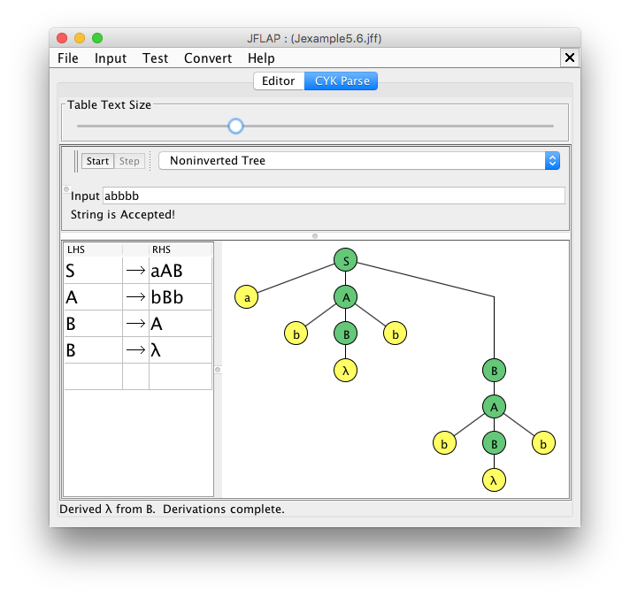
Derivation Trees
AKA parse tree
A derivation tree yields a sentence of the grammar.
Example: abbbb

Slide 21
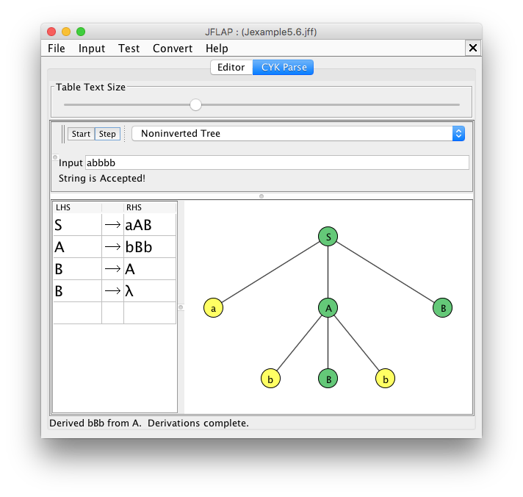
Partial Derivation Trees
It’s a partial derivation tree if not all the leaf nodes are terminal symbols.
A partial derivation tree yields a sentential form of the grammar.
Example: abBbB

Slide 22
Derivation Trees, cont’d
A derivation tree shows which productions are used in deriving a sentence.
But not the application order of the productions.

Slide 23
Ambiguity
Let G = {V, T, E, P) with V = {E, I} and T = {a, b, c, +, *, (, )} and
This grammar is ambiguous.
There are two different derivation trees for the expression a+b*c
E → I
E → E+E
E → E*E
E → (E)
I → a | b | c

Slide 24
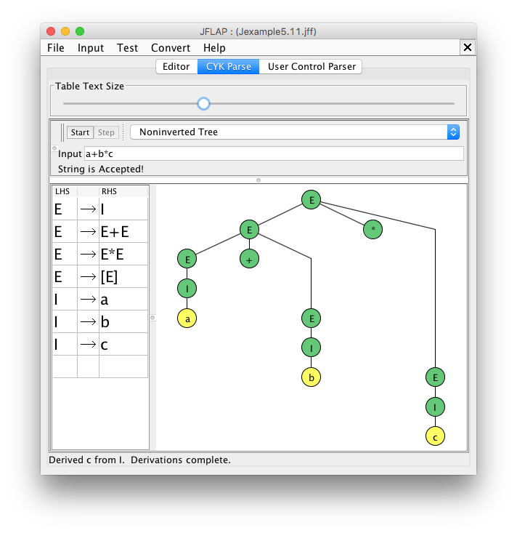
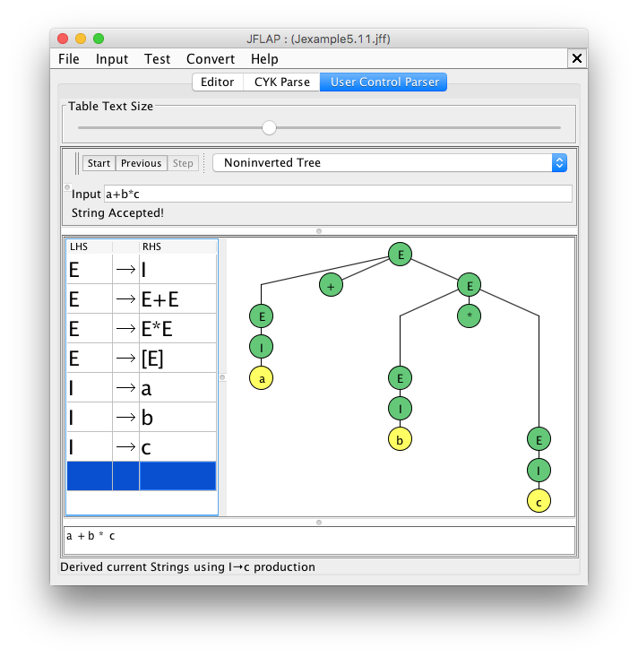
Ambiguity, cont’d
E → I
E → E+E
E → E*E
E → (E)
I → a | b | c

