Slide 1
CS 154 Formal Languages and Computability February 11 Class Meeting
Department of Computer Science San Jose State University Spring 2016 Instructor: Ron Mak
www.cs.sjsu.edu/~mak

Slide 2
JFLAP Manual Derivation
Jexample1.13.jff
Input string aaabbbbaabab
The automatic CYK Parser gets it wrong!
Use the User Control Parser.
JFLAP demo
Jexample1.13.jff

Slide 3
Distinguishable vs. Indistinguishable States
Consider two states p and q of a DFA and all strings w in Σ*.
If there is path from p to a final state implies there is a path from q to a final state, and
If there is no path from p to a final state implies there is no path from q to a final state,
Then states p and q are indistinguishable.
However, if for any one string w there is a path from p to a final state but no path from q to a final state (or vice versa),
Then the states p and q are distinguishable.
Not necessarily
the same final state.

Slide 4
Reducing the Number of States
Given a DFA, how can we simplify it by reducing the number of states?
Of course, we want the simplified DFA to be equivalent to the original one.
One way:
Find and combine indistinguishable states.
Plan:
First eliminate inaccessible states.
Then repeatedly partition the states into equivalence classes of indistinguishable states.

Slide 5
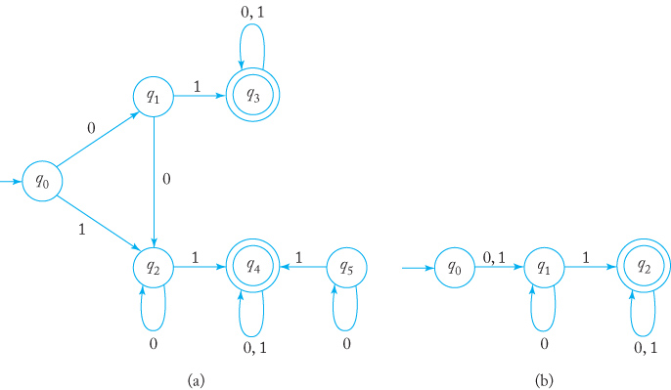
State Reduction Example #1
Remove inaccessible state q5.
Final states q₃ and q₄ are in one equivalence class:
q₀ q₁ q₂ | q₃ q₄
From either q₁ or q₂ , input 1 and input 01 lead to a final state, so they’re together in another equivalence class.
We can’t partition any further, so make new states out of each equivalence class.
q₀ | q₁ q₂ | q₃ q₄
Formal Languages
and Automata, 5th ed.
Peter Linz
Jones & Bartlett, 2012

Slide 6
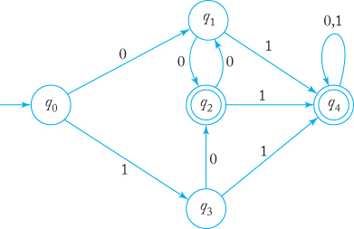
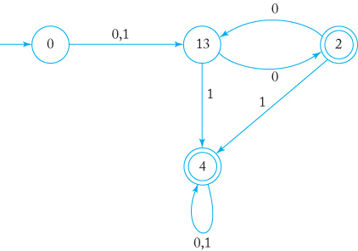
State Reduction Example #2
States q₂ and q₄ are final:
From q₁ and q₃, strings 0 and 1 both lead to final states:
δ(q₄, 0) = q₄ but δ(q₂, 0) = q₁:
No further partitioning is possible.
0 1 3 | 2 4
0 | 1 3 | 2 4
0 | 1 3 | 2 | 4
JFLAP demo
Jexample2.15.jff
Formal Languages
and Automata, 5th ed.
Peter Linz
Jones & Bartlett, 2012

Slide 7
Regular Languages and Automata
A language L is called regular if and only if there exists a finite acceptor M such that L = L(M).
The finite acceptor can be a DFA or an NFA.
Is there a more concise way to describe a regular language?

Slide 8
Regular Expressions
A regular expression consists of strings of symbols from an alphabet Σ, parentheses, and the operators:
+ for union: a + b
• for concatenation: a•b which can also be written ab
* for star-closure: a*
Example: (a + (b•c))* is the star-closure of , which is the language {λ, a, bc, aa, abc, bca, bcbc, aaa, aabc, … }

Slide 9
Regular Expressions, cont’d
Let Σ be an alphabet. Then
The primitive regular expressions are Ø, λ, and .
If r₁ and r₂ are regular expressions, then r₁ + r₂ , r₁•r₂ , r₁*, and (r₁) are also regular expressions.
A string is a regular expression if and only if it can be derived from the primitive regular expressions by a finite number of applications of the rules in (2).

Slide 10
Regular Expression Example
Is (a + b • c)* • (c + ϕ) a regular expression?
Yes, since it is derived from the primitive regular expressions and repeated applications of the rules in (2) on the previous slide.
But (a + b + ) is not.

Slide 11
Regular Expression Languages
We can use a regular expression (RE) r to describe an associated language L(r).
Ø is a RE denoting the empty set.
λ is a RE denoting {λ}.
For every , a is a RE denoting {a}.
If r₁ and r₂ are regular expressions, then
terminating
conditions
recursive definitions

Slide 12
Regular Expression Language Example #1
What language is defined by the RE r = a* • (a + b) ?

Slide 13
Precedence Rules
Consider the RE a • b + c
If it’s (a • b) + c then L(a • b + c ) = {ab, c}.
If it’s a • (b + c) then L(a • b + c ) = {ab, ac}.
To resolve this ambiguity, we use the precedence rules:
star-closure is the highest
concatenation is the next highest
union is the lowest
Therefore, a • b + c is (a • b) + c .

Slide 14
Regular Expression Language Example #2
Let Σ={0, 1}. Find regular expression r such that
RE r must have 00 in it somewhere.
What comes before or after the 00 is arbitrary.
Therefore, r = (0+1)*00(0+1)*
has at least one pair of consecutive zeros}

Slide 15
Regular Expression Language Example #3
Let Σ={0, 1}. Find regular expression r such that
Whenever there’s a 0, it must be followed immediately by a 1.
There may be any number of leading and trailing 1’s.
There can be a 0 at the very end.
Therefore, r = (1*011*)*(0 + λ) + 1*(0 + λ)
has no pair of consecutive zeros}

Slide 16
Regular Expression Language Example #3, cont’d
r = (1*011*)*(0 + λ) + 1*(0 + λ)
Alternate view: The RE r can be a repetition of 1’s and 01’s, with a possible 0 at the end.
Therefore, r = (1 + 01)*(0 + λ)
There is more than one RE for a given language.
Two REs are equivalent if they denote the same language.

Slide 17
Regular Expressions and Regular Languages
Regular expressions and regular languages are the same concept.
For every regular expression r, there is a regular language L = L(r).
The textbook proves this by constructing, for any regular expression r, an NFA that accepts L(r).
Recall that any language accepted by an NFA or a DFA is regular.
Theorem 3.1

Slide 18
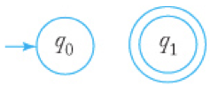
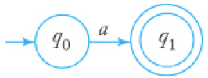
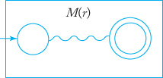
Construct an NFA from a Regular Expression
NFA accepts ϕ
NFA accepts {λ}
NFA accepts {a}
NFA accepts L(r)
Formal Languages
and Automata, 5th ed.
Peter Linz
Jones & Bartlett, 2012

Slide 19
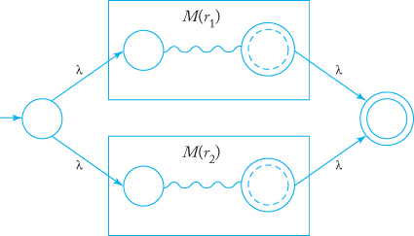
Construct an NFA from an RE, cont’d
NFA accepts L(r₁ + r₂)
NFA accepts L(r₁r₂)
Formal Languages
and Automata, 5th ed.
Peter Linz
Jones & Bartlett, 2012

Slide 20
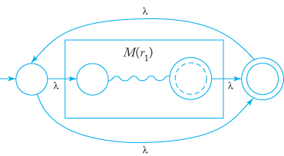
Construct an NFA from an RE, cont’d
NFA accepts L(r*)
Formal Languages
and Automata, 5th ed.
Peter Linz
Jones & Bartlett, 2012

Slide 21
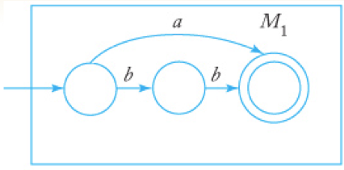
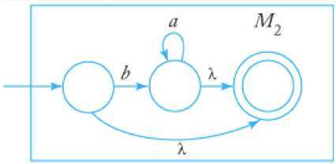
Example: Construct an NFA from an RE
Construct an NFA that accepts L(r), where RE
r = (a + bb)*(ba* + λ)
M₁ accepts
L(a + bb)
M₂ accepts
L(ba* + λ)
Automaton accepts
L((a + bb)*(ba* + λ))
Formal Languages
and Automata, 5th ed.
Peter Linz
Jones & Bartlett, 2012

Slide 22
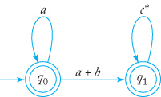
Generalized Transition Graph
Generalized transition graph (GTG): A transition graph where the edges are labeled with regular expressions.
Example:
Formal Languages
and Automata, 5th ed.
Peter Linz
Jones & Bartlett, 2012

Slide 23
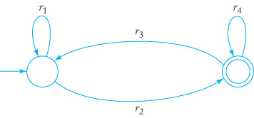
Generalized Transition Graph, cont’d
The canonical form of a two-state GTG:
The RE covers all possible paths and is the graph’s RE.
Formal Languages
and Automata, 5th ed.
Peter Linz
Jones & Bartlett, 2012

Slide 24
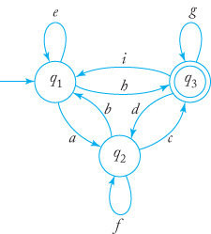
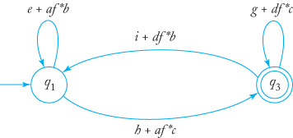
NFA to RE Conversion
Convert the NFA to a GTG.
If the GTG has more than two states, remove the extra states one at a time.
See the procedure in the textbook:
Then apply
Formal Languages
and Automata, 5th ed.
Peter Linz
Jones & Bartlett, 2012

Slide 25
NFA to RE Conversion, cont’d
From an NFA, we can construct a GTG.
Recall that any language accepted by an NFA or a DFA is regular.
From a GTG, we can derive a regular expression.
Therefore, for every regular language L, there is a regular expression r such that L=L(r).
Theorem 3.2

Slide 26
Regular Grammars
A right-linear grammar G = (V,T,S,P) has all its production rules of the form where A and B are in V and x is in T*.
A left-linear grammar has all its production rules of the form
A regular grammar is either right- or left-linear.

Slide 27
Regular Grammars, cont’d
If G is a right-linear grammar, then L(G) is a regular language.
The proof in the textbook involves constructing automata based on the production rules.
If L is a regular language, then there exists a right-linear grammar such that L = L(G).
The language L is regular if and only if there exists a left-linear grammar G such that L = L(G).
Theorem 3.3
Theorem 3.4
Theorem 3.5

Slide 28
Regular Grammars, cont’d
The language L is regular if and only if there exists a regular grammar G such that L = L(G).
Theorem 3.6

Slide 29
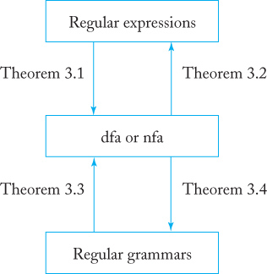
Ways to Describe Regular Languages
Formal Languages
and Automata, 5th ed.
Peter Linz
Jones & Bartlett, 2012

Slide 30
grep and Java’s regex Package
How does grep work?
What happens when you compile a Java regular expression with Pattern.compile()?
Note that regular expressions in Java and grep use | instead of + for the union operation.
Example: (a|b)*abb

Slide 31
grep and Java’s regex Package, cont’d
Given a regular expression such as: (a|b)*abb
Parse the RE.
Construct an NFA for the RE.
Construct a DFA from the NFA.
Minimize the DFA.
Generate a state transition matrix from the minimized DFA.
Use the transition matrix to search for matches.
RE → parse → NFA → DFA → minimized DFA → state transition matrix → search

Slide 32
Midterm Preparation
Understand
proof by induction
language and language rules
grammar: production rules, derivations
deterministic and nondeterministic acceptors
state transition graphs, state transition matrices
applications for string pattern matching
NFA to DFA conversions, reducing DFA states
regular expressions and regular languages

Slide 33
Midterm Preparation, cont’d
Look over the textbook’s exercises
especially the ones with answers in the back
Chapters 1, 2, and 3
Know how to use JFLAP
automata and grammars
Do a manual derivation.

