Slide 1
CS 154 Formal Languages and Computability February 11 Class Meeting
Department of Computer Science San Jose State University Spring 2016 Instructor: Ron Mak
www.cs.sjsu.edu/~mak

Slide 2
Corrected DFA Example #1
1
Starts and ends
with 0
p_{o}
p₁
1
0
0
0
S
1
0
1
q_{o}
q₁
0
Starts and ends
with 1
1

Slide 3
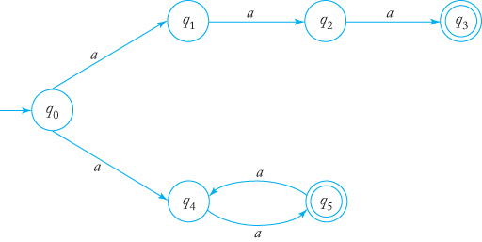
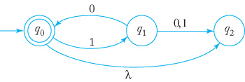
Corrected Feb. 9 Slide 16
Accept either the string aaa
or a string with an
even number of a’s.
(Simpler than the equivalent DFA.)
It should be 10,
not 01.
The string 10 has two walks,
one to q₀ and one to q₂.
The string is accepted because
q₀ is a final state.
Formal Languages
and Automata, 5th ed.
Peter Linz
Jones & Bartlett, 2012

Slide 4
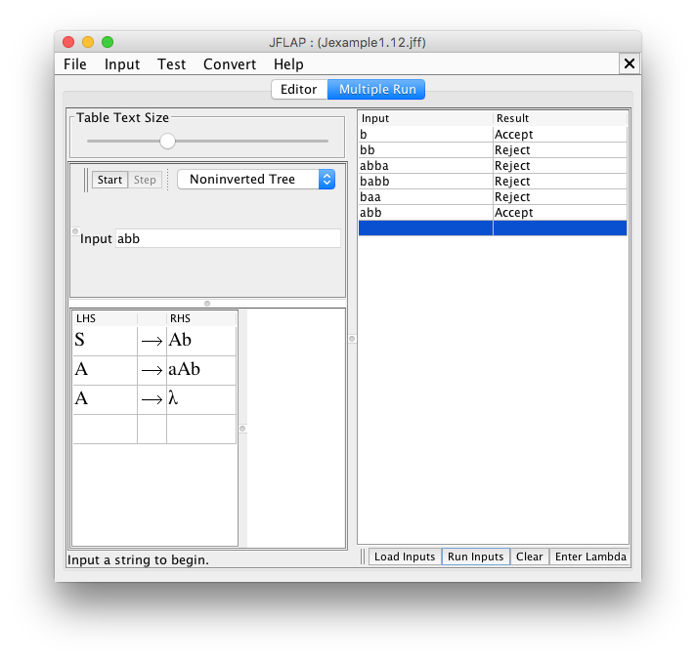
Assignment #1: Problem 1

Slide 5
Assignment #1: Problem 2
The language consists of the strings
that are n a’s followed by n b’s, n > 0,
or the concatenation of two such strings
as substrings. The number of a’s and b’s
in the first substring is independent of
the number of a’s and b’s in the second
substring.

Slide 6
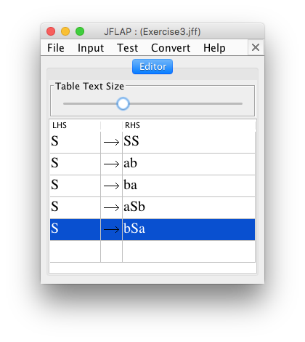
Assignment #1: Problem 3

Slide 7
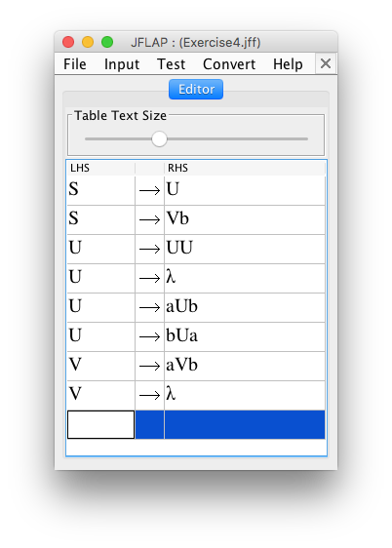
Assignment #1: Problem 4

Slide 8
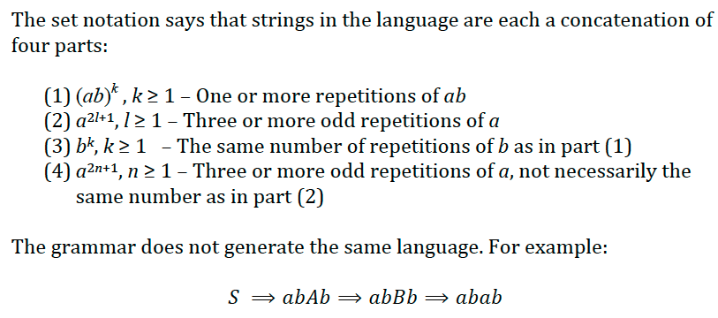
Assignment #1: Problem 5

Slide 9
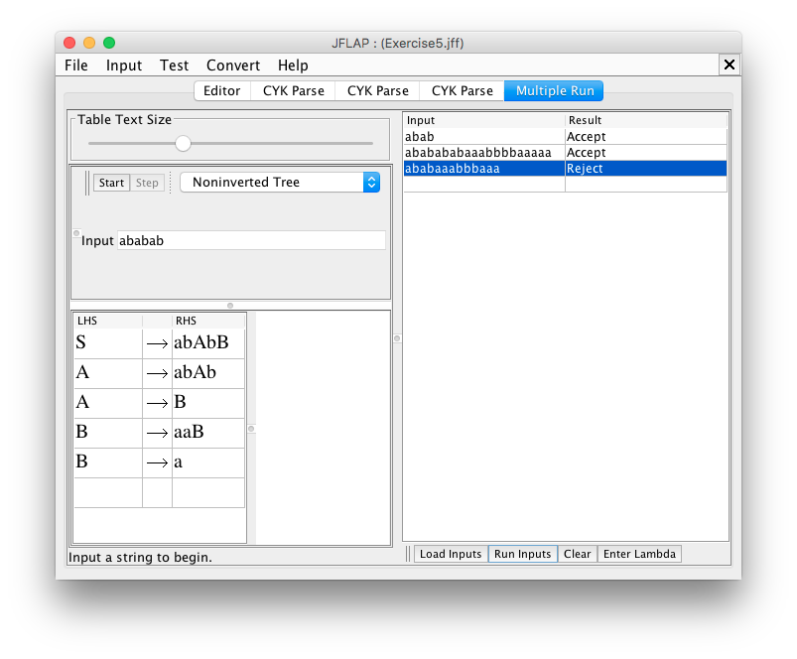
Assignment #1: Problem 5, cont’d

Slide 10
Assignment #1: Problem 6

Slide 11
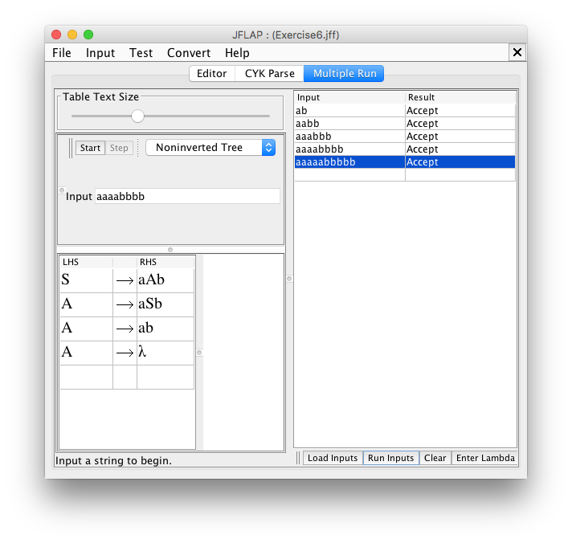
Assignment #1: Problem 6, cont’d

Slide 12
Assignment #1: Problem 7
The Exercise 7 grammar is not equivalent to the Exercise 2 grammar. For example, the following strings are accepted by the latter but not the former:
abaabb
aabbab
abaabb
These strings require the production rule S→SS.
It is incorrect to replace the rule S→aSbaSb with S→SS in the Exercise 7 grammar.
S→aSb does not imply that aSb→S.

Slide 13
Are NFAs More Powerful Than DFAs?
Can NFAs in general accept more languages than DFAs?
A DFA is a restricted kind of NFA.
Therefore, any language accepted by a DFA is also accepted by some NFA.

Slide 14
Are NFAs More Powerful Than DFAs? cont’d
Is there a language accepted by an NFA that cannot be accepted by a DFA?
No: DFAs and NFAs are equally powerful.
For every language accepted by some NFA, there is a DFA that accepts the same language.
Therefore, any language accepted by an NFA is regular.
We can convert any NFA into an equivalent DFA.

Slide 15
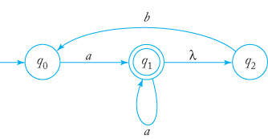
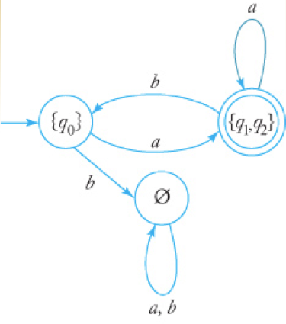
NFA to DFA Conversion Example
NFA | DFA
combined
state
Each state of the DFA must have
a transition on each symbol.
Refer back to the NFA to derive
the transition.
Label the states of the new DFA
after the set of states that the NFA
can be in after each transition.
Formal Languages
and Automata, 5th ed.
Peter Linz
Jones & Bartlett, 2012

Slide 16
Why Convert an NFA to a DFA?
An NFA may be easier to construct.
But an NFA is usually not efficient to run.
An NFA may have multiple paths to try for a given input string.
A DFA follows only one path for a given input string.

Slide 17
NFA to DFA Conversion Algorithm
Label each DFA state by a set of combined NFA states.
Label the DFA start state {q₀}, where q₀ is the NFA start state.
Include any NFA state reachable by λ-transitions from the start state.
For each DFA state that is missing a transition, compute the transition by combining the NFA transitions for each input symbol.
Include any NFA state reachable by λ-transitions after the destination state.
Make any DFA state a final state if it combines any NFA state that was final.
JFLAP demo

Slide 18
Equivalent DFAs
A DFA defines a unique language.
But a given language can have many DFAs that define it.
Two DFAs can be equivalent and yet have a different number of states.
Equivalent DFAs define the same language.

Slide 19
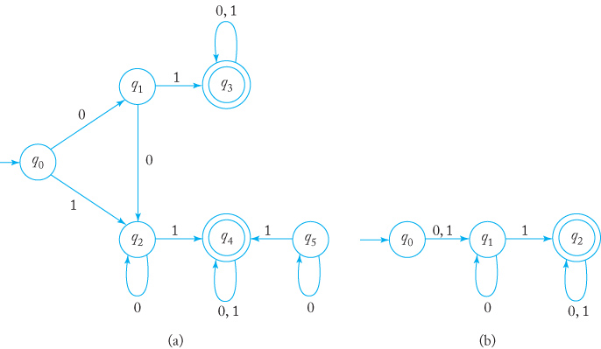
Equivalent DFAs, cont’d
These two DFAs are equivalent:
For most practical purposes, the
DFA with fewer states is desired.
Formal Languages
and Automata, 5th ed.
Peter Linz
Jones & Bartlett, 2012

Slide 20
Distinguishable vs. Indistinguishable States
Consider two states p and q of a DFA and all strings w in Σ*.
If there is path from p to a final state implies there is a path from q to a final state, and
If there is no path from p to a final state implies there is no path from q to a final state,
Then states p and q are indistinguishable.
However, if for any one string w there is a path from p to a final state but no path from q to a final state (or vice versa),
Then the states p and q are distinguishable.
Not necessarily
the same final state.

Slide 21
Reducing the Number of States
Given a DFA, how can we simplify it by reducing the number of states?
Of course, we want the simplified DFA to be equivalent to the original one.
One way:
Find and combine indistinguishable states.
Plan:
First eliminate inaccessible states.
Then repeatedly partition the states into equivalence classes of indistinguishable states.

Slide 22
State Reduction Example #1
Remove inaccessible state q5.
Final states q₃ and q₄ are in one equivalence class:
q₀ q₁ q₂ | q₃ q₄
From either q₁ or q₂ , input 1 and input 01 lead to a final state, so they’re together in another equivalence class.
We can’t partition any further, so make new states out of each equivalence class.
q₀ | q₁ q₂ | q₃ q₄
Formal Languages
and Automata, 5th ed.
Peter Linz
Jones & Bartlett, 2012

Slide 23
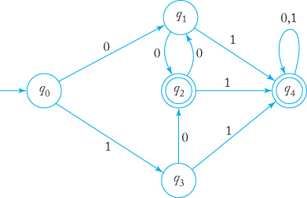
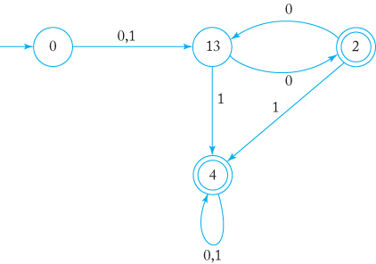
State Reduction Example #2
States q₂ and q₄ are final:
From q₁ and q₃, strings 0 and 1 both lead to final states:
δ(q₄, 0) = q₄ but δ(q₂, 0) = q₁:
No further partitioning is possible.
0 1 3 | 2 4
0 | 1 3 | 2 4
0 | 1 3 | 2 | 4
JFLAP demo
Formal Languages
and Automata, 5th ed.
Peter Linz
Jones & Bartlett, 2012

