Slide 1
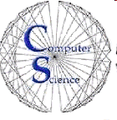
CS 154 Formal Languages and Computability February 9 Class Meeting
Department of Computer Science San Jose State University Spring 2016 Instructor: Ron Mak
www.cs.sjsu.edu/~mak

Slide 2
Review: Automata
An automaton is an abstract model of a digital computer.
An automaton can have:
the ability to read symbols from an input file
the ability to product output
a limited amount of temporary storage
a control unit that can be in one state or another

Slide 3
Deterministic Finite Acceptor (DFA)
An acceptor is an automaton that either accepts or rejects input strings.
A deterministic finite acceptor (DFA) is an acceptor that has no temporary storage.
It only has internal states in its control unit.
Each input symbol uniquely determines a DFA’s move from one state to another according to its transition function.

Slide 4
Languages and DFAs
The set of all strings that the DFA accepts constitutes the language
The DFA represents the language’s rules.

Slide 5
DFA and Associated Transition Graph
If we have a DFA and its associated transition graph G_{M}, can we treat them both equally?
Theorem 2.1 of the textbook basically says yes.
For every q_{i}, q_{j} in Q, and w in Σ⁺ :
if and only if there is a path labeled w in G_{M} from q_{i} to q_{j}.
Proof by induction on the length of w.

Slide 6
DFA Example #1
Create a DFA that accepts all strings on {0, 1} that begin and end with the same symbol.
How can an automaton remember what was the beginning symbol of a string?
Have a different set of states depending on the first symbol!

Slide 7
DFA Example #1, cont’d
1
Starts and ends
with 0
p_{o}
p₁
1
0
0
0
S
1
0
1
q_{o}
q₁
0
Starts and ends
with 1
1

Slide 8
DFA Example #2
Create a DFA that accepts all strings on {0, 1} that do not contain the substring 001.
The basic idea is that if the automaton ever reads 001, it should be in a nonfinal state.
Actually, that state should be a trap.
How can the automaton remember the previous two symbols whenever it reads a 1?

Slide 9
DFA Example #2, cont’d
Again, we must accomplish this with states:
A state for having read a 0.
A state for having read 00.
A state for having read 001.
We can label the states accordingly.
Formal Languages
and Automata, 5th ed.
Peter Linz
Jones & Bartlett, 2012

Slide 10
Regular Languages
A language L is called regular if and only if there exists a DFA M such that L = L(M).
Therefore, to show that a language is regular, all we have to do is find a DFA for it.

Slide 11
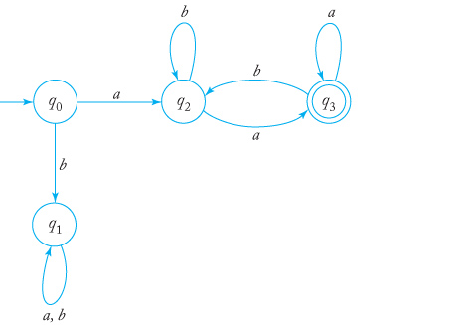
Regular Language Example #1
Is the language regular?
It is if we can find a DFA for it.
After having read the leading a,
we don’t know if a subsequent a
is the last symbol of the string.
So we can actually leave the
final state and later return to it.
Formal Languages
and Automata, 5th ed.
Peter Linz
Jones & Bartlett, 2012

Slide 12
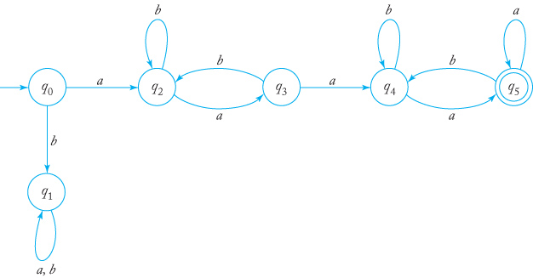
Regular Language Example #2
What about ?
And so L² is also regular.
Formal Languages
and Automata, 5th ed.
Peter Linz
Jones & Bartlett, 2012

Slide 13
Nondeterministic Finite Acceptors (NFA)
Given an input symbol, a nondeterministic finite acceptor (NFA) has a choice of moves.
An NFA’s transition function can take it to any one state from a set of states: where

Slide 14
Nondeterministic Finite Acceptors, cont’d
A transition moves to a subset of states (not to a unique state as in a DFA).
2^{Q} is the powerset of Q.
The set of all subsets of Q.
The second argument of δ can also be λ.
We can make a transition without consuming an input symbol.

Slide 15
Example NFAs

Slide 16
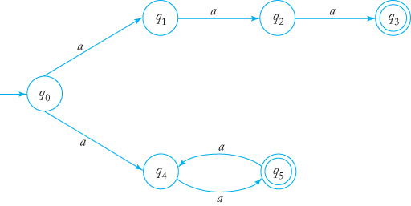
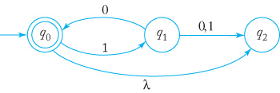
Example NFAs, cont’d
Accept either the string aaa
or a string with an
even number of a’s.
(Simpler than the equivalent DFA.)
The string 10 has two walks,
one to q₀ and one to q₂.
The string is accepted because
q₀ is a final state.
Formal Languages
and Automata, 5th ed.
Peter Linz
Jones & Bartlett, 2012

Slide 17
Language Accepted by an NFA
The language L accepted by an NFA is the set of all strings w for which there is a path labeled w from the initial vertex to some final vertex.

Slide 18
Are NFAs More Powerful Than DFAs?
Can NFAs in general accept more languages than DFAs?
A DFA is a restricted kind of NFA.
Therefore, any language accepted by a DFA is also accepted by some NFA.

Slide 19
Are NFAs More Powerful Than DFAs? cont’d
Is there a language accepted by an NFA that cannot be accepted by a DFA?
No: DFAs and NFAs are equally powerful.
For every language accepted by some NFA, there is a DFA that accepts the same language.
Therefore, any language accepted by an NFA is regular.
We can convert any NFA into an equivalent DFA.

Slide 20
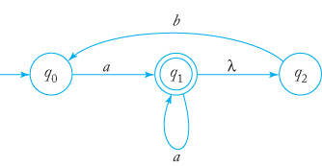
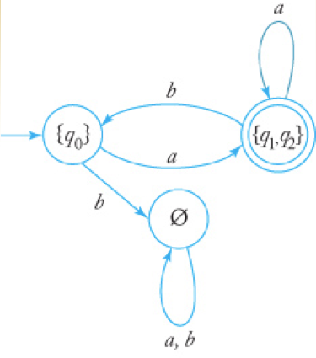
NFA to DFA Conversion Example
NFA | DFA
combined
state
Each state of the DFA must have
a transition on each symbol.
Refer back to the NFA to derive
the transition.
Label the states of the new DFA
after the set of states that the NFA
can be in after each transition.
Formal Languages
and Automata, 5th ed.
Peter Linz
Jones & Bartlett, 2012

Slide 21
Why Convert an NFA to a DFA?
An NFA may be easier to construct.
But an NFA is usually not efficient to run.
An NFA may have multiple paths to try for a given input string.
A DFA follows only one path for a given input string.

