Slide 1
CS 153 Concepts of Compiler Design November 8 Class Meeting
Department of Computer Science San Jose State University Fall 2023 Instructor: Ron Mak
www.cs.sjsu.edu/~mak

Slide 2
Schedule for Oral Project Presentations
December 4
Team 7
HAX
Crazy Compilers
December 6
French Miliary Victories
AKA
Team 404
Present what you have working up to the date of your presentation.
Tell about your source language
Show highlights of your grammar (.g4 file and syntax diagrams)
Compile and run least one sample program.
Q and A
The rest of the class will evaluate your presentation.
Up to 20
minutes
Compiler projects due
Monday, December 18

Slide 3
Presentation Evaluations
During each team’s oral presentation, the rest of the class will evaluate it in a Canvas survey.
Evaluation topics (each rated Excellent, Good, OK, Poor):
Programming language
Grammar
Sample program
Jasmin code generation
Compilation and execution
How was the presentation overall
Class evaluations will be worth about 1/3 of the total project score.

Slide 4
Static Scoping
Pascal uses static (lexical) scoping.
Scopes are determined at compile time by how the routines are nested in the source program.
During run time, variables are bound to their values as determined by the lexical scopes.
The runtime display helps do the bindings.
PROGRAM main1
FUNCTION func2
FUNCTION func3
PROCEDURE proc2
PROCEDURE proc3
SF: proc2
SF: func3
AR: proc3
SF: func2
SF: proc3
3
SF: proc2
2
1
SF: main1
RUNTIME
DISPLAY
RUNTIME STACK
main1
➔ proc2
➔ proc3
➔ func2
➔ func3
➔ proc2

Slide 5
Static Scoping in Java
What value is returned by calling function g()?
What is the binding
of this x with
static scoping?
int x = 0; int f() { return x ; } int g() { int x = 1; return f(); }

Slide 6
Dynamic Scoping
With dynamic scoping, runtime binding of variables to their values is determined at run time by the call chain.
To determine a variable’s binding, search the call chain backwards starting with the currently active routine.
The variable is bound to the value of the first declared variable found with the same name.

Slide 7
Hypothetical Dynamic Scoping in Java
What value is returned by calling function g()?
Call chain: main → g → f
What is the binding
of this x with
dynamic scoping?
int x = 0; int f() { return x ; } int g() { int x = 1; return f(); }
How would you implement runtime dynamic scoping?

Slide 8
Runtime Memory Management
In the “Pascal Virtual Machine” all local data is kept on the runtime stack.
All memory for the parameters and variables declared locally by a routine is allocated in the routine’s stack frame.
PROGRAM main1
FUNCTION func2
FUNCTION func3
PROCEDURE proc2
PROCEDURE proc3
SF: proc2
SF: func3
AR: proc3
SF: func2
SF: proc3
3
SF: proc2
2
1
SF: main1
RUNTIME
DISPLAY
RUNTIME STACK
main1
➔ proc2
➔ proc3
➔ func2
➔ func3
➔ proc2
The memory is later automatically deallocated when the stack frame is popped off the stack.
Recall: Resource Acquisition is Initialization (RAII)

Slide 9
Runtime Memory Management, cont’d
What about dynamically allocated data?
Memory for dynamically allocated data is kept in the “heap”.

Slide 10
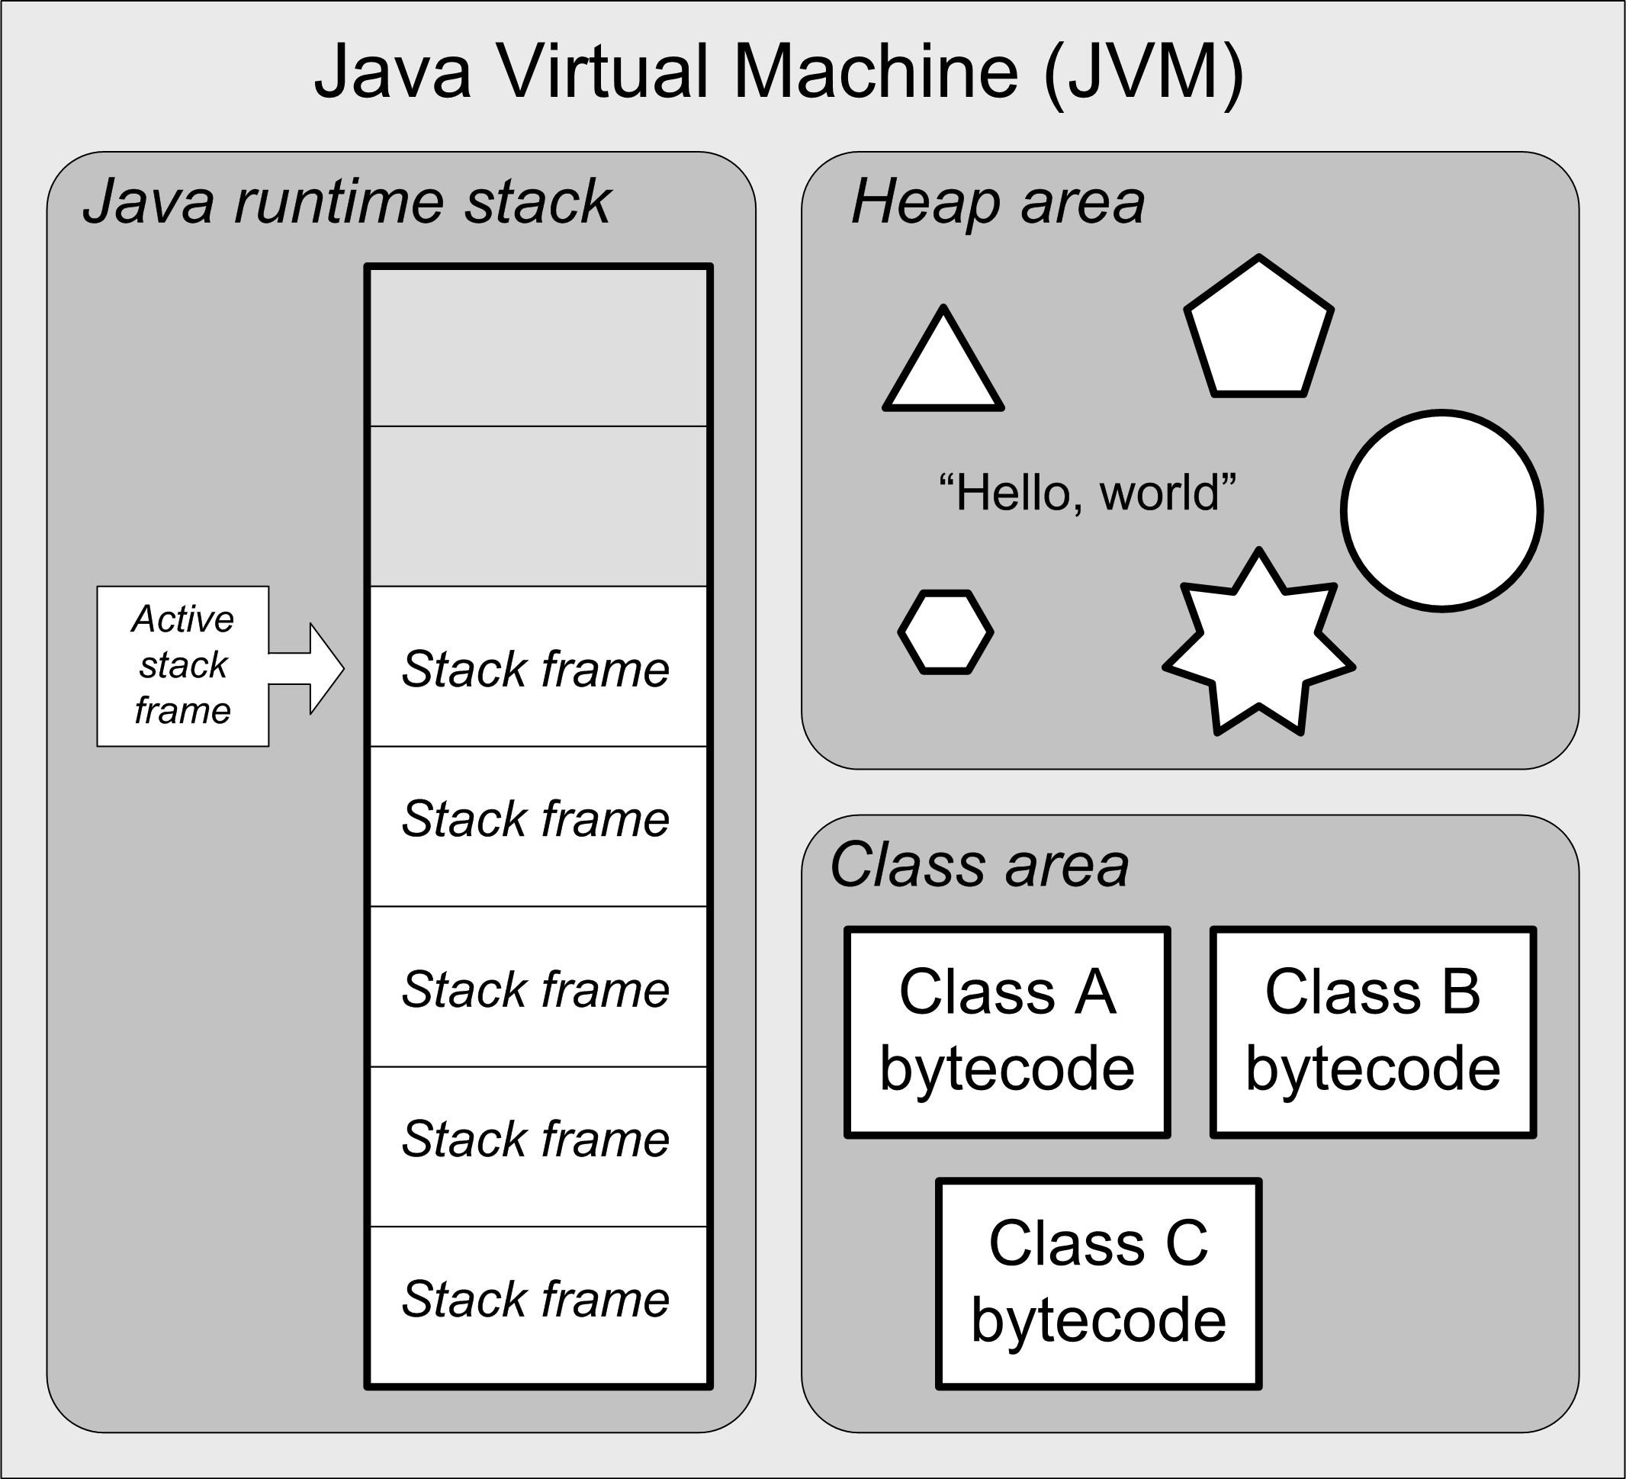
Recall the JVM Architecture ...

Slide 11
Runtime Memory Management, cont’d
Runtime memory can be divided into four partitions:
Static memory
executable code
statically-allocated data
Runtime stack
activation records that contain locally-scoped data
Heap
dynamically-allocated data
such as Java objects
Free memory
Heap
Heap limit
Free memory
Top of stack
Runtime stack
Statically-allocated data
Executable code
Avoid: Heap-stack collision
(Out of memory error)

Slide 12
Runtime Heap Management
Handled by language-specific runtime routines.
Pascal, C, and C++
Call new or malloc to allocate memory.
Call delete or free to de-allocate.
Java and the JVM
Call new to allocate memory.
Automatic garbage collection.
New C++ “smart pointers” can do automatic deletes when
pointer variables go out of scope.

Slide 13
Runtime Heap Management, cont’d
Keep track of all allocated blocks of memory and all free blocks.
Free blocks are “holes” caused by freeing some of the dynamically allocated objects.

Slide 14
Runtime Heap Management, cont’d
When a new object needs to be allocated dynamically, where in the heap should you put it?
You can allocate it at the end of the heap, and thereby expand the size of the heap.
You can find a hole within the heap that’s big enough for the object.

Slide 15
Runtime Heap Management, cont’d
What’s the optimal memory allocation strategy?
Find the smallest possible hole that the object will fit in.
Or randomly pick any hole that’s big enough.

Slide 16
Runtime Heap Management, cont’d
Should you periodically compact the heap to get rid of holes and thereby reduce the size of the heap?
If an allocated object moves due to compaction, how do you update references (pointers) to the object?

Slide 17
Garbage Collection
Return the memory occupied by an object (“garbage”) to unallocated status …
… when there are no longer any references to the object and therefore it is inaccessible.
That memory becomes a freed block (a hole).
Invented by computer scientist John McCarthy in 1959 to automatically manage runtime memory for his language Lisp.

Slide 18
Garbage Collection Algorithms
Reference counts
Mark and sweep
Stop and copy
Generational
... plus others

Slide 19
Automatic Garbage Collection
Automatic garbage collection is great for us programmers, because we don’t have to think about it and write code to free unused objects.
But it can slow runtime performance unpredictably.
Don’t write mission-critical real-time applications in a language that has automatic garbage collection, unless you can programmatically turn GC off when necessary.

Slide 20
Garbage Collection: Reference Counts
Include a counter with each block of allocated memory.
Increment the counter each time a pointer is set to point to the block.
Decrement the counter whenever a pointer to the block is set to null (or to point elsewhere).
Deallocate the block when the counter reaches 0.
Problem: Cyclic graphs
The reference counts never become 0.

Slide 21
Garbage Collection: Mark and Sweep
A type of tracing garbage collection.
Trace which objects are reachable by a chain of references from pointers within stack frames.
Periodically make a pass over the heap to mark all reachable objects.
Various marking algorithms.
This can happen concurrently with program execution.
Make a second pass to sweep (deallocate) objects that are not marked.

Slide 22
Garbage Collection: Stop and Copy
Partition the heap into two halves.
Allocate memory only in one half at a time.
When an allocation fails to find a sufficiently large block of free memory …
Stop program execution.
Copy all allocated blocks to the other half of the heap, thereby compacting it.
Update all references to objects in the allocated blocks.
How do you update pointer values?
Resume program execution.

Slide 23
Generational Garbage Collection: Theory
Most objects are short-lived.
Long-lived objects are likely to last until the program terminates.

Slide 24
Generational Garbage Collection: Practice
Partition the heap into a new generation area and an old generation area.
Allocate new objects in the new generation area.
Keep track of how long an object lives.
Once an object lives past a predetermined threshold of time, migrate it to the old generation area.
The old generation area stays fairly compacted.
The new generation area needs compacting infrequently.

Slide 25
Aggressive Heap Management
Aggressive heap management means doing garbage collection frequently, even when it’s not necessary.
There’s still adequate free space remaining in the heap area.
Keep the heap as small as possible.
Improve reference locality.
Optimize the use of physical memory when multiple programs are running.
Reduce virtual memory paging.

Slide 26
Aggressive Heap Management: Tradeoff
GC operations slow program performance.
But paging to disk can be orders of magnitude slower.

Slide 27
Recall ...
Suppose your computer ran at human speeds.
Access a value in a hardware register:
1 CPU cycle: 1 second
Then the time to retrieve one byte from:
SRAM (cache memory)
5 seconds
DRAM (main memory)
2 minutes
Flash drive
1 day
Hard drive
2 months
Magnetic tape
1,000 years
The high cost of paging!

Slide 28
Change Java’s Heap Size
Typical default heap size: 256 MB.
Command-line options:
-Xms: set an initial heap size
-Xmx: set a maximum heap size
-Xss: set the thread stack size
-Xmn: set the size of the new generation area (the remainder goes to the old generation area)
Example:
Increase the heap size to 1 GB to run myprog
java –Xmx1024m myprog

Slide 29
Garbage Collection Research
Entire books have been written about garbage collection.
It’s still an area with opportunities for research.
You can become famous by inventing a better GC algorithm!
Maybe some form of adaptive GC using machine learning?
Train the GC algorithm on the types of programs that you typically run.

Slide 30
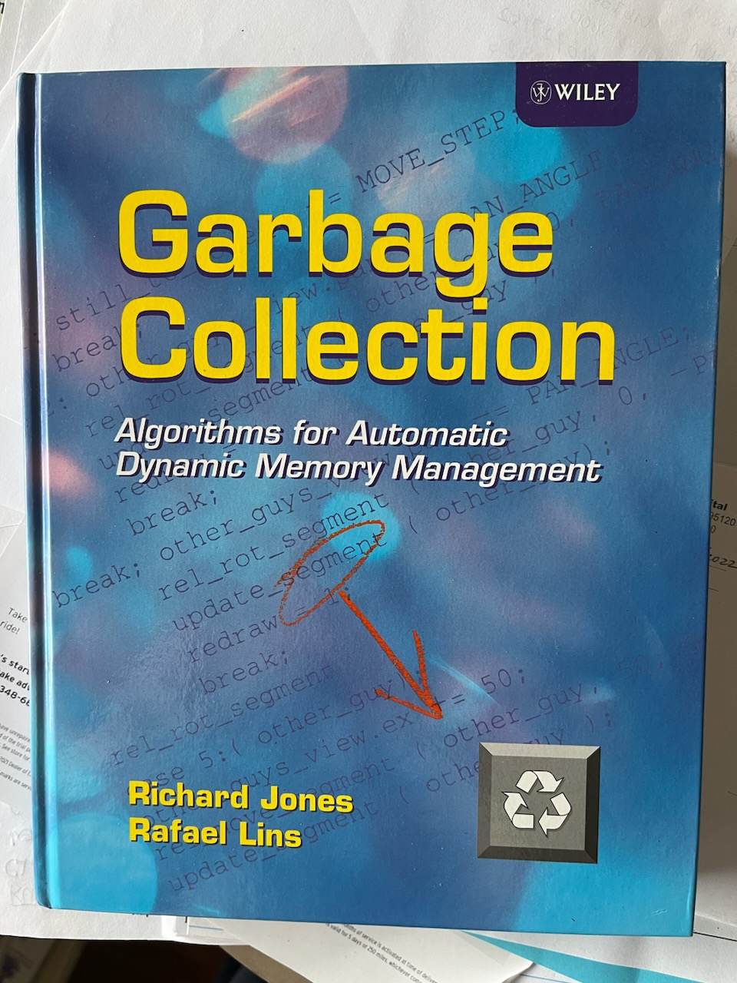
Book on Garbage Collection

