Slide 1
CS 153 Concepts of Compiler Design October 18 Class Meeting
Department of Computer Science San Jose State University Fall 2023 Instructor: Ron Mak
www.cs.sjsu.edu/~mak

Slide 2
Unofficial Field Trip
Computer History Museum in Mt. View
http://www.computerhistory.org/
Provide your own transportation to the museum.
Saturday, October 21, 11:30 – closing time
Special free admission for my students.
Experience a fully restored IBM 1401 mainframe computer from the early 1960s in operation.
Do a self-guided tour of the Revolution exhibit.

Slide 3
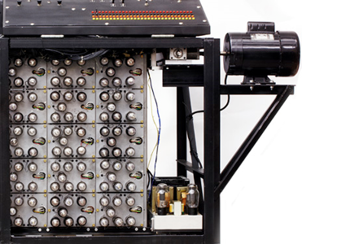
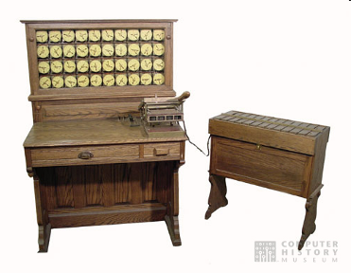
Unofficial Field Trip, cont’d
See the extensive Revolution exhibit!
Walk through a timeline of the First 2000 Years of Computing History.
Historic computer systems, data processing equipment, and other artifacts.
Small theater presentations.
Hollerith
Census
Machine
Atanasoff-Berry
Computer

Slide 4
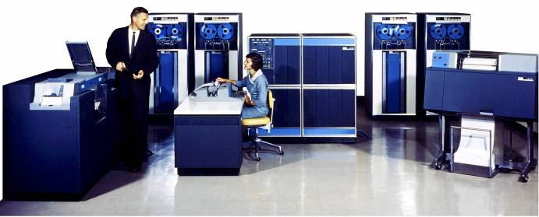
Unofficial Field Trip, cont’d
IBM 1401 computer, fully restored and operational.
A small transistor-based mainframe computer.
Extremely popular with small businesses in the late 1950s through the mid 1960s
Maximum of 16K bytes of memory.
800 card/minute card reader (wire brushes).
600 line/minute line printer (impact).
6 magnetic tape drives, no disk drives.

Slide 5
Unofficial Field Trip, cont’d
Information on the IBM 1401:
General info: http://en.wikipedia.org/wiki/IBM_1401
My summer seminar: http://www.cs.sjsu.edu/~mak/1401/
Restoration: http://ed-thelen.org/1401Project/1401RestorationPage.html

Slide 6
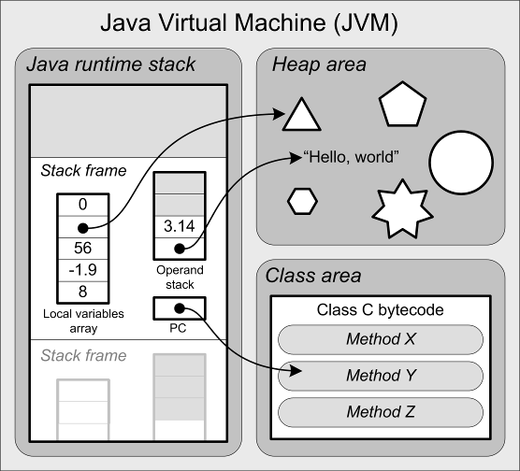
Reminder: JVM Architecture
The runtime stack contains stack frames.
Each stack frame contains:
local variables array
operand stack
program counter (PC)

Slide 7
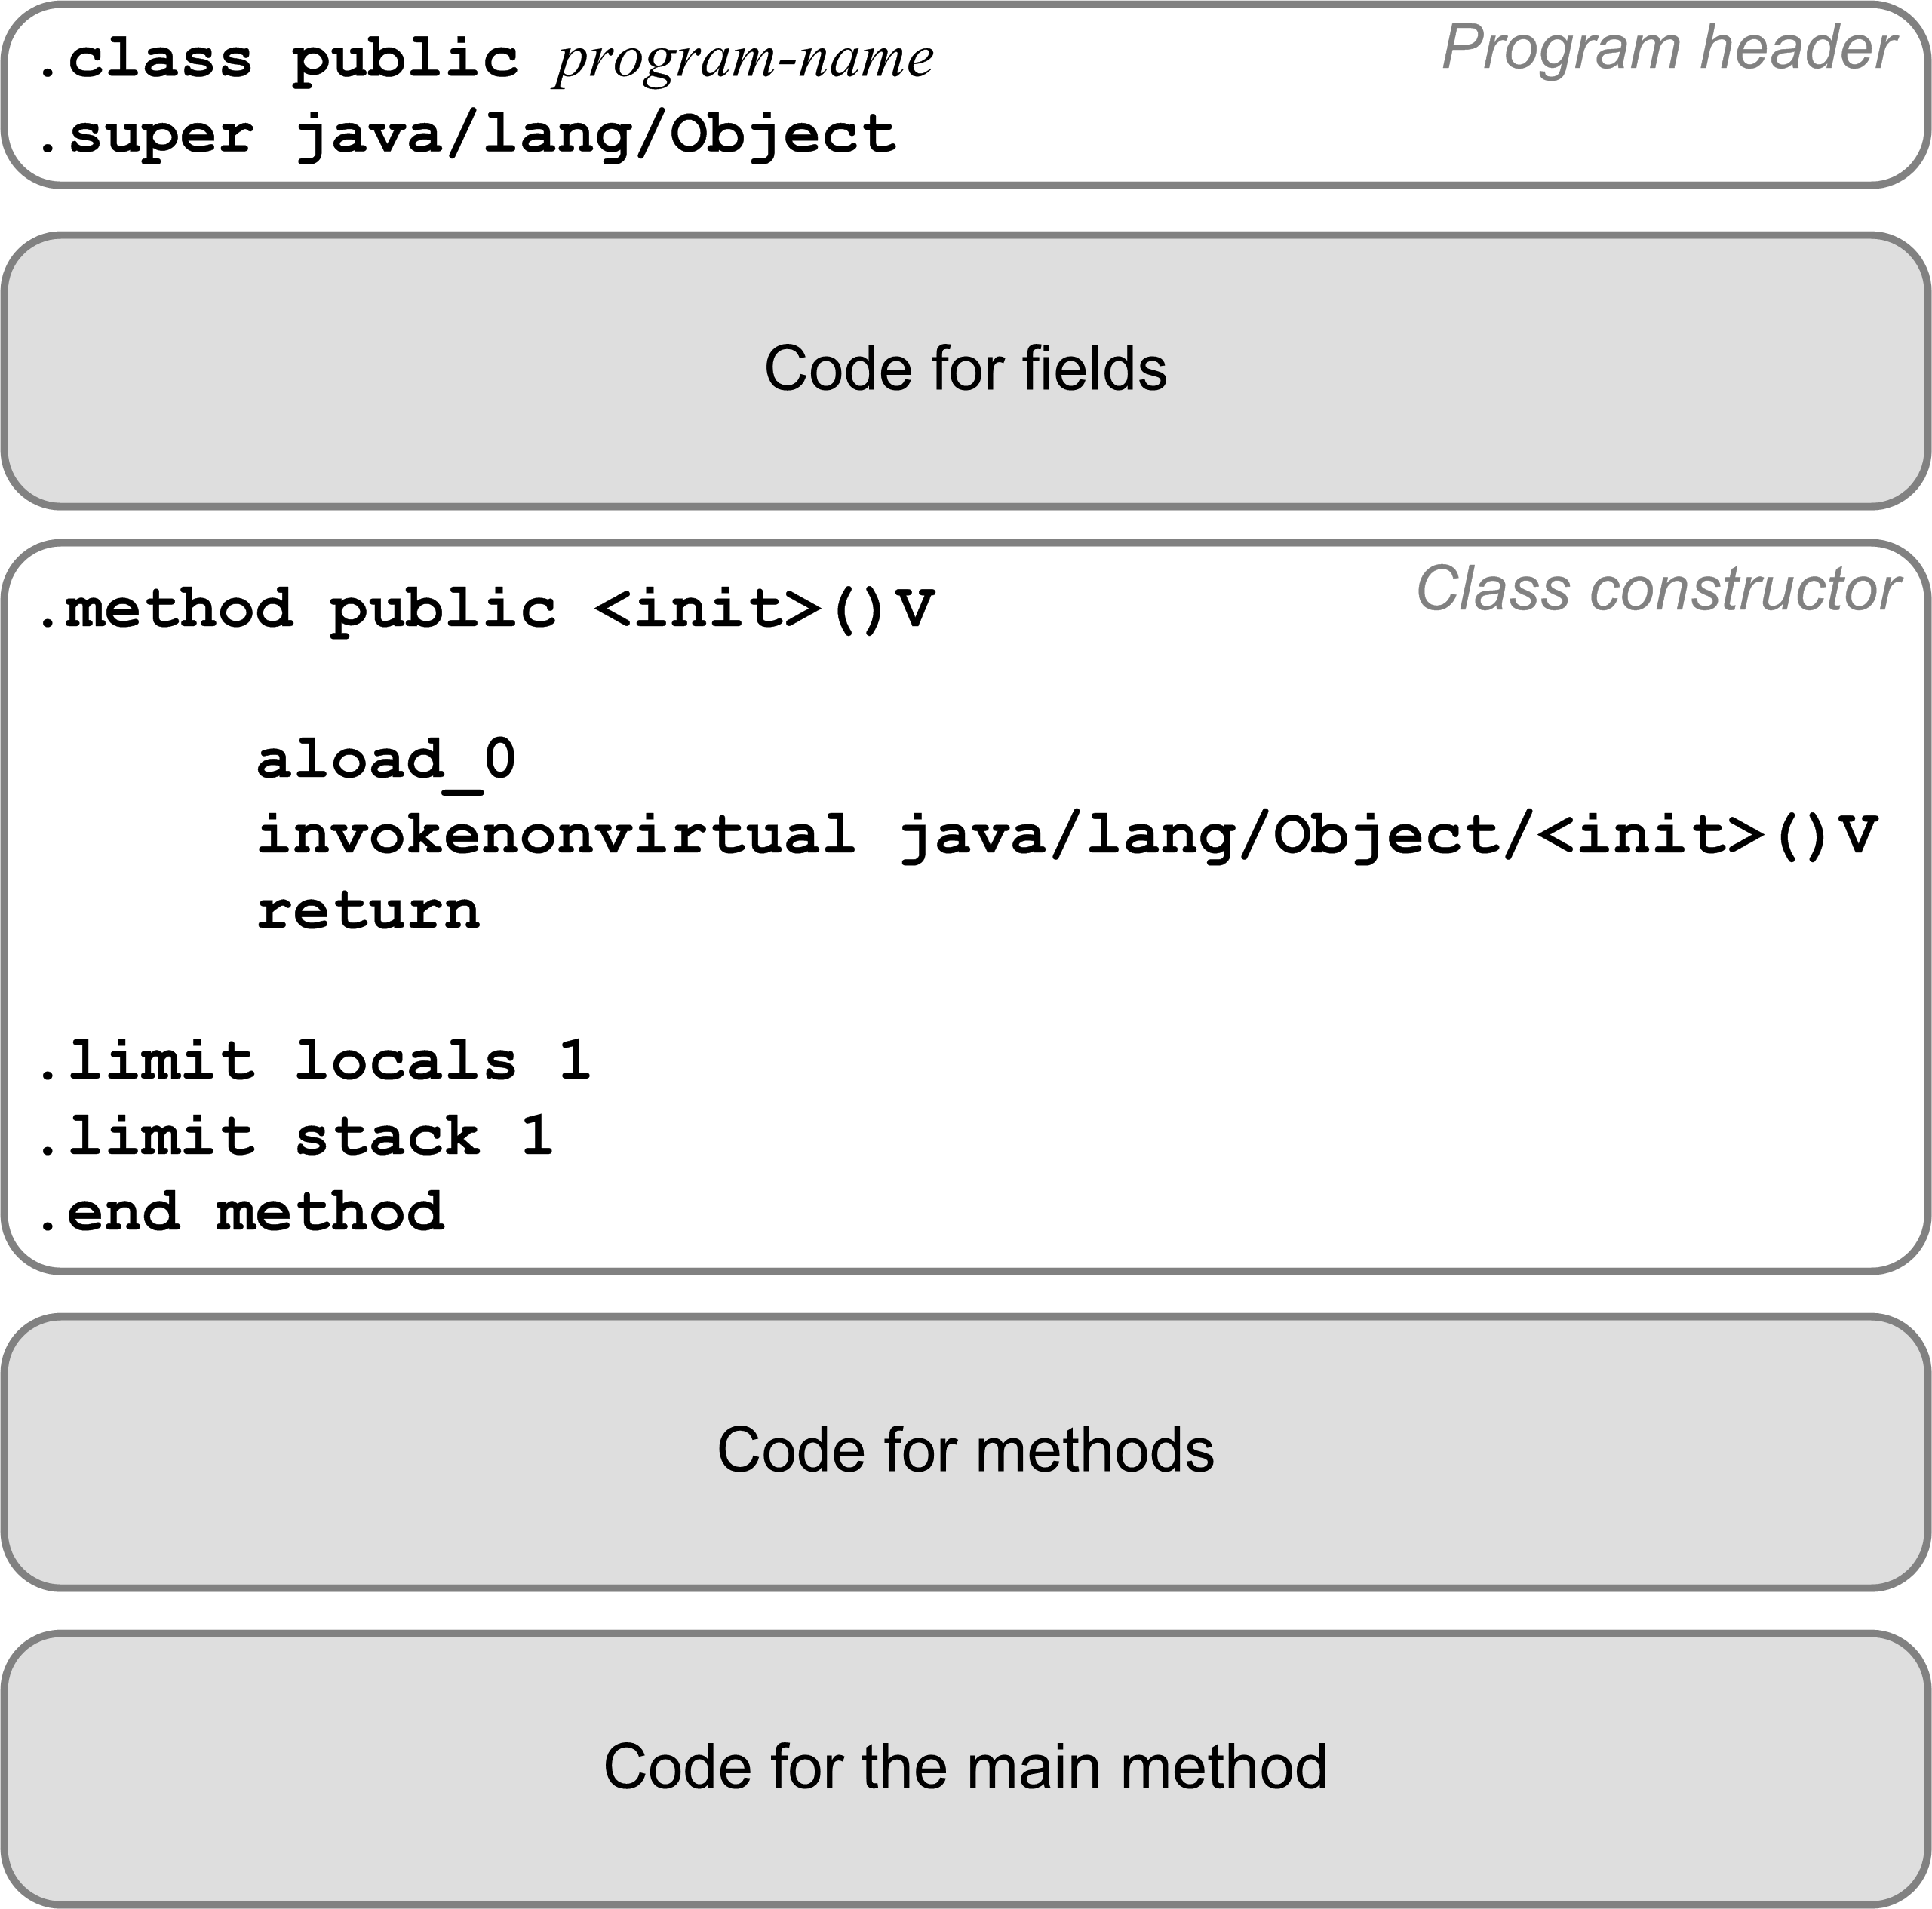
Code Template for a Pascal Program
Translate a Pascal program into a public class.
Program variables become class fields.
Must have a default constructor.
Each procedure or function becomes a private static method.
The main program code becomes the public static main method.

Slide 8
Compilation Strategy
We’ll compile a Pascal program as if it were a public Java class.
The Pascal program name becomes the Java class name.
The main program becomes the main method of the Java class.
We’ll compile each program variable as if it were a field of the Java class.
Fields do have names in a Jasmin program.
Recall that local variables and parameters are referred to only by their slot numbers.

Slide 9
Compilation Strategy, cont’d
We’ll compile each Pascal procedure or function as if it were a private static method of the Java class.
Local variables and formal parameters of the method do not have names in a Jasmin program.
Jasmin instructions refer to local variables and parameters by their slot numbers of the local variables array.

Slide 10
Code Template for the Main Method, cont’d

Slide 11
Assignment Statement Code Template
The code template for an assignment statement to a local variable <variable> := <expression>
code for <expression>
xstore n
Where x is i, l, f, or d depending on the datatype of the computed value of <expression>.
You can generate a shortcut store instruction such as istore_3 (3 is a slot number) whenever possible.

Slide 12
Load and Store Tips
Write special code emitters for loading (pushing) values onto the operand stack.
If loading constants:
Determine whether you can emit a shortcut instruction.

Slide 13
Load and Store Tips, cont’d
To load (push) a variable’s value:
Determine whether it’s a program variable (emit a getstatic instruction with the field name and data type descriptor) or a local variable (emit an appropriate load instruction with the slot number).
Determine whether you can emit a shortcut instruction for a local variable.
Similarly, write special code emitters to store (pop) a value off the operand stack into a program variable or into a local variable’s slot.

Slide 14
What Would James Gosling Do?
What Jasmin code should you generate?
CodeTest.java
public class CodeGen
{
private static float test()
{
float alpha = 0; //* slot #0
float beta = 10; //* slot #1
float gamma = 20; //* slot #2
int thirty = 30; //* slot #3
int forty = 40; //* slot #4
int fifty = 50; //* slot #5
if (forty == fifty)
{
return alpha + 3/(beta - gamma) + 5;
}
else
{
return alpha + thirty/(beta - gamma) + fifty;
}
}
}

Slide 15
What Would James Gosling Do?
What Jasmin code should you generate for this Pascal program?
CodeTest.pas
PROGRAM CodeTest;
FUNCTION test : real;
VAR
alpha, beta, gamma : real;
thirty, forty, fifty : integer;
BEGIN
alpha := 0;
beta := 10;
gamma := 20;
thirty := 30;
forty := 40;
fifty := 50;
IF forty = fifty
THEN test := alpha + 3/(beta - gamma) + 5
ELSE test := alpha + thirty/(beta - gamma) + fifty;
END;
BEGIN
writeln(test())
END.

Slide 16
What Would James Gosling Do, cont’d
If you have a construct in your source language and you don’t know what Jasmin code to generate for it:
Write the equivalent construct in Java.
Compile the Java into a .class file.
Run the jasper disassembler to get an idea of what code you should generate.

Slide 17
What Would James Gosling Do, cont’d
CodeTest.pas
PROGRAM CodeTest;
FUNCTION test : real;
VAR
alpha, beta, gamma : real;
thirty, forty, fifty : integer;
BEGIN
alpha := 0;
beta := 10;
gamma := 20;
thirty := 30;
forty := 40;
fifty := 50;
IF forty = fifty
THEN test := alpha + 3/(beta - gamma) + 5
ELSE test := alpha + thirty/(beta - gamma) + fifty;
END;
BEGIN
writeln(test())
END.
CodeTest.java
public class CodeTest
{
private static float test()
{
float alpha = 0; //* slot #0
float beta = 10; //* slot #1
float gamma = 20; //* slot #2
int thirty = 30; //* slot #3
int forty = 40; //* slot #4
int fifty = 50; //* slot #5
if (forty == fifty)
{
return alpha + 3/(beta - gamma) + 5;
}
else
{
return alpha + thirty/(beta - gamma) + fifty;
}
}
public static void main(String args[])
{
System.out.println(test());
}
}

Slide 18
Jasper
Use the Jasper disassembler: http://www.angelfire.com/tx4/cus/jasper/
It claims to disassemble .class files into Jasmin files suitable for the Jasmin assembler.
Jasper is a Java program.
Google “Java byte code viewer” for other disassemblers.
Java comes with javap, but its output cannot be assembled by the Jasmin assembler.

Slide 19
Jasper, cont’d
.method private static test()F
.limit stack 4
.limit locals 6
.var 0 is alpha F from LABEL0x2 to LABEL0x33
.var 1 is beta F from LABEL0x5 to LABEL0x33
.var 2 is gamma F from LABEL0x8 to LABEL0x33
.var 3 is thirty I from LABEL0xb to LABEL0x33
.var 4 is forty I from LABEL0xf to LABEL0x33
.var 5 is fifty I from LABEL0x13 to LABEL0x33
.line 5
fconst_0
fstore_0
.line 6
LABEL0x2:
ldc 10.0
fstore_1
.line 7
LABEL0x5:
ldc 20.0
fstore_2
.line 8
LABEL0x8:
bipush 30
istore_3
.line 9
LABEL0xb:
bipush 40
istore 4
.line 10
LABEL0xf:
bipush 50
istore 5
private static float test()
{
float alpha = 0; //* slot #0
float beta = 10; //* slot #1
float gamma = 20; //* slot #2
int thirty = 30; //* slot #3
int forty = 40; //* slot #4
int fifty = 50; //* slot #5
if (forty == fifty)
{
return alpha + 3/(beta - gamma) + 5;
}
else
{
return alpha + thirty/(beta - gamma) + fifty;
}
}

Slide 20
Jasper, cont’d
.line 12
LABEL0x13:
iload 4
iload 5
if_icmpne LABEL0x26
.line 13
fload_0
ldc 3.0
fload_1
fload_2
fsub
fdiv
fadd
ldc 5.0
fadd
freturn
.line 16
LABEL0x26:
fload_0
iload_3
i2f
fload_1
fload_2
fsub
fdiv
fadd
iload 5
i2f
fadd
freturn
LABEL0x33:
.end method
private static float test()
{
float alpha = 0; //* slot #0
float beta = 10; //* slot #1
float gamma = 20; //* slot #2
int thirty = 30; //* slot #3
int forty = 40; //* slot #4
int fifty = 50; //* slot #5
if (forty == fifty)
{
return alpha + 3/(beta - gamma) + 5;
}
else
{
return alpha + thirty/(beta - gamma) + fifty;
}
}

Slide 21
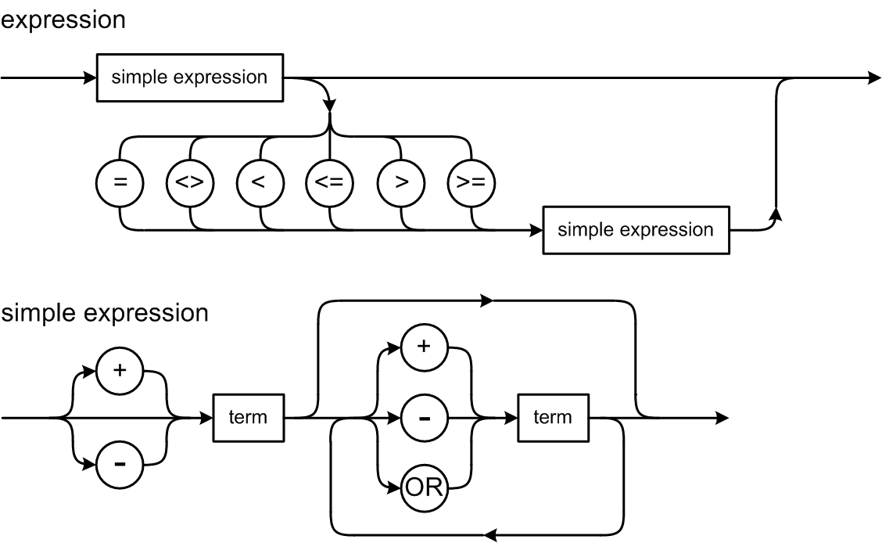
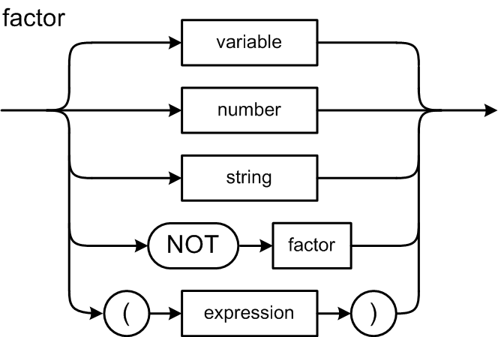
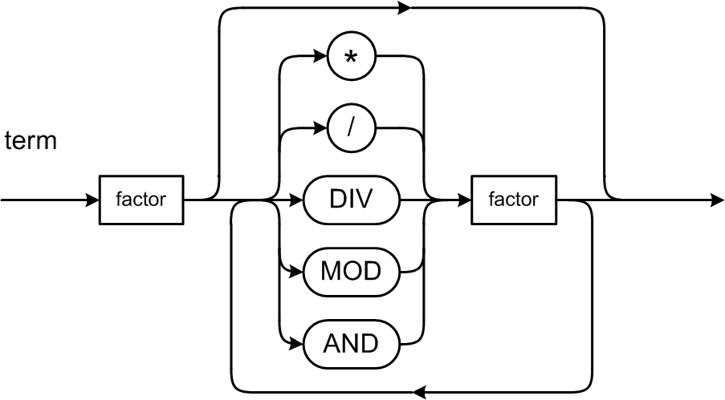
Expression Syntax Diagrams
What code should we generate for a relational expression?

Slide 22
Relational Expressions
Suppose i and j are local integer variables, and that:
i ➔ slot #0 j ➔ slot #1
0 represents false and 1 represents true.
For the expression i < j leave either 0 or 1 on top of the operand stack:
This is a hack that is
easy but inefficient.
The code in red
are the only parts
that change based
on the expression.
iload_0 ; push the value of i (slot #0)
iload_1 ; push the value of j (slot #1)
if_icmplt L003 ; branch if i < j
iconst_0 ; push false
goto L004 ; go to next statement
L003:
iconst_1 ; push true
L004:
Your code generator
also needs to emit labels.

Slide 23
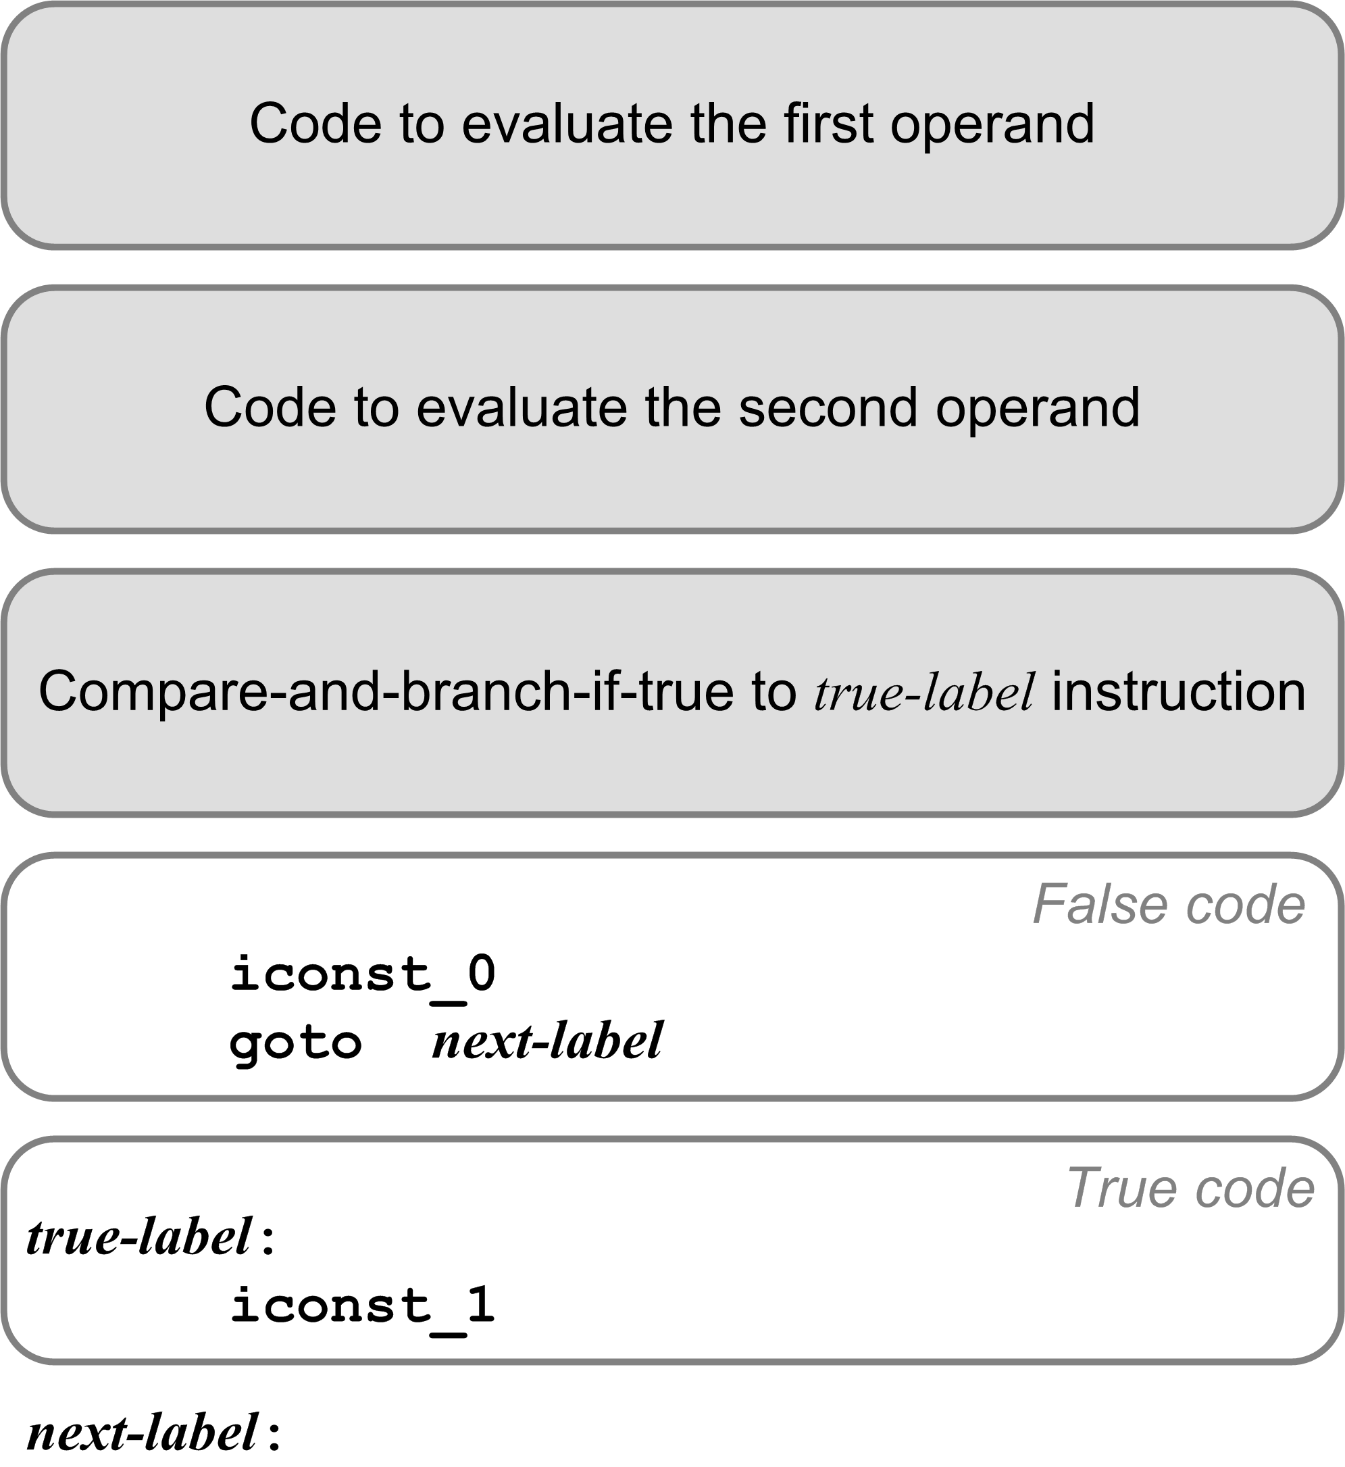
Relational Expression Code Template
iload_0
iload_1
if_icmplt L003
iconst_0
goto L004
L003:
iconst_1
L004:

Slide 24
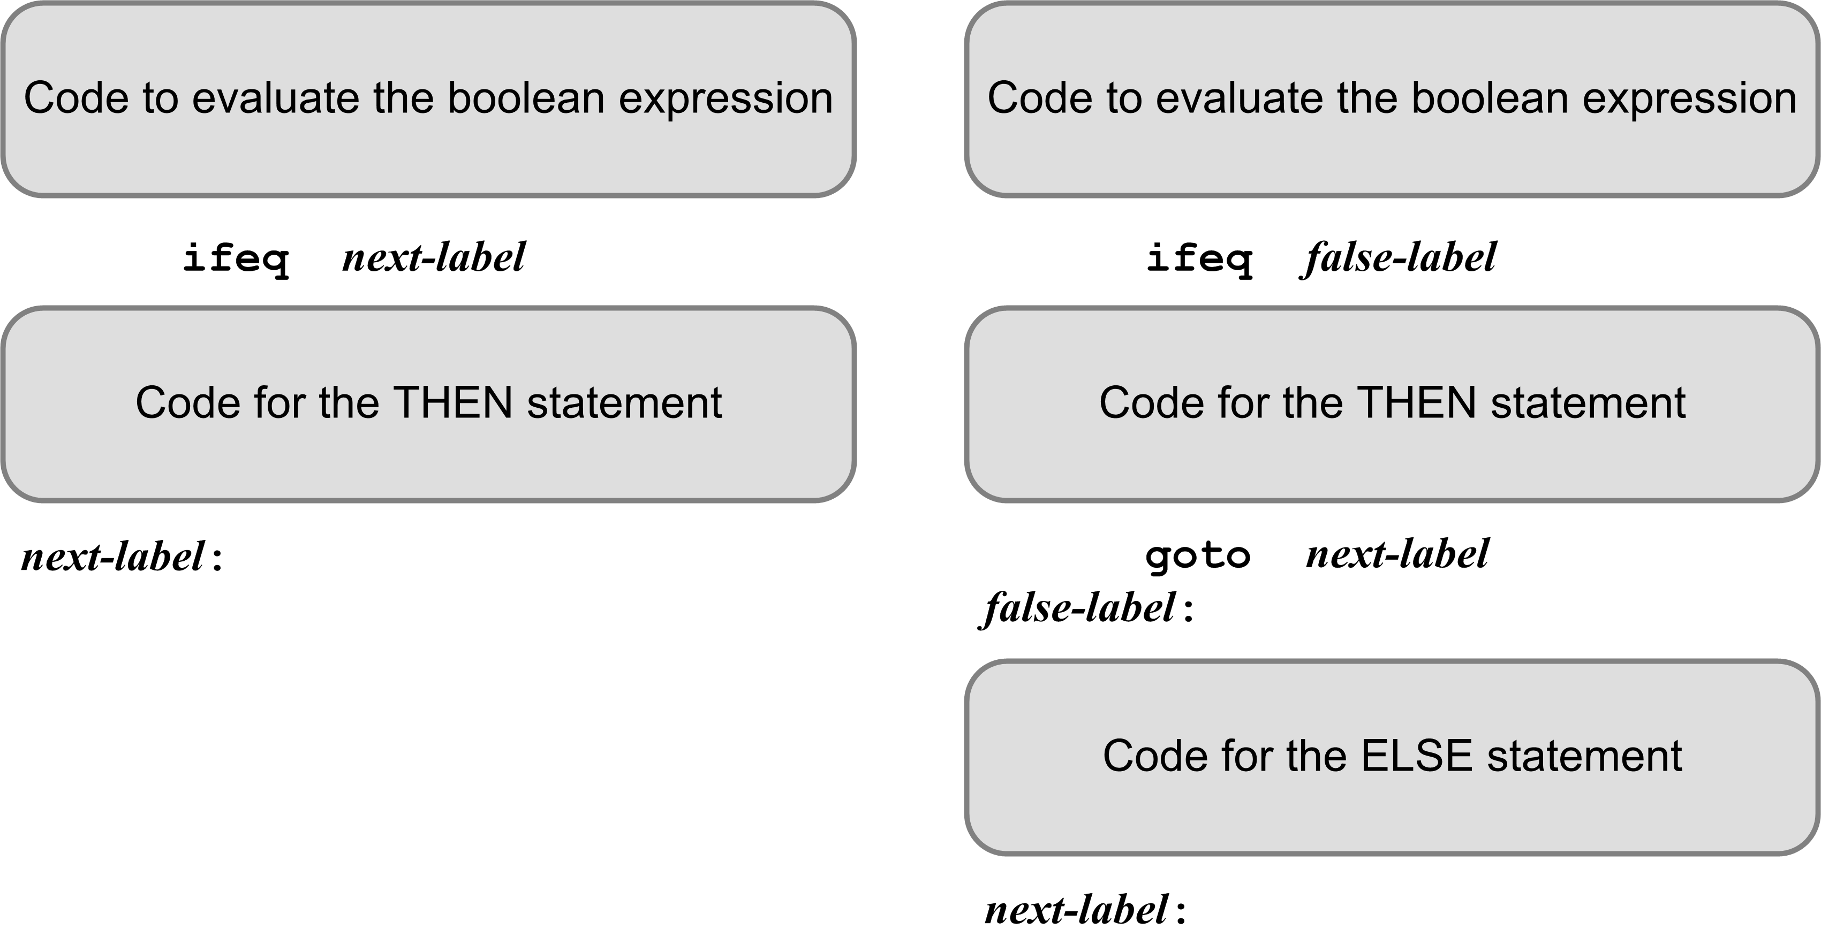
IF Statement Code Templates
The code that evaluates the boolean expression leaves either 0 (false) or 1 (true) on top of the operand stack.
ifeq branches if [TOS] is 0 (the expression is false)

Slide 25
Example: IF Statement
getstatic iftest/i I
getstatic iftest/j I
if_icmplt L002
iconst_0
goto L003
L002:
iconst_1
L003:
ifeq L001
sipush 300
putstatic iftest/t I
L001:
getstatic iftest/i I
getstatic iftest/j I
if_icmpeq L005
iconst_0
goto L006
L005:
iconst_1
L006:
ifeq L007
sipush 200
putstatic iftest/t I
goto L004
L007:
sipush 200
ineg
putstatic iftest/f I
L004:
PROGRAM IfTest;
VAR
i, j, t, f : integer;
BEGIN {IF statements}
...
IF i < j THEN t := 300;
IF i = j THEN t := 200
ELSE f := -200;
...
END.
Variables i, j, t, f
are program variables
and so the Jasmin code
uses their fully qualified
names.

Slide 26
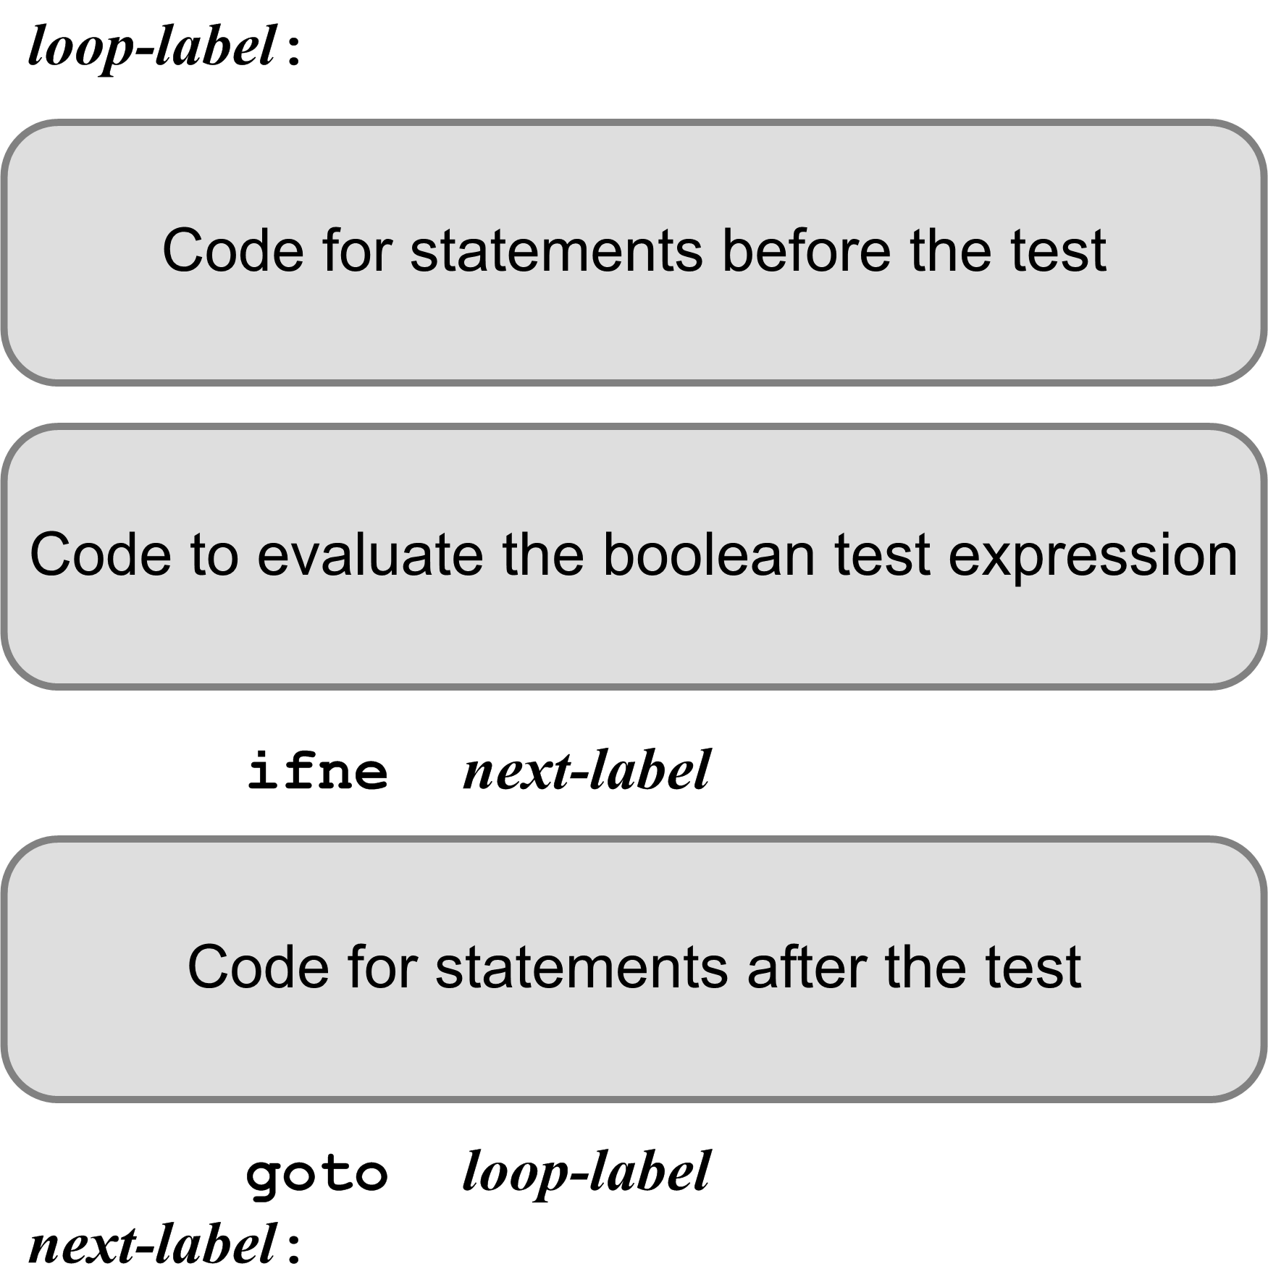
Looping Statement Code Template
The code that evaluates the boolean expression leaves either 0 (false) or 1 (true) on top of the operand stack.
ifne branches if [TOS] is not 0 (the expression value is true)
There may or may not be any code before or after the test.

Slide 27
Example: Newton’s Square Root Function
#3
#0
iconst_0
istore_1 ; i := 0
fload_0
fstore_2 ; root := x
L000:
fload_0 ; x
fload_2 ; root
fdiv ; /
fload_2 ; root
fadd ; +
fconst_2 ; 2.0
fdiv ; /
fstore_2 ; ==> root
iinc 1 1 ; i := i + 1;
iload_1 ; i
bipush 10 ; 10
if_icmpgt L001 ; if i > 10 goto L001
iconst_0 ; false goto L002 L001:
iconst_1 ; true
L002:
ifne L003 ; if true goto L003
goto L000
L003:
fload_2
fstore_3
fload_3
freturn ; return root
FUNCTION sqrt(x : real) : real;
VAR
i : integer;
root : real;
BEGIN
i := 0;
root := x;
REPEAT
root := (x/root + root)/2;
i := i + 1;
UNTIL i > 10;
sqrt := root;
END;
#1
Local
variables
#2
These are local variables
and so the Jasmin code
uses their slot numbers.

Slide 28
Example: FOR Statement
PROGRAM ForTest;
VAR
j, k, n : integer;
BEGIN {FOR statements}
...
FOR k := j TO 5 DO BEGIN
n := k;
END;
...
END.
getstatic fortest/j I
putstatic fortest/k I
L001:
getstatic fortest/k I
iconst_5
if_icmpgt L003
iconst_0
goto L004
L003:
iconst_1
L004:
ifne L002
getstatic fortest/k I
putstatic fortest/n I
getstatic fortest/k I
iconst_1
iadd
putstatic fortest/k I
goto L001
L002:
Program
variables
This is code
emitted for a
general > test.
It can be much
improved!

Slide 29
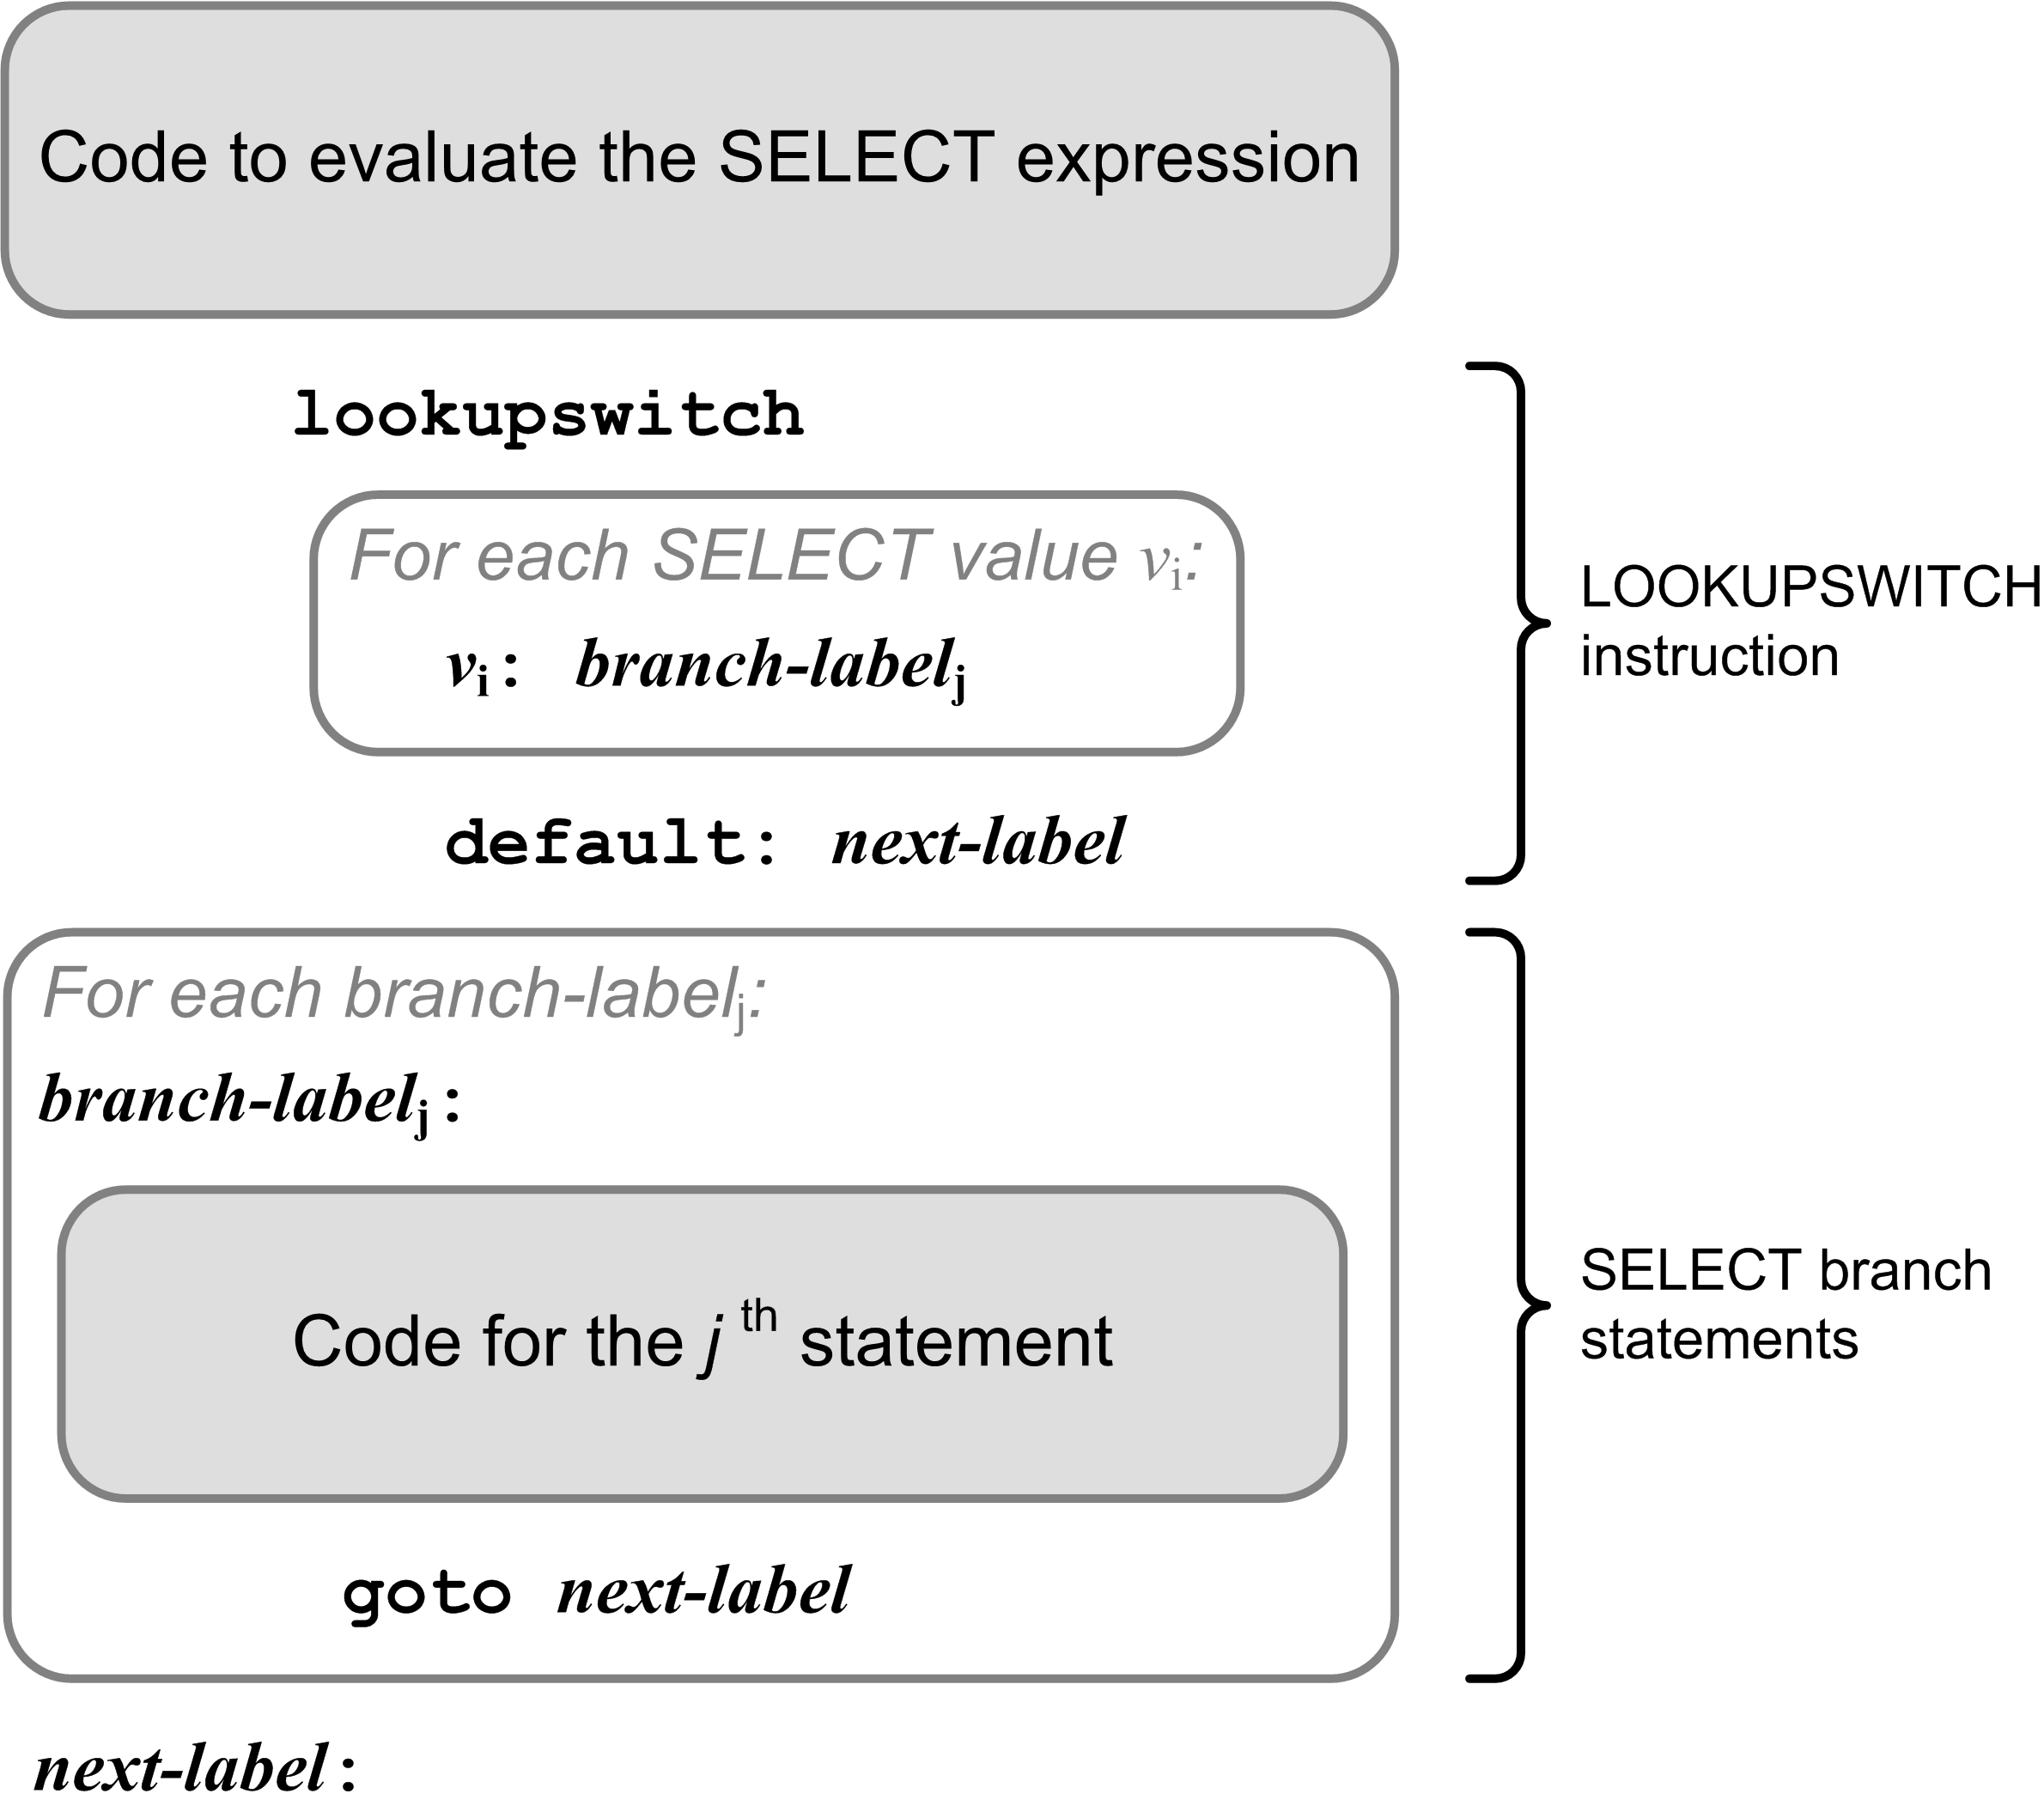
Select Template

Slide 30
Example: CASE Statement
#0
#1
Local
variables
iload_0 ; i
lookupswitch
100: L010
105: L010
200: L020
256: L020
282: L020
default: L099
L010:
sipush 1000
istore_1 ; j := 1000
goto L099
L020:
sipush 2000
istore_1 ; j := 2000
goto L099
L099:
VAR i, j : integer;
...
CASE i OF
100,105: j := 1000;
200,256,282: j := 2000;
END

Slide 31
Pascal Procedures and Functions
Analogous to Java methods (functions).
Two major simplifications for our Pascal compiler:
Standard Pascal is not object-oriented.
Therefore, Pascal procedures and functions are more like the private static methods of a Java class.
Java does not have nested methods.
The JVM does not easily implement nested methods.
Therefore, we will compile only top level (level 1) Pascal procedures and functions.

Slide 32
Procedures and Functions, cont’d
A Pascal program:
The roughly equivalent Java class:
Fields and methods are private static.
PROGRAM ADDER;
VAR
i, j, sum : integer;
FUNCTION add(n1, n2 : integer) : integer;
VAR
s : integer;
BEGIN
s := i + j + n1 + n2;
add := s;
END;
BEGIN
i := 10;
j := 20;
sum := add(i, j);
writeln('Sum = ', sum)
END.
public class Adder
{
private static int i, j, sum;
private static int add(int n1, int n2)
{
int s = i + j + n1 + n2;
return s;
}
public static void main(String args[])
{
i = 10;
j = 20;
sum = add(i, j);
System.out.println("Sum = " + sum);
}
}

Slide 33
Code for a Pascal Function (Static Method)
PROGRAM Adder;
VAR
i, j, sum : integer;
FUNCTION add(n1, n2 : integer) : integer;
VAR
s : integer;
BEGIN
s := i + j + n1 + n2;
add := s;
END;
BEGIN
i := 10;
j := 20;
sum := add(i, j);
writeln('Sum = ', sum)
END.
.method private static add(II)I
.var 0 is n1 I
.var 1 is n2 I
.var 2 is s I
.var 3 is add I
getstatic Adder/i I
getstatic Adder/j I
iadd
iload_0
iadd
iload_1
iadd
istore_2
iload_2
istore_3
iload_3
ireturn
.limit locals 4
.limit stack 2
.end method
Local parameters are
automatically assigned
slot numbers starting at 0.
#3
#0
#1
Local parameters
and variables
#2
Push the return value
onto the caller’s
operand stack.

Slide 34
Code to Call a Function (Static Method)
PROGRAM ADDER;
VAR
i, j, sum : integer;
FUNCTION add(n1, n2 : integer) : integer;
VAR
s : integer;
BEGIN
s := i + j + n1 + n2;
add := s;
END;
BEGIN
i := 10;
j := 20;
sum := add(i, j);
writeln('Sum = ', sum)
END.
.method public static main([Ljava/lang/String;)V
bipush 10
putstatic Adder/i I
bipush 20
putstatic Adder/j I
getstatic Adder/i I
getstatic Adder/j I
invokestatic Adder/add(II)I
putstatic Adder/sum I
...
Program variables
A function call leaves its
return value on top of the
operand stack of the caller.
Use putstatic with a fully qualified field name and type signature to pop a value off the operand stack and store it into a static field.
Use invokestatic with a fully-qualified method name and a type signature to call a static method.

Slide 35
Code for a Pascal Main Program
PROGRAM Adder;
VAR
i, j, sum : integer;
FUNCTION add(n1, n2 : integer) : integer;
VAR
s : integer;
BEGIN
s := i + j + n1 + n2;
add := s;
END;
BEGIN
i := 10;
j := 20;
sum := add(i, j);
writeln('Sum = ', sum)
END.
.class public super Adder
.super java/lang/Object
.private field static i I
.private field static j I
.private field static sum I
.method public <init>()V
aload_0
invokenonvirtual java/lang/Object/<init>()V
return
.limit stack 1
.limit locals 1
.end method
...
Program variables
Private static class fields.
Void method.
No parameters.
Each Jasmin class must have a constructor named <init>.
The local variable in slot #0 contains the value of “this”.
Each constructor must call the superclass constructor.

