Slide 1
CS 153: Concepts of Compiler Design September 11 Class Meeting
Department of Computer Science San Jose State University Fall 2023 Instructor: Ron Mak
www.cs.sjsu.edu/~mak

Slide 2
Assignment #2 Suggested Solution
Changes to Scanner.java
Treat each comment { ... } as a blank.
Changes to Token.java
Add reserved words.
Add special symbols.
Handle '' (two consecutive apostrophes) in strings.
http://www.cs.sjsu.edu/~mak/CS153/assignments/2/solution/Asgn02Solution.zip

Slide 3
Assignment #3: Parser and Executor
Modify the frontend parser to parse and build trees for the following Pascal statements:
while
if
for
case
You may need to add new node types in the intermediate tier.
Add new visit methods to the backend executor to execute the above statements.
Some simple Pascal source files
are forthcoming to test your interpreter.

Slide 4
Assignment #3, cont’d
You can start Assignment #3 by using the code you wrote for Assignment #2, or you can use the suggested solution.
There are simple Pascal input test files for you to test the statements that you’re implementing.
You should make up simpler tests files before attempting these.
Demo

Slide 5
Scanner and Parser Rules of Thumb
Scanner
At any point in the source file, extract the longest possible token.
Example:
<= is a single less-than-or-equal token
Not a greater-than token followed by an equal token
Parser
At any point in the source file, parse the longest possible statement.
Example: IF i = 3 THEN IF j = 2 THEN t := 500 ELSE f := -500
“maximum munch”

Slide 6
An Executor Improvement
The suggested solution to Assignment #2 implements a significant improvement.
The main no longer passes the symbol table to the backend executor.
Previously, method Simple.executeProgram() passed it to the constructor of class Executor.
Since we’re using the hack of storing the runtime values of variables in symbol table entries, how is this possible?
What is the performance improvement?

Slide 7
An Executor Improvement, cont'd
Node.java
Let the parser do the symbol table lookup in the front end and store the pointer to the symtab entry in the tree node.
public class Node
{
...
public SymtabEntry entry;
...
}
Parser.java
private Node parseVariable()
{
// The current token should now be an identifier.
// Has the variable been "declared"?
String variableName = currentToken.text;
SymtabEntry variableId = symtab.lookup(variableName.toLowerCase());
if (variableId == null) semanticError("Undeclared identifier");
Node node = new Node(VARIABLE);
node.text = variableName;
node.entry = variableId;
currentToken = scanner.nextToken(); // consume the identifier
return node;
}

Slide 8
An Executor Improvement, cont'd
private Object visitAssign(Node assignNode)
{
Node lhs = assignNode.children.get(0);
Node rhs = assignNode.children.get(1);
Double value = (Double) visit(rhs);
SymtabEntry variableId = lhs.entry;
variableId.setValue(value);
return null;
}
Less work for the executor in the back end.
A more efficient interpreter during run time!
Executor.java
private Object visitVariable(Node variableNode)
{
SymtabEntry variableId = variableNode.entry;
Double value = variableId.getValue();
return value;
}

Slide 9
Syntax and Semantics
Syntax refers to the rules of the grammar of a source language.
The rules prescribe the proper form of its programs.
The parser “knows” the grammar.
Rules can be described by syntax diagrams.
Syntax checking
Does this sequence of tokens follow the syntax rules?
Performed by the frontend parser.

Slide 10
Syntax and Semantics, cont’d
Semantics refers to the meaning of syntactically correct token sequences of the source language.
Example: Certain sequences of tokens constitute an IF statement according to the language’s grammar.
The semantics of the statement determine
How the interpreter will execute the statement, or
How the compiler or converter will generate object code for the statement.

Slide 11
Syntax and Semantics, cont’d
Semantic actions by the frontend parser based on the meanings of statements and expressions:
Building proper parse trees.
Building symbol tables.
Type checking (which we’ll do later).
The parse trees encode type checking and operator precedence in their structures.

Slide 12
Syntax and Semantics, cont’d
Semantic actions in the back end:
Interpreter: The executor runs the program and performs actions according to the meanings of the statements and expressions.
Compiler and converter: The code generator emits object code that reflects the meanings of the statements and expressions.

Slide 13
Syntax Error Handling
Syntax error handling in the front end is a three-step process:
Detect the error.
Flag the error.
Recover from the error.
Good syntax error handling is important!
A hallmark of a compiler excellence.

Slide 14
Options for Error Recovery
Stop after the first error.
No error recovery at all.
Easiest for the compiler writer, annoying for the programmer.
Worse case: The compiler crashes or hangs.
Become hopelessly lost.
Attempt to continue parsing the rest of the source program.
Spew out lots of irrelevant and meaningless error messages.
No error recovery here, either …
… but the compiler writer doesn’t admit it!

Slide 15
Options for Error Recovery, cont’d
Skip tokens after the erroneous token until …
The parser finds a token it recognizes, and
It can safely resume syntax checking the rest of the source program.
For now, we’ve implemented very simple syntax error handling.
Will our parser get lost attempting to recover?
Will our parser go into an infinite loop or crash?

Slide 16
Top-Down Recursive Descent Parsing
The term is very descriptive of how the parser works.
Start by parsing the topmost source language construct.
Example: The program
Separate parse methods for the various language constructs.
Examples: parseProgram(), parseAssignmentStatement(), parseExpression(), etc.

Slide 17
Top-Down Recursive Descent Parsing, cont’d
Drill down (descend) by parsing the sub-constructs.
Parse methods call lower-level parse methods.
statement →assignment statement → expression →variable → etc.
Use recursion on the way down.
statement →WHILE statement → statement → etc.

Slide 18
Top-Down Recursive Descent Parsing, cont’d
This is the technique for hand-coded parsers.
Very easy to understand and write.
The source language’s grammar is encoded in the structure of the parser methods.
Close correspondence between the parser code and the syntax diagrams.
Disadvantages
Can be tedious coding.
Ad hoc error handling.
Big and slow!

Slide 19
Top-Down Recursive Descent Parsing, cont’d
Bottom-up parsers can be smaller and faster.
Error handling can still be tricky.
To be covered later this semester.

Slide 20
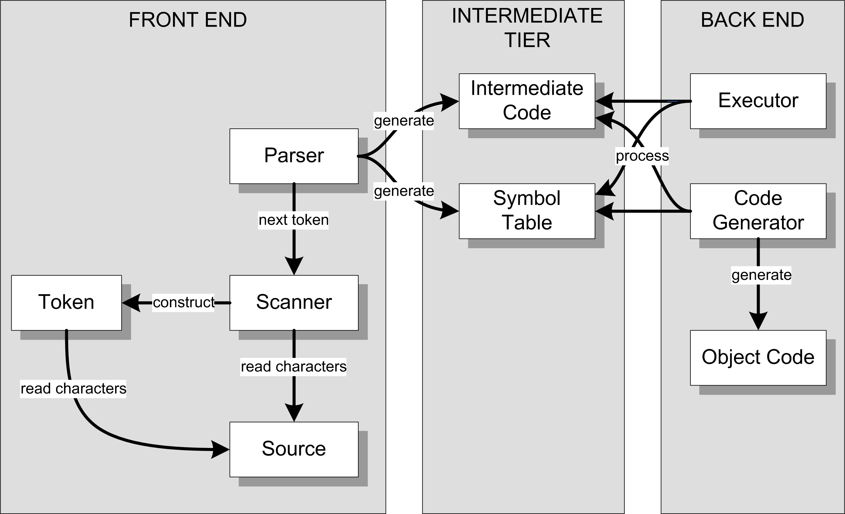
Our Accomplishments So Far
Interpreter
Not yet!
Compiler or
converter

Slide 21
Our Accomplishments So Far, cont’d
Overall structure of a language translator.
Front end, intermediate tier, and back end.
Parser, scanner, and tokens in the front end.
Parse trees and symbol tables in the intermediate tier.
An interpreter for simple Pascal with a working executor in the back end.

Slide 22
Scripting Engine
We now have a simple scripting engine!
We can execute:
Expressions
Assignment statements
Control statements
Compound statements
Scalar and string variables that are untyped

Slide 23
Temporary Hacks for Now
Only one parse tree and one symbol table.
There will be several parse trees and symbol tables.
Variables are scalars (not records or arrays) but otherwise have no declared type.
We haven’t parsed any Pascal declarations yet!
We consider a variable to be “declared” (and we enter it into the symbol table) the first time it appears on the left-hand side of an assignment statement.
We store runtime values of variables in the symbol table.

Slide 24
Parse and Visit Methods
We wrote many frontend parse*() methods:
parseProgram()
parseCompoundStatement()
parseAssignmentStatement()
etc.
We wrote many backend visit*() methods:
visitProgram()
visitStatement()
visitExpression()
etc.

Slide 25
Parse and Visit Methods, cont'd
Writing all the parse*() and visit*() methods was very mechanical and tedious.
Which is why a tool such as ANTLR is useful because it will generate such code for us.
Based on the syntax rules of the language grammar.
The generated code will be in Java.
We'll start using ANTLR on Wednesday!

Slide 26
Can We Build a Better Scanner?
Our scanner in the front end is relatively easy to understand and follow.
Separate token methods for each token type: word(), number(), specialSymbol(), etc.
However, it’s big and slow.
Creates lots of token objects.
Makes lots of method calls.
Write a more compact and faster scanner.
However, it will be harder for us to debug and trace its execution.

Slide 27
Deterministic Finite Automata (DFA)
Pascal identifier
Regular expression: <letter> ( <letter> | <digit> )*
Implement the regular expression with a finite automaton (AKA finite state machine):
letter
1
letter
2
[other]
3
digit

Slide 28
Deterministic Finite Automata (DFA)
This automaton is a deterministic finite automaton (DFA).
At each state, the next input character uniquely determines which transition to take to the next state.
start state
letter
accepting state
1
letter
2
[other]
3
transition
digit

Slide 29
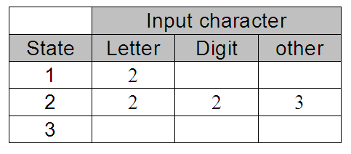
State-Transition Matrix
letter
1
letter
2
[other]
3
digit
Represent the behavior of a DFA by a state-transition matrix:

Slide 30
DFA for a Pascal Number
E
digit
digit
digit
digit
.
+
0
+
3
digit
4
6
digit
7
E
9
10
digit
11
[other]
12
-
-
digit
[other]
[other]
5
8
Note that this diagram allows only an upper-case E for an exponent.
What changes are required to also allow a lower-case e?

Slide 31
DFA for a Pascal Identifier or Number
private static final int matrix[][] = {
/* letter digit + - . E other */
/* 0 */ { 1, 4, 3, 3, ERR, 1, ERR },
/* 1 */ { 1, 1, -2, -2, -2, 1, -2 },
/* 2 */ { ERR, ERR, ERR, ERR, ERR, ERR, ERR },
/* 3 */ { ERR, 4, ERR, ERR, ERR, ERR, ERR },
/* 4 */ { -5, 4, -5, -5, 6, 9, -5 },
/* 5 */ { ERR, ERR, ERR, ERR, ERR, ERR, ERR },
/* 6 */ { ERR, 7, ERR, ERR, ERR, ERR, ERR },
/* 7 */ { -8, 7, -8, -8, -8, 9, -8 },
/* 8 */ { ERR, ERR, ERR, ERR, ERR, ERR, ERR },
/* 9 */ { ERR, 11, 10, 10, ERR, ERR, ERR },
/* 10 */ { ERR, 11, ERR, ERR, ERR, ERR, ERR },
/* 11 */ { -12, 11, -12, -12, -12, -12, -12 },
/* 12 */ { ERR, ERR, ERR, ERR, ERR, ERR, ERR },
};
Negative numbers
in the matrix are the
accepting states.
letter
0
letter
1
[other]
2
digit
+
-
digit
E
digit
digit
digit
digit
.
+
3
4
6
digit
7
E
9
10
digit
11
[other]
12
digit
-
[other]
[other]
Notice how the
letter E is handled!
5
8

Slide 32
A Simple DFA Scanner
public class SimpleDFAScanner
{
// Input characters.
private static final int LETTER = 0;
private static final int DIGIT = 1;
private static final int PLUS = 2;
private static final int MINUS = 3;
private static final int DOT = 4;
private static final int E = 5;
private static final int OTHER = 6;
private static final int ERR = -99999; // error state
private static final int matrix[][] = { ... };
private char ch; // current input character
private int state; // current state
...
}
SimpleDFAScanner.java

Slide 33
A Simple DFA Scanner, cont’d
SimpleDFAScanner.java
int typeOf(char ch)
{
return (ch == 'E') ? E
: Character.isLetter(ch) ? LETTER
: Character.isDigit(ch) ? DIGIT
: (ch == '+') ? PLUS
: (ch == '-') ? MINUS
: (ch == '.') ? DOT
: OTHER;
}

Slide 34
A Simple DFA Scanner, cont’d
private String nextToken()
throws IOException
{
while (Character.isWhitespace(ch)) nextChar();
if (ch == 0) return null; // EOF?
state = 0; // start state
StringBuilder buffer = new StringBuilder();
while (state >= 0) { // not accepting state
state = matrix[state][typeOf(ch)]; // transit
if ((state >= 0) || (state == ERR)) {
buffer.append(ch); // build token string
nextChar();
}
}
return buffer.toString();
}
SimpleDFAScanner.java
This is the
heart of the
scanner.
Table-driven scanners
can be very fast!

Slide 35
A Simple DFA Scanner, cont’d
private void scan()
throws IOException
{
nextChar();
while (ch != 0) { // EOF?
String token = nextToken();
if (token != null) {
System.out.print("=====> \"" + token + "\" ");
String tokenType =
(state == -2) ? "IDENTIFIER"
: (state == -5) ? "INTEGER"
: (state == -8) ? "REAL (fraction only)"
: (state == -12) ? "REAL"
: "*** ERROR ***";
System.out.println(tokenType);
}
}
}
SimpleDFAScanner.java
How do we know which token we just got?
Demo

Slide 36
A Simple DFA Scanner, cont’d
private static final int matrix[][] = {
/* letter digit + - . E other */
/* 0 */ { 1, 4, 3, 3, ERR, 1, ERR },
/* 1 */ { 1, 1, -2, -2, -2, 1, -2 },
/* 2 */ { ERR, ERR, ERR, ERR, ERR, ERR, ERR },
/* 3 */ { ERR, 4, ERR, ERR, ERR, ERR, ERR },
/* 4 */ { -5, 4, -5, -5, 6, 9, -5 },
/* 5 */ { ERR, ERR, ERR, ERR, ERR, ERR, ERR },
/* 6 */ { ERR, 7, ERR, ERR, ERR, ERR, ERR },
/* 7 */ { -8, 7, -8, -8, -8, 9, -8 },
/* 8 */ { ERR, ERR, ERR, ERR, ERR, ERR, ERR },
/* 9 */ { ERR, 11, 10, 10, ERR, ERR, ERR },
/* 10 */ { ERR, 11, ERR, ERR, ERR, ERR, ERR },
/* 11 */ { -12, 11, -12, -12, -12, -12, -12 },
/* 12 */ { ERR, ERR, ERR, ERR, ERR, ERR, ERR },
};
This table is very sparse.
Lots of ERR entries.
What would happen if we added the reserved words and all the special symbols?

