Slide 1
CS 153: Concepts of Compiler Design September 6 Class Meeting
Department of Computer Science San Jose State University Fall 2023 Instructor: Ron Mak
www.cs.sjsu.edu/~mak

Slide 2
Simple Interpreter
Now that we have a basic parse tree and a rudimentary symbol table, we can start the backend tier.
Recall the the backend components only work with the intermediate tier components.

Slide 3
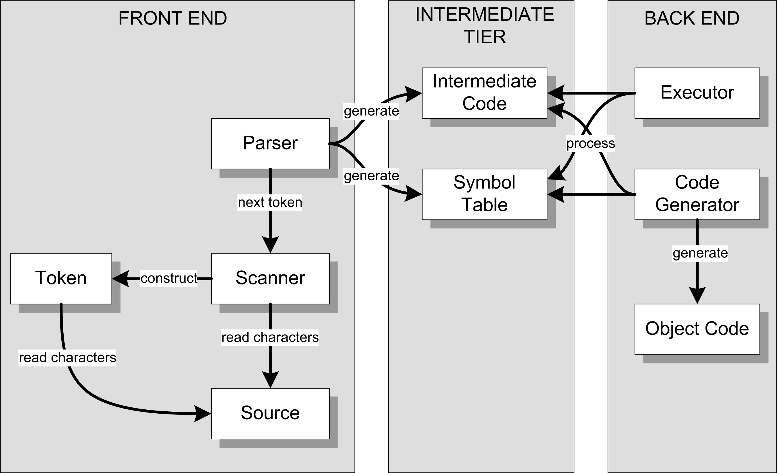
Review: Conceptual Design
Interpreter
Compiler or
converter
Can an interpreter’s backend executor
run a Pascal program using only
the parse tree and the symbol table?

Slide 4
A Hack!
So far, we have not parsed any variable declarations.
The hack:
When a variable appears on the left-hand side (LHS) of an assignment statement (i.e., it’s the target of the assignment) and it’s not already in the symbol table, enter it into the symbol table.
When a variable appears in the right-hand side (RHS), check to see if it’s in the symbol table.
The variable is undeclared if it isn’t in the symbol table.
celsius := (fahrenheit - 32)/1.8

Slide 5
Another Hack!
Storing values calculated during run time into variables’ symbol table entries is a temporary hack we’ll use for now.
This will fail miserably if we have recursion.
We’ll see later where we should actually store calculated runtime values for variables.
Why?

Slide 6
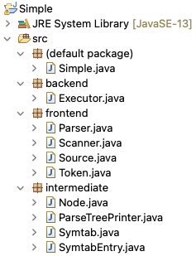
Simple Interpreter
Main

Slide 7
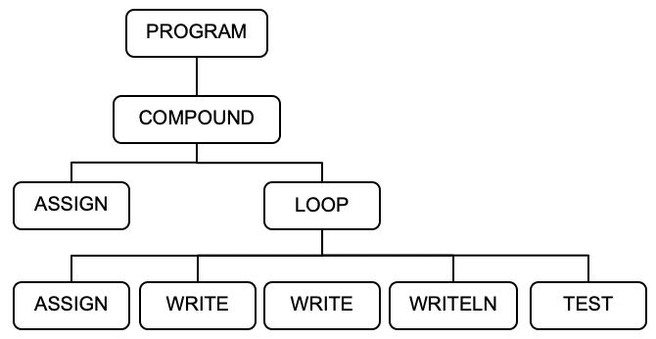
Parse Tree
PROGRAM HelloWorld;
BEGIN
i := 0;
REPEAT
i := i + 1;
write('#'); write(i);
writeln(': Hello, world!')
UNTIL i = 5
END.
<PROGRAM HelloWorld>
<COMPOUND line 3>
<ASSIGN line 4>
<VARIABLE i />
<INTEGER_CONSTANT 0 />
</ASSIGN>
<LOOP line 6>
<ASSIGN line 7>
<VARIABLE i />
<ADD>
<VARIABLE i />
<INTEGER_CONSTANT 1 />
</ADD>
</ASSIGN>
<WRITE line 8>
<STRING_CONSTANT '#' />
</WRITE>
<WRITE line 8>
<VARIABLE i />
</WRITE>
<WRITELN line 9>
<STRING_CONSTANT ': Hello, world!' />
</WRITELN>
<TEST line 10>
<EQ>
<VARIABLE i />
<INTEGER_CONSTANT 5 />
</EQ>
</TEST>
</LOOP>
</COMPOUND>
</PROGRAM>
java -cp bin Simple -parse HelloWorld.txt

Slide 8
Visiting Parse Tree Nodes During Run Time
Class Executor in the backend package contains numerous visit methods for the types of tree nodes:
visitProgram()
visitStatement()
visitCompound()
visitAssign()
visitLoop()
visitTest()
visitExpression()
etc.
We write visit*() methods
because we'll soon see that
the ANTLR compiler-compiler
tool generates visit*()
methods for us.

Slide 9
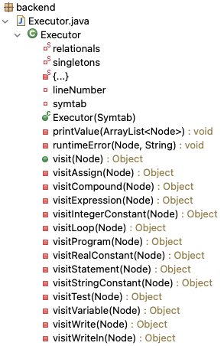
Backend visit* Methods
This is based on the
Visitor Design Pattern.

Slide 10
Example Runs
These source files are named *.txt because they’re not complete Pascal programs.
For example, they are missing variable declarations.
HelloWorld.txt
Temperature.txt
SquareRootTable.txt
java -cp bin Simple -execute HelloWorld.txt
java -cp bin Simple -execute Temperature.txt
java -cp bin Simple -execute SquareRootTable.txt

Slide 11
Visiting Parse Tree Nodes, cont’d
To test the backend executor, the main starts things off with a visit of the PROGRAM node:
private static void executeProgram(Parser parser, Symtab symtab)
{
Node programNode = parser.parseProgram(); // build the parse tree
int errorCount = parser.errorCount();
// If no errors, execute the program using the parse tree.
if (errorCount == 0)
{
Executor executor = new Executor(symtab);
executor.visit(programNode);
}
else
{
System.out.println();
System.out.println("There were " + errorCount + " errors.");
}
}
Simple.java

Slide 12
Visiting Parse Tree Nodes, cont’d
Executor.java
public Object visit(Node node)
{
switch (node.type)
{
case PROGRAM : return visitProgram(node);
case COMPOUND :
case ASSIGN :
case LOOP :
case WRITE :
case WRITELN : return visitStatement(node);
case TEST: return visitTest(node);
default : return visitExpression(node);
}
}
package backend

Slide 13
Visiting Parse Tree Nodes, cont’d
Each visit method returns a value.
Most visit methods return null.
But visit methods for expression nodes each returns a value that the visit calculated.
The return type is type Object to enable returning a value of any scalar type or a String value.

Slide 14
Visiting Parse Tree Nodes, cont’d
private Object visitProgram(Node programNode)
{
Node compoundNode = programNode.children.get(0);
return visit(compoundNode);
}
Executor.java
private Object visitCompound(Node compoundNode)
{
for (Node statementNode : compoundNode.children) visit(statementNode);
return null;
}
Executor.java

Slide 15
Visiting Parse Tree Nodes, cont’d
private Object visitStatement(Node statementNode)
{
lineNumber = statementNode.lineNumber;
switch (statementNode.type)
{
case COMPOUND : return visitCompound(statementNode);
case ASSIGN : return visitAssign(statementNode);
case LOOP : return visitLoop(statementNode);
case WRITE : return visitWrite(statementNode);
case WRITELN : return visitWriteln(statementNode);
default : return null;
}
}
Executor.java

Slide 16
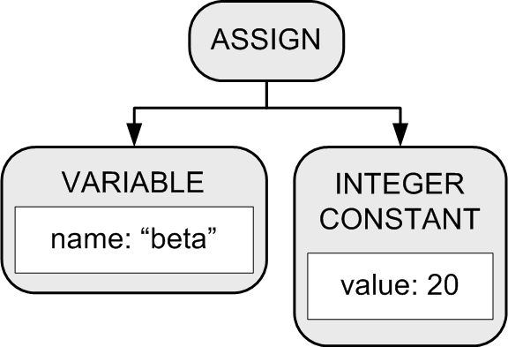
Visiting Parse Tree Nodes, cont’d
Executor.java
private Object visitAssign(Node assignNode)
{
Node lhs = assignNode.children.get(0);
Node rhs = assignNode.children.get(1);
// Evaluate the right-hand-side expression;
Double value = (Double) visit(rhs);
// Store the value into the variable's symbol table entry.
String variableName = lhs.text;
SymtabEntry variableId = symtab.lookup(variableName);
variableId.setValue(value);
return null;
}
Hack!

Slide 17
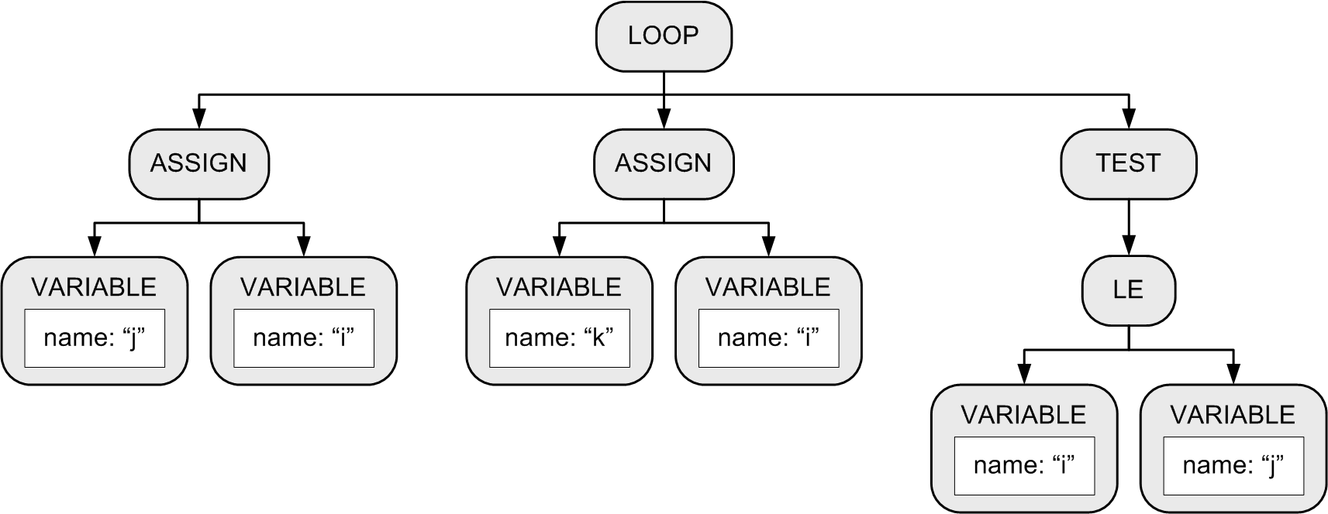
REPEAT Statement
Example:
Keep looping until the boolean expression becomes true.
Execute the loop at least once.
REPEAT j := i; k := i UNTIL i <= j
Use LOOP and TEST nodes for
source language independence.
Exit the loop
when the test
expression
evaluates to
true.

Slide 18
REPEAT Statement, cont’d
Executor.java
private Object visitLoop(Node loopNode)
{
boolean b = false;
do
{
for (Node node : loopNode.children)
{
Object value = visit(node); // statement or test
// Evaluate the test condition. Stop looping if true.
b = (node.type == TEST) && ((boolean) value);
if (b) break;
}
} while (!b);
return null;
}
private Object visitTest(Node testNode)
{
return (Boolean) visit(testNode.children.get(0));
}
Exit the loop
when the test
expression
evaluates to
true.

Slide 19
Cool Facts about the LOOP Subtree
It's language-independent.
It can handle any kind of looping statement.
The TEST node can be any one of the children.
It can be the first, last, or intermediate child.
There can be more than one TEST node.

Slide 20
Evaluating Expressions
Visit the nodes.
Perform the appropriate operation on the child nodes according to the type of node.

Slide 21
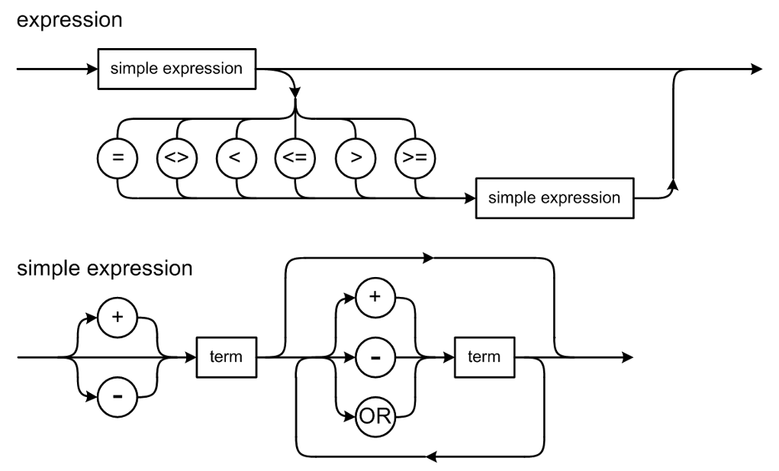
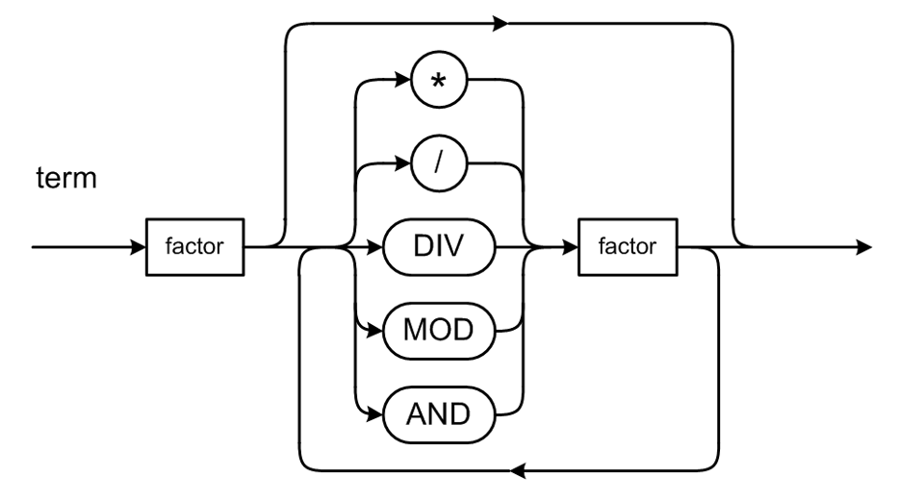
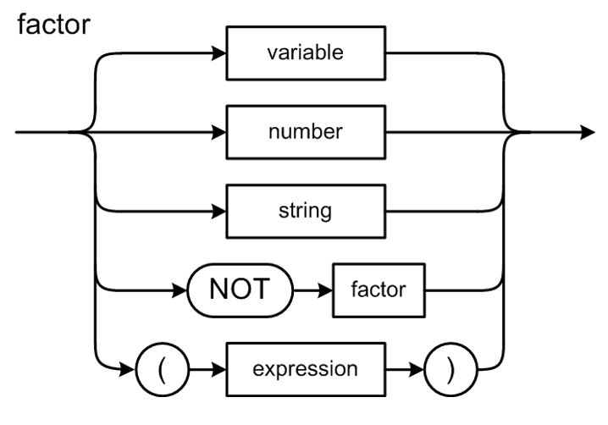
Evaluating Expressions, cont’d
Return the result of the operation.
visitExpression()
visitVariable()
visitIntegerConstant()
visitRealConstant()
visitStringConstant()

Slide 22
Evaluating Expressions, cont'd
Executor.java
private Object visitVariable(Node variableNode)
{
// Obtain the variable's value from its symbol table entry.
String variableName = variableNode.text;
SymtabEntry variableId = symtab.lookup(variableName);
Double value = variableId.getValue();
return value;
}
Hack!
private Object visitIntegerConstant(Node integerConstantNode)
{
long value = (Long) integerConstantNode.value;
return (double) value;
}

Slide 23
Assignment #3: Parser and Executor
Modify the frontend parser to parse and build trees for the following Pascal statements:
while
if
for
case
You may need to add new node types in the intermediate tier.
Add new visit methods to the backend executor to execute the above statements.
Some simple Pascal source files
are provided to test your interpreter.

Slide 24
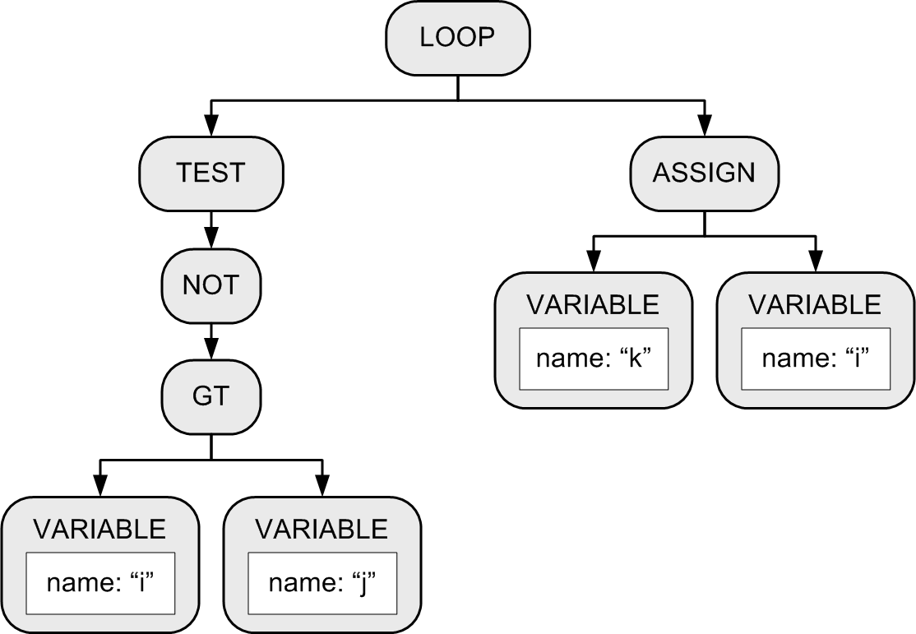
Parse Tree for the WHILE Statement
The statement
can be a
compound
statement.
while i > j do k := i
Why?

Slide 25
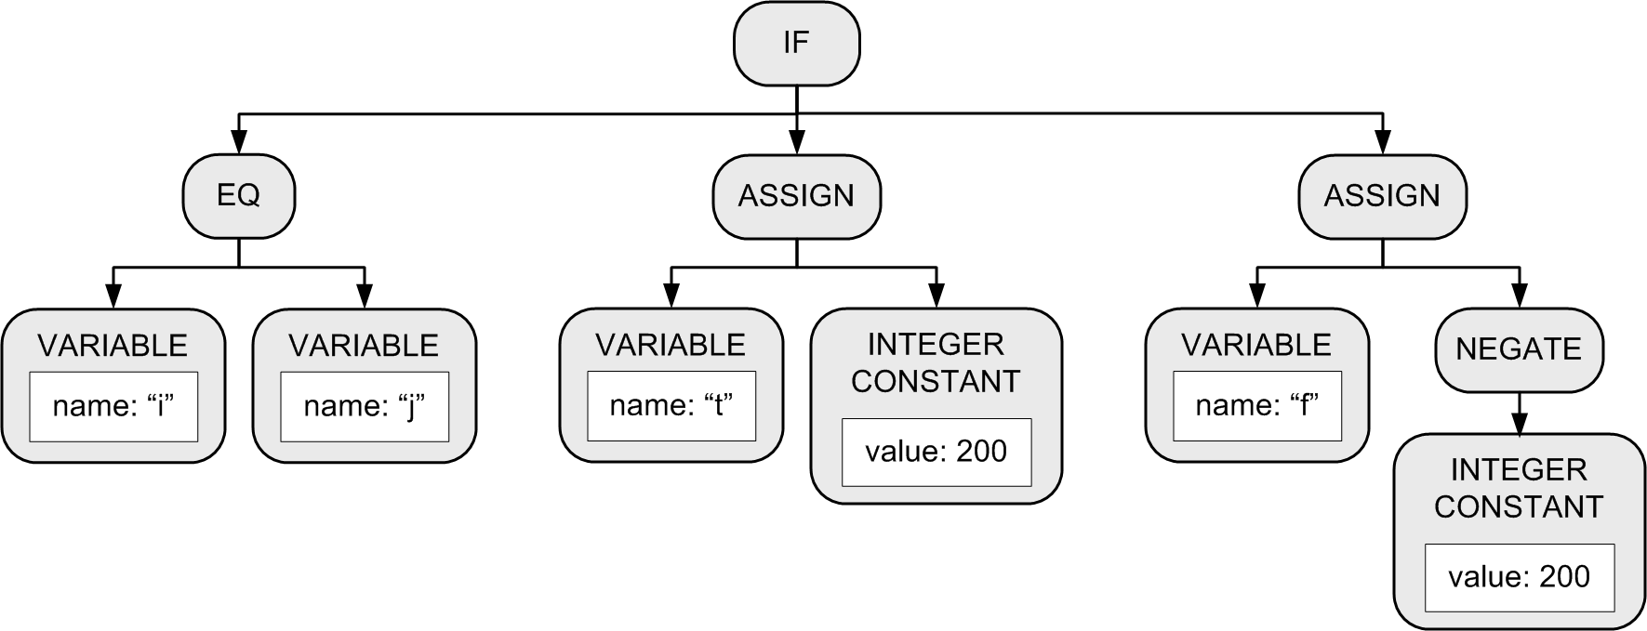
IF Statement
Each statement
can be a
compound
statement.
Example:
IF (i = j) THEN t := 200 ELSE f := -200;
Third child only if
there is an ELSE.

Slide 26
The “Dangling” ELSE
Consider:
Which THEN does the ELSE pair with?
Is it: IF i = 3 THEN IF j = 2 THEN t := 500 ELSE f := -500
Or is it: IF i = 3 THEN IF j = 2 THEN t := 500 ELSE f := -500
IF i = 3 THEN IF j = 2 THEN t := 500 ELSE f := -500

Slide 27
The “Dangling” ELSE, cont’d
According to Pascal syntax, the nested IF statement is the THEN statement of the outer IF statement IF i = 3 THEN IF j = 2 THEN t := 500 ELSE f := -500
Therefore, the ELSE pairs with the closest (i.e., the second) THEN.

Slide 28
Executing an IF Parse Tree
Evaluate the first child’s expression subtree.
If the expression value is true ...
Execute the second child’s statement subtree.
If the expression value is false …
If there is a third child statement subtree, then execute it.
If there isn’t a third child subtree, then we’re done with this tree.

Slide 29
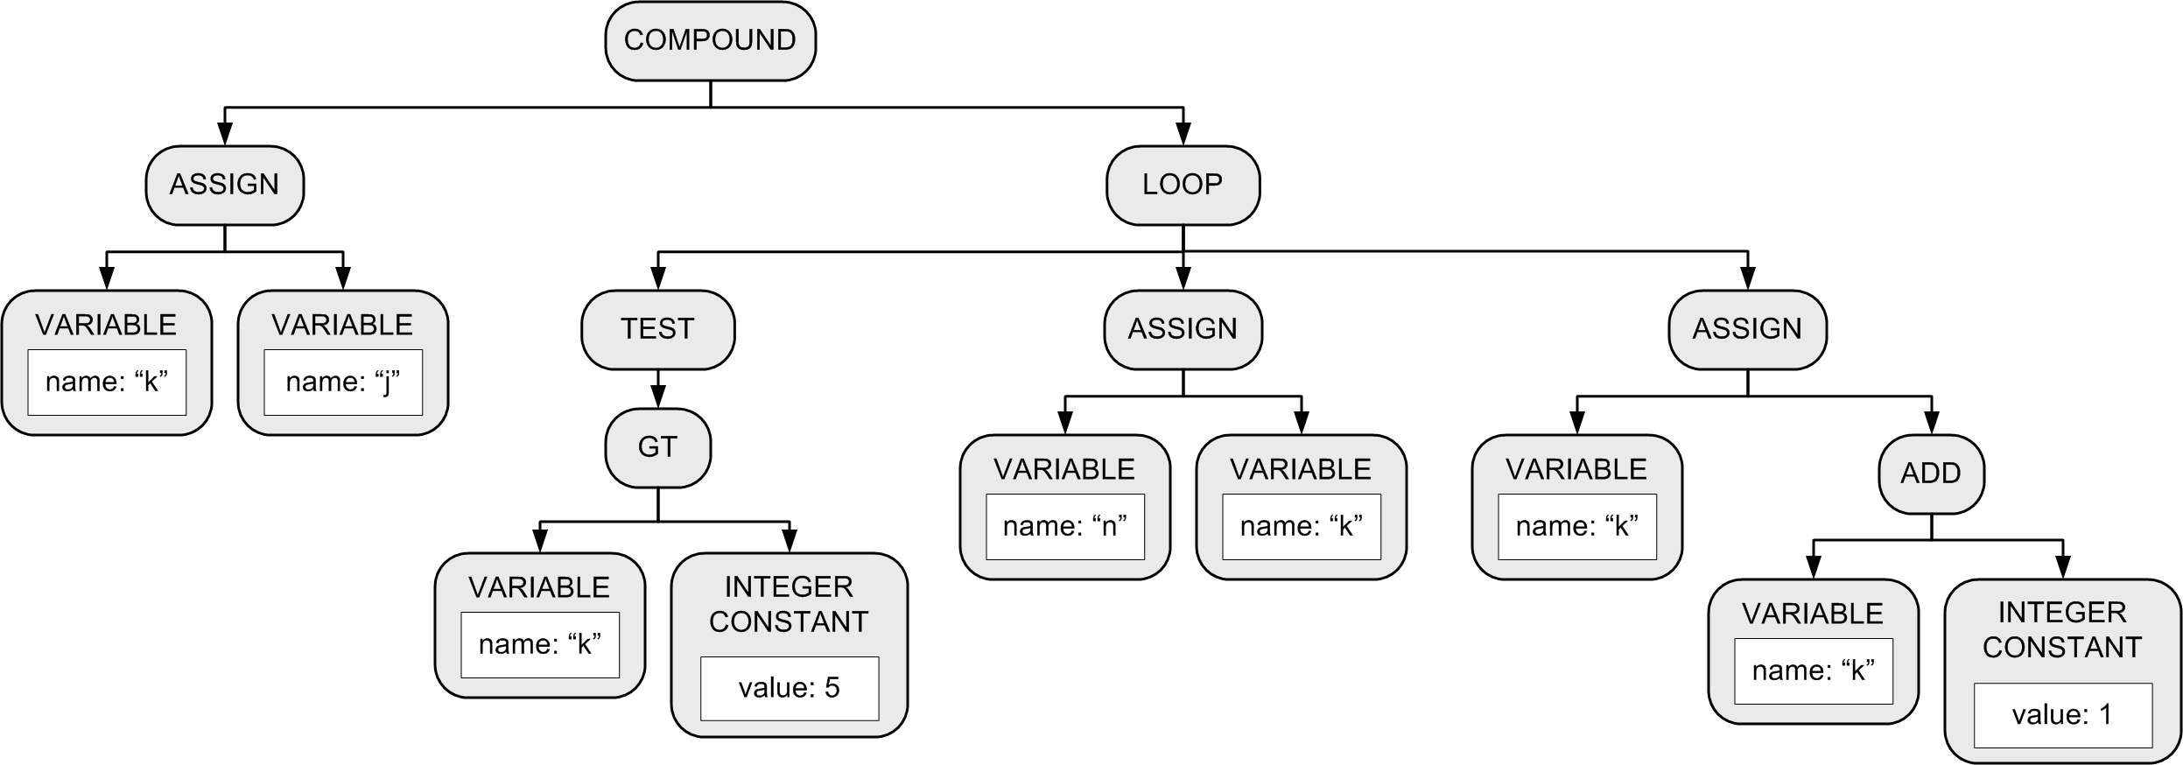
FOR Statement
The statement
can be a
compound
statement.
Example:
FOR k := j TO 5 DO n := k
Increment/decrement
the control variable:
Node type ADD for TO
and SUBTRACT for
DOWNTO.
Initial assignment.
Node type GT
for TO and LT
for DOWNTO.
DO statement.

Slide 30
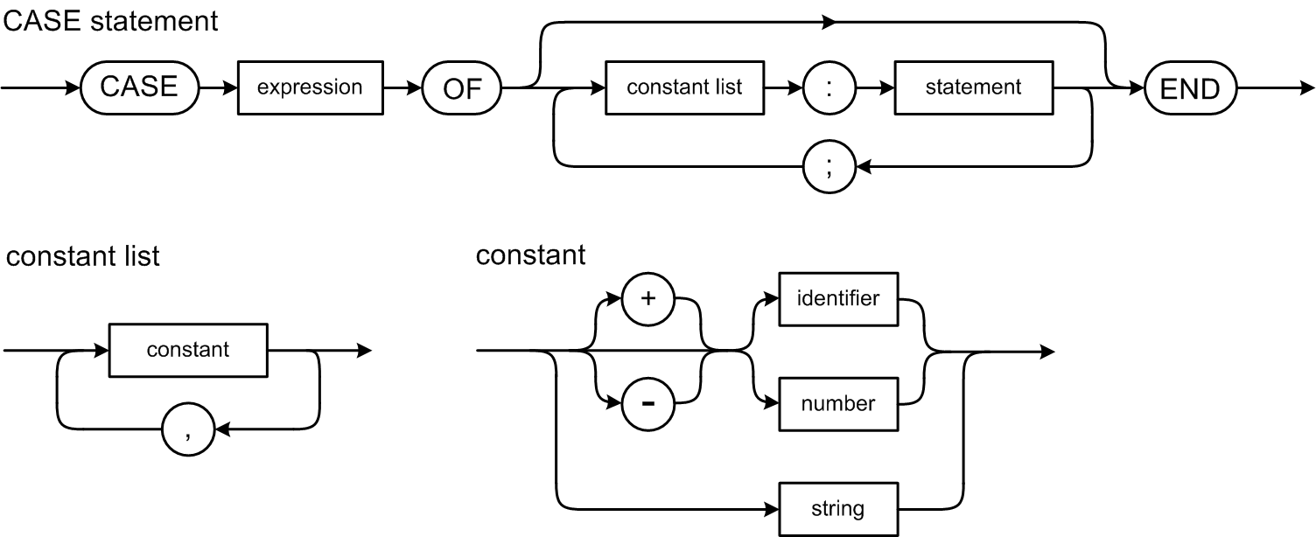
CASE Statement
Example:
CASE i+1 OF 1: j := i; 4: j := 4*i; 5, 2, 3: j := 523*i; END
Note that Pascal’s
CASE statement
does not use
BREAK statements.

Slide 31
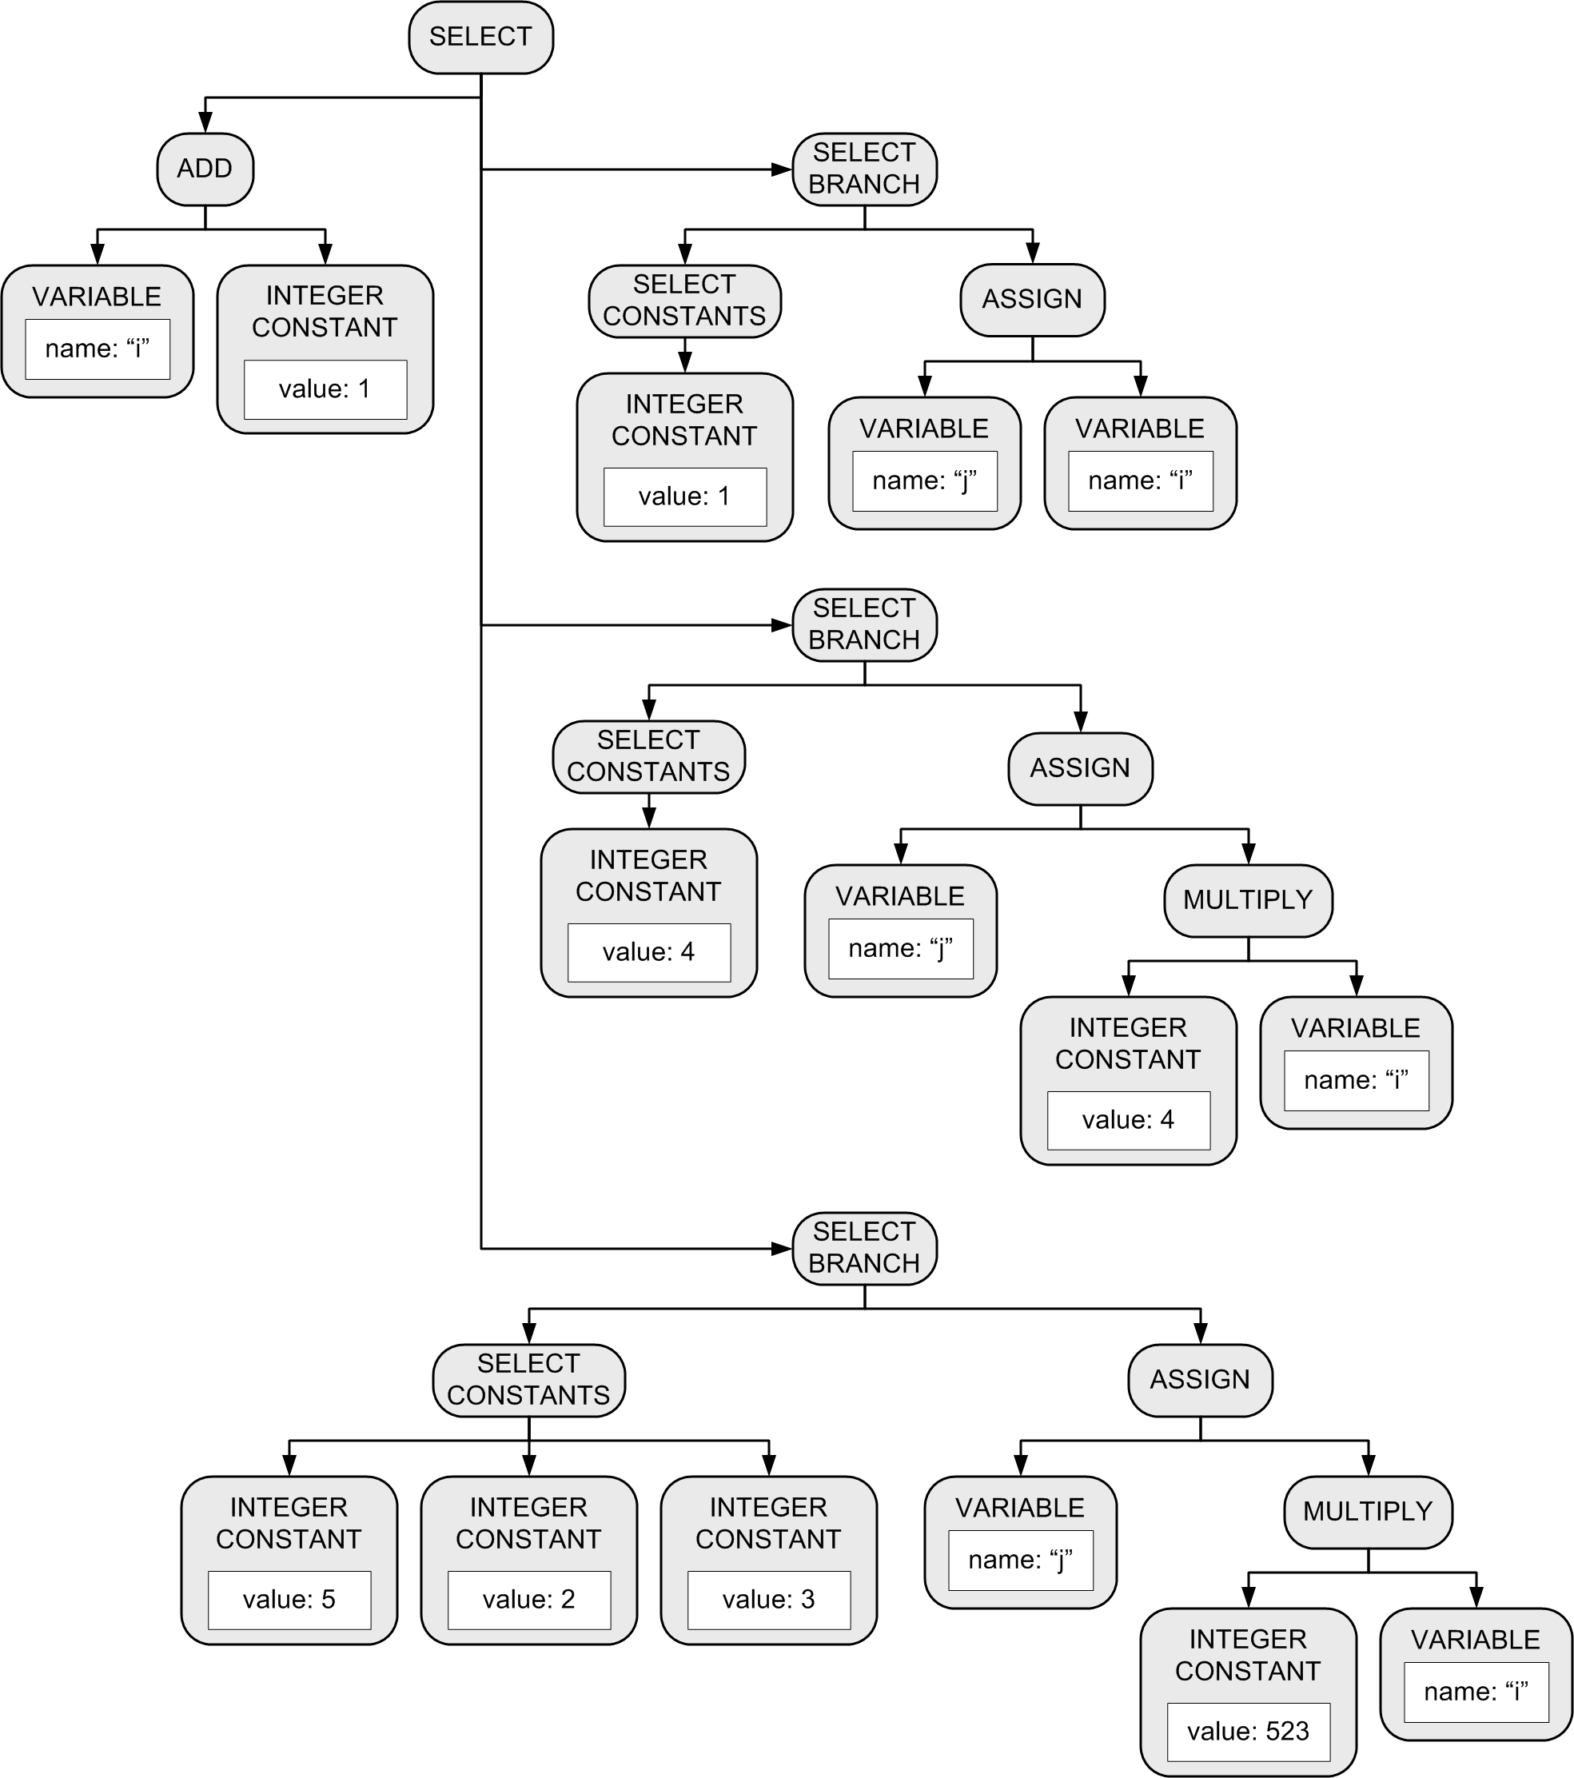
CASE Statement, cont’d
Example:
CASE i+1 OF 1: j := i; 4: j := 4*i; 5, 2, 3: j := 523*i; END

