Slide 1
CS 149: Operating Systems May 12 Class Meeting
Department of Computer Science San Jose State University Spring 2015 Instructor: Ron Mak
www.cs.sjsu.edu/~mak

Slide 2
Android
Designed by Google to run on mobile devices.
NASA uses Android for its “cube sats”.
Based on the Linux kernel and facilities.
Much written in Java.
Combines open-source code with closed-source third-party applications.
Supports a wide variety of proprietary cloud services.
Google Play online store for Android apps.

Slide 3
Android Design Goals
Open-source platform for mobile devices
Support 3rd party apps with robust, stable API
3rd party apps compete on level playing field
Users need not deeply trust 3rd party apps
Support mobile user interaction
Manage app processes for users
Encourage apps to interoperate, collaborate
Full general-purpose OS

Slide 4
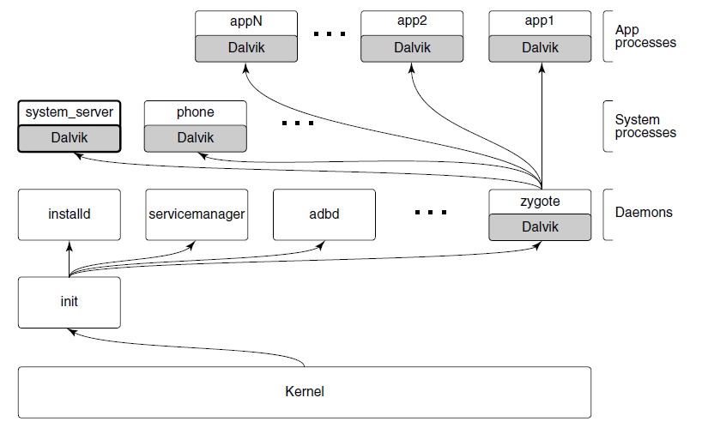
Android Architecture
Modern Operating Systems, 4th ed.
Andrew Tanenbaum and Herbert Bos
Pearson, 2014
ISBN: 978-0133591620

Slide 5
Android Architecture, cont'd
The init process starts Android daemons.
Focused on low-level functions such as managing file systems and hardware access.
Additional layer of processes that run Dalvik's Java language environment.
Dalvik is a managed runtime environment.
Brought up by the zygote native daemon.
JVM bytecode is translated to Dalvik bytecode.

Slide 6
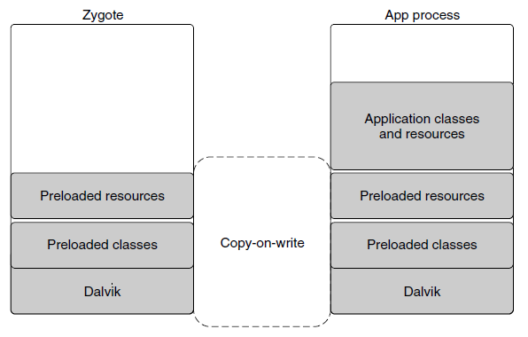
Dalvik
Modern Operating Systems, 4th ed.
Andrew Tanenbaum and Herbert Bos
Pearson, 2014
ISBN: 978-0133591620

Slide 7
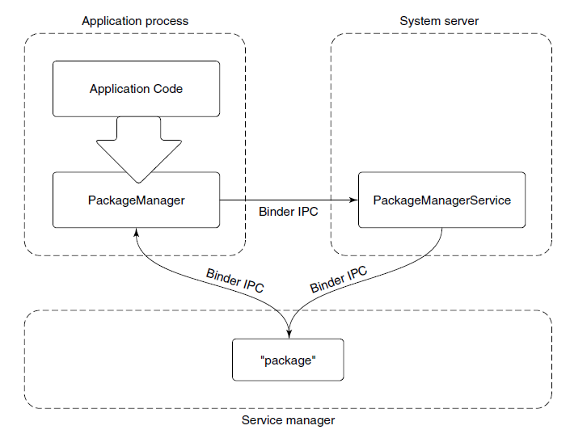
Android Application Framework
Modern Operating Systems, 4th ed.
Andrew Tanenbaum and Herbert Bos
Pearson, 2014
ISBN: 978-0133591620

Slide 8
Package Manager Example
The package manager provides a framework API for apps to call in their local process.
The PackageManager class connects to the corresponding service in the system server.
The PackageManager makes calls on the service.
Calls are implemented as interprocess communication.
Android Binder IPC mechanism.

Slide 9
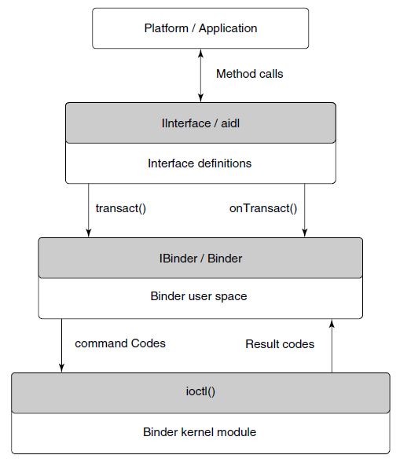
Binder IPC
Relies on remote procedure calls (RPC).
Modern Operating Systems, 4th ed.
Andrew Tanenbaum and Herbert Bos
Pearson, 2014
ISBN: 978-0133591620

Slide 10
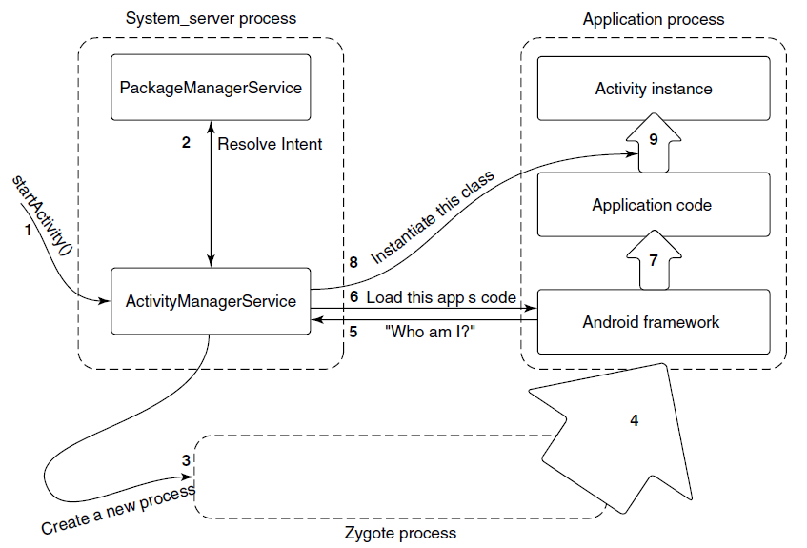
Launching a New Application Process
Modern Operating Systems, 4th ed.
Andrew Tanenbaum and Herbert Bos
Pearson, 2014
ISBN: 978-0133591620

Slide 11
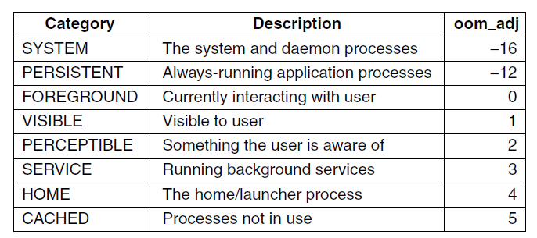
Process Lifecycle
Process importance categories.
oom_adj: a strict ordering to determine which processes to kill first in an out-of-memory situation.
Modern Operating Systems, 4th ed.
Andrew Tanenbaum and Herbert Bos
Pearson, 2014
ISBN: 978-0133591620

Slide 12
Postmortem Reports
Due Monday, May 18 at 11:59 PM
A few paragraphs.
Word document or just an email message
Individual and private.
What did you learn in this class?
What were your accomplishments on your project team?
How well did each of your teammates do?

Slide 13
Final Exam
Section 3 (9:00 AM):
Thursday, May 21 at 7:15 – 9:30 AM in DH 450
Section 2 (3:00 PM):
Monday, May 18 at 2:45 – 5:00 PM in MH 233
Section 8 (6:00 PM):
Tuesday, May 19 at 5:15 – 7:30 PM in MH 223
It will be similar to the midterm.
Covers the entire semester.
More emphasis on the second half.

Slide 14
Disk Storage
Industry standard I/O bus
Host-attached storage
Network-attached storage (NAS)
Storage-area network (SAN)

Slide 15
Disk Storage, cont'd
Disk scheduling algorithms
FCFS: first-come first-served
SSTF: shortest seek time first
SCAN: elevator scheduling
C-SCAN: circular scan
LOOK and C-LOOK
Hierarchical storage management (HSM)
RAID

Slide 16
File Systems
File types
File attributes
File operations
File tables
File locking
File structure
Sequential access
Direct (random) access

Slide 17
File Systems, cont'd
Disk structure
Partitions
Directories
Operations
Single- and two-level
Tree-structured
Acyclic graphs

Slide 18
File Systems, cont'd
File path names
Mounting a file system
File protection
Unix

Slide 19
File Systems, cont'd
Implementation
Layered architecture
Master boot record
Superblock
File-control blocks (inodes)
File allocation algorithms
Contiguous
Linked
File allocation table (FAT)
Indexed

Slide 20
File Systems, cont'd
UNIX directories
Disk block size
Free space management
Reliability
Consistency

Slide 21
File Systems, cont'd
Performance
Caching
Read ahead
Disk arm motion
Log-structured
Virtual
Networked file system (NFS)
NFS mounting

Slide 22
I/O
Device controllers
Polling
I/O interrupts
Priority levels
Application-level interrupt handlers
Sockets
select()
Clocks and timers

Slide 23
Virtualization
Virtual machine manager
Types
Implementation

Slide 24
Distributed Systems
Advantages
Network operating systems
Distributed operating systems
Network structure
LAN and WAN

Slide 25
Distributed Systems, cont'd
Communication structure
Naming
Domain name service (DNS)
Routing
Fixed, virtual, dynamic
Contention
CSMA/CD

Slide 26
Distributed Systems, cont'd
Connection strategies
Circuit, message, packet switching
Communications protocols
ISO 7-layer model
TCP/IP protocol layers
Ethernet
Failure detection
Reconfiguration
Network design issues

Slide 27
Distributed Systems, cont'd
Distributed file system
Structure
Naming and transparency
Naming schemes
Remote file access
Caching
Location
Update policy
Consistency

Slide 28
Protection
Principle of least privilege
Granularity
Domains
UNIX domains
Domain switching

Slide 29
Protection, cont'd
Access matrix
Access control list
Capability list
Role-based access control
Covert channels
Program-level protection

Slide 30
Security
Violations
Methods
Man in the middle
Trojan horse
Trap door
Logic bomb
Stack and buffer overflow

Slide 31
Security, cont'd
Levels
Viruses
Internet worms
Port scanning
Denial of service
User authentication
Firewalls
Cryptography

Slide 32
Case Studies
Linux
Windows 7
Android

Slide 33
IBM Manual, 1925
All parts should go together without forcing.
You must remember that the parts you are reassembling were disassembled by you.
Therefore, if you can’t get them together again,
there must be a reason.
By all means, do not use a hammer.

