Slide 1
CS 149: Operating Systems May 5 Class Meeting
Department of Computer Science San Jose State University Spring 2015 Instructor: Ron Mak
www.cs.sjsu.edu/~mak

Slide 2
Case Study: The Linux Operating System
Linux as a case study of operating systems should be like a semester review.
We’ve pretty much been looking at Linux all along.
Designed by programmers for programmers, to be:
Simple
Elegant
Consistent
Powerful
Flexible

Slide 3
A Brief History of UNIX
MULTICS, 1965-1970
Multiplexed Information and Computing Service
M.I.T. + Bell Labs + General Electric
Ran on the GE 645 mainframe computer.
UNICS, 1969
Uniplexed Information and Computing Service
Ken Thompson at Bell Labs
Initially ran on a PDP-7 minicomputer.
“A castrated MULTICS”
Renamed to UNIX

Slide 4
A Brief History of UNIX, cont’d
UNIX
Ken Thompson and Dennis Richie at Bell Labs: Version 1, 1971
Invented the C language to write the system code.
Landmark paper published, 1974.
Bell Labs: Version 7, 1979 (commercial UNIX)
U.C. Berkeley: Berkeley Software Distribution (BSD 4.0), 1980 (academic and research UNIX)
AT&T: UNIX System V Release 2 (SVR2), 1984
Andrew Tanenbaum: MINIX, 1987
Linus Torvalds: Linux, 1991
See: http://www.levenez.com/unix/unix_a4.pdf

Slide 5
POSIX
Portable Operating System + “ix”
IEEE standard to reconcile UNIX versions.
System V
BSD
Defines a set of library procedures and system calls for every conformant system.
Example: open(), read(), fork()
Some Linux distributions are POSIX certified.

Slide 6
Booting Linux
The Master Boot Record (MBR) in the first sector of the boot disk contains the boot program.
GRUB (Grand Unified Bootloader) can be configured to boot a selected OS from a list of choices (dual booting or multi-booting).

Slide 7
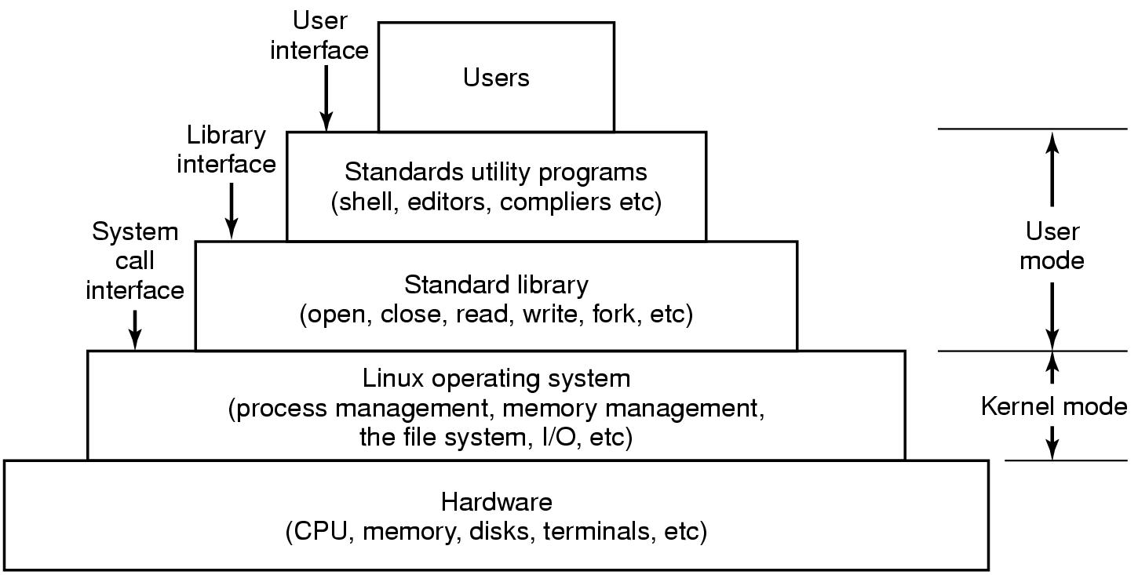
The Layers in a Linux System
Modern Operating Systems, 3rd ed.
Andrew Tanenbaum
(c) 2008 Prentice-Hall, Inc.. 0-13-600663-9
All rights reserved

Slide 8
Linux User Interfaces
Command-line
bash (Bourne again shell) shell
GUI
Full desktop environments
GNOME (GNU Network Object Model Environment)
KDE (K Desktop Environment)
X Windowing System
X window server
xlib library for client applications to interact with the server.

Slide 9
The Linux Kernel
Originally ran only on 80386 chip architecture.
Kernel completely written from scratch.
Traditional non-microkernel implementation.
Ported support software and utilities.
Example: GNU C compiler (gcc)

Slide 10
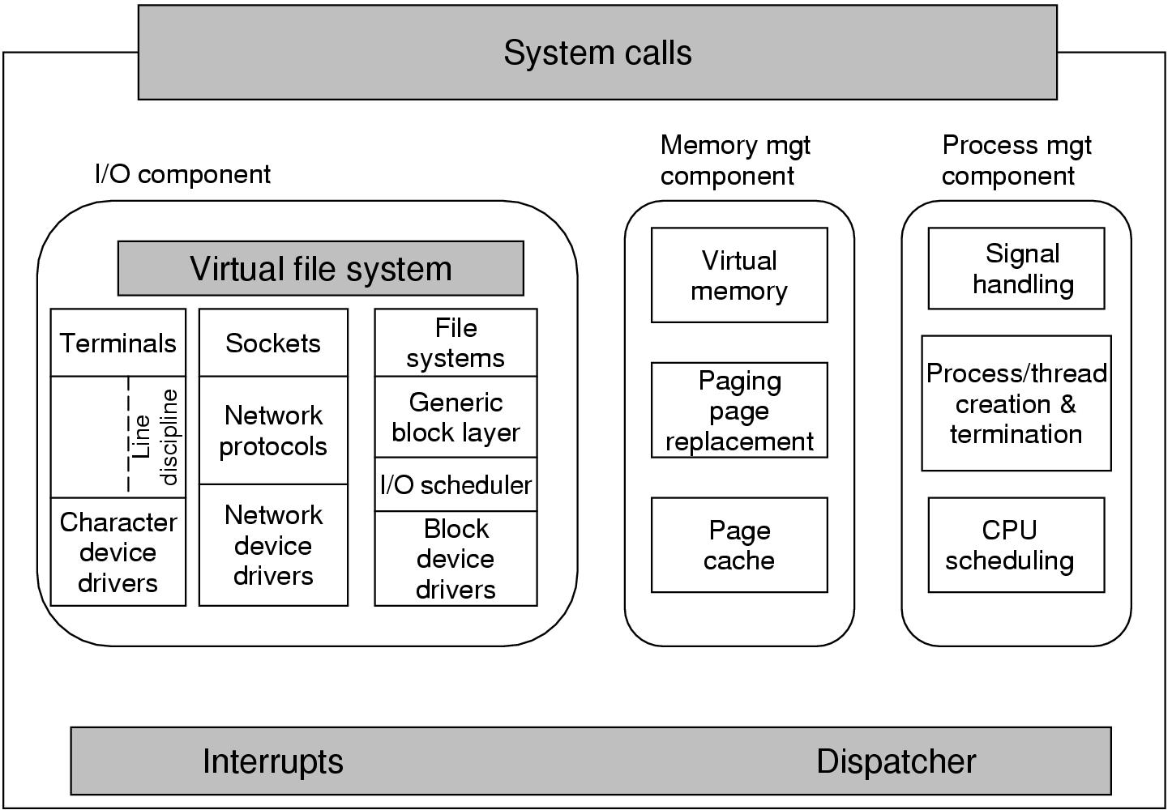
Structure of the Linux Kernel
Modern Operating Systems, 3rd ed.
Andrew Tanenbaum
(c) 2008 Prentice-Hall, Inc.. 0-13-600663-9
All rights reserved

Slide 11
Linux Processes
Each process has an environment that it inherits from its parent in two parts:
Argument vector: Command-line arguments.
Environment vector: name=value pairs.

Slide 12
Linux Processes, cont’d
System call fork() creates a child process.
The child has a copy of the parent’s resources.
Recall: copy-on-write
The exec() family of system calls replace the calling process with a new process.
int pid = fork();
if (pid > 0) {
waitpid(-1, &status, 0);
}
else {
execl("/bin/ls", "ls", "-l", "/home/rmak", NULL);
}
Demo

Slide 13
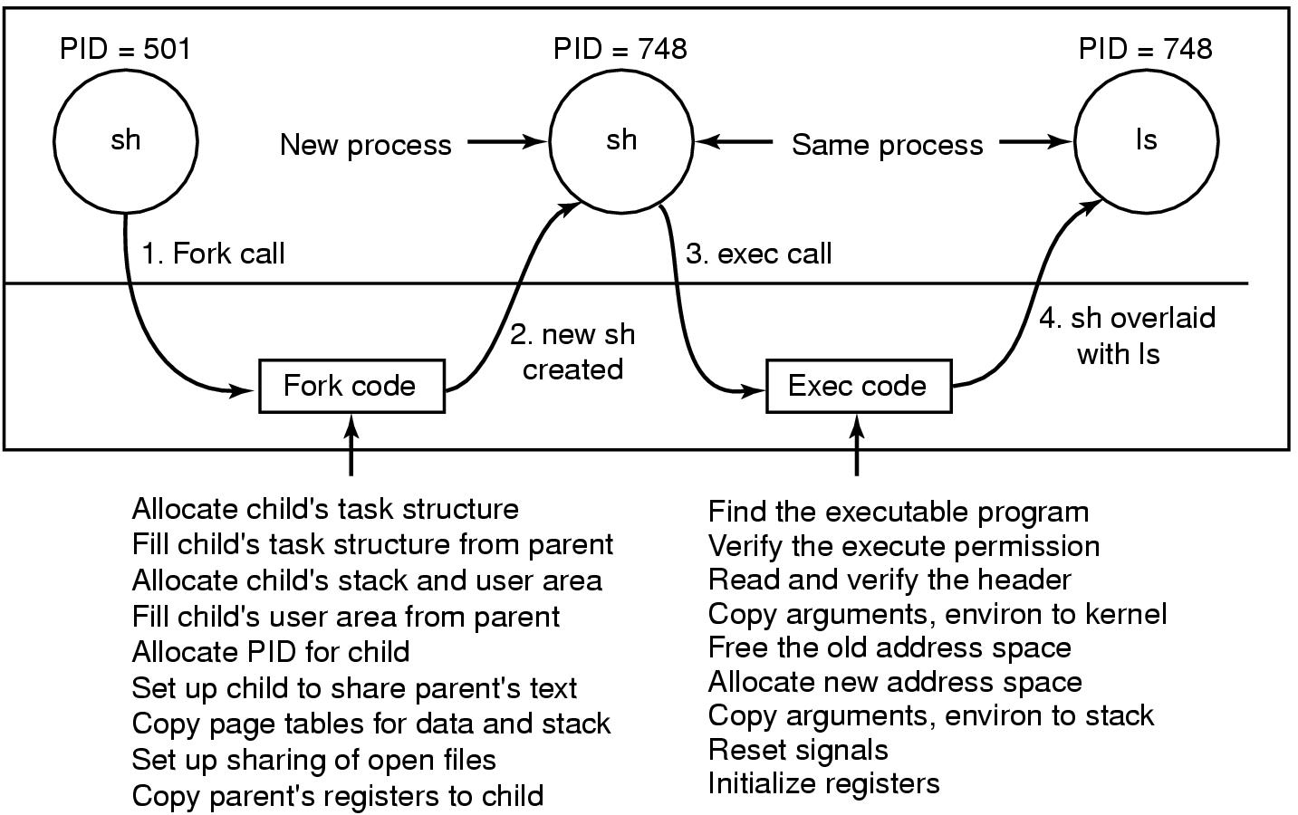
Linux Processes, cont’d
Modern Operating Systems, 3rd ed.
Andrew Tanenbaum
(c) 2008 Prentice-Hall, Inc.. 0-13-600663-9
All rights reserved

Slide 14
Linux Processes and Threads
Linux tasks represent processes and threads.
Same internal process descriptor:
Scheduling parameters
Memory image
Signals
Machine registers
System call state
File descriptor table
Accounting
Kernel stack
Miscellaneous

Slide 15
Linux clone()
Besides the fork() system call, Linux also has the clone() system call.
Creates a new thread.
Either in the current process or in a new process.
Depending on the sharing_flags bitmap.
pid = clone(function, stack_ptr, sharing_flags, arg)
Modern Operating Systems, 3rd ed.
Andrew Tanenbaum
(c) 2008 Prentice-Hall, Inc.. 0-13-600663-9
All rights reserved

Slide 16
Linux Scheduler
Real-time
Priority-based and preemptive.
Priority ranges 0-99.
FCFS and round-robin, as required by POSIX.
Timesharing
Pre-emptive Completely Fair Scheduler (CFS).
Uses a red-black tree as the runqueue data structure.
CFS always schedules the task which has the least amount of time left on the CPU.
Typically the leftmost node in the tree.
nice command and system call can adjust a process’s priority up or down.

Slide 17
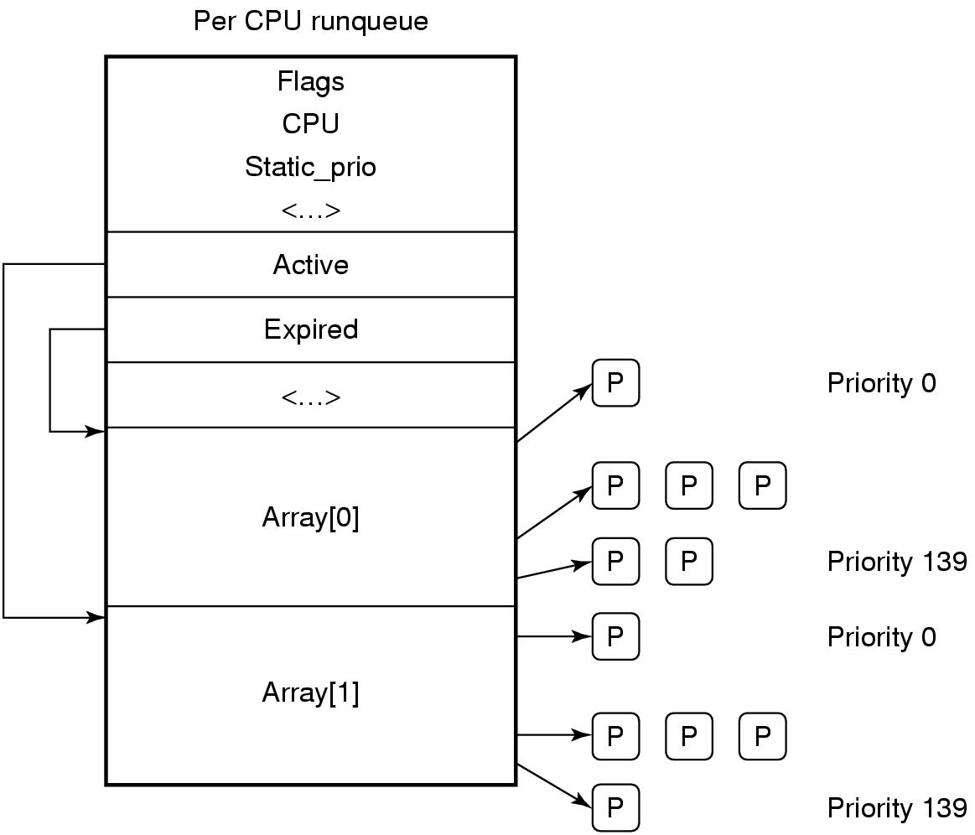
Linux Scheduler, cont’d
The runqueue is associated with each CPU.
Two arrays, active and expired.
Each contains 140 list heads, one per priority level.
Each list head points to a list of processes at that priority level.
Modern Operating Systems, 3rd ed.
Andrew Tanenbaum
(c) 2008 Prentice-Hall, Inc.. 0-13-600663-9
All rights reserved

Slide 18
Linux Interprocess Communication
Borrowed from System V interprocess communication (IPC)
Shared memory
Semaphores
Message queues
Pipes
Each pipe has a pair of wait queues to synchronize the reader and writer.

Slide 19
Linux Memory Management
Allocate and free physical memory.
Pages
Groups of pages.
Small blocks of RAM.
Uses the buddy system.
Virtual memory
Memory-mapped into the address space of the running process.

Slide 20
Process Address Space
Text segment
Executable code.
Normally read-only.
Data segment
Process variables, strings, arrays, and other data.
Two parts
initialized data
uninitialized data (BSS = Block Started by Symbol) or heap
System call brk() sets the data segment size.
Stack segment
Grows toward lower virtual addresses.

Slide 21
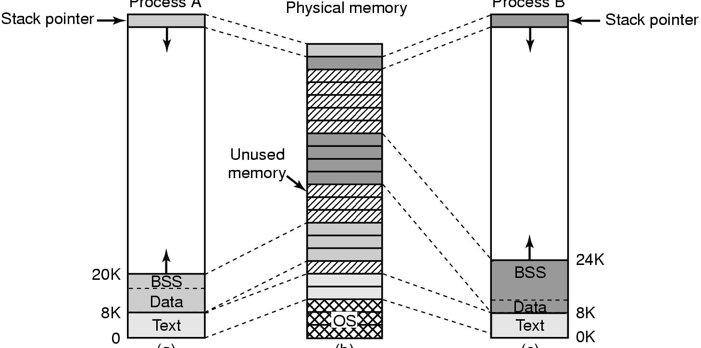
Process Address Space, cont’d
Process A
Process B
Modern Operating Systems, 3rd ed.
Andrew Tanenbaum
(c) 2008 Prentice-Hall, Inc.. 0-13-600663-9
All rights reserved

Slide 22
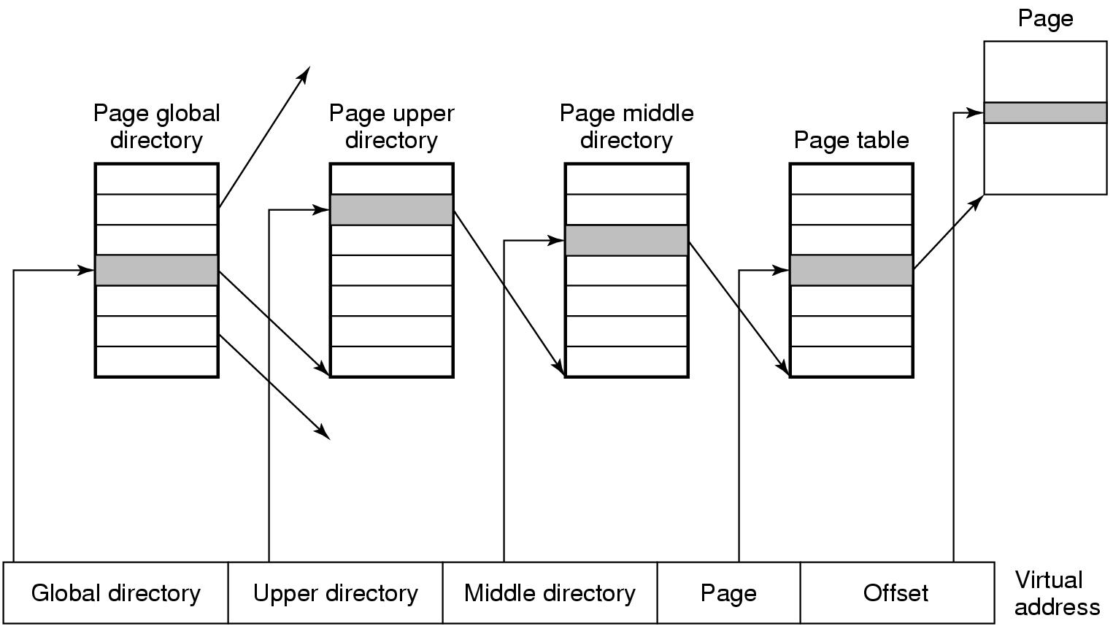
Four-Level Page Tables
Each virtual address consists of five fields.
Modern Operating Systems, 3rd ed.
Andrew Tanenbaum
(c) 2008 Prentice-Hall, Inc.. 0-13-600663-9
All rights reserved

Slide 23
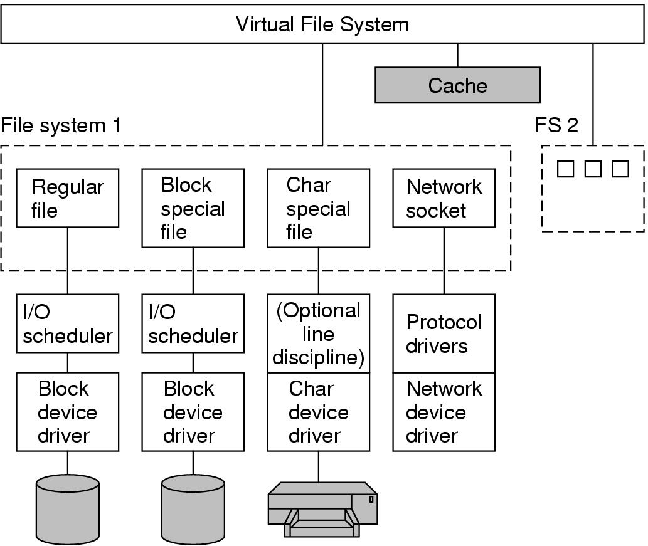
Linux File System
A file can be anything capable of handling the I/O of a stream of data.
Modern Operating Systems, 3rd ed.
Andrew Tanenbaum
(c) 2008 Prentice-Hall, Inc.. 0-13-600663-9
All rights reserved

Slide 24
Linux ext3 File System
Default block size is a function of the total size of the file system.
Block sizes of 1, 2, 4, and 8 KB supported.
To maintain high performance, cluster physically adjacent I/O requests.
Journaling file system
Transactions are logged to a journal.
Journal entries are replayed to the actual file system.
Journaling may improve file system performance.

Slide 25
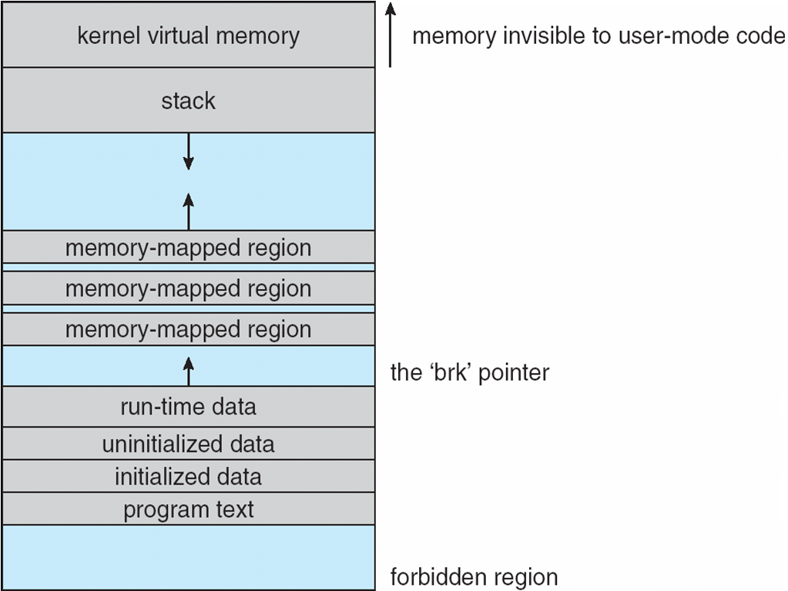
Linux Executable Files
Old format: a.out
New format: ELF
Memory layout:
Operating Systems Concepts, 9th edition
Silberschatz, Galvin, and Gagne
(c) 2013 John Wiley & Sons. All rights reserved. 978-1-118-06333-0

Slide 26
Linux File Directories
Store directories on disk just like normal files.
Each directory block is a linked list of entries.
Each entry contains:
entry length
file name
inode number

Slide 27
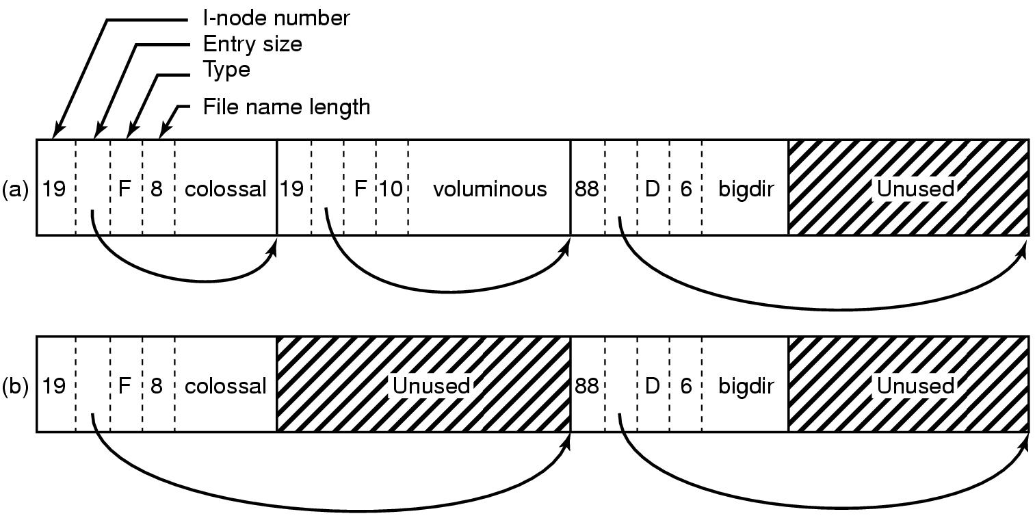
Linux File Directories, cont’d
A Linux directory with three files.
The same directory after the file “voluminous” has been removed.
Modern Operating Systems, 3rd ed.
Andrew Tanenbaum
(c) 2008 Prentice-Hall, Inc.. 0-13-600663-9
All rights reserved00

Slide 28
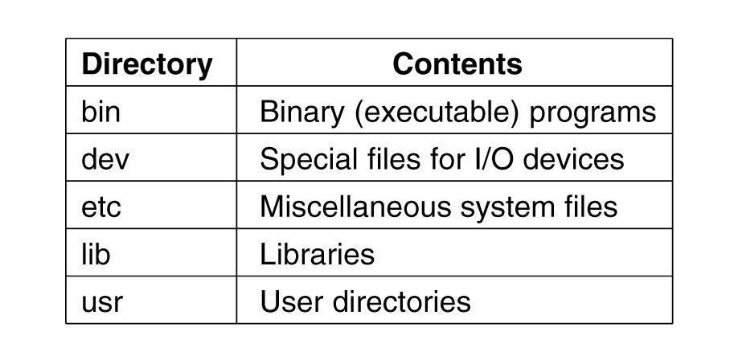
Important Linux Directories

Slide 29
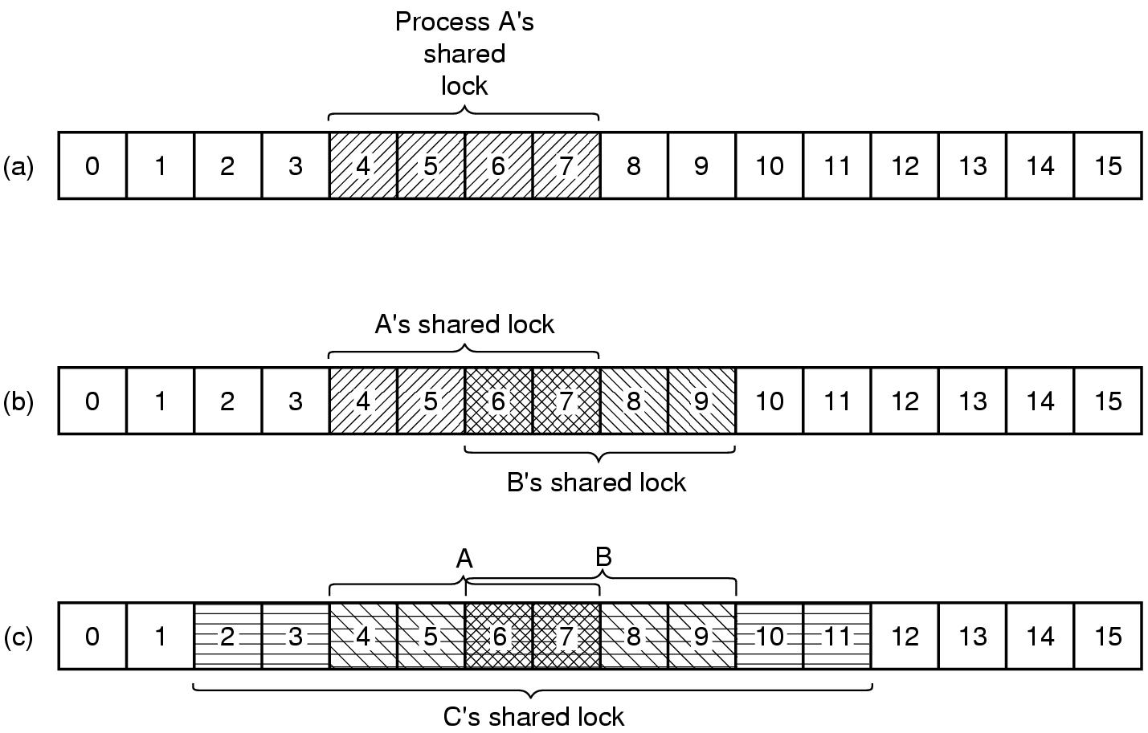
Linux File Locking
Shared locks and exclusive locks.
Modern Operating Systems, 3rd ed.
Andrew Tanenbaum
(c) 2008 Prentice-Hall, Inc.. 0-13-600663-9
All rights reserved00

Slide 30
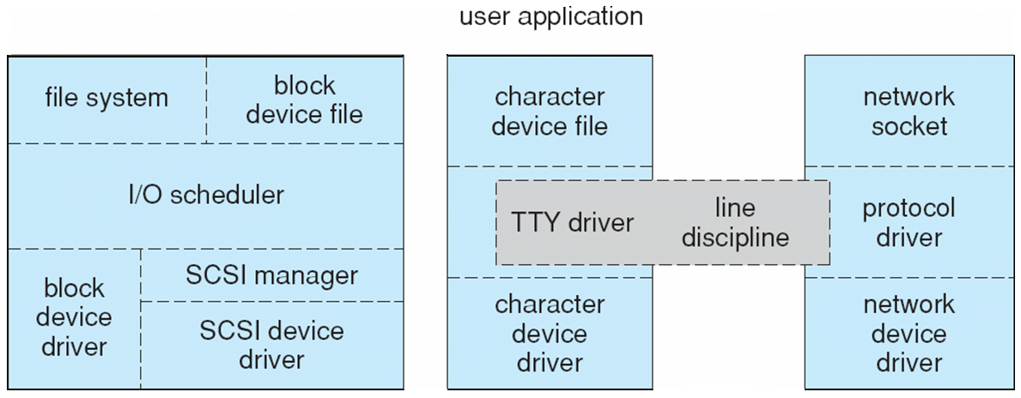
Linux I/O
Device-driver overall structure.
Block devices
Character devices
Network devices
Operating Systems Concepts, 9th edition
Silberschatz, Galvin, and Gagne
(c) 2013 John Wiley & Sons. All rights reserved. 978-1-118-06333-0

Slide 31
Linux I/O, cont’d
Block devices
Traditionally used C-SCAN disk scheduling across all processes.
New algorithm: Completely Fair Queuing (CFQ)
One request list per process.
Each lists maintained according to C-SCAN.
Lists are serviced round-robin.
Character devices
Line discipline interprets terminal device data.
Network devices

Slide 32
Linux Networking
Supports standard Internet protocols
UNIX-to-UNIX.
Non-UNIX operating systems.
Three networking layers:
Socket interface
Protocol drivers
Network-device drivers
User applications perform all networking requests through the socket interface.

Slide 33
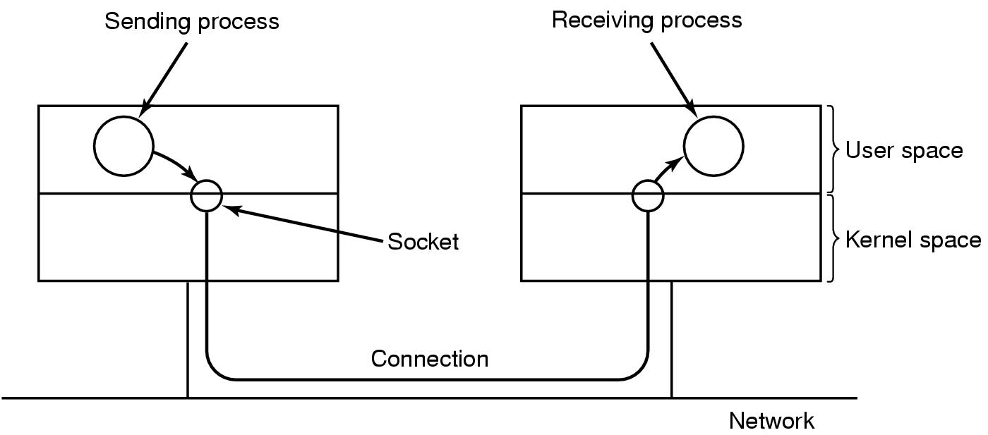
Linux Networking, cont’d
The uses of sockets for networking.
Modern Operating Systems, 3rd ed.
Andrew Tanenbaum
(c) 2008 Prentice-Hall, Inc.. 0-13-600663-9
All rights reserved00

Slide 34
TCP/IP Protocol Suite
IP protocol implements routing between hosts.
UDP, TCP, and ICMP protocols implemented on top of the routing protocol.
UDP
Arbitrary individual datagrams between hosts.
TCP
Reliable connections between hosts.
Guaranteed delivery of packets in order.
Automatic retransmissions of lost packets.
ICMP
Carry error and status messages between hosts.

Slide 35
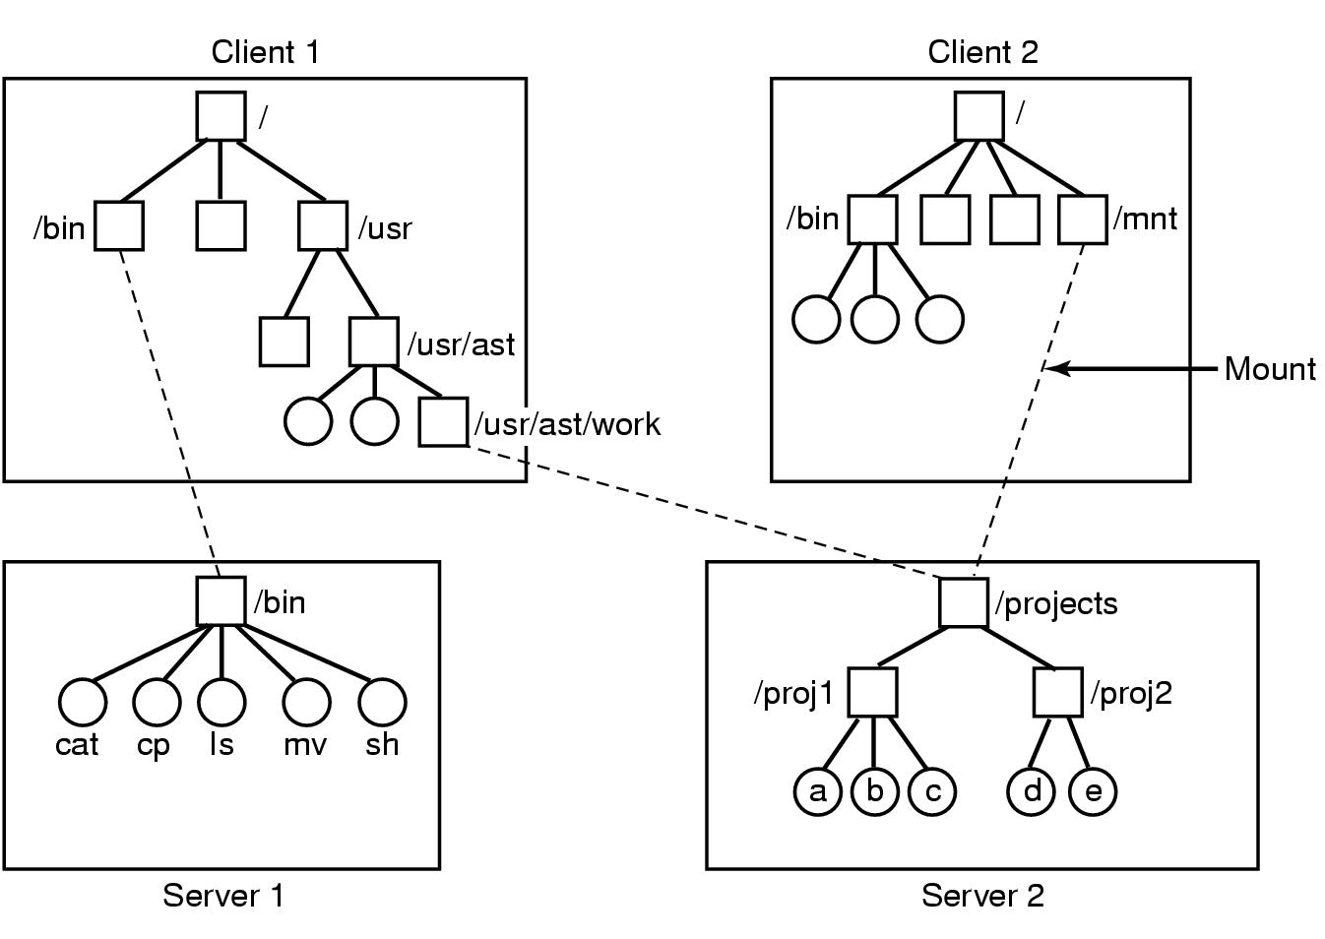
NFS Mounting
Modern Operating Systems, 3rd ed.
Andrew Tanenbaum
(c) 2008 Prentice-Hall, Inc.. 0-13-600663-9
All rights reserved00

Slide 36
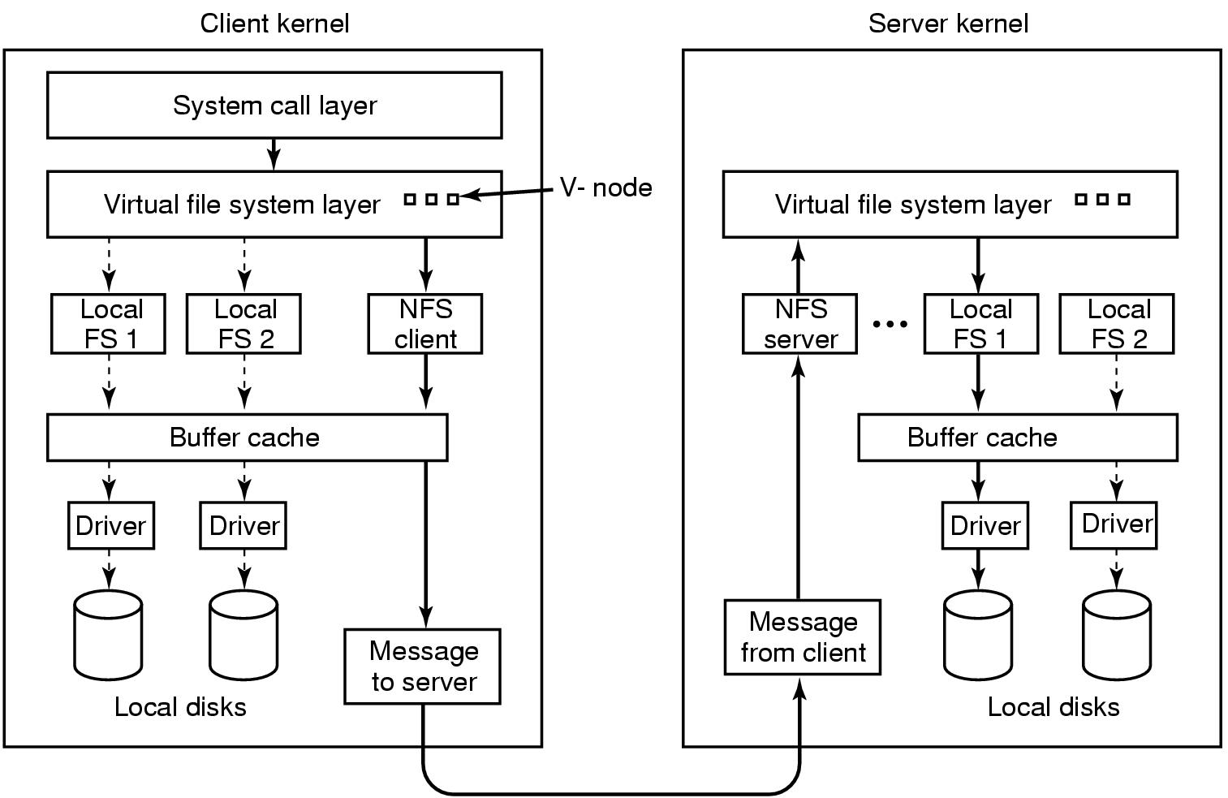
NFS Implementation
Modern Operating Systems, 3rd ed.
Andrew Tanenbaum
(c) 2008 Prentice-Hall, Inc.. 0-13-600663-9
All rights reserved00

Slide 37
Linux Security
Authentication
User password combined with a “salt” value in the system password file.
One-way transformation function.
Pluggable authentication modules (PAM)
Access control
User identifier (UID)
Group identifier (GID)
setuid() and setgid() system calls
Enable a program to run with privileges different from those of the user running the program.

